Slide 1
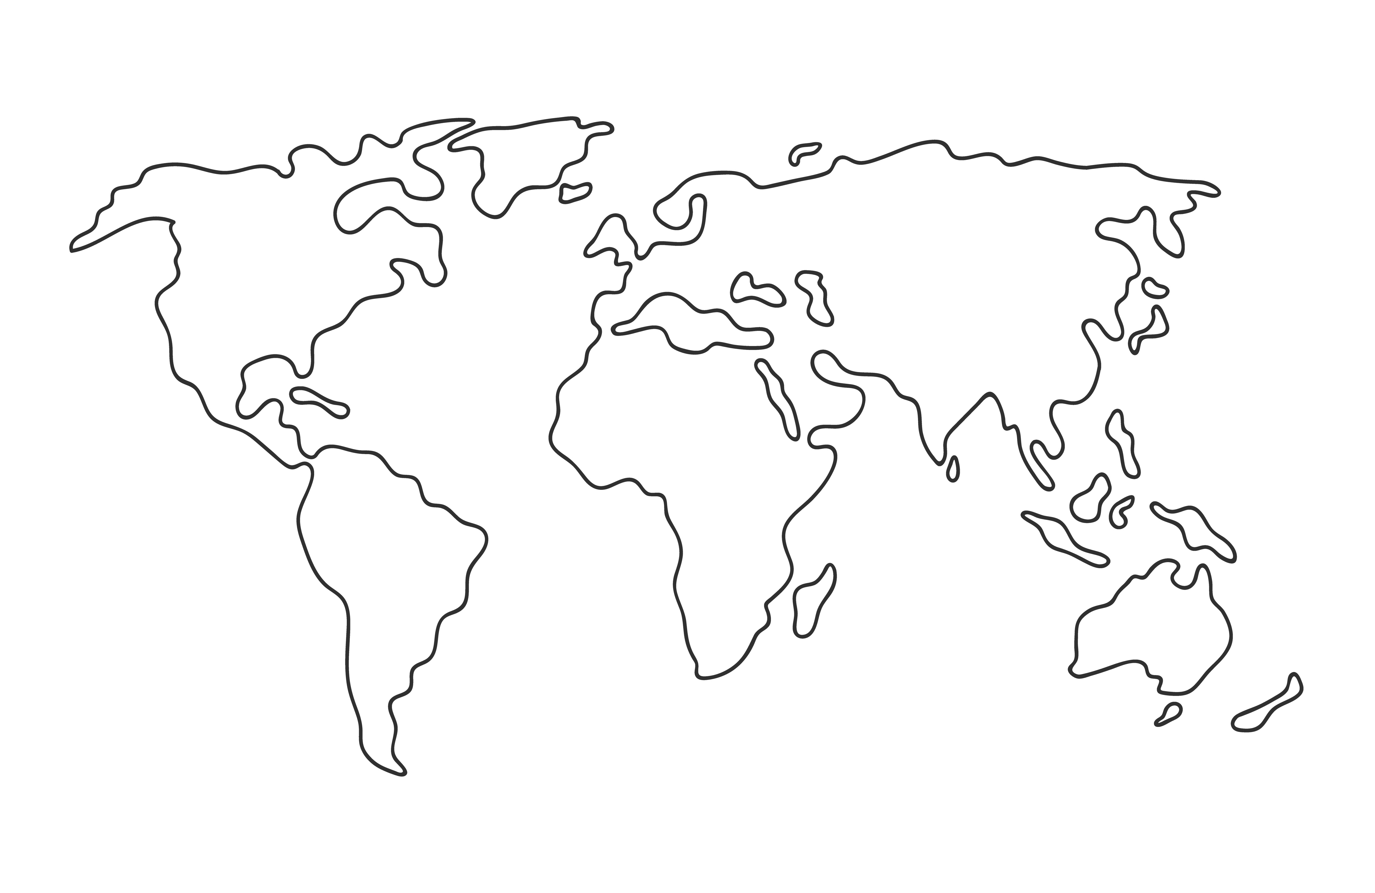


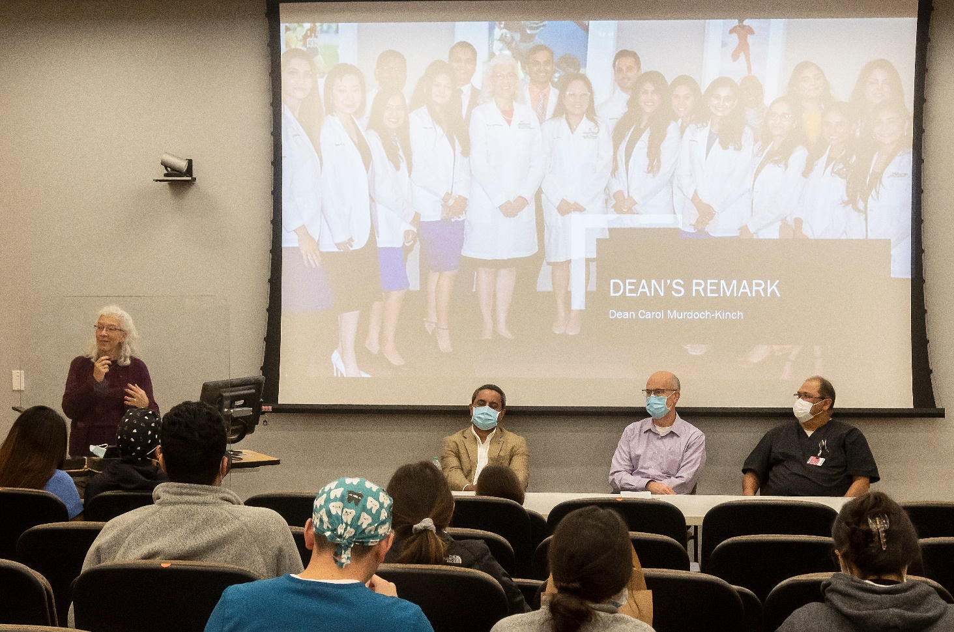
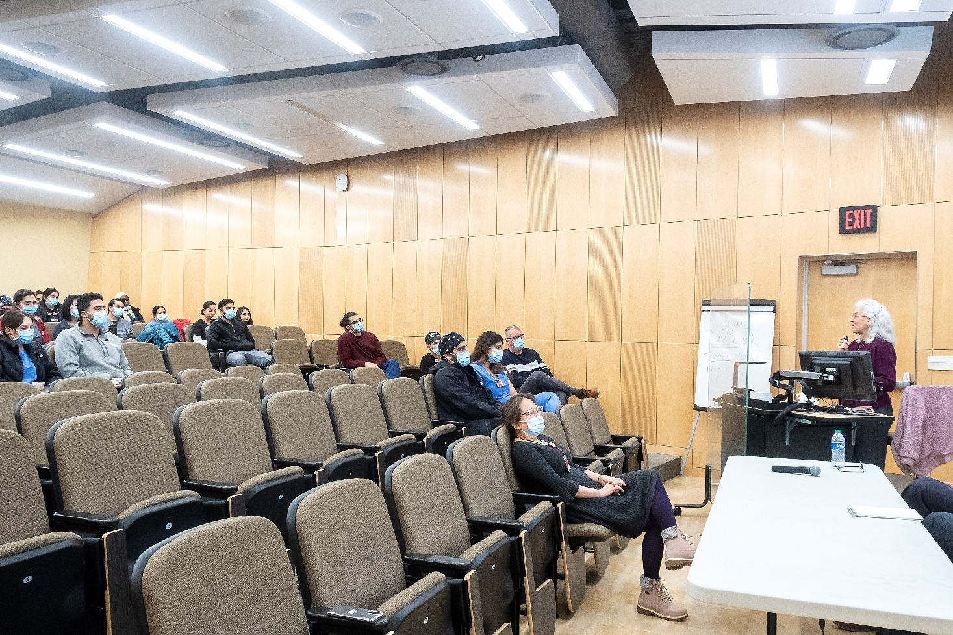
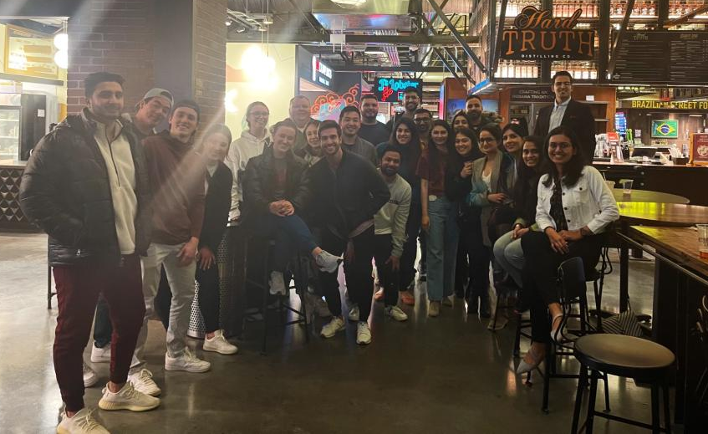
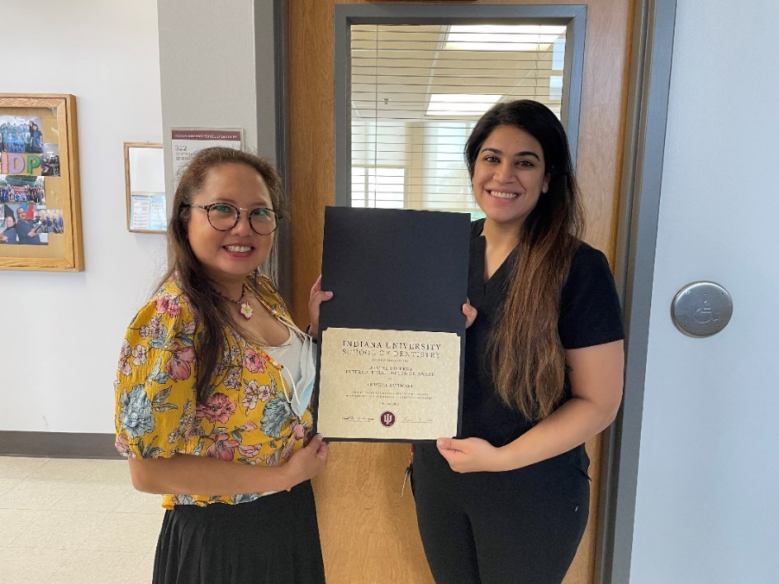
Knowing Me, Knowing You, Bringing International and Traditional Dental Students Together
Dr. Sopanis Cho, Clinical Assistant Professor, Director of the International Dentist Program, Indiana University School of Dentistry
Muddasir Mohammed: BDS, MS, MBA Student, Indiana University School of Dentistry
Sean Stone, Dentistry Librarian, Indiana University School of Dentistry Library
INTRODUCTION: The International Dentist Program (IDP)
EVENTS: Three events were held as part of the program
SURVEY: D2 Responses after the first event
FIRST EVENT
Traditional D2 and IDP students were invited to a lunch and learn kick-off meeting (November 1, 2021) where food was provided. The program introduced the IDPs to their DDS colleagues, and part of our work promoting Diversity, Equity and Inclusion (DEI) at the Dental School with the unveiling of the newly formed student organization: the International Student Dental Association (ISDA).
The highlight was a panel discussion featuring three faculty members with extensive experience supporting the international students which focused on creating a sense of belonging and how we can promote a culture of respect in the Dental School. Dean Carol Murdoch-Kinch was able to attend the event and show her support for the IDPs and DEI by actively participating in the discussion.
The International Dentist Program (IDP) matriculates dentists graduated from outside the United States through an accelerated 30-month version of the traditional DDS program so that they can take board examinations and attain a U.S. DDS. As much as possible, IDP students study with cohorts of students in the traditional DDS program. This can prove challenging, however, as IDP students represent myriad differences in education, training, culture, and life experiences. Because of this, the early portion of the IDP curriculum ensures that student preclinical and other skills are equilibrated to similar levels so that they can effectively merge with their peers from the traditional DDS program. IDP students’ matriculation is staggered from traditional DDS students and when they join them as classmates the D2s have already spent one and a half years together forging relationships and adjusting to being dental students. Because of this and their diverse backgrounds, IDP’s have reported significant challenges that can hopefully be addressed by changing the climate with a program of improved communication and events.
RESULTS & CONCLUSIONS
We have observed positive momentum in creating an environment of greater mutual support for IDPs and feelings of being included and valued by third-year dental students.
The program led to the creation of a new student group for international students
The ISDA assisted in helping to orient their first cohort of incoming IDP students
Survey responses from D2s were very positive both in their thoughts about IDPs as well as related events
The IUPUI Regatta, one of the most popular annual events, had numerous teams that included both traditional and IDP students representing the Dental School.
A new annual award, The Dental Student Intercultural Inclusion Award, was presented to both IDP and traditional students who have made significant contributions to creating a culture of international inclusion at the Dental School
SECOND EVENT
We organized a more intimate and informal meeting between IDP and D2 students (November 17, 2021) featuring healthy snacks. We encouraged sincere and honest discussion to allow participants to learn from each other’s diverse backgrounds and experiences. IDP students were very open and honest about some of the challenges they faced which turned out to be surprising and eye-opening for many of the traditional second-year students. The discussion led to significant and empathetic discussions of how students can be supportive of each other.
THIRD EVENT
We provided refreshments for a meeting of the officers in the newly formed ISDA who organized two zoom meetings to provide helpful information to the incoming IDP students prior to their matriculation in January 2022. This group of students in ISDA was instrumental in welcoming the new international students and in helping them transition into a very intensive program. This new student organization was able to effectively translate one of this program’s primary goals into action by improving the sense of belonging among the incoming international students.
Student Shweta Ambwani receive the new Dental Student Intercultural Inclusion Award from Dr. Cho
Grant Support for New Programs
We obtained an IUPUI Faculty Inclusivity Grant that facilitated the creation of programming to address issues related to the student culture at the Dental School and some of the challenges faced by the IDP students. It allowed for the creation of a series of presentations and panel discussions, including some organized by the IDP students, educating others on the IDP experience and featuring faculty and students promoting DEI.
We will continue to formally assess the outcomes of this initiative through qualitative assessments as well as the students’ academic performance, patient care, and hopefully through additional research funding in DEI.
Notes:
Prints as 48x72 at 200%.

