Slide 1
THE AFRICAN AMERICAN FUNNEL PROJECT:
OUR PAST & OUR FUTURE
Presented by: Dr. Gemmicka Piper
Midwest Archivist Conference 04/06/2019

Slide 2
NACO
SACO
Modification or addition to Subject Headings
Draws on pre-existing classification taxonomies to establish relationships in the bibliographic record
Changes undergo a editorial review process by L.O.C.
Modification or addition to the Naming Authority Files
Draws on Marc 21 and RDA Format to designate relationship changes.
Changes are made independently by institutions.

Slide 3
Statement of purpose:
“The goal of the funnel is to improve the overall discoverability and access to resources pertinent to the study of African American history, life, and culture. We focus on creating new and updating old subject headings relating to the African American experience as needed. ”

Slide 4
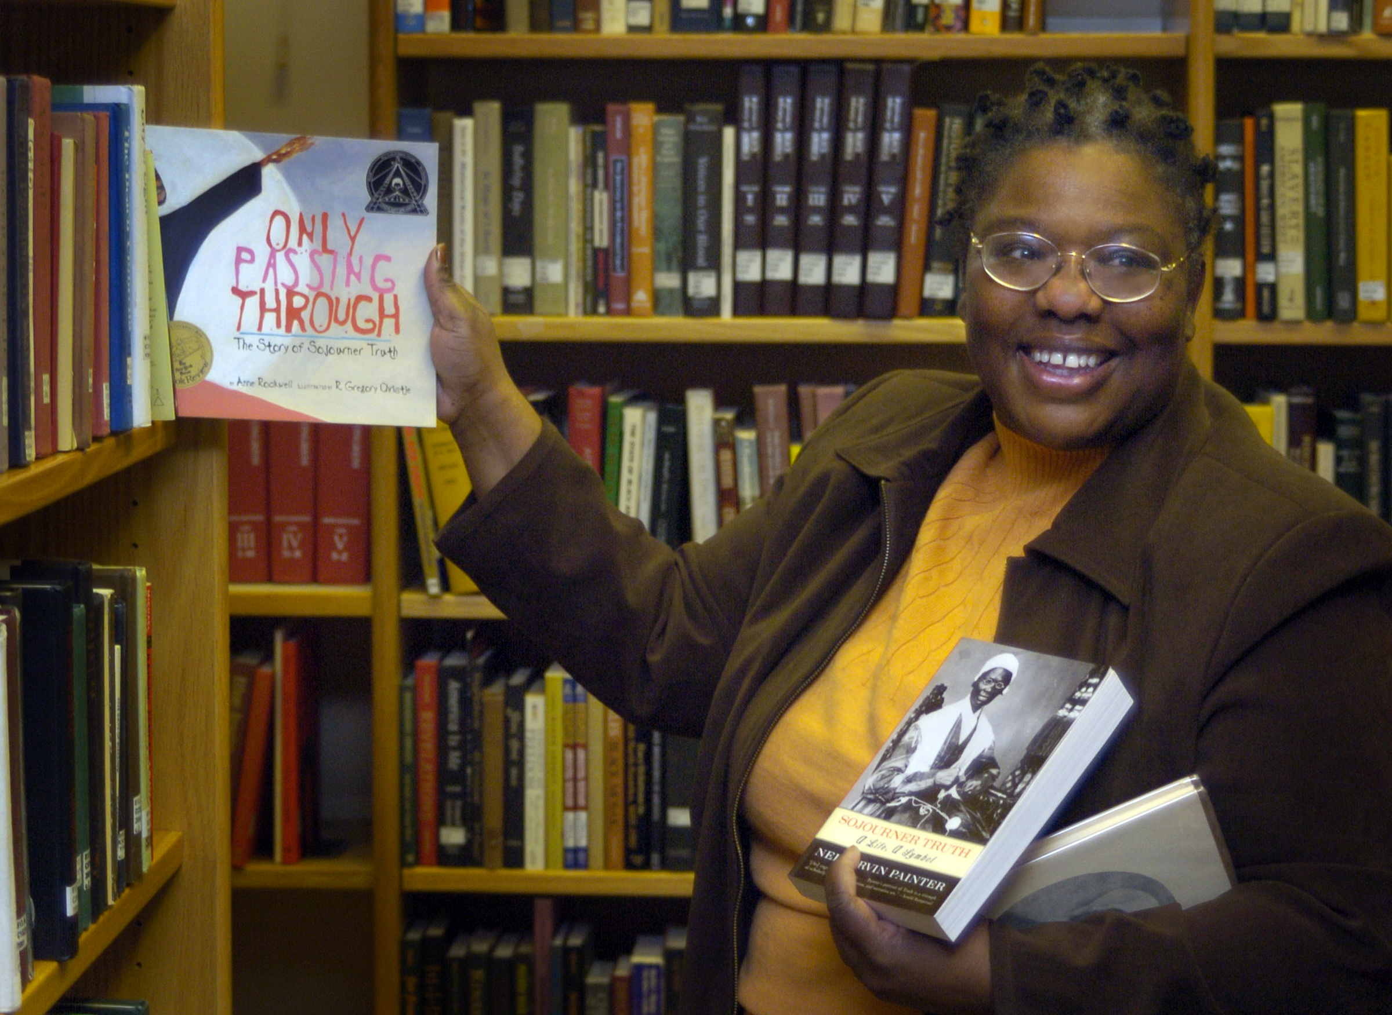
Origin:
  PCC lead initiative to offer cataloging training to HBCUs-Cornelia Owens Goode initiated discussion in 1998.
  African American Subject Funnel Participants Survey (1999) revealed interest/widespread need for improved cataloging of AA resources.
  Support of then ACRL Division-AFAS ( now African American Subject Librarians interest group). ALA Midwinter San Antonio, TX (2000)
  Dorothy Ann Washington, then President of AASLIG, chairs the first AA Funnel committee

Slide 5
Rough Timeline:
2000-2008
2008-2014
2014-2015
2015-2016
2016-2017
2018-Now
Dorothy Ann Washington
Inactive
Carmelita Pickett
Camille Ann Brewer
Inactive
Gemmicka Piper

Slide 6
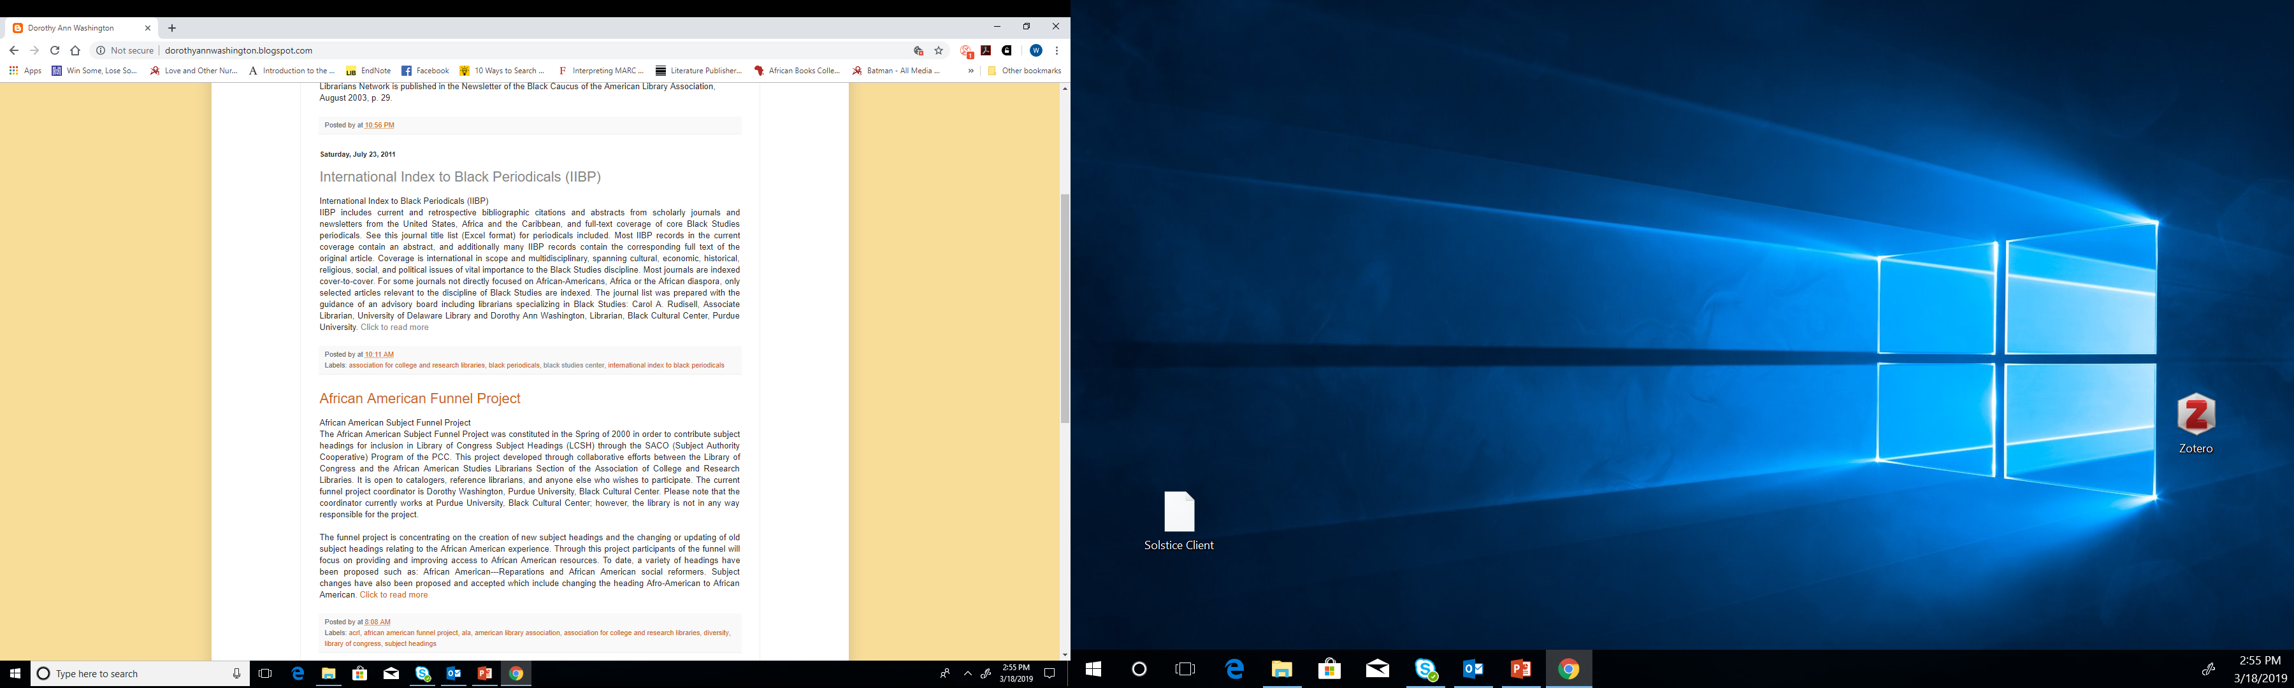
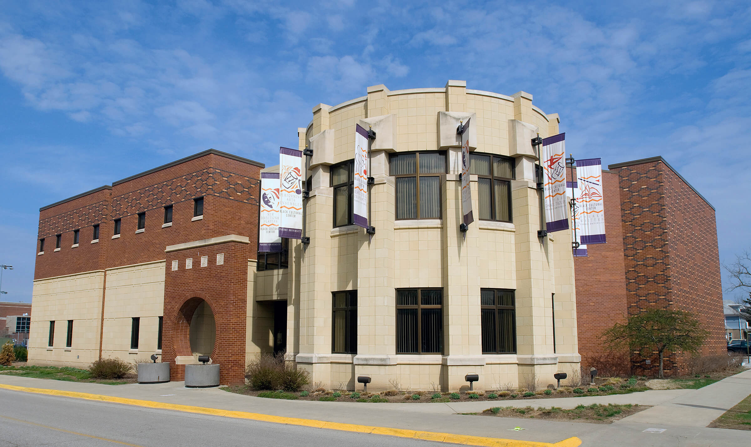
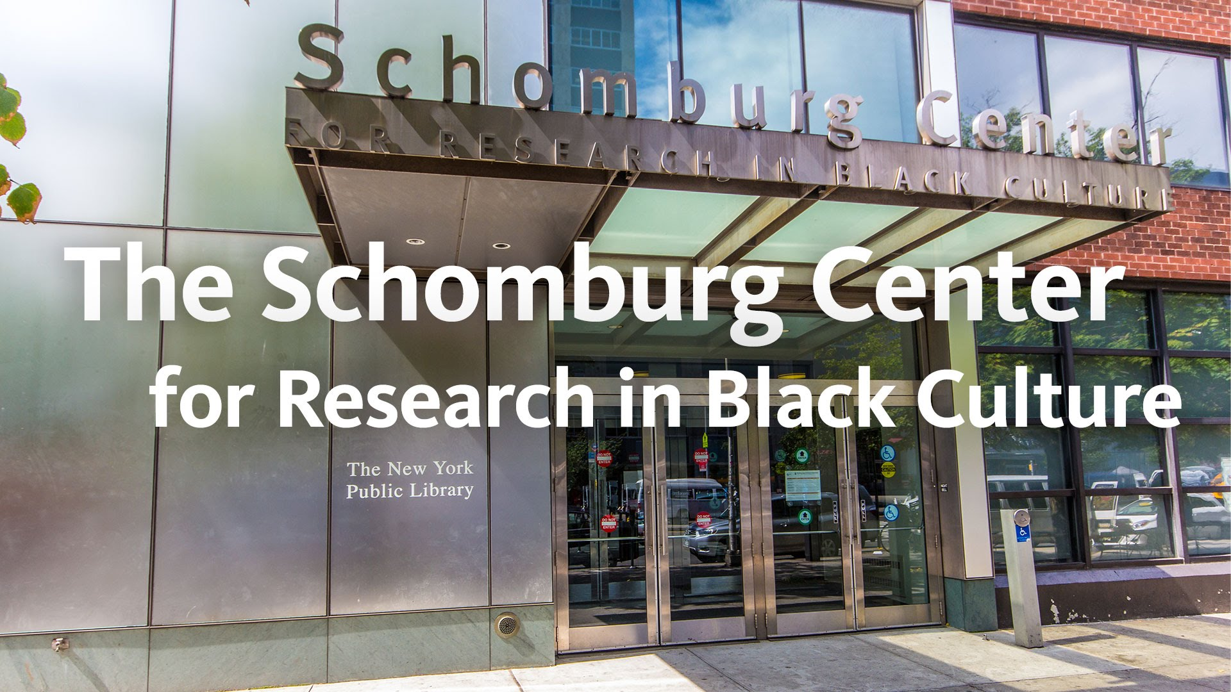
Uncovering a Mystery
Black Cultural Center Library, Purdue
Saturday, June 23, 2011

Slide 7
One Change Creates Wide Impact
“November 29th, 2000, the subject heading Afro-Americans and subject headings that included the adjectival qualifier Afro-American…were changed to African Americans and African American”
“Effective Dec. 1st, 2000, LC Catalogers began assigning only the new forms African Americans and African American…as subject headings in current bibliographic records.”- LOC Cataloging Newsline (8)5, June 2000.

Slide 8
Thinking About Subject Headings…
Complex Subdivision
Intersectional (sexualities, political affiliations, religious, genre etc.)
Globalization (Diaspora, multiethnic identities)
Current/Progressive (“the idea of the first”, roles etc.)

Slide 9
Diversity and Collaboration
Internal Roles: Catalogers, Subject Experts, and Special Collections
External Institutions: academic libraries, special libraries, public libraries, national museums
Projects we might assist on:
Revising Finding Aids
Advise for local as well global changes
Framing the exhibition of sensitive material/collections

Slide 10
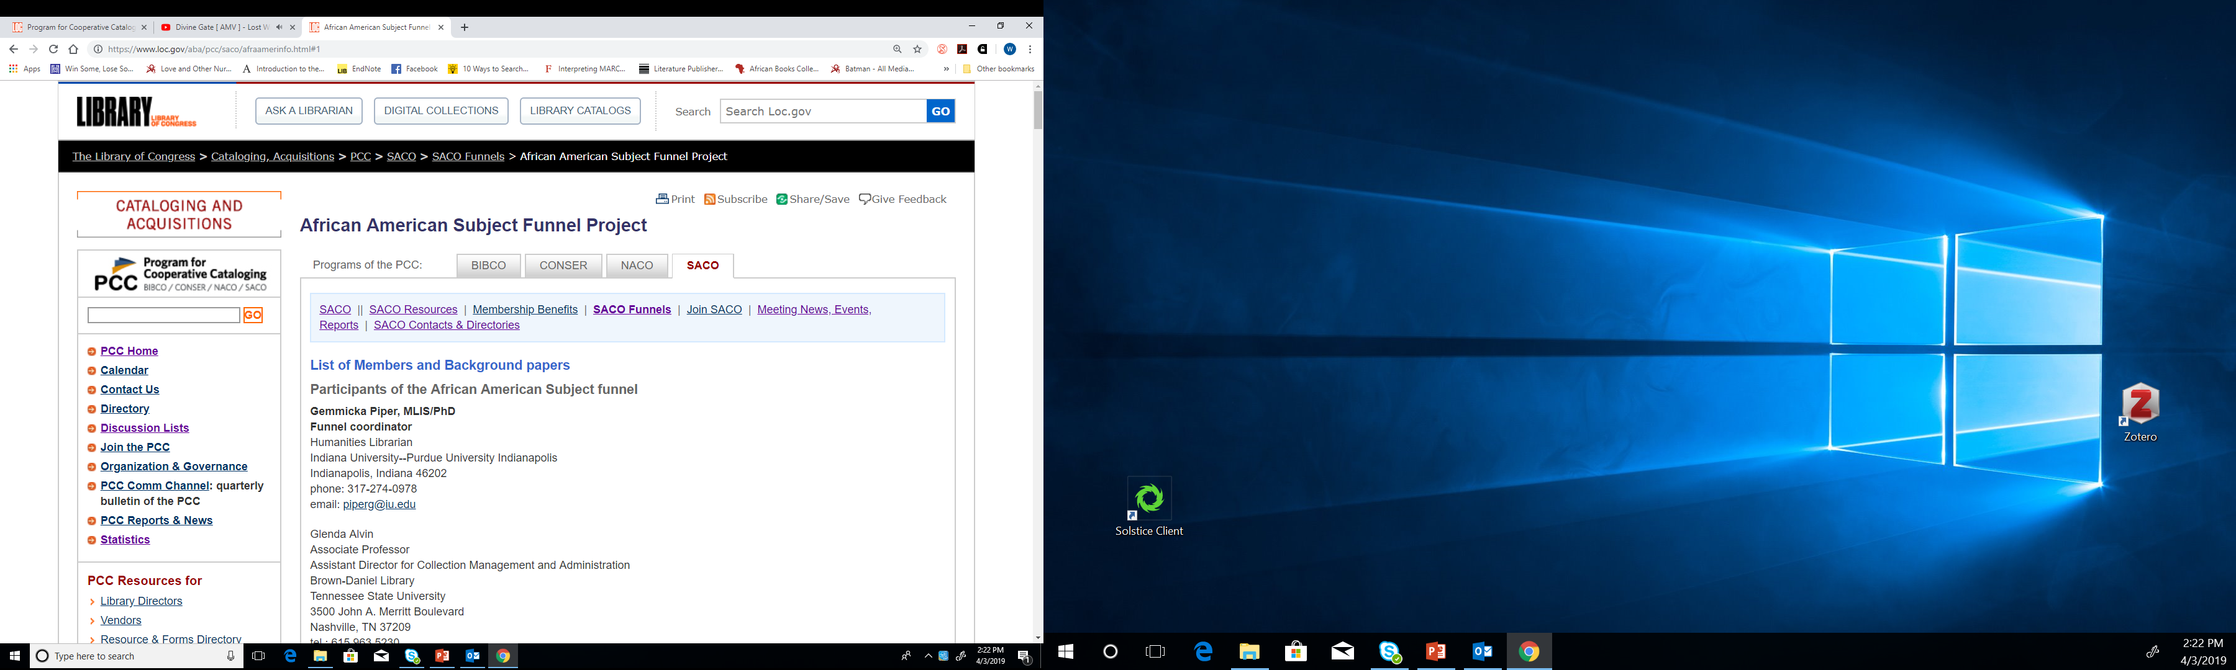
Contact Information
https://www.loc.gov/aba/pcc/saco/afraamerinfo.html#1

