Slide 1

Get Ready!
Sit at a table and say hi to everyone..
Get out a laptop, tablet, or phone and get online
Load a discovery tool of your choice , or.. use ours – IU Indianapolis’s OneSearch

Slide 2
Let’s Get Dicey
Rolling for and Taking the Initiative to Using Games in the Classroom
Mari Kermit-Canfield & Gary R. Maixner III

Slide 3
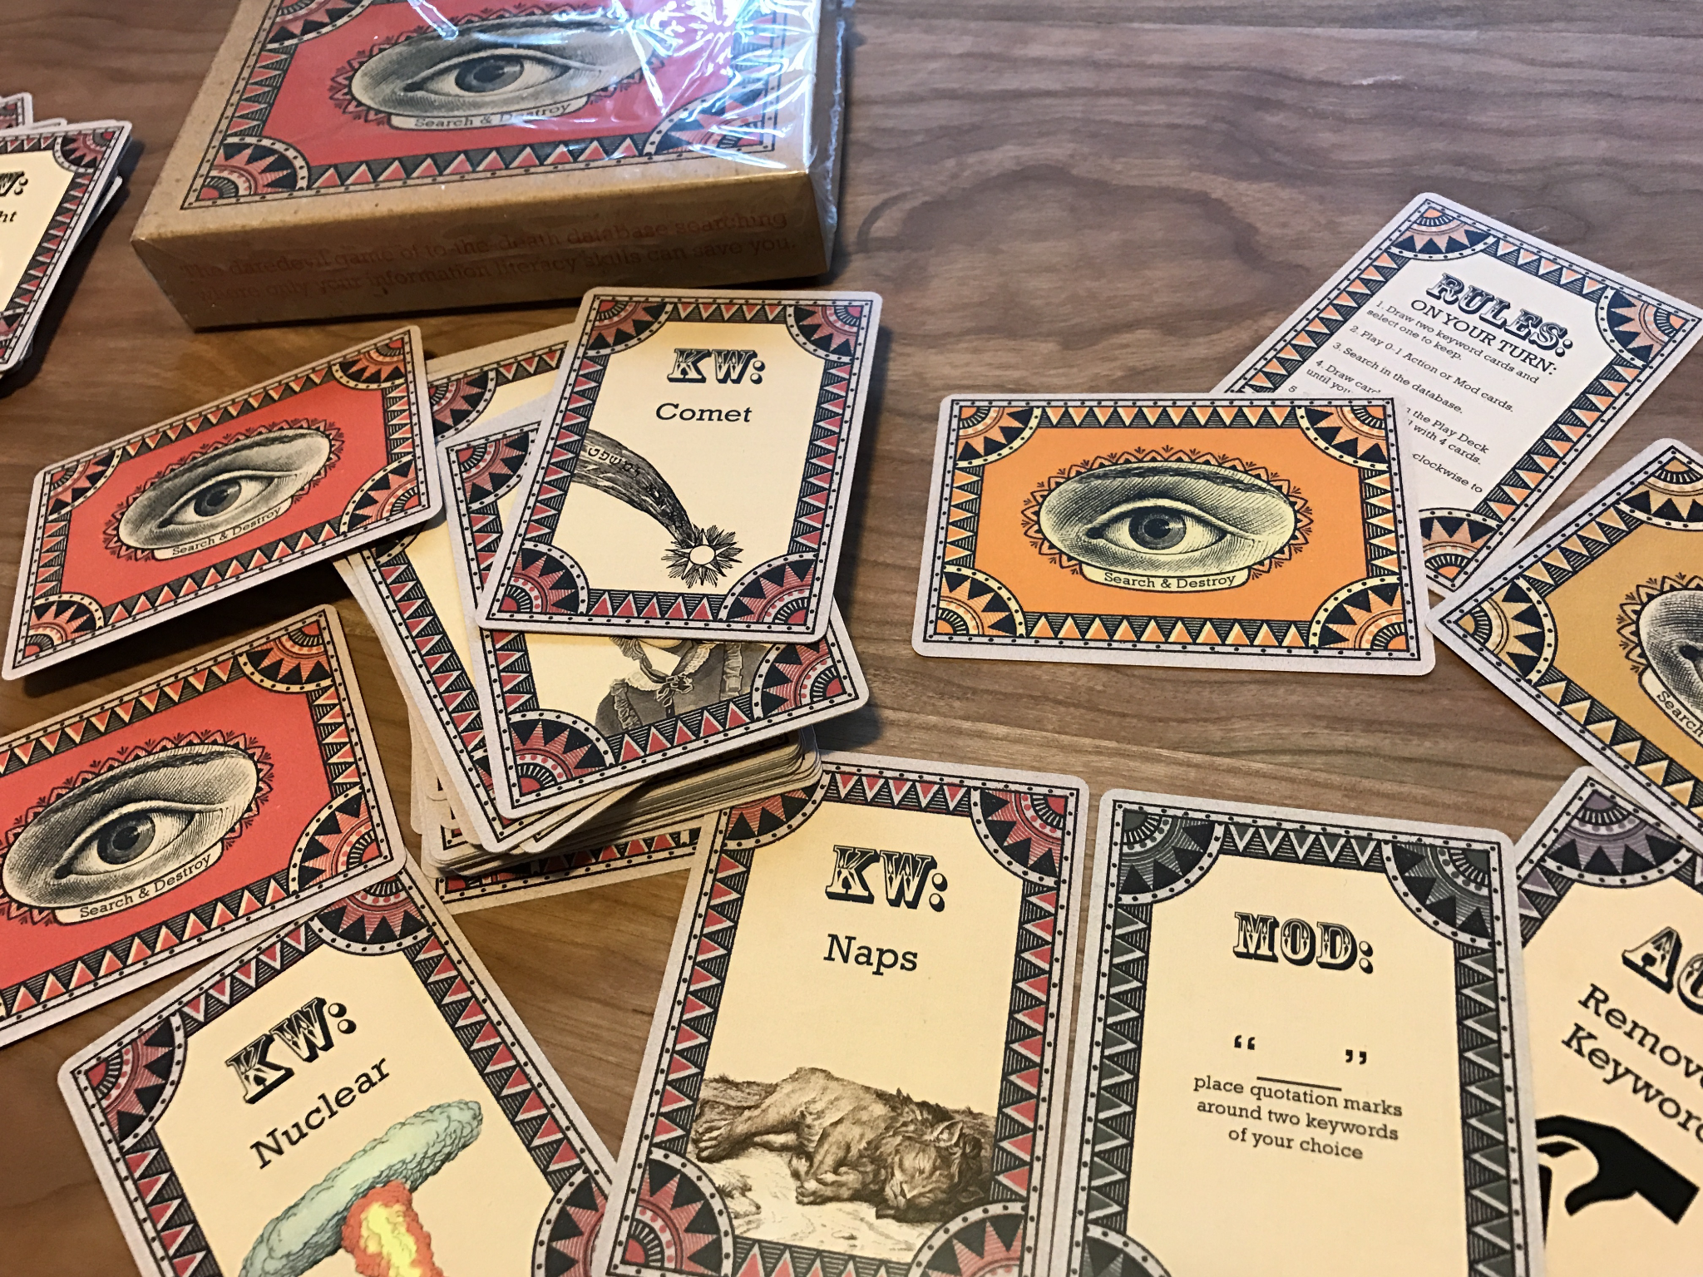
Why Are We Using Games in the Classroom?

Slide 4
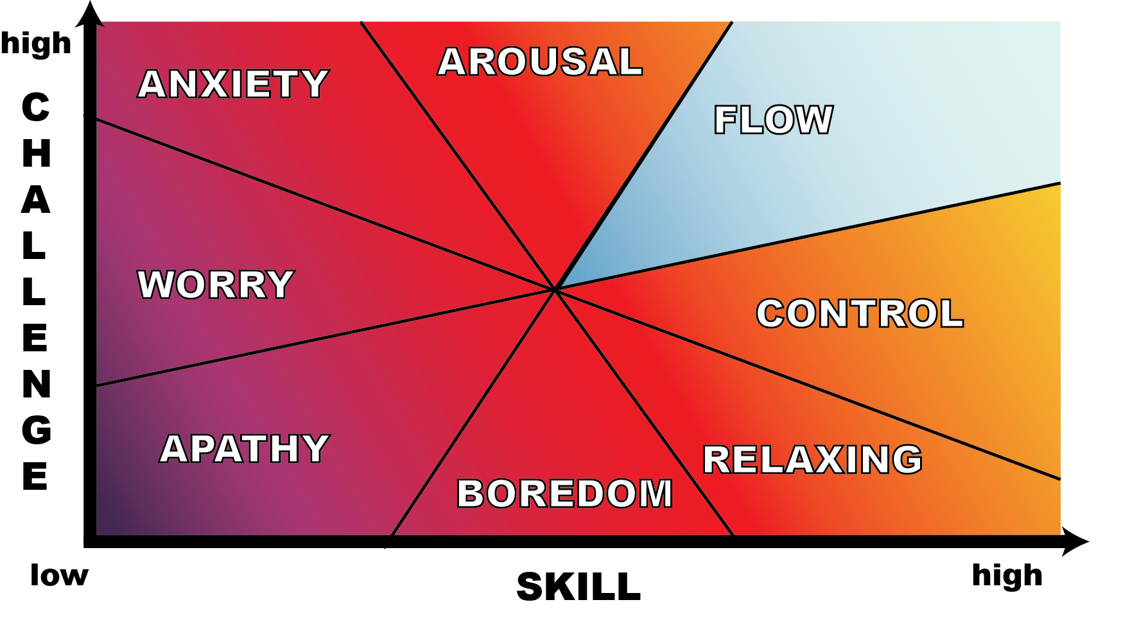

Slide 5
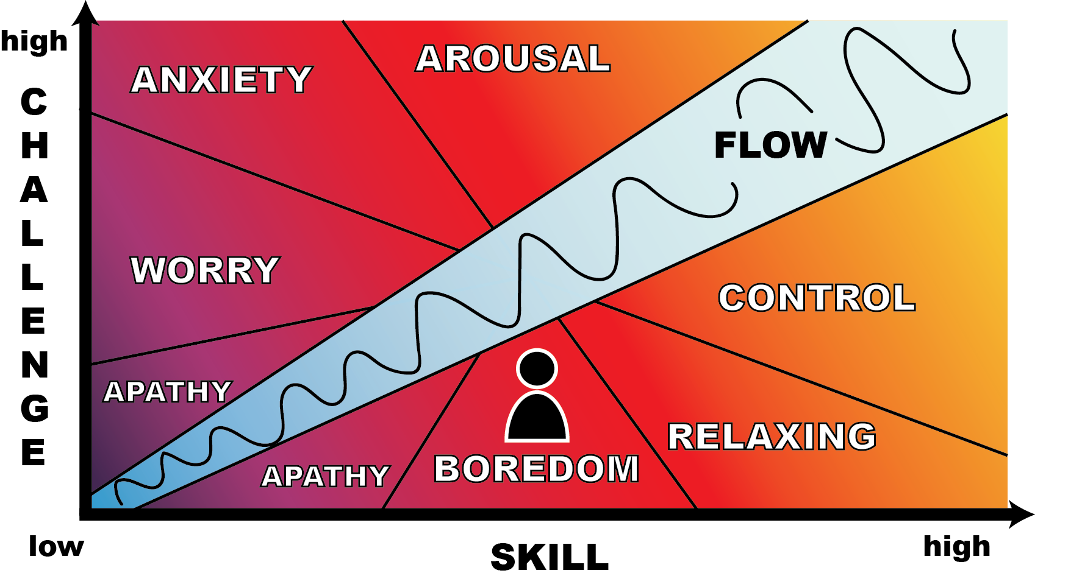

Slide 6
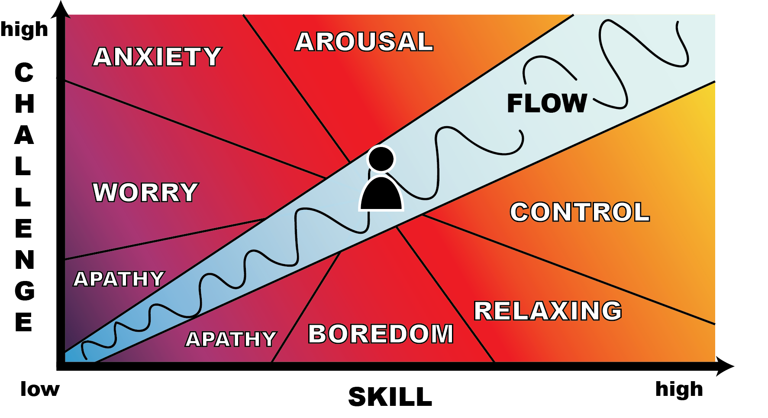

Slide 7

Notes:
Dopamine receptors opening

Slide 8

The “experience”

Slide 9

Signature
Attention Activities

Slide 10

Mapping Learning Outcomes
Database Use
Faceting
Search String Development
Boolean Searching
Need to search to play
Cards that force “modifiers”
Each turn add a search term
Add an “or” card
Notes:
GBL vs Gamification

Slide 11

Can the Learning be messy?
Notes:
Mari example with Biomed

Slide 12
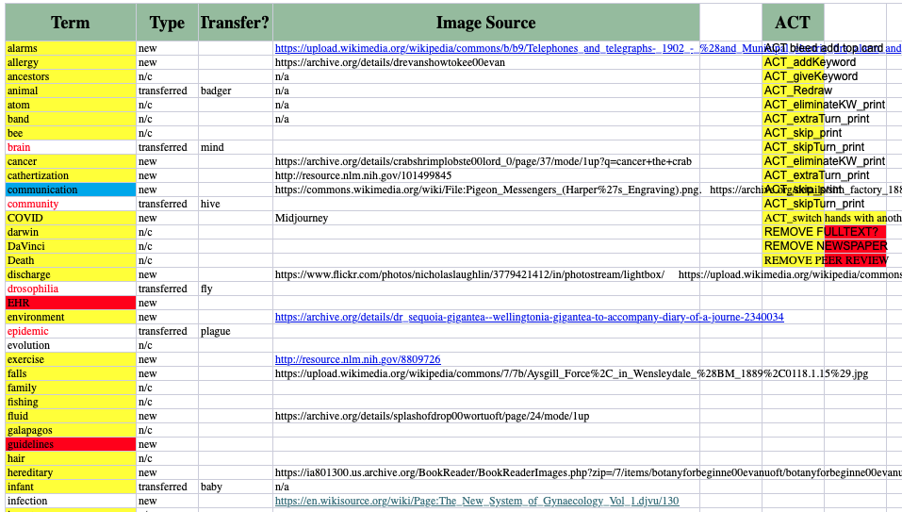
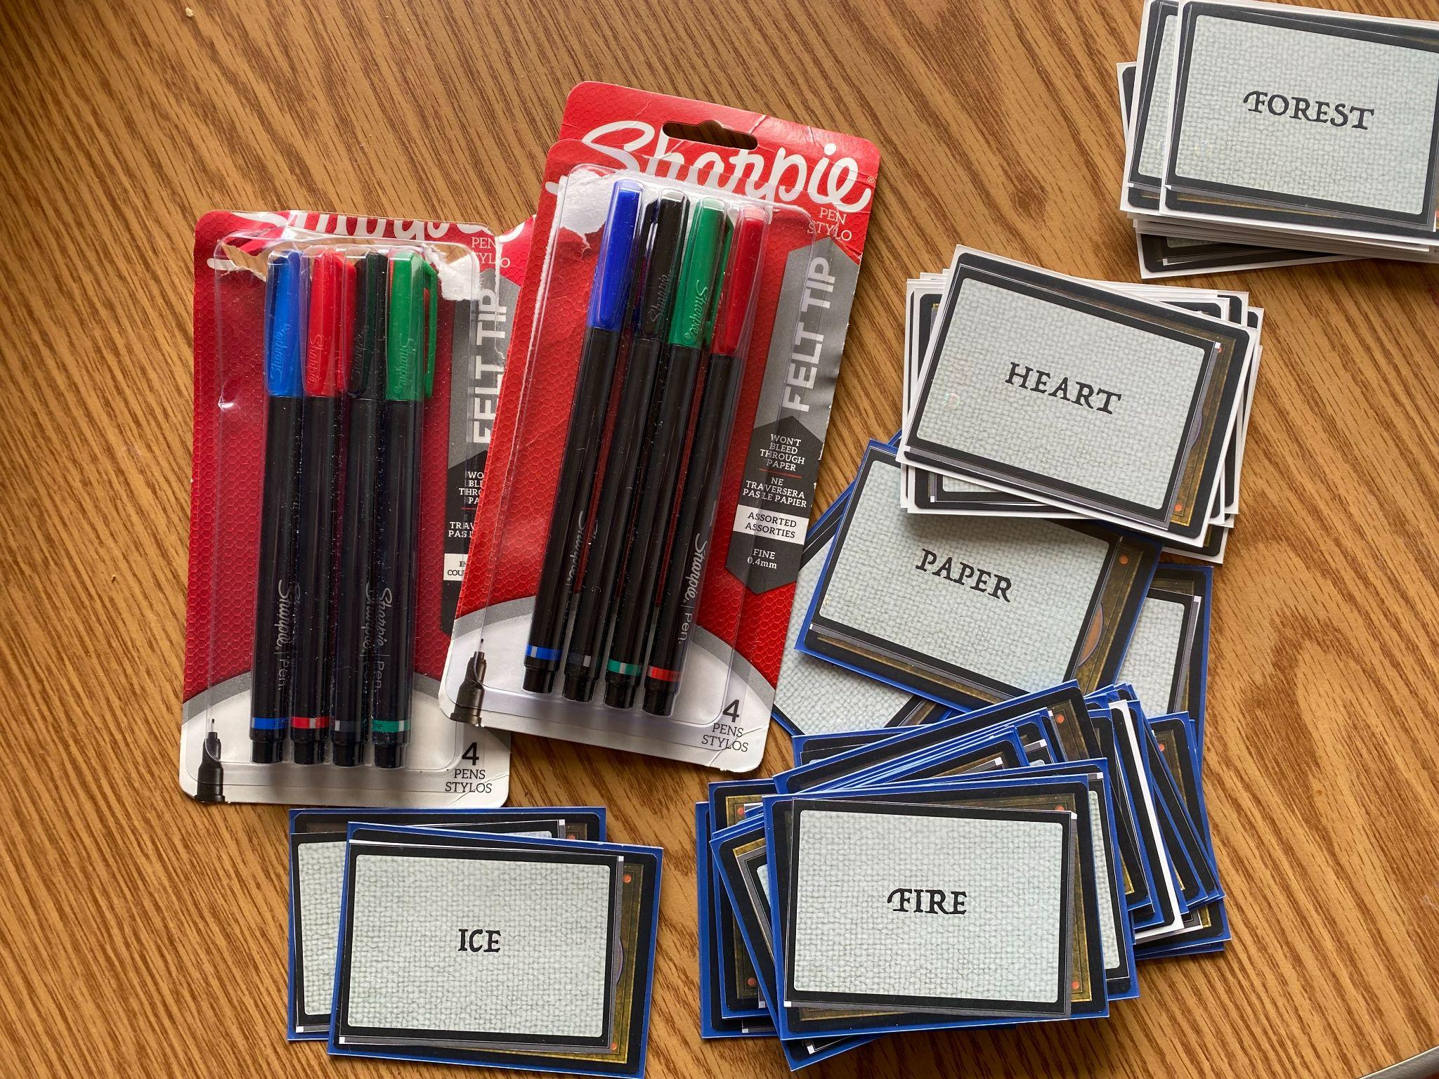
It Doesn’t need to be perfect to start!

Slide 13

Creating a Look and Feel

Slide 14









Slide 15
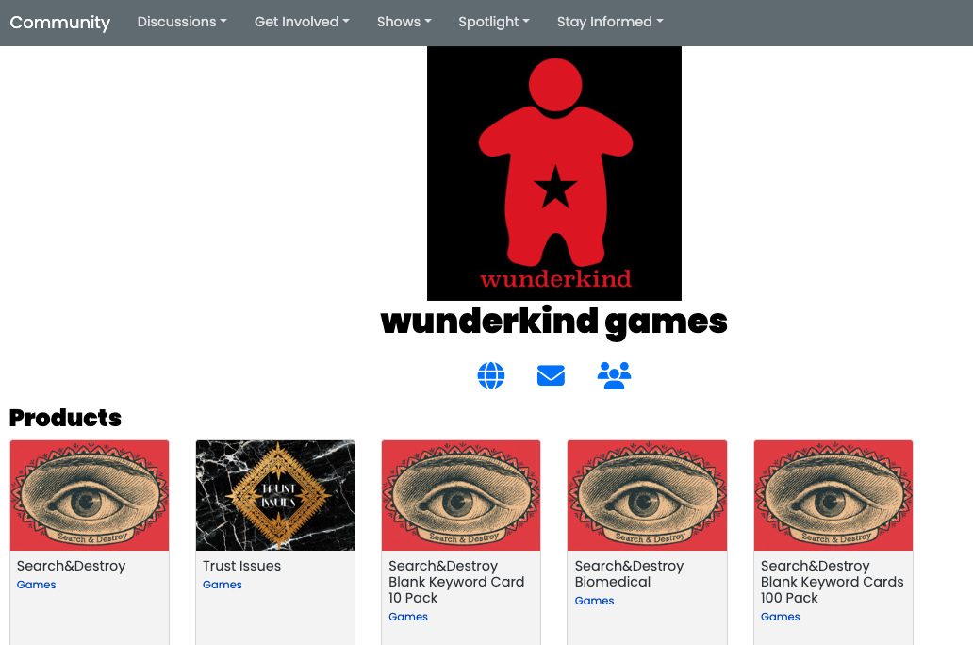
Published Products

Slide 16
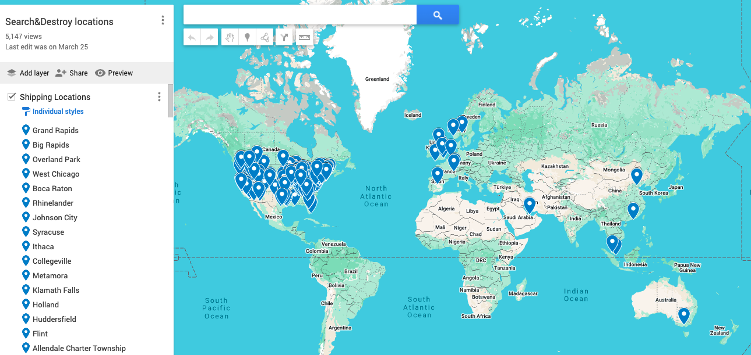

Slide 17
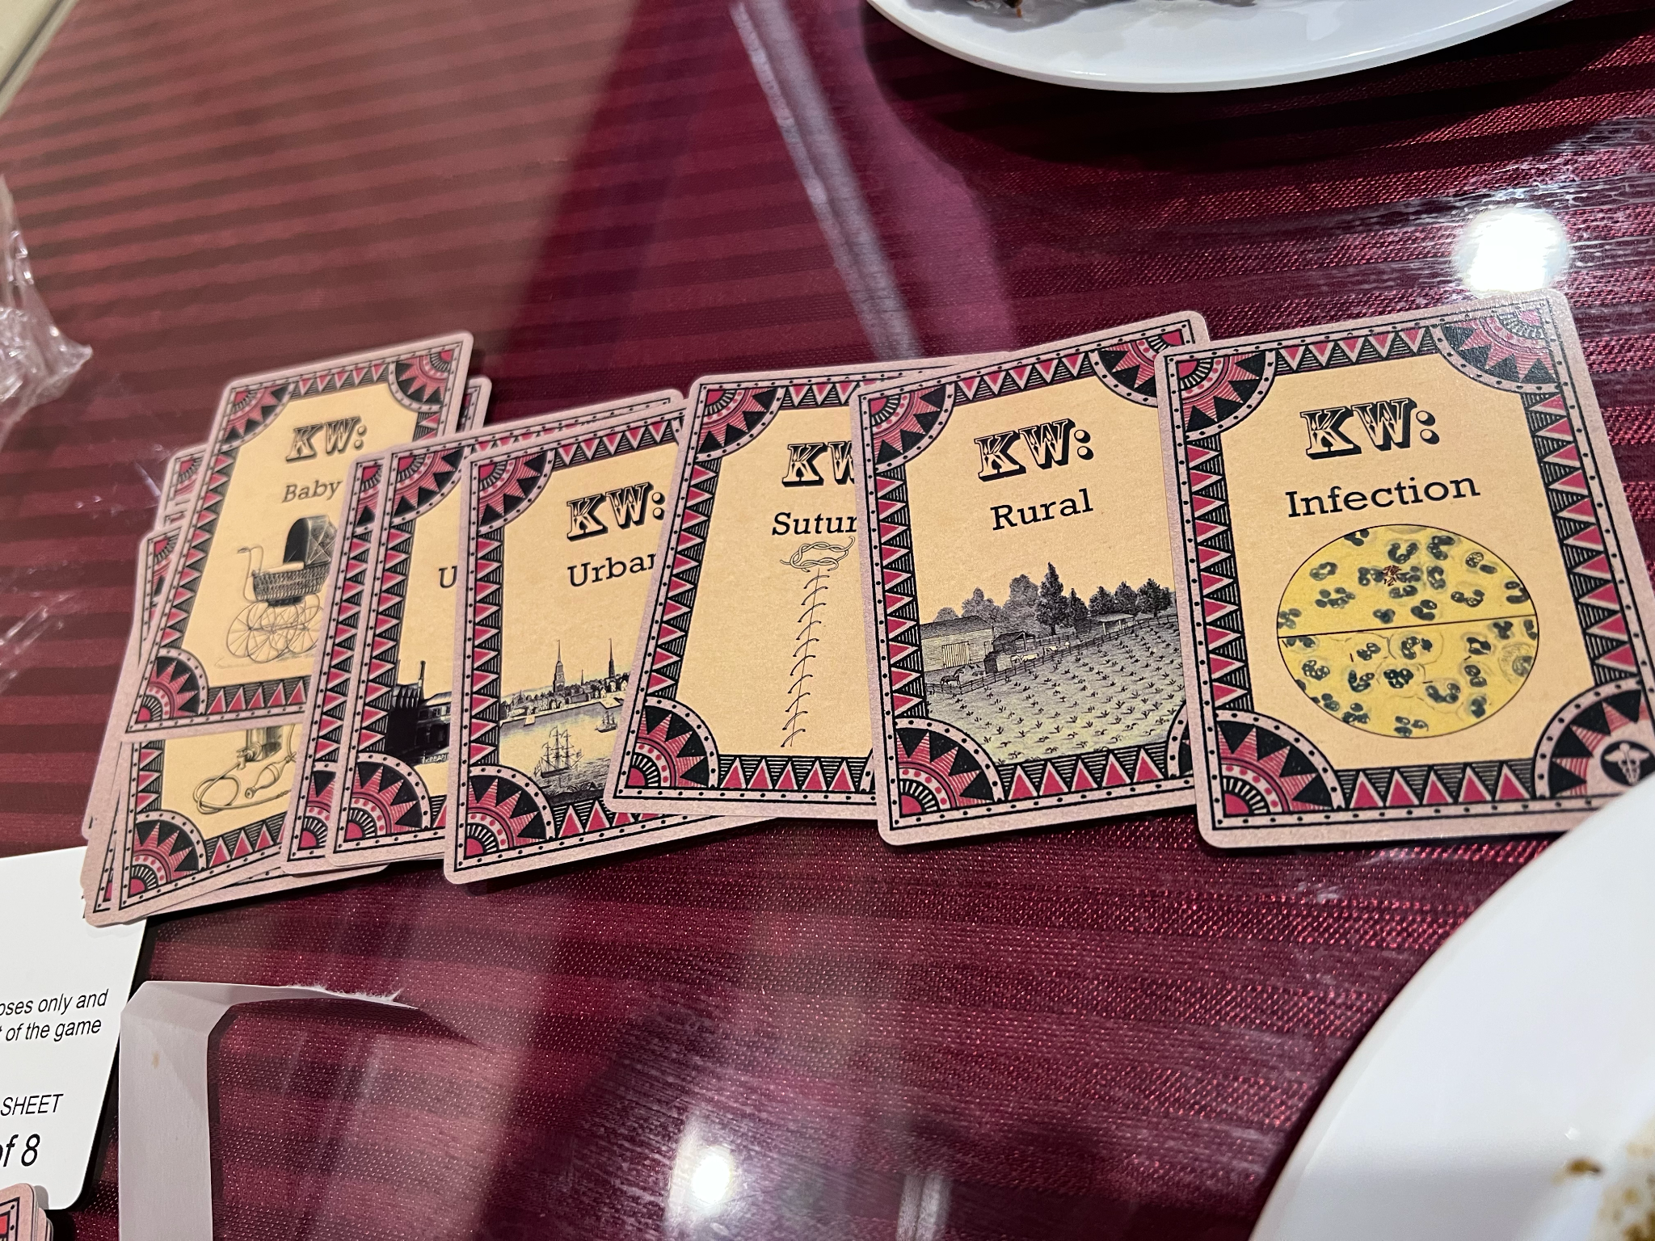
Expansions and Continuing Work

Slide 18


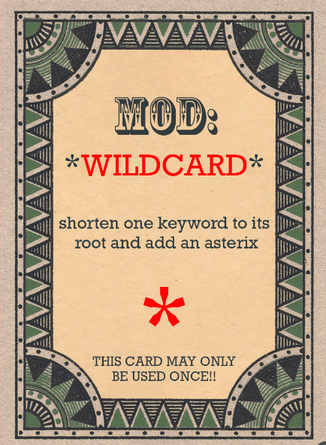

More new versions coming!

Slide 19
Let’s play some games!
Get into groups of 3-5. Choose a game to play and have someone come up to get it. Make sure everyone has rules!
A. Search&Destroy
B. Trust Issues
C. Connection Draft
Learn how to use library databases while playing cutthroat cards and forming ridiculous queries!
How do you evaluate statements for validity? Do you have Trust Issues?
Learn how to mind-map with this intense and quick game for 4 people and a timer!

Slide 20

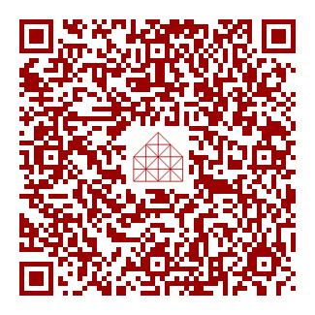
Let’s play Search&Destroy
Open up the game in front of you! Get into teams of two!
https://library.indianapolis.iu.edu/

Slide 21
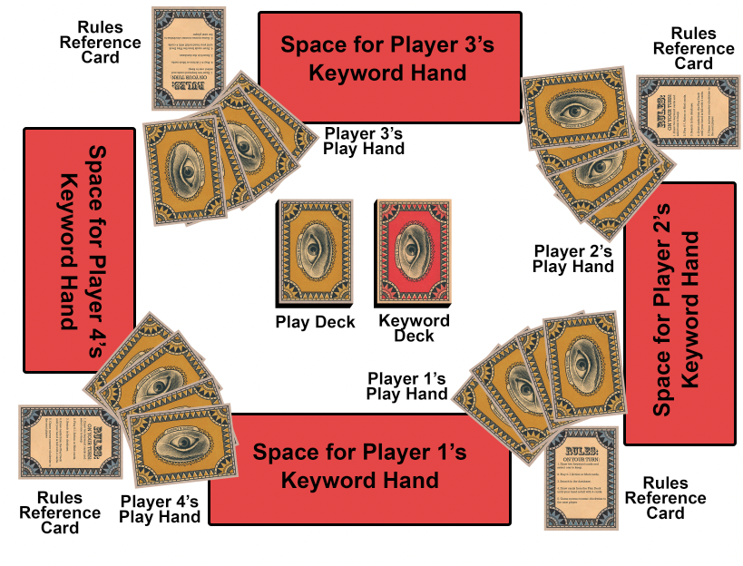
Set up!
Shuffle both decks, keep them separate
Get into teams of two
Each team gets their technology set up
Every team draws four yellow cards from the Play Deck - keep these secret
Determine which team will play first!

Slide 22
How to Play
Draw two Keyword Cards (red deck) and select one to keep
  Place the one you keep in front of you where everyone can see and discard the other
Play 0-1 Action or Mod (yellow deck) cards
  You cannot on your first turn
Search in the database using all of the Keywords and Mods that you have
  If you have results, you’re still in the game!
Draw back up to 4 cards from the Play Deck (Action and Mod Cards)
Game passes to next player

Slide 23



Draw Two KW Cards, choose, one, and place in front of you..

Slide 24
Draw Two KW Cards, choose, one, and place in front of you..

Slide 25





2. Play zero or one Action or Mod Card (on yourself or another player)..
Don’t do this first turn!

Slide 26
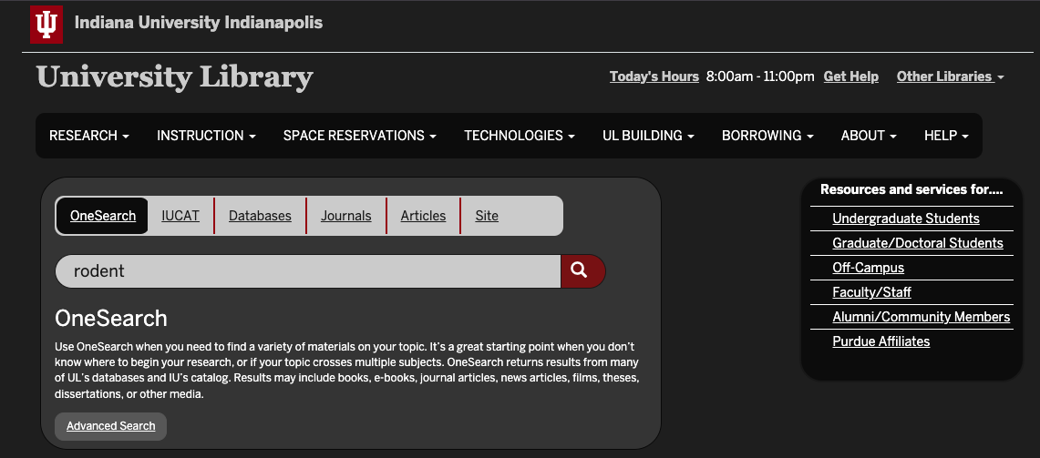
3. Search in the Database using all keywords and all mods .

Slide 27
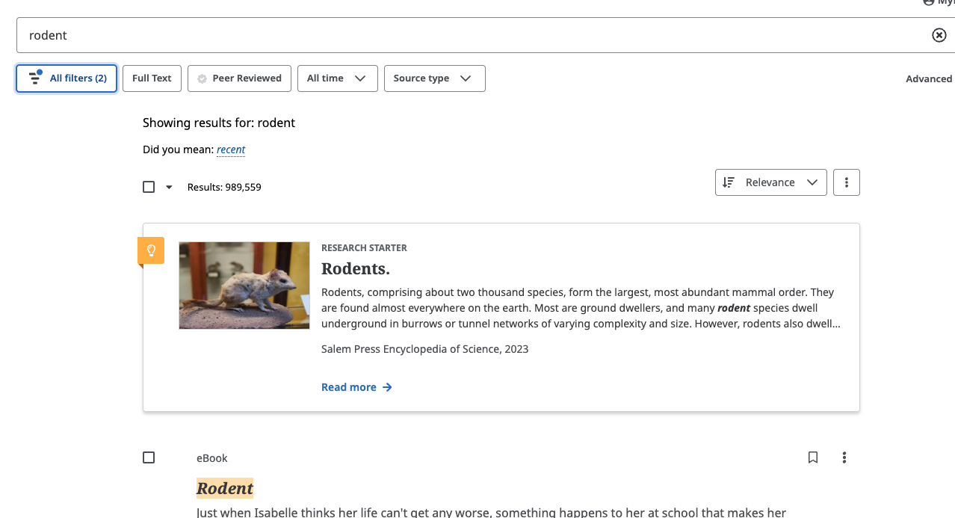
3. Search in the Database including all keywords and all mods .

Slide 28
4. Draw yellow cards until you have four.

Slide 29
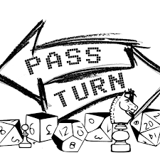
5. Pass turn to next team!..

Slide 30
How to Play
Draw two Keyword Cards (red deck) and select one to keep
  Place the one you keep in front of you where everyone can see and discard the other
Play 0-1 Action or Mod (yellow deck) cards
  You cannot on your first turn
Search in the database using all of the Keywords and Mods that you have
  If you have results, you’re still in the game!
Draw back up to 4 cards from the Play Deck (Action and Mod Cards)
Game passes to next player

Slide 31
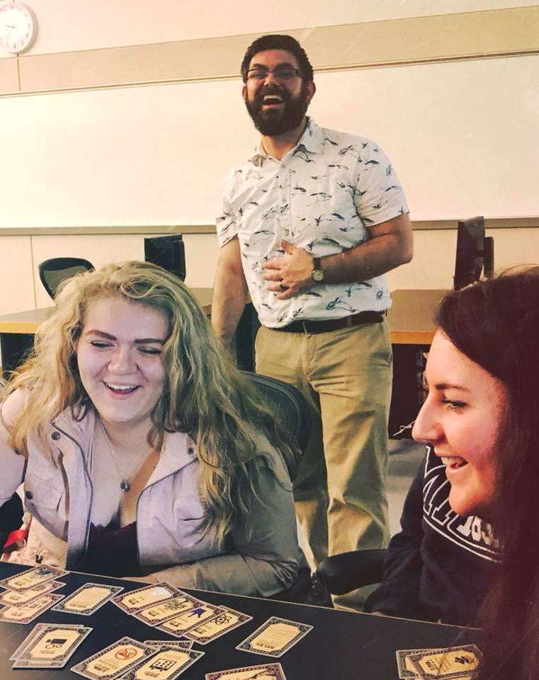
What was your experience like? Anything surprising?

Slide 32

Post Play Class Discussion

Slide 33
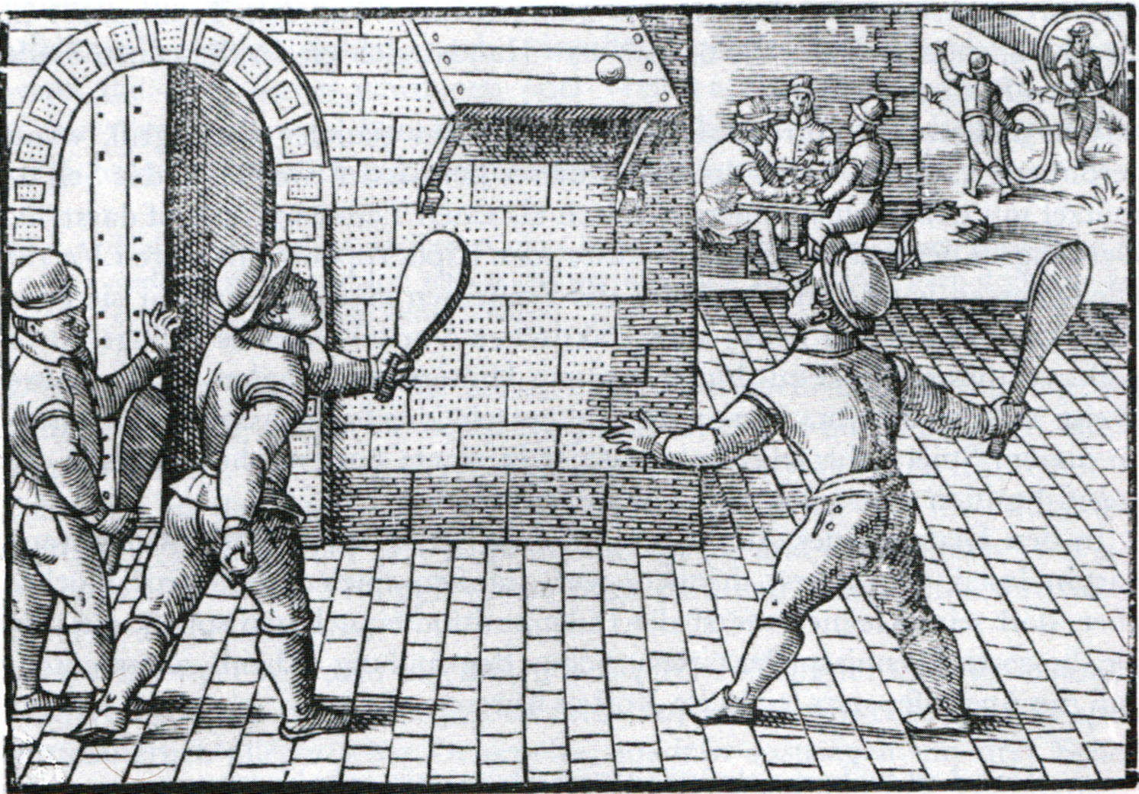
What was your experience?

Slide 34

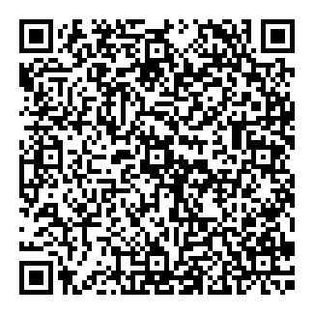

Contact us!
Mari Kermit-Canfield
Creative Learning Librarian
MariKermit@ferris.edu
Gary R. Maixner III
User Experience Librarian and Liaison to Communication Studies
gmaixner@iu.edu

