Slide 1
Managing the changing climate of business collections
THE CHARLESTON LIBRARY CONFERENCE 2019

Slide 2

Welcome!
Lively Lunch Discussion
3 Brief Presentations
Determining value through collection assessment
Critical librarianship & new resource selection
Managing accessibility with business resources
Facilitated Discussion
Photo Source: http://pxhere.com/en/photo/1450327

Slide 3
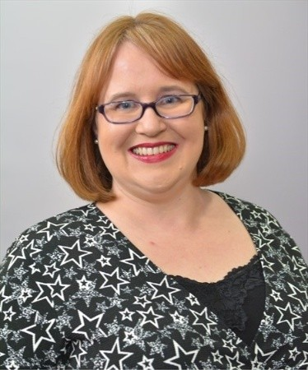

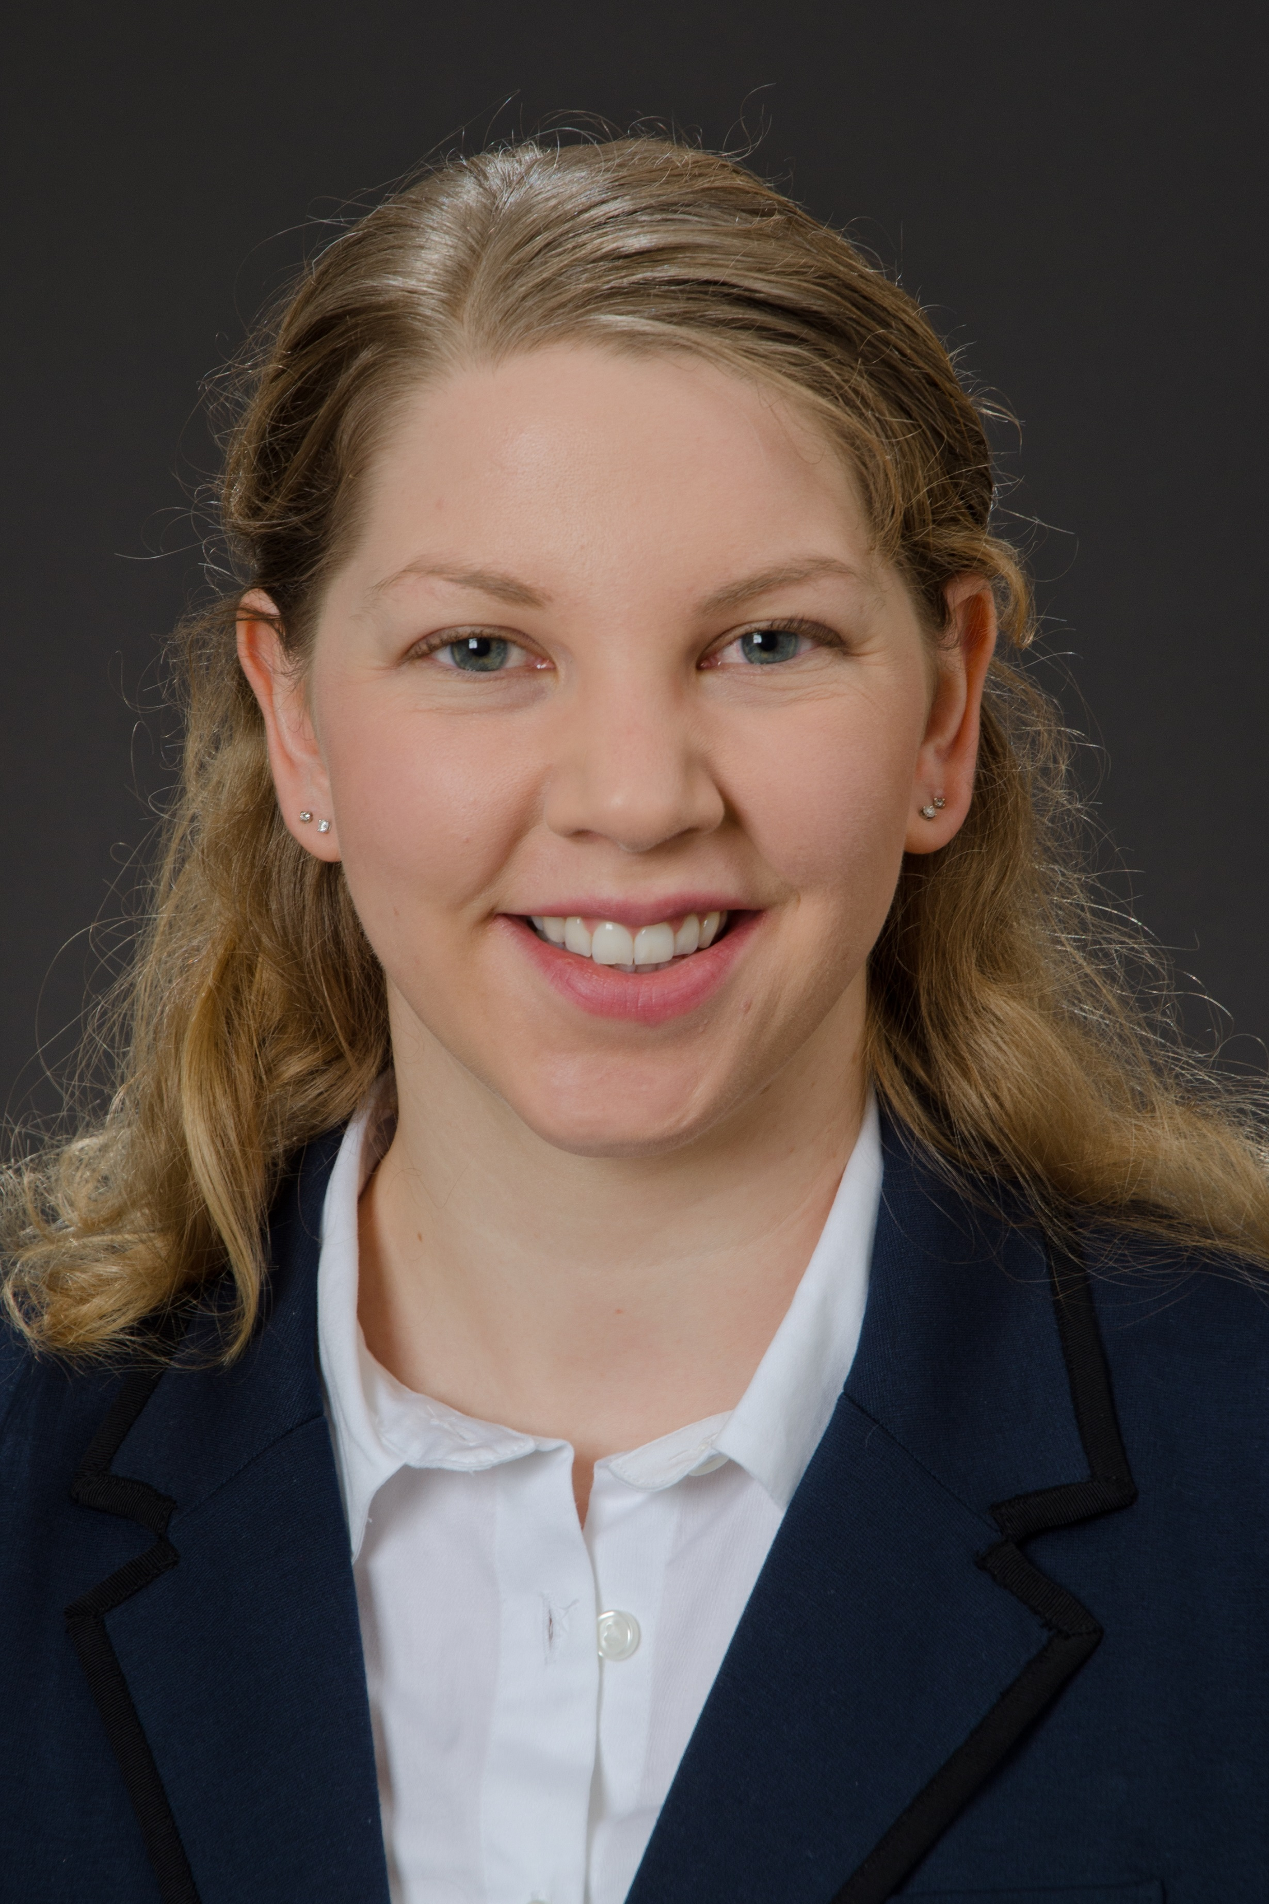
SPEAKERS
KATHARINE V. MACY
Assistant Librarian
Business & Economics
Indiana University - Purdue University Indianapolis
macyk@iupui.edu
ORCID ID: 0000-0002-6283-7143
HEATHER A. HOWARD
Assistant Professor
Business Information Specialist
Purdue University Libraries
howar198@purdue.edu
ORCID ID: 0000-0002-9047-8555
ALYSON VAALER
Assistant Professor
Business Librarian
Texas A&M University Libraries
asvaaler@library.tamu.edu
ORCID ID: 0000-0003-3258-0209

Slide 4
Determining Value through Collection Assessment
1
Katharine V. Macy

Slide 5
6%
3%
52.7%
Projected annual increase for journal content
(Library Journal 2018)
5-YR CAGR of Collection Budgets, a significant gap!
(Association of Research Libraries 2011-2016)
Portion of library budget spent on electronic materials at academic institutions. (Almanac 2018)
Notes:
Just some quick statistics:
Library journal projected journals to increase 6% in price for 2019. I have personally found that my electronic resources tend to follow that trend.
Meanwhile a survey of 114 ARL institution has shown only a 5% Compound Annual Growth Rate in collection budgets. This is a significant gap. Especially when considering that Chronical for Higher Education has determined that 52.7% of spending is on electronic materials (dominated by serial resources) and is only likely to grow, especially as libraries trend toward emphasizing providing access to ownership.
As a business librarian who is managing a complex collection of database resources I’m between a rock and a hard place. Especially when I consider all the other elements that go beyond price and use such as accessibility which my college Alyson will discuss and social justice which Heather will touch on in a few minutes.

Slide 6

Today’s Goal
Photo Source: https://flic.kr/p/rnZjv6
Notes:
Today our goal is to figure out how to bloom despite this rocky environment created by the forces that are changing and weathering our current collection management climate. By creating a dialogue between librarians and vendors as to what we are considering when managing collections.

Slide 7
Managing business collections
I want to…
Value resources in context of
  Library’s collection
  User needs
In order to…
Fill gaps
Cancel unused resources
Plan upfront and honest conversations with vendors
I don’t want to…
Purchase duplicate content
Cancel resources that are used
Make rushed decisions
Buy resources as a one-off

Slide 8
User Needs
Stakeholder analysis of Faculty & Students
Notes:
Curriculum mapping and signature assignments
Research your researchers – faculty surveys and outreach

Slide 9
Key Metrics
Price History
Determine the average price increase over a 3 and 5 year interval. (Note 5 years requires 6 years of data to calculate average 5 year increase)
$/Use
Attempts to create a quantitative value. However, on its own using this metric can be problematic. Another possible metric $/Citation.
Content Coverage
Map content, look for areas of duplication with competitive resources (including similar content), unique content.
Use
Measure how often the source was clicked, downloaded, read. Varies widely depending on the type of resource.
Core Resource
Is the resource critical for a teaching or research activity for the business school? Are there other options available that could replace that resource if budgets become an issue?
Portion of spend
Using the most recent price to determine what portion a resource contributes to a budget at the collection level (business) or library level. Helpful for setting priorities.

Slide 10
SETTING PRIORITIES
Only so much time in the day

Slide 11
Priorities for making changes
Existing Resources
Apply the Pareto Principle (80/20 rule) looking at use and/or cost.
Set thresholds for review on different metrics.
  Example: Over 5% average annual increase over 3-5 years
New Resources
Gap analysis of collection to determine options for trial
Coordinate for feedback from key stakeholders during trial
Communicate expectations clearly with stakeholders especially faculty
  Beloved resource from trial may not provide the most value.
Notes:
Communication: make clear that you are looking at content to fill a gap, avoiding duplication, uniqueness of content, fit for research and teaching needs, and price. A beloved resource from the trial may prove too expensive, and a cheap resource may not provide much new content. All factors will be considered and the librarian makes the judgement call considering how the new resource fits within the entire collection.

Slide 12
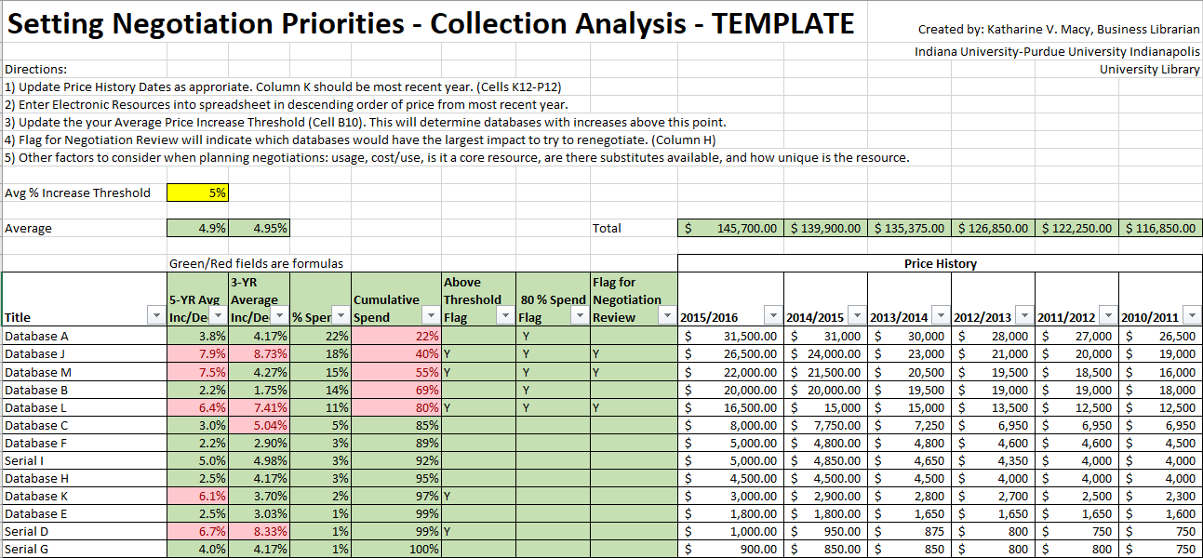
Template: http://hdl.handle.net/1805/12032
Notes:
This template enables the collection of price history to determine the average price increase over a set period, as well as perform a Pareto analysis. I pair this with the other collected metrics (usage, content, whether it is a core resource) in a full negotiation review. I use all the data gathered to answer my key questions: What gaps do we need to fill, what can we eliminate in order to ensure we can provide the most necessary resources, and how can we work with vendors to ensure we are maximizing value – which goes beyond price – it’s about paying what is fair for the content.

Slide 13
A holistic review of the collection provides the context necessary for individual resource reviews.

Slide 14
Success!
This process has enable me to add and expand resources while maintaining a tight budget. This process enables goal setting for principled negotiations and supports decision making.

Slide 15
Critical Librarianship & New Resource Selection
2
Heather A. Howard

Slide 16
“Critlib is short for “critical librarianship,” a movement of library workers dedicated to bringing social justice principles into our work in libraries. We aim to engage in discussion about critical perspectives on library practice. Recognizing that we all work under regimes of white supremacy, capitalism, and a range of structural inequalities, how can our work as librarians intervene in and disrupt those systems?”
-critlib.org

Slide 17
Evaluating Resources
How was the information acquired?
Was anyone harmed in the information acquisition process?
Was anyone left out of the data?
Who owns the company? Are we contributing to harm with our dollars?
Who will have access? Who won’t?

Slide 18

S&P, Moodys, & Fitch contributed to the 2007-8 financial crisis with inflated credit ratings for risky loans

Slide 19
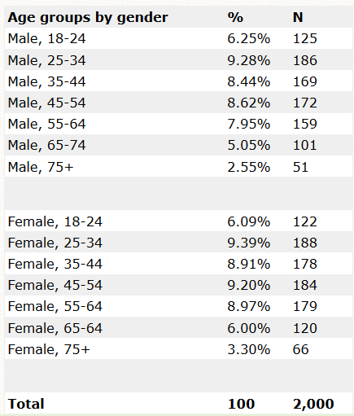
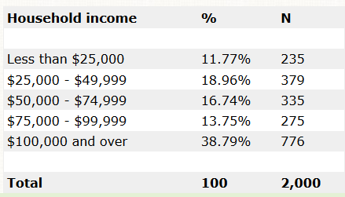
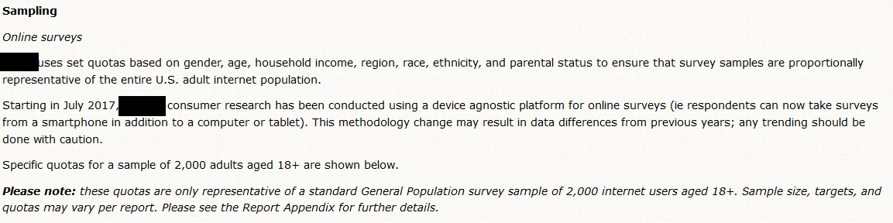

Slide 20
Problematic Categories
A - Power Elite 🏰
American Royalty
Platinum Prosperity
Kids and Cabernet
Picture Perfect Families
Couples with Clout
Jet Set Urbanites
B - Flourishing Families 👪
Generational Soup
Babies and Bliss
Family Fun-Tastic
Cosmopolitan Achievers
C - Booming with Confidence 💣
Aging of Aquarius
Golf Carts and Gourmets
Silver Sophisticates
Boomers and Boomerangs

Slide 21

Problematic Categories
D – Suburban Style
Sports Utility Families
Settled in Suburbia
Cul-di-sac Diversity
Suburban Attainment
E – Thriving Boomers
Full Pockets, Empty Nests
No Place Like Home
Unspoiled Splendor
F – Promising Families 👪
Fast Track Couples
Families Matter Most

Slide 22
Problematic Categories
G – Young, City Solo
Status Seeking Singles
Urban Edge
H – Middle Class Melting Pot
Progressive Potpourri
Birkenstocks and Beemers
Everyday Moderates
Destination Recreation
I – Family Union
Stockcars and State Parks
Blue Collar Comfort
Steadfast Conventionalists
Balance and Harmony

Slide 23
Stockcars and State Parks
Definition:
Middle-class couples and families living in more remote rural communities.
Stockcars and State Parks contain mostly middle-class families and empty-nesters living in remote rural communities. The adults have turned high school diplomas and some college education into decent wages from a mix of service-sector, farm and blue-collar jobs. Their kids are mostly grown and out of the house, although a quarter of the households still have adult children at home. The houses, situated on substantial lots, are large enough to be a bargain at a less-than-average $185,000. Far from urban centers, the neighborhoods where this segment lives are safe enough; no one worries about crime or violence.

Slide 24
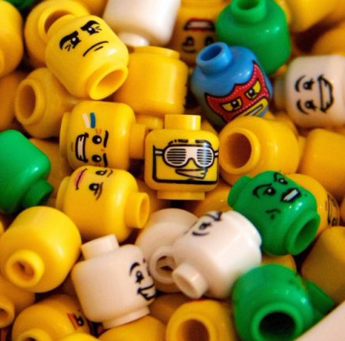
Problematic Categories
Born in America
Old and Rich Households
Trailer Park City
Unattached and Available
Very Rich Asians
Very Spanish

Slide 25
Managing Accessibility with Business Resources
3
Alyson Vaaler

Slide 26





Accessibility: How and Why
Section 508 Amendment: Rehabilitation Act of 1973
Mandates that all electronic and information technology developed, procured, maintained, or used by the federal government be accessible to people with disabilities
Screen Magnification Software
Text Readers
Speech Input Software
Alternative Input Device
Screen Readers
Notes:
-Section 508 recently revised in January 2017, requirements went into effect Jan 2018, to be more up to date and incorporate current web standards of accessibility
-requires federal agencies to comply, universities get some $$ from federal agencies for grants and inititaves
-on higher education radar, several lawsuits, Berkley
Types of Assistive Technology often referred to when we say a product is accessible

Slide 27
Confirming Accessibility
Contract Language
VPATS
Self Assessment
User Testing

Slide 28
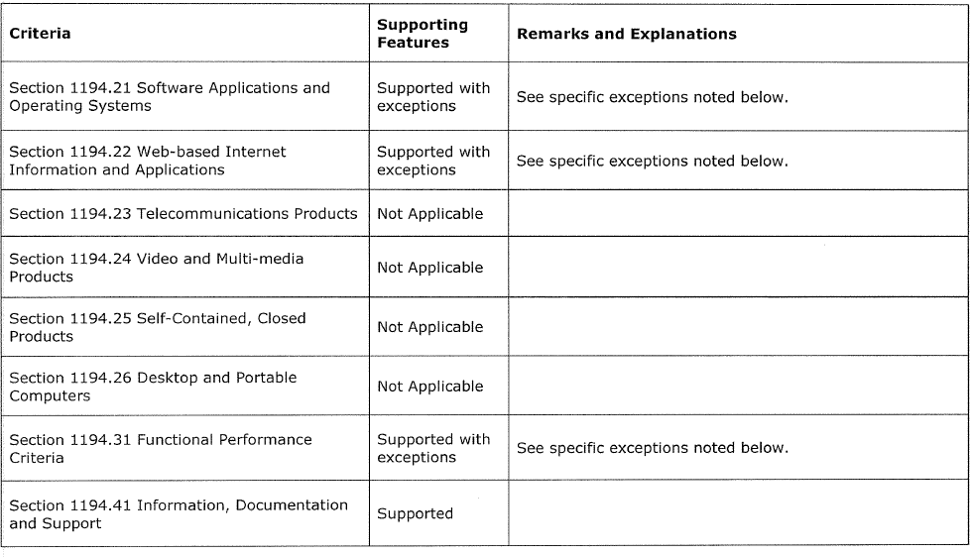
VPAT
Voluntary Product Accessibility Template
Notes:
VPAT evaluates how accessible a product is according to section 508 Standards
-self disclosing
-details each aspect of the Section 508 requirements and how the product supports the criteria
Currently have requested VPATS for 32 products, 5 of these are business specific products, 1 of these business products has a VPAT, others didn’t know what it stood for and one product vendor admitted that their key focus as a business are commercial clients and that they weren’t investing in accessibility because it wasn’t required of them.
-Can request “marketplace exceptions” if a product fills a need that other databases don’t provide, not a pass for accessibility but an “acceptance of temporary risk”

Slide 29
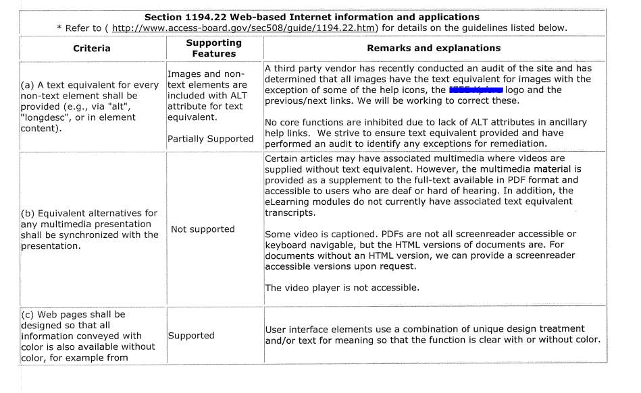

Slide 30
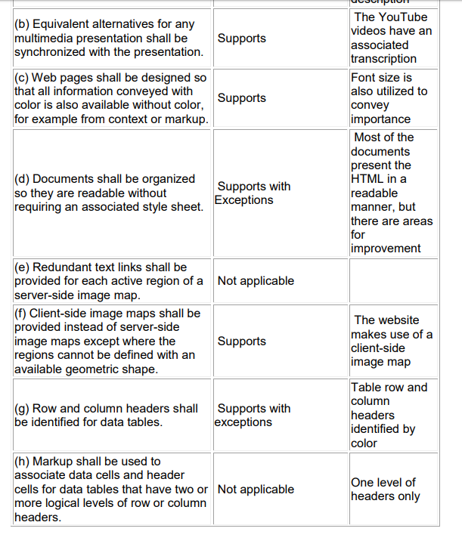

Slide 31
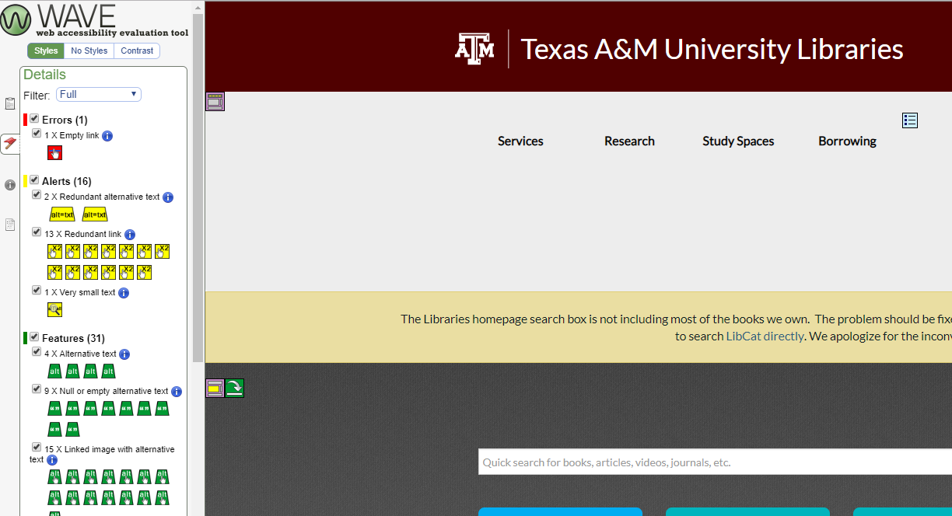
Notes:
Wave
Code Validation Services
Browser Extensions
Only check on page at a time, have to have someone skilled at interpreting results and know if the errors are a big deal or not
Some cost money

Slide 32
Challenges
Knowledge of accessibility software
Once problems detected, intrepretation necessary
For business resources, no incentives to invest in accessibility

Slide 33
References
Almanac. (2018). “Library Spending, by Sector, 2015-16.” The Chronical of Higher Education, available at: http://www.chronicle.com/article/Library-Spending-by-Sector/244160 (accessed 17 October 2018)
Association of Research Libraries. (2016). “Library Investment Index.” Retrieved from https://www.arlstatistics.org/analytics (accessed 17 October 2018)
Bosch, S., Albee, B., & Henderson, K. (2018). Death by 1,000 cuts. Library Journal, 143(7), 28. Retrieved from ABI/INFORM Collection (ProQuest) (accessed 17 October 2018)
Presentation template by SlidesCarnival

Slide 34

Let’s Discuss!
What are you considering?
Collection priorities?
Sticking points for resources and/or vendor agreements?
Librarians: what do you want vendors to know?
Vendors: what do you want libraries to know?
Presentation questions
Photo Source: Chris Battaglia https://flic.kr/p/GzRr2

