Slide 1

IMPACT: ART THERAPY AND AGING ADULTS
Haley Rush, ATR-P, LMHCA
Grant Scholarship Recipient
Lifeline Youth and Family Services
Eileen Misluk-Gervase, ATR-BC, LPC, LMHC, CEDCAT
Herron School of Art + Design, IUPUI

Slide 2


Healthcare Initiatives, Inc
Torrie Rhoades
Katie Cooley
Alexa Hart
Participants, staff, and organizations that supported this research study
*Releases for artwork and imagery were obtained

Slide 3
Presentation Goals
Overview of the grant proposal
Identification and use of the BBQ scales for aging adults
Successes and challenges faced in the implementation of services
Short and long-term benefits of this program.

Slide 4
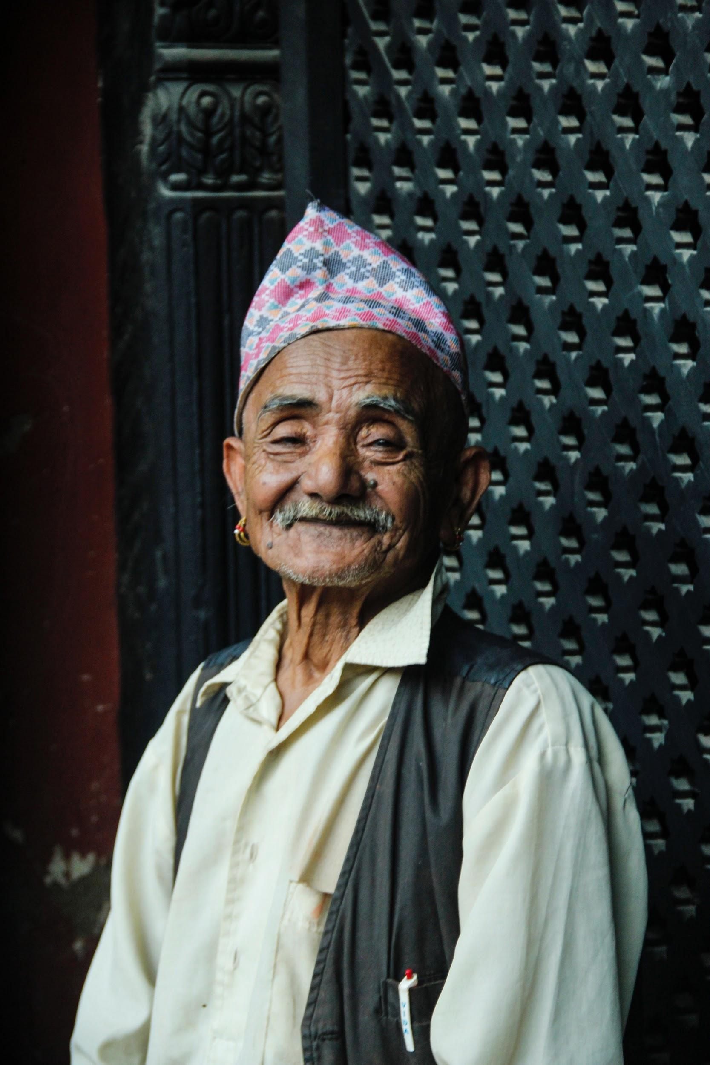
OLDER ADULTS
47.8 million older adults- ages 65 and up living in the United States (July, 2015); 14% of the total population and has increased by 1.6 million since 2014 (United States Census Bureau, 2017).
It is predicated that there will 98.2 million older adults by 2060 and this will account for 25% of the population (United States Census Bureau, 2017).
Adults 55-75+ spent 58-60% of their time watching TV and 11-13% of their time in “Other Leisure” activities (e.g. reading, computer, arts, hobbies, and travel) (Older Americans: Key Indicators of Well-Being, 2016)

Slide 5
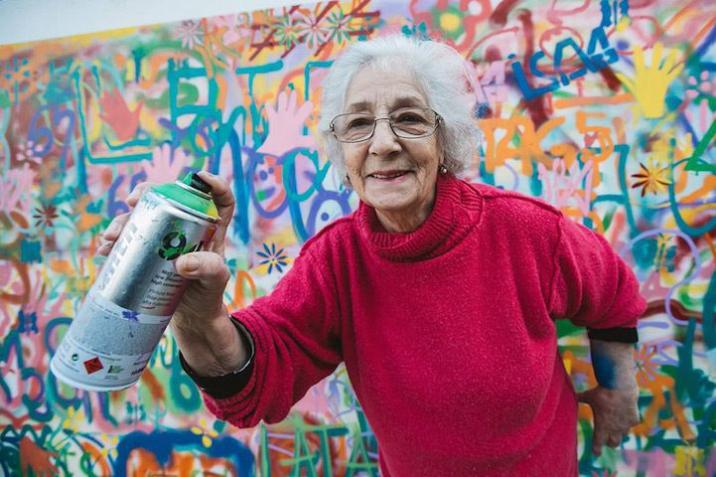
NEEDS FOR OLDER ADULTS
Mental stimulation to reduce cognitive decline
Developing new skills for cognitive improvement
Social interaction/engagement
Redefining purpose
Building on existing strengths
Promoting autonomy
Providing developmentally appropriate opportunities for enrichment

Slide 6
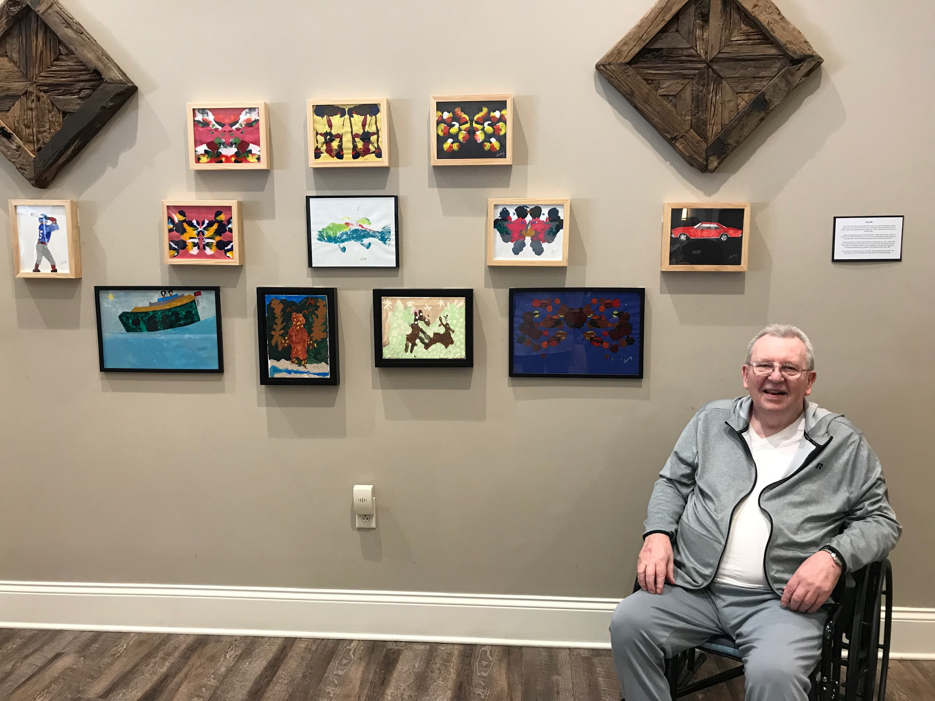
ART THERAPY WITH OLDER ADULTS
Creative process supports the life review process which is a normal and healthy development phase in later life (Haber, 2005; Hanneman, 2005; Magniant, 2008).
The use of imagery supports memory recall and tangible evidence of the therapeutic process (Kelley, 2017; Hinkle, 2018).
Learning a new task supports the development of new neural pathways, strengthens existing pathways, and supports a healthy brain (Alders, 2012).
Art making requires a curious process that encourages cognitive flexibility, risk taking, decision making, and autonomy
Ability to explore, process, and heal from life experiences and build resilience and understanding of the aging process (Alders, 2016).

Slide 7

OVERVIEW OF FUNDING
Two art therapists to serve as the project manager (12 hours per week)
Two internship placements for 2nd year students with scholarships
Two Internship placement for 1st year students
Support for conference attendance
Art materials (consumables and non-consumables)
Celebration and art show at each facility
Statistician to analyze results
Publication support

Slide 8

Study At-A-Glance
32 week study
Internship: Individual, group, and open studio art therapy programming
Study: GDS & BBQ, material use, programming attendance, focus/theme of structured groups, verbalizations, testimonials
Increase in a sense of agency, creative expression, and social engagement which are all key components in a high quality of life.

Slide 9
Recruitment & Participants
The Indiana University IRB approved study (1805467216)
Researchers, Project Manager, and Activities Coordinator
Flyer distribution to participants and family members
Participants and their legally authorized representative (LAR) were required to complete the informed consent
The age of the participants were from 65-100 years old with or without mild cognitive impairments.
Cognitive impairments were not assessed for beyond the ability to answer the evaluation tool questions.

Slide 10

Schedule: September, December, & April
Geriatric Depression Scale (GDS)
Brunnsviken Brief Quality of life scale (BBQ)
Testimonials
Schedule: Ongoing
Material use
Programming attendance
Focus/theme of structured groups
Verbalizations
For the purpose of this presentation, data on the BBQ will be discussed.

Slide 11
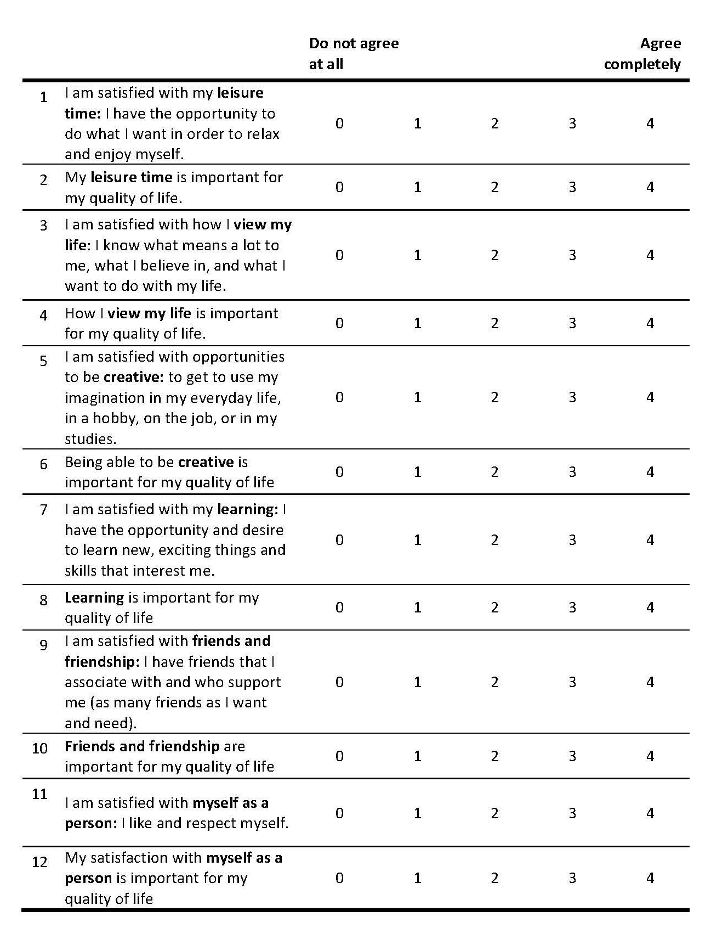
Brunnsviken Brief Quality of Life scale (BBQ)
₂₀₁₆
validated self-rating scale for subjective quality of life
Twelve questions covers six areas of how satisfied you are with these, and how important they are to you.
Six areas: leisure time, view my life, creative, learning, friends and friendships, and myself as a person
Likert type scale: do not agree at all (0) to completely agree (4)

Slide 12

Internship: served 50 individuals
Study: Seventeen or 34% of the internship participants
Retention: Fourteen participants, thirteen who self-identified as female and one who self-identified as male completed the study. A total of two females and two males dropped out of the study with a retention rate of 82%.
BBQ: Significance was found in the Importance factor of Leisure and Learning.
Notes:
Two participants dropped out of the study after enrollment because of a lack of interest. One participant dropped out after the pre-assessment and 1 dropped out after the mid-assessment due to increasing cognitive impairments.

Slide 13
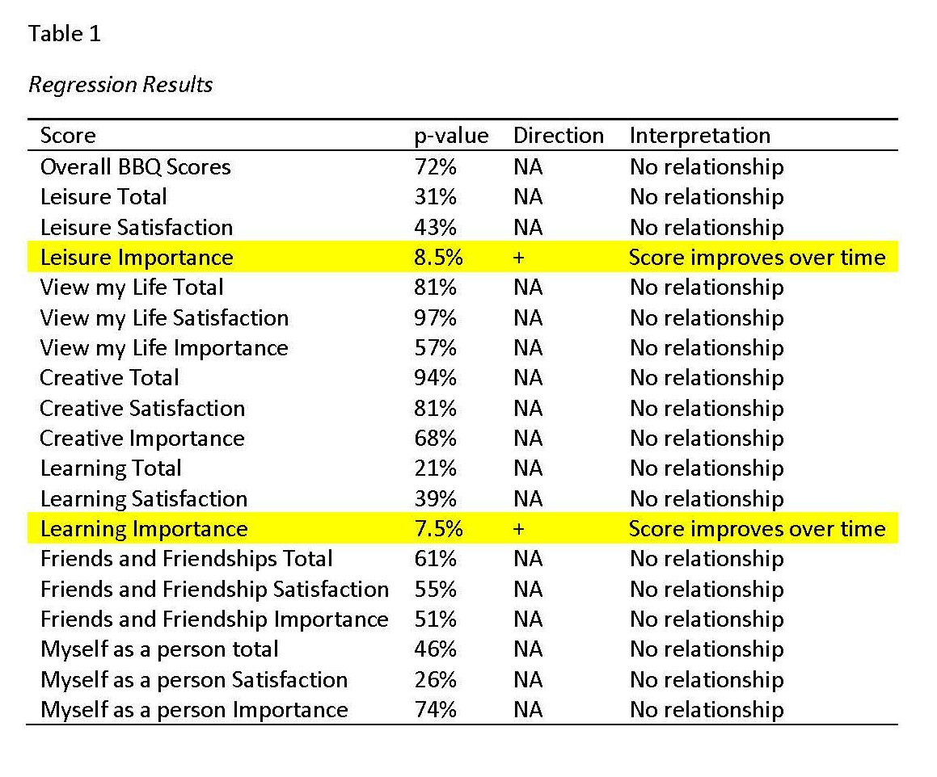
Regression
What is the probability that the score has no relationship to the intervention?
Notes:
Column 1 indicates the score being assessed. Column 2 lists the p-value- the probability that there is no relationship between the score and the pre, mid, and post evaluations. Column 3 When that probability is low enough (10% or less), column 3 notes (when the probability is 10% or less) the direction- whether the relationship is increasing or decreasing over time (+/-). Column 4 briefly explains the relationship.

Slide 14
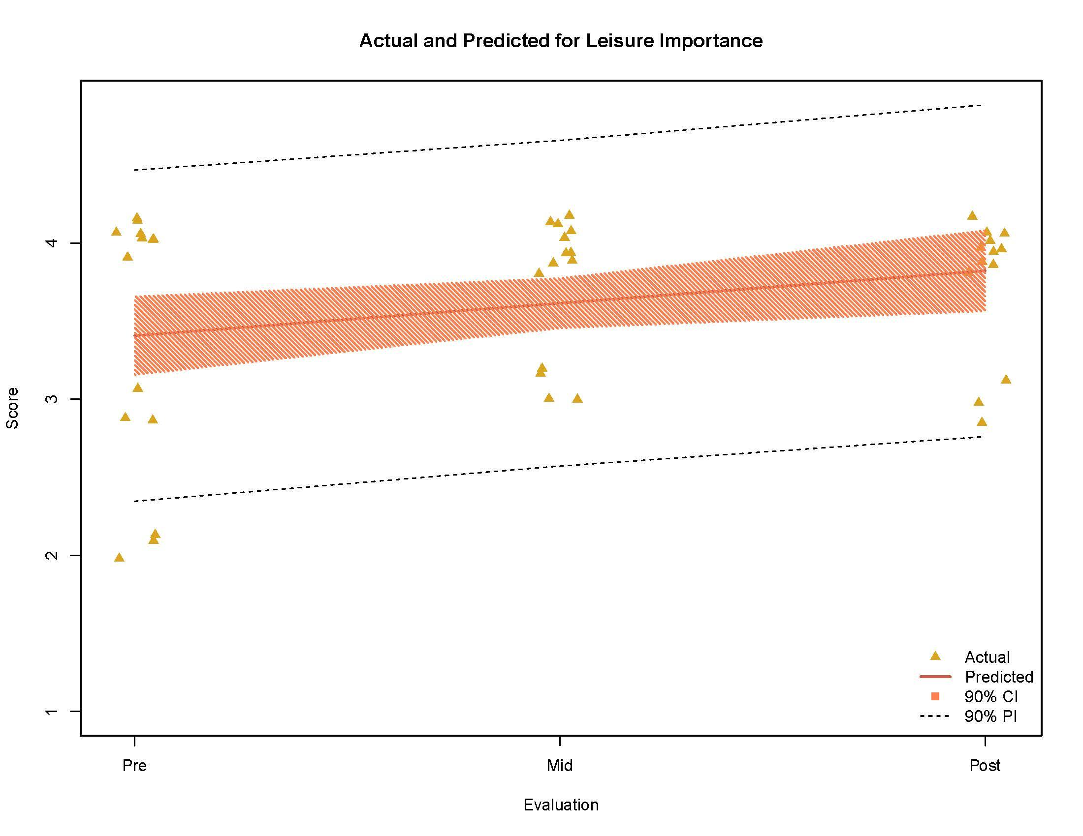
Notes:
confidence interval
probability interval

Slide 15
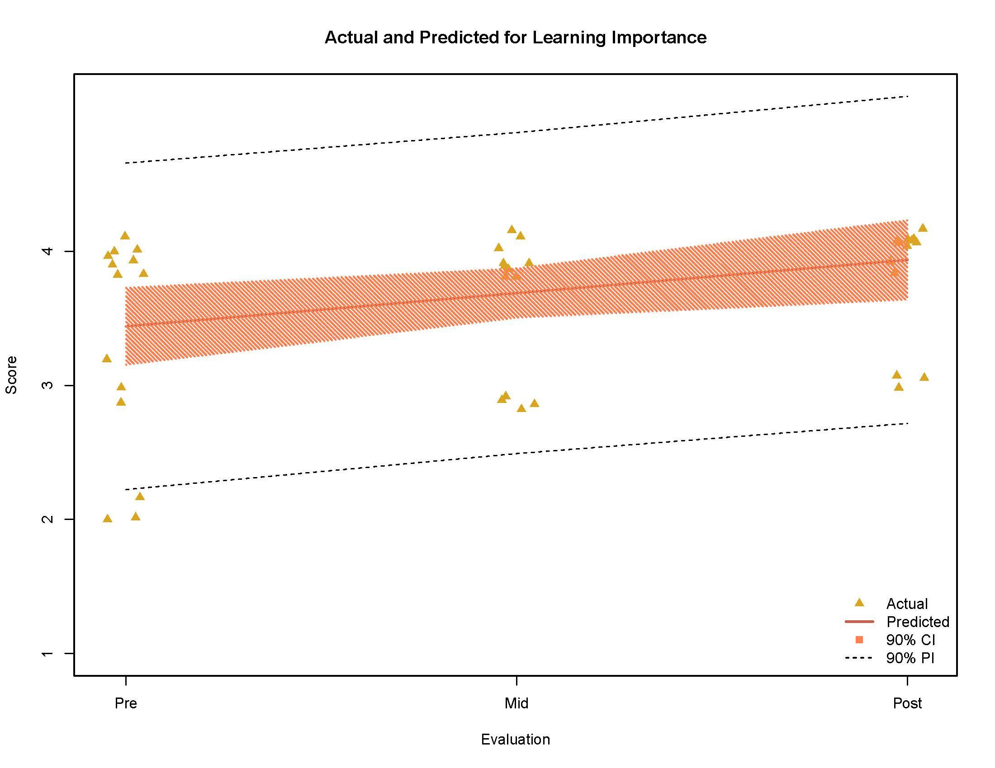

Slide 16
Discussion
What challenges did we face in the granting writing and IRB process?
Did the study results reflect the observational experiences of the interns and their supervisors?
What challenges were experienced during the study?
What are the implications of this research?
If replicated, what would we do differently?
Notes:
Small sample size with 41 data sets over 3 time peroids
Interns were also the researchers
2 sites with a wide variety of participant functioning level
challenges: BBQ as tool, assessment timeline, participation, space, open studios. material use, cognitive impairment, rapport building

Slide 17
REFERENCES
Alders, A. (2012). The effect of art therapy on cognitive performance among ethnically diverse older adults (Unpublished doctoral dissertation). Florida State University.
Alders, A. (2016). Art Therapy with Older Adults: A Focus on Cognition and Expressivity. In D.E. Gussak & M.L. Rosal (Eds.). The Wiley Handbook of Art Therapy (pp.272-279). Chichester, UK: John Wiley & Sons.
Cha, H. (2015, June 15). Pass Grandma the Spray Paint: Street Artists Team with the Elderly to Revitalize Old Neighborhoods [Blog post]. Retrieved from https://www.yahoo.com/news/pass-grandma-the-spray-paint-c1433376796462.html
Federal Interagency Forum on Aging and Related Statistics. (2016). Older Americans: Key indicators of well being. Retrieved from https://agingstats.gov/docs/LatestReport/Older-Americans-2016-Key-Indicators-of-WellBeing.pdf
Haber, D. (2006). Life review: Implementation, theory, research, and therapy. The International Journal of Aging and Human Development, 63(2), 153-171.
Hannemann, B.T. (2006). Creativity with dementia patients. Gerontology. 52, 59-65
Hinkle, B. (2018). A short-term art therapy group for individuals with dementia (Unpublished master's thesis). Herron School of Art and Design, IUPUI.
Magniant, R. C. P. (2014). Art Therapy with older adults: A sourcebook. Charles C Thomas Publisher.

Slide 18


