Slide 1


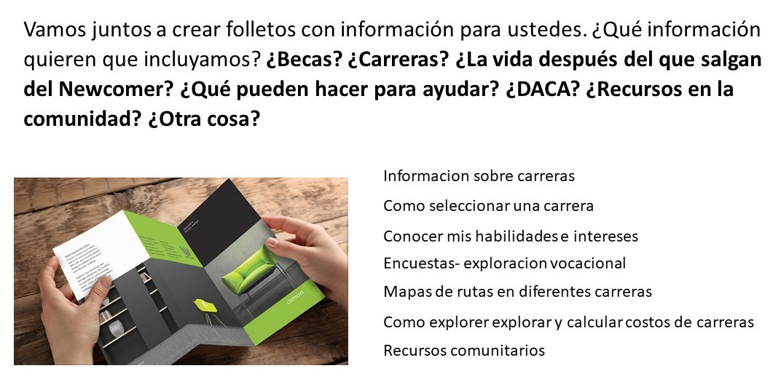
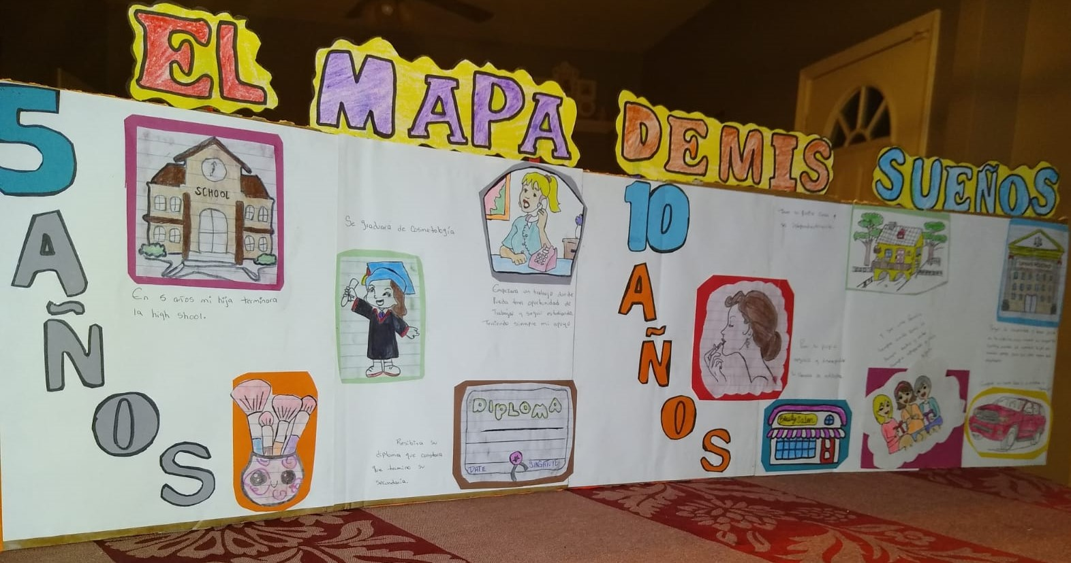
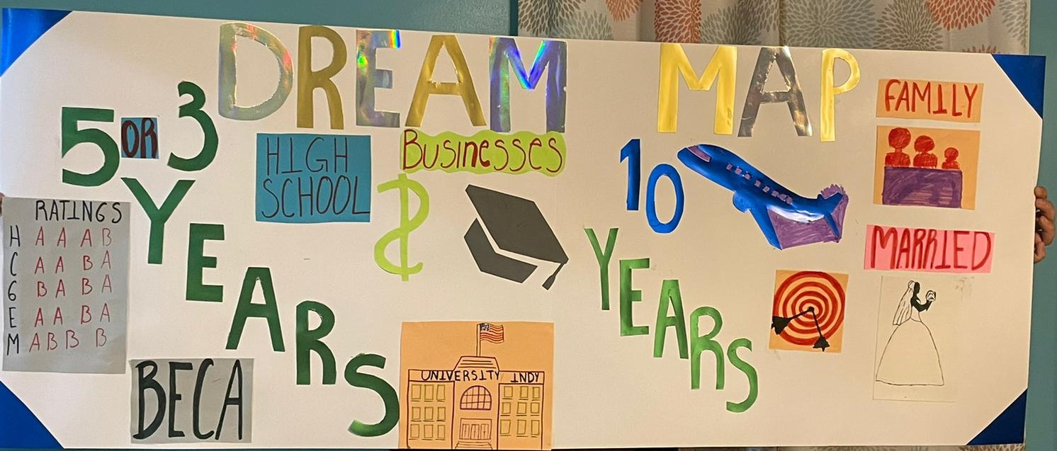
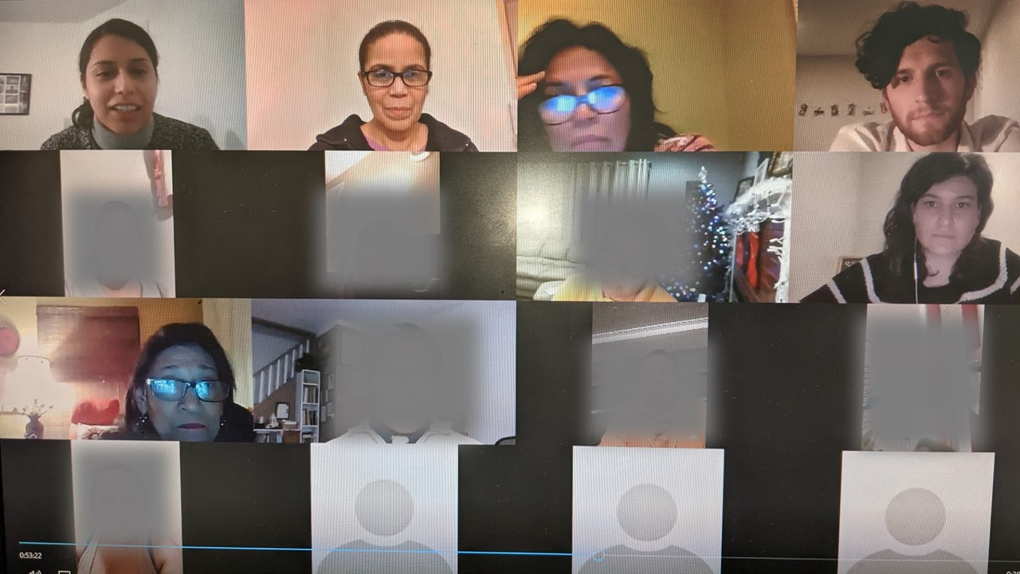
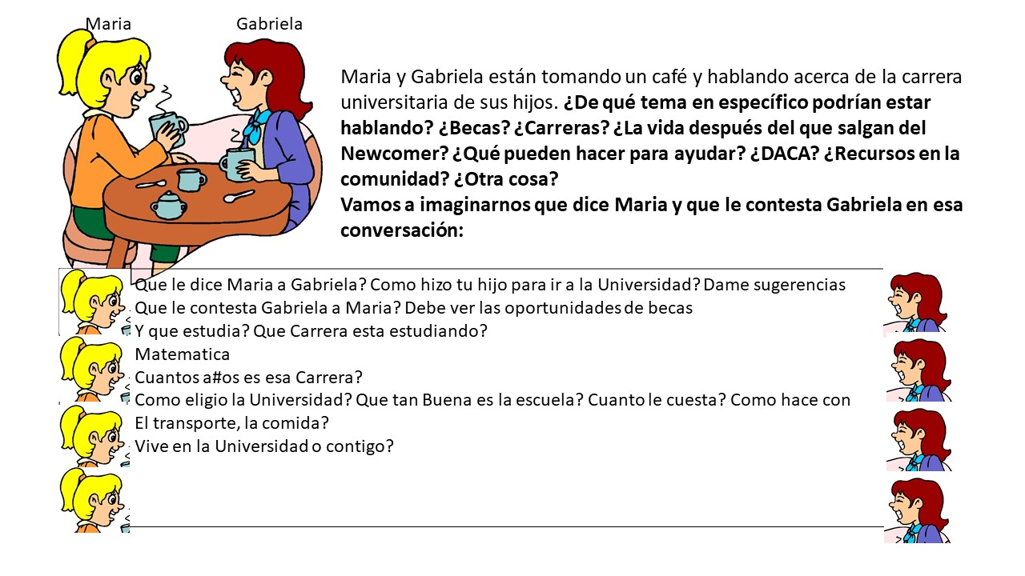
Co-Constructing Culturally Relevant College & Career Readiness Resources for Latinx Families
Devin Wolfe and Silvia Garcia
Indiana University School of Social Work
Abstract
Methods
Results continued
Recent studies show that Latinx newcomer parents are not prepared to support their children throughout the college preparation process due to a lack of understanding of the U.S. college process, the complex financial aid system, and the diversity of post-secondary choices.
Utilizing a design-based implementation research methodology, the research team (1 faculty member, 1 staff member, 1 graduate student, and 3 community partners) conducted virtual meetings with Latinx parents and 2 college students to understand and address their major questions and concerns about college and career readiness, as well as their approach to better communicate this content. Based on the knowledge gained so far, the research team is co-developing prototypes to discuss, implement and co-evaluate with parents.
This is a design-based implementation research (DBIR) (Fishman, et al., 2013) that invites stakeholders' participation in the design, implementation and evaluation of the final solutions.
Sampling: Homogeneous purposeful
Population: 13 Latinx parents; 62% female; 54% employed. Median income family level <$20,000; 77% completed High School; 93% have First Generation students.
Data gathering and analysis occurs in five study phases: 1) Focusing the problem; 2)Thinking about possible solutions; 3) Co-designing the solution; 4) Implementing the solution; 5) Co-evaluating the solution
In another virtual session, we asked participants for ideas to create brochures.
Results
Conclusions
Introduction
Mi mapa de sueños en 5 AÑOS 👨🏻‍🎓👨‍💻sacar buenas calificaciones para seguir estudiando y aprender oficios ⚙🔧⛏🔐 tambien ser un emprendedor 👠👗👚y en 10 AÑOS 🚘🏚️✈️ si Dios quiere y me permite llegar a ese tiempo 👏
Newcomer Latinx parents have fewer direct avenues to the institutional information they need to help their students succeed in high school and beyond. Our meetings helped build basic college-going knowledge and social capital that can be leveraged through specific strategies and resources they can use in their communities.
Our research has not yet concluded. So far, we have collected vital information to continue to the production phase of the project.
Parents have specific concerns about aspects that may not be an issue for other parents who have lived longer in the U.S. The resources developed by the research team will be focused on informing parents on matters that concern them the most:
How do I know which IPS high school will be best to prepare my child for their career?
What are the career paths after High School? How can we prepare students to choose a career?
Will my child be eligible to pursue the education necessary for a career after high school?
What financial help is available for my child to go to college?
What documents are required to work in the United States?
Goal: To produce culturally relevant college and career readiness resources for Latinx parents and caregivers.
Literature Review: Racialization and inequality rule many aspects of the lives of Latinos in the U.S., including access to quality education. Latino youth and families struggle to succeed in an education system that is based on a mainstream, middle-class family foundation (Viramontez-Aguiano & Lopez, 2012). Given the role that parents play in their children’s educational choices (Carey, 2016), it is important to expose families to information anchored in their cultural and educational background to bridge them with community resources that they are either not aware of or are inaccessible.
The participatory approach used in this study values the role of the user (Latinx parents) in the design and production of culturally relevant college and career resources.
Significance of the study: Methodologically, the study uses a relatively new user-center design method that engages families and researchers in co-learning and co-producing resources. The project fills a gap of needed resources to inform Latinx parents of postsecondary opportunities, as well as keeping them actively involved in their children's career decisions during and after high school. The resources produced in this project can be used in Latino-serving schools and organizations, and Latino-serving universities to educate parents and caregivers.
For the third virtual session, we sent instructions to parents via Whatsapp and asked them to send us pictures or their “Mapa se sueños” (Vision Boards), which they created with their children. We received pictures and texts.
References
Carey, R. L. (2016). “Keep that in mind… You’re gonna go to college”: Family influence on the college-going processes of Black and Latino high school boys. The Urban Review, 48(5), 718-742.
Fishman, B. J., Penuel, W. R., Allen, A. R., Cheng, B. H., & Sabelli, N. O. R. A. (2013). Design-based implementation research: An emerging model for transforming the relationship of research and practice. National society for the study of education, 112(2), 136-156.
Viramontez Anguiano, R. P., & Lopez, A. (2012). El miedo y el hambre: Understanding the familial, social, and educational realities of undocumented Latino families in North Central Indiana. Journal of Family Social Work, 15(4), 321-336.
During a virtual session, we asked participants for ideas to create dialogues for videos. Below is a dialogue created with parents.
First virtual meeting of Latinx parents and college students with the research team (de-identified)

