Slide 1


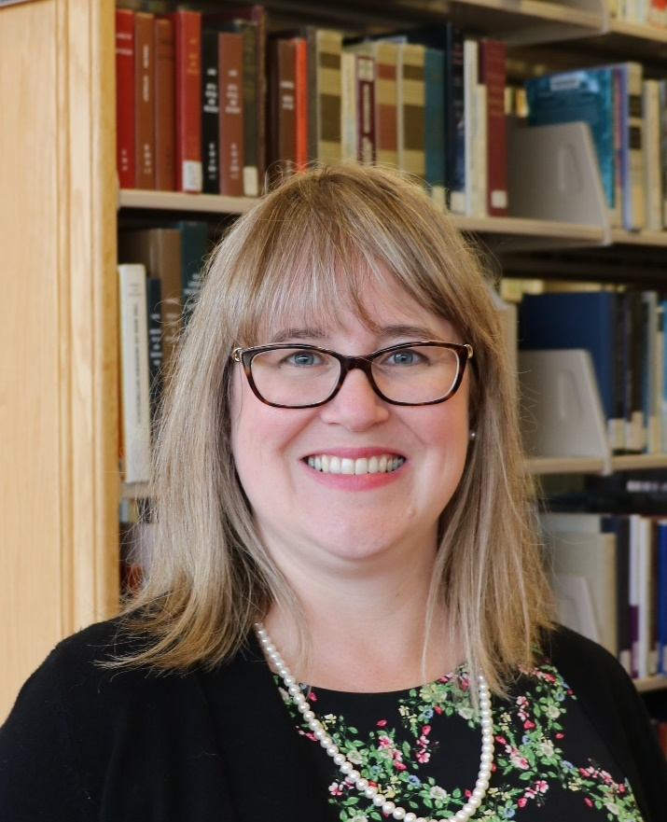
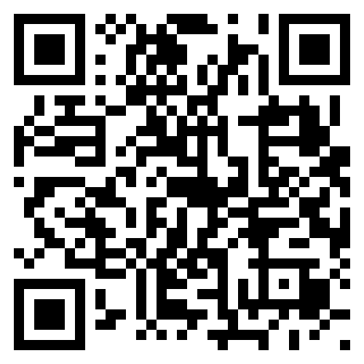
Expand Your Collection Horizons with Negotiation Skill Development to Address Today and Tomorrow’s Challenges
Katharine V. Macy
Indiana University Indianapolis

Slide 2
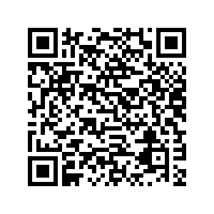


Code of Conduct
The Charleston Library Conference is an inclusive, professional conference. We respect free speech and invite diverse perspectives and opinions. All participants are expected to treat others with respect and consideration, keeping the conference environment free of discrimination or harassment, maintaining professional and ethical conduct at all times. Visit our website to read the full text.

Slide 3
Help us make sure this session is accessible!
Please do the following to allow all attendees to fully participate in this session:
• All speakers should use microphones.
• Speakers and participants should identify themselves by
name and affiliation during the presentation and Q&A.
• Speakers should repeat/rephrase all questions into
microphones before answering them.

Slide 4
Poll Question
How do you feel about negotiations?

Slide 5

Planning and executing negotiations is very similar to chess

Slide 6

the ONEAL project
ONEAL = Open Negotiation Education for Academic Libraries
An IMLS funded project to teach negotiation skills to academic library workers who work with vendors

Slide 7
93 attendees
20 library workers
35 interviewees
Average attendance to three community forums in Fall 2022
Participated in Curriculum Planning Workshop in November 2022
Qualitative research study in Spring 2023
26 pilot testers
Completed the Foundations curriculum in Fall 2023
Notes:
Nothing for the community without the community

Slide 8
Foundations Module
Foundations | Introduction to the Curriculum
 | Contracts & Licensing
 | Introduction to Negotiations
 | Negotiation Planning Part 1: Strategy
 | Negotiation Planning Part 2: Internal Review
 | Negotiation Planning Part 3: Vendor Research
Issues | Accessibility

Slide 9
Curriculum Content
Lesson Plans
Recorded Lectures
Hands-on Exercises
Carefully constructed to maximize learning
Over 5 hours of recorded videos with accessible alt.
Using best pedagogical practice
Case Studies
Workbook
Group Activities
Best way to improve is to practice!
All lessons are available for individual download or in workbook.
To support classes and larger group learning
Notes:
Each lesson consists of three parts – a Watch/Read/Listen section that provides the introductory materials necessary for the lesson, a Review section that provides additional resources , and a Do section that allows the learner to apply what they have learned in a hands-on way. All the hands-on activities are available either all together as a workbook that can be completed alongside the curriculum, or as individual downloads that allow the learner to focus on specific lessons. One of the key activities that runs through the curriculum is a negotiation journal, which encourages the learner to reflect on their planning for negotiations, the vendor’s reaction, and the results of negotiation. Learners are also encouraged to journal throughout the lessons in structured and unstructured ways.
Case studies and group activities are also available as part of the curriculum, providing opportunities to enhance and deepen learning.

Slide 10
https://sparcopen.org/our-work/negotiation-resources/oneal/
Access the curriculum

Slide 11
New Strategies Module – Nov/Dec 24
Developing values-driven negotiations
Introduction to power mapping and applications
Additional content on contract and licensing terms
AI showing up in everything!
Strategies for engagement: students, faculty, library workers, administrators

Slide 12
Privacy & Surveillance
Issues Module Lesson Coming Early 2025!

Slide 13
Poll Question
Which resource negotiation hot topic do you most want to learn more about?

Slide 14
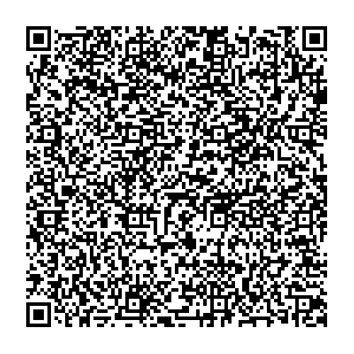
Hot Topic Resource Handout

Slide 15
Poll Question
What is your biggest challenge with negotiations right now?

Slide 16
THANKS!
https://oneal-project.org/

