Slide 1
Open Access and Social Justice
(Or, Health Information Access is Important!)
Caitlin Pike, MLS, MPH, AHIP
IUPUI University Library
Indianapolis, Indiana, USA

Slide 2
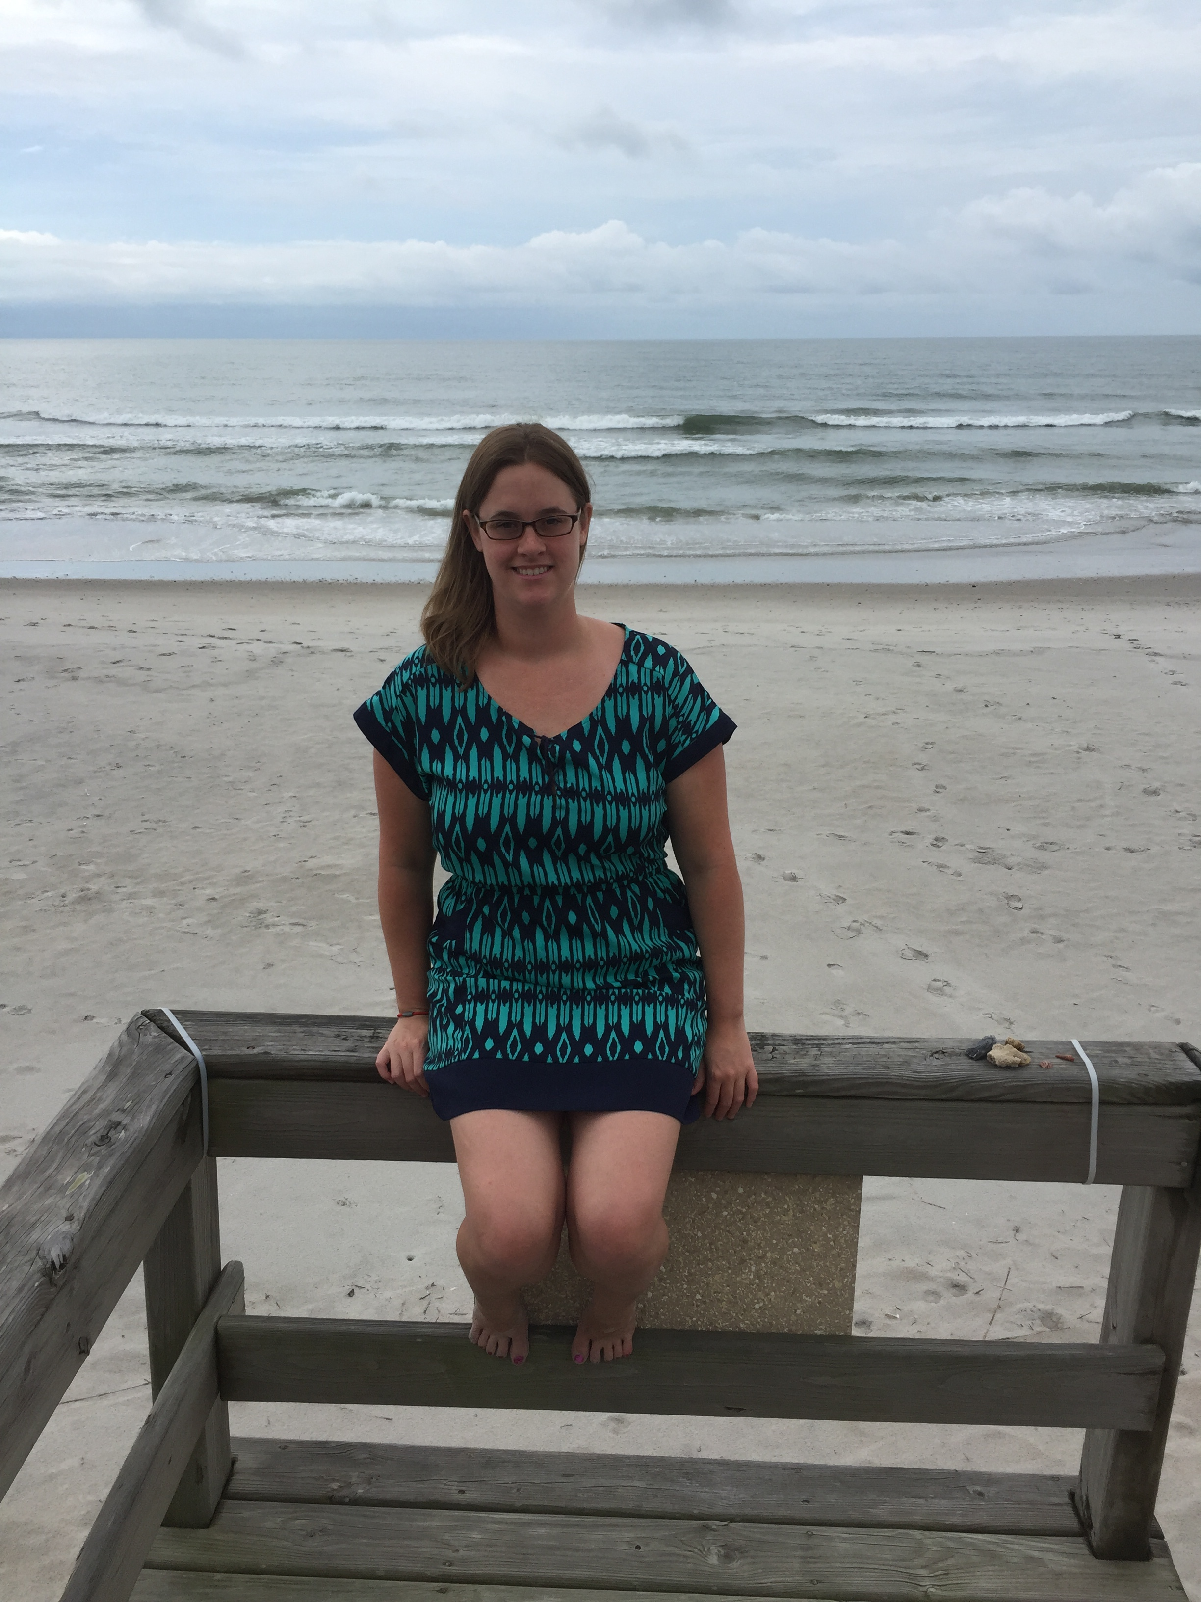
Caitlin A. Pike
Research Engagement Coordinator
Nursing and Medical Humanities Librarian
Email: caiapike@iupui.edu
Phone: 317-274-2885
Twitter: libris_fidelis
Former Chief Mate. Earl Grey Enthusiast. Friend of Squishy-Faced Dogs.

Slide 3
Agenda
10:55 – Overview of Open Access, Social Justice, and Undergraduate Survey Results
11:05 – Knowledge Café
11:25 – Share Results with the Group
11:35 – Wrap-Up

Slide 4
Defining Our Terms
Open Access, Social Justice, and Health Equity

Slide 5
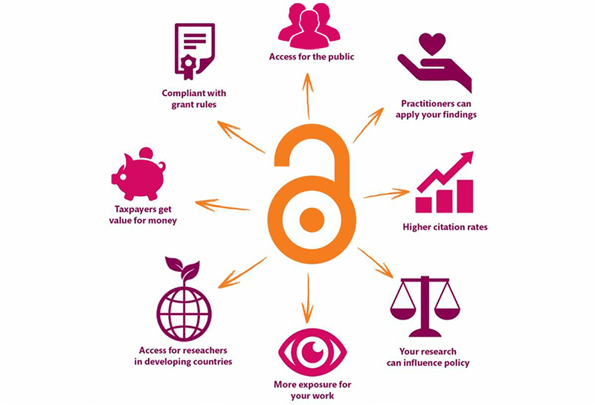
Open Access
According to SPARC:
Open Access is the free, immediate, online availability of research articles coupled with the rights to use these articles fully in the digital environment.
Open Access ensures that anyone can access and use these results—to turn ideas into industries and breakthroughs into better lives.
Source: https://kib.ki.se/en/publish-analyse/open-access

Slide 6
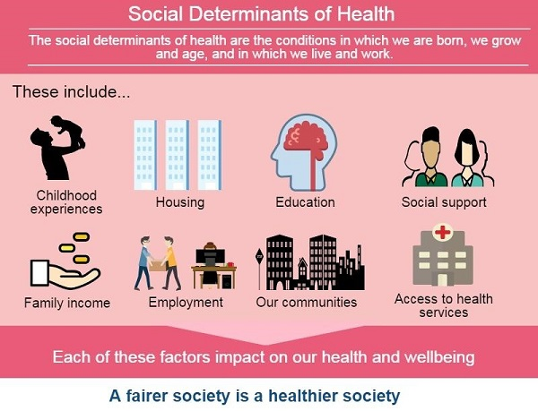
Social Justice
The idea of acting with equality, fairness and dignity to all human beings.
“Social justice is the view that everyone deserves equal economic, political and social rights and opportunities.”
– National Association of Social Workers
“Social justice also imposes on each of us a personal responsibility to work with others to design and continually perfect our institutions as tools for personal and social development.”
– Center for Economic and Social Justice
Source: https://www.healthyfife.net/health-inequalities/

Slide 7
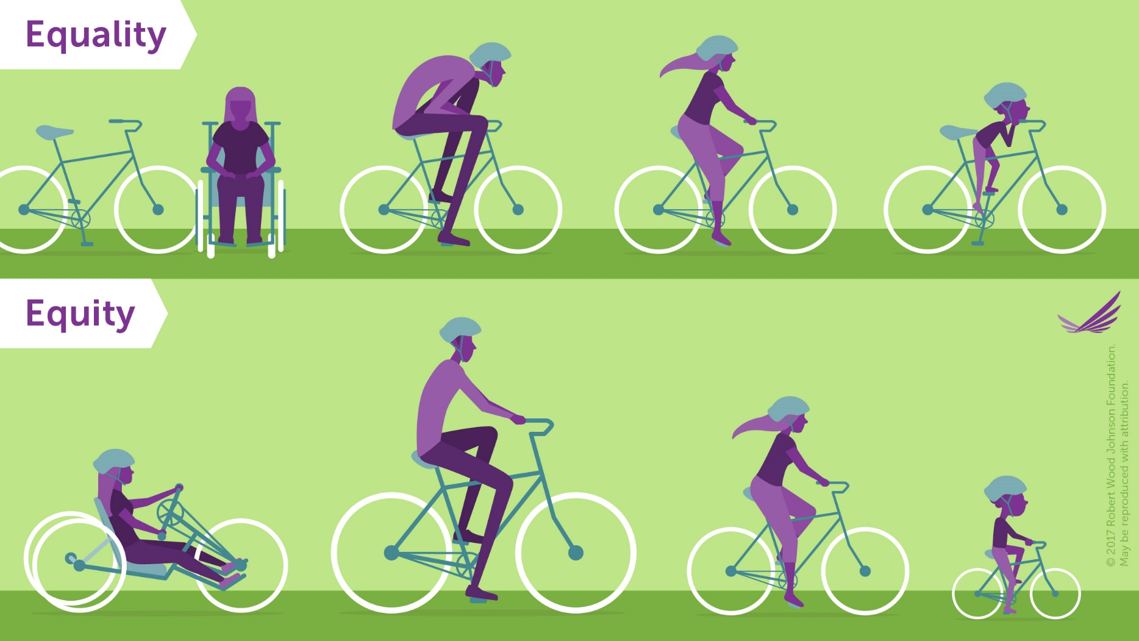
Equality vs. Equity
Social Justice should (hopefully) aim to be equitable.
The goal of equality is to make sure that everyone has the same things to be successful.
Equity is trying to understand where people are coming from and give them what they need to be successful.
Equality is similar to equity in that it is seeking fairness for everyone, but it assumes that everyone starts equally as well.
Source: https://www.rwjf.org/en/library/infographics/visualizing-health-equity.html
http://www.societyfordiversity.org/equality-vs-equity/

Slide 8
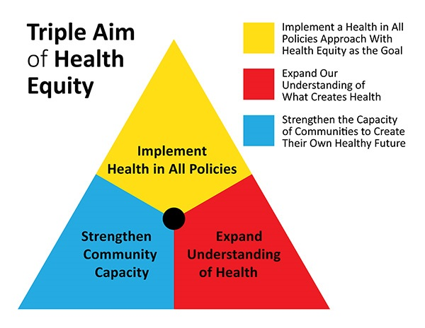
Health Equity
American Public Health Association:
Everyone has the opportunity to attain their highest level of health.
How do we achieve health equity?
  We value all people equally.
  We optimize the conditions in which people are born, grow, live, work, learn and age.
  We work with other sectors to address the factors that influence health, including employment, housing, education, health care, public safety and food access.
Source: https://www.planning.org/blog/blogpost/9104610/

Slide 9
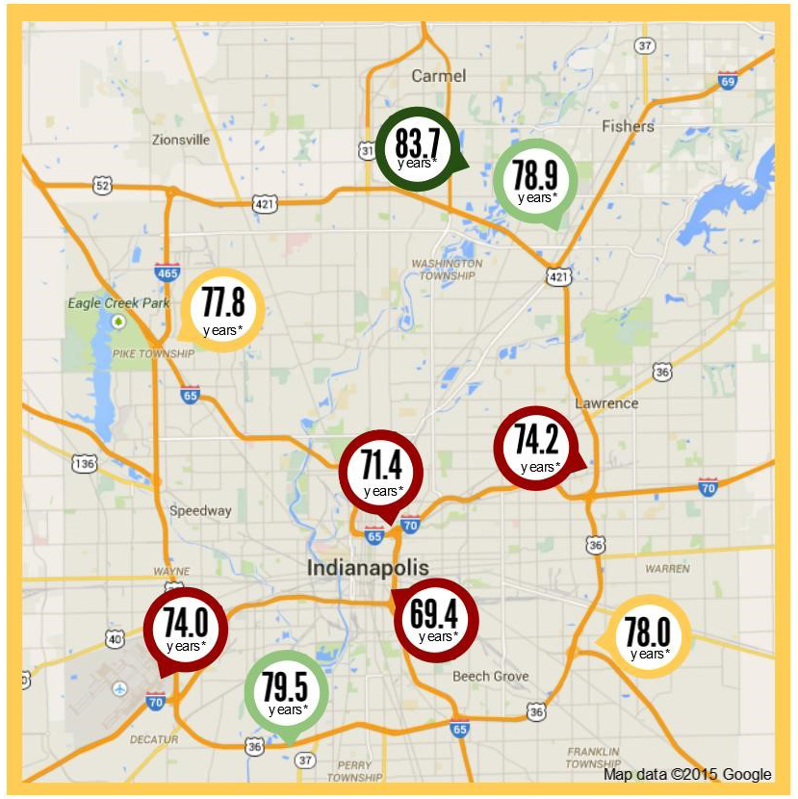
Why Does It Matter?
Life Expectancy in the Indianapolis Metro Area
46033
  High School Graduates: 99%
  Median Household Income: $124,712
46225
  High School Graduates: 69.3%
  Median Household Income: $33,688
28 miles and 14 years of life
(Source: 2013-2017 American Community Survey 5-Year Estimates)
Worlds Apart: Gaps in Life Expectancy in the Indianapolis Metro Area

Slide 10
Student Views on Open Access
International Open Access Week 2018
Is information access important?

Slide 11
Demographics
Year in School | Number of Students
Freshman | 31
Sophomore | 18
Junior | 20
Senior | 23
Masters | 8
Professional School | 1
Total: | 101

Slide 12
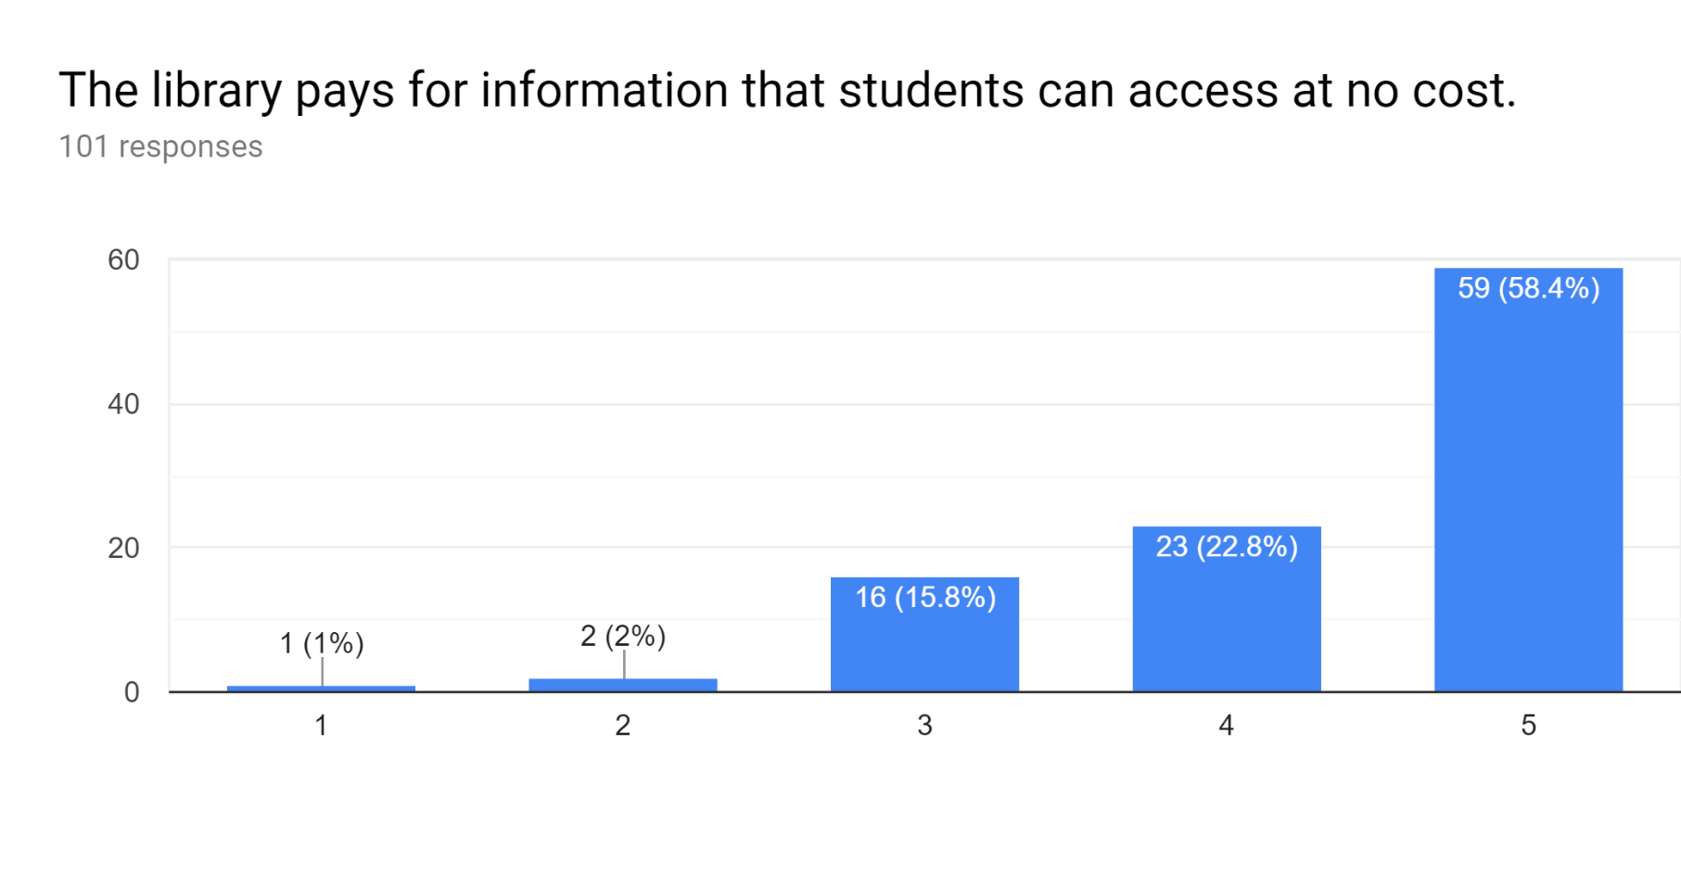
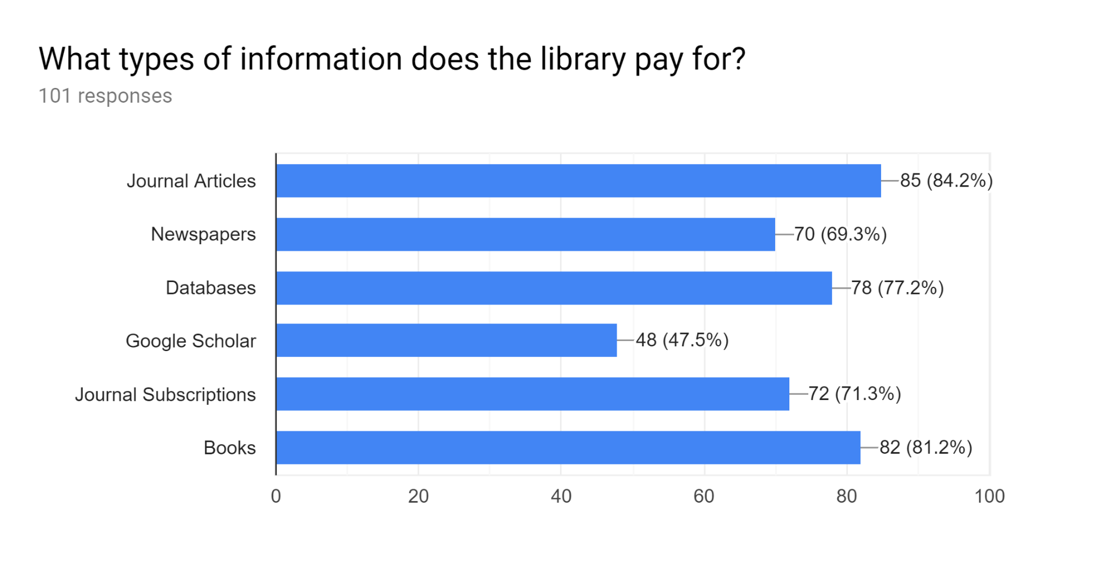
What does the Library pay for?
Definitely Not Definitely

Slide 13
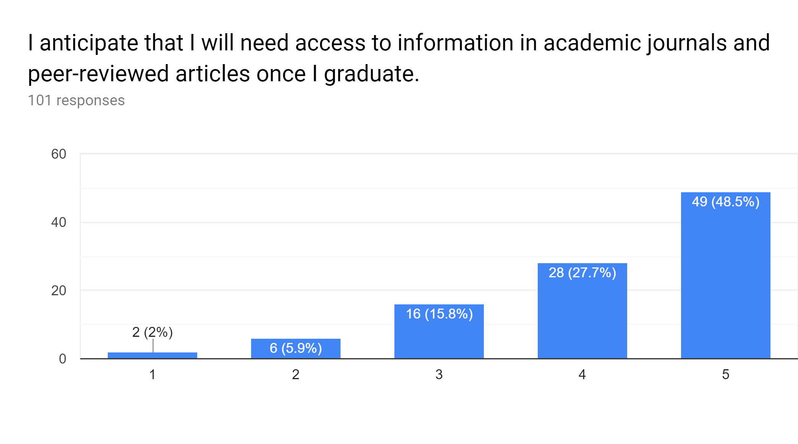
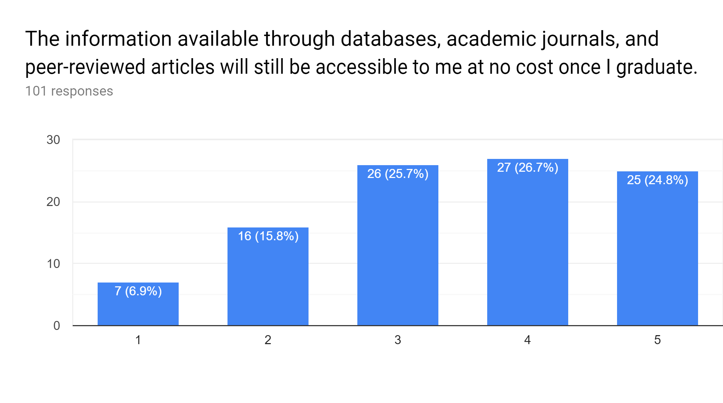
Anticipating Need and Accessibility
Definitely Not Definitely
Definitely Not Definitely

Slide 14
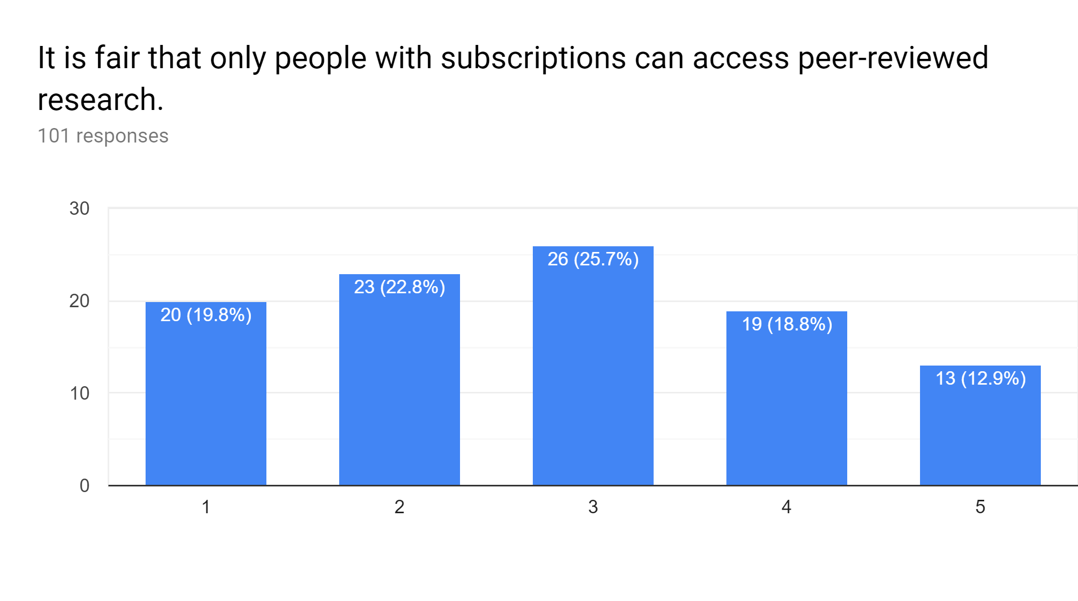
Are subscriptions fair to those who can’t pay?
Definitely Not Definitely

Slide 15
It is fair that only people with subscriptions can access peer-reviewed research. [Definitely Not (1 or 2)]
Research should be available at low to no cost so people have the ability to properly educate themselves on subjects of interest. Subscription fees only serve as a barrier for people who want to educate themselves, but do not have the means to do so.
(Junior, Environmental Science)
Peer reviewed research should be at least accessible to the author. (Freshman, Policy Studies)
Paywalls prevent the growth of knowledge. (Senior, CIT)
Pay-walls to access scholarly journals create gatekeeping that limits access to leading, peer-reviewed research. It essentially creates a disconnect between experts in respective fields and students and the “lay-man.” (Graduate Student, English)
Most research is paid for with public funds. (Senior, Economics)

Slide 16
It is fair that only people with subscriptions can access peer-reviewed research. [Neutral (3)]
I'd love to access the articles without a subscription, but I understand that people need to get paid for their work. (Sophomore, Media Arts and Science)
Everything costs money. (Junior, Sports Management)
I feel everyone should have access to reputable information. (Senior, Tourism, Event, and Sports Management)
Knowledge should be accessed by all. It's how society can fully innovate. (Junior, Social Studies Education)
I feel people should have equal opportunity to access these avenues of research. (Sophomore, Business)

Slide 17
It is fair that only people with subscriptions can access peer-reviewed research. [Definitely (4 or 5)]
As a business student, you need to make a profit. (Senior, Finance and Management)
They spent a lot of money doing research and so they should have the right to charge a little at least. (Freshman, Biology)
I think that people should have to buy so that the people [doing] the research can get paid. (Freshman, Nursing)
Peers spend their valuable time, so they deserve compensation. (Freshman, Chemistry)

Slide 18
Activity: Knowledge Cafe
Instructions:
1. Please break into groups and select a recorder for your table.
2. Each group should answer the questions, and write your summary thoughts on the sheet in front of you.
  Some of the questions are meant to be difficult or uncomfortable, and that’s okay!
3. We’ll come back together and discuss your results at the end.

Slide 19
Questions for Each Group
Social Questions
1. What groups of people in your communities have been traditionally marginalized? How does this affect their health, or their access to care?
2. How have you experienced the benefits of privilege (race, socioeconomic class, education, citizenship, ability, etc.) ? How do you think that has affected your health?
3. What are examples of recent discrimination in your life or in the news that you have experienced or witnessed? Who was targeted?
Healthcare-Related Questions
1. Historically, how has access to health information created benefits or barriers to potential users?
2. In thinking about medical research, what groups have been understudied or studied unethically? How might this influence their view of the medical establishment?
3. When thinking about medical research, what stakeholders are concerned about open access and why?
Library-Related Questions
1. Consider what marginalized groups exist in your community. With your marginalized groups in mind, how would you advocate to faculty, students, administrators, or doctors regarding why they should make their work open access?
2. Can and should librarians be advocates for broader social change in a professional capacity? If so, how should they go about it? If not, why?
3. Should librarians take a stand against social injustice as a part of their professional duties? If so, what are the most effective ways to do this? If not, why?

Slide 20
Final Takeaways
(The next one is the most important slide!)

Slide 21
I believe that we shouldn’t be neutral!
What’s the point?
  Open access gives anyone with an internet connection access to health-related research.
  This access exists regardless of income, education, geographic location, or any other factor.
  It promotes health equity, citizen science, and helps to create a more informed public.
Why Should Librarians Advocate for Open?
Allows patients and their families to better understand a diagnosis, and to advocate for their own heath.
Provides access to current research for healthcare providers who may not be able to afford article fees.
Makes increasingly more sense, as public and donation dollars fund medical research that should be accessible to those groups.
Offers an opportunity to question who is being disenfranchised by paywalls.
Dismantles the traditional model of publishing that perpetuates blind allegiance to impact factors and journal reputation.
Personal responsibility plays a key role in health, but the choices we make depend on the choices we have available to us. (Robert Wood Johnson Foundation)

Slide 22
Resources for Learning More…
Social Justice
Harvard Implicit Bias Tests
Critical librarianship in health sciences libraries: an introduction
Critical Librarianship: A Blog
Social Justice and Library Work: A Guide to Theory and Practice
Open Access
Scholarly Publishing and Academic Resources Coalition (SPARC)
OpenCon Diversity and Inclusion Report
Marketing Techniques for Open Access in the Health Sciences
Rewarding Open Access in Promotion and Tenure: Driving Institutional Change

Slide 23
Questions?
Thank you!
Caitlin Pike
caiapike@iupui.edu

