Slide 1

Intro to Strategies
ONEAL Project, June 2025
Notes:
Hello friends. A quick note before we start: this was largely recorded in several stages because of resources that were published around that time we wanted to incorporate right away. It's also clear at this point—I'm speaking from Spring of 2025—that academic library's usual strategies and tactics, allies and relationships, are under intense surveillance and attack. To be frank, there is always a low boil happening, but this is no longer a "slow" unmaking of libraries, the kind that we've seen in higher education for the last 40 years of the project to censor and eliminate information. And so, rather than release a full strategies module, we'll introduce strategies and begin working through a few different techniques. Everywhere, our institutions are tasked with managing manage new priorities and visions, so we want to offer some tools rather than blueprints, to avoid being prescriptive in a moment that demands bravery. Who knows what tomorrow will bring?

Slide 2
About ONEAL
ONEAL is the Open Negotiation Education for Academic Libraries. We are an IMLS-funded project to teach negotiation skills to academic library workers.
Although we’re focused on academic library context, there are lessons within the curriculum that we hope all library workers at any type of institution can use in their professional and personal lives.
Notes:
ONEAL is the Open Negotiation Education for Academic Libraries. We are an IMLS-funded project to teach negotiation skills to academic library workers.
Although we’re focused on academic library context, there are lessons within the curriculum that we hope all library workers at any type of institution can use in their professional and personal lives. The grant is ending, but we’ll continue building and expanding the curriculum and keep building our community for practitioners. Of note, two members of the project team have taken on new jobs and a new suite of responsibilities, so we need a little time to situate ourselves in those contexts before we pursue other funding sources.

Slide 3
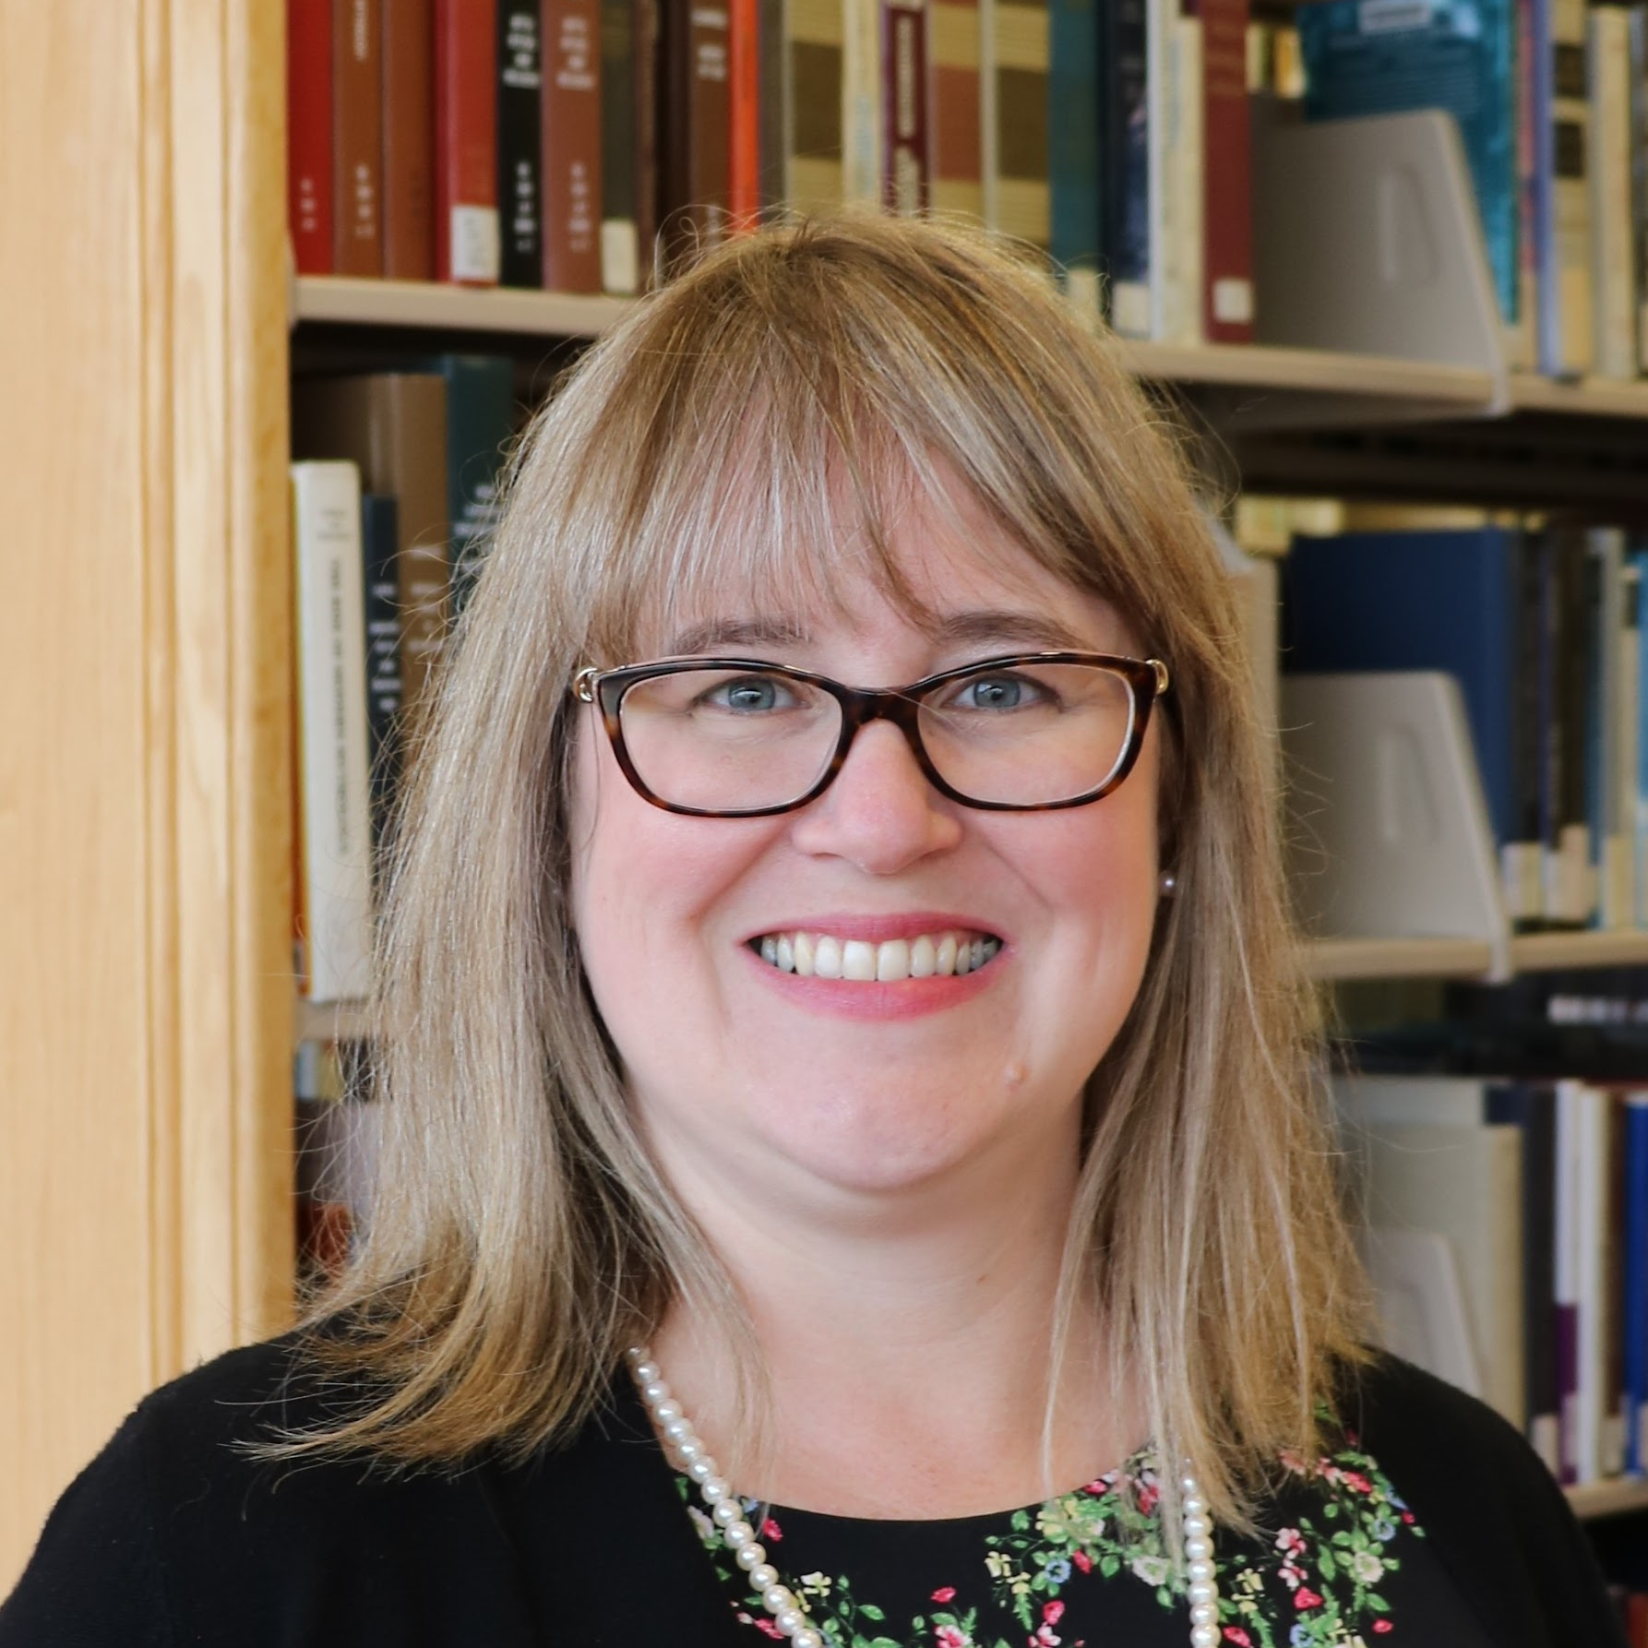


Project Team
Katharine V. Macy
Scarlet Galvan
Courtney Fuson
Associate Dean of Scholarly Communications & Content Strategy,
IU-Indianapolis
macyk@iu.edu
Collection Strategist,
University of Chicago, scarletg@uchicago.edu
Asset Management Librarian, Belmont University, courtney.fuson@belmont.edu
Notes:
This is ONEAL’s project team. We met through a variety of social media and professional development channels, but the thing we have in common is we each learned about negotiation and strategy on the job. This is fine, but we also wanted there to be information that was accessible to as many people as possible. Much of strategy and negotiation have different contours because they’re working in industries with more flexibility. Academic libraries—especially when we’re talking about collections strategy—are often dealing with sole source content providers and operating within economies of prestige, because of how researchers and teaching faculty are acculturated into their disciplinary norms. So we have a number of industry-specific considerations that aren’t covered in broad negotiation and strategy curriculum.

Slide 4

Patience
Notes:
I’m Scarlet Galvan, as of this recording I’m the Collection Strategist Librarian at University of Chicago Library. I’ve worked for a variety of different libraries including public libraries, more specialized spaces like medical libraries and health sciences where I got started, libraries supporting small rural communities, and high research activity institutions. You may hear my trusty assistants, Pekoe and Meep, in the background on this recording. They occasionally like to trill contributions into the mic.
Like the rest of the ONEAL team, I have experience in a number of different contexts and we’ve developed the curriculum to address the questions we encountered most often during our practitioner forums early in the grant, and the issues we continue to see in our own work, as well as spaces like ER+L, Timberline Acquisitions Institute, SPARC’s Negotiation Community of Practice, and more vendor-oriented spaces like Charleston. We’ve heard from small to medium publishers and content providers looking to expand into the academic market that this content is useful for them as well, and while we may expand the curriculum in the future, ONEAL is directed at academic library workers.

Slide 5
Agenda for this section
Introduction and goals
Why have a strategy?
How values play out in collections
Techniques for setting and investigating priorities

Slide 6
Goals
Explore a selection of change management and priority setting tools for strategy implementation
Evaluate where broader institutional goals intersect with library strategy
Explore a selection of engagement techniques for other library workers, faculty members, university administrators, office of general counsel, and procurement specialists.

Slide 7
Is this a different version of girl boss or lean in?
Notes:
During the grant we received an enormous amount of feedback that we’ve done our best to incorporate, because one of ONEAL’s operating principles is “nothing about the community without the community” because everyone on the project team does the kind of work for a living. Occasionally, we get a variation of this question. “Is this a different version of girl boss or leaning in?” and I know where this comes from but it’s a limited and ungenerous critique, and I’d encourage anyone having this response to remember that it’s possible to do more than one action in a given system. We can do more than one thing. In this case, it usually comes with a demand to “dismantle the means of production” which is fine as a goal. We know scholarly publishing is broken. We know it incentivizes and amplifies the confusion between prestige and quality.
Ultimately, libraries, library workers, content providers, and all the intermediaries between them share a fate. I think it’s possible to re-imagine the library-vendor relationship to be more equitable, to stop confusing business relationships with genuine partnerships that have shared goals, and to use negotiation and strategy for many purposes including organizing your workplace.

Slide 8
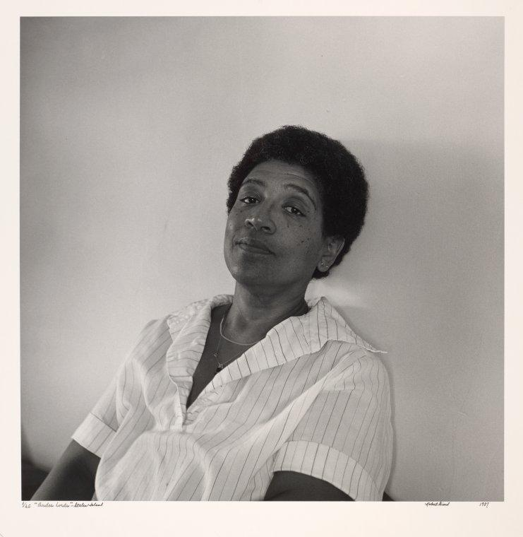
Audre Lorde.
Staten Island, NY. 1987.
Photograph by Robert Giard
NYPL Digital Collections
Notes:
https://digitalcollections.nypl.org/items/5e66b3e8-cd03-d471-e040-e00a180654d7
So, in 1984 Audre Lorde published a collection of writing, Sister Outsider which includes an essay you might have read a quote from called “The Master’s Tools Will Never Dismantle the Master’s House.” If you’ve never read any Audre Lorde, you deserve a treat, go find yourself anything she wrote and spend some time with her. Audre Lorde passed in 1992, she was an incredible Black writer, poet, librarian, and so many other things.
The full quote deserves a read; it’s often truncated which removes important context.
“Those of us who stand outside the circle of this society's definition of acceptable women; those of us who have been forged in the crucibles of difference -- those of us who are poor, who are lesbians, who are Black, who are older -- know that survival is not an academic skill. It is learning how to take our differences and make them strengths. For the master's tools will never dismantle the master's house. They may allow us temporarily to beat him at his own game, but they will never enable us to bring about genuine change. And this fact is only threatening to those women who still define the master's house as their only source of support.”
So when we talk about the master’s tools and the act of using them to dismantle the master’s house, Lorde is telling us directly to find and create many tools simultaneously. We have do to this while powerful and organized entities work to discredit libraries of all kinds. Our survival, in a deeply personal and collective way, depends on our capacity to imagine what tools and strategies might help us rebuild and create new systems.

Slide 9
Part I
“I believe that all organizing is science fiction - that we are shaping the future we long for and have not yet experienced.”
― adrienne maree brown
Why have a strategy?
Notes:
“I believe that all organizing is science fiction - that we are shaping the future we long for and have not yet experienced.”
― adrienne maree brown
I like this take on organizing because it mentions longing, and gets away from the idea that successful performances at work are dispassionate ones, or ones without care.

Slide 10
Primary texts
Managing Licensed E-Resources: Techniques, Tips, and Practical Advice, edited by Galadriel Chilton
e-Resource Licensing Explained, by Katie Zimmerman; Rachael Samberg; Samantha Teremi; Sandra Enimil; and Erik Limpitlaw
Fostering Change: A Team-Based Guide, by Brianna Marshall, Dani Brecher Cook, and Cinthya Ippoliti
Notes:
As part of our commitment to make ONEAL accessible to as many people as possible, all of our primary texts and any resources linked in the curriculum are openly available through a variety of creative commons or other license types. These are all linked in the curriculum document for this module, and are straightforward to find from the search engine of your choice. We might reference or suggest books that aren’t open by default, but the primary texts are. [read this slide]
The first text is: Managing Licensed E-Resources: Techniques, Tips, and Practical Advice, edited by Galadriel Chilton, this is available open access through Pacific University Press.
The second, where you can find some of the best disection and techniques around legal jargon and meaning in contracts just came out this year and is also open access through UC Berkely and the Association of Research Libraries: e-Resource Licensing Explained, by Katie Zimmerman; Rachael Samberg; Samantha Ter-EMy; Sandra EnEmil; and Erik Limpitlaw
The last is from ACRL, Fostering Change: A Team-Based Guide, by Brianna Marshall, Dani Brecher Cook, and Cinthya Ip-Pol-ity.
Relative to the other parts of ONEAL, this module has more reading and more reflective prompts because strategy is context-dependent. In particular, we’ll get into some of the prompts from Fostering Change in the planning and engagement section of this module we’ll release soon.

Slide 11
Strategy helps focus our effort, goals, and time.
A strong strategy helps organizations work deliberately rather than reactively.
Notes:
I think we’re all to some degree in situations where the level of uncertainty is high and persistent. The everyday becomes quite chaotic. You end up leaning into very well-worn pathways to respond, pathways that have been with us our entire lives, and it feels like it’s asking a lot of our colleagues (and ourselves) when we’re trying to put out huge fires, to have a consultant or well-meaning facilitator take us away from our fire fighting, put us in a room with whiteboards and post-its, and ask “Let’s imagine if it wasn’t on fire, what would we do with an entirely different bucket?”
To be fair to those facilitators: yes, those are good questions to ask. But our capacity to answer them might be limited. And it’s frustrating to be in a perpetual crisis state, trying to put out those fires, and have people ask us questions instead of getting some help. It’s hard to imagine an ideal future for the organization. We carry our own histories into work, our reactions, those well-worn neural pathways.
Strategy helps focus our effort, goals, and time. A strong strategy helps organizations work deliberately rather than reactively. Just on an everyday level, one of the best supervisors I’ve ever had was someone who would tell me to sleep on ideas or responses. Not because they weren’t good enough, but because the first response I’d have might not be the best I could do. They were on that well-worn path, and it was a real kindness for a boss to slow me down. So, this will take time. Not only is that okay, but it’s part of the work. And it can help you contain the situation to turn the chaos down.

Slide 12
Strategy helps us grasp what we can do, and what we cannot do any longer.
Notes:
This is why this is on its own slide. I can’t tell you the number of strategic plans I’ve read that are absolute laundry lists of everything and not appropriately scoped. It would be impossible to lead in those spaces because the remit is too broad, trying to do everything without stopping anything.
So many libraries run into this issue because we tend to believe that our spaces and services are for everyone, and they aren’t. Even public institutions, public libraries have a scope. We have communities we’re part of with specific needs, and it’s not everybody on Earth.
We believe we should meet every need, say yes to every request, and we can’t. It’s not realistic. That’s never been the case, there was not an idyllic past where libraries were able to meet every need, but what IS happening, is libraries are tasked with recreating the social safety net: that’s true of academic libraries as well. Student food pantries that include cleaning supplies and sanitary products; the enormous work many of us took on in the early pandemic, workshops for re-skilling, university bridge programs for new students who aren’t acculturated into higher education, taking on more service in shared governance as tenure-track lines erode, and finding ways to inject information literacy into the curriculum meaningfully. All of these, like the tasks reassigned to public libraries over the last 40 years or so, are the responsibility of other entities. For academic libraries, without a clear strategy, we end up taking on work or developing services to solve problems the university itself is creating and maintaining. It doesn’t mean don’t do these things, it means be thoughtful and deliberate about how we do those things.
Strategy centers what we can do. It can be a guide to tell us what is in and out of scope.

Slide 13
Collections strategy includes most library services
Content
Metadata
Licensing
Discovery
Rights
Access
Notes:
Collection strategy specifically, interacts with most library services and forms the basis of how the majority of users will experience the library, even if they also come to the physical building. Most users will treat your website and associated platforms as a library branch.

Slide 14
How does licensing impact library values?
Accessibility
Many types of access
Author rights, including AI
Learning management system use
Scholarly sharing
User privacy
Resource sharing
Text and data mining
…So much more!
Notes:
So licensing is where the library and institutional values play out, because these are contracts that establish the relationship and explain what we can or cannot do with those materials. Put another way: how libraries do strategies for collections is a substantial component of institutional values in practice.

Slide 15
Explicit and implicit values exercise
Gather public-facing mission, vision, and values statements from the library and the organization. If the library or organization are in the process of revising these, use the most recent versions.
What does the organization claim it values?
What does the library claim it values?
How are these values currently reflected in the library’s strategy and planning?
Notes:
Gather public-facing mission, vision, and values statements from the library and the organization. If the library or organization are in the process of revising these, use the most recent versions.
What does the organization claim it values?
What does the library claim it values?
How are these values currently reflected in the library’s strategy and planning? This exercise requires some thinking, reflection, and discussion. You can do it solo, but it helps to bounce what you’re seeing off another person. Feel free to hop in the discord and talk to someone or send the project team an email. It’s okay if this takes time, we’re setting up moving toward that strategy, and this is an important part of that process. If you feel a big gap between the organization’s stated values and what it’s actually doing: that’s okay, it’s probably not your job to fix it, and this is very common, so know you’re not alone in living in that gap.
Note for people with new leadership: if you have new leadership---like a new dean or director, and they’ve been in that position for less than five years, you’ll want to compare the values statements from before their hire to any new mission, vision, values, or strategic planning documentation they’ve developed since then. I just started a new job within the last year; one of the first things I did after looking over the strategy was to read everything the leadership had communicated out to the organization—in this case, we send out a Message of the Week—so that I could get a better sense of the language used to describe how people work here and learn what was important to them.

Slide 16
Explicit and implicit values exercise
Find a copy of the university’s budget. Where does the university spend money?
Find a copy of the university’s master plan. What investments is the organization planning to make?
Find a copy of the library’s budget. Where does the library spend money? What vendors does it spend the most with?
Look at your calendar. How are you spending your time? Does it feel the same, or different from how others in the organization spend their workdays.
Notes:
There’s a saying that gets attributed to several different people, something along the lines of “don’t tell me your values, show me your budget and I’ll tell you your values.” I’d modify this to include “Show me your calendar,” because how we spend our time is important. This gets into what is “visible” in our time, for example mentoring is not as well recognized as committee work or other kinds of service, even though it’s incredibly time-intensive and we may not document it as well. I’ve worked for libraries where a group of people took a walk around campus together during lunch time. I’ve seen people who very openly have time blocked off to work on projects, to be sure to move and take breaks, to have time for thinking and reflection. This is especially important for people who are in meetings all day, have many direct reports, or both. You must have time to reflect on everything you’re taking in. So yes, they value doing good work. They also want me to care for myself and my time well enough that I can keep doing that work effectively. The budget is a values document, so is a calendar.

Slide 17
Part II
"There is power in letting go what is not ours to carry, or what others in their unskillfulness, have tried to place upon us."
--Brenda Salgado
Techniques for setting and investigating priorities

Slide 18

It might be time to stop doing some things.
Notes:
Before we get into this, I want to note that in order for any of these techniques to work, we have to be willing to address head on: what’s working, and what isn’t about our processes, about how we do the work of librarianship. We did the best we could with the tools we had at the time, and it’s probably time for some new ways of thinking. I can’t tell you how many “Start, Stop, Keep” exercises I’ve been part of where library workers identified a number of tasks we could stop doing to reallocate time to what needed to be done, and we just…kept doing everything. This gets back to the issue with so many strategic plans, is that they have an endless remit and scope, maybe because people believe that’s limiting. But it’s actually quite stressful, and doesn’t do anything to advance the narrative about the library or its expertise, it’s just a list of things you’re doing.

Slide 19
Pareto analysis, or the 80/20 rule, can help focus effort and attention
Notes:
Macy, K.V. (2018). Information creates relative bargaining power in vendor negotiations. The Bottom Line, 31(2), 137-149.

Slide 20
Pareto analysis in academic libraries can look like “80% of the use comes from 20% of the materials,” in a packaged deal.
Notes:
But it can also help prioritize which contracts to focus on. I often hear people say that they give the same amount of effort to every licensing and renewal decision, and I’ve watched that approach burn people out. Not all work requires the same level of attention and effort. The ONEAL Project’s founding director, Katharine Macy, has a green OA copy of her paper, Information creates relative bargaining power in vendor negotiations. The Bottom Line, 31(2), 137-149, where she uses Pareto analysis to decide how to focus effort in her collection analysis. This paper and her template are linked in the curriculum, but essentially using the 80/20 rule helps prioritize where to look for the most impactful actions, rather than devoting the same level of energy of a contract that costs a thousand dollars as you would one that runs a million dollars. Remember, the tool doesn’t make the decision for you, it gives you information. You still must apply your context to the financial decision.

Slide 21
Power mapping is a visual way to understand influence, authority, and connections.

Slide 22
Why use this technique?
Power mapping is used by organizers, outreach, collective power work, and many others as part of strategy development.
Notes:
Power mapping is used by community organizers, activists, people doing outreach, collective power work and for individual work
If you’ve done any kind of stakeholder needs exercise this will feel similar, or if you’ve done any work as part of an organizing campaign, power mapping is used in those contexts also. I like this as a technique because it lets library workers do something we’re used to doing: find and evaluate information from many sources quickly and leverage our own expertise. Especially if your organization spends a great deal of time in shared documents or other collaborative spaces, this can be a break from that which engages people differently.
Power maps can be a good way to: explore early research questions. It can help us “see the whole board” and it’s quite flexible because a map can be as straightforward or complex as needed. We’ll talk through some examples and develop one before you try the exercise.

Slide 23
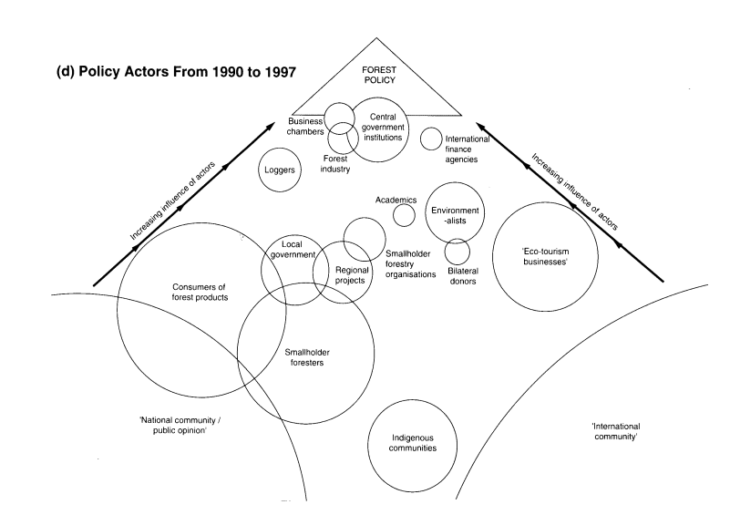
Power map example
Notes:
This is, for example, a kind of power map. This specific map is called a “stakeholder influence map” and in this case it’s meant to build a visualization of influence between different policy actors, various communities, and forest policy in Costa Rica from 1990 to 1997. The size of each circle can express how broad certain kinds of influence are, and show relationships between entities where those circles overlap. So here, we can see in the lower left that public opinion has a broad but low influence as an actor in this context, and it overlaps with consumers of forest products who are as a group, taking in a certain amount of media which influences their decisions. Compare that to the central government at the top of this diagram, which is perhaps not as ‘broad’ an influence at this time, but has direct power over forest policy.
The full paper is available in the curriculum if you, like me, enjoy the occasional dive into interesting white papers.

Slide 24
Power Mapping Matrix
Most influence or power
Strong opposition
Strong support
Least influence or power
Notes:
This is another kind of powermap, where you can chart a specific goal around stakeholder influence in the process, and how they feel about it:
let’s say you want the faculty senate to endorse use of open or library-acquired resources in all first year courses.

Slide 25
Power Mapping Matrix Ex: Faculty Senate Chair
Most influence or power
Faculty senate chair
Strong opposition
Strong support
Least influence or power
Notes:
The chair of the faculty senate is a faculty member at the business school. Several faculty in the business school assign expensive textbooks they authored, and they don’t want to lose the revenue stream from intro courses, so we’ll say they have a lot of influence and are well positioned in the university’s governance structure. So, we’ll put them here in the upper left quadrant.

Slide 26
Power Mapping Matrix Example: Arts & Sciences Faculty
Most influence or power
Faculty senate chair
Arts & Sciences faculty
Strong opposition
Strong support
Least influence or power
Notes:
The College of Arts and Sciences have many vocal proponents of the proposal and examples of where they’ve embedded open or library-acquired materials into courses with great outcomes. The library is well connected there, and we can probably get our existing support to be even stronger.

Slide 27
Power Mapping Example: Carla
Most influence or power
Carla
Faculty senate chair
Strong opposition
Strong support
Arts & Sciences faculty
Least influence or power
Notes:
Finally, we have Carla.
Every organization has at least one good example of this, where we might point to structural power or an org chart and say a university president or other administrator has all the power, but a woman named Carla who is the administrative assistant (and has been for 30 years) who can see the calendars of every dean and shapes what their days look like is probably the person with the most persistent influence. All campuses have someone like this. This is all to say, sometimes influence and power look different depending on our objectives and where we are in the organization.

Slide 28
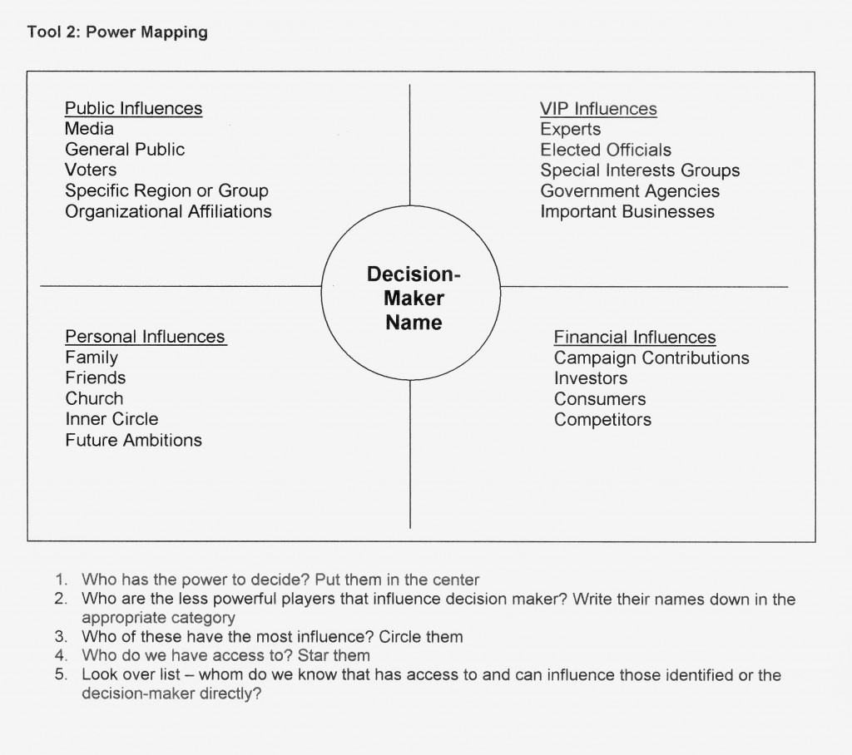
Power Mapping An Individual’s Influences
Notes:
Sometimes we need to understand the influences around a specific person or entity with decision making power. This map is from organizing for power dot org and it has a slightly different design where you’re visualizing different types of influence. This kind of power map can help us understand what forces generate the most influence around the decision maker, so we apply a messaging strategy more effectively, and we focus our energy ways that create impact for our goals.

Slide 29
Example: CFO
CFO
Notes:
Here’s an example of how this might work. For context, we’ll say this is at a midsize, public, state university, we’ll call it Fictional University where the goal is to shift the Chief Financial Officer’s views on user privacy. He’s made a couple of offhand comments during presentations like “Privacy is dead” and “Students don’t care about privacy because they’re all on social media” and while there are some institutional safeguards around these assumptions, there’s research that disproves these claims and it’s creating issues for the library. So, we’ll put the CFO in the center of our map and briefly think through some potential influences.

Slide 30
Example: CFO Public Influences
Media and PR
Student groups
Regional trends
CFO
Notes:
Under public influences, we have these items: local media and public relations
Student groups
Regional trends in industry, population, and how the neighborhoods around the university are changing.

Slide 31
Example: CFO’s Public VIP Influences
Media and PR
Student groups
Regional trends
EDUCAUSE
Gartner
Chronicle op eds
Regional tech leaders
CFO
Notes:
But, the things you notice the CFO forward most often, are from EDUCAUSE, Gartner, op eds from the Chronicle of Higher Education, and letters to the editor from regional technology leaders

Slide 32
Example: CFO Personal Influences
Media and PR
Student groups
Regional trends
EDUCAUSE
Gartner
Chronicle op eds
Regional tech leaders
CFO
Ambition
Public image
Notes:
Under personal influences, we’ll say they seem fairly ambitious and care about their public image. There’s only been one issue you know about, but the CFO reached out personally to address it, he didn’t delegate the task. The CFO might also have close working relationships and friendships at that level of the organization, so what those people think will be important as well.

Slide 33
Example: CFO Financial Influences
Media and PR
Student groups
Regional trends
EDUCAUSE
Gartner
Chronicle op eds
Regional tech leaders
CFO
Ambition
Public image
Enrollment
Formal industry partnerships
Alumni
Notes:
Under financial influence, I might also include alumni especially if the finance office has a high number of student workers that go on to work for those regional finance leaders. Right now, the CFO is too new to have personal knowledge of those connections, but he wants to build them in order to create a specific public image.
Even though this was just an explainer-example, I can see right away that if I want to start shaping this person’s opinion, I have a number of ways to do that. In particular, I could focus my effort on sources he trusts already that support the library’s view.

Slide 34

Up next: planning and engagement.
Notes:
That’s the end of this introduction – up next we’ll talk about planning and engagement, and finish with bringing everything together. Thanks for sticking with us during the strangest time.

