Slide 1
Open Access to Health Information
A Social Justice Issue
Caitlin Pike, MLS, MPHc, AHIP
IUPUI University Library
Indianapolis, Indiana, USA

Slide 2
Agenda
10:45 – Introductions
10:50 – Overview of Open Access, Social Justice, and Undergraduate Survey Results
11:05 – Knowledge Café
11:45 – Share Results with the Group
11:55 – Wrap-Up

Slide 3
Defining Our Terms
Open Access, Social Justice, and Health Equity

Slide 4
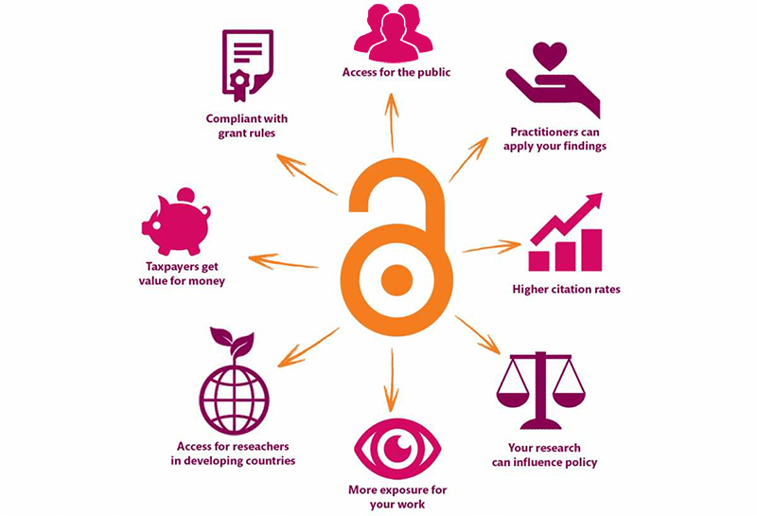
Open Access
According to SPARC:
Open Access is the free, immediate, online availability of research articles coupled with the rights to use these articles fully in the digital environment.
Open Access ensures that anyone can access and use these results—to turn ideas into industries and breakthroughs into better lives.
Source: https://kib.ki.se/en/publish-analyse/open-access

Slide 5
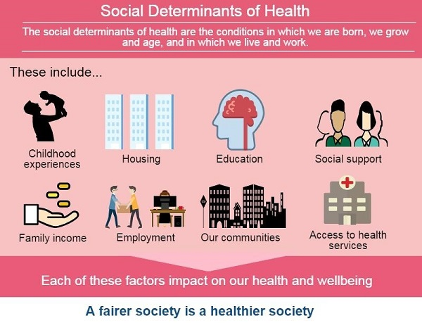
Social Justice
The idea of acting with equality, fairness and dignity to all human beings.
“Social justice is the view that everyone deserves equal economic, political and social rights and opportunities.”
– National Association of Social Workers
“Social justice also imposes on each of us a personal responsibility to work with others to design and continually perfect our institutions as tools for personal and social development.”
– Center for Economic and Social Justice
Source: https://www.healthyfife.net/health-inequalities/

Slide 6
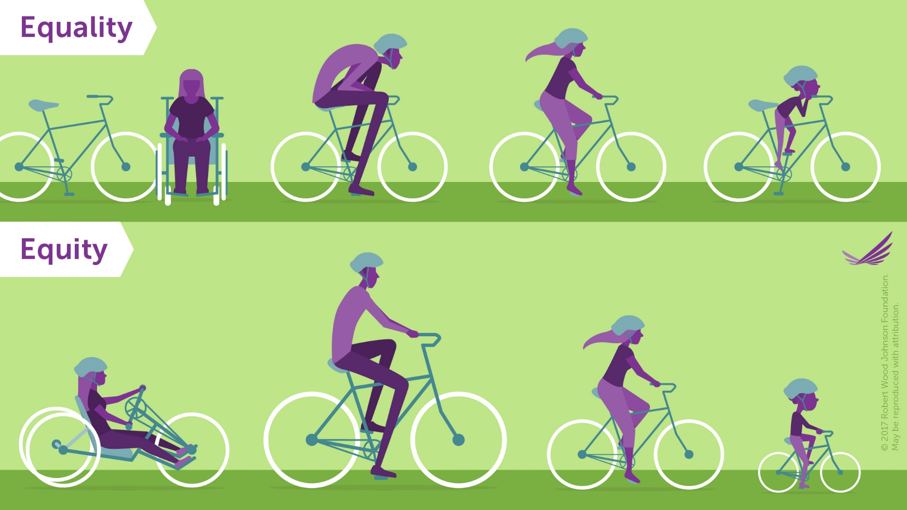
Equality vs. Equity
Social Justice should (hopefully) aim to be equitable.
The goal of equality is to make sure that everyone has the same things to be successful.
Equity is trying to understand where people are coming from and give them what they need to be successful.
Equality is similar to equity in that it is seeking fairness for everyone, but it assumes that everyone starts equally as well.
Source: https://www.rwjf.org/en/library/infographics/visualizing-health-equity.html
http://www.societyfordiversity.org/equality-vs-equity/

Slide 7
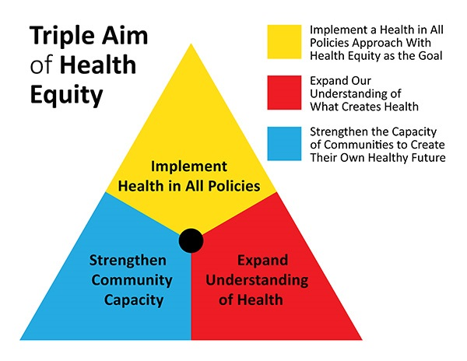
Health Equity
American Public Health Association:
Everyone has the opportunity to attain their highest level of health.
How do we achieve health equity?
  We value all people equally.
  We optimize the conditions in which people are born, grow, live, work, learn and age.
  We work with other sectors to address the factors that influence health, including employment, housing, education, health care, public safety and food access.
Source: https://www.planning.org/blog/blogpost/9104610/

Slide 8
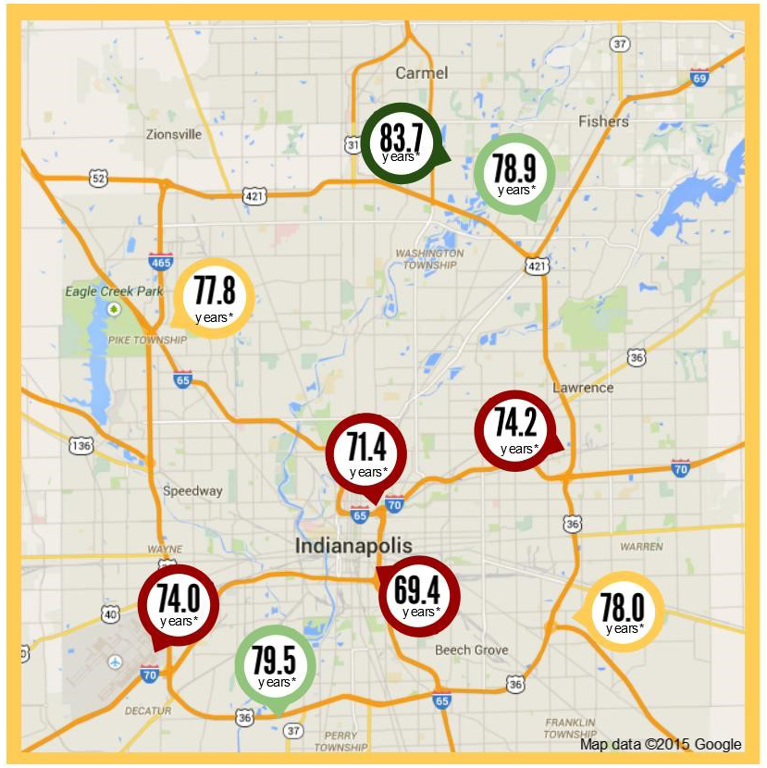
Why Does It Matter?
Life Expectancy in the Indianapolis Metro Area
46033
  High School Graduates: 99%
  Median Household Income: $124,712
46225
  High School Graduates: 69.3%
  Median Household Income: $33,688
28 miles and 14 years of life
(Source: 2013-2017 American Community Survey 5-Year Estimates)
Worlds Apart: Gaps in Life Expectancy in the Indianapolis Metro Area

Slide 9
Student Views on Open Access
International Open Access Week 2018
Is information access important?

Slide 10
Demographics
Year in School | Number of Students
Freshman | 31
Sophomore | 18
Junior | 20
Senior | 23
Masters | 8
Professional School | 1
Total: | 101

Slide 11
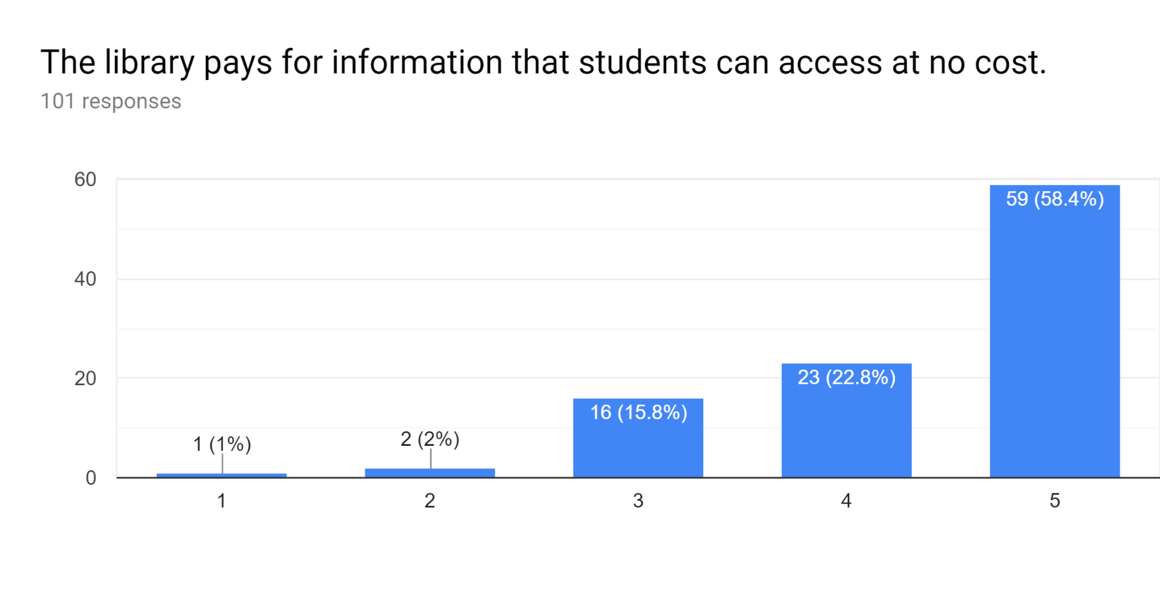
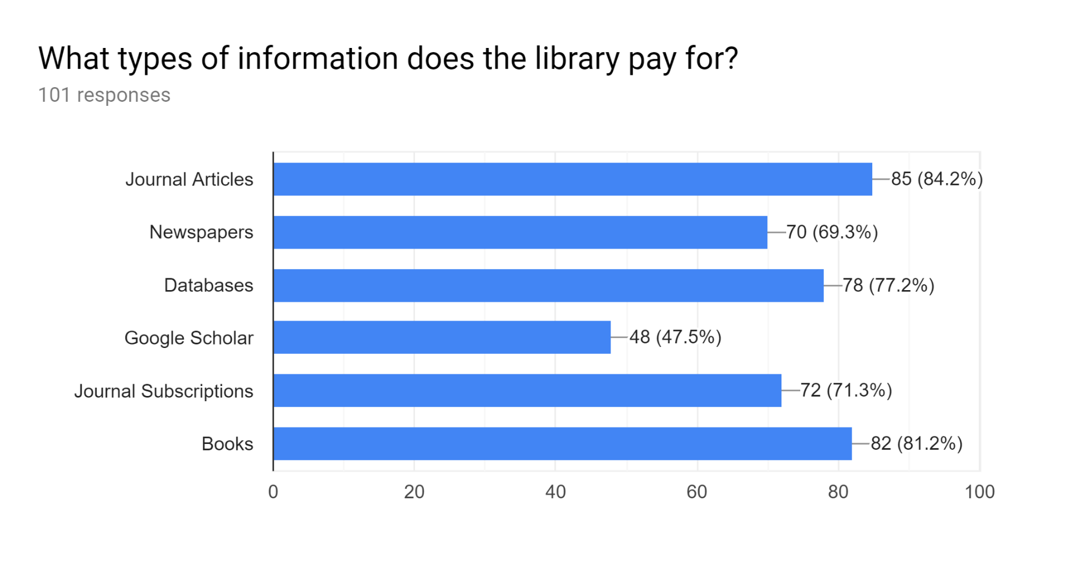
What does the Library pay for?
Definitely Not Definitely

Slide 12
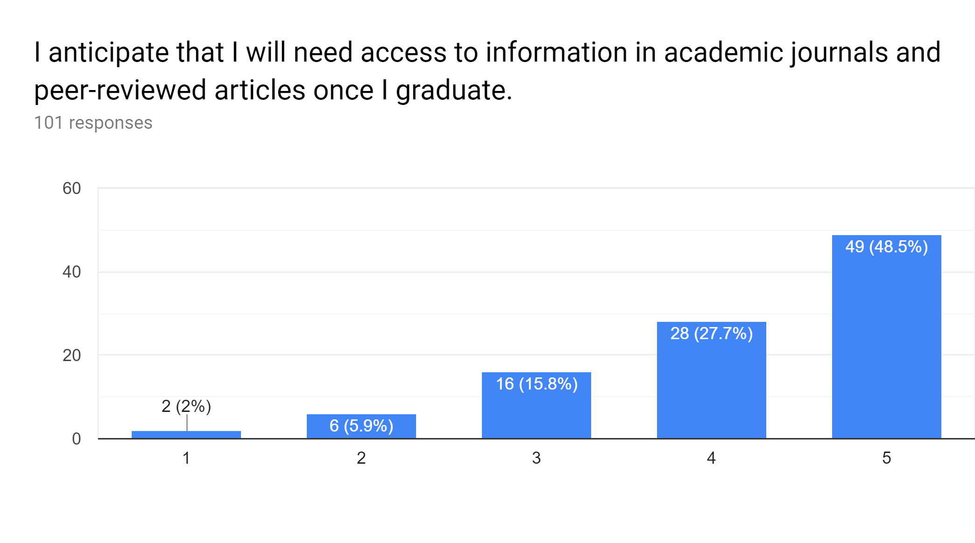
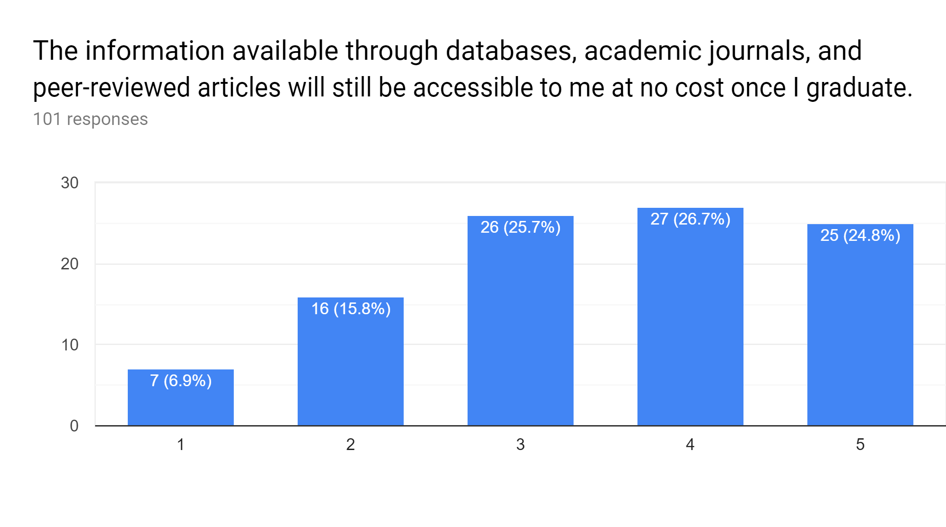
Anticipating Need and Accessibility
Definitely Not Definitely
Definitely Not Definitely

Slide 13
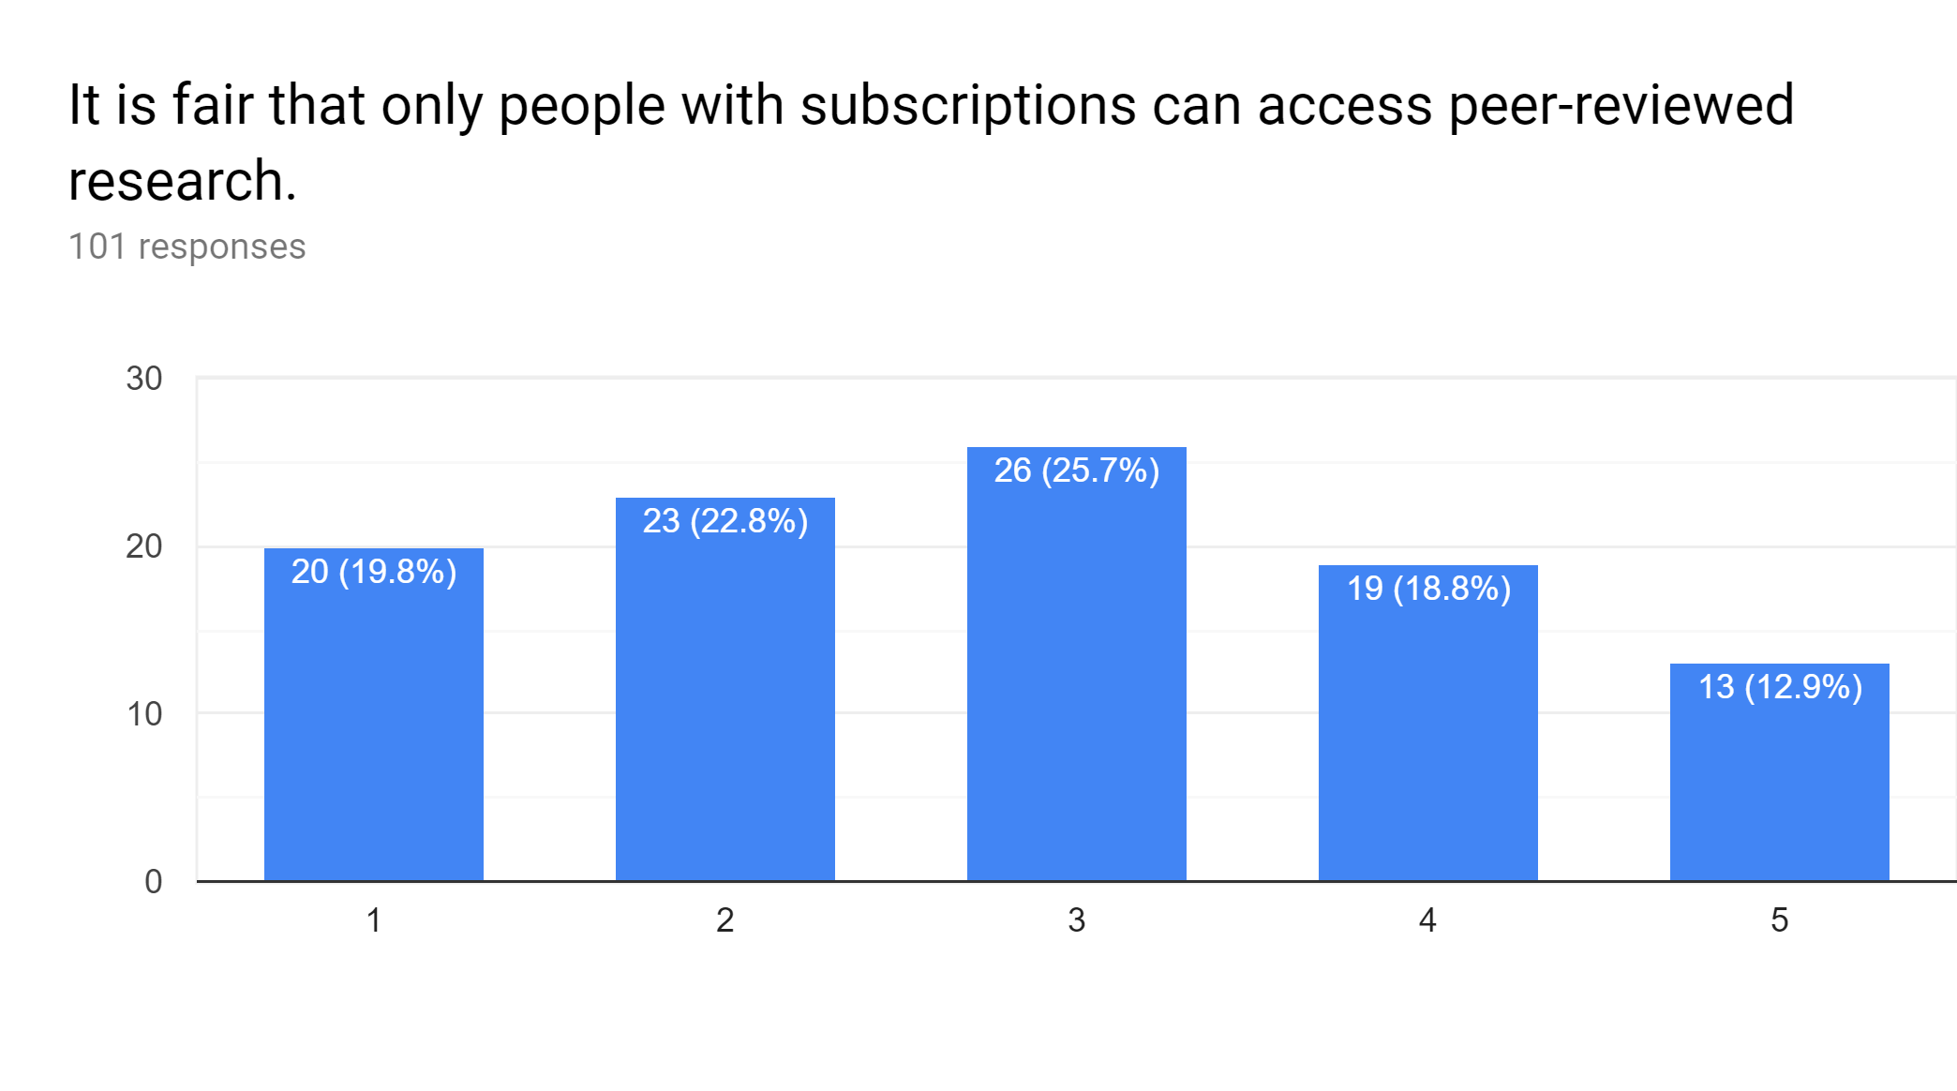
Are subscriptions fair to those who can’t pay?
Definitely Not Definitely

Slide 14
It is fair that only people with subscriptions can access peer-reviewed research.
Definitely Not (1 or 2)
Everyone should have access to scientific research so they aren’t misinformed. (Freshman, Mechanical Engineering)
Research should be available at low to no cost so people have the ability to properly educate themselves on subjects of interest. Subscription fees only serve as a barrier for people who want to educate themselves, but do not have the means to do so.
(Junior, Environmental Science)
Access to information is important for everyone. (Senior, Journalism)
People should have free access to knowledge. (Sophomore, Philanthropy)
Paywalls prevent the growth of knowledge. (Senior, CIT)
Peer reviewed research should be at least accessible to the author. (Freshman, Policy Studies)
Pay-walls to access scholarly journals create gatekeeping that limits access to leading, peer-reviewed research. It essentially creates a disconnect between experts in respective fields and students and the “lay-man.” (Graduate Student, English)
Most research is paid for with public funds. (Senior, Economics)

Slide 15
It is fair that only people with subscriptions can access peer-reviewed research.
Neutral (3)
I'd love to access the articles without a subscription, but I understand that people need to get paid for their work. (Sophomore, Media Arts and Science)
Everything costs money. (Junior, Sports Management)
I feel everyone should have access to reputable information. (Senior, Tourism, Event, and Sports Management)
Knowledge should be accessed by all. It's how society can fully innovate. (Junior, Social Studies Education)
I feel people should have equal opportunity to access these avenues of research. (Sophomore, Business)

Slide 16
It is fair that only people with subscriptions can access peer-reviewed research.
Definitely (4 or 5)
I think that if it gives you a leg up, then you should have to pay. (Sophomore, Audio Engineering and Music Technology)
As a business student, you need to make a profit. (Senior, Finance and Management)
They spent a lot of money doing research and so they should have the right to charge a little at least. (Freshman, Biology)
Because some information took a lot of money and time to get. (Sophomore, Media Arts and Science)
I think that people should have to buy so that the people [doing] the research can get paid. (Freshman, Nursing)
Any research that is reviewed by members of a specific group should be oriented for only members who have payed for membership, and thus those who have put in the time to review these pieces should be rewarded for the effort that they have put in. (Freshman, Chemistry)
Peers spend their valuable time, so they deserve compensation. (Freshman, Chemistry)

Slide 17
Activity: Knowledge Cafe
Instructions:
1. Please select a moderator and a recorder for your table.
2. Each group should answer the first question, and write your summary thoughts on the sheet in front of you.
3. Read through and answer the rest of the questions with your group.
  Some of the questions are meant to be difficult or uncomfortable, and that’s okay!
4. We’ll come back together and discuss your results at the end.

Slide 18
Final Takeaways
(The next one is the most important slide!)

Slide 19
I believe that we shouldn’t be neutral!
What’s the point?
  Open access gives anyone with an internet connection access to health-related research.
  This access exists regardless of income, education, geographic location, or any other factor.
  It promotes health equity, citizen science, and helps to create a more informed public.
Why Should Librarians Advocate for Open?
Allows patients and their families to better understand a diagnosis, and to advocate for their own heath.
Provides access to current research for healthcare providers who may not be able to afford article fees.
Makes increasingly more sense, as public and donation dollars fund medical research that should be accessible to those groups.
Offers an opportunity to question who is being disenfranchised by paywalls.
Dismantles the traditional model of publishing that perpetuates blind allegiance to impact factors and journal reputation.
Personal responsibility plays a key role in health, but the choices we make depend on the choices we have available to us. (Robert Wood Johnson Foundation)

Slide 20
Resources for Learning More…
Social Justice
Harvard Implicit Bias Tests
Critical librarianship in health sciences libraries: an introduction
Critical Librarianship: A Blog
Social Justice and Library Work: A Guide to Theory and Practice
Open Access
Scholarly Publishing and Academic Resources Coalition (SPARC)
OpenCon Diversity and Inclusion Report
Marketing Techniques for Open Access in the Health Sciences
Rewarding Open Access in Promotion and Tenure: Driving Institutional Change

Slide 21
Questions?
Thank you!
Caitlin Pike
caiapike@iupui.edu

