Slide 1
Multimodality, Online Oncology Learning Curriculum: An Adaptable, Asynchronous Learning Resource
Phillip Pham, Vidya Dandu, Jennifer King, Jennifer Schwartz
Notes:
Hi Everyone, my name is Phillip and am honored to be able to present our project entitled a Multimodality, Online Oncology Learning Curriculum: An Adaptable, Asynchronous Learning Resource. I was able complete this project with the help of my co-resident Dr. Dandu and of course my mentors Dr. King and Dr. Schwartz

Slide 2
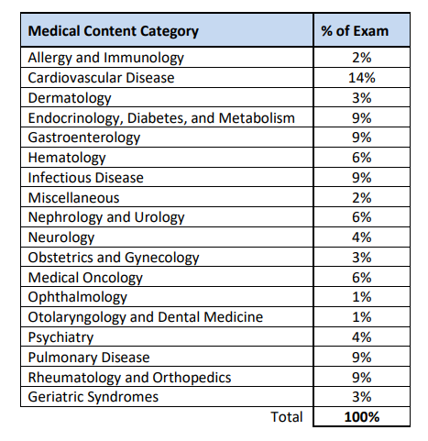
Increasing Exposure To Oncology
Dedicated educational resources
Using multiple learning styles
Providing relevant board content
Notes:
A bit of background on our project, we understand that oncology is one of the fastest changing fields and has a significant amount of information that isn’t as commonly seen on traditional wards. This makes it difficult for learners to be up to date with relevant knowledge. Our project aims to remedy this problem by increasing learners exposure to oncology, and as we do this garner interest in the field of oncology itself for our learners. We set out to do this by creating a dedicated educational resource to oncology, of which the residency curriculum did not have. Along with making this resource adaptable to the many different learning styles that may be encountered. Finally as seen here, oncology as well as hematology remain as significant portions of our own internal medicine board exams and these resources are meant to address that. We actually have dedicated required rotations for rheumatology, geriatrics, this is not the case with oncology and or hematology, although in terms of board content are equivalent.

Slide 3
Innovative Design
Based on Learning Science principles
Varied Formats to adapt to learner styles
Learning Module
Case Based Learning Questions
High Yield Topic Summary
Notes:
How did we go about this? Our project revolved around learning modules dedicated to different types of cancers. We had a unique design for each learning module to account for learners perceived notion of preferred learning styles while utilizing effective learning science principles to maximize knowledge acquisition. While they varied in format, each module still contained case based questions and a High Yield Summary for learners to take home.

Slide 4
Learning Science
Retrieval
Contrasting Cases
Immediate Feedback
Just-in-time learning
Notes:
So lets talk about what learning science is. The basic definition of learning science revolves around the scientific understanding of how people learn. There are many principles that make up learning science and serve as best practices within the field
In oncology specifically , learning science is becoming increasingly important with its fast pace, constant new discoveries and updates to general knowledge requiring educators to provide information in an efficient maner. In our own project we tried to incorporate some of these learning principles.
The first principle was Retrieval- which is recalling or bringing back information from memory as seen through the application of knowledge for our post lecture cases
Just-in-time learning- providing learners with relevant information in an environment where they can immediately use it, this is seen as we integrate this curriculum into oncology rotations itself
Immediate Feedback- giving learners feed back as soon as they complete the modules or questions
Contrasting Cases- presenting two cases almost identical, with one case is slightly different to highlight changes in management, seen through our testicular cancer module, where we took two identical cases but contrasted them through seminoma and non seminoma disease
All of these are examples of how learning sciences plays a role in our modules

Slide 5
Module Format
Pre-Survey to assess knowledge and comfort with topic
High-yield, ≤10 minute podcast or PowerPoint Voiceover covering cancer type
Interactive, case-based questions reinforcing topic
Post-survey to assess change in knowledge and comfort with topic
PDF with high-yield facts reviewing the module content
Notes:
Our final product followed this basic structure. Pre-surveys to assess knowledge and comfort with topic, followed by a brief 10 minute high yield presentation either in Voiceover PowerPoint or Podcast. Case based questions incorporated either before or after the lectures, re-evaluation of learner’s experience with the post survey and finally PDF with the high yield facts that they are able to bring with them or keep with it.

Slide 6
Module Walkthrough
Notes:
As an example, we’ll walkthrough one of our modules. Specifically our lung cancer module.

Slide 7
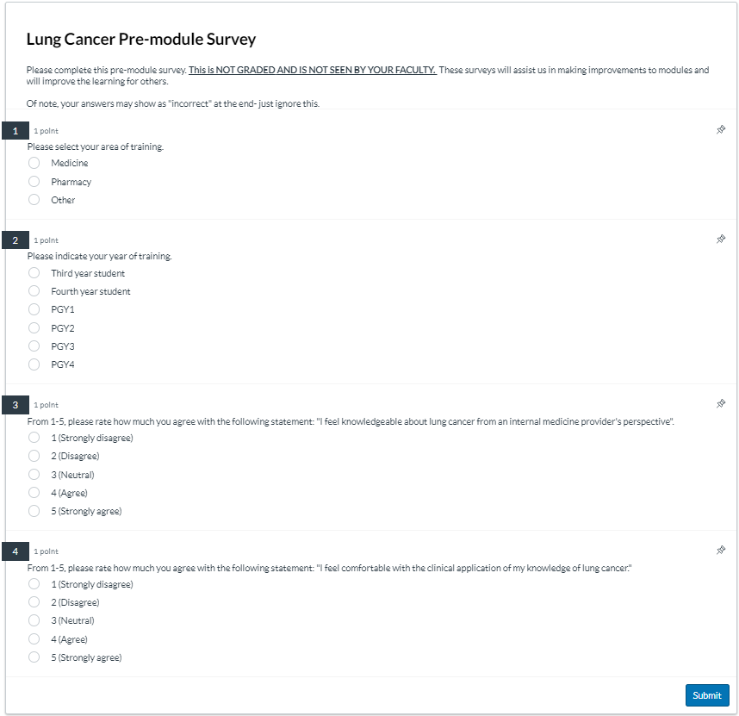
Module Example
Notes:
Here is our pre-module survey, it collects data on the level of training of the learner and then delves into knowledge and comfort with cancer to be discussed

Slide 8
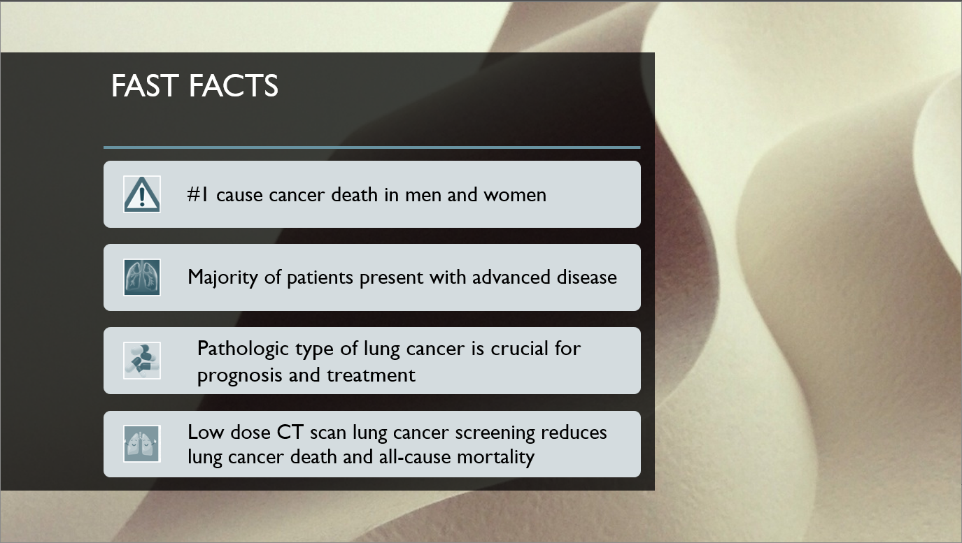
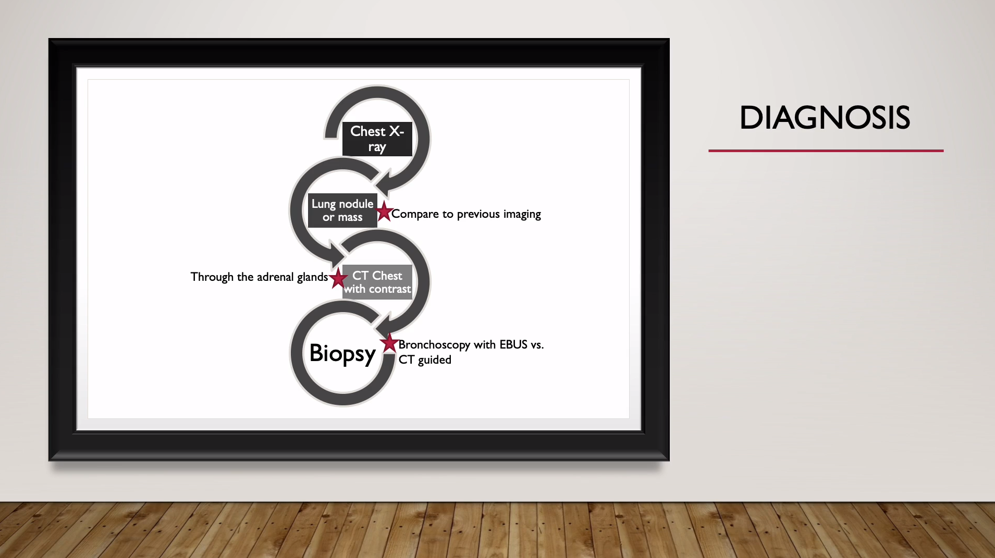
Module Example
Notes:
Our lung cancer module utilized a voiceover PowerPoint. Here are example slides from the presentation. All our modules are created to disseminate the information needed to know clinically as an internist in only 10 minutes. In contrast, in my experience as a resident, when we do have dedicated lectures, these often span an hour and many times provide an extraneous load for our learners.

Slide 9
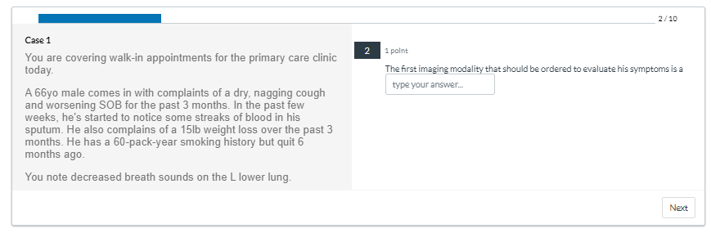
Module Example
Notes:
Next we have example of some of our case based questions, they are brief and meant simply to utilize knowledge from the presentation and ask learners to apply what they may have learned, feedback is given but not as a formal grade.

Slide 10
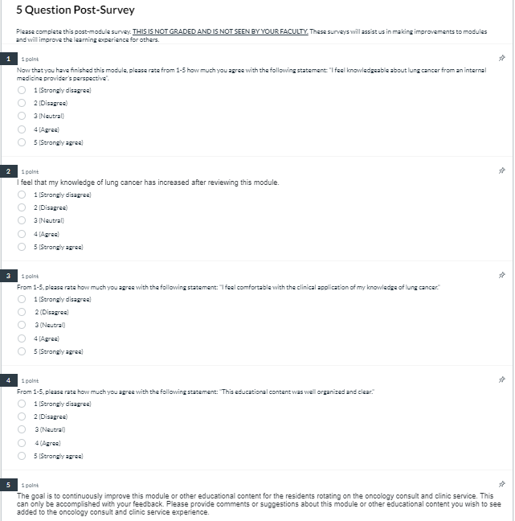
Module Example
Notes:
Next our post survey again addresses comfort and knowledge level. And in further modules also asks for feedback on the module format to help guide future presentations. As you can see, all surveys utilized a Likert scale from 1-5. And from this median values were analyzed from our survey.

Slide 11
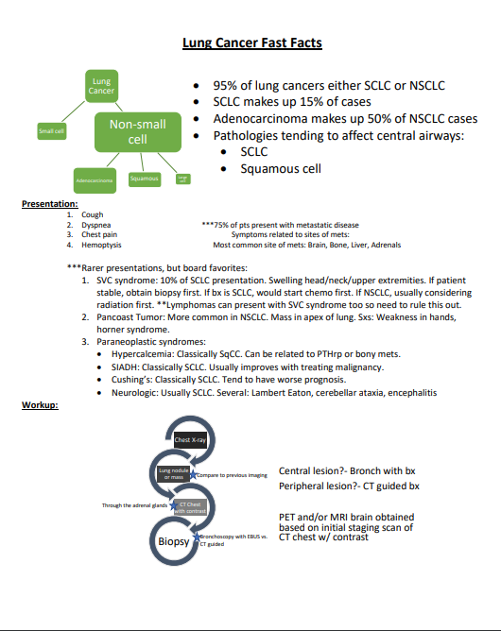
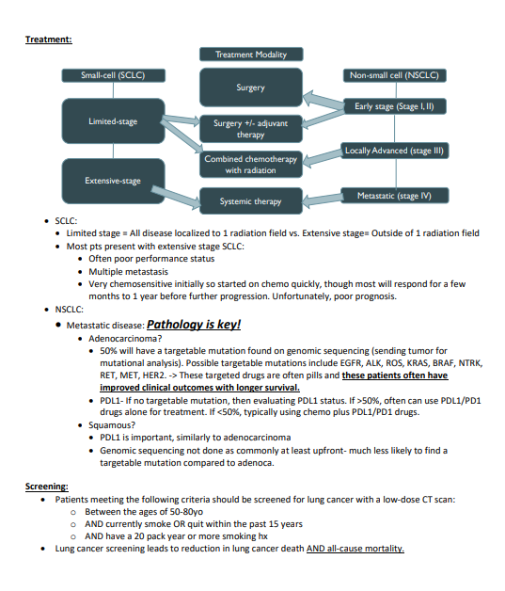
Module Example
Notes:
Finally this slide shows our high yield learning summary. Even for a topic as broad as lung cancer, we created this “cheat sheet” that goes over all essential information needed for a primary team or primary care physician to know in the management or presentation of lung cancer.

Slide 12
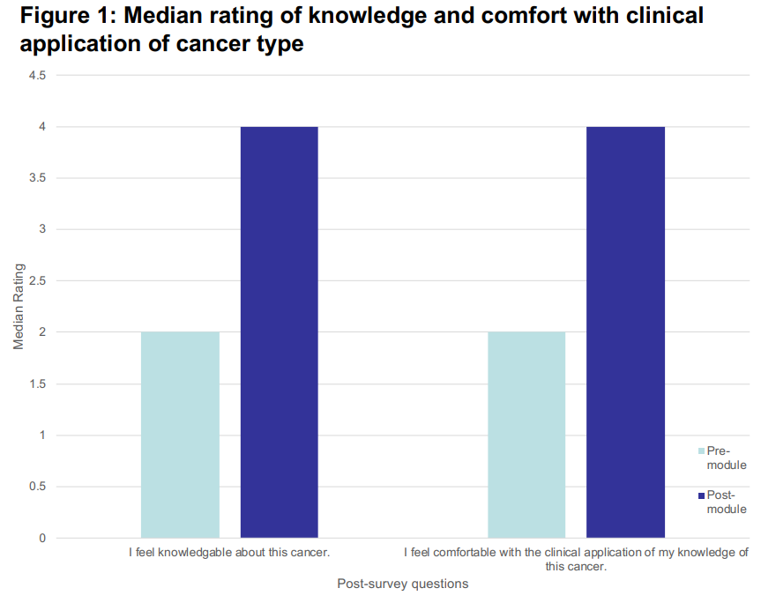
Outcomes
Notes:
Here we have our outcomes.
Twenty-one (n=21) learners completed both pre and post survey responses, PGY1: 7, PGY2: 9, PGY3: 4, PGY4: 1
When asked about “I feel knowledgeable about this cancer” or “I feel comfortable with the clinical application of my knowledge about this cancer” scores increased from 2 for fair to 4 for agree with statistical significance.
Again when asked if "feeling knowledge of specific cancer type increased" was 4-Agree (3)
All of this is very encouraging that we are meeting the needs of our learners

Slide 13
Module Feedback
6 learners completed feedback
Two modules created, Voice-Over PowerPoint vs Podcast
Podcast Least Preferred
2 Preferred Pre-case questions then PowerPoint
4 Preferred PowerPoint voice-over followed by cases
Three further PowerPoint Modules created
Notes:
Moving on to our data specific to each module.
Two modules initially created
Lung Cancer module which we saw before, with the VoiceOver PowerPoint and case based questions
Breast cancer which was a high-yield podcast with a handout to follow along with case-based questions afterwards.
6 learners completed ranking for preferred module learning style
4 preferred voice over PowerPoint with case based questions
2 preferred upfront cases to work through followed by voice-over PowerPoint for reinforcement.
Podcast preferred the least
3 more modules have been created, with plans to continue to expand into oncology and hematology

Slide 14
Take Home Point
Asynchronous Oncology Curriculum
Learning Science Principles
Adaptive Framework
High Yield Information
Case-Based Learning
Using learning science principles and an adaptive framework, this online, asynchronous oncology curriculum has resulted in improvements in learners perceived knowledge and clinical application of oncology topics
Notes:
So what is our take home point?
Using learning science principles and an adaptive framework, our online, asynchronous oncology curriculum has resulted in improvements in learners perceived knowledge and clinical application of oncology topics
To reiterate, all the components of each module with Learning Science Principles, Adaptive Framework, Interactive Case based learning and a focus on High Yield Information has become the tenets to our newly created Oncology Curriculum that can accommodate to our residents clearly busy schedules

Slide 15
Increased Learner Participation
Hematology Module Creation
Next Steps?
Feedback On Learner Preferences
Incorporation Into Rotations
Notes:
So what are the next steps for our project?
On the learner side, we plan on expanding to both malignant hematology and benign hematology while finishing the remainder of Solid Tumors. At the moment, learners get access to this resource during our oncology core and consult rotations, both of which not all residents will have. Because of this, our goal is to make this resource part of the curriculum for more rotations such as our hematology/ambulatory/clinic rotations.
From our side, we hope to have increased learner participation and recognition of our effective learning tool but also to better understand our learner’s preferences.

Slide 16
Questions?
Notes:
Thank you so much for taking time to listen to our presentation, special thanks to Drs. King and Schwartz for all the guidance during this time! Open the floor to questions?

