Slide 1
SCHOOL OF SOCIAL WORK
Young Adults with the Mental Health and Criminal Justice System Involvement: A Preliminary Study
Saahoon Hong, Betty Walton, Hea-Won Kim, & Stephanie Moynihan
Indiana University School of Social Work
SSWR 27th Annual Conference: Jan. 15, 2023

Slide 2
Young Adults with Dual System Involvement
AGENDA
2. Machine Learning Approach: Detecting
Critical Factors of Categorizing/Predicting
Young Adults with Dual System Involvement
3. Practical Implication

Slide 3
Young Adults with BHS and Justice System Involvement

Slide 4

Juvenile Justice and Delinquency Prevention (JJDP) Act

Slide 5
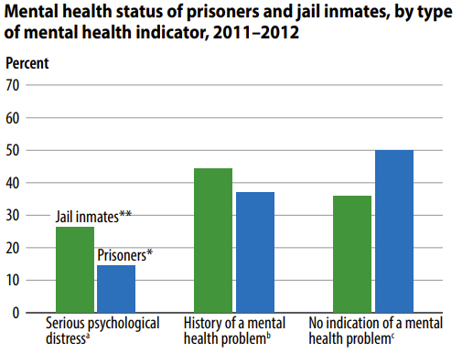
Bronson & Berzofsky’s study
(2017)
50%
44%
37%
36%
26%
14%

Slide 6
Other studies
Young adults with mental health needs experience increased criminal behaviors, peaking at 16-25 years (Stolzenberg & D’Alessio, 2007; Pullmann, 2010).
Lack of support for young adults' behavioral health needs -> Further involvement in the justice system (Sung et al., 2011; Williams, 2015).
Maximum Diversion (McAra & McVie, 2010).

Slide 7
SECTION TITLE GOES HERE IF NECESSARY
In the state of Indiana, the third highest referral source for adult behavioral health services was the criminal justice system.
Little is known about individuals’ needs, challenges, and successes after they were referred to state-run BHS.

Slide 9
Study Aim
SECTION TITLE GOES HERE IF NECESSARY
1. To categorize/predict young adults with dual mental health and justice system involvement in publicly funded treatment and support services
2. To examine the association of dual system involvement and behavioral health outcomes

Slide 10
Methods

Slide 11
Sample & Inclusion Criteria
Adults Needs and Strengths Assessment (ANSA)
Justice System Involvement by using the ANSA Legal Functioning (criminal justice system involvement) item and the legal basis of referral indicator were used.

Slide 12
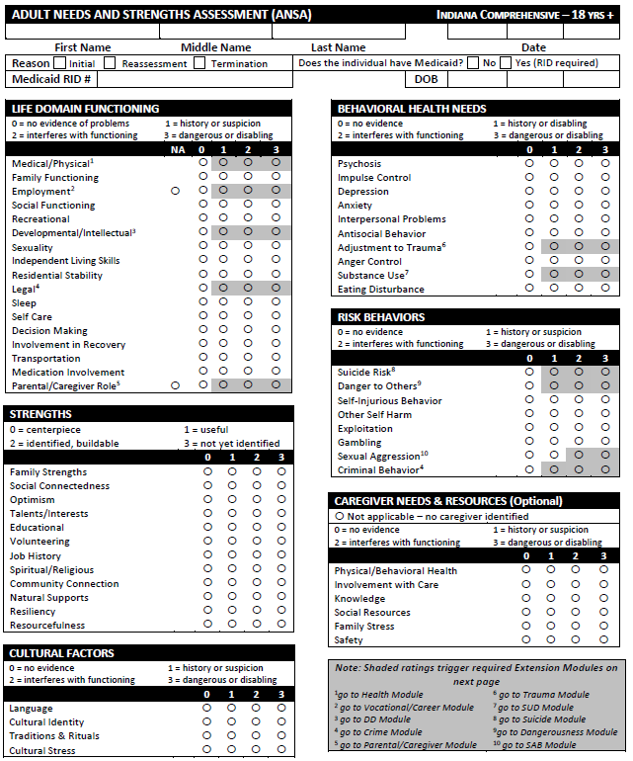

Slide 13
Flowchart of the dataset development
ANSA 2019
Age 18 to 65+
(n=69,423)
ANSA 2019
Age 18-25
(n=8,170)
BHS ONLY (n=4,679; 57%)
BHS with History of JS
(n=1,443; 18%)
BHS with Current JS
(n=2,048; 25%)

Slide 14
SUBTITLE GOES HERE IF NECESSARY
Female (52%), White (82%), Black (11%), Hispanic (7%)
History of JS (18%) and current justice system involvement (25%)
Male*Current JS (35%) vs. Female*Current JS (16.7%)
Black*Current JS (29%) vs. White*Current JS (25%)

Slide 15
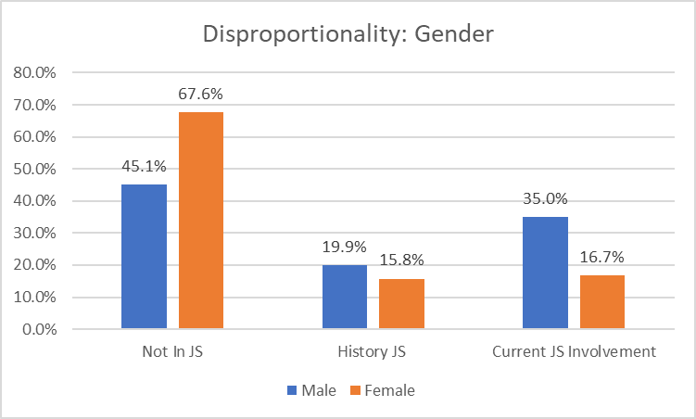
Figure 1. Mean TAI differences between BHS and Current dual system involvement

Slide 16
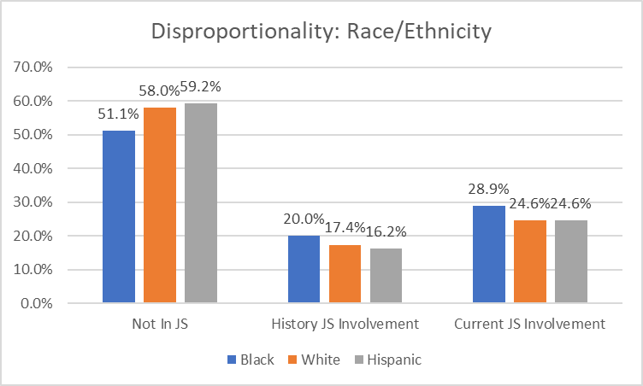
Figure 1. Mean TAI differences between BHS and Current dual system involvement

Slide 17
Data Analysis
Data mining Approach: Chi-squared Automatic Interaction Detection (CHAID) & Classification and Regression Trees (CRT).
HLR with Dummy Code

Slide 18
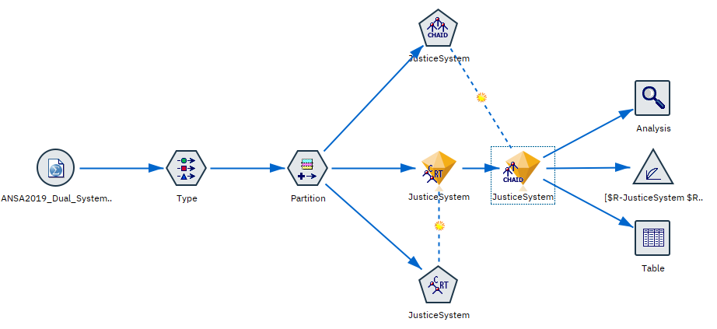
Applied Machine Learning Model

Slide 19
Results

Slide 20

Research Question #1.
What factors were critical in predicting dual behavioral health and justice system involvement for adults participating in publicly funded treatment and support services?

Slide 21
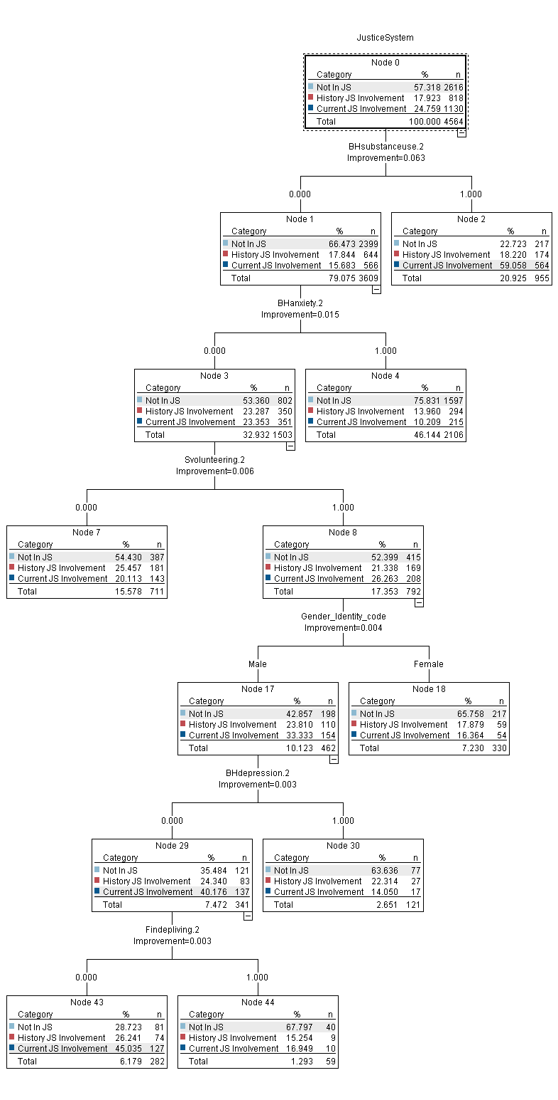
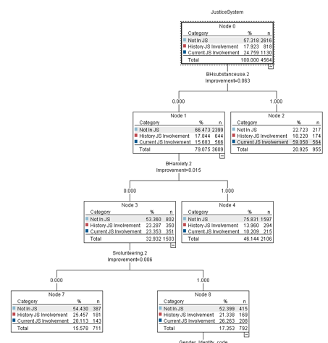

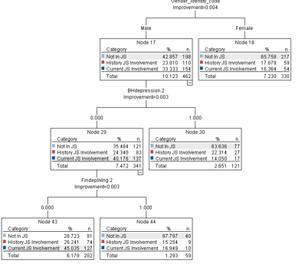

Slide 22
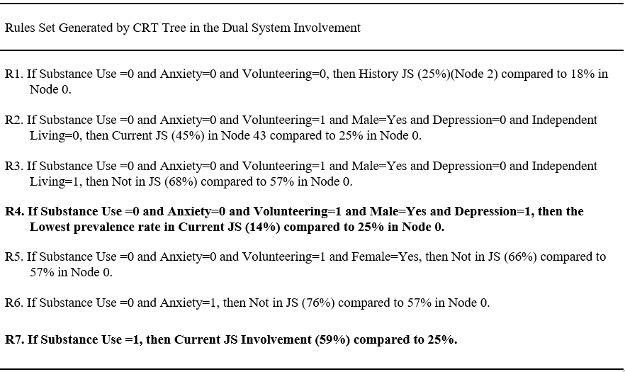

Slide 23
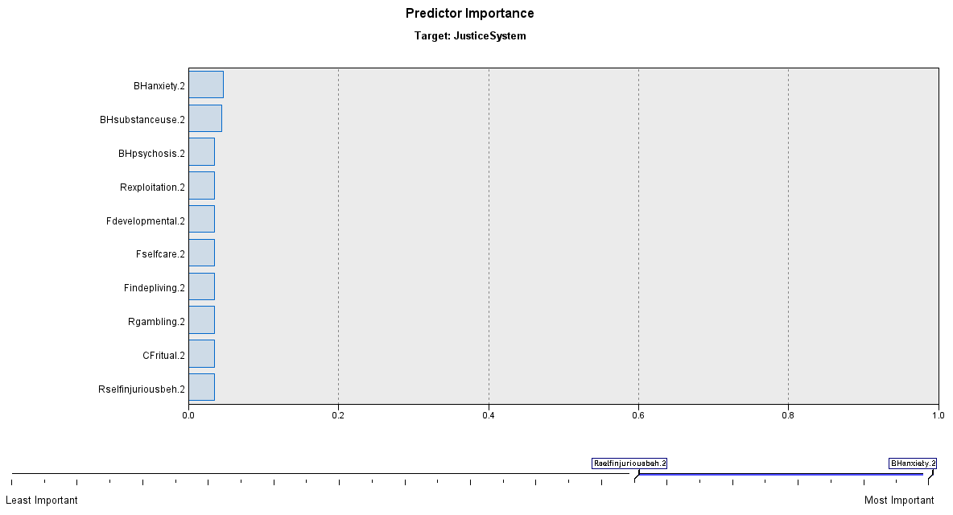
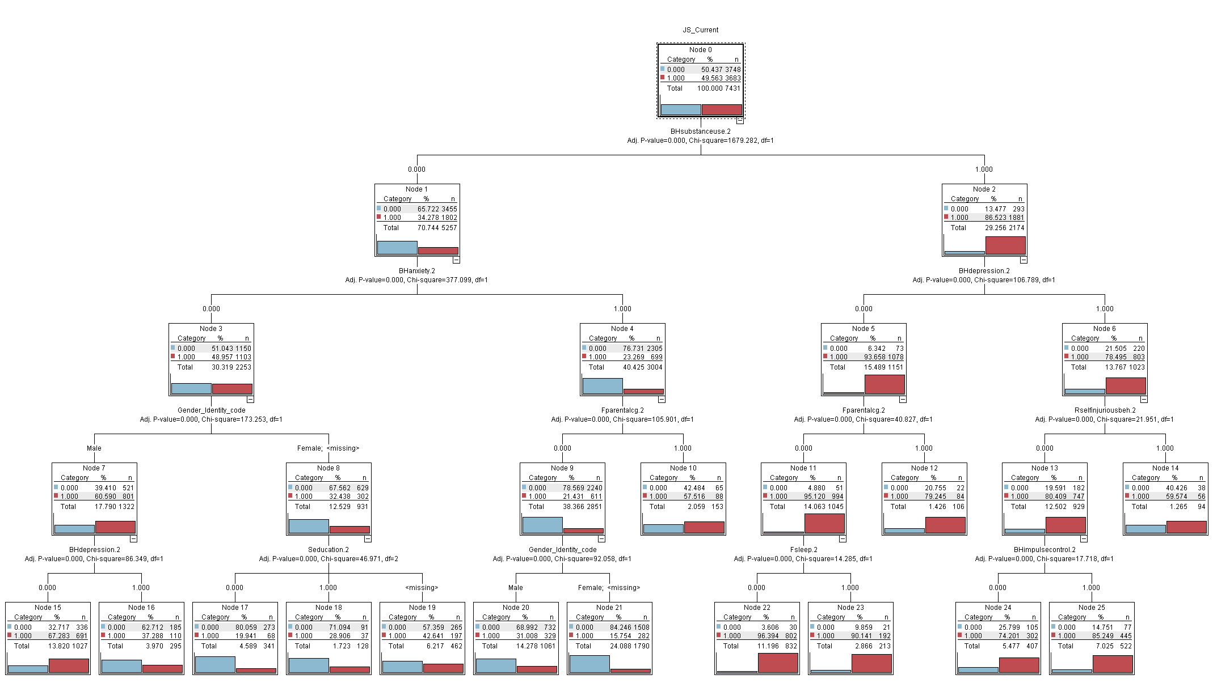
CRT Model: Predictor Importance for the target variable of Current Dual System Involvement

Slide 24
Research Question #2.
To what extent dual-system involvement was associated with behavioral health outcomes (TAI Reduction Rate)?
TAI Reduction Rate = (# of Actionable Ratings EVER – LAST) / EVER

Slide 25
Figure 1. Mean TAI differences between BHS and Current dual system involvement

Slide 27
HLM Results for TAI Reduction Rate
 | Model 1 |  |  | Model 2
 | B | SE | p | B | SE | p
(Constant) | 0.32 | 0.02 | 0.00 | 0.35 | 0.02 | 0.00
Gender: Male | 0.00 | 0.01 | 0.90 | -0.01 | 0.01 | 0.04
Black | -0.01 | 0.02 | 0.49 | -0.01 | 0.02 | 0.50
Hispanic | 0.02 | 0.01 | 0.18 | 0.02 | 0.01 | 0.16
White | 0.00 | 0.01 | 0.75 | 0.00 | 0.01 | 0.71
JS_Ever |  |  |  | 0.10 | 0.01 | 0.00
JS_Current |  |  |  | -0.19 | 0.01 | 0.00
Dependent Variable: TAI Reduction Rate

Slide 28
Conclusion

Slide 29
Anxiety and Substance Use (SUD) were the top two strongest predictors of characterizing individuals with dual system involvement
The current dual system involvement experienced lower rates of clinical improvement (maybe because of hard to meet the unique needs of these adults or much more complicated needs)
CRT Decision tree model: Intersection of ANSA items, gender, race/ethnicity, and other demographic information.
Further in-depth analysis of dual-system involvement that leads to support infrastructure to manage behavioral health needs better.

Slide 30
References
Bronson, J., & Berzofsky, M. (2017). Indicators of mental health problems reported by prisoners and jail inmates, 2011–12. Bureau of Justice Statistics, 1-16.
McAra L, McVie S (2010). Youth Crime and Justice: Key Messages from the Edinburgh Study of Youth Transitions and Crime. Criminology and Criminal Justice 10(2) 179-209. 17. McAra L, McVie S (2014).
Pullmann, M. D. (2010). Predictors of criminal charges for youth in public mental health during the transition to adulthood. Journal of child and family studies, 19(4), 483-491.
Sung, H. E., Mahoney, A. M., & Mellow, J. (2011). Substance abuse treatment gap among adult parolees: Prevalence, correlates, and barriers. Criminal Justice Review, 36(1), 40-57.
Stolzenberg, L., & D’Alessio, S. (2007). Co-offending and the agecrime curve. Journal of Research in Crime and Delinquency, 45, 65–86.
Williams, R. (2015). Addressing Mental Health in the Justice System. NCSL legisbrief, 23(31), 1-2.

Slide 31


Acknowledgment

Slide 32

Notes:
Open it for Discussion and any Questions about this study.

Slide 33
Contact Information
Saahoon Hong, Ph.D.
saahong@iu.edu
Betty Walton, Ph.D.
beawalto@iu.edu
Hea-Won Kim, Ph.D.
heakim@iupui.edu
Stephanie Moynihan, MSEd
stnjacks@iupui.edu

