Slide 1
Exploring 3D Scanning
for the Creation of
Digital Cultural Heritage Collections
JD Schaumberg
Anna Proctor
Jenny Johnson
October 26, 2015

Slide 2
Introduction
IUPUI University Library
  Urban Campus right in the center of downtown Indianapolis, Indiana
Civic Engagement-university mission
  Work with Cultural Heritage and Community Organizations to create digital collections
  80 digital collections

Slide 3
Digital Collections
Audio Video
Negatives Photographs

Slide 4
Digital Collections
Text-Based
Large Format

Slide 5
CONTENTdm

Slide 6
Established Metadata Standards and Best Practices for Digitization

Slide 7

3D Digitization- 2009 Pilot Project
Conner Prairie Interactive History Park

Slide 8


3D Digitization in 2015

Slide 9
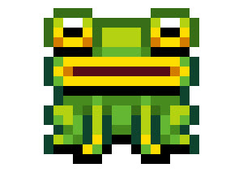
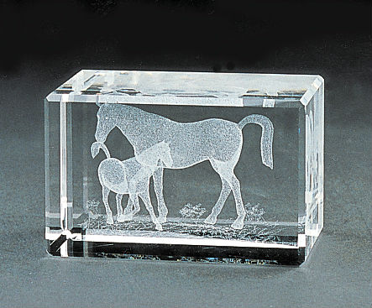
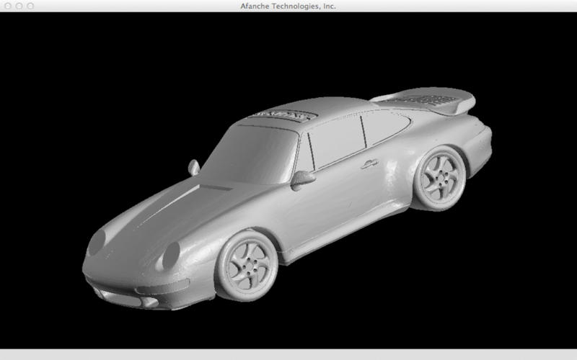
Tagged Image File Format vs.
Standard Tessellation Language
Tiff is a collection of 2D points.
Stl is a collection of 3D points
Stl Formats are foundation of a 3D model.

Slide 10
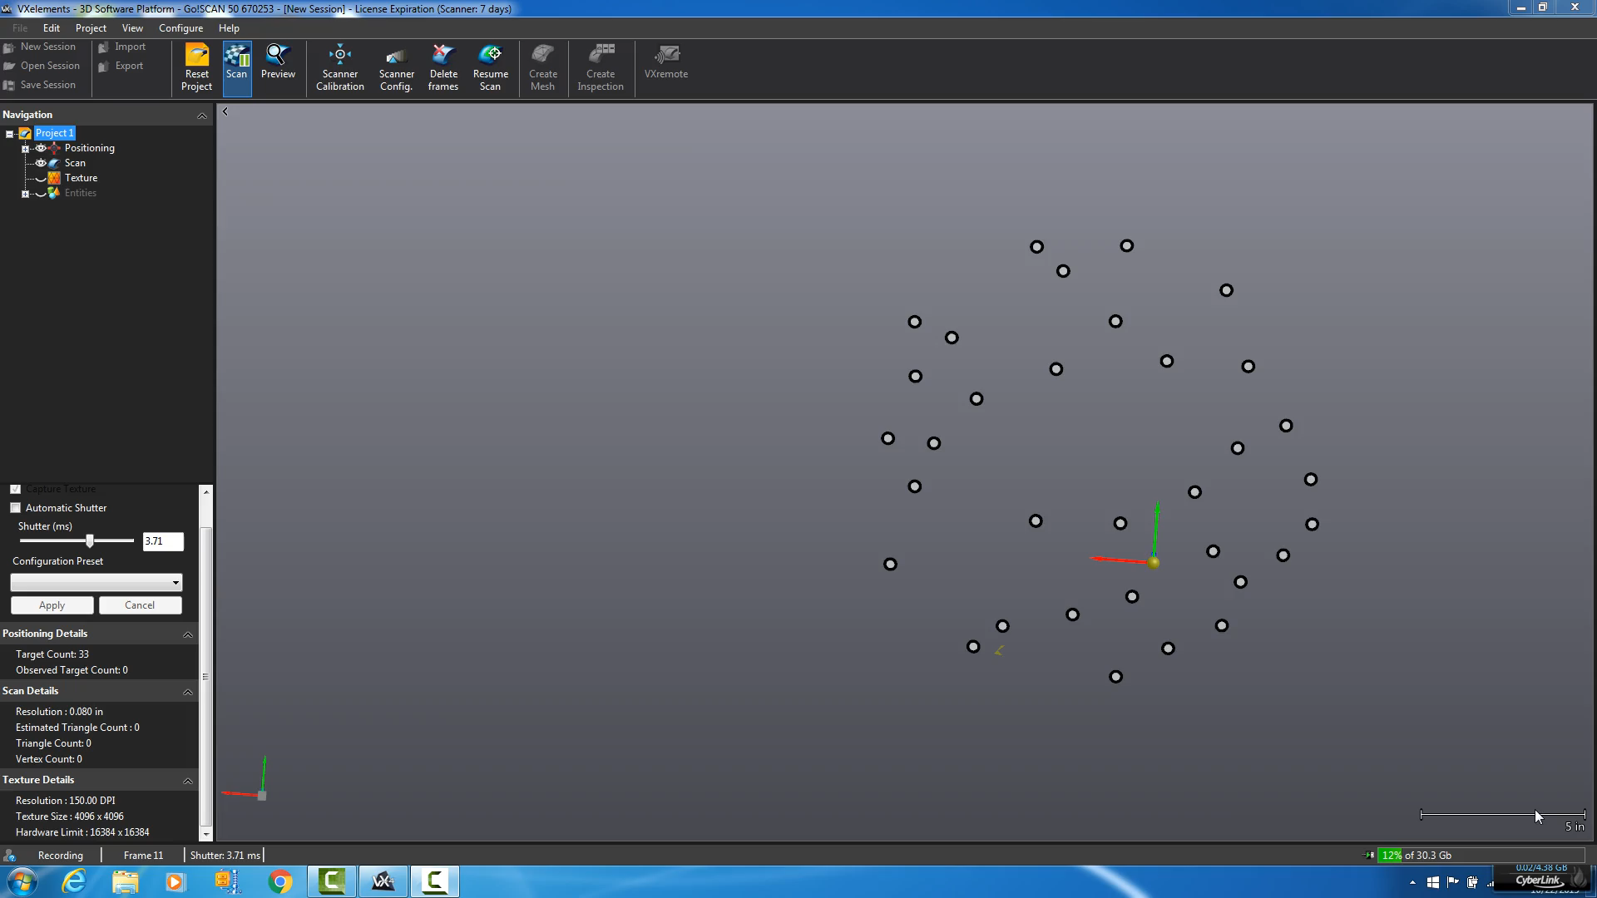
Scanning Demo

Slide 11

Scanning Demo

Slide 12
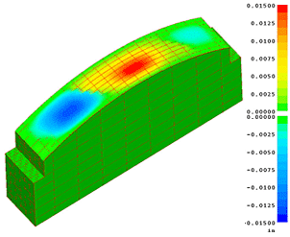
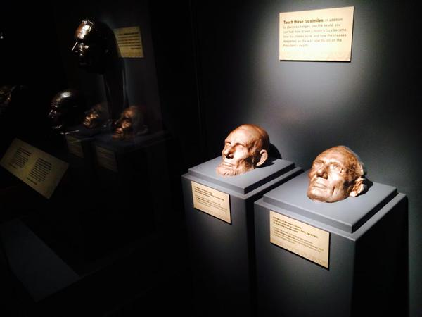
Benefits of 3D Digitization
Comparative analysis
Education and research
3D printing

