Slide 1
Elevating the ‘open’ Conversation
Caitlin Pike, MLS, MPHc, AHIP
IUPUI University Library
Research Engagement and Scholarly Service Coordinator
Health Sciences Librarian

Slide 2
Defining Our Terms
Open Access, Social Justice, and Health Equity

Slide 3
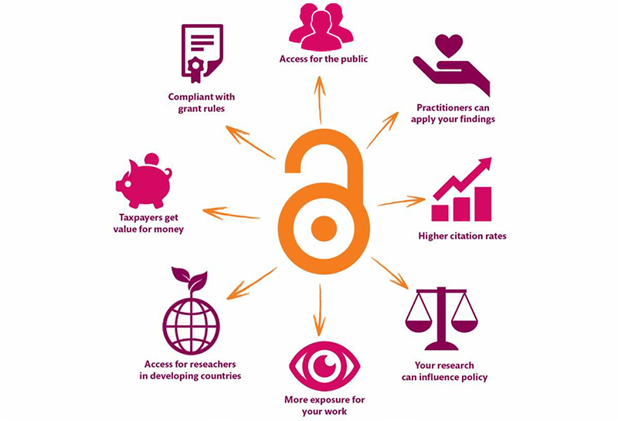
Open Access
According to SPARC:
Open Access is the free, immediate, online availability of research articles coupled with the rights to use these articles fully in the digital environment.
Open Access ensures that anyone can access and use these results—to turn ideas into industries and breakthroughs into better lives.
Source: https://kib.ki.se/en/publish-analyse/open-access

Slide 4
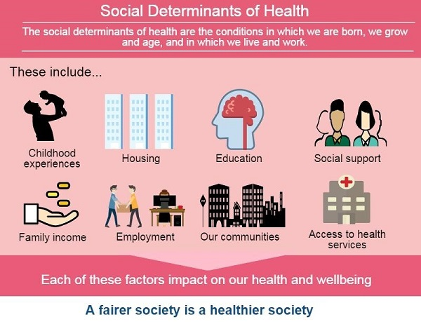
Social Justice
The idea of acting with equality, fairness and dignity to all human beings.
“Social justice is the view that everyone deserves equal economic, political and social rights and opportunities.”
– National Association of Social Workers
“Social justice also imposes on each of us a personal responsibility to work with others to design and continually perfect our institutions as tools for personal and social development.”
– Center for Economic and Social Justice
Source: https://www.healthyfife.net/health-inequalities/

Slide 5
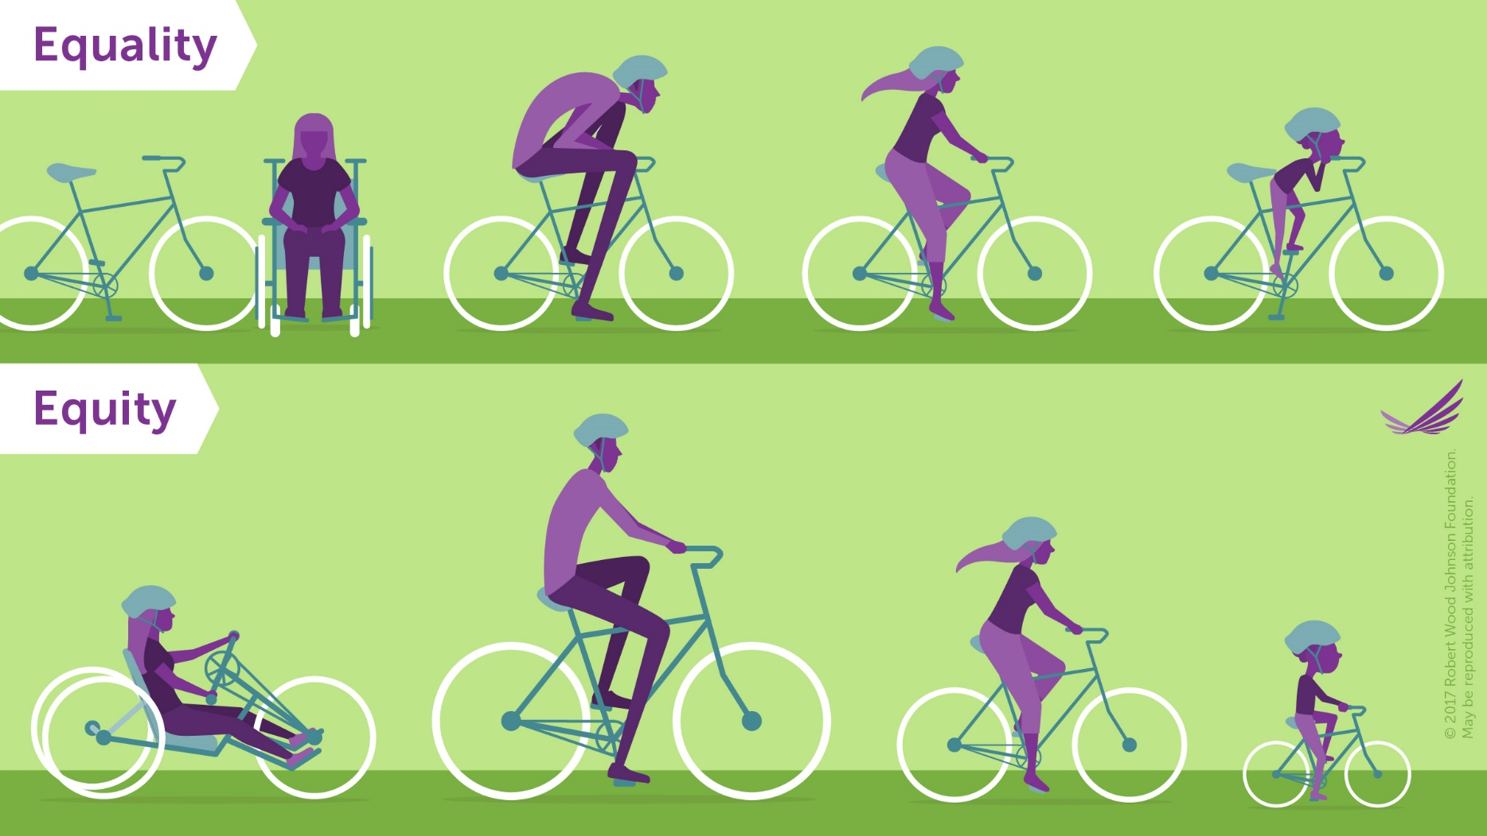
Equality vs. Equity
Social Justice should (hopefully) aim to be equitable.
The goal of equality is to make sure that everyone has the same things to be successful.
Equity is trying to understand where people are coming from and give them what they need to be successful.
Equality is similar to equity in that it is seeking fairness for everyone, but it assumes that everyone starts equally as well.
Source: https://www.rwjf.org/en/library/infographics/visualizing-health-equity.html
http://www.societyfordiversity.org/equality-vs-equity/

Slide 6
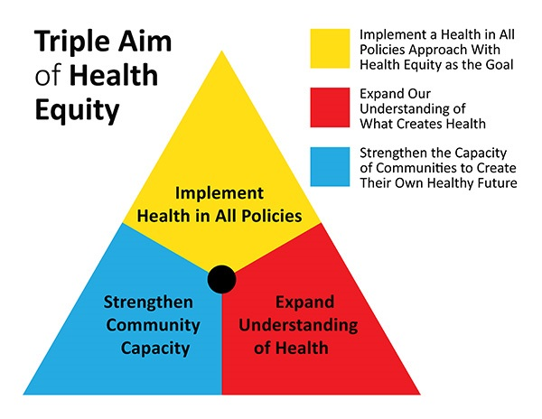
Health Equity
American Public Health Association:
Everyone has the opportunity to attain their highest level of health.
How do we achieve health equity?
  We value all people equally. We optimize the conditions in which people are born, grow, live, work, learn and age. We work with other sectors to address the factors that influence health, including employment, housing, education, health care, public safety and food access.
Source: https://www.planning.org/blog/blogpost/9104610/

Slide 7
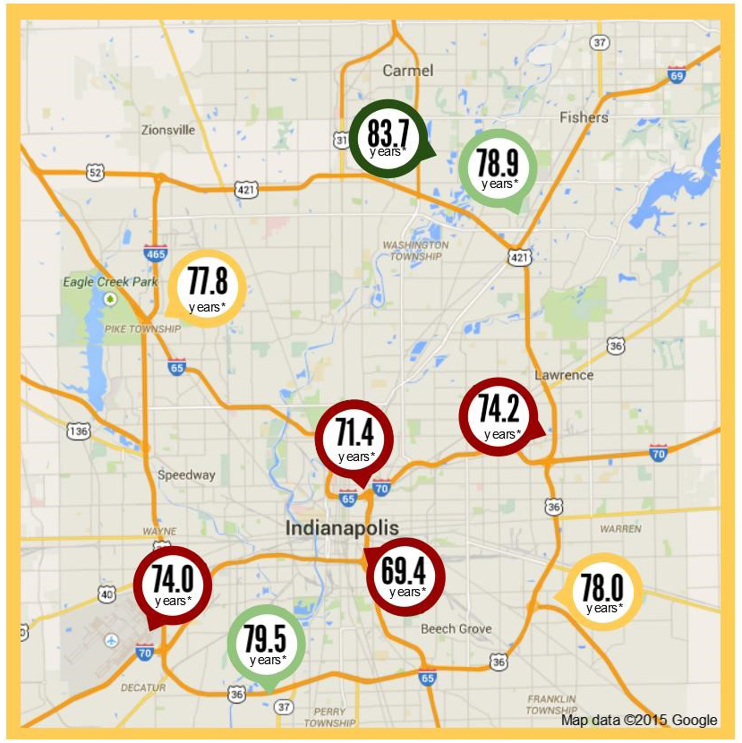
Why Does It Matter?
Life Expectancy in the Indianapolis Metro Area
46033
  High School Graduates: 99%
  Median Household Income: $124,712
46225
  High School Graduates: 69.3%
  Median Household Income: $33,688
28 miles and 14 years of life
(Source: 2013-2017 American Community Survey 5-Year Estimates)
Worlds Apart: Gaps in Life Expectancy in the Indianapolis Metro Area

Slide 8
Student Views
International Open Access Week 2018
Is information access important?

Slide 9
Demographics
Year in School | Number of Students
Freshman | 31
Sophomore | 18
Junior | 20
Senior | 23
Masters | 8
Professional School | 1
Total: | 101

Slide 10
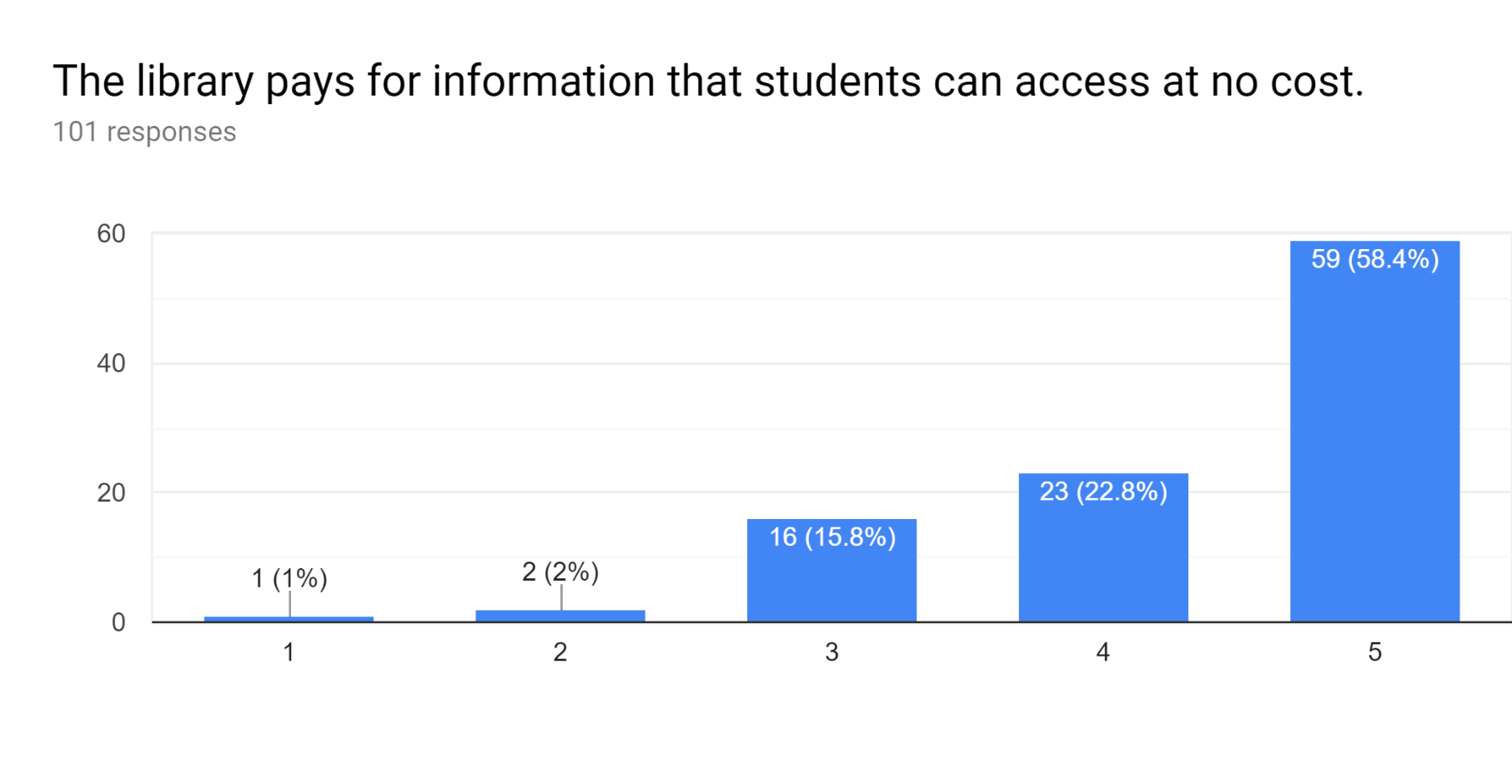
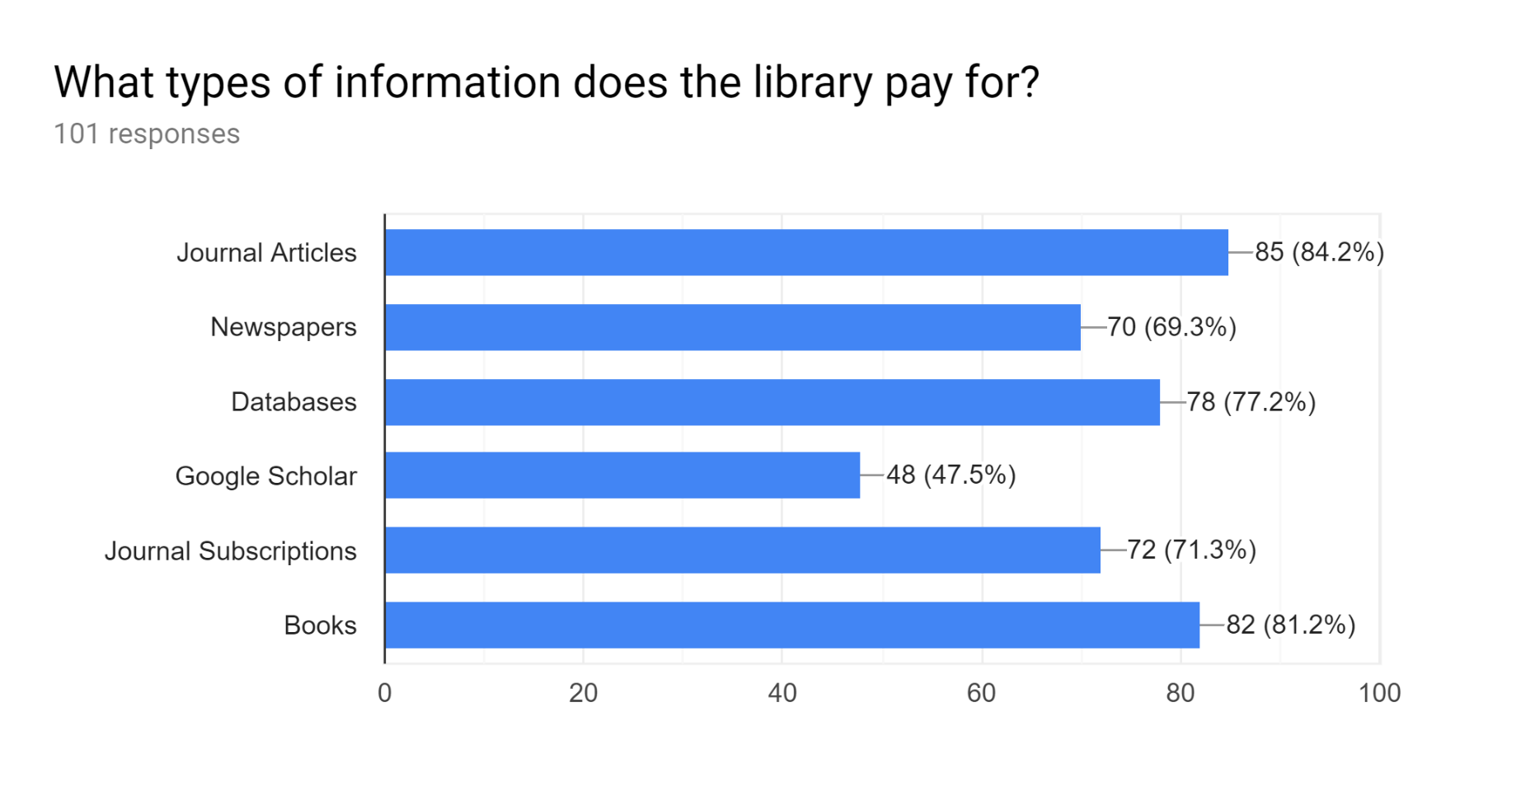
What does the Library pay for?
Definitely Not Definitely

Slide 11
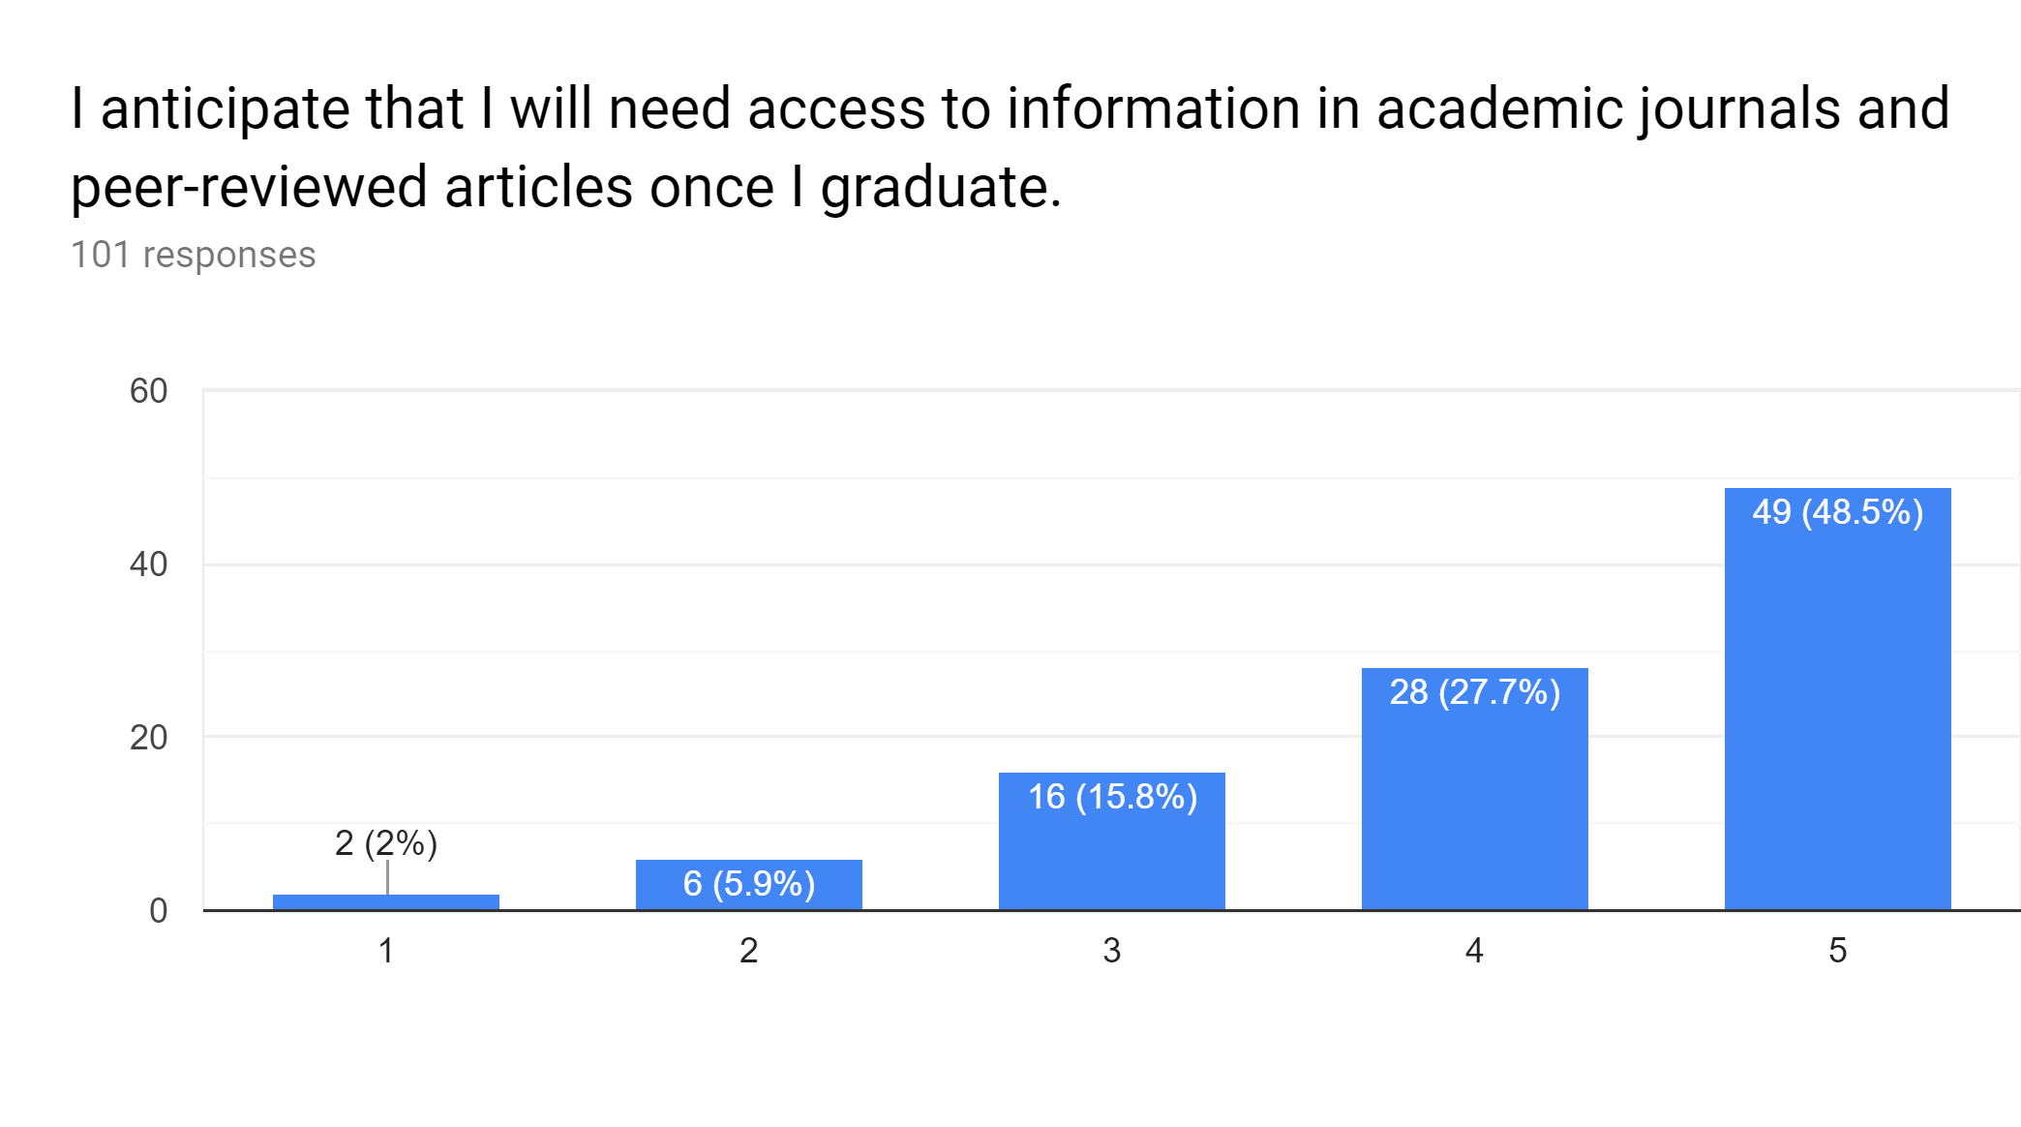
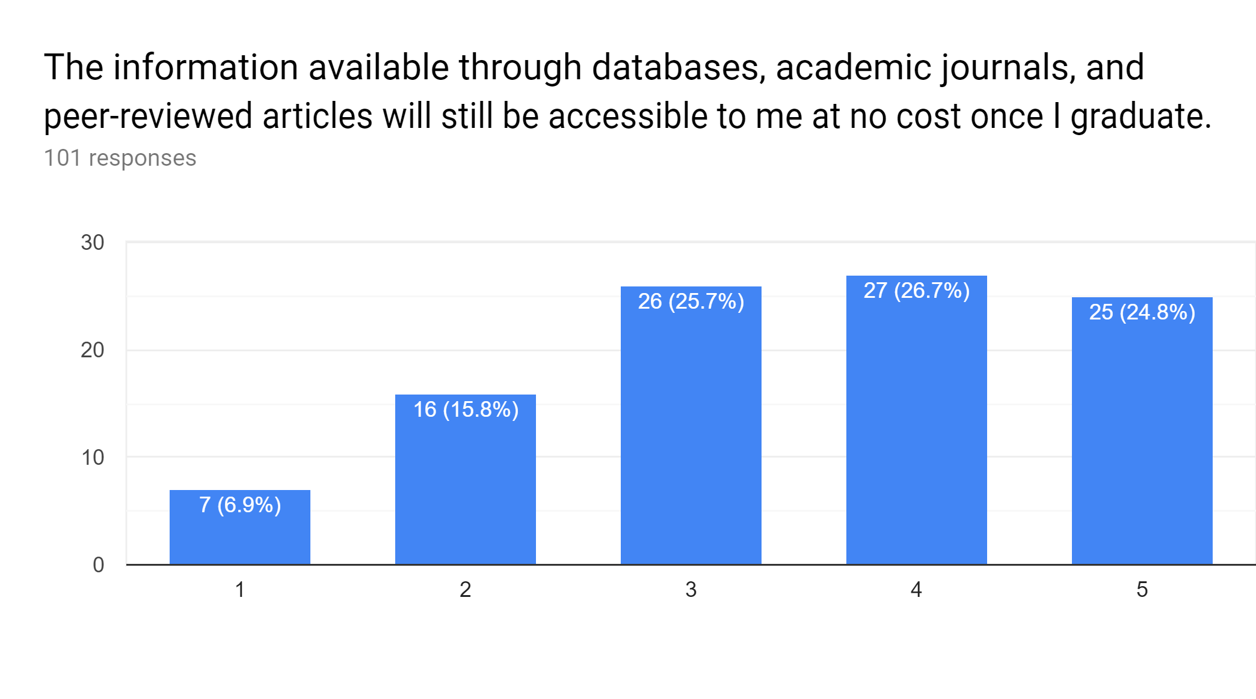
Anticipating Need and Accessibility
Definitely Not Definitely
Definitely Not Definitely

Slide 12
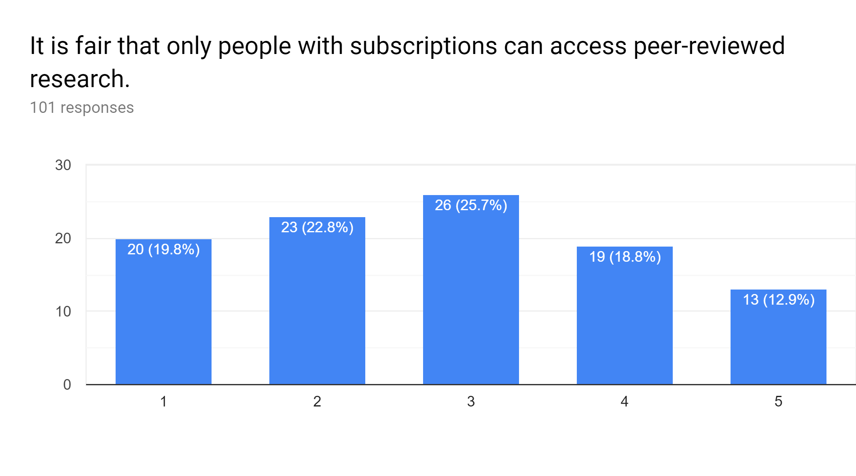
Are subscriptions fair to those who can’t pay?
Definitely Not Definitely

Slide 13
It is fair that only people with subscriptions can access peer-reviewed research.
Definitely Not (1 or 2)
Everyone should have access to scientific research so they aren’t misinformed. (Freshman, Mechanical Engineering)
Research should be available at low to no cost so people have the ability to properly educate themselves on subjects of interest. Subscription fees only serve as a barrier for people who want to educate themselves, but do not have the means to do so.
(Junior, Environmental Science)
Access to information is important for everyone. (Senior, Journalism)
People should have free access to knowledge. (Sophomore, Philanthropy)
Paywalls prevent the growth of knowledge. (Senior, CIT)
Peer reviewed research should be at least accessible to the author. (Freshman, Policy Studies)
Pay-walls to access scholarly journals create gatekeeping that limits access to leading, peer-reviewed research. It essentially creates a disconnect between experts in respective fields and students and the “lay-man.” (Graduate Student, English)
Most research is paid for with public funds. (Senior, Economics)

Slide 14
It is fair that only people with subscriptions can access peer-reviewed research.
Neutral (3)
I'd love to access the articles without a subscription, but I understand that people need to get paid for their work. (Sophomore, Media Arts and Science)
Everything costs money. (Junior, Sports Management)
I feel everyone should have access to reputable information. (Senior, Tourism, Event, and Sports Management)
Knowledge should be accessed by all. It's how society can fully innovate. (Junior, Social Studies Education)
I feel people should have equal opportunity to access these avenues of research. (Sophomore, Business)

Slide 15
It is fair that only people with subscriptions can access peer-reviewed research.
Definitely (4 or 5)
I think that if it gives you a leg up, then you should have to pay. (Sophomore, Audio Engineering and Music Technology)
As a business student, you need to make a profit. (Senior, Finance and Management)
They spent a lot of money doing research and so they should have the right to charge a little at least. (Freshman, Biology)
Because some information took a lot of money and time to get. (Sophomore, Media Arts and Science)
I think that people should have to buy so that the people [doing] the research can get paid. (Freshman, Nursing)
Any research that is reviewed by members of a specific group should be oriented for only members who have payed for membership, and thus those who have put in the time to review these pieces should be rewarded for the effort that they have put in. (Freshman, Chemistry)
Peers spend their valuable time, so they deserve compensation. (Freshman, Chemistry)

Slide 16
Final Takeaways
(The next one is the most important slide!)

Slide 17
We shouldn’t be neutral!
What’s the point?
  Open access gives anyone with an internet connection access to health-related research.
  This access exists regardless of income, education, geographic location, or any other factor.
  It promotes health equity, citizen science, and helps to create a more informed public.
Why Should Librarians Advocate for Open?
Allows patients and their families to better understand a diagnosis, and to advocate for their own heath.
Provides access to current research for healthcare providers who may not be able to afford article fees or journal subscriptions.
Makes increasingly more sense, as public and donation dollars fund medical research.
Offers an opportunity to question who is being disenfranchised by paywalls.
Dismantles the traditional model of publishing that perpetuates blind allegiance to impact factors and journal “reputation”.
Personal responsibility plays a key role in health, but the choices we make depend on the choices we have available to us. (Robert Wood Johnson Foundation)

Slide 18
Questions?
Thank you!
Caitlin Pike
caiapike@iupui.edu

Slide 19




Scenarios of Health Engagement Experiences and Health Justice in Rural Libraries
Bharat Mehra
Professor & EBSCO Endowed Chair in Social Justice
School of Library & Information Studies, University of Alabama
Everette Scott Sikes, Doctoral Student, School of Information Sciences, University of Tennessee.
Vandana Singh, Associate Professor, School of Information Sciences, University of Tennessee.
Medical Library Association’19: Elevate

Slide 20
The Scope
Mehra@MLA—2019
Today I will highlight scenarios or narratives of health engagement experiences in rural libraries based on qualitative analysis of feedback collected from 15 rural librarians in the Southern and Central Appalachian (SCA) region during semi-structured interviews conducted in 2017-2018.
The presentation highlights respondents’ perspectives of the:
  “aboutness” of their health-related engagement
  collaborating partners
  encountered challenges
  resulting outcomes
Scenarios were documented in broader interviews on specific health activities and community engagement in eleven domains, including agriculture, diversity, economy, education, environment, government, health, law, manufacturing, social welfare, and other.
Scenarios provide a taxonomic classification of health-related programs relevant to the region and a framework of practice related to their implementation.

Slide 21
Mehra@MLA—2019
Assessment of Rural Library Professionals’ Role in Community Engagement in the Southern and Central Appalachian Region: Mobilization from Change Agents to Community Anchors (CA2CA@SCA-RL)
Institute of Museum and Library Services, Laura Bush 21st Century Librarian – FY 2017 Guidelines (Community Anchors Project Category: Planning Grant), July 2017 – June 2019
Subcontracted to the University of Alabama
(PI: B. Mehra. Co-PI: V. Singh. Project Manager: S. Allard)
URL: http://scholar.cci.utk.edu/ca2ca-sca-rl/
PARTNERS 1) Blount County Public Library, Maryville, TN; 2) Clinch River Regional Library, Clinton, TN; 3) Library of Virginia, Richmond, VI; 4) Sevier County Public Library System, Sevierville, TN; 5) Wiggins Memorial Library, Buies Creek, NC.

Slide 22
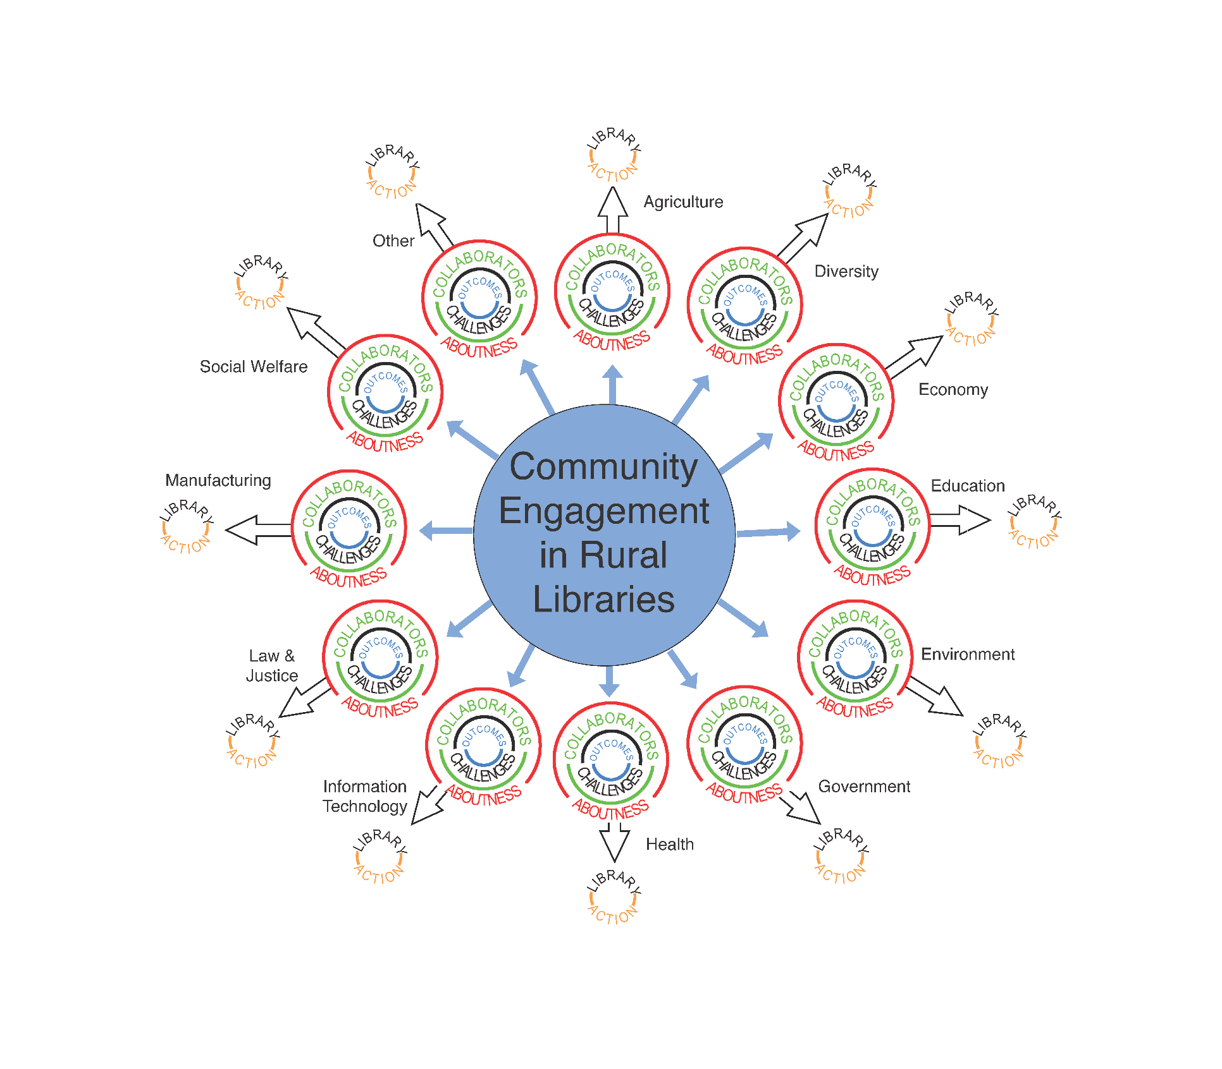

Community Engagement Framework in Rural Libraries—Domain Specific
Aboutness-Collaborators-Challenges-Outcomes
Mehra@MLA—2019

Slide 23
Definitions
The U. S. Bureau of the Census defines “rural” as areas with fewer than 2,500 people and open territory (Economic Research Service, 2007).
The Encyclopedia of Rural America defines the related concept of “nonmetropolitan” counties to describe the spread of housing developments outside the boundaries of metro areas that have no cities with as many as 50,000 residents (Rathge, 1997), in addition to being non-urbanized (Office of Management & Budget, 1998).
The Appalachian Regional Commission, created as a United States federal-state partnership, identifies Central Appalachia to include: West Virginia’s nine south counties, eastern Kentucky, Virginia’s southwestern tip, and the northwestern portion of Tennessee, while Southern Appalachia includes most of Virginia and Tennessee as well as the western Carolinas and the northern parts of Georgia, Alabama, and Mississippi (ARC, 1974; Bush, 2003).
Mehra@MLA—2019

Slide 24
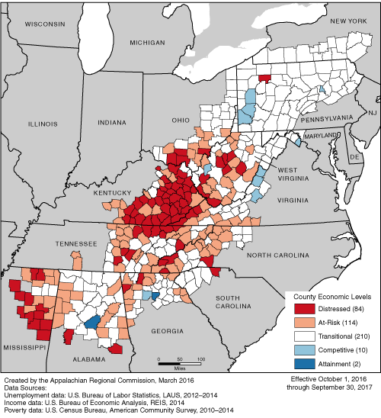
The Context of the Southern and Central Appalachian Region
According to an ARC (2016) study entitled “County Economic Status and Distressed Area in Appalachia, FY 2017” of the 420 Appalachian counties, 84 counties are economically distressed, and another 114 considered economically at-risk.
Mehra@MLA—2019

Slide 25
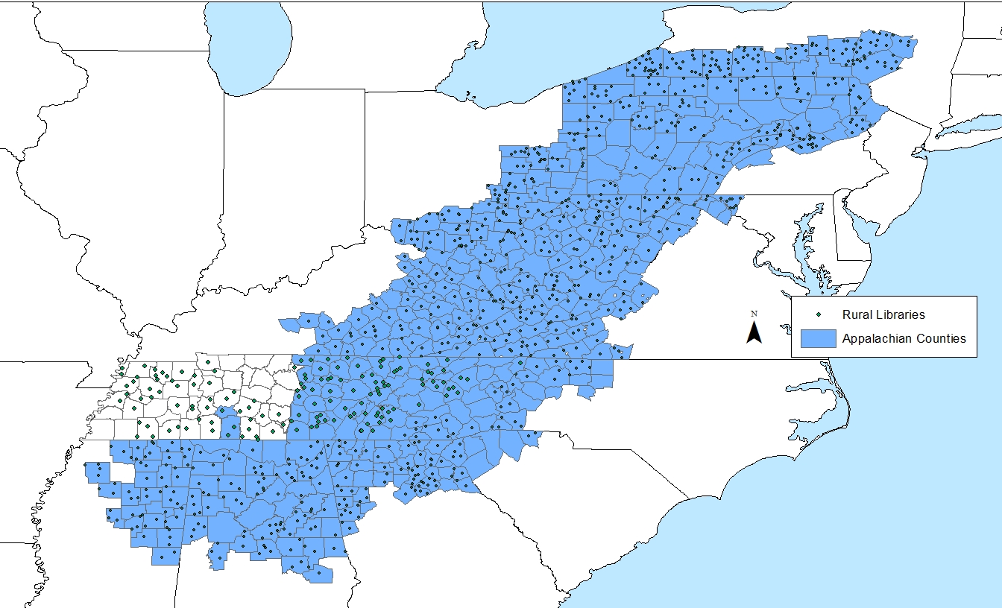
Forty-two percent of residents in the Appalachian region are living in rural areas, compared with 20 percent of the national population (ARC, 2015).
According to the U.S. Census Bureau, 2007-2011 American Community Survey, two-thirds of Appalachian counties had populations of fewer than 50,000 people, and 125 counties had fewer than 20,000 residents. According to IMLS Data Files, 352 of the 420 Appalachian counties are considered rural.
The Context
Appalachian rural residents face limited financial opportunities, information poverty, unemployment, low levels of educational attainment, lack of access to adequate IT resources, and other unique debilitating environmental circumstances (Bardwell et al., 2009; Black, Mather, and Sanders, 2007; Mehra, Black, Singh, and Nolt, 2011; Schwartz, 2004).
The region’s labor force participation is low, at 59.5% compared with 64.2% nationally (ARC 2015).
Mehra@MLA—2019

Slide 26
Health Justice Imperative
SCA rural libraries have been overlooked in the library and information science (LIS) professions and beyond.
Scenarios of rural librarians’ health-related experiences provide a glimpse of an “untold” picture of rural library engagement with external stakeholders to overcome challenges and achieve tangible outcomes in spite of the unique conditions and limited resources (ARC, 2015b; Mehra, Bishop, & Partee II, 2018).
As a health justice tool, scenarios challenge the hegemonic imagination of mainstream American society, news media, and popular culture that has only presented the SCA rural belt in deficit light.
They serve as a counter-point to past unfair and marginalizing representations in their constructive asset recognition of the SCA rural librarians’ positive examples of health-related experiences.
Mehra@MLA—2019

Slide 27
Data Analysis
Transcriptions of interview audio recordings were compiled into a single digital file and open coding of the data provided systematic sorting into broad themes.
Axial coding identified the development of key topics and categories/themes using illustrative project examples and scenarios of participant responses.
Selective coding established categories, topics, and themes that were related to the inquiries of research.
Coding provided an analytic framework for understanding the data and for an investigation of the thematic relationships found in interviewee responses.
P12D5Q1a: “So, what we have are these really cool backpacks (PE2) that are filled with, you know, leaf identification, animal identification, all of those kind of environment identification books (T1) and we have a compass and a magnifying glass, things like that that people can check out and take on a hike with them to improve your health (T2).”
Mehra@MLA—2019

Slide 28
Response Type Definitions and Examples
Response Type | Definition | Example
Aboutness [a] | Responses that offer overviews or general descriptive details about projects, programs, and initiatives. | P11D7Q1a: “Last summer, part of our summer reading was a walking club and they walked and talked about the books they’d been reading.”
Partners [p] | Responses that name or specify external collaborating organizations and individuals who have assisted with or coproduced projects, programs, or initiatives. | P6D7Q2p: “They have a very active health foundation and the library there has partnered with the local health foundation to do at least a couple of different program series.”
Challenges [c] | Responses that outline, describe, or reference specific problems, difficulties, obstacles, or complications related to the deployment of projects, programs, and initiatives. | P6D7Q4c: “Well, money’s a challenge. \do So, we’re doing a fundraiser every year to be able to pay for the help and to set up and clean up and provide the programming.”
Outcomes [o] | Responses that specify or describe tangible or intangible results, products, or effects of projects, programs, and initiatives. | P6D7Q5o: “We do a fundraiser in February to raise enough money to pay a couple of part-time people to kind of run that program just for the summer and it’s been really popular and something we’re really proud of.”
Mehra@MLA—2019

Slide 29
Code Descriptions and Illustrative Examples
Code Identifier + Description | Example
P1-P15: Designates individual participants. | P6D7Q2p: “That is a very active health foundation, and so the library’s just a great partner because we have good parking and a big meeting room and are always looking for partners.” [P6 = Participant 6, Female, Age 59 years, Director].
D1-D12: Indicates domain under which the response falls. | P11D7Q1p: “We have had blood drives. We’ve partnered with the Health Department to come in and do tables and talk about well-care and taking care of your children.” [D7 = Health].
a = “aboutness”; p = partners; c = challenges; o = outcomes. | P10D7Q2p: “But, talk about collaboration and partners. We’ve got lots of partners with that.” P2D7Q3c: “Our space. Twenty-six hundred square feet causes some interesting challenges.”
T1, T2, etc. Designates primary theme or themes found in the response. | P9D7Q5o“So, it’s a way for people to be in a private place and do this mental health assessment without having to go to a clinic or tell anyone that they think they need help (T6). We are about to embark on a big LSTA-funded programming series with money devoted to mental health (T3) in the spring and that will be one of the things we try to advertise and highlight.” [T6 = Need for anonymity; T3 = grant funded opportunities].
C1, C2, etc. Designates category of the response in different themes. | P11D7Q5o “I think we’ve had a lot more use of the library as a result of it (T1), which is a great outcome. Of course, we’re hoping that they’re becoming more information literate (T2) about whatever that topic (T2-C1) is and taking home more information to improve their family’s lives (T2-C2).” T2 = increased information literacy; T2-C1 = individual level; T2-C2 = family level].
PE1, PE2, etc. Indicates project examples. | “We have a group that comes and works and meets with and counsels with victims of domestic violence (PE2).” [PE2 = Domestic Violence Counseling]

Slide 30
Mehra@MLA—2019
Age | Number of Respondents
30-39 years | 3
40-49 years | 3
50-59 years | 3
Over 60 years | 2
Undisclosed | 4
TOTAL | 15
Years of Professional Service
5 years or less | 1
6-10 years | 7
15-20 years | 1
Over 20 years | 6
TOTAL | 15
Location in Rural SCA County
North Carolina | 3
Tennessee | 8
Virginia | 4
TOTAL | 15
Self-Identified Professional Title
Assistant Director | 1
Branch Supervisor | 1
Business Coordinator/HR Specialist | 1
County Director | 2
County Librarian | 1
Director of Libraries | 1
Library Director | 6
Library System Director | 1
Regional Library Director | 1
TOTAL | 15
Participant Demographics and Professional Titles

Slide 31
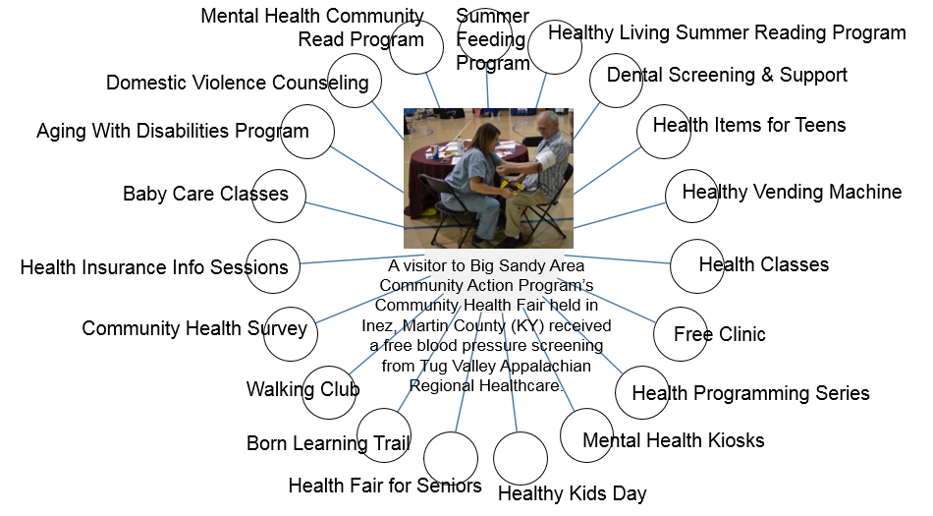
Health-Related Information Offerings of Community Engagement in Rural Libraries
“What I do is work with a free sustained clinic to provide education for chronic disease management and partner to reach more clientele, the working uninsured, for people that sort of fall between the cracks, they’re working but they either are not provided insurance through their place of employment or else they’re underinsured if they have insurance…Or with some people who were able to get insurance, but still they couldn’t afford the premium under the Affordable Care Act. So, we partner with people and provide health services like doctors, nurses, that serve as library board members, and we work with them through grants and contracts and local fundraising, to support the clinic and to provide healthcare.”
Mehra@MLA—2019

Slide 32
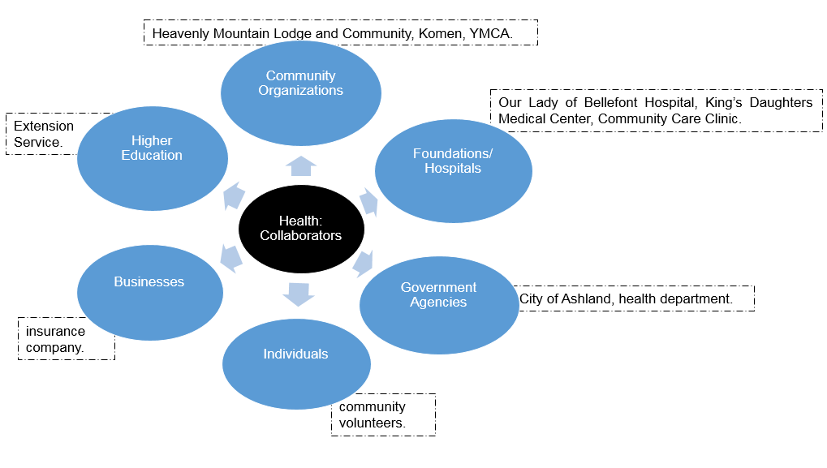
Service: Health Programming Series “In Wilkes County, they have a very active health foundation and, over the last couple of years, the library there has partnered with the local health foundation to do at least a couple of different programs…The Susan B. Komen breast cancer program has been presented in each of my libraries in each of my counties. And again, that’s just something they offer that we’re happy to offer a home for.”
Service: Health Classes “We partner with the Extension Office…You really have to rely on your partners because library staff can give you book information about it, but we’re not trained health professionals, so we certainly don’t want to speak to health things that we don’t know about.”
Partners
Mehra@MLA—2019

Slide 33
Limited Planning, Organizing, and Resources
For the summer feeding program, with schools, it was a little bit chaotic, the planning…I can’t recruit volunteers if I don’t know the details on your end…somewhere the paperwork didn’t get filed, it was not as organized as I would prefer…we learned that kids don’t care about sandwiches. They want a hot lunch and, the library does not have the equipment to keep it hot, so I think we’re not doing this program next year…as I said, this community self-segregates. And, all of my volunteers were Caucasian and occasionally some African-American kids would look into the room where we had the lunches and look around and then leave. I don’t know what was motivating that, but, you know, it’s unfortunate.”
Health: Challenges
Community Characteristics
Management
Resources
Limited Space
If you could imagine three hundred and fifty people in twenty-six hundred square feet…In April, I’m going to do a session on the logistics of programming from fifty to three and fifty in twenty-six hundred square feet and some of the lessons we have learned on furniture purchasing, computer purchasing, chairs, and how we have come to deal with that issue.”
convincing people to change decades worth of bad habits and adopting healthy ones, getting people to come.
Challenges
Lack of Public Awareness
“I would say that meeting and attracting your target population is probably our biggest challenge. Information sharing about our programs. Making sure it’s in the paper and on Facebook.”
making he space comfortable, communication at times.
having space in the meeting room.
Mehra@MLA—2019

Slide 34
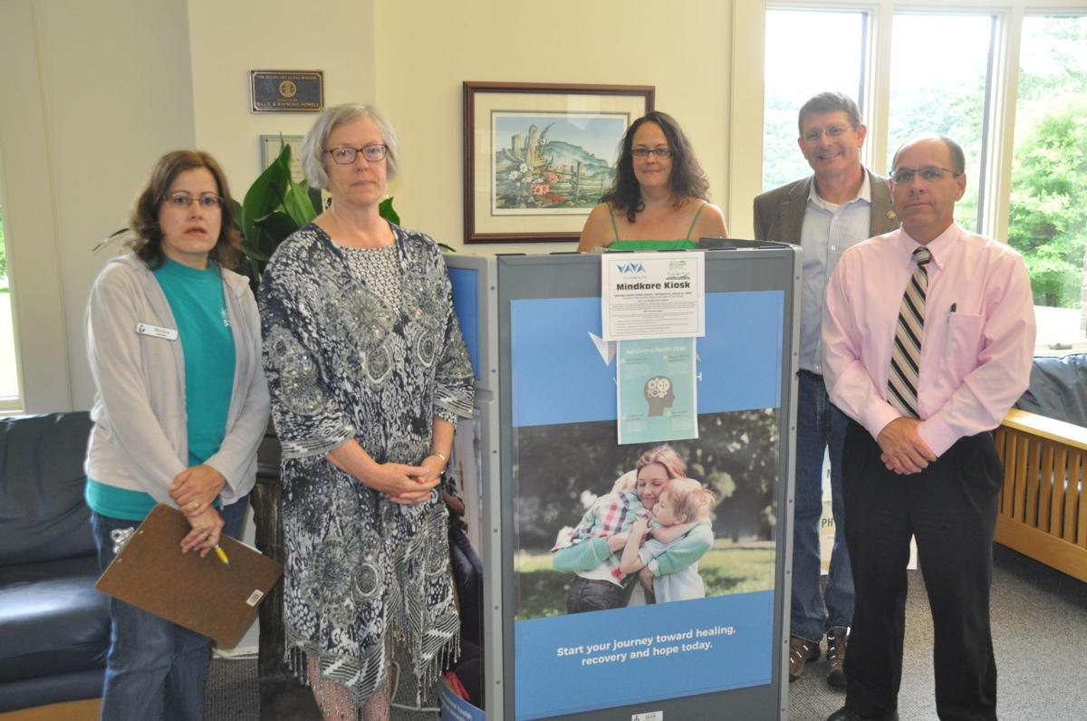
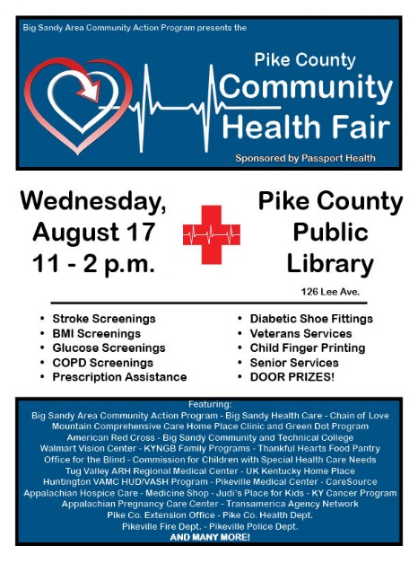
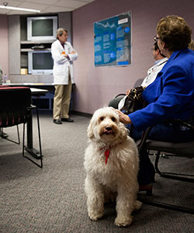
Monica Caruso of the Watauga County Public Library, Appalachian Regional Library Director Jane Blackburn, Danyale Isaacs of Vaya Health, Watauga County Commissioner Billy Kennedy and Watauga County Manager Deron Geouque pose with the new Vaya Mindkare Kiosk at Watauga County Public Library on June 22, 2018.
SERVICE: MENTAL HEALTH KIOSKS
“So, it’s a way for people to be in a private place and do this mental health assessment without having to go to a clinic or tell anyone that they think they need help…we are about to embark on a big LSTA-funded programming series on mental health in the spring and that will be one of the things we try to advertise and highlight.”
“In June of 2017, Vaya Health equipped the Alleghany Public Library with a MindKare Kiosk. The kiosk is a program that offers a quick, anonymous screening assessment for treatable conditions like depression and anxiety, as well as information about treatment resources in the area. Vaya Health is a public managed care organization that oversees Medicaid, federal, state and local funding for services on mental health, substance use and intellectual/ developmental disability needs.” [Source: Appalachian District Health Department (2018). 2017 Community Health Report Alleghany County].
The Human Animal Bond in Tennessee (H.A.B.I.T.): In collaboration with the University of Tennessee College of Veterinary Medicine and the Human Animal Bond in Tennessee (H.A.B.I.T.), Preston Medical Library hosts regular canine-assisted stress reduction visits.
SERVICE: SUMMER FEEDING PROGRAM
“I asked four or five churches to each take a day of the week for the six weeks of the summer feeding program…a lot of these people don’t really come into the library and now they were able to come in and see how we try to reach out to the community, which is a value similar to a lot of churches. They’re able to meet me and I was able to talk to them and they were able to meet some of the other staff, so that now, if their kids need homework help, they know the library’s not a scary place anymore because you’ve already had that face-to-face connection as part of the feeding program.”
SERVICE: DOMESTIC VIOLENCE COUNSELING
“We have a group that comes and works and meets with and counsels with victims of domestic violence. We provide a quiet, out-of-the-way space where people don’t see them coming and going. They’re not in the public eye. “
HEALTH
OUTCOMES

Slide 35
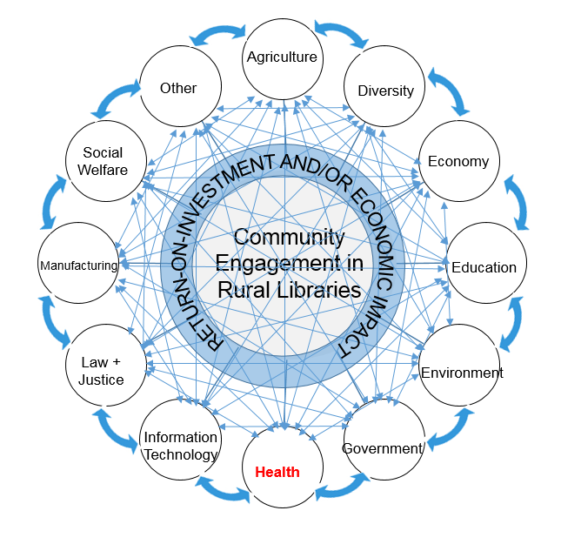
Community Engagement Framework in Rural Libraries—Domain Specific
Aboutness-Collaborators-Challenges-Outcomes
Mehra@MLA—2019

Slide 36
Conclusions
Scenarios provided a glimpse of community-engaged health-related practices and experiences of rural librarians in the SCA region.
As tools to further health justice within the broader context of marginalization in the LIS professions, they provided a “voice” of/to SCA rural librarians towards individual, social, and community empowerment.
These narratives also served to highlight the understanding of health-related information offerings in the context of their impacts on other domains representing the intertwining elements in the lives of rural residents.
As a result, they provided strong justification for the rural libraries to plan and implement health initiatives in terms of constructs related to return-on-investment economics associated with impacts generated across multiple settings.
Mehra@MLA—2019

Slide 37
Questions and Comments?
Mehra@MLA—2019
Thank you!
Acknowledgement:
Mehra, B., Sikes, E. S., and Singh, V. (forthcoming). Scenarios of Health Engagement Experiences and Health Justice in Rural Libraries. International Journal of Information, Diversity, & Inclusion (Special Issue: Health Justice.

Slide 38
Are the “leading” journals bad for your health?
Jere Odell
Scholarly Communication Librarian
IUPUI
jdodell@iupui.edu
This work is licensed under a Creative Commons Attribution 4.0 International License.

Slide 39
Three Guineas
Virginia Woolf, 1938
“Behind us lies the patriarchal system, the private house … Before us lies the public world, the professional system, with its possessiveness, its jealousy, its pugnacity, its greed.” pg. 43
Guinea 1775. Classical Numismatic Group. CC BY SA
https://commons.wikimedia.org/wiki/File:Guinea_1610342.jpg

Slide 40
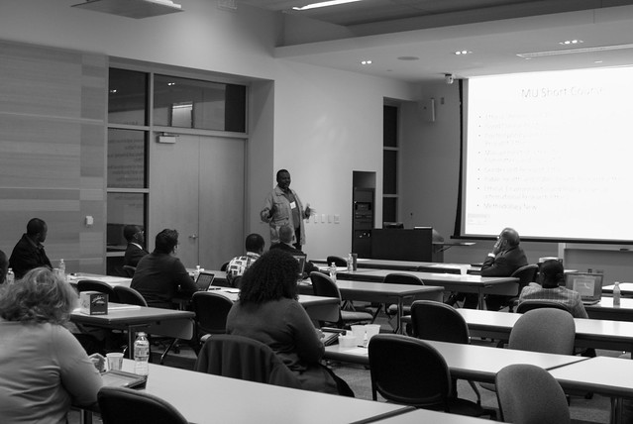
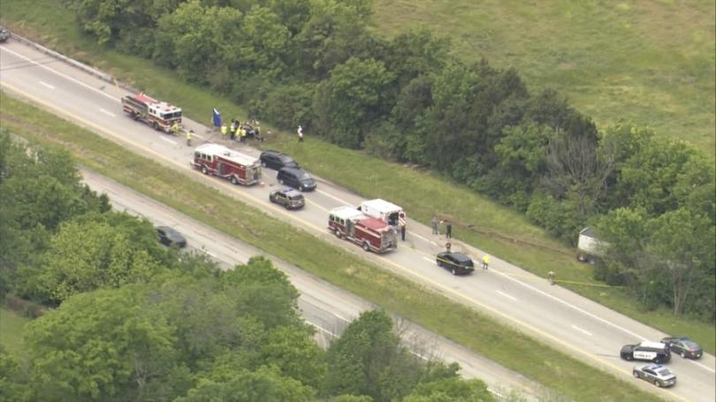
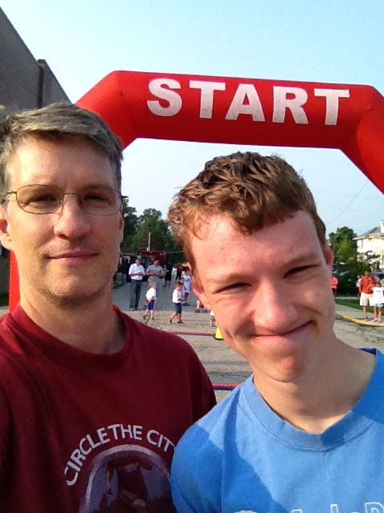
Three Accounts

Slide 41
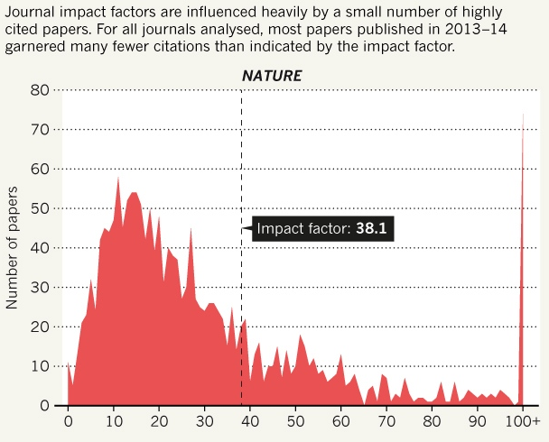
“The question we should ask is whether the communication system and the reputational system of science and scholarship should be one and the same.”
  -- Jean-Claude Guédon. Open Access: Toward the Internet of the Mind, 2017: https://www.budapestopenaccessinitiative.org/boai15/Untitleddocument.docx
(Callaway, Nature News, 2016)

Slide 42
“For those in the global south, as much as citation is valued by authors, the positive influence of the research output on society should be of the greatest value … how does it improve the quality of life of the citizenry of the world.”
  -- Reggie Raju. (2018, February 7). Predatory publishing from a global south perspective. Library Publishing Coalition Blog: https://librarypublishing.org/predatory-publishing-global-south-perspective/

Slide 43
“[W]e claim that our work as librarians is a positive good, that we’re fighting the good fight by working towards open access as a social justice issue. But librarianship – and scholarly communication – does not exist in a vacuum. Just like cataloging, access services, and technology in all its biases, scholarly communication also has problems with equality. And we’re all complicit in this, myself included.”
  -- Charlotte Roh. "Scholarly Communication in a Time of Change: Considering the Impact of Bias, Diversity, and Traditional Publishing Structures as Scholarly Communication Moves to New Platforms and Systems (Talk Transcript)" California Academic Research Libraries (2018): http://works.bepress.com/charlotteroh/43/

Slide 45
Image of highway accident used without permission.

Slide 46
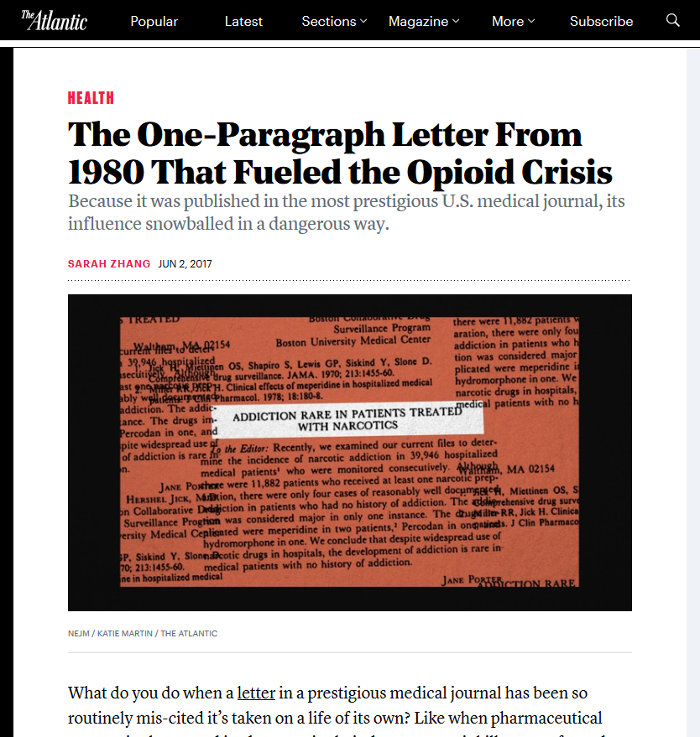

Slide 47
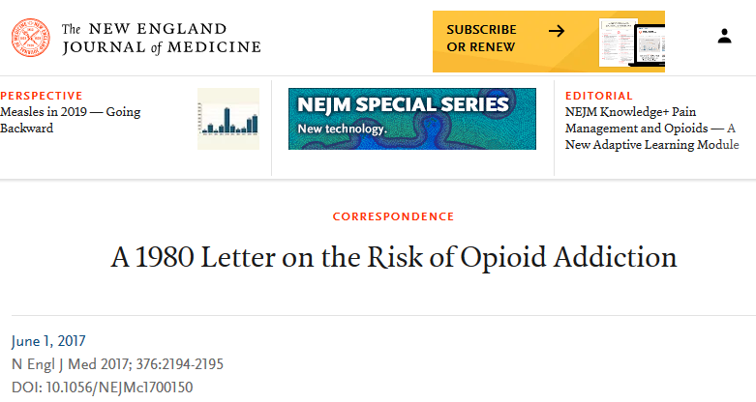
“The New England Journal of Medicine (NEJM) is the world’s leading medical journal ….”
In conclusion, we found that a five-sentence letter published in the Journal in 1980 was heavily and uncritically cited as evidence that addiction was rare with long-term opioid therapy. We believe that this citation pattern contributed to the North American opioid crisis … Our findings highlight the potential consequences of inaccurate citation and underscore the need for diligence when citing previously published studies.

Slide 48
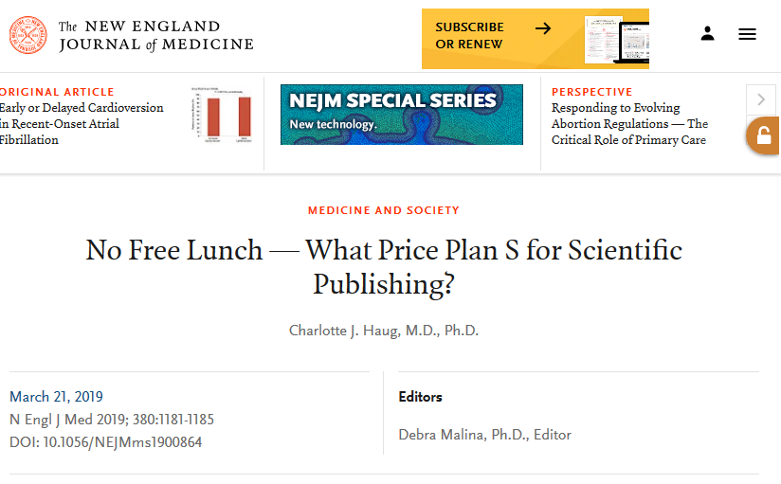
“In 2001, we were optimistic …. We had never heard of Internet trolls, fake news, fake science, fake journals, or fake peer review. And we couldn’t imagine a “dark web” where child pornography was distributed anonymously, where terrorist organizations such as ISIS could recruit new members, where identities and property could be hidden and stolen and could influence elections and threaten the concept of democracy.”
“Many scientists want their work to be vetted and endorsed by third parties with a reputation for quality and independence; such an endorsement comes from many sources, including long-established journals.”

Slide 50
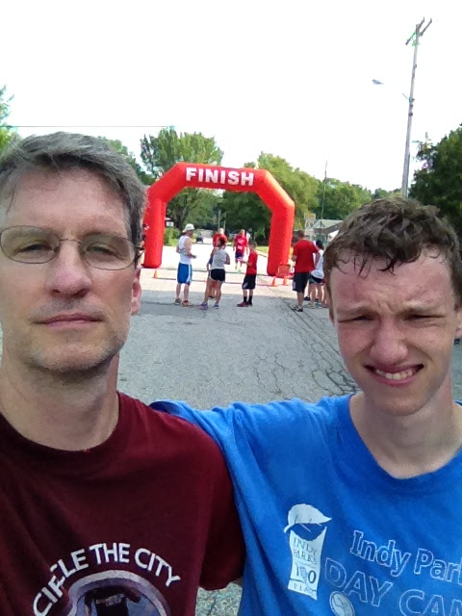

Slide 51
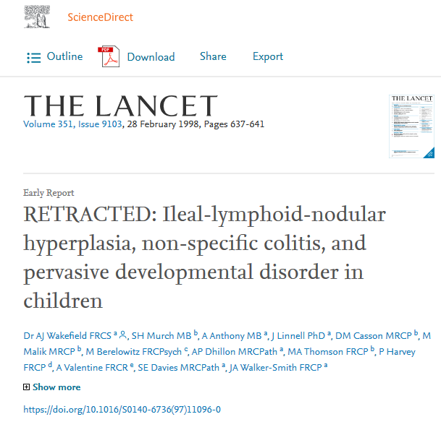
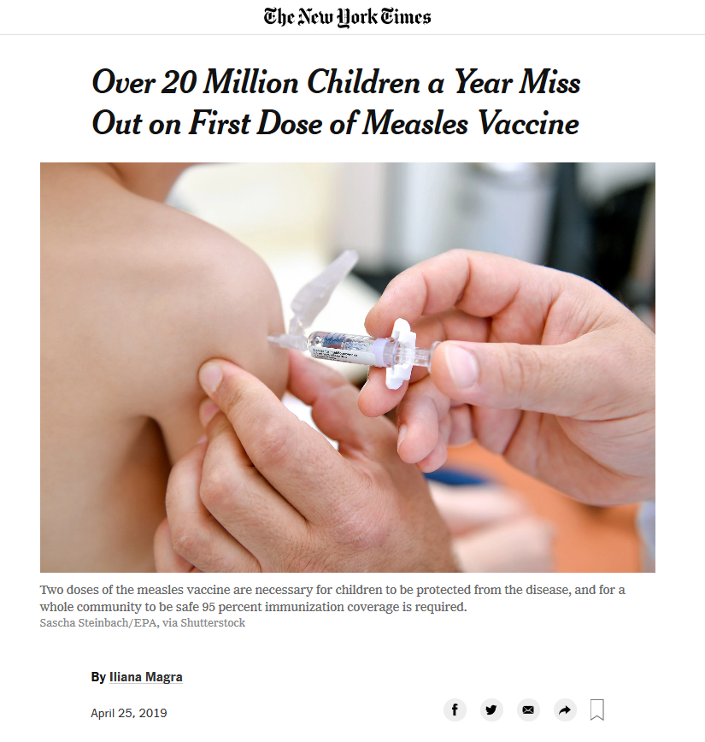
“The Lancet is the world's leading independent general medical journal ….”

Slide 52
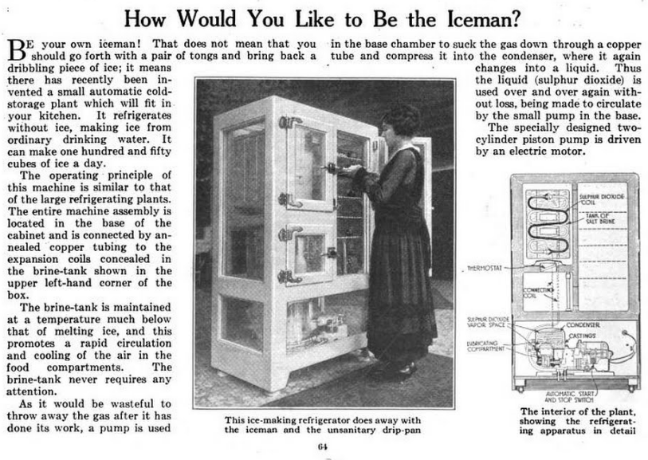
“No longer the abjected ‘refrigerator mother,’ today’s ‘autism mom’ is supposed to be a child-saving hero, …. The discourse, however, remains one of covert parental guilt: if your child becomes an autistic adult, it’s your fault because you failed to do enough to save him or her.”
Waltz, M. M. (2015). Mothers and Autism: The Evolution of a Discourse of Blame. AMA Journal of Ethics, 17(4), 353–358. https://doi.org/10.1001/journalofethics.2015.17.4.mhst1-1504.
https://en.wikipedia.org/wiki/File:Early_household_refrigerator_in_Popular_Science_1919.png

Slide 53
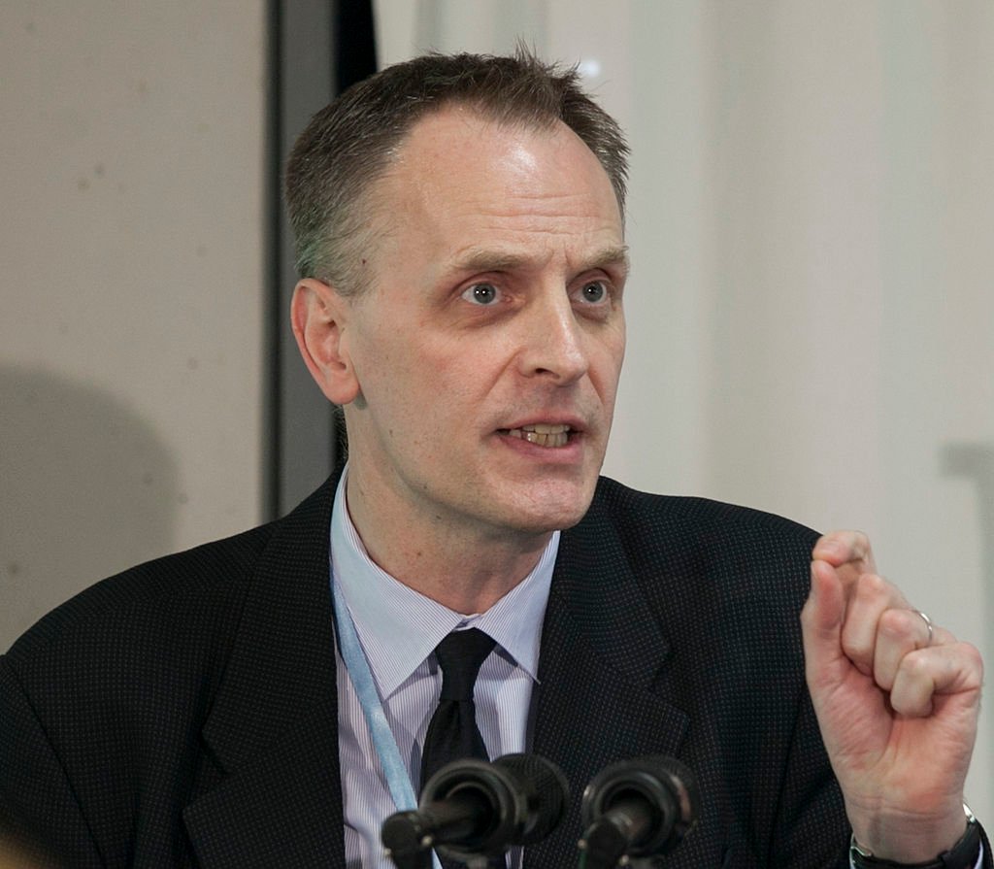
“I do not regret publishing the original Wakefield paper. …. I worked at the Royal Free from 1988 to 1990 and met him on many occasions. He is a committed, engaging, and charismatic clinician and scientist. He asks big questions about diseases - what are their ultimate causes? - and his ambition often brings quick and impressive results.”
    -- Horton, R. C. (2003). Second opinion: doctors, diseases and decisions in modern medicine. London: Granta Books.
Richard Horton, editor-in-chief of The Lancet
“I don't know whether they are strong enough to withstand the tailwinds behind Plan S or visions that seek to eliminate primary research from journals entirely. I believe … The Lancet stands for something important, something worth protecting and strengthening.”
      -- Horton, R. (2018). Offline: The future of scientific knowledge. The Lancet, 392(10162), 2337. https://doi.org/10.1016/S0140-6736(18)33039-3
https://en.wikipedia.org/wiki/Richard_Horton_(editor)#/media/File:Dr._Richard_Horton,_Editor_in_Chief,_the_Lancet_(cropped).jpg

Slide 55
Miranda Gabbard, Bioethics3-40. CC BY
https://www.flickr.com/photos/mgabbie450/8711106721/in/album-72157633376956112/

Slide 56
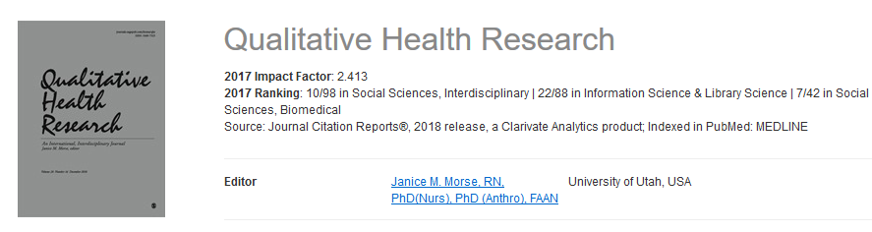

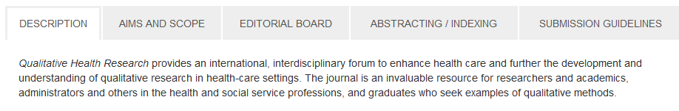

Slide 57
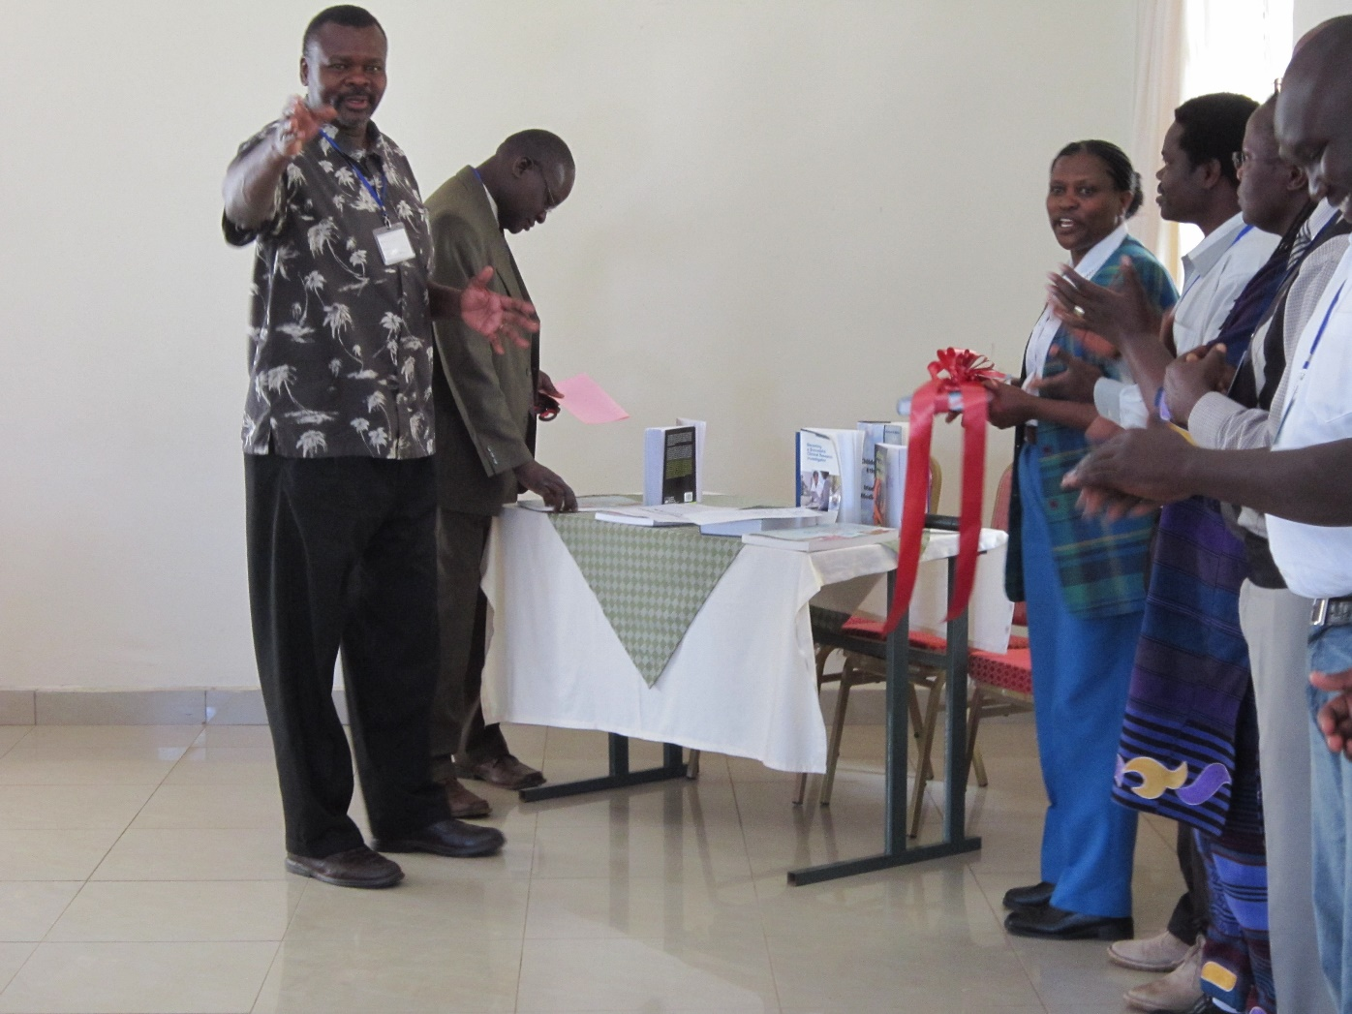
Photo used with permission from Indiana University Center for Bioethics

Slide 58
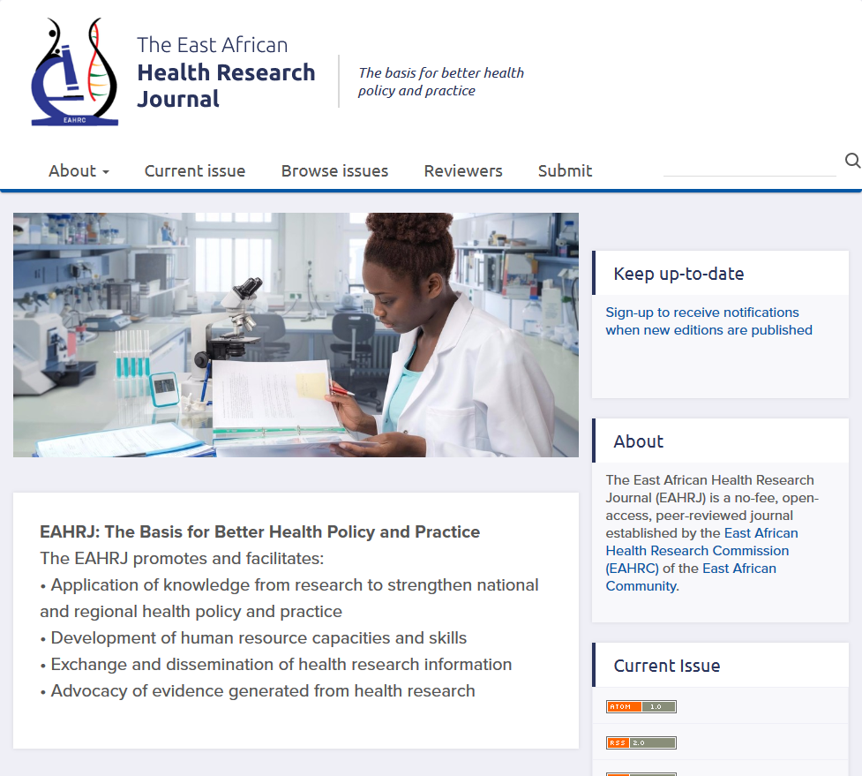

Slide 59
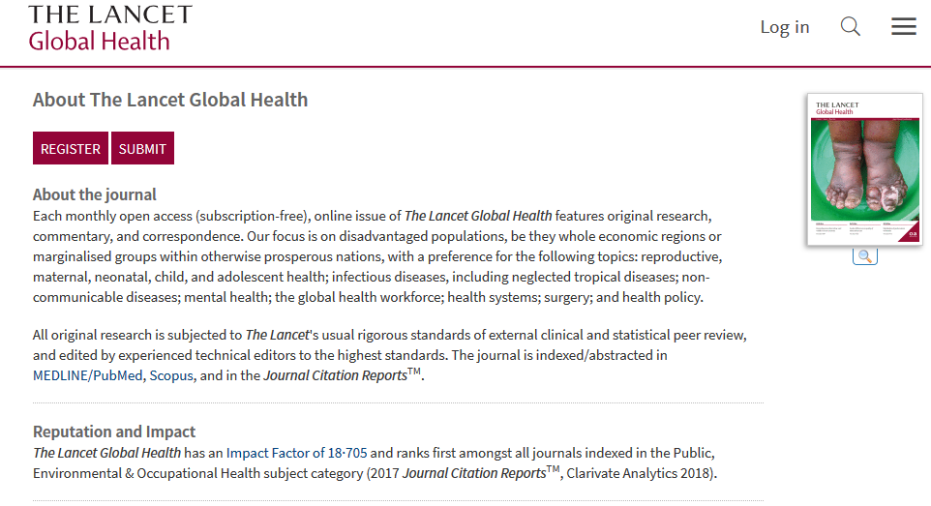
$5,000.00 APC

Slide 60
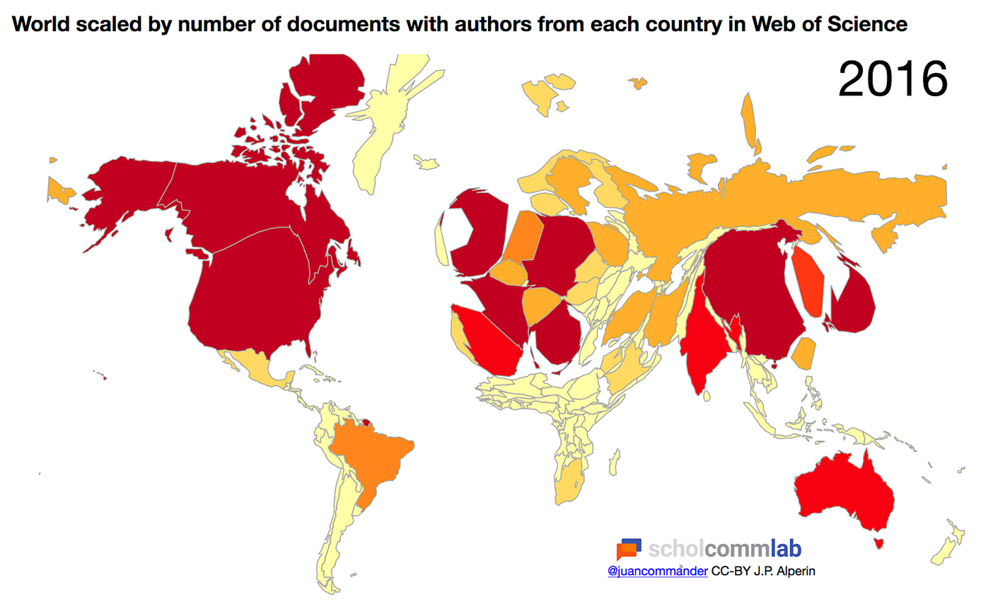
“SciELO and Redalcy …, despite the fact that both services are open-access. Many North American scholars have never even heard of these meta-publishers or the journals they aggregate. Their content is largely hidden, the neighborhood remote and unfamiliar.”
“Thus, commercial publisher platforms are nice neighborhoods for scholarly publications. On the other hand, some open-access platforms are more like publication favelas.” -- J.B.
https://blog.scielo.org/en/2015/08/02/motion-to-repudiate-mr-jeffrey-bealls-classist-attack-on-scielo/

Slide 61
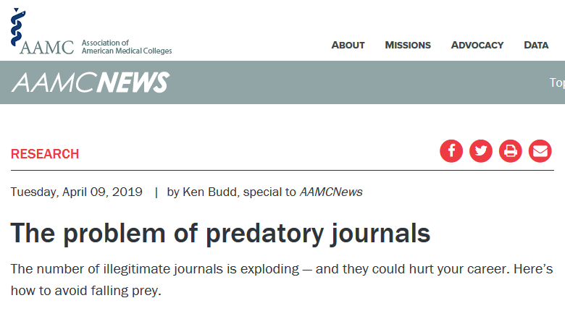
Eroding science
Open access could soon become more prevalent. For example, in September 2018, 11 agencies that award around $8.8 billion in annual research grants announced that they would require the scientists they fund to make their papers free to read upon publication, starting in 2020. The initiative, called Plan S, comes from funders in 11 different European countries.

Slide 62
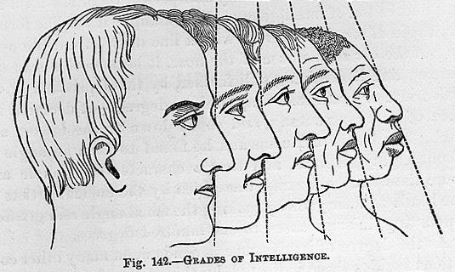
Evidence-based decisions?
Seiberth, S., Yoshioka, J., & Smith, D. (2017). Measuring Prejudice: Race Sciences of the 18-19th Centuries. Retrieved from: http://scalar.usc.edu/works/measuring-prejudice/
Notes:
The “evidence” for what is and what is not a “predatory” journal relies on a data set (B.’s list) that was informed by suspicion and prejudice.

Slide 63
Meanwhile … Is this an “exploding” problem?
IUPUI Articles 2017 (excluding Medicine)
Trusted? | Items
Yes | 1080 (98.3%)
No (appears to be disreputable) | 14 (1.3%)
Maybe | 5 (.5%)
Total | 1099
Journal requires APC and makes false claims about indexing, etc.
No evidence of dishonesty, but below threshold for “trusted” (e.g., not in the DOAJ)

Slide 64
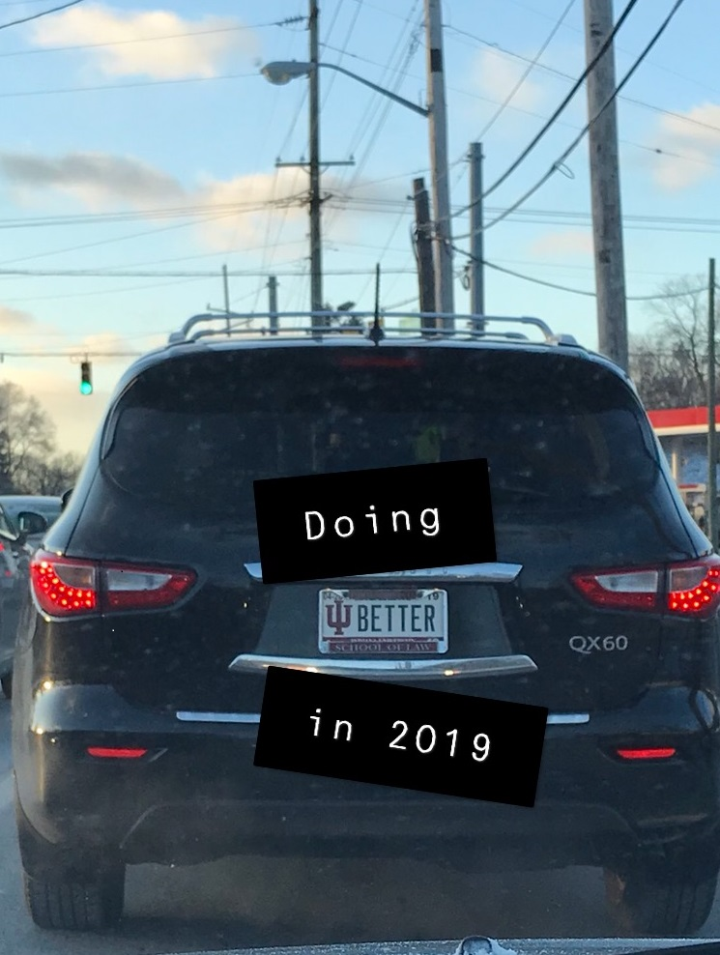
In what ways does our work build and limit the well-being of our communities?
Where do we invest our money, expertise, and time?
Some things to consider doing a little better in 2019:
Stop using the phrase “predatory journals”
Begin divesting from the reputation economy
Invest a bit more of your budget in open & equitable infrastructure
Build global & diverse collections
Hire a diverse workforce
Stop doing free- or conflicted-labor for corporate publishers (boards, focus groups, product testing, editing, reviewing, ….)
Be up front about the flaws of the impact factor and other journal ranking systems
Intentionally read and cite authors beyond your comfort zone
Make your own work open & reward your colleagues for doing the same
Image by Hannah Craven, CC-BY

Slide 65

“We can best help you prevent war not by repeating your words and following your methods but by finding new words and creating new methods ... not by joining your society but by remaining outside your society ….” Virginia Woolf, Three Guineas. pg. 143
Questions?
Jere Odell
jdodell@iupui.edu
Image by Brocco. CC BY NC SA
https://it.wikipedia.org/wiki/File:Virginia_Woolf_(4)-2.jpg

Slide 66
References
Alperin, J. P. (2018, September 8). World scaled by number of documents with authors from each country in Web of Science: 2016. https://doi.org/10.6084/m9.figshare.7064771.v1
Budd, K. (2019, April 9). The problem of predatory journals. AAMCNews. Retrieved from https://news.aamc.org/research/article/problem-predatory-journals
Callaway, E. (2016). Beat it, impact factor! Publishing elite turns against controversial metric. Nature News, 535(7611), 210. https://doi.org/10.1038/nature.2016.20224
Guédon, J.-C. (2017, March 17). Open Access: Toward the Internet of the Mind. Retrieved from https://www.budapestopenaccessinitiative.org/boai15/Untitleddocument.docx
Haug, C. J. (2019). No Free Lunch — What Price Plan S for Scientific Publishing? New England Journal of Medicine, 380(12), 1181–1185. https://doi.org/10.1056/NEJMms1900864
Horton, R. (2018). Offline: The future of scientific knowledge. The Lancet, 392(10162), 2337. https://doi.org/10.1016/S0140-6736(18)33039-3
Leung, P. T. M., Macdonald, E. M., Stanbrook, M. B., Dhalla, I. A., & Juurlink, D. N. (2017). A 1980 Letter on the Risk of Opioid Addiction. New England Journal of Medicine, 376(22), 2194–2195. https://doi.org/10.1056/NEJMc1700150
Magra, I. (2019, April 26). Over 20 Million Children a Year Miss Out on First Dose of Measles Vaccine. The New York Times. Retrieved from https://www.nytimes.com/2019/04/25/world/europe/children-measles-vaccine.html
Motion to repudiate Mr. Jeffrey Beall’s classist attack on SciELO. (2015, August 2). Retrieved April 26, 2019, from SciELO in Perspective: https://web.archive.org/web/20190405102043/https://blog.scielo.org/en/2015/08/02/motion-to-repudiate-mr-jeffrey-bealls-classist-attack-on-scielo/
Raju, R. (2018, February 7). Predatory publishing from a global south perspective. Retrieved April 5, 2019, from Library Publishing Coalition Blog: https://librarypublishing.org/predatory-publishing-global-south-perspective/
Roh, C. (2018). Scholarly Communication in a Time of Change: Considering the Impact of Bias, Diversity, and Traditional Publishing Structures as Scholarly Communication Moves to New Platforms and Systems (Talk Transcript). Presented at the California Academic Research Libraries. Retrieved from https://works.bepress.com/charlotteroh/43/
Seiberth, S., Yoshioka, J., & Smith, D. (2017). Measuring Prejudice: Race Sciences of the 18-19th Centuries. Retrieved from: http://scalar.usc.edu/works/measuring-prejudice/
Waltz, M. M. (2015). Mothers and Autism: The Evolution of a Discourse of Blame. AMA Journal of Ethics, 17(4), 353–358. https://doi.org/10.1001/journalofethics.2015.17.4.mhst1-1504.
Woolf, V. (1938). Three guineas. New York: Harcourt, Brace and Co.
Zhang, S. (2017, June 2). The One-Paragraph Letter From 1980 That Fueled the Opioid Crisis. The Atlantic. Retrieved from https://www.theatlantic.com/health/archive/2017/06/nejm-letter-opioids/528840/

Slide 67


Consumer Health Information Justice
Beth St. Jean, Associate Professor
Gagan Jindal, Doctoral Candidate
Yuting Liao, Doctoral Candidate
“Of all the forms of inequality, injustice in health is the most shocking and the most inhuman because it often results
in physical death.” (Dr. Martin Luther King, Jr., 1966)
MLA ‘19 Annual Meeting
May 5, 2019

Slide 68
Outline
Introduction
  Consumer Health Information Behavior (CHIB)
  Health Justice
  CHIB Health Justice
  Health Literacy / Disparities in Health Literacy
Study 1: Is Ignorance Really Bliss?: Exploring the Interrelationships Among Information Avoidance, Health Literacy and Health Justice (St. Jean, Jindal, & Liao, 2017)
Study 2: Factors motivating, demotivating, or impeding information seeking and use by people with type 2 diabetes: A call to work toward preventing, identifying, and addressing incognizance (St. Jean, 2017)
CHIB Model of Health (In)Justice
Future Work

Slide 69
Introduction

Slide 70
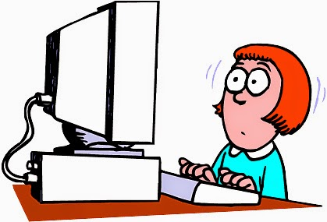
Consumer Health Information Behavior (CHIB)
Umbrella term encompassing people’s health-related information needs and the activities in which they engage (or not) in order to seek, assess, manage, use, etc. health-related information.
Information Needs
Information Seeking
Information Avoidance
Information Management
Information Assessment
Information Sharing
Information Use
Information Non-Use
…..
Information
Verb

Slide 71

Health Justice
Every individual is morally entitled to “a sufficient and equitable capability to be healthy” (Venkatapuram, 2011, p. 20).
But we’re not there…
  Life expectancy is positively correlated with income
    40-year-old men in top 1% income bracket live 15 years longer than those in bottom 1% (87.3 vs. 72.7)
    For women: 10 years longer (88.9 vs. 78.8)
    These gaps grew between 2001 and 2014 (Chetty et al., 2016)
  And with educational attainment and race
    Whites with ≥ 16 years of education by age 25 live 10(f) to 14(m) years longer than Blacks with < 12 years of educ.
    These gaps have widened over time (Olshansky et al., 2012)
Source: MLSA

Slide 72
Individual Factors
(e.g., income, race, educational attainment, health literacy, self-efficacy, computer/Internet access/use, social support)
Health Trajectory / Quality of Life / Health Outcomes
CHIB?

Slide 73

Health Literacy
“The degree to which individuals have the capacity to obtain, process, and understand basic health information and services needed to make appropriate health care decisions” (Ratzan & Parker, 2000)
Health literacy is a multi-faceted construct:
  Reading ability (IOM, 2004)
  Health-related knowledge (IOM, 2004)
  Critical thinking (Ormshaw et al., 2013)
  Communication skills (Ormshaw et al., 2013)
  Numeracy (NN/LM, 2014)
  Visual literacy (NN/LM, 2014)
  Media literacy (Norman & Skinner, 2006)
  Computer literacy (Norman & Skinner, 2006)
  Motivation and self-efficacy (Nutbeam, 1996)
Source: Linkedin

Slide 74
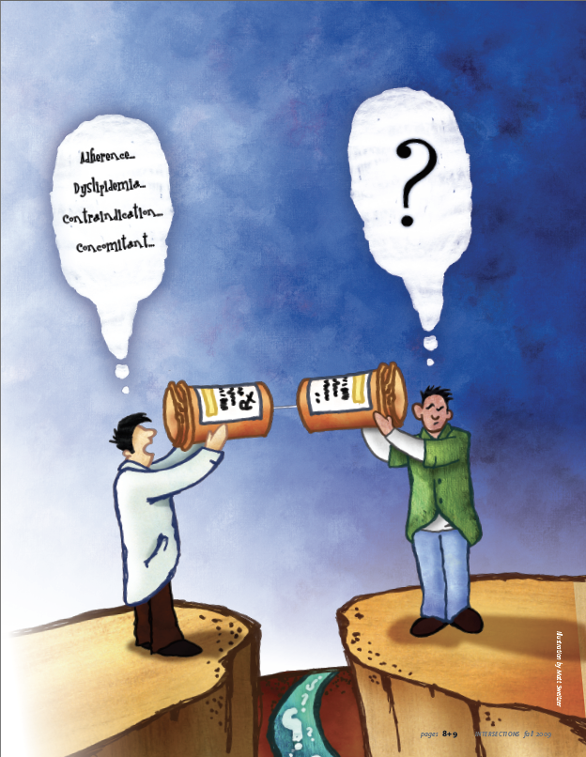
Disparities in Health Literacy
Nearly 90% of U.S. adults have a below-proficient level of health literacy (Kutner et al., 2006)
Low health literacy levels are more prevalent among older, minority, immigrant, and low-income populations (NN/LM, 2014)
People with low health literacy are more likely to have poor health outcomes (Baker et al., 2007; IOM, 2004; Schillinger et al., 2002)
Disparities in health literacy have contributed to health inequities and
to the lack of health justice in the U.S.
Source: ASHP Intersections
Health literacy is a stronger predictor of one’s health than
one’s age, race,
educational attainment, employment status,
and income
(Weiss, 2007)

Slide 75
Study 1: Is Ignorance Really Bliss?:
Exploring the Interrelationships Among Information Avoidance, Health Literacy and Health Justice (St. Jean, Jindal, & Liao, 2017)

Slide 76
Study 1: Is Ignorance Really Bliss?
Research Questions:
  RQ1: How prevalent is information avoidance among U.S. adults?
  RQ2: What types of demographic, information-seeking, cognitive/perceptual, and social factors are associated with information avoidance?

Slide 77

Information Avoidance
Many people cope with illness by seeking out information
However, some individuals prefer
to avoid health information to:
  Maintain or increase their uncertainty (Brashers et al., 2000; Case et al., 2005);
  Control their anxiety (Pifalo et al., 1997);
  Maintain hope (Brashers et al., 2000)
Information avoidance can result from,
and result in, low health literacy
The relationship between
information avoidance and health literacy remains largely unexplored
Source: eLearning Mind

Slide 78

Methods
Secondary data analysis
  U.S. National Cancer Institute’s (NCI) 2014 Health Information National Trends Survey (HINTS)
  HINTS 4 Cycle 4 SPSS data set (https://hints.cancer.gov/)
  Final n = 3,677 (34.6%)
  Data Collection period: 8-11/2014
  Data Analysis: Cross-tabs;
  Chi-square tests of independence

Slide 79
Participants
N = 3,677
Gender:
  60% F (n = 2,184)
  40% M (n = 1,424)
Age: 18-98 [M (SD) = 51.9 (21.17)]
Race/Ethnicity:
  60% Non-Hispanic White
  17% Hispanic
  16% Non-Hispanic Black/African-American
  7% Other

Slide 80
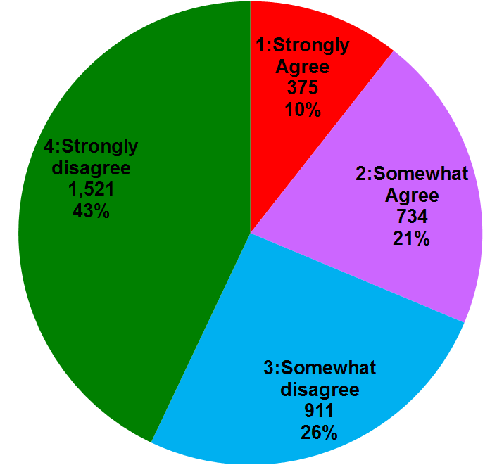
Findings: Prevalence of Info. Avoidance
  How much do you agree or disagree with this statement:
  “I'd rather not know my chance of getting cancer”?
“Information Avoiders”:
1,109/3,541 (31.3%)

Slide 81
Findings: Demographic Differences
Older age
Lower educational attainment
Lower household income
Unemployed, disabled, retired
(vs. employed, homemakers, or students)
No health care coverage

Slide 82
Findings: Demographic Differences - Age

Slide 83
Findings: Demographic Differences - Education

Slide 84
Findings: Demographic Differences: HH Income

Slide 85
Additional Factors Correlated with Information Avoidance
Never go online
No broadband access
No tablet, smartphone
No health apps
Not used Internet re: cancer
Never looked for health information from any source
Encounter barriers if did seek cancer information:
  Search took a lot of effort
  Felt frustrated during the search
  Information was hard to understand
  Concerned about info. quality
Less trust toward doctors, government health agencies, and the Internet
Lower health- & information-related self-efficacy
Report less social support
  No regular healthcare provider
  No friends/family they can talk to about their health
Feel more fatalistic
  Health behaviors don’t matter
  Limited control over weight/smoking
  Quitting smoking won’t help
  “It seems like everything causes cancer”

Slide 86
Study 2: Factors motivating, demotivating, or impeding information seeking and use by people with type 2 diabetes: A call to work toward preventing, identifying, and addressing incognizance
(St. Jean, 2017)

Slide 87
Study 2: Factors motivating, demotivating, or impeding information seeking and use by people with type 2 diabetes
Research Questions:
  RQ1: What are the factors that motivate or impede information seeking and use by this population?
  RQ2: What are the information needs and information seeking and use practices of this population?
  RQ3: What sources and types of diabetes-related information do these individuals find useful?

Slide 88
Recruitment
Recruited 34 adults who recently:
  Were diagnosed with type 2 diabetes
  Began insulin for this condition
  Developed a diabetes-related complication
Recruitment Methods:
  Flyers
  Online ad
  Diabetes-related support groups

Slide 89
Methods
< 12 months
4 to 6 months
Time
Diagnosis/
Exacerbation
Initial Interview
(< 12 months)
Follow-up Interview
(5 to 18 months)
Background Questionnaire
Semi-Structured Interview
Health Condition Questionnaire
Card-Sorting Exercises
Semi-Structured Interview
Timeline
Health Condition Questionnaire
Card-Sorting Exercises

Slide 90
Study Participants
Factor | Participant Distribution
Gender | Male: 14 (41%) Female: 20 (59%)
Age | Range: 32 to 81; Mean: 53.4 Majority (n=29; 85%) between 40 and 69
Educational Attainment | Some college or lower: 17 (50%) 2-year college degree or higher: 17 (50%)
Computer/ Internet | Computer/Internet access at home: 26 (75%) Do not use Internet at all: 5 (15%)
Type 2 Diabetes | Diagnosis date range: 1980 to 2010 Majority (n=19; 56%) diagnosed in 2009 or 2010 Twelve (35%) had had diabetes > 5 years
A1C Test | Range: 5.6 to 14.0; Mean₁: 7.8; Mean₂: 7.3

Slide 91
CHIB Model of Health (In)Justice

Slide 92
Individual Factors:
Demographics
  Older age
  Less education
  Lower HHI
  Unemployed, disabled, or retired
  No health coverage
Computer/Internet access and use
  Do not use Internet
  Do not own tablet, smartphone, basic cell phone
Low self-efficacy
Limited health/
information/digital literacy
Less likely to look for health information
Have encountered barriers during any prior health-related information seeking
Less trust toward health information sources (doctors, Internet, and government agencies)
Less social support
Prefer non-collaborative decision-making
Feel more fatalistic
CHIB Model of Health (In)justice
2. CHIB PROCESS:
3. Health Trajectory / Quality of Life /
Health Outcomes
Incognizance
Information Need Identification / Articulation
Information Seeking
(or avoidance)
Information
Comprehension / Assessment / Management
Information Incorporation / Adaptation / Use (or non-use)
4. SITUATION/CONTEXT: RESOURCES & OPPORTUNITIES / LIMITATIONS & BARRIERS

Slide 93
1. Individual Factors
Demographics
  Older age
  Less education
  Lower HHI
  Unemployed, disabled, or retired
  No health coverage
Computer/
Internet access and use
  Do not use Internet
  Do not own tablet, smartphone, basic cell phone
Lower health & info. self-efficacy
Limited health/
information/
digital literacy
Less likely to look for health information
Encountered barriers during health-related information seeking
Less trust in
some sources
of health info.
Doctors
Internet
Govt. agencies
Less social support
Prefer non-collaborative decision-making
Feel more fatalistic

Slide 94
Barriers: Physical Limitations
“I wish I did this more often but I don’t learn about the side effects. I try to read the label, but God, it’s small print!” (I13)
“I like to pick up health tips and I’m not much of a reader anymore because my eyes are bothering me and I shake and I can’t concentrate or remember what I read. I hate that crap. So that’s the way to do it for me, just listen, keep my ears open.” (I22)

Slide 95
Barriers: Resource Limitations
“That's my problem that I have, I don't have enough money. After I pay my bills, I pay my rent, my lights, my gas… The phone and, of course, cable. [chuckle] The cable is more important than medication. It’s my medication, you know?” (I26)
“How do I find out about diabetes without having a computer?” (I26)
“[My doctor] tried to send me to… [diabetes-related] classes. They were like once a week, I think, but I didn’t have the transportation or the gas money to go that far… every week.” (I26)

Slide 96
Barriers: Fatalism
“I feel like this, I'm 63. I'm not going to live forever. If I want a chocolate cookie, I'm going to eat the damn thing and I'll take some more insulin for it…. It don't help the A1C, but I'm going to eat it anyway… We all got to go sometime. I'd just as well go with a chocolate cookie in my mouth!” (I05)

Slide 97
Barriers: Mistrust toward Government
“We can’t really rely on the folks that is getting paid to help you because if they getting paid because you’re disabled, they’re not going to help you become… undisabled because that’s their paycheck… It’s a multi-billion, trillion dollar disease. I don’t know if the government would want you to have a cure for diabetes. There is so much money, pharmaceutically, to be made on diabetics.” (I22)

Slide 98
Barriers: Mistrust toward Doctors
“A lot of people… don’t take their medicine consistently on time… because they don’t feel there’s any consequences. And they don’t believe the doctor that gives it to them. They don’t trust them or believe in them” (I27)
“I don't even think doctors have malicious intent. I just think that they're just misinformed, miseducated, because pharmaceutical companies give them their education… All they know is what they've been taught.” (I20)

Slide 99
Barriers: Shame, Blame, and Stigma (1)
“I was so ashamed of having diabetes. I really didn't want anyone to know… I did something to cause this, you know. If I had been promiscuous or something like that and got a venereal disease, “Okay, yeah, I did this.” But I mean, I was like, ‘What did I do?’” (I17)

Slide 100
Barriers: Shame, Blame, and Stigma (2)
“The attitudes of family and people in the community… I mean, sometimes I think… that cancer has more support with it than either mental illness or diabetes. You know, that there's more a rallying... by the community… The only thing I can see is lung cancer, you know, if you smoke and that... then it's your fault if you get lung cancer. But other kinds of cancers, it's not considered your fault… You got it [diabetes], you don’t have much support for having it, and so why bother?” (I27)

Slide 101
2. CHIB Process
Info. Incorp. / Adapt. / Use
(or non-use)
Incog-nizance
Info. Need Identif. / Articulation
Info. Seeking (or avoidance)
Info.
Comp. / Assess. / Mgmt.

Slide 102
Barriers: Incognizance (1)
“I was naïve about it…
I thought it was just like… you take a pill, it solves the problem… So I didn’t have any need to know. I didn’t think I had a need to know.” (I32)
“I was always thirsty… That should’ve rang a bell in my mind, but it didn’t… It just didn’t dawn on me that maybe there was a problem.” (I01)
“You don’t understand the symptoms of high blood sugar or blurry eyes, going to the bathroom. You don’t connect to that, you’re not a doctor, you know?” (I06)

Slide 103
Barriers: Incognizance (2)
“At first… people were giving me things… ‘Here, you need to read this’… I wasn’t convinced that I needed it.” (I32)
“I didn’t know I needed to know until I found out something.” (I32)

Slide 104
Fear as Motivator of Information Seeking to Overcome Incognizance
“At first, I feared the diabetes, now I fear what I don’t know about the diabetes. It’s kind of a shift. And that’s, I think, why I’m motivated to read information about it and learn about it, because there may be something I don’t know. And the reason I feel that way is because I’m finding there are a lot of things I don’t know… What else is out there I don’t know?” (I06)

Slide 105
Barriers: Not Actively Seeking Information
“I don’t look for it, but when it’s there, I take it. I use it…. Whatever he (interviewee’s doctor) wants me to know, he’ll tell me.” (I05)
“I don’t really go looking for [diabetes-related information]… I mean, I’ll get a question every now and again but… Like, say I’m in a store and I see a little brochure that says, ‘Do you have diabetes?’ and it asks questions and stuff. Then I like to start reading it and see if it’s something I want to know about.” (I15)

Slide 106
Barriers: Unaware of Information Sources
“There’s no problem with motivation [to look for diabetes-related information], but it’s where to get the information.” (I06)
“Maybe she [interviewee’s daughter] could find out what I was really supposed to eat. There are all these people always saying to me, ‘You know, you’re supposed to eat healthy.’ Okay, what is healthy?” (I26)

Slide 107
Barriers: Difficulties Accessing Information
“Nurses and doctors… They’re busy all the time and every time you try to ask them, they’re in the middle of something… They’re running here, running there… It’s not like you get to sit down and have a chat.” (I21)
“I wish there would have been more of a package that you got… ‘Congratulations. Here’s your diabetes starter information kit’… Something that had multiple parts to it, not just ‘Here’s a drug and we’ll see you in three months.’” (I34)

Slide 108
Barriers: Difficulty Finding Information
“Government agency Websites. I’m on Medicare now and there’s nothing more convoluted than a government Website, but I had to go there.” (I14)
“I had trouble finding the answer and I’m the queen of searching. Plus, I’m an MD and I still couldn’t necessarily get the answer that was right…” (I11)

Slide 109
Difficulty Finding Personally Relevant Information
“When I was first diagnosed… there was a diabetes education program but it was… mostly, not all, but mostly a one-way information dissemination kind of process, rather than [an] interactive process based upon my particular circumstances.” (I29)
“When you’re on the road driving a truck, how can you eat six little meals a day? You can’t… You have to eat when it’s possible.” (I05)

Slide 110
Barriers: Difficulty Understanding Information
“Doctors give you all these big-old, long words about what’s wrong with you.” (I20)
“The information on the American Diabetes Association is written above the education level… of most people that would be searching.” (I11)
“I’m not saying that the doctors are lying to you, but they give it to you sometimes in such a way that you don’t understand it real crystal clear.” (I21)

Slide 111
Barriers: Difficulty Assessing Information (1)
“I figure when I put it in that search engine, I’m more likely to get the most up-to-date, refreshed information… Not always the case… A lot of times you’re led to stale Websites with old information.” (I14)
“Find a third, fourth, or fifth [website]. See which one is more accurate… And if neither one of them are, go somewhere else.” (I10)
“Like the way that you tell there's something that can be trusted is you look at the original, keep trying to find the original.” (I20)

Slide 112
Barriers: Difficulty Assessing Information (2)
“If you’re not a healthcare practitioner, you’re just Johnny Joe Layman out there, I think there’s too much out there. If you’re reading too much, you can really get confused… And I think that’s the danger about it.” (I33)
“Sort out conflicting information. That’s a lot of work. I probably wouldn’t go to that effort.” (I32)

Slide 113
Barriers: Information Non-Use
“My doctor has told me … that I should exercise more. So that was useful…
It’s not like I take her advice.” (I26)
“A lot of stuff I did know, I just didn’t do it or really make a conscious effort.” (I35)
“Learn what I can do to improve my health… probably often I do that. Whether I actually follow the advice or not… Not as often as I look it up.” (I34)

Slide 114
Future Work
We are conducting further work to build on this model by incorporating:
  Selected components of other information behavior models.
  Findings from additional empirical studies of CHIB.
  An additional class of influencing variables – characteristics of the information/sources that people consult, but as they interact with characteristics of the individual.

Slide 115

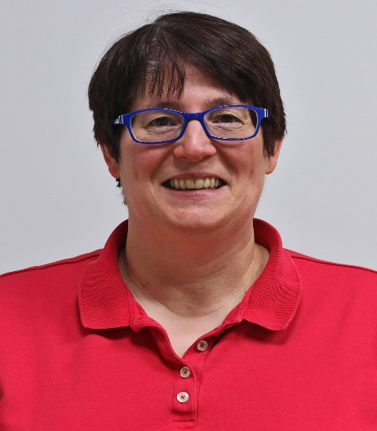
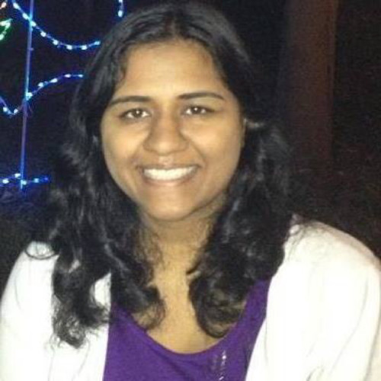

Contact Information
Beth St. Jean, PhD, Associate Professor
bstjean@umd.edu
Gagan Jindal, MPH, Doctoral Candidate
gjindal@termpmail.umd.edu
Yuting Liao, MA, Doctoral Candidate yliao598@terpmail.umd.edu

Slide 116
1. Individual Factors:
Demographics
Socioeconomic factors
Physical factors
Experiential factors
Knowledge/Skills
Beliefs/Perceptions
Emotions/Attitudes
Personality/Coping style/ Information orientation
Preferences/Values/
Goals/Priorities
Social factors
3. CHIB PROCESS:
Incognizance
Information Need Identification / Articulation
Information Seeking
(or avoidance)
Information
Comprehension / Assessment / Management
Information Incorporation / Adaptation / Use (or non-use)
4. Health Trajectory / Quality of Life /
Health Outcomes
2. Information/Source Factors:
Everyday exposure
Awareness
Serendipity
Perceived accessibility
Perceived convenience
Perceived usability/Ease of use
Prior use/experiences
Perceived topical & situational relevance
Perceived cognitive relevance
Perceived affective relevance
Perceived accuracy/
comprehensiveness
Perceived credibility/trustworthiness
Persuasiveness
Currency
Novelty
Perceived Fit/Relatability
Perceived similarity to self
Recommended by trusted other(s)?
Perceived social presence
Matches pre-existing beliefs?
Perceived usefulness
Perceived as actionable, given one’s present situation?
========== 5. SITUATION/CONTEXT: RESOURCES & OPPORTUNITIES / LIMITATIONS & BARRIERS ===========

