Slide 1
Induction of Fetal Demise Before Abortion
Alexandra Mahdasian-Miller, MD
PGY-2
Family Planning, April-May 2021
Notes:
Hi there everyone, I’m Allie Mahdasian, I’m one of the second year residents and I’ve had the privilege to rotate on Family Planning during April and May. First of all thanks to everyone who has joined to listen today as well as a big thank you to Tina, Dr. Stutsman, Dr. Bernard and everyone else who works tirelessly to make this rotation so fruitful and educational for the residents. It is such a privilege to take care of this patient population and I am excited to talk to you all today about something that I had the opportunity to witness and be a part of on two separate occasions during my rotation. My talk today will be a discussion of induction of fetal demise before abortion.

Slide 2
Objectives
Discuss feticide and role in abortion planning
Review methods of feticide
Procedure consent & steps
Explore pharmacologic agents
Notes:
To discuss the role of feticide and why patients and providers may choose to include it within their abortion planning.
To review historic, as well as current methods of feticide
We will discuss the general risks, informed consent and steps to the procedure.
Finally, we will touch on the specific pharmacologic agents utilized in modern iatrogenic demise, including the doses, routes, risks and most recent data.

Slide 3
Induced abortion is the second most commonly performed procedure in reproductive aged women
Over the past three decades, multiple modalities for induction of demise prior to procedures have been studied
  This is termed “feticide” in the literature
  This has been used prior to both second-trimester abortion as well as nonselective/selective fetal reduction
Notes:
Induced abortion is the second most commonly performed procedure in reproductive aged women, second only to cesarean section. There are multiple settings in which induction of demise is preferred, which we will discuss throughout this presentation. But, over the years and especially over the past three decades, induction of fetal demise has been studied in response to the rise of advances in infertility medicine, specifically IVF, legislation restricting abortion provision and most recently, specifically in response to federal legislation banning “partial birth abortion”, which we will further discuss in the next few slides. Induced fetal demise, or feticide as it is referred to in the literature, refers any technique, route or agent that is performed, utilized or carried out on the fetus or its environment in order to cause asystole or cessation of cardiac activity. This can be used as an adjunct to termination of pregnancy after the first trimester or for selective/nonselective reduction of one or more fetuses in a multiple gestation. The purpose of this discussion will revolve around these specific indications and methods of iatrogenic feticide, not on the subsequent procedures (for example induction termination or D&E)

Slide 4
Language
Abortion
Feticide
Multifetal Reduction
Selective Reduction
Notes:
As we have talked about multiple times in previous presentations on this rotation, grand rounds, etc. Language and its correct usage is imperative when discussing this topic (amongst many topics in our profession) in order to appropriately relay the clinical setting for which procedures are being utilized. Abortion is defined by medical dictionaries as expulsion from the uterus of an embryo or fetus prior to viability. This can occur spontaneously or be induced. Feticide is defined as the destruction of the embryo or fetus in the uterus independently of gestational age and is not determinative whether the uterus is emptied. Multifetal reduction is the process to induce fetal demise of one or more fetuses’ in a multifetal gestation in order to improve pregnancy outcomes in the setting of higher order multiples. Selective reduction is induction of fetal demise of one or more fetuses’ with fetal abnormalities in a multifetal pregnancy.

Slide 5
Reasoning
Gonzalez v. Carhart
  Affirmation of the Partial-Birth Abortion Ban Act of 2003
  The Act is defined as “deliberately and intentionally delivering a living fetus until the entire fetal head is outside the body of the mother or any part of the fetal trunk past the navel is outside the body of the mother for the purpose of performing an overt act that the person knows will kill the partially delivered living fetus” and
  “performs the overt act, other than completion of delivery, that kills the partially delivered living fetus…”
Notes:
Opposition to abortion has been prevalent for a long time, but the discussion surrounding routine use or at least routine discussion of feticidal injection began in 2003-2004 with the passage of federal legislation regarding second-trimester abortion techniques. With new legislation, feticidal injections began to be adopted more regularly by 2T surgical abortion providers as a way to ensure that their documentation and practice adhered to the newest legal requirements. Gonzalez vs. Carhart was a Supreme Court case that took place in April of 2007, which upheld the partial-birth abortion ban act of 2003. Obviously, as has been mentioned by multiple previous presentations, the inflammatory language is evident in the legislation. Nowhere in medical literature is this terminology used, however, this ban makes illegal a “partial-birth abortion” which is, as stated above, ***. This law was timed in response to a form 2T abortion mostly utilized at 20-24wks termed a dilation and extraction, a procedure which, at its peak of use, still only made up 0.03-0.05% of all abortion where the provider attempted to remove the fetus intact. However, this verbiage gained traction and became a sticking point throughout the 90s and early 2000s, culminating in this “partial birth abortion ban act”, which is quoted above.
Therefore, by electing to use an agent with established feticidal properties at a dose and by a route that have been established to ensure cardiac asystole in most cases, there is no intention of performing the banned abortion procedure. The law itself is vague and therefore leaves some room for interpretation and therefore ethicist advise that requirement of induction of demise should be left up to the clinician.
This decision explicitly permits a “standard D&E”, which includes multiple passes with the use of extracting forceps.

Slide 6
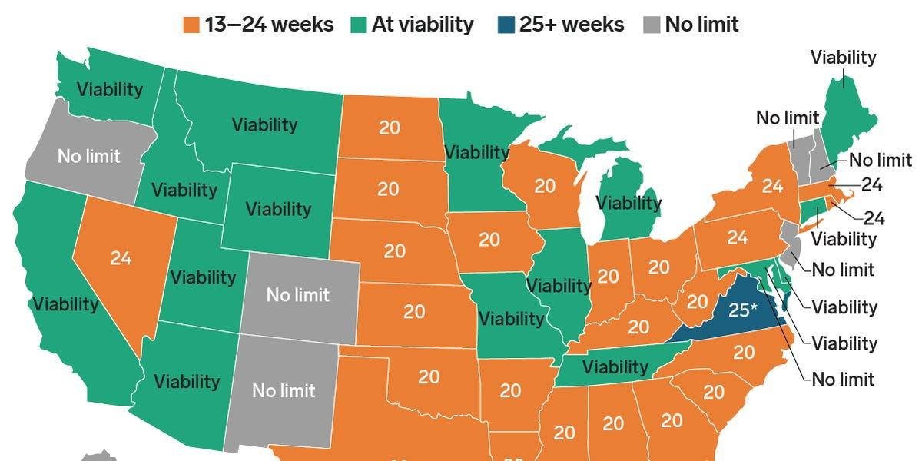
Reasoning
**Procedural Timing**
Notes:
Continuing in the vein of legal reasoning, feticide is utilized by providers in an effort to quote “stop the clock” in states where there is a limit imposed on patient’s access to procedural termination. By enacting iatrogenic fetal demise, time is lengthened through weekends, holidays, prior scheduling conflicts, etc. to ensure that patient’s receive the care that they require with an appropriately trained 2T abortion provider.

Slide 7
Reasoning
Use for multifetal reduction, selective reduction
Prior to induction termination/D&E
Patient preference
Concern of fetal pain?
Notes:
Outside of legal reasoning, a commonly reported use of feticide is utilization for selective reduction and multifetal reduction.
There is a role prior to induction termination, in order to prevent the possibility of a fetus being born alive. Data shows that patients and members of the medical care team tend to prefer to avoid delivery of a nonviable fetus with signs of life when the original intent was pregnancy termination. This tends to arise more commonly when multiple days of osmotic dilators are used and labor occurs prior to D&E procedure or in an induction abortion that was not preceded by the use of a feticidal agent.
Some patients prefer to have an induced demise prior to a procedure. This preference is difficult to assess due to influence by counseling, education as well as patient belief that this preference is more socially acceptable.
Some policies in different states that restrict access to abortion care at more advanced gestational ages have been based on the concept of fetal pain. Obviously, the study of this is difficult, as study interpretation of fetal pain is rudimentary and typically based on assumptions of peripheral sensation transmission to thalamocortical pathways that then transmit pain signals to the brain. This assumes higher cortical functioning, with a high enough central development that these neuron transmission can then be interpreted as pain signals. The gestational age at which neural maturation is developed is unclear, however, systematic reviews of the newest available evidence states that fetal pain perception is unlikely before 29 weeks of gestation.
***AVOIDING THE MEDICAL, ETHICAL AND EMOTIONAL CONSEQUENCES OF SIGNS OF LIFE AT THE TIME OF DELIVERY IS A WIDELY RECOGNIZED BENEFIT OF FETAL DEMISE BEFORE INDUCTION TERMINATION***

Slide 8
Benefit?
Questionable decrease in induction-to-abortion time
Use in placenta previa for bleeding
Notes:
Single RCT comparing feticide to placebo evaluated intra-amniotic digoxin and utilized procedure duration as a proxy for ease of D&E. With 1mg of intra-amniotic digoxin, there was no difference in procedure time or physician-reported case difficulty. There was also no difference in EBL, pain scores or complications, however, this study was not powered to determine whether there was a difference in these outcomes.
The use of feticidal agent at the time of dilator placement has been reported to promote cervical ripening and fetal maceration. The 2001 case series of 1677 late second-trimester abortions employed intrafetal digoxin administered 2-3 days prior to D&E.. There was a report of SUBJECTIVE softening of products of conception and the study had only three major complications (0.2%) and minor complication rate was 6%.
There has also been some discussion surrounding the potential for utilization of feticide to reduce blood loss in terminations. A small retrospective chart review of a subset of women with complete placenta previa undergoing 2T induction termination suggested that using a feticidal agent reduces blood loss. Of women who terminated their pregnancies, the first 9 cases did not receive a feticidal agent and the last 6 received intracardiac KCl to induce demise. Hemorrhage was defined as blood loss requiring transfusion. There was no statistically significant difference in the number of patients with hemorrhage but a secondary analysis comparing hemoglobin levels demonstrated that blood loss may be lower in at least a subset of women whose induction terminations are preceded by feticide. However this would require much more rigorous study.

Slide 9
In short…
NO evidence currently supports the use of induced fetal demise to increase the safety of second-trimester medical or surgical abortion

Slide 10
Methods
Mechanical
Sclerotic (outdated)
Pharmacologic
Umbilical Cord Transection
Notes:
There have been multiple methods of feticide utilized since the early 1980s, the first successful selective termination was documented in 1978 by Aberg et al. in 1978 by method of intracardiac puncture.

Slide 11
Mechanical Methods
Cardiac puncture
Air embolization
Less commonly used:
  Hysterotomy
  fetoscopic cord ligation/transection
  intrafunic steel coil placement
  gestational sac aspiration
Notes:
Mechanical Methods:
Cardiac puncture with exsanguination. This method requires an excessive amount of skill to induce injury, while also keeping the patient comfortable.
Air embolization is efficacious, though it has been remarked by those who have utilized this method that the air can cause significant artifact on ultrasound, thus making it difficult to identify and confirm asystole.
Less commonly used methods that have really only been utilized in single case studies or limited case series are demise via hysterotomy, fetoscopic cord ligation with transection, intrafunic steel coil placement and gestational sac aspiration. These are so infrequently used that even finding the specifics or protocols for me to remark further upon that was not feasible.

Slide 12
Sclerotic
Adhesive/occlusive agents
Described in case reports, single case series
Not recommended: technical difficulty, demise in 48% of attempts
Notes:
Sclerotic methods of induced demise are mostly outdated and not recommended or utilized by many practitioners due to the inconsistent success rate. Though sclerotic means of demise were described, in the case series of 12 women cited by the Society of Family Planning, only 48% of attempted cases were successful in achieving demise. The agents utilized included ethanol and enbucrilate intrafunically and intrahepatically.

Slide 13
Pharmacologic
Hypertonic saline, hyperosmolar urea, calcium gluconate
Potassium chloride
Digoxin
Lidocaine
Notes:
Chemical injections to pharmacologically induce demise are the most frequently studied methods as well as the most commonly used methods for inducing fetal demise. Hypertonic saline has been studied but has been associated with DIC, hemorrhage and electrolyte abnormalities when used for induction terminations and has been associated in some instances with failure to achieve demise.
KCl was first described to induce demise in 1988 and since then has been used in thousands of case studies at different doses, routes and techniques. Asystole is typically reported within minutes. In the US, KCl is used generally by specialists in infertility and MFM.
Digoxin was utilized beginning in the 1980s with various techniques and routes without any reported major feticide-related complication and without clinically significant maternal cardiac events.
Lidocaine has been used to achieve fetal asystole and is utilized here at IU. We will discuss this in depth further on in this presentation. In even the most recent literature, there has only been limited studies, so this can really be considered “cutting edge”.
As of now, no randomized trials compare modalities of inducing demise.

Slide 14
Umbilical Cord Transection
Transection at the beginning or during procedure
Eliminates risks/complications of secondary procedures
High success rates
Notes:
Transecting the umbilical cord at the beginning/during procedure and awaiting cessation of fetal cardiac activity is a potential technique to eliminate concern of violation of the Partial-Birth Abortion Ban Act of 2003, which applies only when the fetus has cardiac activity. This was first described in 1972. A 2013 case series reviewed 407 cases in which this method was reviewed to determine success, time to fetal asystole and complications.

Slide 15
Requirements
Informed consent
Skilled practitioner
Appropriate ultrasound equipment
Medication/Instruments necessary to complete procedure
Notes:
This slide may seem obvious or self-explanatory, but in order to provide an appropriate setting for any of these procedures to occur, all of these pre-requisites must be met. The patient must be willing and have an understanding of the procedure and have given their informed consent. There must be a skilled practitioner, which typically includes either a FP trained abortion provider or an infertility/MFM practitioner. We will dive into what roles different specialists play and how their skill sets contribute to different methods of these procedures during this presentation. There must be appropriate ultrasound equipment, either transabdominal or transvaginal and correlating equipment to complete the procedure depending on the practitioners comfort. And finally, whatever medication (we will focus specifically on KCl, Digoxin and Lidocaine pharmacologic agents) or other instruments that may be utilized to perform the procedure.

Slide 16
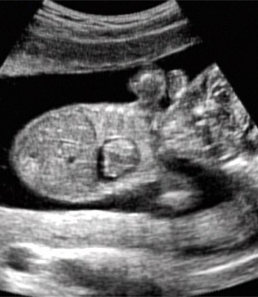
Procedure Equipment
Sterile equipment
Local anesthetic
25-30 gauge needle
18-22 gauge spinal needle with 10-20 mL syringe
Digoxin, KCl, Lidocaine 1%
Sterile saline flushes
Notes:
This slide is just a list of what should be obtained prior to starting the procedure. Sterile gloves, drape and antiseptic solution to clean the abdomen for needle injection. Local anesthetic for maternal abdominal wall injection. Typically 1% lidocaine is utilized. Small gauge needle for local injection administration. An 18-22 gauge spinal needle with appropriate sized syringe. Whatever pharmacologic agent that will be utilized for the injection, either digoxin, KCl or lidocaine. And finally sterile saline flushes.
This image is obviously not in real time but demonstrates asystole with a concomitant pericardial effusion, likely from saline injection to confirm intracardiac placement.

Slide 17
Informed Consent
Maternal discomfort
Rupture of membranes
Preterm Labor
Infection
Failure
Prolonged time to demise (particularly with digoxin)
Demise of other fetuses
Severe maternal risks: allergic reaction, cardiac arrhythmia, seizures, death

Slide 18
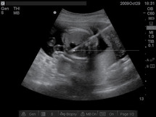
Intra-cardiac Injection Steps
Inject local
Spinal needle directed into the fetal heart
Aspiration to confirm intracardiac placement
Injection of sterile saline
Injection of feticidal agent
**All performed under ultrasound guidance
Notes:
Inject local (typically lidocaine)
Spinal needle insertion directed into the fetal heart
Aspiration to confirm intracardiac placement, may or may not aspirate ventricular blood
Injection of sterile saline, turbulence noted in LV suggestive of correct placement
Injection of feticidal agent

Slide 19
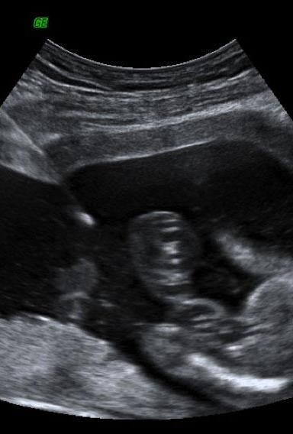
Intra-amniotic Injection Steps
+/- local anesthetic
Spinal needle placed into amniotic cavity
Aspiration of amniotic fluid
Injection of feticidal agent
**All performed under direct sonographic visualization
Notes:
+/- local anesthetic into maternal abdominal wall
Spinal needle passed into amniotic cavity
Aspiration of amniotic fluid
Injection of feticidal agent into amniotic sac

Slide 20
Transvaginal Injection Steps
Place speculum
Vaginal preparation
Paracervical block
Amniocentesis needle placed
Complete procedure
Notes:
Unlike transabdominal injection, the needle and syringe is connected prior to starting
Speculum is placed in usual fashion
Injection site is cleansed with betadine, hibiclens, etc
Paracervical block is performed at junction of the anterior cervicovaginal fold in the midline
Amnio needle is injected under US guidance at 45 degree angle for 0.5cm and then adjusted parallel to the axis of the cervix. The needle is advanced through the cervical stroma and into the uterus. For intra-amniotic placement, aspiration of a few mL of amniotic fluid for placement confirmation. For intra-fetal placement, US is used to confirm needle positioning
Medication then injected

Slide 21
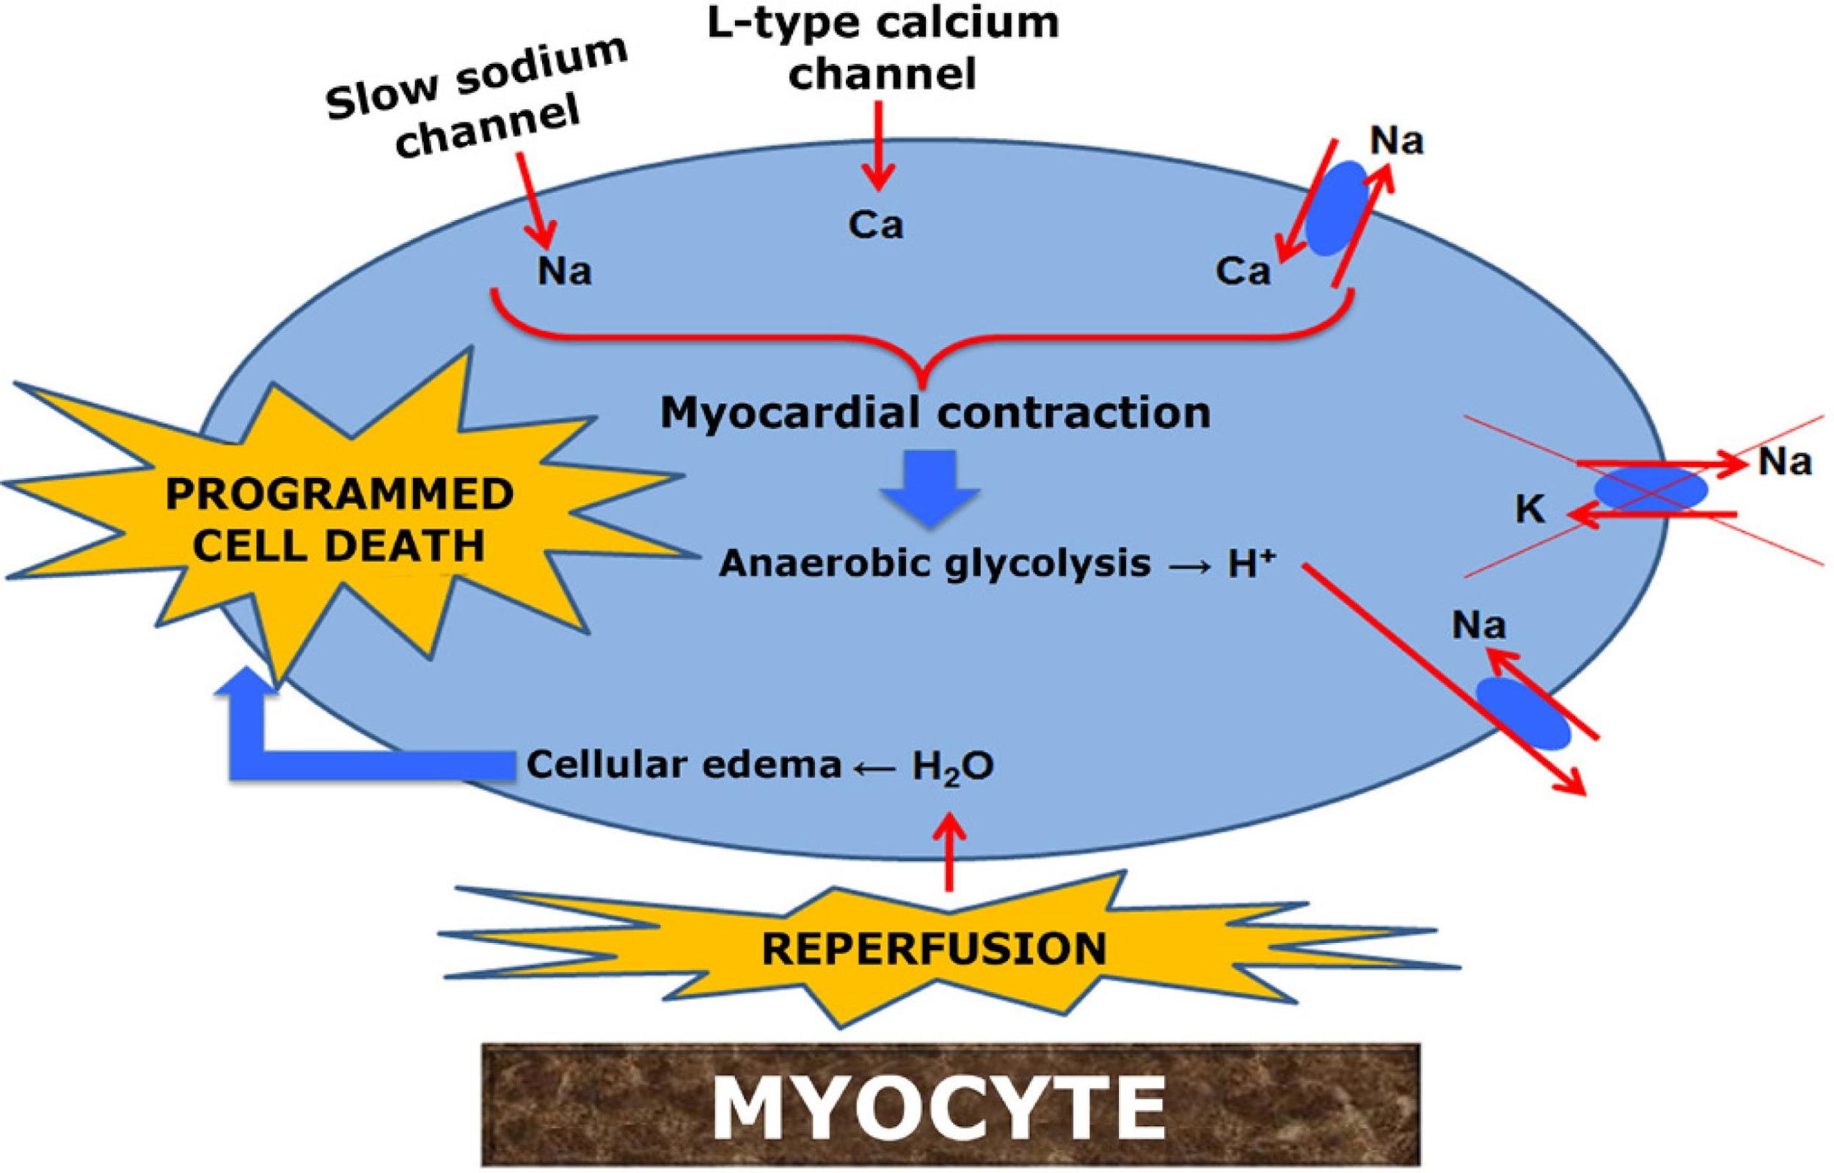
Potassium Chloride
Decreases conduction of action potentials in cardiac myocytes
2-3 mL until asystole
Notes:
KCl achieves its effect by disrupting the balance of intra- and extracellular potassium ions, decreasing the conduction of action potentials in cardiac myocytes, thus leading to bradycardia and eventually, to asystole. Because it must be administered by intracardiac injection for maximum effect on the myocardium, KCl injection requires more technical skill than intra-fetal or intra-amniotic digoxin injection. However, KCl can also be injected into the umbilical vein. In the largest series that described KCl for feticide, 239 LV injections between 17-24 weeks were 100% successful and all took </= 5 minutes to perform. There are three small series involving KCl injections into the umbilical veins with success rates from 87-100%.
The most common technique of KCl administration is via transabdominal intracardiac injection performed under US guidance. Concentrated KCl (2 mEq/mL) is injected in aliquots of 2-3 mL until asystole is observed for 2-5 minutes. KCl may be injected in increments of 5 mL over a number of minutes. Typically, a total of 6-10 mEq is required. Thus far, no RCTs compare routes of administration, though there is a large retrospective review that compares transabdominal and transcervical procedures. The comparison focused on delivery rates and there was little reported regarding the feticidal injection itself.

Slide 22
Side Effects/Complications
Intracardiac- no maternal complications
Intra-umbilical- no maternal effects
Single case report of maternal cardiac arrest
Notes:
In the largest set of case series of 239 intracardiac KCl injections, there is no report of maternal complications. In three series of patients who underwent intra-umbilical vein administration of KCl, there was no report of changes in postprocedural maternal electrocardiograms, potassium concentrations or other adverse maternal outcomes. There is one case of maternal cardiac arrest during an attempted intracardiac KCl injection. The etiology was thought to be maternal absorption of KCl when the needle passed through the fetus and into the maternal uterus and pelvis.

Slide 23
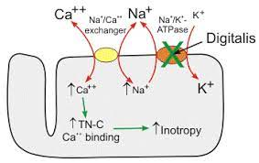
Digoxin
Inhibits sodium-potassium ATPase, eventually leading to AV block
Intra-amniotic, intracardiac, intra-fetal, intrafunic
1-2mg with good efficacy
Notes:
Digoxin functions by inhibiting the sodium-potassium ATPase, which regulates sodium and calcium concentrations indirectly. This increases cardiac contractility and eventually leads to AV block. The original use was in a large case series in tandem with hyperosmolar urea. Digoxin can be given via intra-amniotic injection or intra-fetal injection and therefore requires less skill than intracardiac or intra-funic placements. There is an option for intrafunic injection as well. Intra-amniotic injections are the easiest procedures technically, however have a higher failure rate than intracardiac injection or intrafetal injection. Intracardiac can be given at 1mg. Intra-amniotic digoxin injections tend to be performed 1-2 days prior to abortion as asystole is typically not immediate as it is in the cases of KCl and lidocaine. Intrafetal injections are typically 2mg however doses of even 1mg have been reported as extremely effective at inducing demise with a minimum of reported side effects. These injections can be done transabdominally as well as trans-vaginally at the time of dilator placement. The failure rate of digoxin administered intrafetally is <10%, whereas intra-amniotic administration failure rates range from 8-31%.

Slide 24
Digoxin injection considerations
CI to digoxin for cardiac conditions:
  Hypersensitivity/allergy
  Hx of ventricular tachycardia or fibrillation, idiopathic hypertrophic subaortic stenosis, constrictive pericarditis, amyloid disease, 2nd/3rd degree heart block, WPW syndrome + atrial fibrillation
  Chronic renal failure
  Use of meds that impact digoxin clearance
  Known bleeding disorder

Slide 25
Side effects of Digoxin
Vomiting
No noted rhythm or conduction abnormalities
Maternal digoxin concentrations low therapeutic
Coagulation studies normal
Notes:
In a double-blinded RCT, 16% of women receiving 1mg of intra-amniotic digoxin injection vs. 3% of plaebo experienced vomiting. This has not been described with either intra-fetal digoxin or KCl. In one prospective study, 8 patients between 19-23 weeks received 1mg of digoxin intra-amniotically had serial serum digoxin levels drawn for 48 hours along with holter monitoring and serial coagulation labs. There were no noted rhythm or conduction abnormalities, the peak digoxin concentration was in the low therapeutic range and coagulation studies remained in the normal range.
In

Slide 26
Lidocaine
High concentrations cause cardiac arrest
Non-toxic dose lowers risk profile
Notes:
Lidocaine functions by prolonging the inactivation of fast voltage-gated sodium channels, raising the depolarization threshold, making the heart less likely to initiate action potentials. It is utilized to treat arrhythmias, but when given in toxic quantities, leads to cardiac arrest. Effective and rapid cessation of fetal heart activity has been reported with lidocaine amount below the maternal toxic dose and there is no known maternal contraindication for fetal intra-cardiac lidocaine. In most cases, the lidocaine dose used for fetal demise is 20mL of 1% lidocaine or less. Given the non-toxic dose of lidocaine used, the risk profile of lidocaine compared with KCl is much lower, even in the event of inadvertent maternal injection. In case reports of accidental direct maternal injection of 2.8-4.2 mg/kg lidocaine were reported without any adverse effect. A recent study demonstrated a 95% success rate at achieving asystole. This was consistent with the few other studies that have been done, which demonstrate 92-98% success. Lidocaine may be injected intracardiac or intrafetal, with intracardiac more effective but technically more difficult.

Slide 27
Side Effects/Complications
No maternal side effects
Notes:
Thus far, there are no

Slide 28
Citations
Denny CC, Baron MB, Lederle L, Drey EA, Kerns JL. Induction of fetal demise before pregnancy termination: practices of family planning providers. Contraception. 2015;92(3):241-245.
Diedrich J, Drey E; Society of Family Planning. Induction of fetal demise before abortion. Contraception. 2010 Jun;81(6):462-73.
Drey EA, Thomas LJ, Benowitz NL, Goldschlager N, Darney PD. Safety of intra-amniotic digoxin administration before late second-trimester abortion by dilation and evacuation. Am J Obstet Gynecol. 2000 May;182(5):1063-6.
Isada NB, Pryde PG, Johnson MP, Hallak M, Blessed WB, Evans MI. Fetal intracardiac potassium chloride injection to avoid the hopeless resuscitation of an abnormal abortus: I. Clinical issues. Obstet Gynecol. 1992 Aug;80(2):296-9. PMID: 1635748.
López-Cepero R, Lynch L, de la Vega A. Effectiveness and safety of lidocaine in the induction of fetal cardiac asystole for second trimester pregnany termination. Bol Asoc Med P R. 2013;105(1):14-7. PMID: 23767379.
Second-trimester abortion. Practice Bulletin No. 135. American College of Obstetricians and Gynecologists. Obstet Gynecol 2013;121:1394–1406.
Senat MV, Fischer C, Bernard JP, Ville Y. The use of lidocaine for fetocide in late termination of pregnancy. BJOG. 2003 Mar;110(3):296-300. PMID: 12628271.
Sharvit M, Klein Z, Silber M, Pomeranz M, Agizim R, Schonman R, Fishman A. Intra-amniotic digoxin for feticide between 21 and 30 weeks of gestation: a prospective study. BJOG. 2019 Jun;126(7):885-889. doi: 10.1111/1471-0528.15640. Epub 2019 Mar 12. PMID: 30703286.
Tocce K, Leach KK, Sheeder JL, Nielson K, Teal SB. Umbilical cord transection to induce fetal demise prior to second-trimester D&E abortion. Contraception. 2013 Dec;88(6):712-6.
Tolu LB, Tufa TH, Abas F, Kahn C, MacAfee L, Prager S, Bell JD. Intra-cardiac lidocaine administration to induce fetal demise before late second-trimester abortion: Retrospective review. Int J Gynaecol Obstet. 2021 Apr;153(1):125-129.
Tufa TH, Prager S, Lavelanet AF, Kim C. Drugs used to induce fetal demise prior to abortion: a systematic review. Contracept X. 2020 Nov 9;2:100046.

