Slide 1


Library: Using VR to Enhance Anatomy Education for Medical Imaging Learners
  Chelsea Misquith M.I.
  Emerging Technologies Librarian
  Ruth Lilly Medical Library
  Debra Patterson M.S., R.T.(R)(MR)(CT)
  Assistant Professor of Clinical and Imaging Sciences Programs
  Department of Radiology and Imaging Sciences

Slide 2
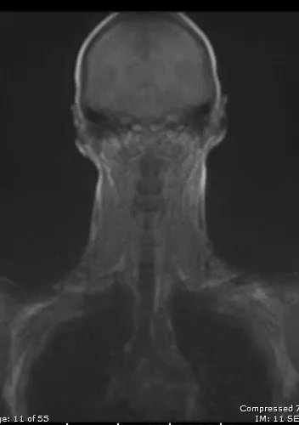
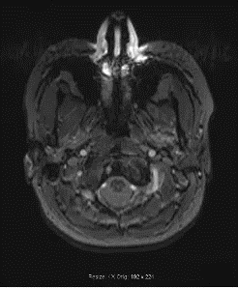
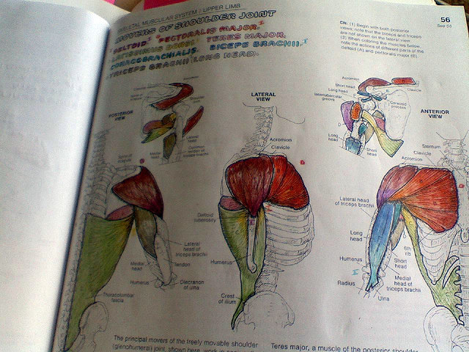
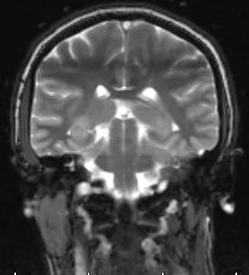
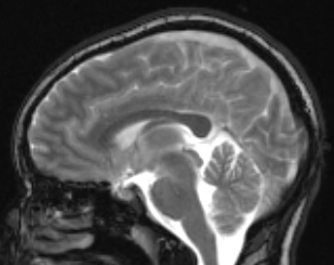
Introduction: VR in Medical Imaging
Undergraduate medical imaging students:
  Bone Densitometry (BD)
  Cardiac Interventional (CI)
  Computed Tomography (CT)
  Nuclear Medicine (NMT)
  Magnetic Resonance Imaging (MRI)
  Mammography (M)
  Vascular Interventional (VI)
  Limited interaction & retention
Still Images
Cine Images
Textbook
Notes:
My curricular focus and research pertains to undergraduate medical imaging students in the following modalities. Traditionally, my students have learned anatomy through didactic lectures and a textbook (pic 1). Throughout the years, educators have added modality-specific anatomical images (Pic 2). More recently, we have added cine images (pic 3 then Pic 4) to enhance both anatomical knowledge and function. All of these strategies have served a purpose, but allow for limited interaction and retention of knowledge.
To enhance anatomy education and allow for increased interaction, knowledge retention, and ownership of learning, I found the Ruth Lilly Medical Library NEXUS Lab. In collaboration with Chelsea, we explored the possibility of adding virtual reality to 4 of the 7 modality students I oversee in the Medical Imaging Technology Program. CT, NMT, MRI, and VI. After reviewing VR anatomy environments, we chose to go forward in using 3D Organgon Anatomy as our VR platform.
Chelsea will now tell you about the Ruth Lilly NEXUS Lab.

Slide 3
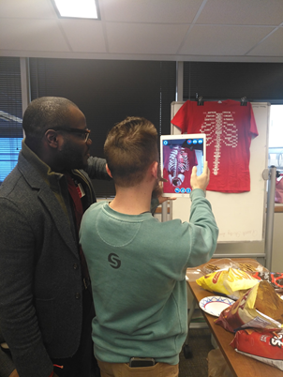
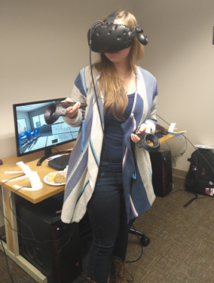
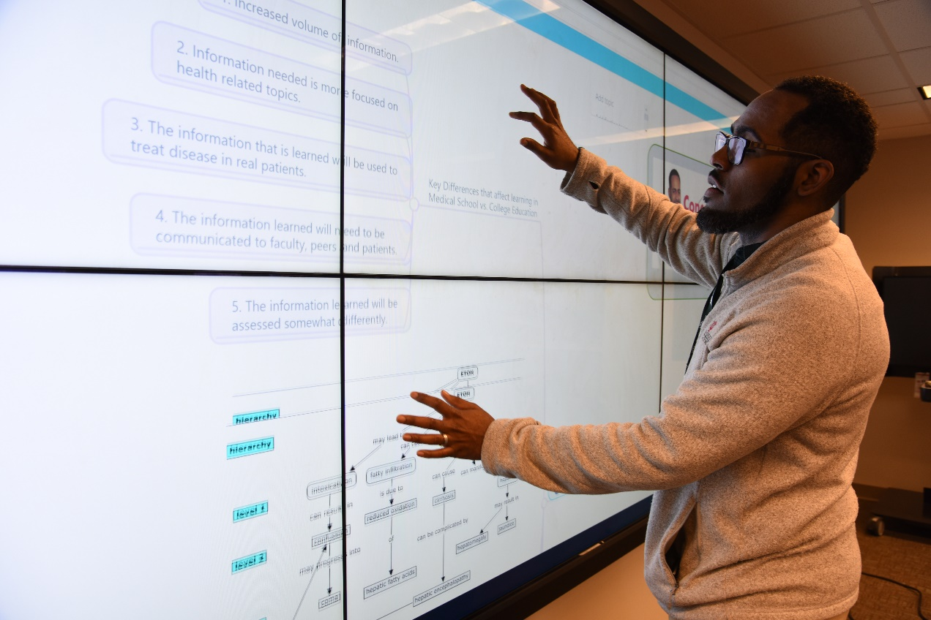
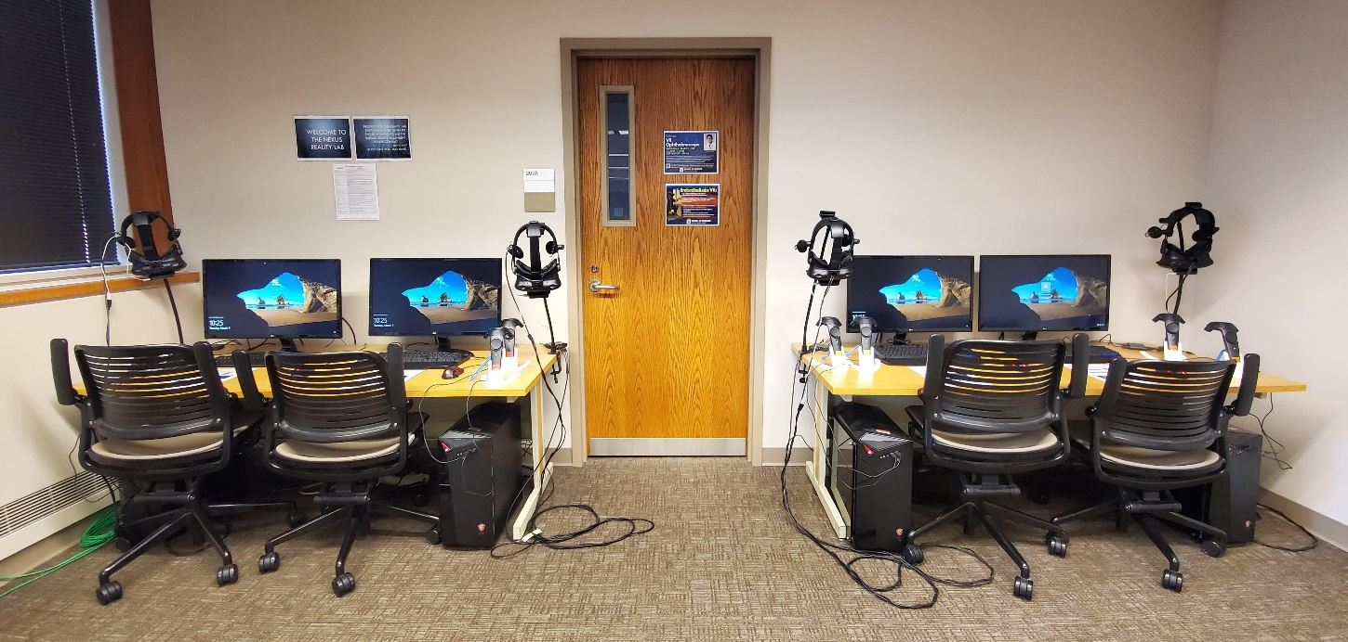
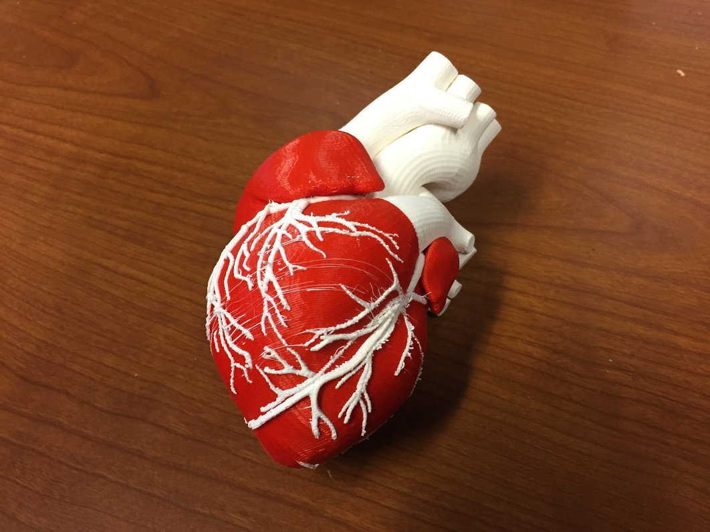
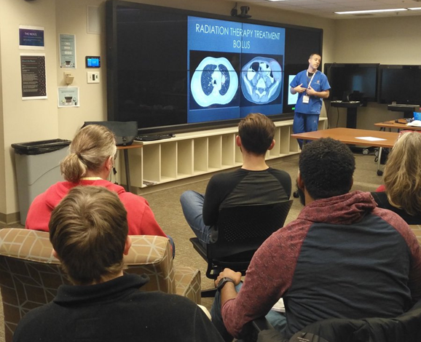
VR at the Medical Library
Nexus Collaborative Learning Lab, IB 207
24/7 access for students, on demand for faculty and staff
Services:
4 HTC Vive headsets and stations
Touch-enabled IQ-Wall with Solstice
3D Printing Service
TechTalks and classes/events
Google Cardboard and Virtuali-Tee
AR shirt
Notes:
The Nexus Collaborative Learning Lab is located on the second floor of the Ruth Lilly Medical Library. All students at the IU School of Medicine have 24/7 access to the space with their Crimson Cards – faculty and staff affiliated with the School can request this access if they wish. Anyone affiliated with the IU School of Medicine has access to the services offered in the Nexus at no charge.
Services include:
4 HTC Vive headsets and stations – multiple VR apps available, including 3D Organon VR (for anatomy) and EmbodiedLabs VR (program that allows the user to virtually experience and better understand various patient perspectives)
Giant touch-enabled IQ- Visualization Wall with Solstice, which is an app that allows for desktop screens to be projected for a better learning experience
3D Printing Service – print in PLA plastic and resin options
TechTalks and classes/events throughout the year
Google Cardboard and Virtuali-Tee AR shirt – these can be checked out from the library and used with apps downloaded on your smartphone

Slide 4
Development of VR Labs
VR Lab Student Structure
  First cohort: 19 students from CT, NMT, MRI & VI (6 pairs/1 triad)
Familiarity (1/19)
VR Lab Content Structure
  Learn
  Interact
  Enjoy
  Accountable
Lab 1: While in the 3D Organon VR Anatomy program, go to the body system where you would expect to find the external jugular vein.
Once you have located this anatomy answer the following questions:
a. The EJV:
i. runs on the _____ side of the _____.
ii. arises from the _____.
iii. receives tributaries from the _______, ______, and _______.
iv. empties into the: _______
Notes:
In creating the VR lab groups, Chelsea and I decided to divide the 1st cohort of 19 students from CT, NMT, MRI, and VI into 6 pairs and 1 triad. This was done to facilitate interaction, collaboration and safety in the VR environment.
Prior to the 1st VR lab, we found that only 1 out of the 19 students had minimal VR experience. All 19 students were excited about the prospect of using VR in anatomy education and felt it would enhance their learning.
We sought to create a total of 4 VR labs for the Spring 2020 semester. Our plan was to oversee and mentor the student groups for Lab 1, then allow each group to conduct the remaining labs on their own at the Ruth Lilly NEXUS Lab.
In creating the 1st VR lab, we determined the structure must include 4 goals: learn the anatomy, interact with one another, enjoy this new learning environment, and provide proof of accountability in conducting these labs on their own (Pic 1). With these goals in mind, we came up with the 1st lab assignment. In the VR program, selecting a particular anatomical objects provides the students with specific text information that they can use to fill in answers to questions in the assignment, thus letting us know that they have actually used the VR program instead of Google.

Slide 5
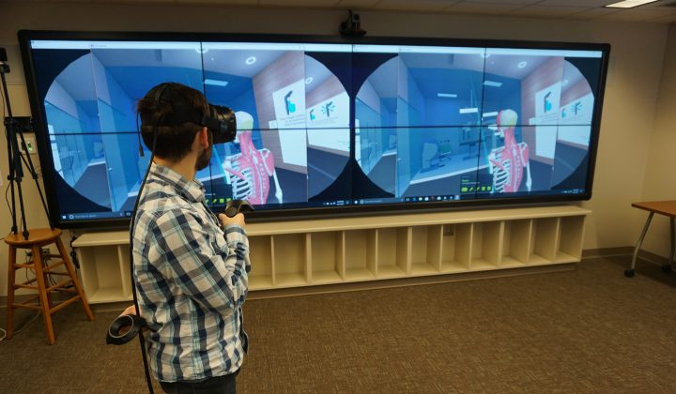
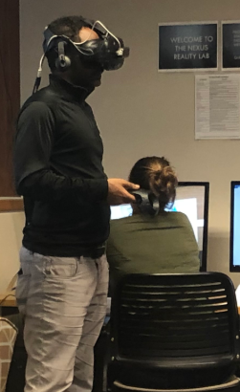
Implementation of VR Labs
Lab 1: While in the 3D Organon VR Anatomy program, go to the body system where you would expect to find the external jugular vein. Once you have located this anatomy answer the following questions:
a. The EJV:
i. runs on the _____ side of the _____.
ii. arises from the:
iii. receives tributaries from the _______, ______, and _______.
iv. empties into the: _______
VR Lab Orientation
  NEXUS IQ Visualization Wall
  3D Organon Anatomy
VR Lab 1 (Assist/Observe) ​
VR Labs 2-4 (Independent)
  Labs revised based on:
    Observation
    Feedback
“I enjoy being able to choose anatomy I am interested in and describing how it is important to MRI .”
"I felt that I only looked at parts and filled in the blanks because I had to."
"I am not well versed with nuclear medicine scanning so I was able to look up a few articles in regard to NUGA studies and found it extremely interesting. This modality is very different from MRI but also very similar so it has been interesting to learn more about Nuclear Medicine and how our exams differ and also the similarities between them."
Lab 2: Select the neuroimaging anatomy of your choice, inspecting it completely by bringing it close to you and viewing it from all angles. Note any characteristics, such as curves, texture, adjoining anatomy, etc., to find connections that will assist you in understanding a process or retaining anatomical knowledge for your modality.
Example: If I were to select the pituitary gland, I would inspect it and state that it is a very small pea-sized structure, therefore my MRI slice thickness in the coronal and sagittal planes is very thin (~2-3mm) to allow for increased detail.
"I would like if each week we had a different anatomy section we could explore and make our own assignment in a way."
"Overall, I think the lab is awesome, but if I were to change something it would be to make it a little more modality specific."
"You beat me to this! I was going to choose this as it is also a very important part of anatomy in MRI as well. Knowing the anatomy of the ventricles and IVS allow us to accurately set up long axis slices of the heart. I found it interesting how the models in the VR software after pulling out the ventricles look exactly like Long Axis Cardiac slices during MR scans.”
Notes:
When implementing the VR labs into the course, Deb held a VR orientation session in the NEXUS Lab using the IQ Visualization Wall to project the instructions we developed (Pic 1). Using the Solstice app on the IQ-Wall, students were able to watch Deb maneuver anatomical objects in the VR environment, which gave them a better understanding of what was expected of them in the assignment. The orientation was a great way to introduce students to how the program worked, and getting to see their instructor use the VR stations was a good way to let them know that VR doesn't have to be intimidating!
Following this orientation, each group proceeded to conduct VR Lab 1 (Pic 2) with our assistance and for our observation.
Observation and student feedback (Feedback 1 - 3 quotes) from lab 1 provided us with ways to build Lab 2 (Pic 3) go over Lab 2 assignment. As you can see from the comments, students preferred Lab 2 and began to think beyond just the anatomy (Feedback 2 – 3 quotes).

Slide 6
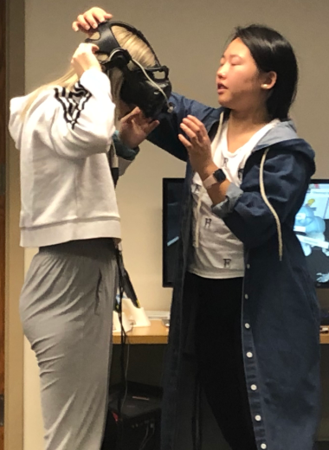
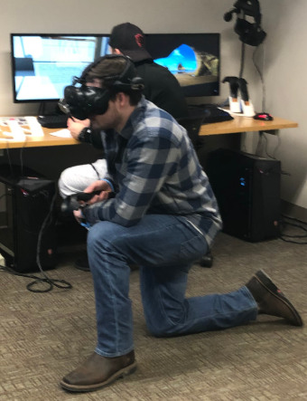
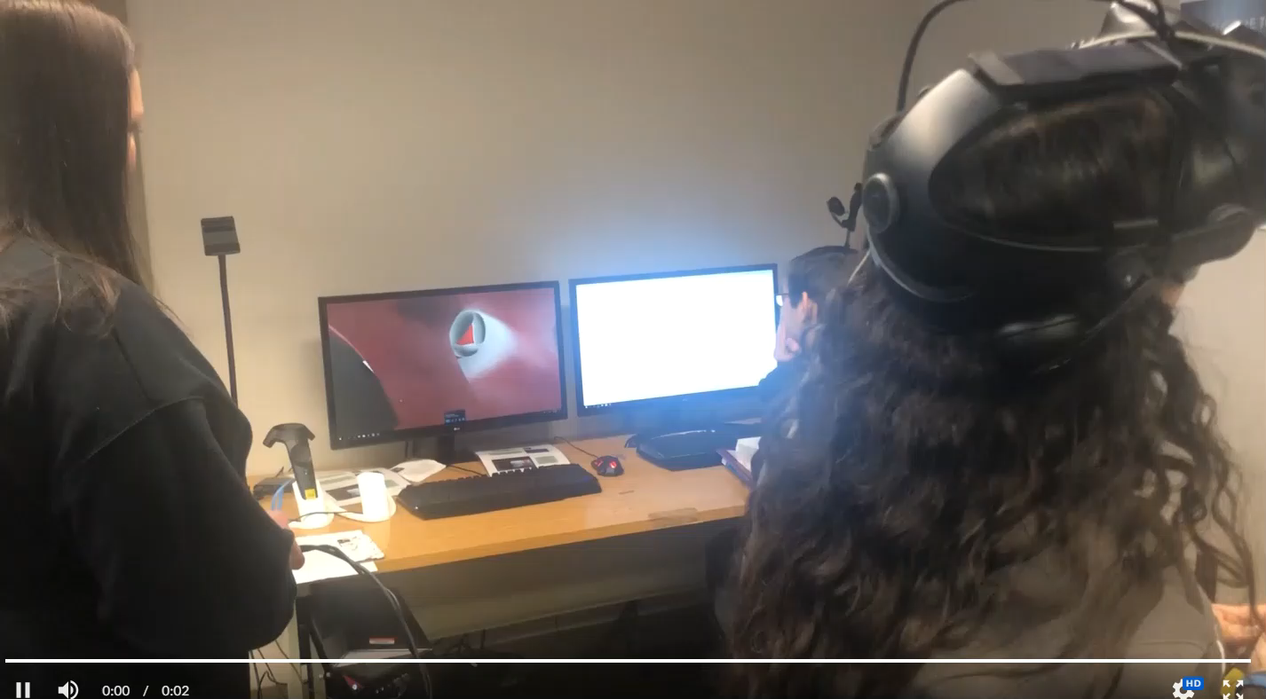
Lab 2-4 Feedback & Future Applications
Undergraduate medical imaging students:
  Bone Densitometry (BD)
  Cardiac Interventional (CI)
  Computed Tomography (CT)
  Nuclear Medicine (NMT)
  Magnetic Resonance Imaging (MRI)
  Mammography (M)
  Vascular Interventional (VI)
  Ultrasound (US)
  Radiography (R)
"During this lab I found it beneficial to activate the setting where the anatomy selected is highlighted but everything else is translucent. This was helpful in understanding its exact location and how superficial or deep it lies within that particular organ.”
3D Organon Anatomy Enterprise Edition
Notes:
(Pic 1 & 2) We are continuing to collect feedback from students which will be taken into consideration while creating future labs and assignments to produce positive learning outcomes (Pic 3) then feedback (Pic 3)..
Next semester, we plan on adding students from BD, CI, and M to the VR learning environment to enhance their learning as well.
After creating and presenting these labs to Deb's colleagues, ultrasound faculty have begun to incorporate VR into their curriculum and radiography faculty plan on doing so this summer.

Slide 7
VR at the Medical Library
Thank you!
Questions?
Nexus Collaborative Learning Lab: https://library.mednet.iu.edu/nexus/
3D Printing Service Guide: http://iupui.libguides.com/3Dprinting
VR Service Guide: https://iupui.libguides.com/VRAR
Email: rlmltech@iu.edu
Notes:
Does anyone have any questions?
Thank you again for inviting us today to demonstrate how VR can be used to enhance medical education.

