Slide 1


Campus Study Spaces

Slide 2
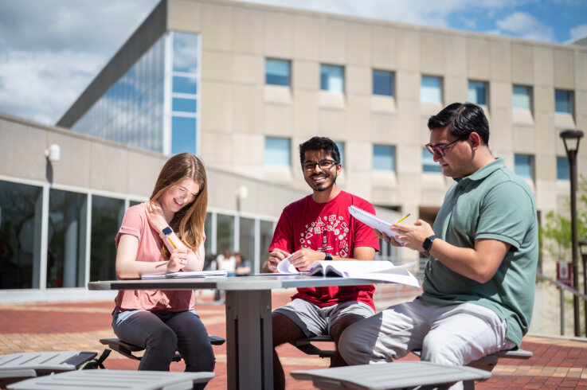
Team Overview
SECTION 1

Slide 3

Clara Pineda
Team Overview
Senior double majoring in Applied Statistics and Global & International Studies.
President of the Undergraduate Student Government
President of the Honors College Student Council
Researcher at IUSM Department of Pediatrics
Top 100 student 2024 and 2025

Slide 4

Hailie Ridge
Team Overview
Senior majoring in Exercise Science with double minors in Medical Sociology and Psychology
Rehabilitation Intern at Riley Children’s Hospital
Top 100 Recipient
Vice President for Undergraduate Student Government
International Student Success Ambassador
IU OT Class of 2028

Slide 5

Simran Shergill
Team Overview
Junior, Biology and Neuroscience Double Major
Honors College Chancellors Scholar
Top 100 Recipient
Research Assistant for IUSM Department of Orthopaedic Surgery
Director of Sponsorships for Regatta

Slide 6

Roufa Hanna
Team Overview
Senior, Exercise Science Major & Mathematics Minor
Chess Club President & Coptic Jags Vice President
Practice Squad Player for the IU-I Women's Soccer Team
Research Assistant at IU School of Medicine
Top 100 Recipient 2023 & 2024
IU DPT Class of 2028

Slide 7
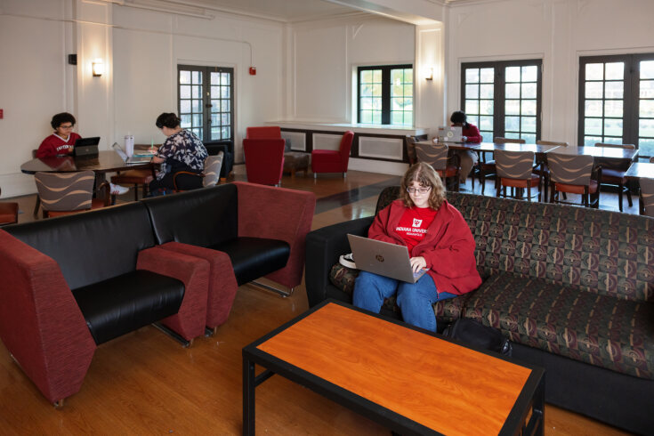
Background
SECTION 2

Slide 8
Background
Study spaces provide many benefits to students:
  Offers options for quiet or active learning environments, individual study, and group work
  Collaborative spaces help students develop teamwork skills
  Allows for different learning preferences
  Having designated spaces improves mental health by reducing stress and improving productivity
  Promotes a sense of community

Slide 9
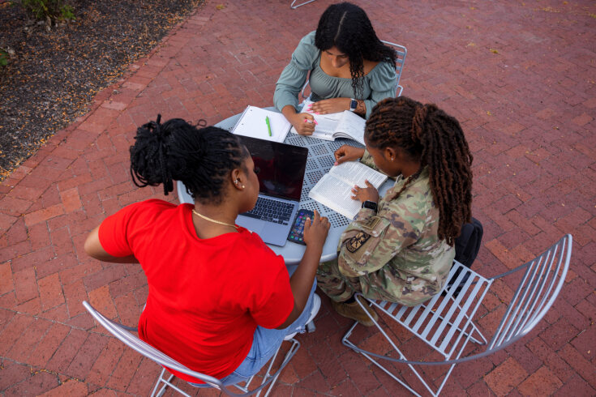
Presentation Goals
SECTION 3

Slide 10

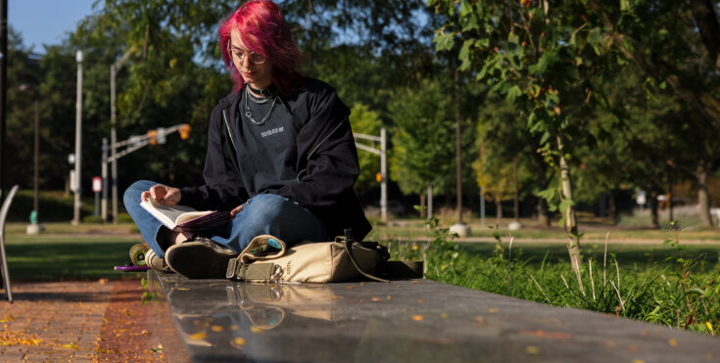
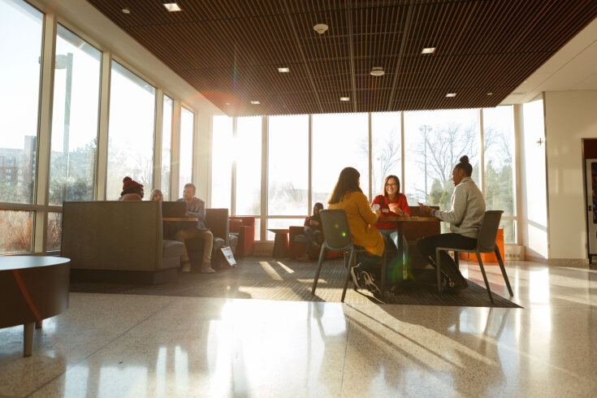
Presentation Goals
Motivate students to study on campus and collaborate with peers
0
3
0
1
Inform the IUI student body about the vast study spaces available to them
0
2
Address potential improvements to enhance students' study experience
Notes:
Change pictures

Slide 11
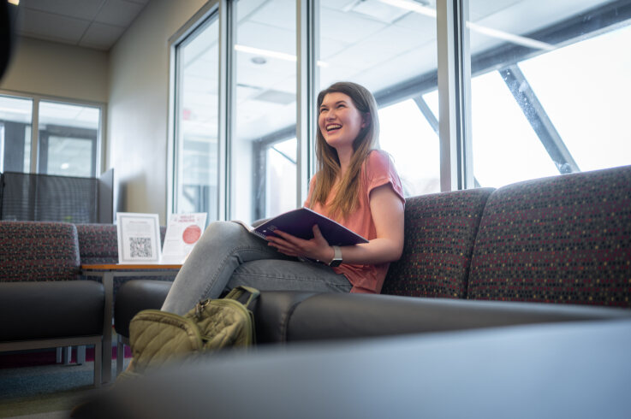
Topic Overview
SECTION 4

Slide 12

Access to various study resources
Regular and colour printers across campus
Whiteboards
Charging stations
3
1
Areas designated for different learning styles:
Quiet floors
Collaborative study spaces
2
Students can book individual study spaces in the library, so students can have their own sense of space.
Extended library hours during finals each semester
4

Slide 13

Research Methods
SECTION 5

Slide 14
We Used a Survey Method – Questionnaire
We used a combination of multiple-choice and open-ended questions.
  How likely are you to utilize campus study spaces when preparing for exams or completing homework/assignments?
  Do you prefer quiet individual study spaces, collaborative group spaces, or both?
  What are the biggest challenges you face when using study spaces on campus?
  Do you think having more designated quiet rooms across campus would improve your study experience?
Target audience: Undergraduate and Graduate students.

Slide 15

Findings
SECTION 6

Slide 16
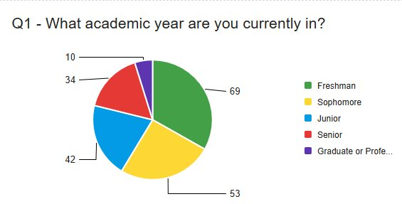
We had over 200+ responses from 16 different Schools
Our Top 2 Schools were
the School of Science (40%) and the School of Health & Human Sciences (27%)

Slide 17
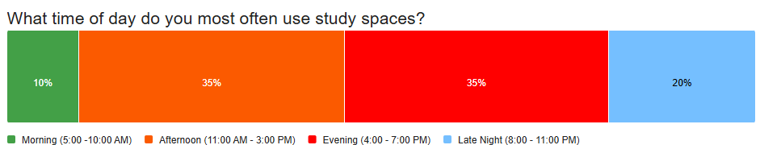
Most Frequent Time of Day for Using Study Spaces

Slide 18
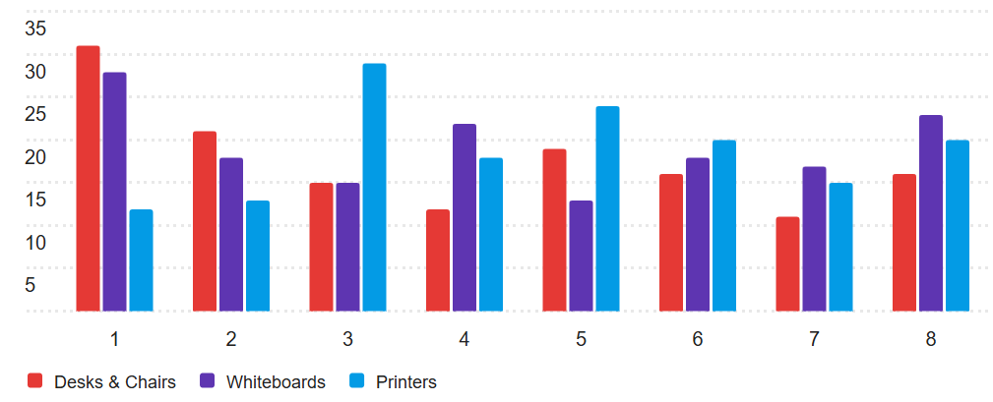
Ranking Resources by Impact on Study Experience (1 = Most Helpful, 8 = Least Helpful)
Our Top 3 most impactful resources were: Desks & Chairs, Whiteboards, & Printers

Slide 19
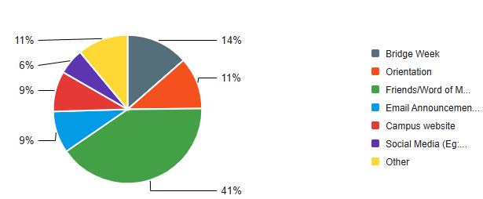
Current Methods for Discovering Available Study Spaces on Campus
Top two methods were Friends/ Words of Mouth (41%) & Bridge Week (14%)

Slide 20
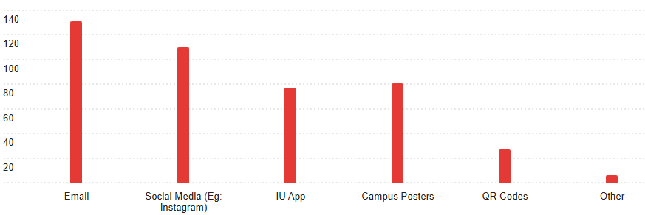
Here are the Preferred Platforms for Learning About New or Updated Study Spaces

Slide 21

Recommendations and Future Work
SECTION 7
Notes:
Potential suggestions
○Opening classrooms during finals week, to make more study spaces available
○Adding printers to commonly used study spaces, to improve printer access

Slide 22
Many students answered that they are highly likely (86) or likely (72) to utilize on campus study spaces when preparing for assignments or exams.
Recommendations
Since most students said barriers to studying are lack of seating and noise, more areas and spaces students can go to focus on a private or group level can be beneficial.
Additionally, most students (169) reported that if their more designated quiet rooms across campus their study experience would improve.
The ability access to whiteboards and chairs with desk were a top priority for students when studying, so we can improve the study experience by increasing those two aspects.
Students can benefit from advertising about study spaces specifically via email or social media as most hear about study spaces from word of mouth.

Slide 23
Building Specific
Students would benefit from more seating and whiteboards as currently the spaces are often busy.
CAMPUS CENTER
CAVANAUGH
IT has a lot of study spaces, but would greatly benefit from more whiteboards available"
INNOVATION HALL
Needs additional rooms or spaces as when events or practices are happening, it can be hard to find spots.
SL/LD
Most students would like more designated quiet space as it gets loud during peak hours.
More study spaces for those in between classes, the current spaces become crowded easily.
NATATORIUM
Needs more private study spaces and collaborative areas.
LIBRARY
More comfortable seating such as bean bags and fixing outlets on the 3rd and 4th floor.
ICTC

Slide 24
Recommendations to increase overall study spaces across campus:
Options and resources for studying can be increased by allowing students to utilize classroom space during peak hours and peak seasons such as midterms and finals.
Marketing the classrooms as a study space option and providing the students with a way to use them without disrupting class schedules can help to remove many of the current barriers to studying on campus.

Slide 25
Questions & Thank You!

