Slide 1
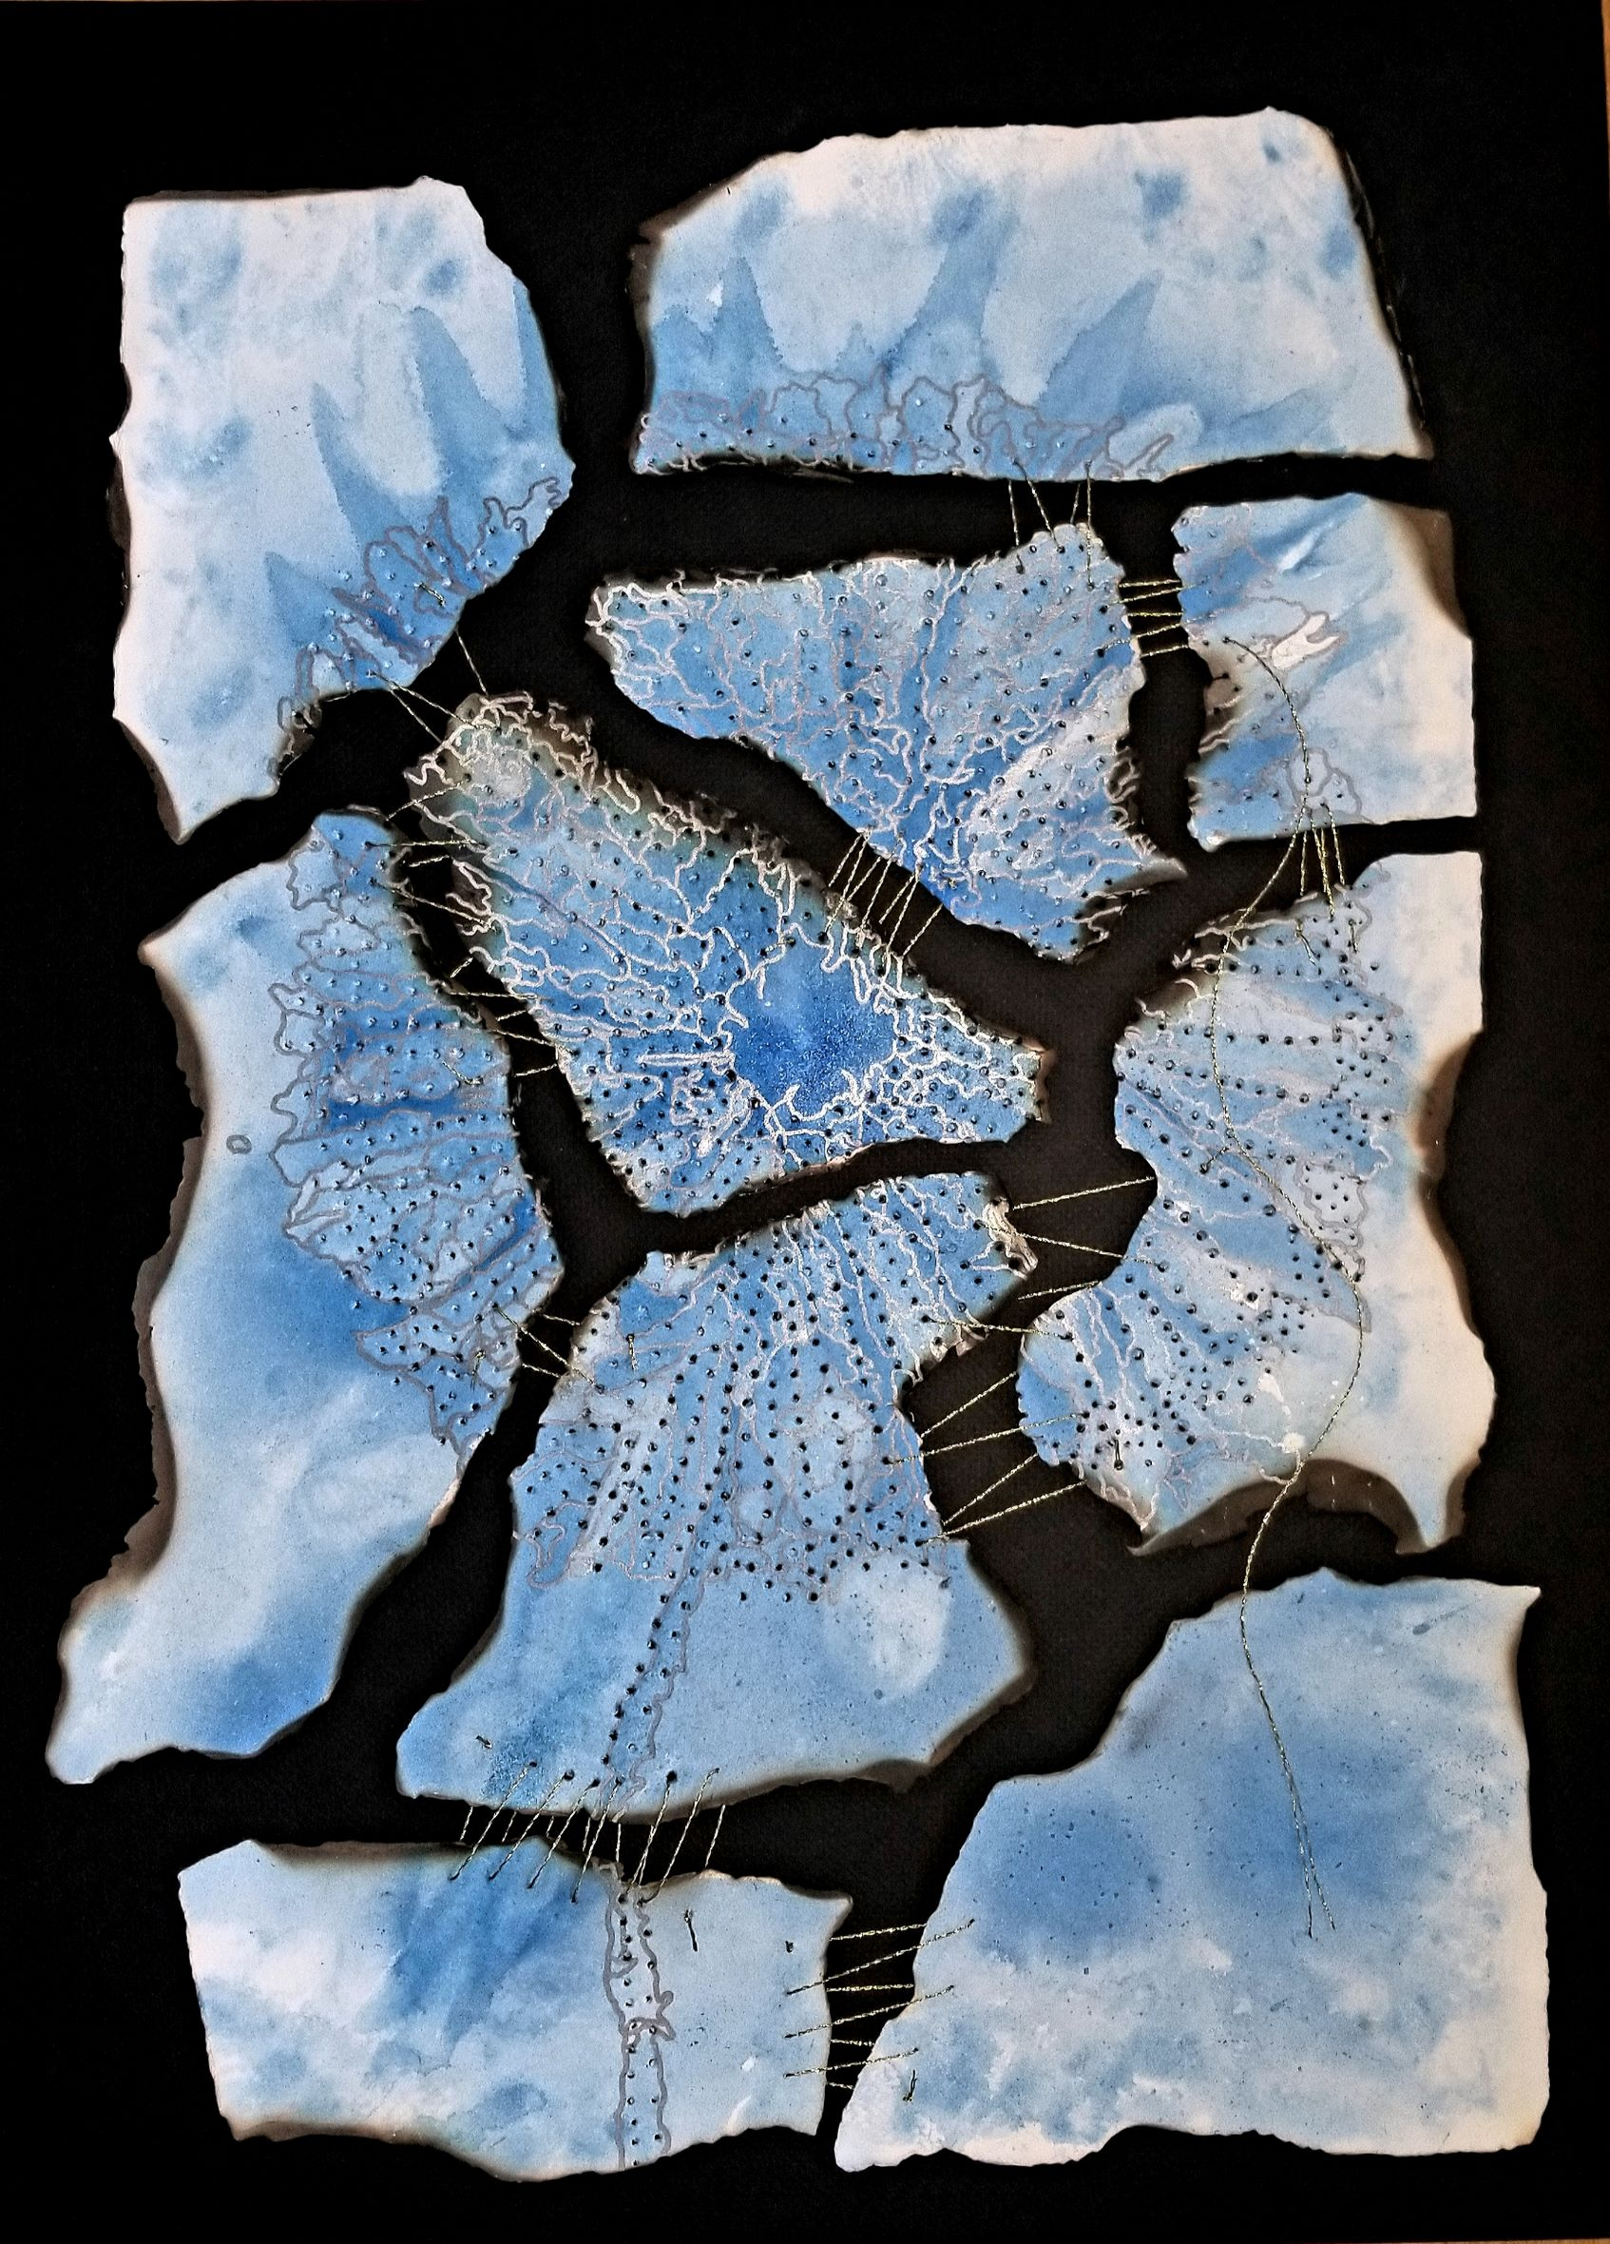
The Artist
&
The Therapist
Eileen Misluk-Gervase, MPS, LPC, ATR-BC, LMHC, CEDCAT
Director, Art Therapy
Assistant Professor, Herron School of Art + Design, IUPUI
CAA 2020
February 15, 2020

Slide 2
Objectives
What is art therapy?
Difference between art therapy and therapeutic art making
Role of art making in art therapy
Benefits and challenges of programs in art schools
Overview of Herron’s graduate art therapy program

Slide 3
What is art therapy?
Active therapeutic process that integrates the mind and body, allowing an individual to uncover, explore, and process emotional content through art making.
Pairs fear-arousing emotions with positive new sensory experiences as a means of coping, regulating, and integrating (Hass-Cohen, 2008).
Encourages spontaneous engagement, support attention and logical understanding, and create a holding space for overwhelming experiential states (Shore, 2014).
Emerged from the work of artists and educators to help individuals process traumatic memories, enhance communication skills, and live more fully.
Art therapists' practice in schools, community centers, hospitals, mental health agencies, and supportive facilities.

Slide 4
Art therapy vs. Therapeutic Art Making
Art therapy integrates psychological and counseling principles into the development and implementation of individual and group art therapy sessions with measurable behavioral and psychological outcomes.
Therapeutic art making is the process of engaging in art making independently or with others that results in positive outcomes.

Slide 5
Making in Art Therapy
Experiential and process-based art making that is viewed as an extension of the self.
Use the formal elements and principles of design to build dialogue about the art. NO CRITIQUE!
Art making is used to uncover, explore, and bring awareness to the presenting issues and ways to live more fully.
Art can be made in one session or over several depending on the needs of the client.
Art therapists use a wide range of materials within facility and safety protocols.

Slide 6
Graduate Art Therapy Programs
Approximately 10% of art therapy programs in the United States are housed within art schools.
Art therapy programs in art schools have a unique advantage over programs housed in schools of counseling, education, or medicine. They keep the process of making, creating, and engaging in art relevant on a daily basis.
Allows graduate students to maintain their personal art making, further develop their skills, and in turn share their knowledge with the individuals they work with.
Expands the discourse among students and faculty by engaging in conversations around public art, healing communities through art making, and social justice through the arts.
Provides an understanding of the differences between art therapy and therapeutic principles of art making and creating. Allowing for greater collaboration between art therapists and professional artists to enhance and enrich our communities.

Slide 7
Benefits of
Art Therapy Graduate Programs in Art Schools
Development of the artist identity alongside the art therapist identity.
Continuum of needs for arts as a means of communication, advocacy, and cultural integrity.
Partnering with community organizations on art initiatives.
Career exposure
Increased interest in our graduate program with a growing pool of applicants (36 per year)

Slide 8
Challenges
Curriculum Oversight: Accreditation Council on Art Therapy Education, Art Therapy Credentialing Board, & state licensing boards.
Profession of Art Therapy is small and lacks diversity which creates challenges in identifying qualified faculty and adjuncts..
University administration is often unfamiliar with the governing bodies that set standards.
Students are not eligible for fellowships--need for increased scholarships and incentives to recruit more diverse students; paid internship supervisors

Slide 9
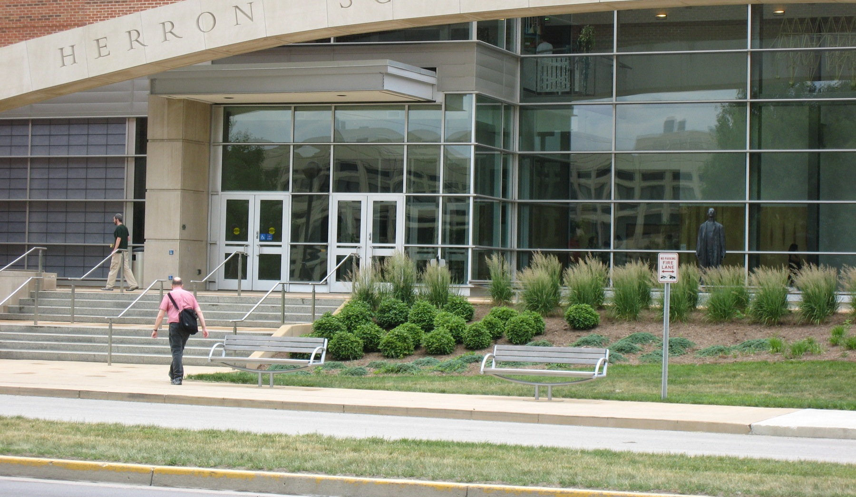
Herron School of Art + Design, IUPUI
Program started in 2012 with the first graduating class in 2014.
Cohort model- 12 students per year
60 credit, full-time program (5 semesters) with 3 full-time faculty & 1 adjunct.
Over 60 community partnerships for internships
Our 39 graduates have provided 35,443 internship hours and provided services for 13,753 individuals in the Indianapolis area.
Each of these students represented Herron and exposed organizations and individuals to the arts and its healing potential.

Slide 10
Professional Associations
American Art Therapy Association
Art Therapy Credentialing Board
Accreditation Council for Art Therapy Education

Slide 11
Eileen Misluk emisluk@iupui.edu

