Slide 1

Building more bonds and widening our reach:
Strategic expansion of chemical information skills instruction for undergraduates using the online environment
Eric Snajdr
Indiana University–Purdue University Indianapolis
April 8, 2021
American Chemical Society Spring 2021 Meeting
Macromolecular Chemistry: The Second Century

Slide 2
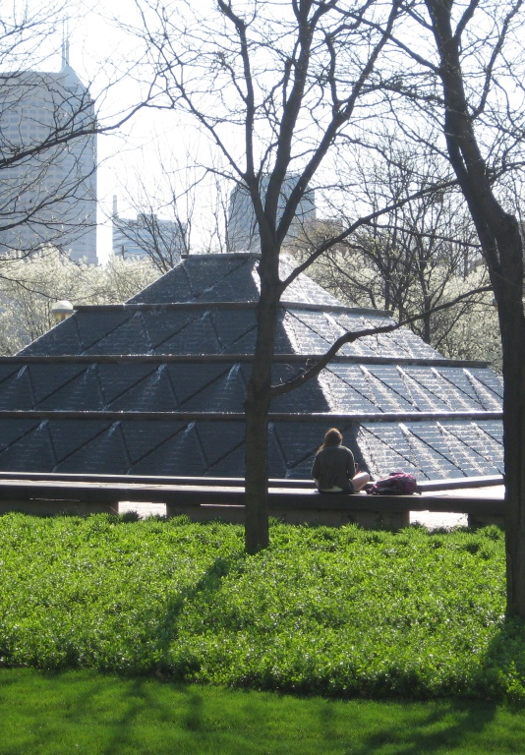
Overview
Examine an example of a library curricular instructional plan for chemistry undergraduates
Explore various methods to expand library instruction using online platforms
Investigate the Transparency of Learning and Teaching framework and how it can improve assignments

Slide 3
Curricular plan – Chem. Info. skills instruction
Collaborative effort
Used a template adapted from an ACRL workshop*
  For each course, outlined
  Learning outcomes
  Assessments
  Teaching strategies
* created by Steven Hoover (Syracuse), Jennifer Fabbi, Anne Zald, Erin Rinto (UNLV)
Notes:
For many years I worked closely with the Department of Chemistry at IUPUI in developing a library educational curricular plan
where chemical information skills instruction was inserted into strategic points of the chemistry undergraduate degree programs.
The planning involved me, members of the department’s curricular committee, and key teaching faculty. Communication and coming together in a shared space of understanding of what we were trying to accomplish was key for the plan’s success.
We examined courses in the degree program and identified ones that were a good fit for integrating information skills concepts.
We used
ACS Chemical Information Skills for Undergraduates
ACRL Information Literacy Standards for Science and Engineering/Technology
ACRL Framework for Information Literacy for Higher Education
And divided up Learning outcomes based on these, into 4 different courses.
The template helped to keep the planning organized and with it, we outlined for each course the learning outcomes, assessments, and teaching strategies. The template also helped to develop alignment among all three.

Slide 4
Pre-pandemic
100
Intro Course
200
Cornerstone
300
Organic Lab 2
400
Capstone
Notes:
Here is a pre-pandemic layout of the courses included in our information skills curricular plan. It included a 100 level intro to science course, a 200 level chemistry cornerstone, a 300 level organic lab, and a 400 level capstone course I’ll go through each very briefly and describe library instruction for each course.

Slide 5
Pre-pandemic
  Yellow highlight = ONLINE COMPONENT
First
100
Intro Course
200
Cornerstone
300
Organic Lab 2
400
Capstone
  1st session
  (online async.)
  2nd session
  (1.5 hr)
  1st session
  (2 hr)
  2nd session
  (2 hr)
  Individual research consults
  Pre-test (prior knowledge probe)
  Post-test
  1 session
  (2 hr)
Notes:
Pre-pandemic, for the Intro to science course for chemistry majors, I provide one library instructional session face-to-face, giving new students an orientation to some of the big picture resources and services of the Library as well as an introduction to scientific information. I provide an in class learning activity as well as an assignment which is tied to a mini research project students complete later in the semester. However, for many years, including pre-pandemic, I have used an online component, a pre-test and a post test delivered through the course’s online learning management system.
NOTE: throughout the rest of my presentation, any online instruction is labeled with yellow to help differentiate what is online and what is face-to-face.
The pre-test given a week before my session, helps me assess the students prior knowledge and adjust specifics of what I include or emphasize in the face-to-face session. Additionally a post-test given at the end of the semester helps assess effectiveness of my instruction

Slide 6
Pre-pandemic
First
First
100
Intro Course
200
Cornerstone
300
Organic Lab 2
400
Capstone
  1 session
  (2 hr)
  1st session
  (2 hr)
  2nd session
  (2 hr)
  Individual research consults
  1st session
  (online async.)
  2nd session
  (1.5 hr)
Notes:
Cornerstone in Chemistry, a 200 level class, delves deeper into science communication topics for example, students begin to explore scientific writing and the research process. In this class I have two library assignments which are tied to their coursework.
Again this is pre-pandemic. The 1st session, (in yellow) was designed as a flipped classroom approach. It involves an online module delivered through the learning management system. It includes an online instructional video I created which combines mini-lecture, and contains demos covering an introduction to search logic and database searching. Additionally, the module includes a pre-search assignment, where students develop search terms and synonyms on research topics they will explore as the semester progresses.
The second session, face-to-face, involves librarian mini-lecture, demo, hands on practice then in-class work on a database search assignment where students continue to develop skills such as comprehensive subject searching and identifying key references and citation searching to identify related articles.

Slide 7
Pre-pandemic
First
First
100
Intro Course
200
Cornerstone
300
Organic Lab 2
400
Capstone
  1 session
  (2 hr)
  Discussion question (prior k. probe)
  Discussion question (prior k. probe)
  1st session
  (2 hr)
  2nd session
  (2 hr)
  Individual research consults
  1st session
  (online async.)
  2nd session
  (1.5 hr)
Notes:
Prior to the first session, students complete an online discussion question (on the Learning Management System) helping to probe the prior knowledge of students. The lead instructors for the course have set this up and have used a variety of questions over the years, but a few examples are,
“What science information skills have you already developed? List some examples.“
“What questions do you have coming into this session about scientific information or using the library?”
Several years ago I would also give the students an ungraded quiz on Boolean logic as we began to wonder if students did not need instruction in this area, however, several years of student data showed a large amount of students had misconceptions of Boolean logic. This reinforced the need to teach it. And this happened so consistently that we simply dropped doing the quiz in recent years.
Before my second session, students complete an online discussion question. This discussion question has varied but often is something like,“
What information skills do you still need to obtain to complete your schooling and to continue into your career?”
“How do you view the usefulness of the resources available at the library in your future career?”
I have found these questions very helpful, as it helps me to learn more about my students, their career aspirations, and helps me to make my instruction more relevant to the students current and future lives.

Slide 8
Pre-pandemic
First
First
100
Intro Course
200
Cornerstone
300
Organic Lab 2
400
Capstone
  1 session
  (2 hr)
  1st session
  (2 hr)
  2nd session
  (2 hr)
  Individual research consults
Notes:
In this 300 level course, students learn advanced laboratory techniques of organic chemistry and it affords a prime opportunity for introducing chemistry specific information skills for example, locating chemical and physical properties of substances, including spectra and obtaining information on a substances and reactions.
Prior to the pandemic, learning experiences were divided into two sessions in the library, each with a rather extensive assignment
During the sessions, I lead students through mini lectures/demos/ and provide in-class time for them to work on the assignments. In addition to the assignments, questions on the course final exam have provided additional assessment of student learning
Pre-pandemic there was no online component.

Slide 9
Pre-pandemic
First
First
100
Intro Course
200
Cornerstone
300
Organic Lab 2
400
Capstone
  1 session
  (2 hr)
  1st session
  (2 hr)
  2nd session
  (2 hr)
  Individual research consults
Notes:
The capstone class includes independent research projects. For this class, I do not provide any in-class instruction, instead, I provide one-on-one guidance through individual point of need appointments.
Pre-pandemic there was no online component.

Slide 10
Pre-pandemic
100
Intro Course
200
Cornerstone
300
Organic Lab 2
400
Capstone
  1 session
  (2 hr)
  1st session
  (online async.)
  2nd session
  (1.5 hr)
  1st session
  (2 hr)
  2nd session
  (2 hr)
  Individual research consults
Notes:
So here is a quick overview of my pre-pandemic instruction where only one session (in yellow) was delivered in an online format.
After the onset of the pandemic, I was able to successfully transfer the entire curricular plan to online. Here’s a look at the transition to totally online.

Slide 11
During pandemic
100
Intro Course
200
Cornerstone
300
Organic Lab 2
400
Capstone
1 session
synch.
(Zoom)
1st session
asynch.
(Modules)
2nd session
synch.
(Zoom)
1st session
asynch.
(Modules)
2nd session
asynch.
(Modules)
  Individual research consults
  (Zoom/email)
Notes:
It is a mix of synchronous (with the blue Zoom label) and asynchronous modules (labeled in red).
For the 100 level class and the second session of the 200 level class, I chose to use synchronous online instruction. This was based on several factors. For the 100 level class, because it is my first time working with these students, I prefer to allow for more interaction which Zoom can provide. For both of these classes, the in-class learning activities as well the assignments lend themselves to live (librarian) demonstrations directly followed by student practice, then student in-class work on a specific portion of the assignment, while the lead instructors and I are on hand for any specific questions.
For the 300 level Organic 2 lab, I spent considerable time transitioning the two 2-hour sessions and the assignment for each to online modules. I revised much of the written instructions, replaced my live in-class demos, with 7 videos, which were placed in the modules at appropriate places and paired with written instructions.

Slide 12
During pandemic
First
100
Inro Course
1 session
200
Cornerstone
1st session
300
Org. Lab 2
1st session
(Modules)
400
Capstone
Individual research consults
2nd session
300
Org. Lab 1
synch.
asynch.
synch.
1 session
asynch.
(Zoom)
(Zoom)
2nd session
asynch.
asynch.
(Modules)
(Modules)
(Modules)
Notes:
Here is the same information as the previous slide but with a gap in the middle. At the onset of the pandemic and while the transition to online teaching was taking place I worked with the lead instructor for a large lab class – Organic Chemistry 1, in developing online instruction regarding avoiding plagiarism. This instruction became part of an online module for the course.

Slide 13
During pandemic
100
Inro Course
1 session
200
Cornerstone
1st session
300
Org. Lab 2
1st session
(Modules)
400
Capstone
Individual research consults
2nd session
300
Org. Lab 1
synch.
asynch.
synch.
1 session
asynch.
(Zoom)
(Zoom)
2nd session
asynch.
asynch.
(Modules)
(Modules)
(Modules)
Notes:
On this slide I have added this course in the middle, showing its place in the complete sequence of the ”during pandemic” curricular plan.
As part of the Organic Lab 1 course, students gain practice in authoring a Journal of Organic Chemistry style Note, based on research results in their labs. This assignment is a prime avenue for building on students understanding of what is plagiarism and how to avoid it. I assisted in the module by creating an instructional video and with helping with written Instructions This was accompanied by an assignment involving an anti-plagiarism pledge and a short essay by the students about plagiarism. This course has over 260 students and 26 sections per year so it would probably not be feasible for me to provide this instruction face to face
-----
Now I will switch gears a little bit and talk about reworking learning experiences for all of these courses as I pivoted them all to the online environment. I used it as an opportunity to implement improvements in many assignments. Many of these improvements were related to applying the Transparency in Learning and Teaching format.

Slide 14
Transparency in Learning and Teaching in Higher Education (TILT)
Improving assignments by making explicit the
Purpose
Tasks
Criteria for Success
Notes:
The TILT framework quote “aims to advance equitable teaching and learning practices that reduce systemic inequities in higher education”. “Using TILT can help instructors create learning experiences that are clearer in purpose to the students, and more equitable for students to achieve success.”
TILT can improve assignments by making explicit the
The Purpose
The tasks
And the Criteria for Success
For example, for the Purpose - what skills and knowledge students will gain from the assignment and how might students use these in further schoolwork, and in life beyond school. For Tasks - what steps are students to follow, what are they to do, how are they to do it. For Criteria - providing clear examples, allowing students to understand what success looks like as well as providing guidance which allows students to know they are on the right track
This is not restricted to assignments in the online environment. However, it can be extremely useful for this. I found by improving my instructions (tasks) and providing clear “criteria for success” it provided a smoother experience for the students for Online modules (asynchronous learning), especially, since I am not able to guide them as easily as I would in a face to face setting.

Slide 15
Transparency in Learning and Teaching in Higher Education (TILT)
Examples of assignments and resources
https://tilthighered.com/tiltexamplesandresources
Notes:
TILT provides a nice list of example Assignments in a wide range of disciplines. In the examples they show before and after the TILT format is applied.
But I’ll walk you through a very quick glimpse of what I put together for the first module of two modules for my Organic 2 lab

Slide 16
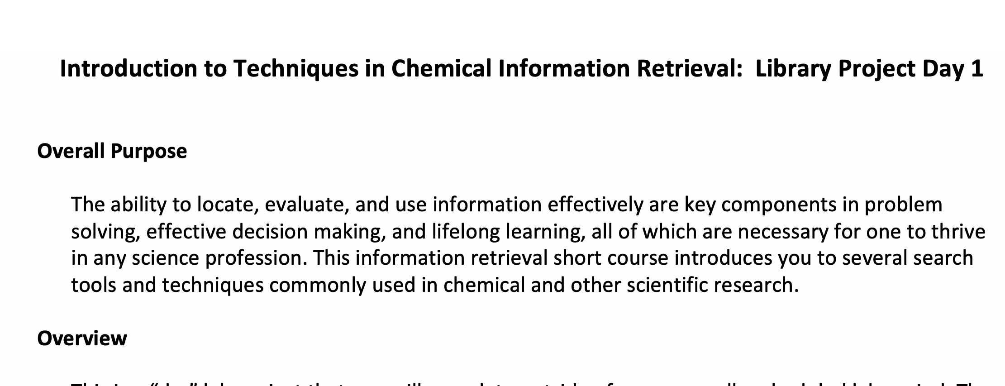
TILTed assignment
Notes:
Here is a screen shot of the top of the first page of my Organic 2 lab assignment #1. I start off the assignment with a big picture, purpose, providing rationale, overall, for why this work is important.

Slide 17
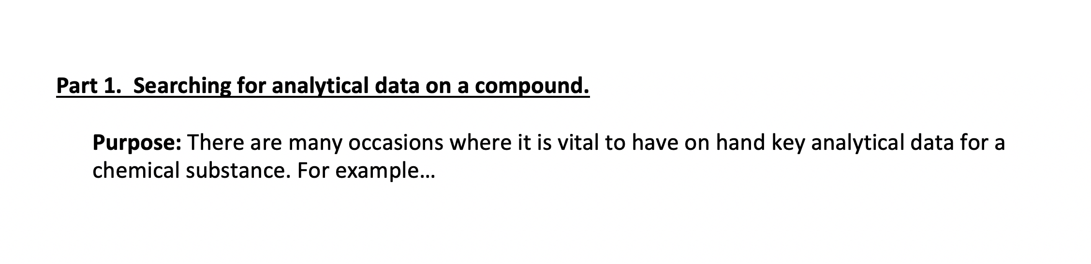
Transparency in Learning and Teaching in Higher Education (TILT)
Notes:
This assignment has multiple parts, and for each part I state, upfront the “why”. Providing students with the rationale for why this particular part of the assignment is important.

Slide 18
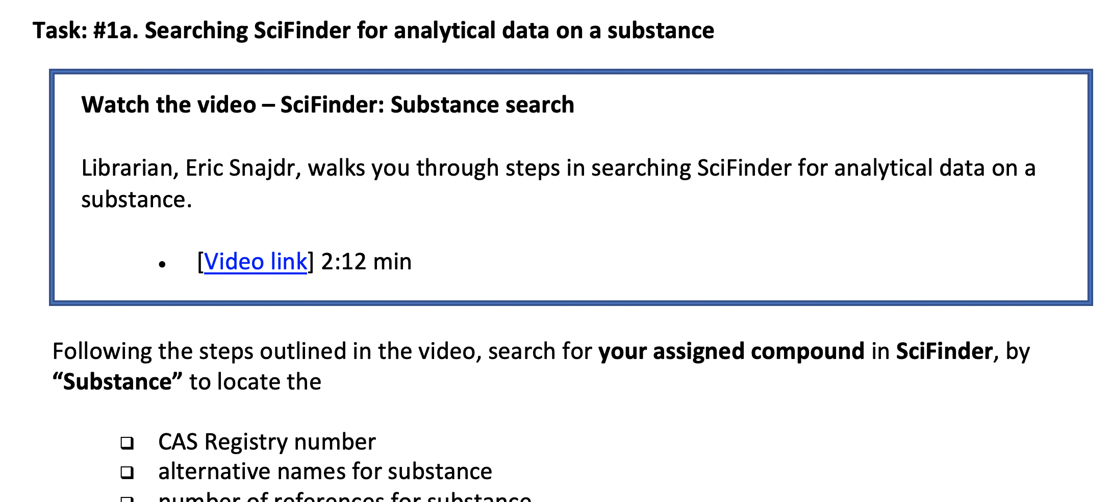
Transparency in Learning and Teaching in Higher Education (TILT)
Notes:
Then I divided the module into what are hopefully very clear tasks with instructions and a checklist of steps.

Slide 19
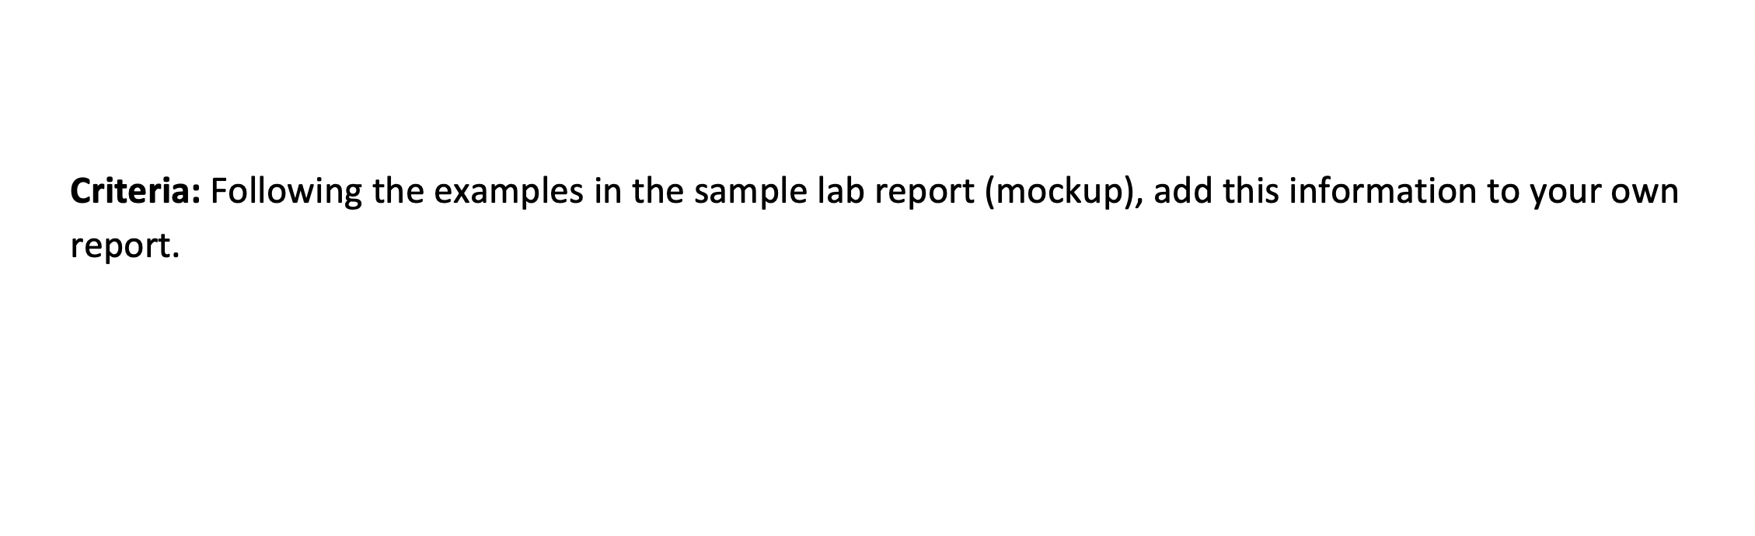
Transparency in Learning and Teaching in Higher Education (TILT)
Notes:
And finally, providing specific criteria for success, with examples of what success looks like. For this assignment there is a separate document, a sample lab report that gives examples of what the completed assignment should look like.

Slide 20
Post-pandemic?
100
Inro Course
1 session
200
Cornerstone
1st session
300
Org. Lab 2
1st session
400
Capstone
Individual research consults
2nd session
300
Org. Lab 1
asynch.
1 session
asynch.
2nd session
(Modules)
(Modules)
Notes:
Finally, I’d like to leave you with what I hope my curricular plan for chemistry look like post pandemic. If I have my way, it will look something like this…My preference would be mostly back to face to face, but continuing with all of my online classroom assessment techniques that I had in place prior to pandemic (like the pre-test and post-test and the pre-class discussion questions/ prior knowledge probes)
Also, continuing with Cornerstone session 1 being an online flipped classroom approach. As well as the avoiding plagiarism training remaining as an online module for the Organic 1 lab.
But for all of the other sessions, I hope they can pivot back to face to face. For me face-to-face is unmatched in the ability to get to know the students, for all of the one-on-one (student-teacher) interactions that take place during in-class work time, the student-student interactions during in-class work time, the ability for me to meet students at point of need as they are working on assignments during class time. Personally, I really miss the ability to see the students screens as I walk the room as they practice a skill directly after my demonstrations. It allows such immediate and specific feedback that completely gets lost on Zoom.
----
I hope my presentation has helped sparked some ideas of your own as you develop or perfect your own
curricular plans. As well as how you manage the ongoing journey of teaching online during the pandemic and work to improve assignments.
Thank you all for your time and attention and look forward to learning from you all in the future.

Slide 21
References
Committee on Professional Training, Undergraduate Professional Education in Chemistry. ACS Guidelines and Evaluation Procedures for Bachelor's Degree Programs; American Chemical Society: Washington, DC, 2015.
Curricular Library Educational Services Plan Framework was adapted from “Meet Us On the Corner of Intentional and Strategic” workshop presented at ACRL April 12, 2013 by Steven Hoover (Syracuse), Jennifer Fabbi, Anne Zald, Erin Rinto (UNLV)
Snajdr, E. Science Information Literacy Instruction across the Undergraduate Curriculum. The 5th Annual True North Science Bootcamp 2019. Ottawa, Canada. May 31, 2019. http://hdl.handle.net/1805/21398
Snajdr, E. Curricular Library Educational Services Plan for Undergraduates in Chemistry. 2020.
https://scholarworks.iupui.edu/handle/1805/23177
TILT Higher Ed, Transparency in Teaching an Learning. https://tilthighered.com/ (accessed April 2021).

Slide 22

Thank you!
Eric Snajdr
Associate Librarian
University Library
Indiana University – Purdue University, Indianapolis
esnajdr@iupui.edu

