Slide 1


Applied Improvisation and Art Making in Group Therapy
Eileen Misluk-Gervase, LPC, ATR-BC, LMHC, CEDS
Assistant Professor, Director of Art Therapy
Herron School of Art + Design, IUPUI
Notes:
How long are core courses good for
Grad courses in ED but over 2 years
I am an RD, can I have therapist sign off
Does supervisor have to be member?
What is the cost of the core courses?
Process has become more involved, can we be grandfathered. 2000 is now 2500 hours
I meet everything except required presentations.
When did iaedp certification begin? Late 80’s, first RD in 1993 – CED-N
CEDS Equivalency – have everything except 5 years of supervising others. Is there anything I can do to do this in less than 5 years.
Which universities offer ED courses that are approved by iaedp for the core course requirements?
RD completing core courses. I notice I am also being tested as if I am a provider or therapist getting specialty certification. Does final exam include everything or can I focus on nutrition?
When do I turn in case study?
Average cost to attend symposium?

Slide 2
Purpose
Engage in applied improv and art making techniques to enhance empathetic listening skills and foster rapport building among group members.
Demonstrate the application of applied improvisation and art making in eating disorder group therapy to develop safety and attunement, risk-taking and acceptance, and mastery and agency focusing on the specific needs of clients with eating disorders.
Clients who participated in applied improvisation have demonstrated increased willingness to participate in therapy and enhanced progress toward clinical goals (Alana & Ansaldo, 2018).

Slide 3
Learning Objectives
Participants will be able to:
1. Explain the benefits of applied improvisation for clients with eating disorders.
2. Identify specific improv games and art activities that can be used in eating disorder group therapy.
3. Demonstrate skills for facilitating applied improvisational and art making techniques.

Slide 4
Five Rules of Improv
1. Listening
2. Accepting (Yes)
3. Supporting (And)
4. Letting go of mistakes
5. Taking risks

Slide 5
Applied Improv
Facilitates the practice of spontaneous communication and interaction, developing participants’ tolerance of uncertainty and ambiguity (Lawrence & Coaston, 2017).
Clarifies communication and enhances trust and collaboration among the clinical team (Sheesley, et al., 2016).
Creates a safe and trusting environment for developing professional relationships, adapting quickly to unfolding situations, and collaborating—skills necessary for communication in stressful situations (Rossing & Hoffmann-Longtin, 2018).
Physically and mentally engages clinicians in effective clinical behaviors, including person-centeredness and flexibility (Lawrence & Coaston, 2017; Sheesley, et al., 2016).
Requires responsiveness to ambiguity and change, focus and attention to the present moment, and collaboration with others (Hoffmann-Longtin, et al., 2018).

Slide 6
Misconceptions & Fears
1. I must be funny.
2. I have acting skills.
3. Everyone will laugh at me.
4. I will embarrass myself.
5. I will embarrass other people.
6. This is dumb and I won’t benefit from participating.
7. I can’t do ________.

Slide 7
Celebrating Vulnerability
Failure is a sign that you are pushing yourself to do something new.
Laughing together versus being laughed at.

Slide 8
Art Therapy vs. Art Making
Art therapy
  A masters level degree in art therapy and clinical training and supervision by a registered art therapist.
  Art making is used as the primary mode of exploration, discussion, meaning-making, and healing in therapy.
Art Making in the Clinical Setting
  Used by mental health clinicians to help clients bridge conversations, express feelings, or reduce stress

Slide 9
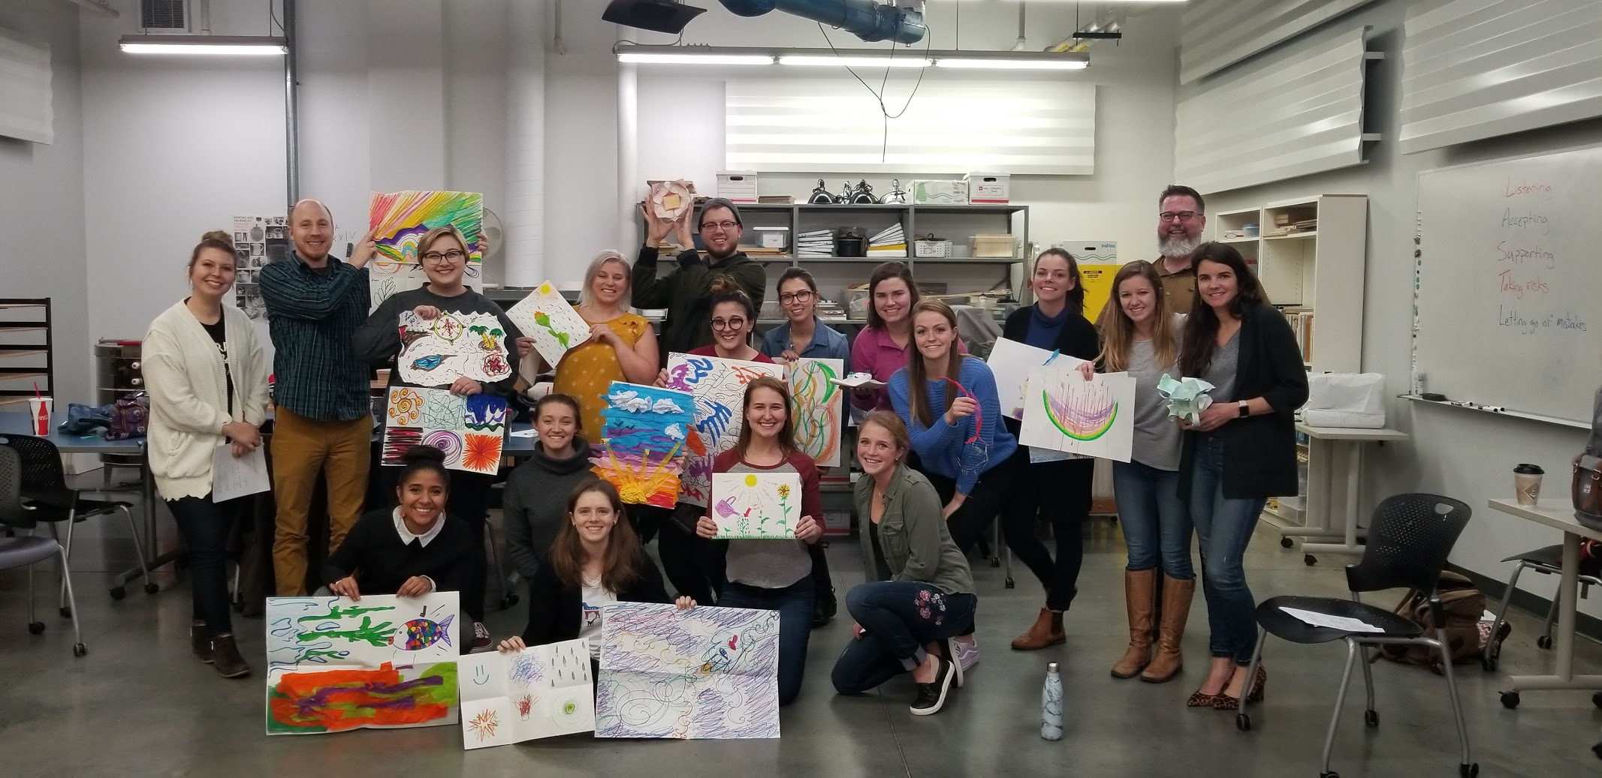
Art Making and Applied Improv

Slide 10
Six Phases of Therapy
Safety & Attunement
  Supports mirroring and relational interactions (Farley, 2017)
Risk-Taking
  Letting go of intellectualization, increase tolerance and a capacity for appropriate risk taking (Farley, 2017)
Acceptance
  Stress reduction, increase self-compassion and awareness, supports body sensation acceptance (Llyod-Hazlett, 2020; Schwenke et al., 2020)
Mastery
  Failure as a necessary part of gaining mastery; promote self-esteem, self-efficacy, and resilience (Schwenke et al., 2020)
Agency
  Expression of actual feelings, spontaneity, and experimentation (Farley, 2017)
Notes:
Safety/attunement focused on rapport building through activities that supported mirroring and relational interactions between participants.
Risk taking/acceptance focused on letting go of intellectualization and allowing the subconscious to lead in creative activities, increase tolerance, and increase capacity for appropriate risk taking (Farley, 2017). Engaging in mindfulness, a non-judgmental attention for moment to moment (Kabat-Zinn, 1990), has the capacity to reduce stress, increase self-compassion, and increase awareness of thoughts, feelings, and body sensation fostering acceptance (Llyod-Hazlett, 2020; Schwenke, et al., 2020).
Mastery is defined as patterns of achievement that incorporates challenges, persistence, and a view of failure as a part of gaining mastery rather than a lack of ability (American Psychological Association (APA), 2020). Mastery is a key component in psychological wellness which includes self-esteem, self-efficacy, and resilience (Schwenke et al., 2020). Agency was viewed as the expression of actual feelings, developing spontaneity, freedom to experiment, promotion of insights into inter and intrapersonal dynamics, and collaboration (Farley, 2017).

Slide 11
Eating Disorder Goals in Applied Improv
1. Cognitive flexibility
2. Frustration tolerance
3. Normalizing failure
4. Present in the here and now
5. Tolerating the body in space

Slide 12
Multilayered Approach
1. Multiple phases of therapy can be addressed within a single game.
2. Scaffolding games throughout a single session supports skill development.

Slide 13
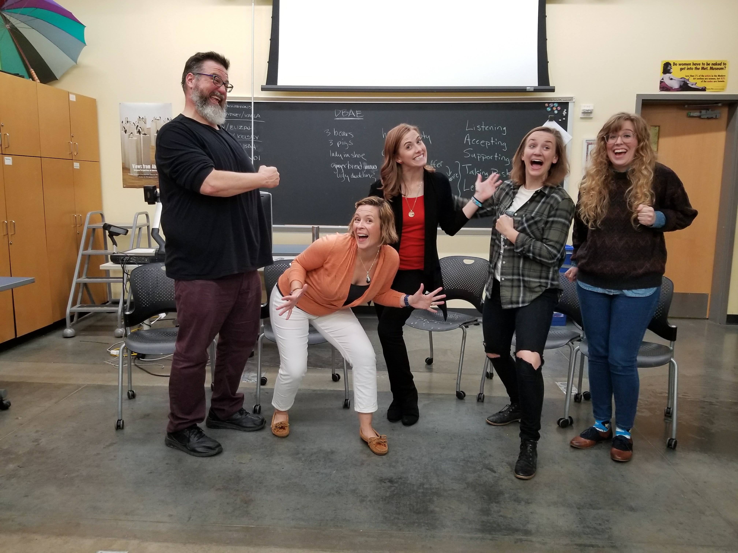
Let’s Play Some Games!

Slide 14
Safety & Attunement Games
Art Making: Using lines, shapes, and colors create an abstract picture.
Everyone Come Over Here If…
  Goals: Build safety and set the tone of the group; introduce low risk games
  Example: Everyone come over here if you used the color green.
  Example: Everyone come over here if you have traveled abroad.
Name Game
  Goals: Build safety and set the tone of the group; introduce low risk games
  Example: I am Eileen and I like swirls.
Whoosh, Bang, Pow
  Goals: Celebrate and normalize failure as a sign of vulnerability, courage, and resilience in a low-risk environment

Slide 15
Risk Taking & Acceptance Games
Go, stop, stop, go
  Goals: listening, making mistakes, normalizing failure, frustration tolerance
  Addictions: clap, shout hurray, slow/fast motion, high five
  Art making: easily adaptable to focus on art making
Yes, and: Glass of Milk & Gift Giving
  Goals: listening and accepting, cognitive flexibility, ambiguity
Party planning (but, or, and)
  Goals: Cognitive flexibility and reframing
I am a Tree
  Goals: acceptance, spontaneity, emotional tolerance, body exposure
1 Word at a Time: Books
  Goals: cognitive flexibility, emotional tolerance
  Art Making: Partner up and create the cover for one of the book titles

Slide 16
Mastery & Agency Games
White Paper Photos
  Goals: autonomy and self-efficacy
Mundane Olympics
  Goals: listening, accepting, body awareness and exposure
  Examples: vacuuming, washing a car, folding laundry
Postcards from …
  Goals: autonomy, cognitive flexibility, experimentation
  Art making: Close your eyes and create an image. Imagine that you are visiting this “place” and write a letter home.
Awkward Family Photos
  Goals: Body awareness and spontaneity
  Art Making: Using stick figures, draw an awkward family/friend photo.

Slide 17
Adaptions for Virtual Sessions
1. Use hand raising, name change, and chat features.
2.Use break-out rooms for small group or paired activities.
3. Keep everyone UNMUTED to support spontaneous participation.
4.Participating on a computer is better than a phone or tablet.

Slide 18
Facilitators
1. Model and participate
2. Be flexible and adaptable to the group needs
3. Recognize own “failures”
4. Everyone’s level of participation is different
5. Redirection through new ideas

Slide 19
References
Farley, N. (2017). Improvisation as a meta-counseling skill. Journal of Creativity in Mental Health, 12(1), 115-128. https://doi.org/10.1080/15401383.2016.1191402
Hoffmann-Longtin, K., Organ, J. M., Helphinstine, J. V., Reinoso, D. R., Morgan, Z. S., & Weinstein, E. (2018). Teaching advocacy communication to pediatric residents: the efficacy of applied improvisational theater (AIT) as an instructional tool. Communication Education, 67(4), 438-459. https://doi.org/10.1080/03634523.2018.1503314
Lawrence, C. & Coaston, S. C. (2017). Whose line is it, anyway? Using improvisational exercises to spark counselor development. Journal of Creativity in Mental Health, 12(4), 513-528. http://doi.org/10.1080.15401383.2017.1281185
Llyod-Hazlett, J. (2020). Improv-ing clinical work with stepfamilies. Journal of Creativity in Mental Health, https://doi.org/10.1080/15401383.2020.1762817
Schwenke, D., Dshemuchadse, M.,Rasehorn, L., Klarholter, D., & Scherbaum, S. (2020). Improv to improve: The impact of improvisational theater on creativity, acceptance, and psychological well-being. Journal of Creativity in Mental Health. https://doi.org/10.1080/15401383.2020.1754987
Sheesley, A. P., Pfeffer, M., & Barish, B. (2016). Comedic improv therapy for the treatment of social anxiety disorder. Journal of Creativity in Mental Health, 11(2), 157-169. https://doi:10.1080/15401383.2016.1182880
Rossing, J. P. & Hoffmann-Longtin, K. (2018). Making sense of science: applied improvisation for public communication of science, technology, and health. In T.R. Dudeck & C. McClure (Eds.), Applied improvisation: Leading, collaborating, and creating beyond the theatre (pp.245-266). London, UK: Methuen Drama.

Slide 20
Contact Information
Eileen Misluk
emisluk@iupui.edu

