Slide 1

From Paper to Purgatory
The History of Electronic Medical Records and Their Impact on Health Care
Bill Tierney, MD
Professor of Global Health and Associate Dean for Population Health & Health Outcomes

Slide 2
Conflicts of interest
None

Slide 3
Health care is a service business
What physicians and other clinicians deliver…
  Information, advice
  medication
  devices
  surgery
  physical therapy
  comfort, hope, better outcomes (hopefully!)

Slide 4
Health care is an information business
What physicians and other clinicians actually do…
  find information (prior medical records)
  gather information (history, physical, lab)
  process information (diagnoses, treatments → decisions)
  record information (notes, reports, etc.)
  communicate information (information, advice, orders, letters)
The quality, efficiency, and effectiveness of care depend on our ability to manage information

Slide 5
A case…
81 y.o. man arrives in the ED awake, confused after a fall
No reliable information from the patient
No local records
Nobody accompanied him in the ambulance
Physical examination → severe orthostatic hypotension, non-focal neuro exam, Parkinsonian tremor, ataxia
Mental exam → pleasant, conversant, mild dementia, expressive aphasia

Slide 6
A case…
Lives alone with caretaker after wife’s death
Family lives out of state → no contact information
Lab tests → normal except ↑ creatinine (2.0)
Imaging → small intracerebral bleed, cerebral atrophy
Neurosurgeon → hospitalize for observation

Slide 7
A case…
Patient’s in-home caregiver calls son → father in hospital
Son calls hospital and is told, “Your father is in intensive care, his condition is critical, and I can’t tell you any more because of HIPAA.”
Son not allowed to speak to his doctors → can’t provide…
  Name of the patient’s primary care physician
  Past medical history → Lewy body dementia, MSA, prostate cancer
  Medications father is taking, desire for no invasive treatments
  Prior reaction to Sinemet → severe agitation and delirium

Slide 8
A case…
Hospitalist writes admitting orders
Orders include Sinemet for patient’s “Parkinson Disease”
Patient becomes delirious and agitated
  Sedated with lorazepam
  Adverse reaction → pulmonary arrest → cardiac arrest
  Successfully resuscitated
  Placed on a ventilator

Slide 9
A case…
Patient in ICU, remains in a coma
Neurosurgeon repeats exam and CT scan → small hematoma does not explain coma → “due to arrest?”
Family flies in from out of state
  Informs them the patient did not want invasive measures
  Makes arrangements for nursing home placement if the patient wakes up
  Return home awaiting outcome of treatment

Slide 10
A case…
Patient remains in a coma
Breathing improves → off ventilator → transfer to ward
Ward medicine service → no family contact information
Patient stabilized and transferred to a nursing home
Family unaware of transfer to nursing home
Patient has another arrest → full resuscitation → dies

Slide 11
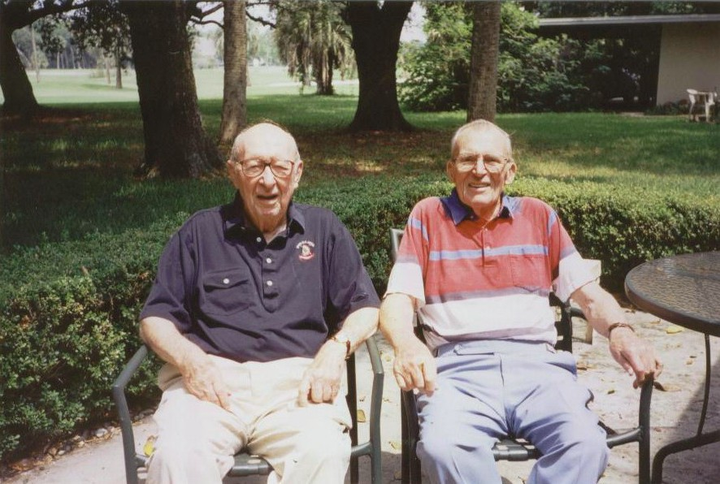

Slide 12
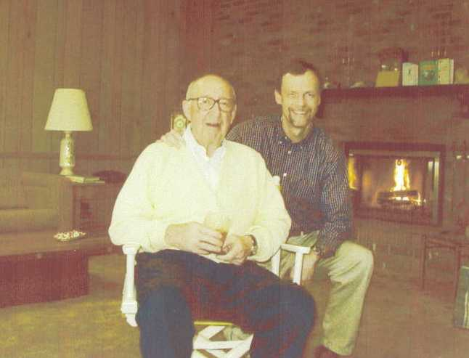

Slide 13
What happened here?
No communication between outpatient/inpatient care
  PCP’s office had no EHR, only paper records
  But they had electronic billing!
  No way to communicate between health care providers
The drug reaction had been recorded in PCP’s records
It didn’t follow the patient to the hospital
No information → poor (fatal) management

Slide 14
What happened here?
Health care is an information business
The quality, safety, efficiency, effectiveness, and costs of care depend on having:
  The right information
  On the right person
  At the right time & place
  Presented in the right way
  To make the right decisions
The “five rights” of health information

Slide 15
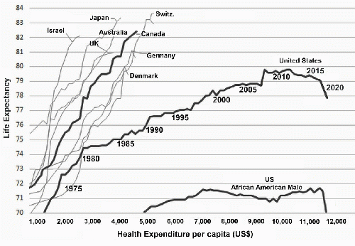
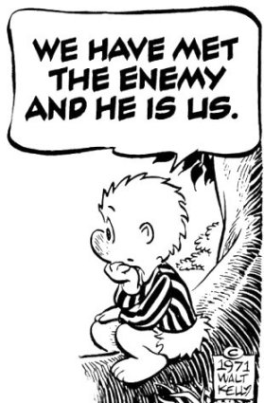
U.S. health care
Health care in the U.S. is broken
Poor communication is a major culprit
We are all health care consumers
We are all health care payers
We deserve better
Our patients deserve better
Our communities deserve better
We can do better

Slide 16

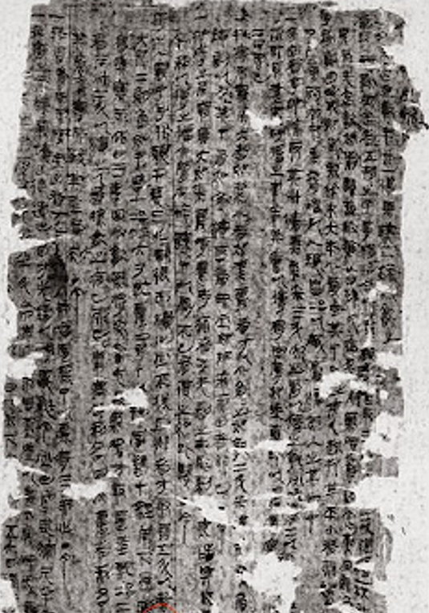
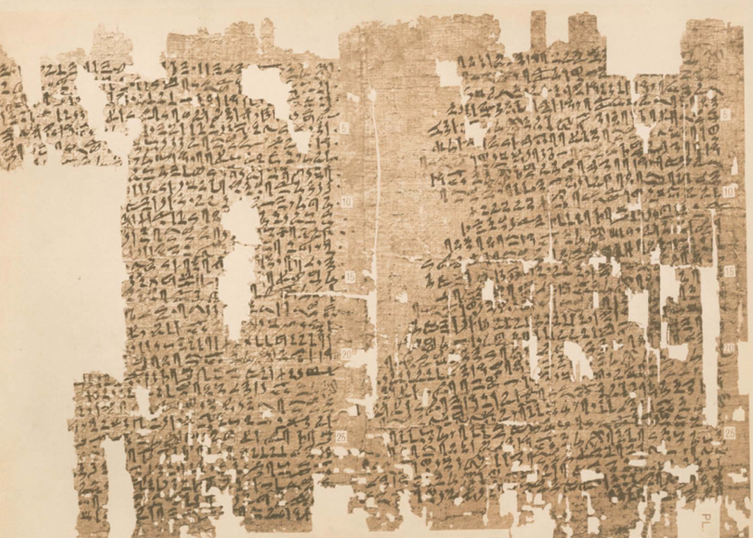

Slide 17

Why document?
Create a record for longitudinal care
  Future visits to self
  Future visits to others
  Patient inquiries
  Research → practice, academic
Billing → diagnoses, time & effort & materials
Practice management
Quality improvement, best practices, malpractice
Most Important reason:
To help the clinician comprehensively think about the patient, the visit, what was found, and what is needed

Slide 18
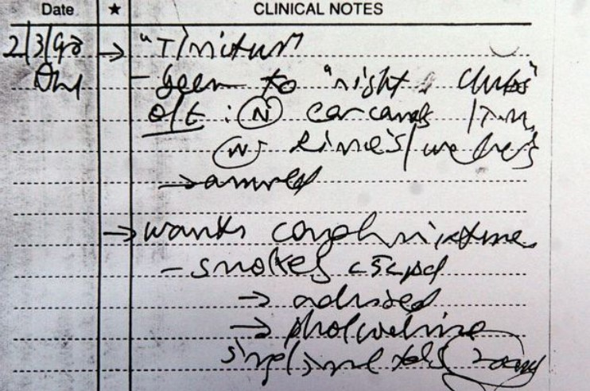
Documentation before the digital era

Slide 19
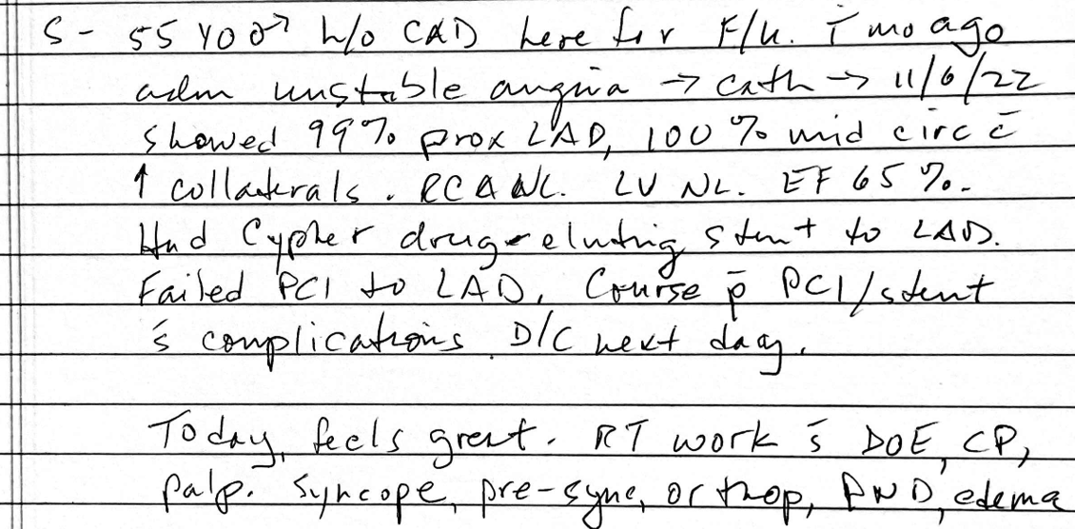
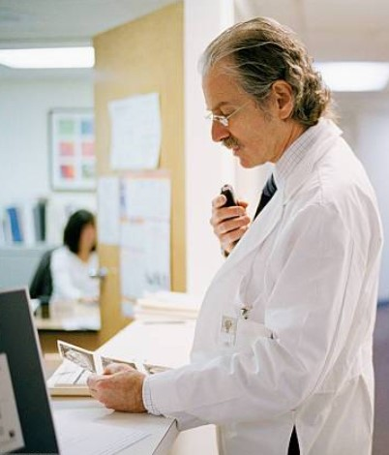
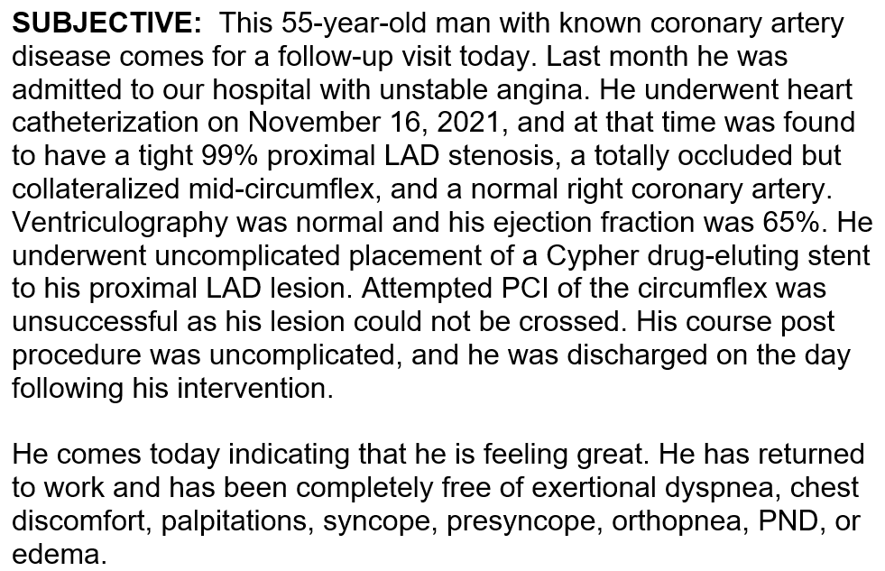
Documentation before the digital era

Slide 20
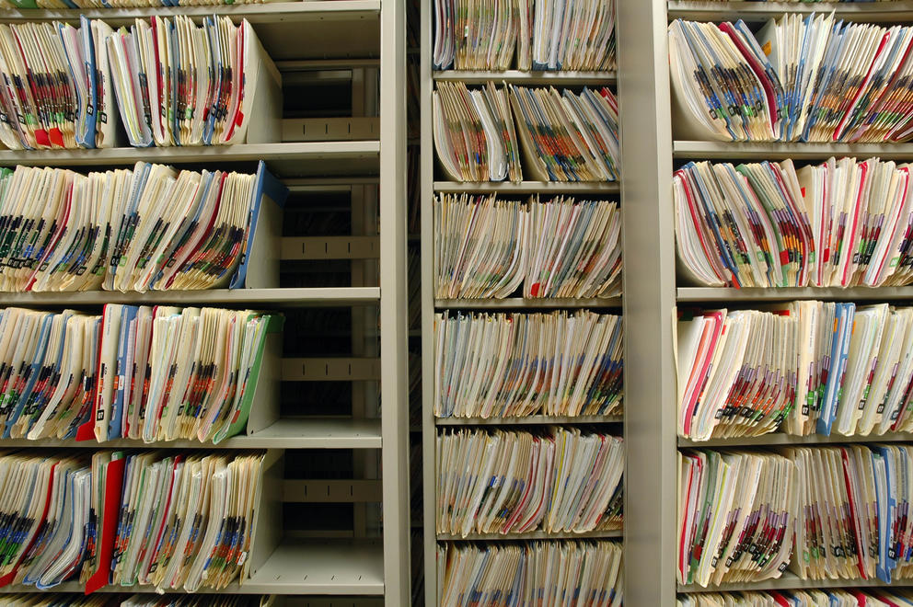

Slide 21
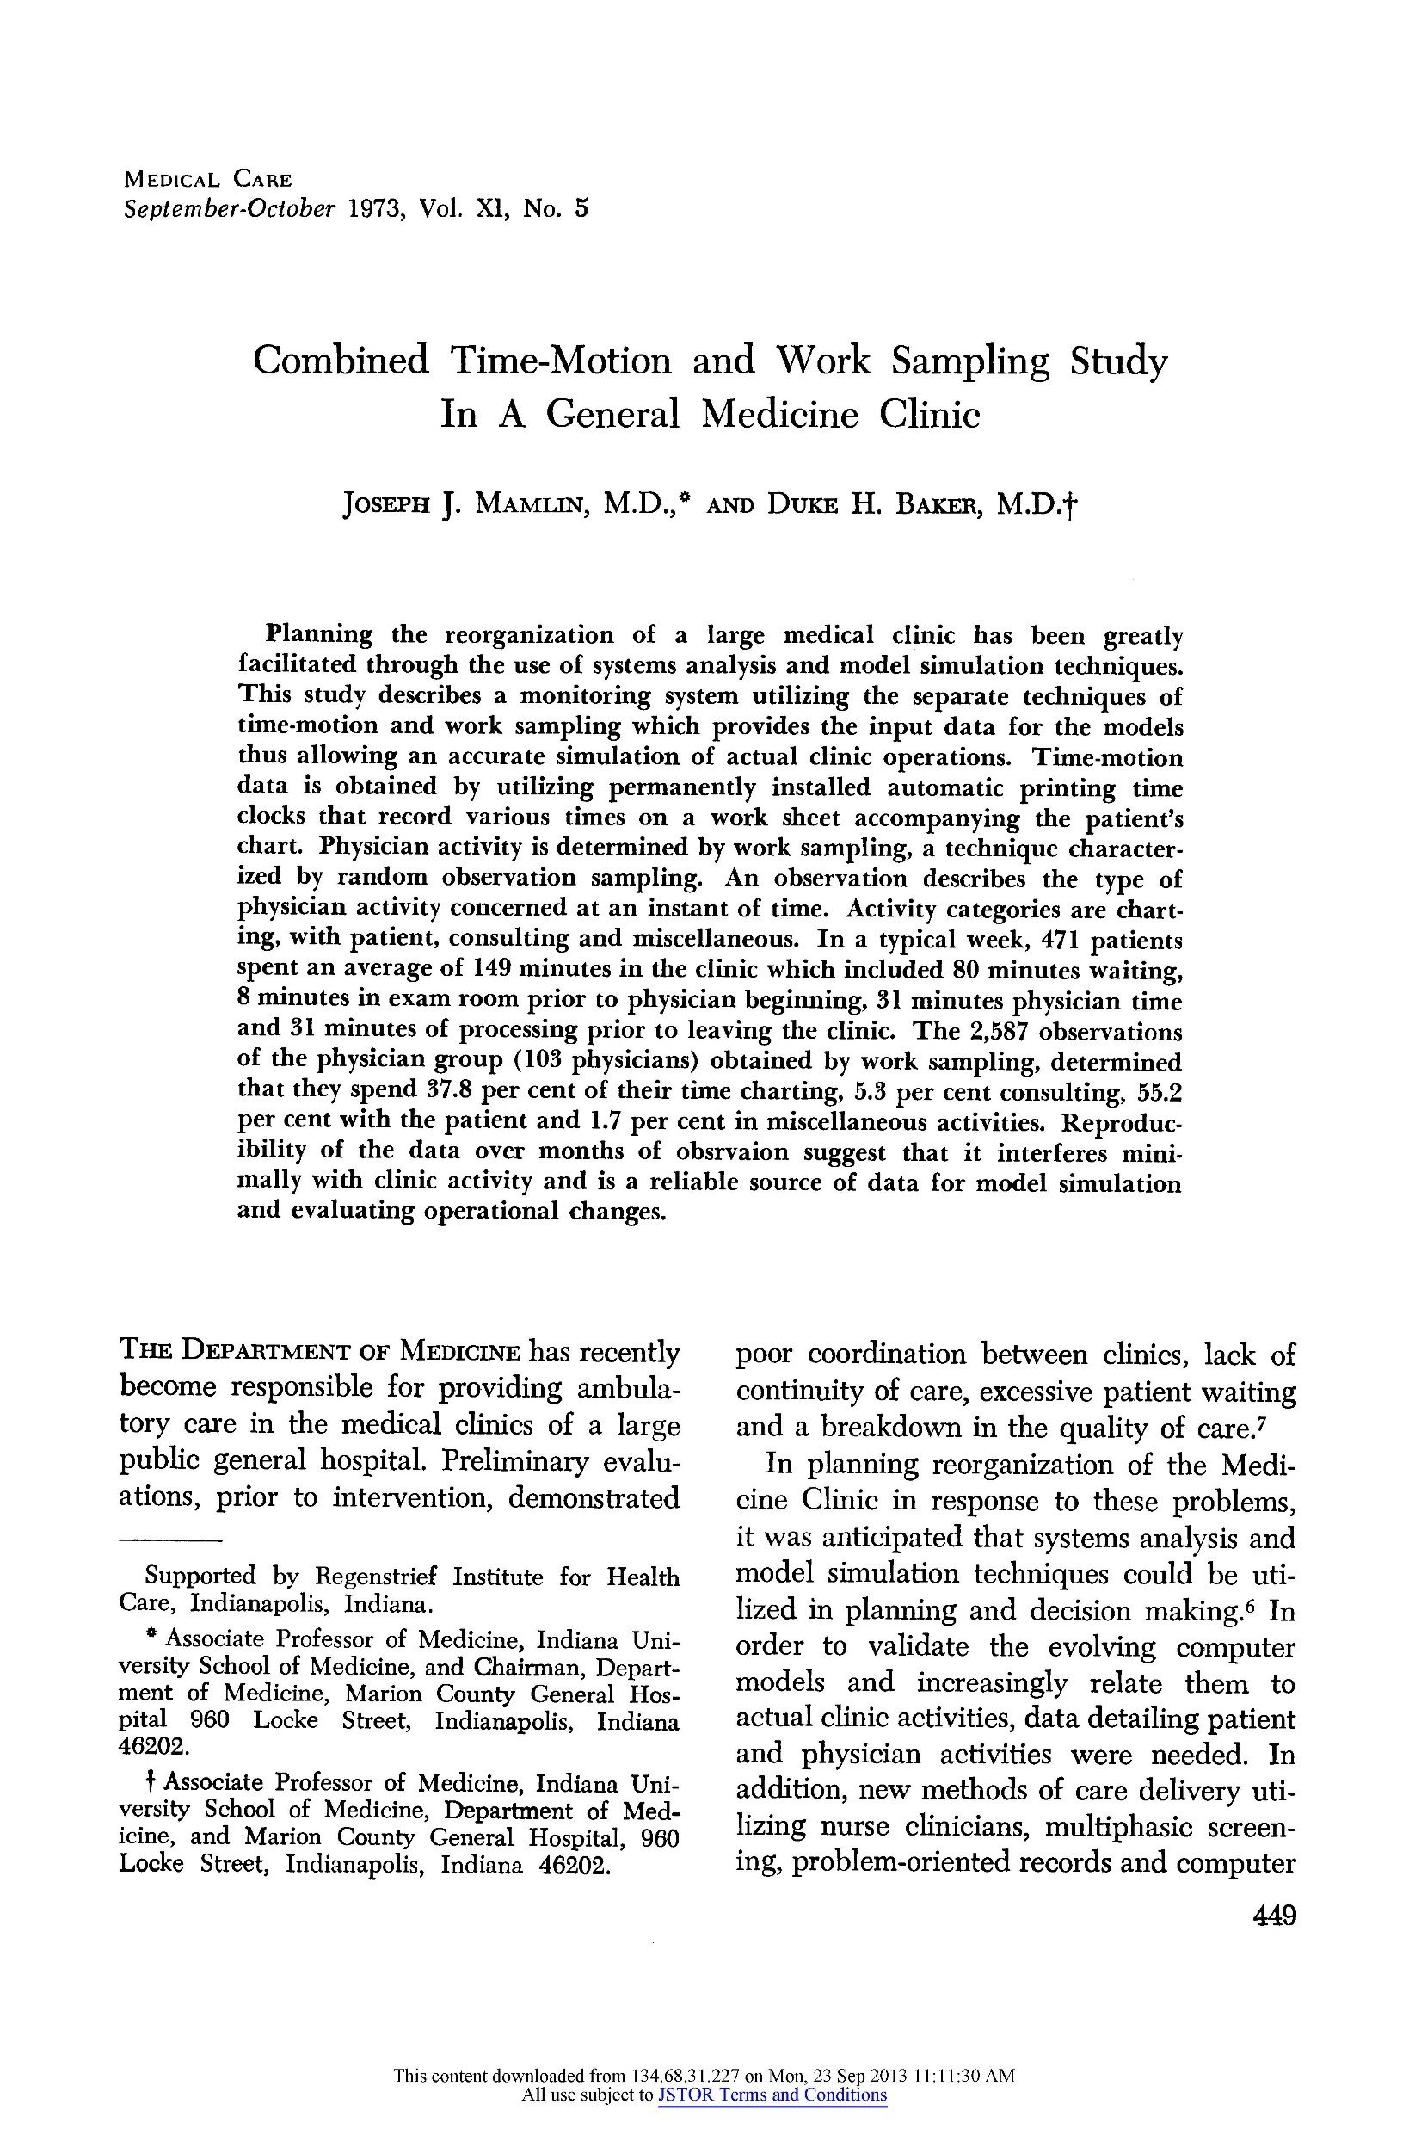
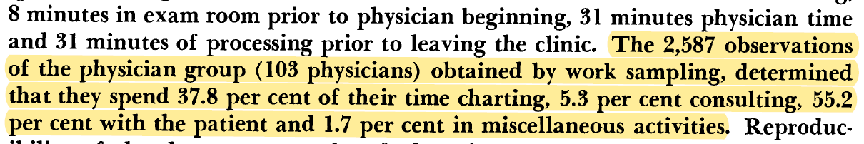

Slide 22
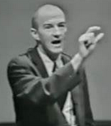
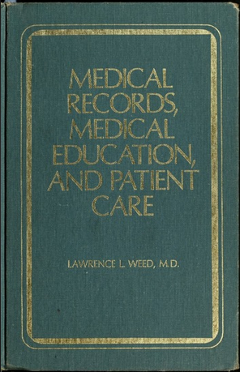
Larry Weed: Problem-oriented medical record
Standard note format: SOAP
  Subjective
  Objective
  Assessment
  Plan
Organized clinical thinking
Preparation for computerization → Problem-Oriented Medical Information System (PROMIS)

Slide 23
Paper is good!
Cheap
Easy to use → no user manual
Portable
Malleable

Slide 24
Paper ain’t so good!
Easily corruptible
Not searchable
Difficult to secure
No control over what’s written
Often illegible
Expensive, cumbersome to store, retrieve

Slide 25
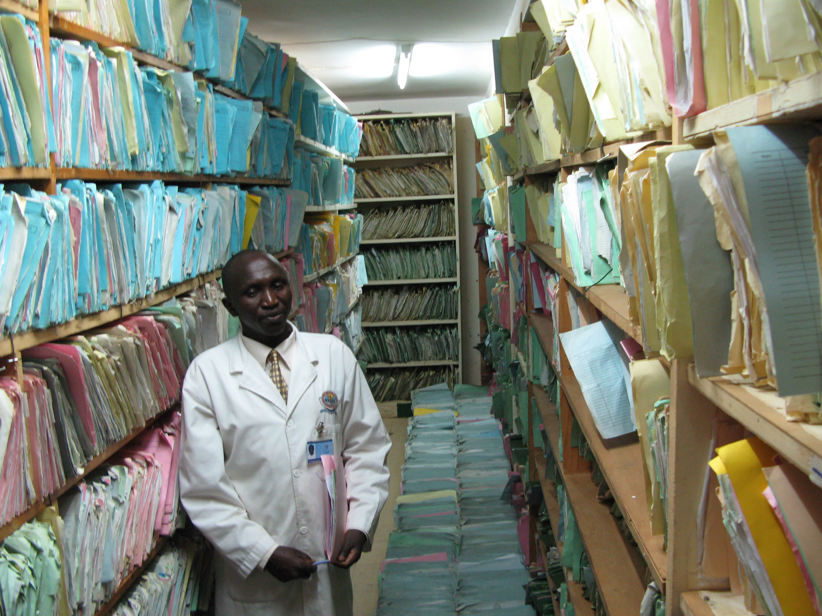

Slide 26
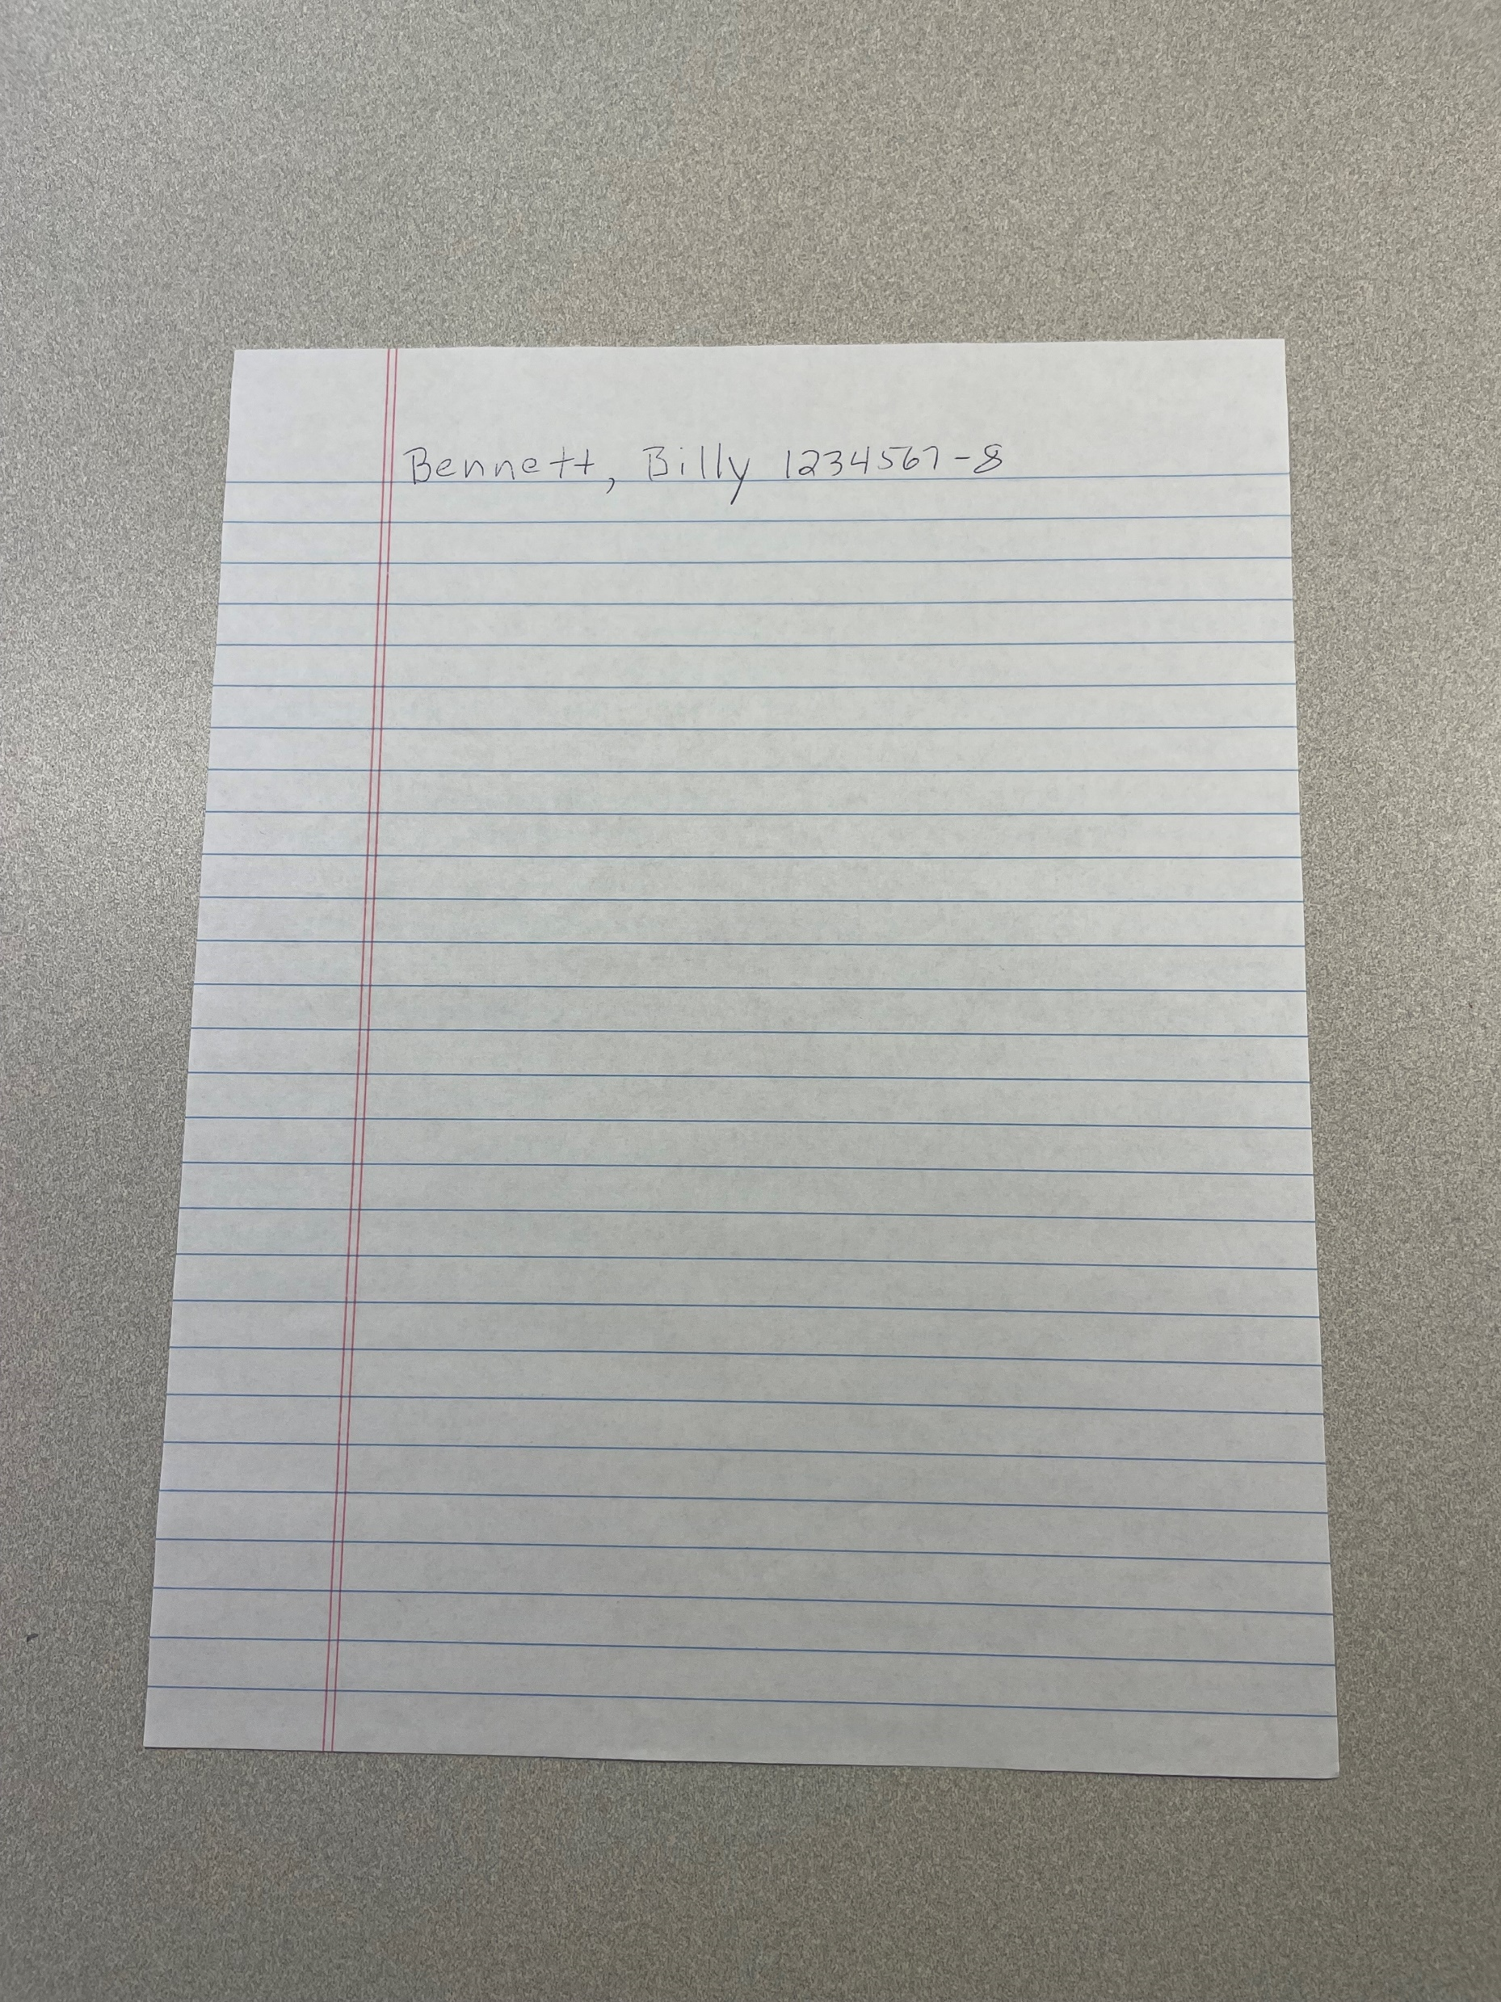
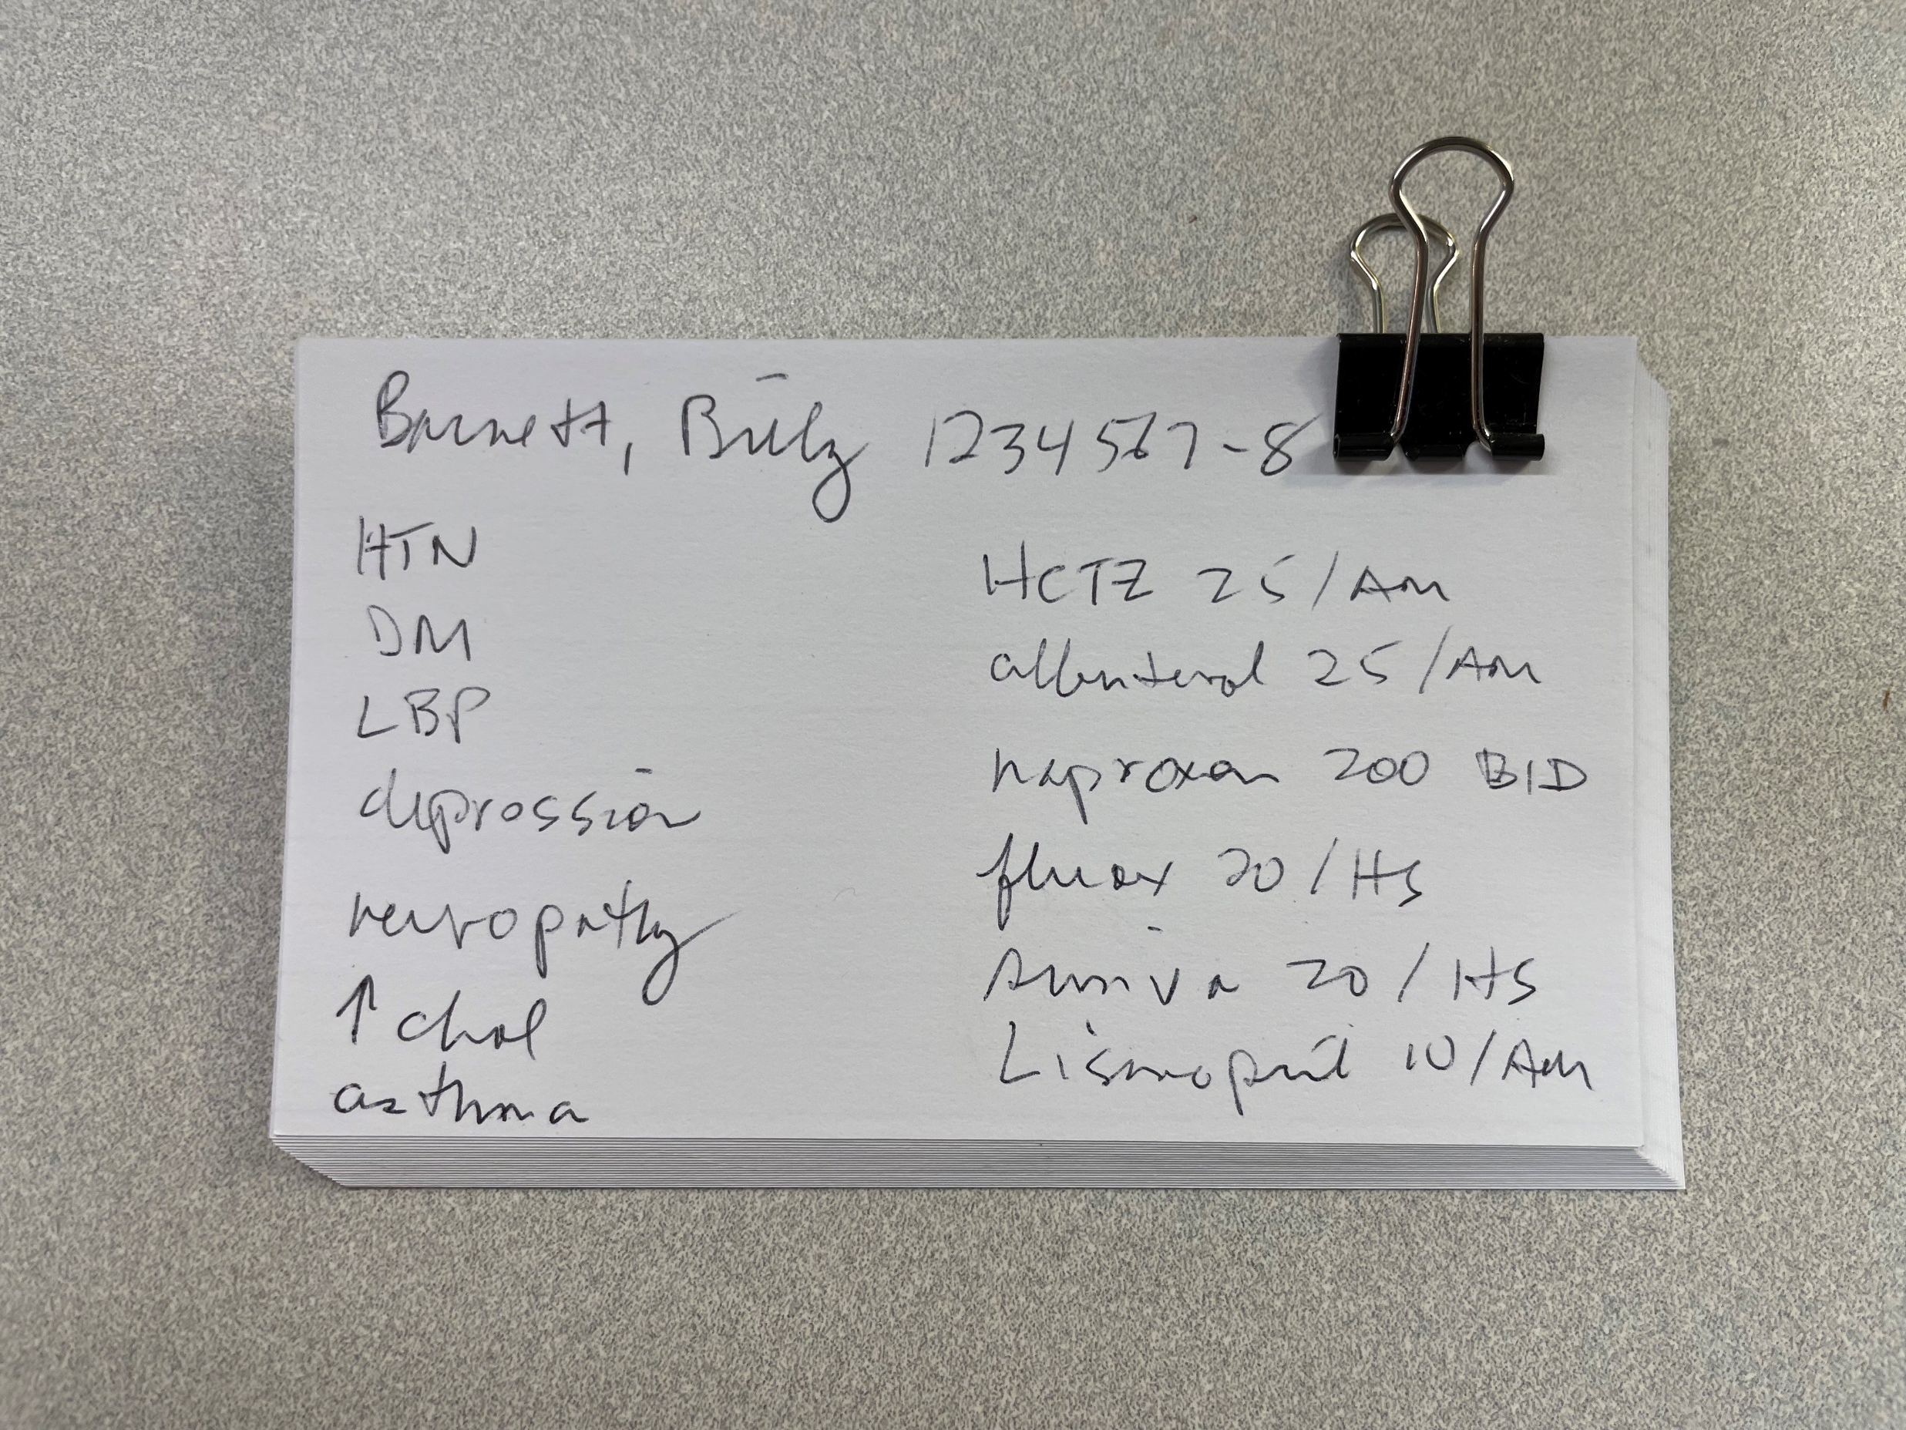

Slide 27
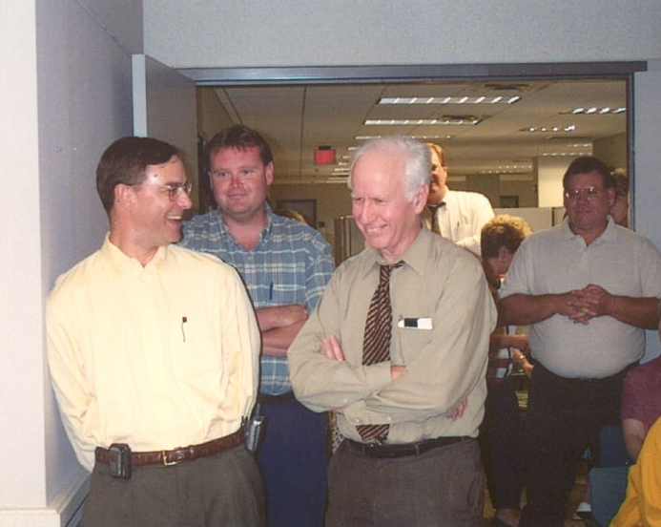
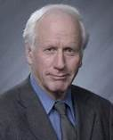
Clement J. McDonald, MD, MS
Clem

Slide 28
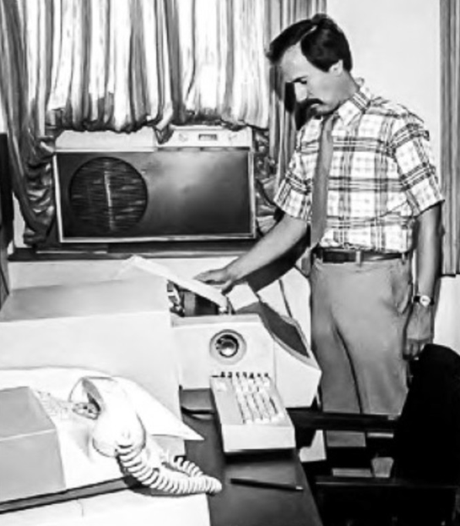
1972

Slide 29
1974: Initial RMRS Prototype
Registration and scheduling (ADT)
  Patient ID, demographics (birthday, sex, race)
  Billing information (billing diagnoses, insurance, etc.)
  Appointments scheduled
  Appointments kept
    Location
    Dates
    Clinician(s) seen

Slide 30
1974: Initial RMRS Prototype
Registration and scheduling (ADT)
Laboratory information system
  Clinical test results
  Coded results of xrays and other imaging studies
  Vital signs
  Diagnoses
  Other digitized data (from encounter form, etc.)

Slide 31
1974: Initial RMRS Prototype
Registration and scheduling (ADT)
Laboratory information system
Pharmacy system
  Drugs dispensed
    Drug name, dosage form, dose
    Patient instructions
    Days supply given
    All data necessary to manage the Wishard Pharmacy

Slide 32
1974: Initial RMRS Prototype
Registration and scheduling (ADT)
Laboratory information system
Pharmacy system
Database
  Patient name
  Date
  Dictionary term (coded)
  Value (number, code, free text)

Slide 33
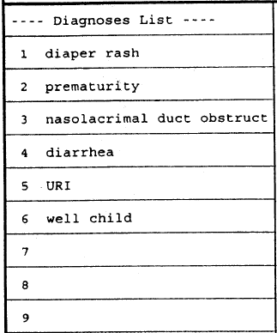
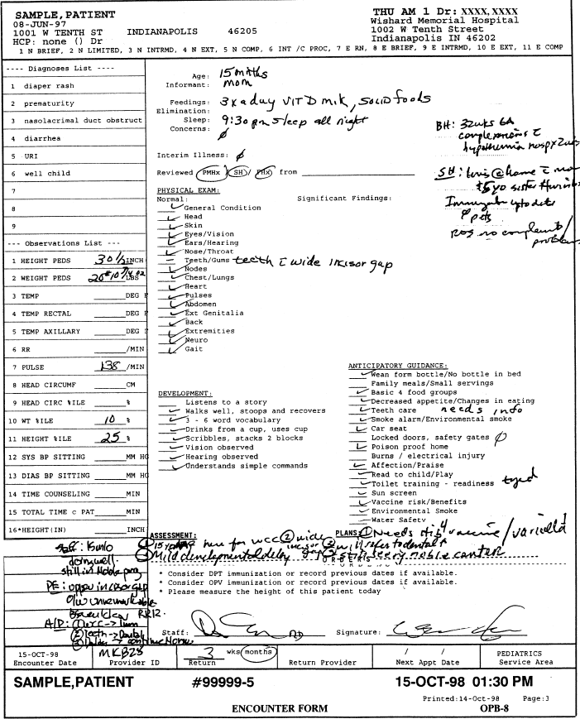
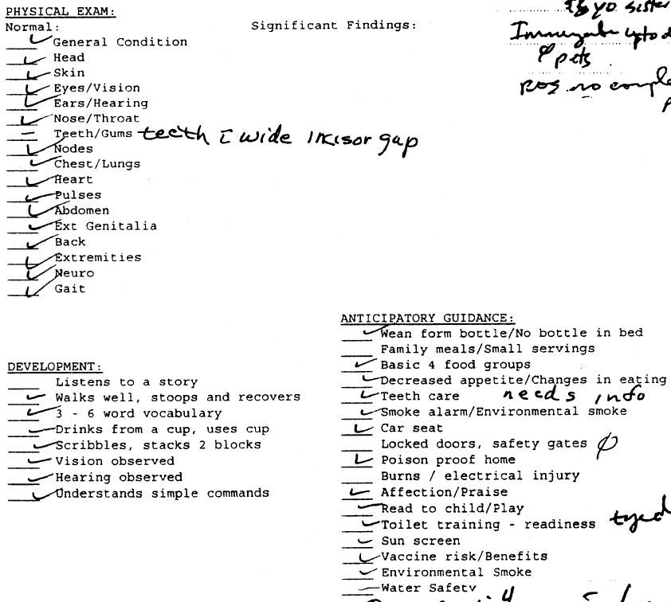
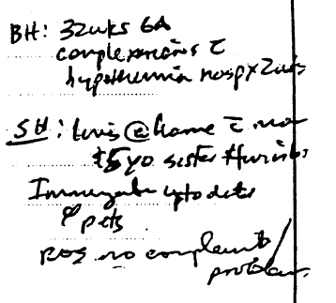
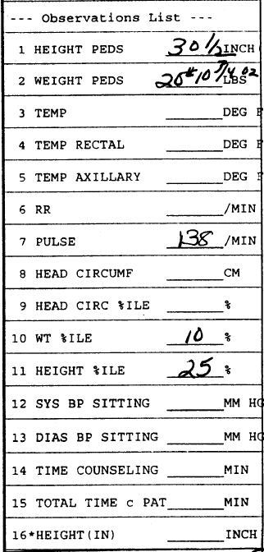
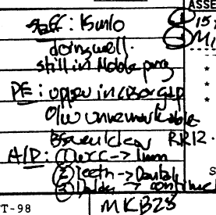

1977

Slide 34
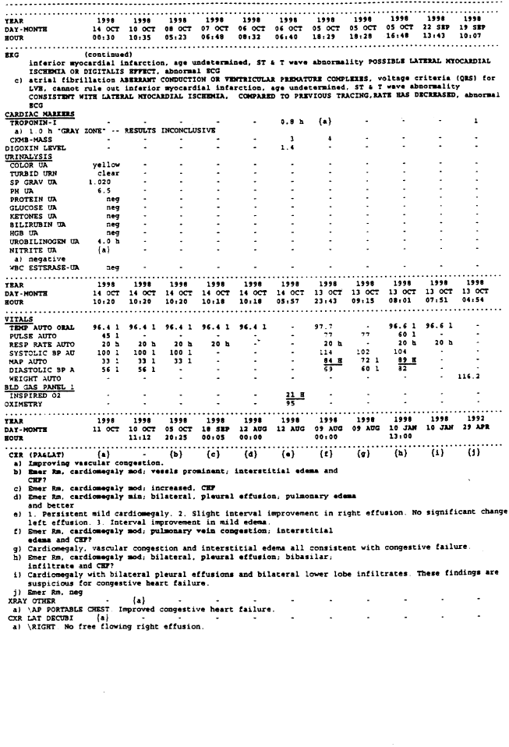
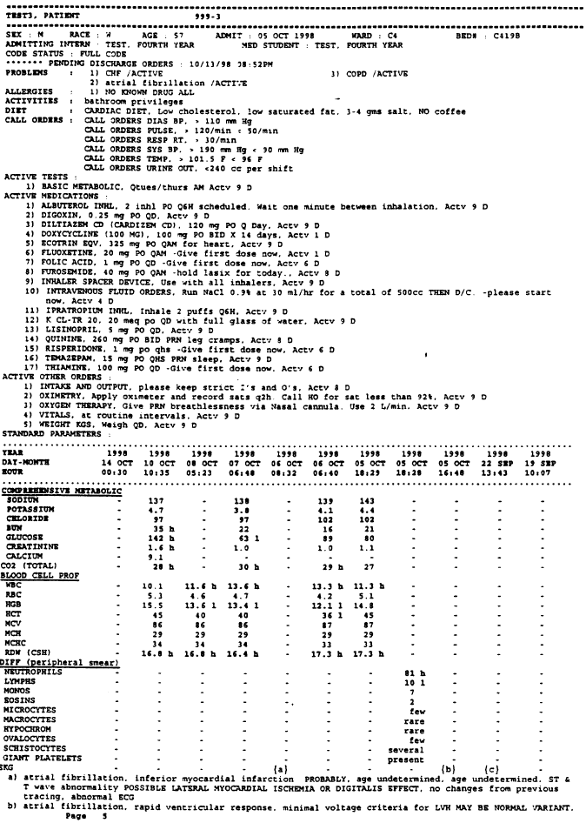

1974

Slide 35
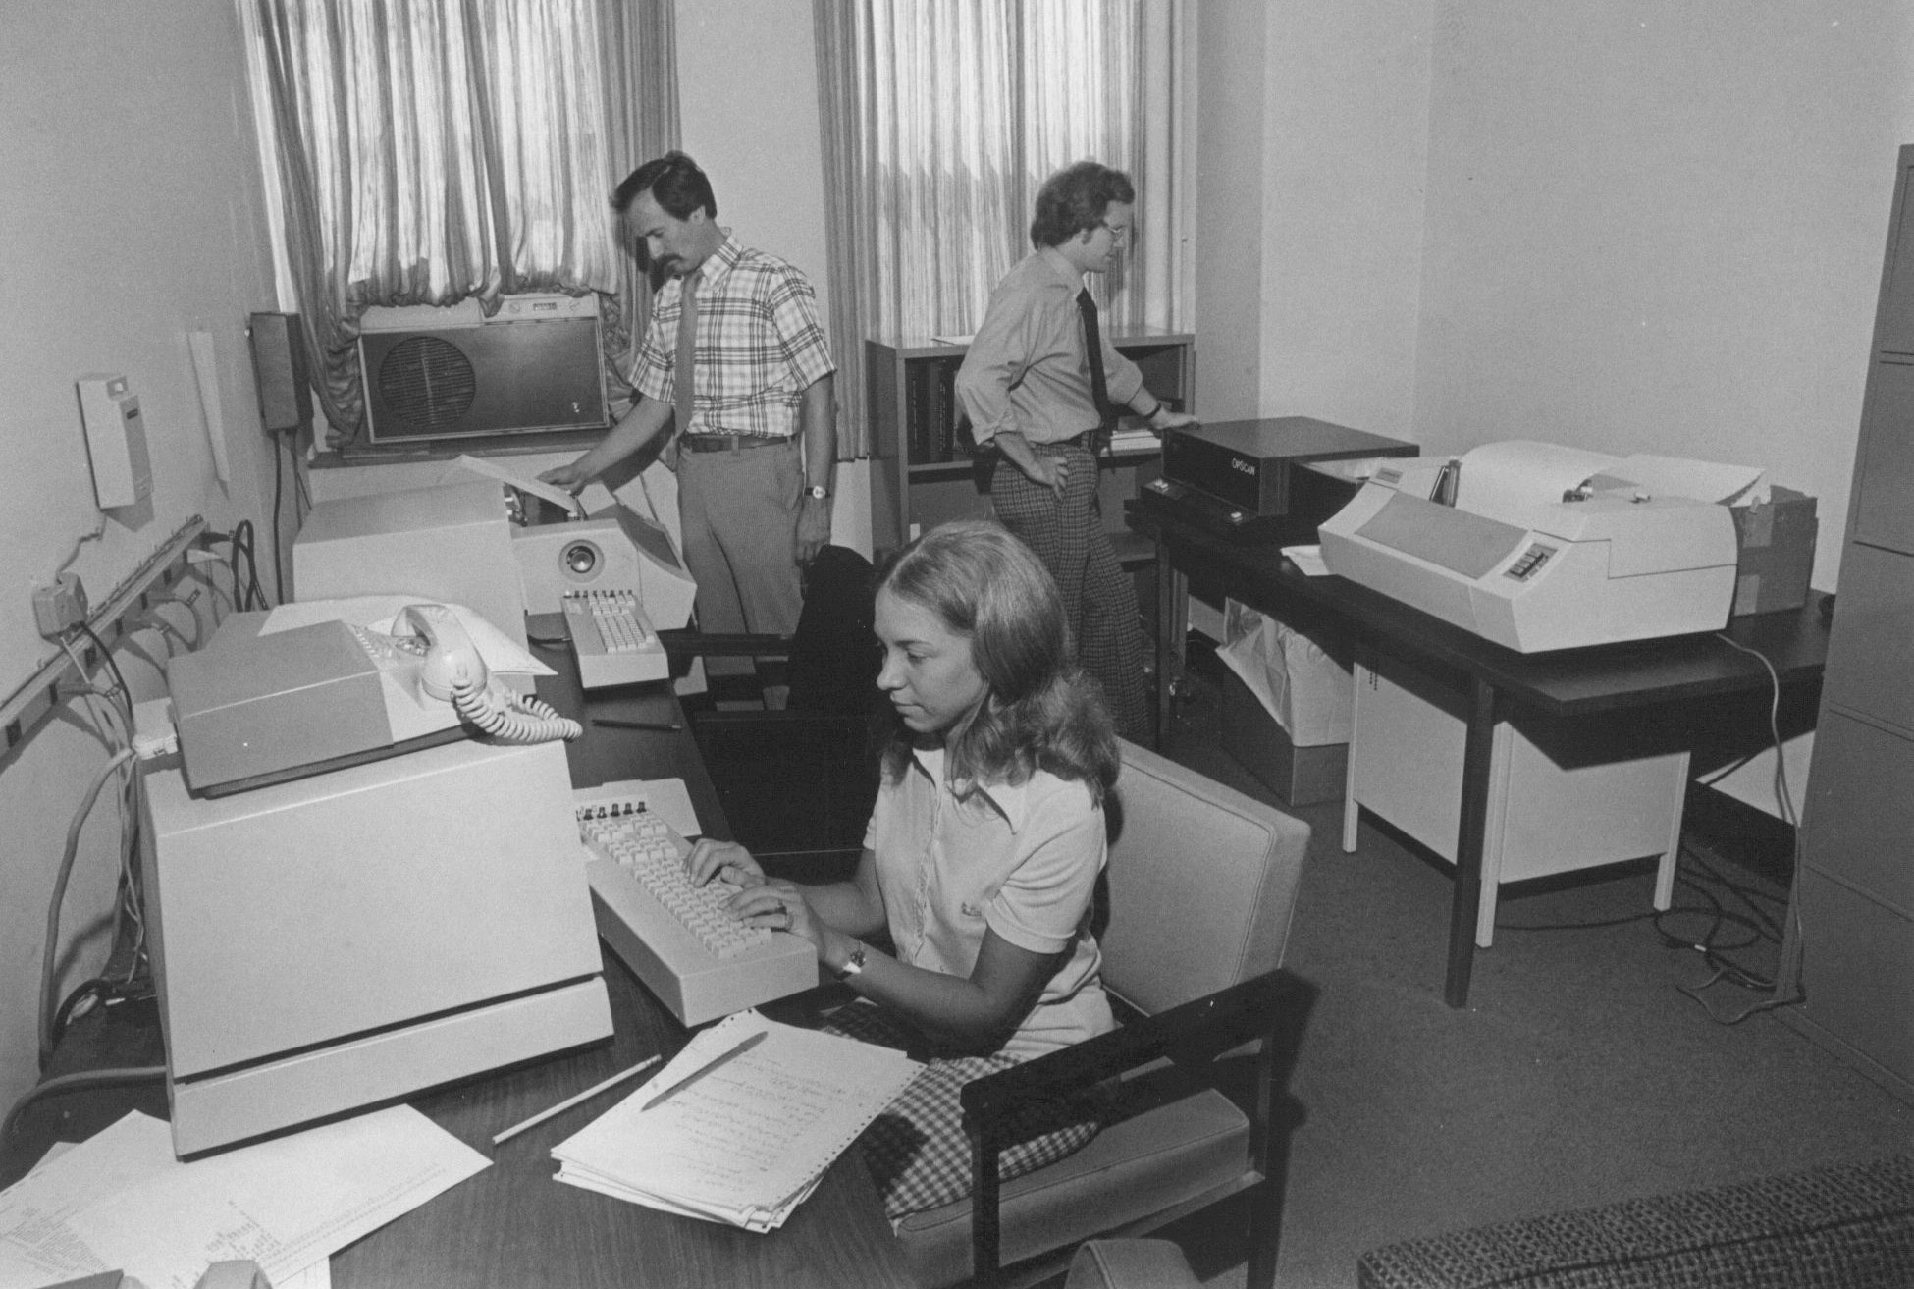
RMRS Deployment Timeline
1972-74 Initial development & implementation
1974-76 Wishard Hospital Diabetes Clinic

Slide 36
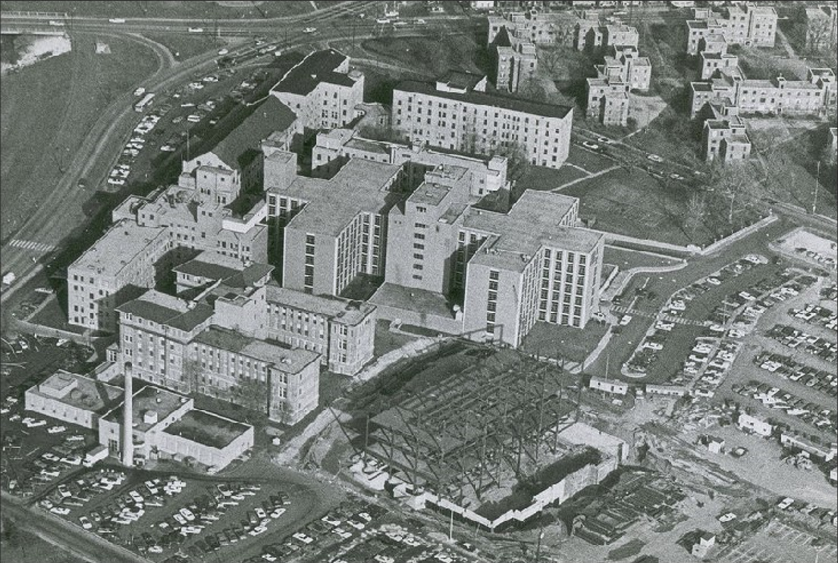

Slide 37
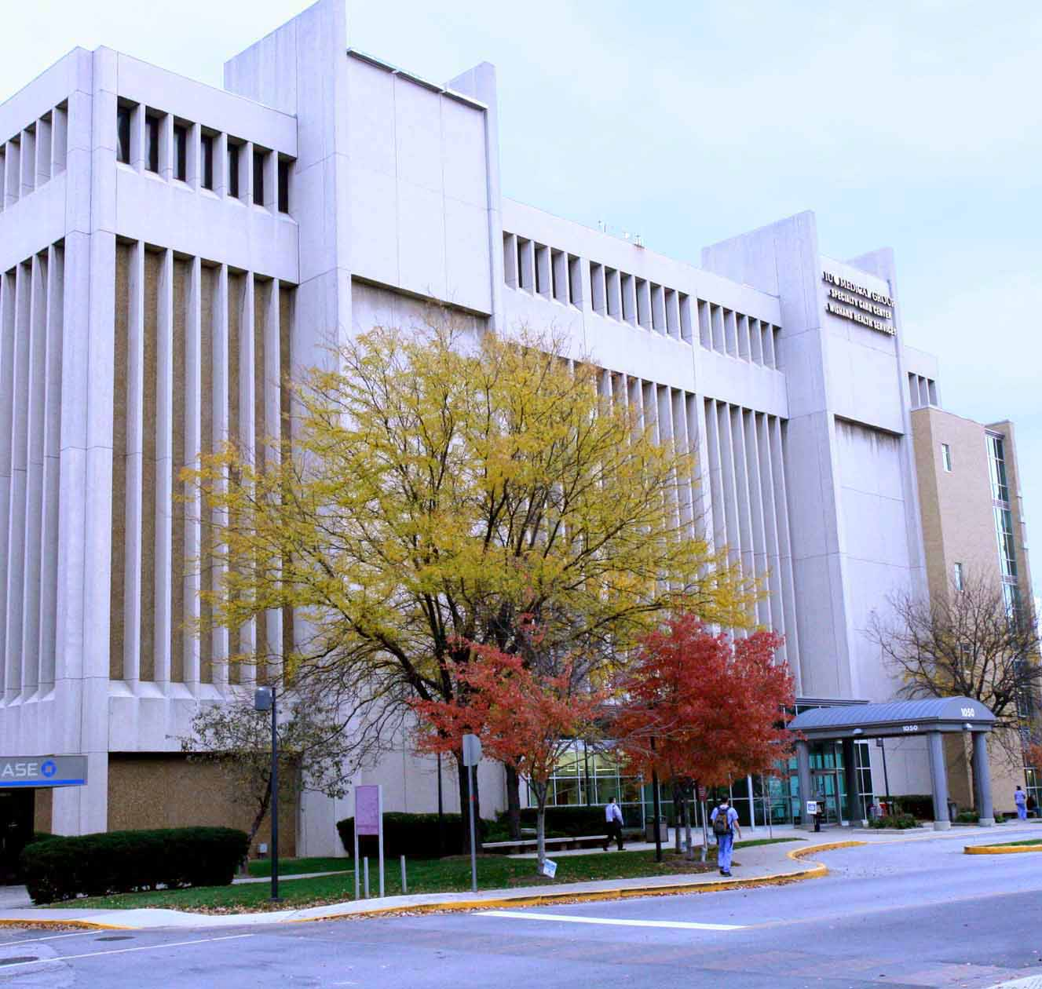

Slide 38
RMRS Deployment Timeline
1972-74 Initial development
1974-76 Wishard Hospital Diabetes Clinic
1977 Wishard Hospital General Medicine Clinic
1979 Wishard Hospital Special Medicine Clinics
1983 Wishard Hospital Pediatric & Ob/Gyn Clinics
1986 Deployed in Wishard Emergency Dept and
for all hospital admissions

Slide 39
Documentation in practice workflow
Patient checks in → clerk at desk → ADT system
Patient waits…
Medical attendant collects vitals → encounter form
Clinician (physician, APP) reviews patient’s chart in work room
Patient in room → clinician enters room
Takes history, review paper chart, physical exam, discussion
Patient leaves room, clinician goes to work room
Clinician writes note, orders, requisitions, letters, etc.
Key EHR implementation point:
The clinicians used a paper platform for documentation

Slide 40
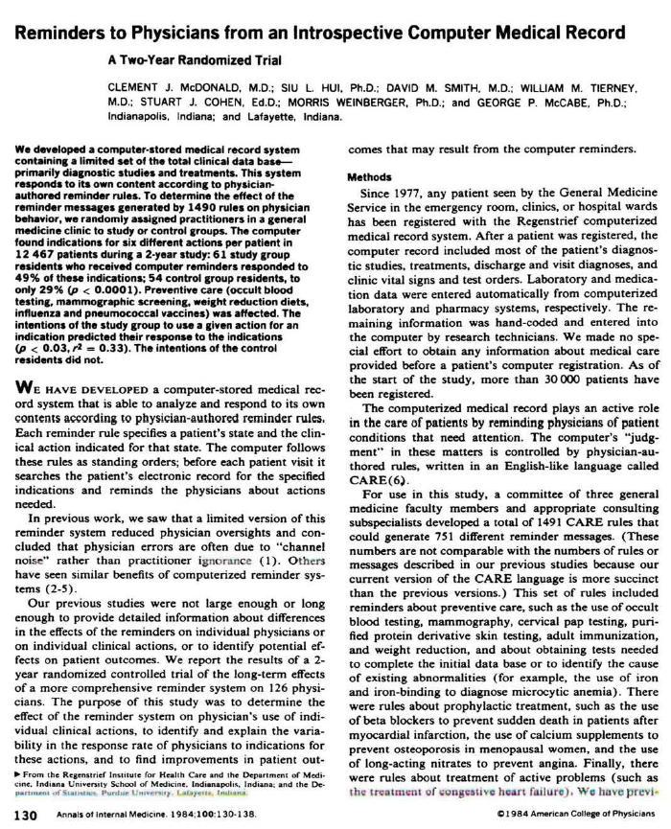
Reminder Study
Randomized, controlled trial
Site = General Medicine Clinic
Intervention = encounter forms, summaries, reminders
Control = encounter forms, summaries, no reminders
Duration: 1978-80
Subjects
  114 resident physicians, 11 faculty internists, 4 NPs
  12,467 patients

Slide 41
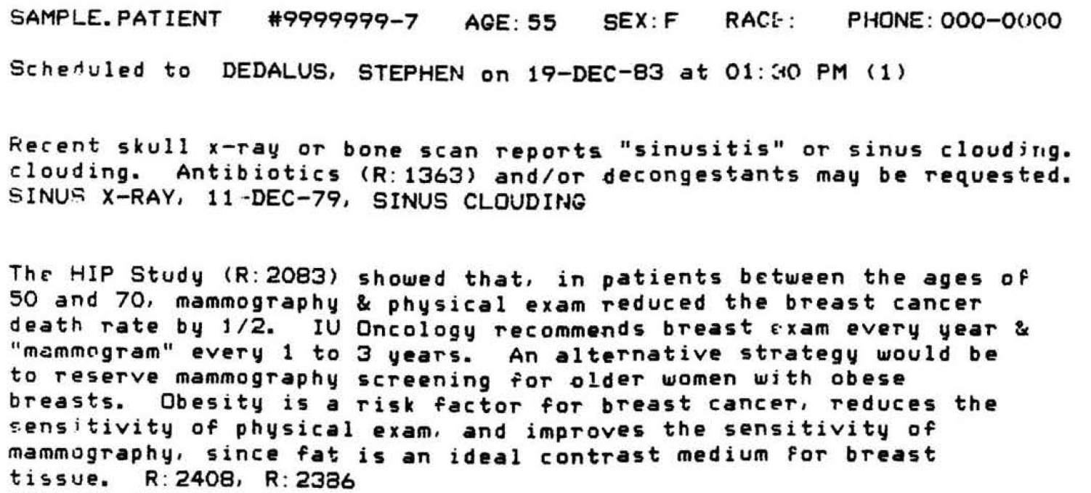

Slide 42
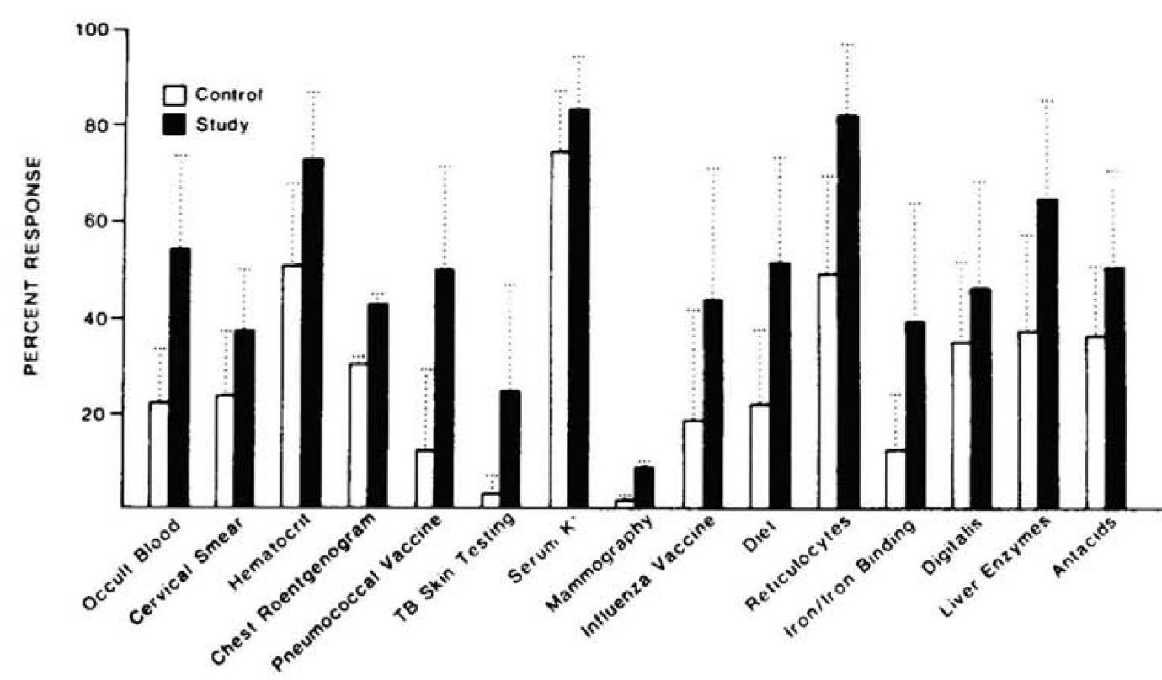
Intv: 49%
Con: 29%

Slide 43
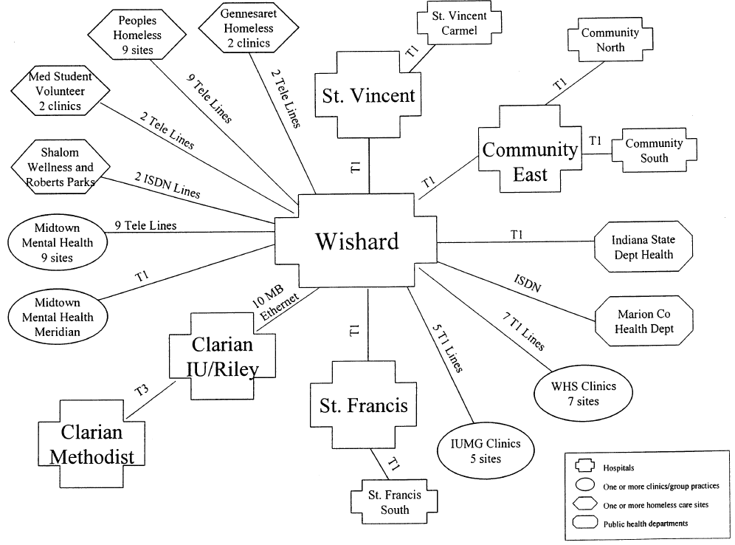
1986
One of the nation’s first distributed EHR networks

Slide 44
Computer-Based Order Entry
RMRS → capture of patient information
No interaction with clinicians when they make decisions
Constrained ability to affect decisions, care, outcomes
Strategy: capture clinician orders and notes electronically by having physicians type notes and orders into a computer

Slide 45
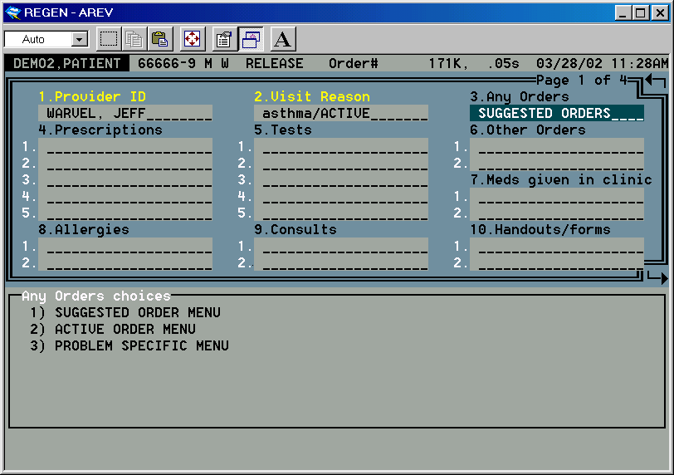

Slide 46
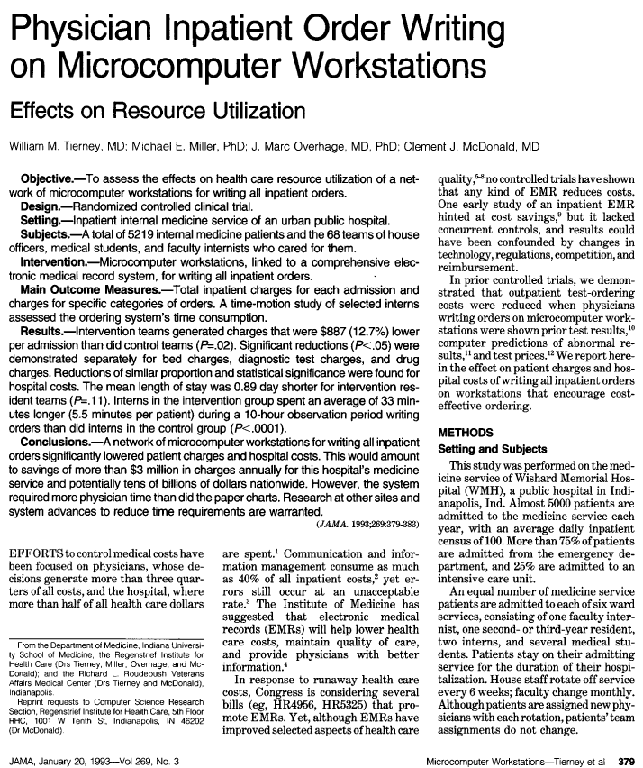
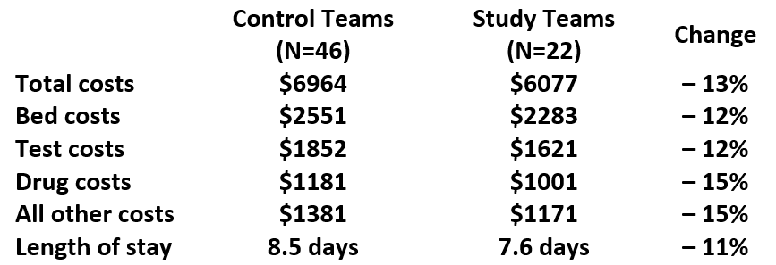

Slide 47

Among 92 safety net health systems, Wishard Health Services had the highest quality score and was in the bottom quartile in costs

Slide 48
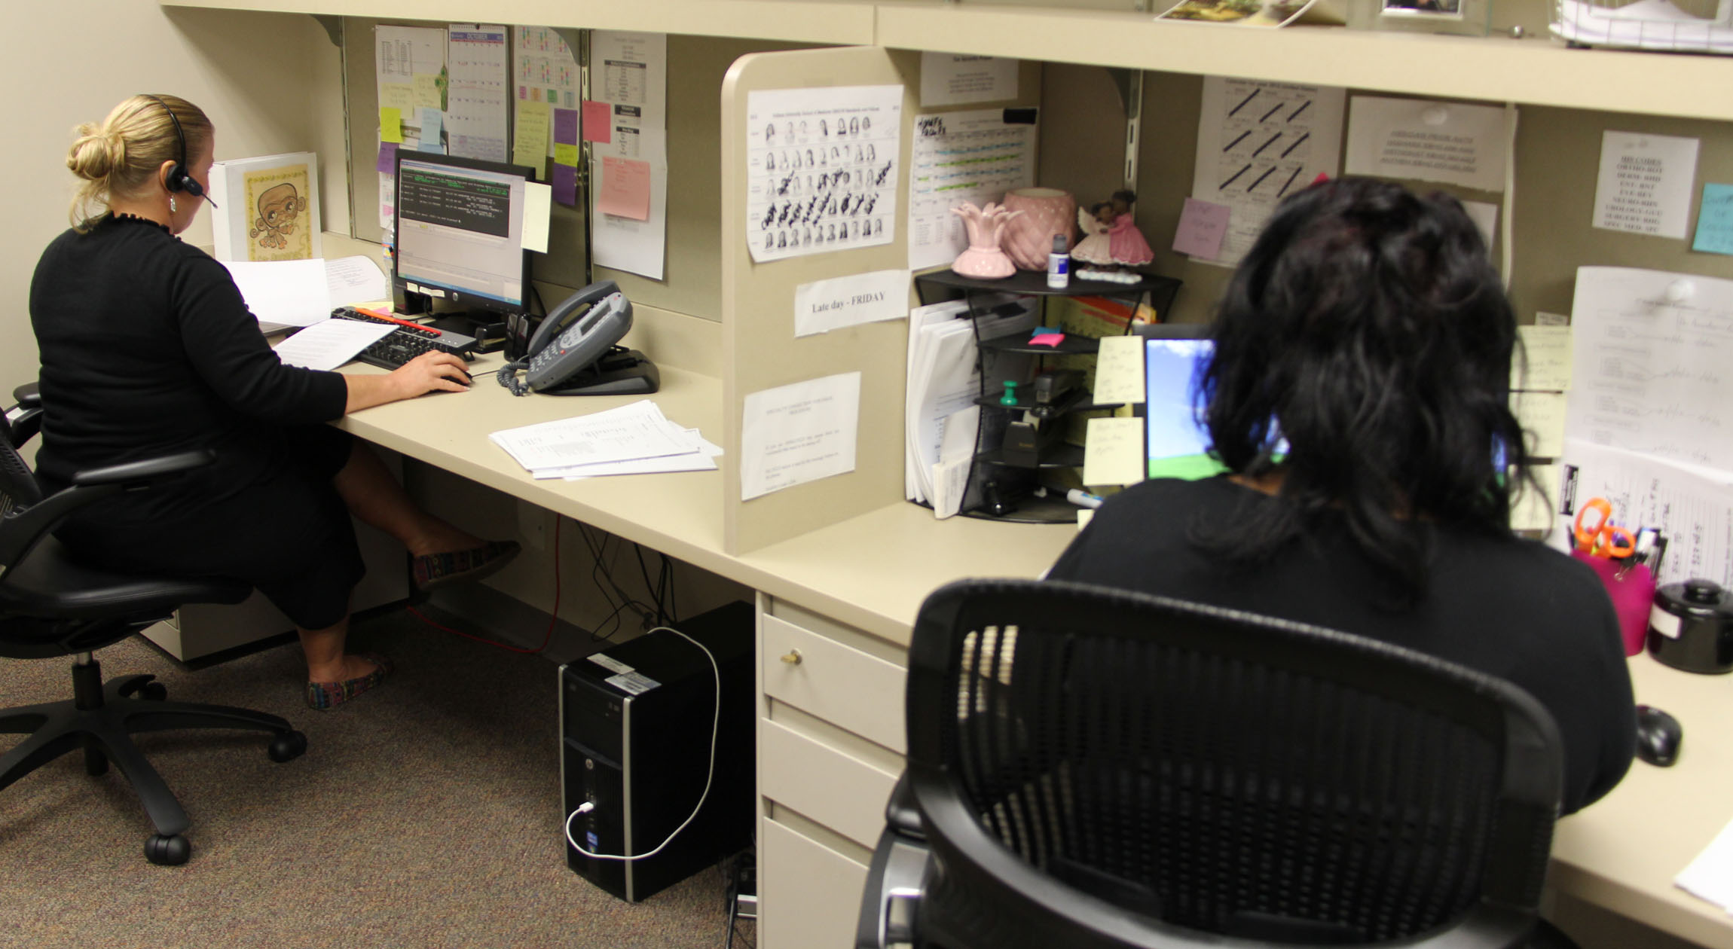
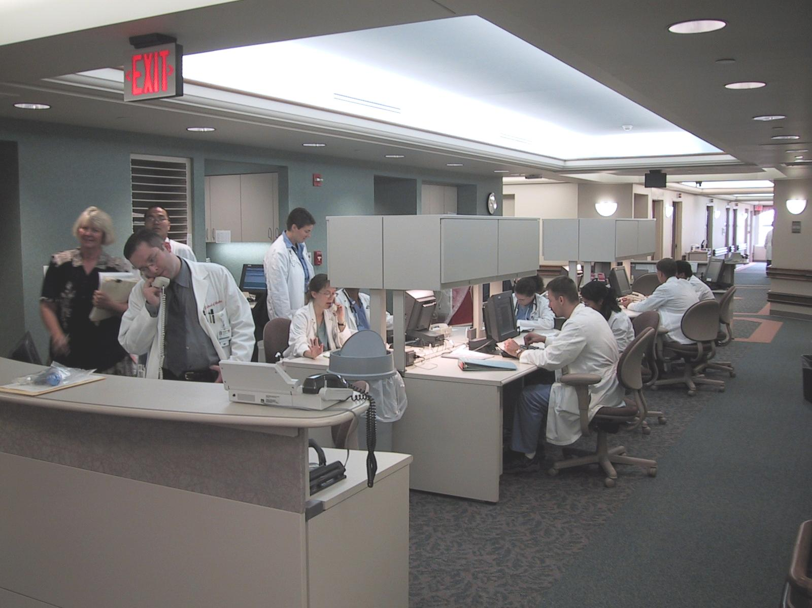
1988
2012

Slide 49
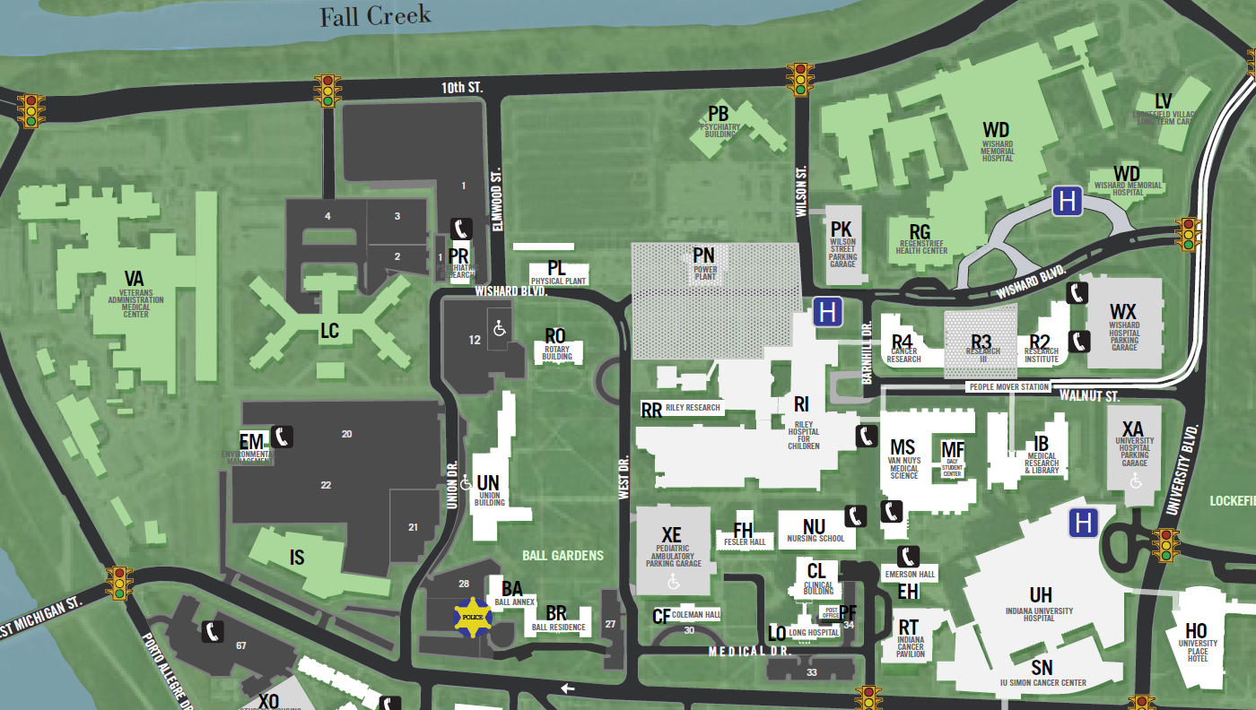
1989
1988

Slide 50
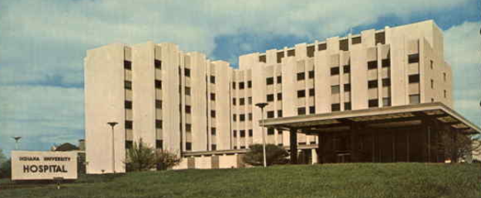
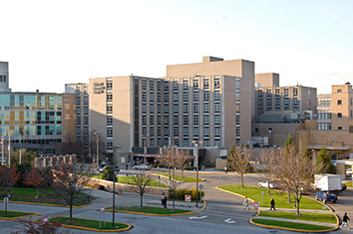
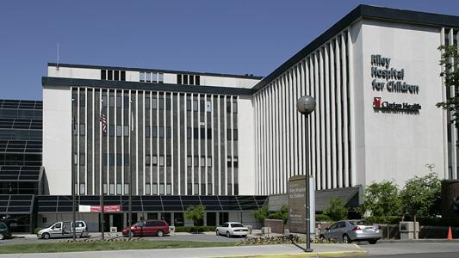
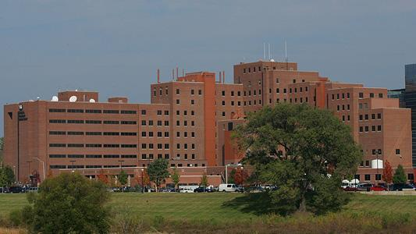
The first U.S. health information exchange
1988
1989

Slide 51
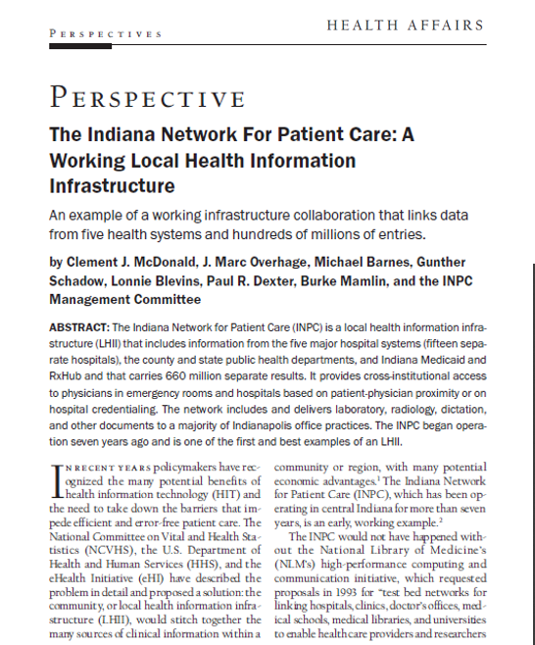
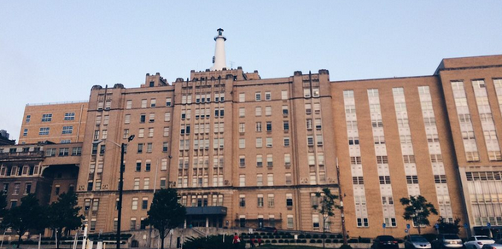
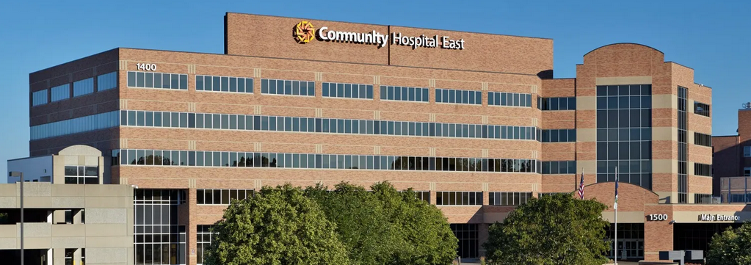
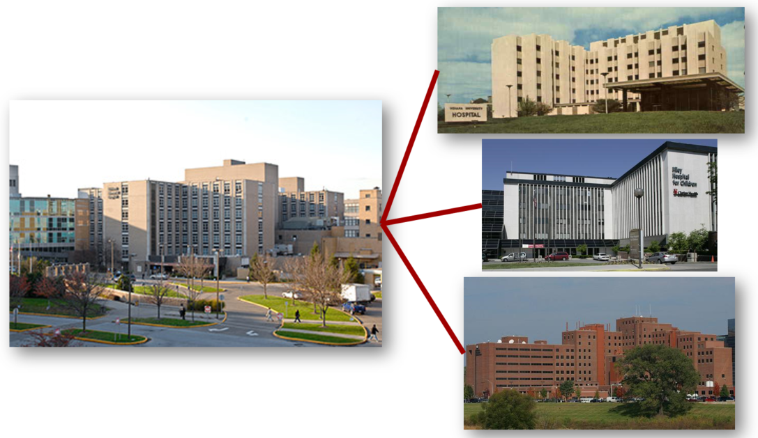


1995

Slide 52

Indiana Network for Patient Care
Number of Hospitals

Slide 53


Slide 54
INPC core data feeds
Admission and discharge data
Clinical laboratory data (blood, urine, other fluids)
Microbiology laboratory data
Pathology reports
Radiology and other imaging reports
Clinicians’ notes
Optional: cardiology procedure notes, EKGs

Slide 55


Slide 56


Slide 57



Slide 58

Hospital & physician EHR adoption

Slide 59

American Recovery & Reinvestment Act of 2009

Slide 60
Hospital & physician EHR adoption

Slide 61



Involving patients → portals
Hyperportalitis

Slide 62
Problems with EHRs
Expensive, incompletely developed, inflexible, poorly vetted commercial EHRs → “one size fits all” solutions
Medical note bloat

Slide 63


Slide 64

Documentation in the digital era

Slide 65

Problems with EHR implementation
Expensive, incompletely developed, inflexible, poorly vetted commercial EHRs → “one size fits all” solutions
Medical note bloat
Clinician burden and burnout
Cutting and pasting in medical notes
Alert and reminder fatigue
Failed expectations to improve health care & outcomes

Slide 66
Examples of EHR problems
One hospital: 15% drug orders → DDI alert → 97% ignored. Half of remainder → harmful orders.
One hospital: 740K interruptive alerts in 3 months → 4% valid; 1.3M non-interruptive alerts → 2.5% → action
Nurses entering data into flowsheets rather than how the patient was doing → better or worse
Click fatigue: 400-500 nurse clicks to admit a patient

Slide 67

Physicians spend 44% of their clinical time on their computers
Primary care physicians spend 2 hours per day of “pajama time”
on their computers

Slide 68

Examples of EHR problems
Tough to find information in the myriad of EHR notes
Distracted clinicians working on exam room computers

Slide 69
Examples of EHR problems
Tough to find information in the myriad of EHR notes
Distracted clinicians working on exam room computers
Wrong diagnoses persist in the EHR
Poor care when the EHR system is down → reliance on templates and menus for orders
Cutting and pasting notes → unreadable EHRs

Slide 70


2022

Slide 71


Potential solutions
Enhance institutional and user readiness & competency
  E.g., downtime readiness & training
  Clinicians review EHRs and GROSS (get rid of stupid stuff)
Use state-of-the-art data entry tools (e.g., voice recognition, AI scribes → write notes from ambient talk)
No single physician-written note → each provider documents what they do, “smart chart” can compile text and data for notes, letters, forms, etc.

Slide 72

Potential solutions

Slide 73
Potential solutions
Allow clinicians to be clinicians first and foremost
  Stop using clinical notes for billing!!!
  Minimize use of physicians for information gathering
Establish clinician user committees to modify their EHR
  Follow user-centered design approaches
  Minimize training needs → obvious interfaces
Measure burden (clicks, pages viewed) and impact of quality improvement interventions → eliminate failures

Slide 74



Future directions and research
Effective use of AI/ML
  Writing notes based on ambient conversations and data
  Extracting needed data from EHRs → “little data”
Capture social health risk data
  Neighborhood Social Deprivation Index → ↑ care efforts
  Housing → Medicaid pay rent for housing insecure patients
  Food deserts → prescribe (and deliver) food as medicine
  Transportation → health care, work, grocery stores
  Legal aid → domestic violence, evictions
Capture, store, manage, and use social data the same as clinical data

Slide 75


Slide 76


