Slide 1
I do, and I understand:
The value of active learning in the classroom

Slide 2
I do, and I understand:
The value of active learning in the classroom
Emily Murphy, Lecturer
Kelley School of Business Indianapolis
murphyem@iupui.edu

Slide 3

What is active learning?
“Anything that involves students doing things and thinking about the things they are doing”
(Bonwell and Eison, 1991)

Slide 4

Why is active learning important?
Learning is more durable and lasting when students are cognitively engaged in the learning process
(Bransford, Brown, & Cocking, 2000)
The memory and understanding of information is greater if a learner attempts to produce or generate information rather than exclusively receiving it from an instructor or textbook
(Bertsch et al., 2007)

Slide 5
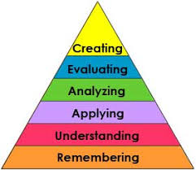
Why is active learning important?
    Active learning helps students to ascend Bloom’s Taxonomy from remembering and understanding to analyzing, evaluating, and creating.

Slide 6
Why is active learning important?
    Applying: “Carrying out or using a procedure through executing, or implementing”
    Analyzing: “Breaking material into constituent parts, determining how the parts relate to one another and to an overall structure or purpose through differentiating, organizing, and attributing.”
    Evaluating: “Making judgments based on criteria and standards through checking and critiquing.”
    Creating: “Putting elements together to form a coherent or functional whole.”
        (Anderson & Krathwohl, 2001)

Slide 7

Why is active learning important?
    Keeps the students interested and engaged
    Better understand application to “real world”

Slide 8
Active learning methods
Doing things and thinking about the things they do (metacognition)
Clickers/Quizzes
Just-In-Time Teaching
Minute Papers
Role Playing
Think-Pair-Share

Slide 9
Active learning in Business Communications

Slide 10
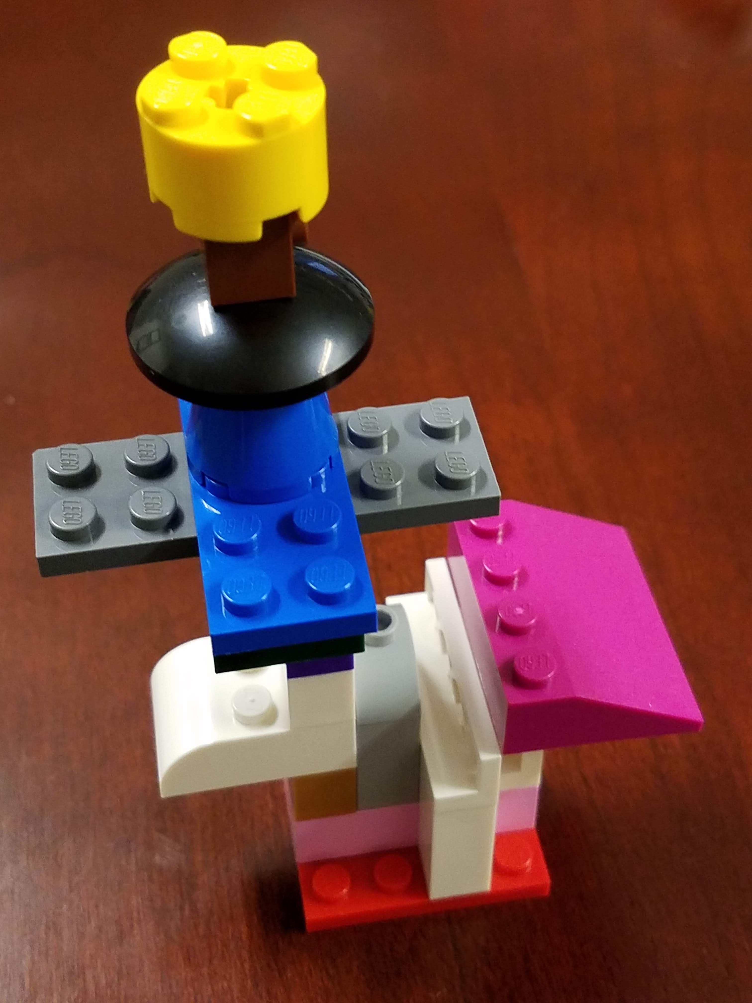
Gizmo activity
Divide students into teams
Ask them to build a gizmo
Take a picture
Write instructions on how to build the gizmo
Trade with other team
Try to build new gizmo
Illustrates the importance of word choice, formatting, clarity, accuracy

Slide 11

Document review
Divide students into teams
Ask them to edit a poorly worded, poorly formatted document
Review letter with class, requesting changes
Provide revised copy
Illustrates the importance of word choice, formatting, conciseness

Slide 12

Diversity exercise
Divide students into teams
Each student is given handout with behaviors
Students are paired with member of different team
Students are asked to “get 5 pieces of information about the person”
Classroom debrief on the experience
Creates awareness of verbal and non verbal barriers, respecting differences, communication in a culturally diverse context takes time and patience
(Hogan-Garcia, 1999)

Slide 13

Parallel thinking exercise
Write a word on the board
Say “write” every 5 seconds for 1 minute
Each time the instructor says “write,” students are to write the first word that pops into their heads
Ask students to share the last word on their lists
Illustrates how we all view and interpret the world through our own experiences and perceptions.

Slide 14
Active learning: dos and don’ts

Slide 15

Active learning dos
Explain why you are teaching this way
Circulate the room and encourage engagement
Be flexible
Make activities short and focused
Take class size and logistics into consideration
Make students accountable
Make group activities challenging
Schedule activities before discussing concepts

Slide 16

Active learning don’ts
Immediately tell the students the answers
Leave activities unresolved
Spend too much time with one group or individual
Expect everything to go exactly as you anticipate
Wait for every group/person to finish
Expect eager and full participation
(Adapted from “What Not To Do,” 2013)

Slide 17
Active learning: what do you do?

Slide 18
Thank you!

Slide 19

References
Anderson, L. W., & Krathwohl, D. (2001). A taxonomy for learning, teaching, and assessing: A revision of Bloom’s taxonomy of educational objectives.
Bertsch, S., Pesta, B., Wiscott, R. & McDaniel, M. (2007). The generation effect: A meta-analytic review. Memory & Cognition, 35, 201-10. doi: 10.3758/BF03193441
Bonwell, C. C., & Eison, J. A. (1991). Active Learning: Creating Excitement in the Classroom. ASHE-ERIC Higher Education Report, Washington DC: School of Education and Human Development, George Washington University.
Bransford, J., Brown, A., & Cocking, R. (2000). How People Learn: Brain, Mind, Experience, and School. Washington, D.C.: National Academy Press
Hogan-Garcia, M. (1999).The Four Skills of Diversity Competence: A Process for Understanding and Practice. Wadsworth Publishing Company
What Not To Do. (2013, January). Retrieved from http://www.cwsei.ubc.ca/resources/files/WhatNotToDo_CWSEI.pdf

