Slide 1
Kick starting use of electronic lab notebooks at IU School of Medicine
Erin D. Foster
Elizabeth C. Whipple
Hannah J. Craven
2020-08-14
Notes:
This presentation we’ll give an overview of the first year of getting started with an ELN service at the IU School of Medicine in Indianapolis Indiana. My name is Erin Foster and I willl cover background (how we got involved), who’s involved, what exactly the service looks like, areas of growth/challenge, and end with tips on what libraries should consider before/while moving into this space.

Slide 2
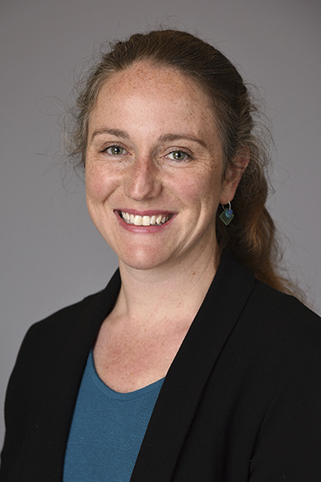
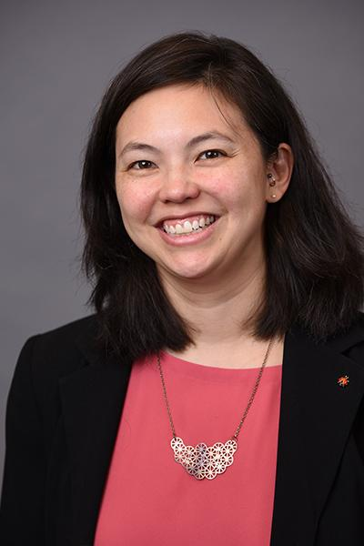
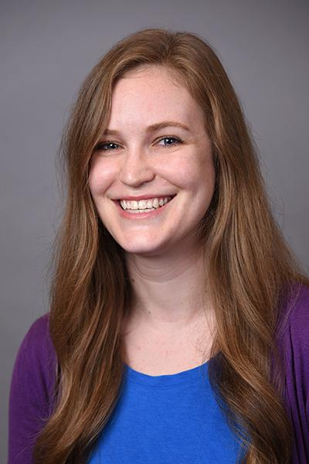
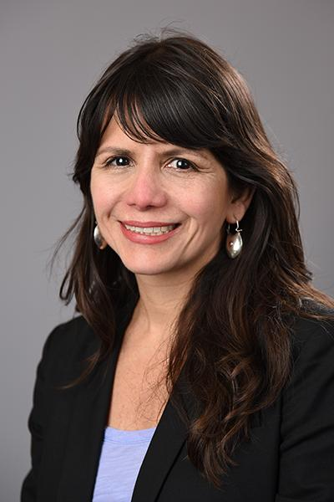

The team
Erin
Beth
Hannah
Mirian
0000-0001-6908-9849
0000-0002-0103-6318
0000-0002-1701-3655
0000-0002-6233-7480
Notes:
Here is the team of folks that have been involved in making this work happen! Myself (as Data Services Librarian) led the efforts to conduct the pilot project and spin up the service. Beth (Asst Director for Research & Translational Sciences) and Hannah (Research & Scholarly Communications Librarian) became involved to build capacity within the library to support this work. We also wanted to include Mirian Ramirez (Research Metrics Librarian) since she was onboarded after this support started and is part of the team to steward this service. The four of us these positions also form the “Research Team” for the Ruth Lilly Medical Library, which is focused on the supporting the research mission for the IU School of Medicine.
I will add a quick note, that as of June 2020, I am now at UC Berkeley as the Research Data Mgmt Program Service Lead. So I am no longer with IUSM Medical Library, but the rest of my colleagues on this slide are continuing this good work!

Slide 3


IU School of Medicine (IUSM) consists of 9 regional campuses and 1 medical library.
Incoming MD class (Fall 2020) has 365 students.
As of Jan 2020, IUSM ranked 14th (out of 92) public medical schools that receive NIH funding.
Indiana by Linseed Studio from the Noun Project
Star by Rauan from the Noun Project
Notes:
Just some quick context for those who may not be familiar. IU School of Medicine is made up of nine campuses distributed throughout the state of Indiana. The Ruth Lilly Medical Library is located at the Indianapolis campus (star) and serves that campus in addition to the eight others. The library is housed within the Education arm of the school so there’s strong integration into the curriculum and a lot of great work to support the largest medical school in the US (over 360 students in the most recent class).
Over the past four or so years, the library has made a concentrated focus on expanding support to the Research arm of IUSM. The forming of the “Research Team” (four of us in the last slide) is an example of how the library has moved to demonstrate that support. Additionally, IUSM itself has grown significantly in its research funding (particularly from NIH) with the past 4 years seeing a 70% increase in NIH funding.
Citations:
https://medicine.iu.edu/md/admissions/class-selection
https://medicine.iu.edu/news/2020/01/iu-school-of-medicine-continues-record-setting-research-trend-up-5-spots-in-national-institutes-of-health-rankings#:~:text=The%20increase%20propels%20IU%20School,respectively%2C%20and%20both%20school%20records.

Slide 4

Background (1)
IUSM Office of Research Affairs was interested in providing institutional access to an electronic lab notebook (ELN) system to tackle issues related to space, discoverability, and intellectual property.
Notes:
In support of the expanding research enterprise at IUSM, the Office of Research Affairs identified electronic lab notebooks (ELNs) as a tool to leverage to address areas of 1) physical space limitations within labs, 2) discoverability of research information - ease of access, etc.), and 3) keeping track of intellectual property - both researchers and the Schools. In the context of our School, the Office of Research Affairs initiated this work and identified the library as the spot to “own” this service and connect with researchers to adopt and train in use of an ELN.

Slide 5
Background (2)
See 2019 MLA presentation
for backstory
http://hdl.handle.net/1805/23220
Identified LabArchives as the ELN of choice and a pilot was conducted between September 2018 - March 2019.
The pilot included 15 labs across
12 departments/divisions in IUSM.
Notes:
Started off with a pilot of LabArchives in Fall 2018 and ran through Spring 2019. Last year at MLA, we talked about the steps to getting up and running this pilot and went into more detail as to how this effort is related to the requirement of data mgmt plans at IUSM. We presented on this part of the work at MLA last year and in the upper right hand corner of this slide, there is a link to our institutional repository where that presentation can be accessed and viewed in would like more backstory.
The rest of this presentation covers the official launch of LabArchives at IUSM and the subsequent adoption and service development.

Slide 6

Officially launched LabArchives in April 2019 with 136 users across IU campuses.
Photo by SpaceX on Unsplash
Notes:
Following the pilot, in April 2019, availability of LabArchives was broadened to the entirety of the IU School of Medicine (across all 9 campuses) as well as the Bloomington campus at large. LabArchives is paid for by the IU School of Medicine Office of Research Affairs so it is “free” for researchers (faculty, staff, students) to sign up. It is behind two-factor so users authenticate with their IU username/password. Following the pilot - and after bringing pre-existing IU LabArchives users under the official license - we began April 2019 with 136 users.

Slide 7
Electronic lab notebook (ELN) support
Trainings.
Hour long and include ELN best practices with a demo of LabArchives.
Scaled down from holding twice a month to once a month.
Consults.
One on one with researchers or with a particular lab.
Mostly meet with lab leadership (PIs, lab managers).
Guidance.
Have an ELN Toolkit guide that addresses best practice & access FAQs.
Maintain an IU KnowledgeBase page with access information.
Notes:
Our support/service is like many others that you are familiar with centers on three modes - standing trainings, (usually) one off consults, and documentation/guidance.
The trainings are an hour long and provide context around why to use an ELN, some best practice guidance/advice, and then end with a demo of LabArchives itself with folks signing up for an account, getting time to play around with the tool. We used to hold these trainings twice a month, but downscaled to once a month due to attendance as well as staffing (with me leaving my position).
The consults are often one on one with researchers in particular labs or research groups. Most often it’s with lab leaders like Principal Investigators or Lab Managers, but sometimes it’s been a medical student and/or grad student who is doing research with a group for semester/rotation and wants to pilot use of the ELN in the lab. I have found these engagements to be the most interesting and helpful for the purposes of understanding the research process better and getting a sense (anecdotally) of common challenges faced by researchers at IUSM. These conversations can span beyond just LabArchives and get into storage and security as well as dissemination of research questions.
Finally, the guidance piece is pretty standard - we put together a Libguide and have a general page on LabArchives access/FAQs in our institutional IT knowledgebase so information is broadly accessible across IU and not just limited to those who come to the library. I’ll provide a link to these slides at the end of the presentation so you can check out the hyperlinks to these resources later!
ELN toolkit: https://iupui.libguides.com/IUSMELNToolkit/Home
IU KB page: https://kb.iu.edu/d/azyf

Slide 8
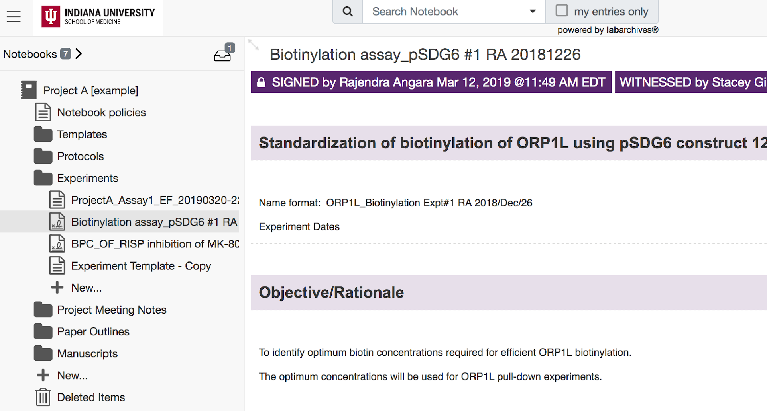
Setting up for success
Our approach with trainings and consults is to provide research groups/labs/individuals a “heads-up” on what they need to consider before jumping into use of an ELN.
Four areas of guidance we focus on:
Notebook structure
Notebook access
Templates & documentation standards
What belongs in an ELN
Notes:
I did want to quickly expand upon the trainings because we’ve worked to be thoughtful in how to present the information so it’s not just a “tool demo” or promo for LabArchives, but is more action driven and aimed at setting up labs for success in their use of an ELN. In many ways, we work to be agnostic and really provide information that can be useful regardless of what particular ELN product is being used. There are many challenges that can come with use of an ELN (which we cover in the training) including time, culture, security concerns, etc. With that in mind, we want users to consider some key areas before (ideally) or at least concurrent with their adoption of LabArchives into their labs.
Those areas include [read bullet points]. I’m happy to provide more details on each area if you’re curious following this presentation so please reach out - but just briefly:
Notebook structure - so is the lab going to stick with a traditional “person per notebook” structure? Or, to take advantage of the collaboration aspect on an ELN, switch to project level notebooks whereby any lab members working on that project are added to the corresponding notebook
Notebook access - which lab members have to access to which notebooks and at what level? LabArchives has four roles that can be assigned to users so we discuss the pros/cons to all of those.
Templates/documentation standards - this definitely hits differently depending on the lab, but there is often a challenge within labs of consistently documenting experiments and/or other research processes so we advocate for (prior to setting up ELN in lab) the lab coming together and talking through expectations for documentation. Just because it’s electronic and searchable, doesn’t mean ELNs can’t easily become digital junk drawers so this gets folks thinking about this early on
What belongs in an ELN - so there are practical limits to what can be stored in LabArchives (at least at our institution) so we talk through those. Also, this is where I encourage folks to not completely up end their existing research info/data mgmt process and remember that the ELN is fundamentally just a digital version of their physical notebooks. So what would be captured in paper should be captured electronically (for example) - start off at that point and then maybe expand use of ELN in lab to be beyond that (higher level of data storage, etc.). This depends too on the enthusiasm of the lab adopting - how much time do they want to spend reworking their current research practice?
An area of challenge in developing this service is thinking through how to further support those labs that adopt LabArchives. What ongoing support would be useful to these groups once they are up and running?

Slide 9
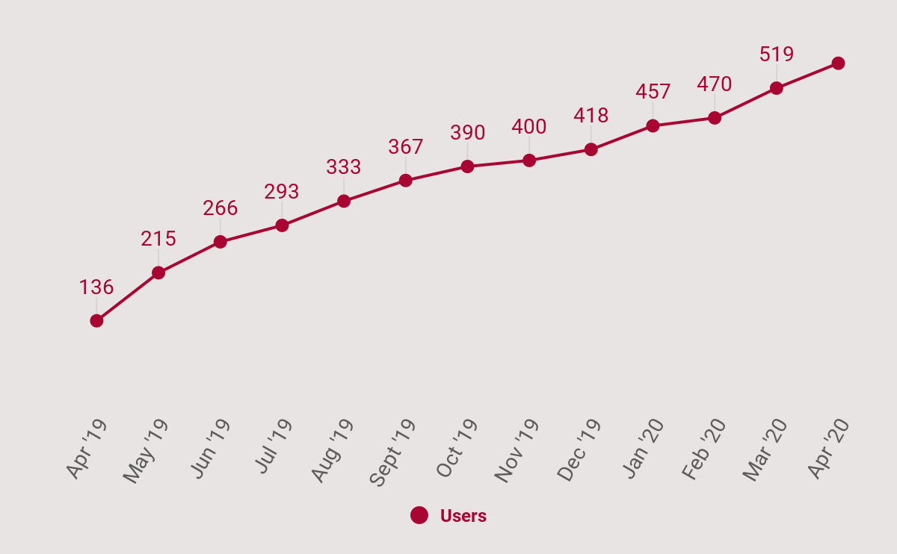
And then there were 560 users
Notes:
Back to metrics - a year after the launch of LabArchives, there were 560 users of LabArchives across the campuses. As of June, I believe the number is 600 so it’s been slowly, but surely increasing in spite of everything. A couple points to clarify. This user number is IUSM users plus Bloomington campus at large - so I can show you a breakdown by campus on the next slide that gives you a sense of how many of these are IUSM specific users. Also, a user (for the purposes of how LabArchives counts them) are people that have signed up for a LabArchives account. So it doesn’t really convey “use” in the daily, weekly, monthly sense, which is arguably what we need to identify in order to speak to adoption over all. That is a piece that still challenging to nail down - the whole adoption piece - and will be an ongoing puzzle for us within the library to think about how to convey to leadership as this service develops.

Slide 10
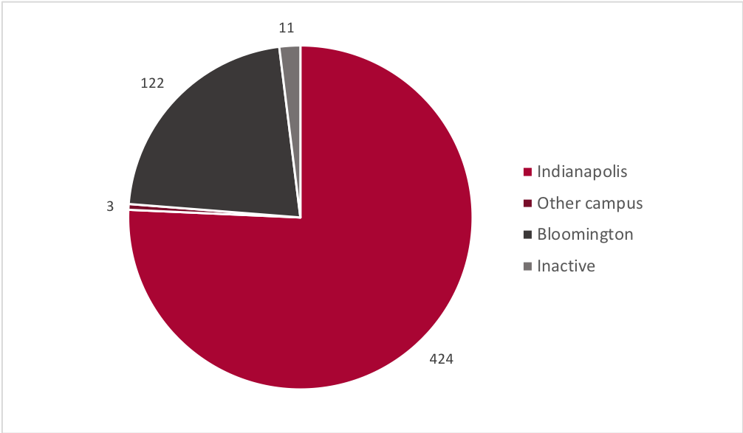
User highlights
Most LabArchives users are in basic science departments at IU School of Medicine.
Non-IUSM users tend to be out of the biology and chemistry departments.
Notes:
Some more high level details on users - a lovely pie chart to demonstrate that most users are at our Indianapolis campus where the majority of School of Medicine folks are housed. Next largest fraction of users at Bloomington and then we’re slowly seeing use at other campuses (v. slowly). Again more granular details can be given if you’re interested, but generally most LabArchives users at IUSM are in basic science departments so not in clinical research areas, which makes sense to me due to the historical use of lab notebooks in that research. And non-IUSM users tend to be in the Biology or Chemistry departments elsewhere (well, at Bloomington). Incidentally, those departments had several labs that were using LabArchives prior to IUSM licensing it, which again makes sense to me due to the use of notebooks in these fields of research as well.

Slide 11

What are users saying?
Highlights from a survey distributed in October 2019:
Half of respondents (n=30) currently used LabArchives more often than an alternative (e.g., paper notebook)
Over half (i.e., 53%) indicated that use of LabArchives improved lab efficiency
Forty responded that use of an ELN encouraged at least one of these information/data management best practices:
  Shared protocols
  Templates for consistently documenting activities like experiments
  Naming conventions
Photo by Volodymyr Hryshchenko on Unsplash
Notes:
In addition to these numbers and institution breakdown, we’ve distributed a user survey twice - once for early adopters/pilot folks in March 2019, then again in October 2019. These are highlights from the Oct 2019 survey, which was only sent to IUSM users (n=233 at the time). We had 60 people respond and these are some (cherry picked) responses. About half of the responders use LabArchives more often then another alternative, like a paper notebook. This is an example of (over time) a metric that would be interested to track...also perhaps comparing this response with another question’s responses where we ask how long the respondent has been using LabArchives (i.e., 0-3 months, 6mos-1year, etc.). Might give us a better sense of adoption over time for individuals. Thirty two responders indicated that they strongly agreed/agreed that use of the ELN improved their lab’s efficiency, which is great and can be a persuasive tidbit when we talk to other researchers. Finally, forty respondents indicated that use of LabArchives/ELN encouraged some information/data mgmt best practices we plugged in training like shared protocols, templates for consistent documentation, and - everyone’s favourite - naming conventions.
Overall, I think the goal is to distribute this survey once a year to users. It’s a great way to supplement what numbers we receive from LabArchives and try to build a bigger picture of what our users think/need.

Slide 12
Strengthening the process through policy
Beyond the basics of the ELN service, there are multiple areas where this service overlaps with School policy and guidance around handling of research data.
Some questions to be addressed:
How long should research data be retained?
What if someone wants to use another ELN?
What happens to research data/ELN when people leave IUSM?
Notes:
In a callback to the impetus behind this service/effort from IUSM Office of Research Affairs, there are some outstanding workflows/policy areas that overlap with providing an ELN to researchers. The following questions are continued areas of discussion at IUSM - and I’m sure at other institutions - when it comes to research processes and guidance. These areas include :read bullet points: - just quickly, being involved in this process has familiarized us in the library as to how tools are evaluated, from a security standpoint, for use by institutional researchers as well as illuminated a gap in how research data/intellectual property is tracked/retained once folks leave IUSM. Most researchers understand that IU (in this case) “owns” the research data generated while they are at IUSM, but the practice of how that ownership is tracked and asserted, especially when faculty/labs leave, is more difficult to nail down.
In short, there really are a significant number of ways in which the library’s involvement as a service provider position in regards to ELNs position to the library to really engage with the IUSM research enterprise, which as previously mentioned early on in this presentation, had been a priority.

Slide 13
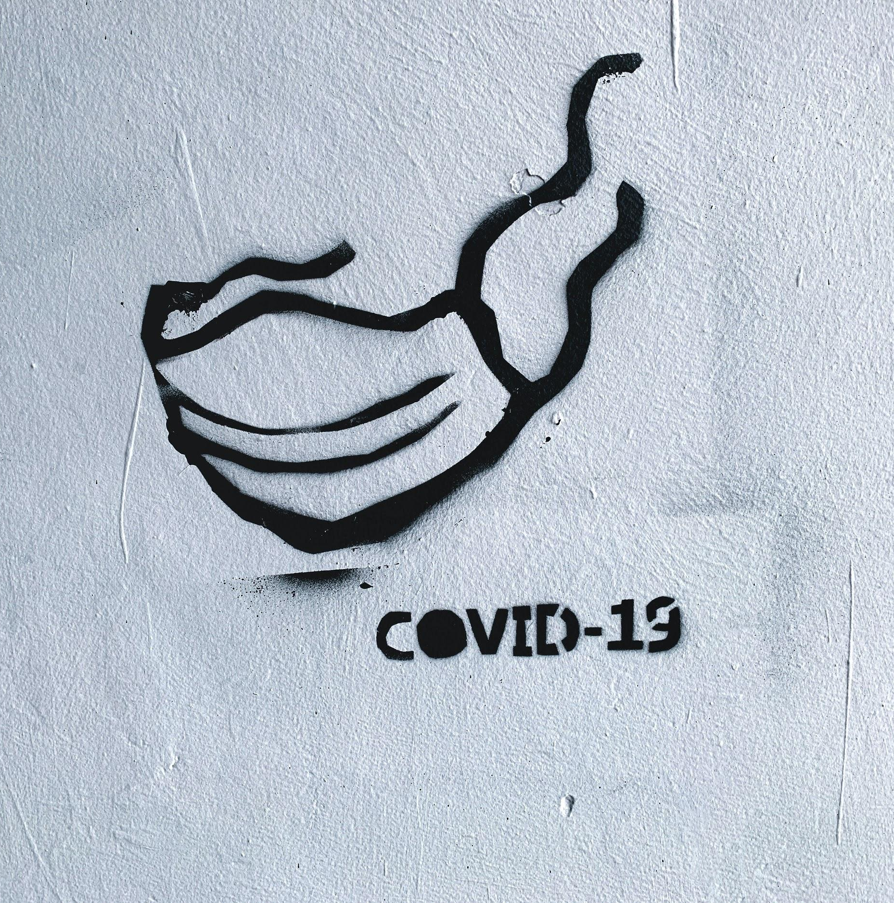
How does this align with restart research efforts?
Photo by Adam Nieścioruk on Unsplash
Notes:
As many of us understand as well, the current circumstances have affected the ability of researchers to access their spaces and conduct research. Anecdotally, we’ve seen a decrease in attendance at our monthly (Zoom) trainings. However, I’m curious as to how having an ELN perhaps allowed greater access to research for those labs that had adopted it into their workflows. This could end up be (retrospectively) an opportunity to demonstrate the practical benefits to ELN adoption within a lab. Perhaps next time the user survey is distributed, there could be a question as to use during the shutdown and that could form a baseline for further exploration/study.

Slide 14

Getting started locally
Before starting a local service, here are some tips to consider:
What is the institutional incentive?
Who will “own” the service?
How will you build a community of practice?
Ideally, employ a top down and grassroots approach.
Photo by Sam Dan Truong on Unsplash
Notes:
Lastly, some tips that we encourage institutions/libraries interested in involving themselves in ELNs think about:
Institutional incentive - what larger initiatives and/or goals does the availability of an ELN support? We had the Office of REsearch Affairs basically provide us with these since they instigated the effort, but is crucial to getting buy in.
Service ownership - varies by institution. With ELNs, ownership resides with libraries, frequently with IT, sometimes a shared model. Needs to established early on otherwise (as we’ve all experienced) nothing happens. This also is key in terms of money for licensing a product if that’s the way your institution goes.
Community of practice - this is definitely an ongoing point of development, but what can you set up within your institution to encourage ongoing adoption and give users spaces to learn from each other? Can be much more persuasive of an adoption tool than any library class that peer-to-peer sign off or demo
As many of us can probably understand, a combo of “top down”, “bottom up” approach is ideal. The leadership/administrative push helps get over humps such as early adoption and maintaining a certain level of campus/school interest. And the grassroots approach is where individual researchers/labs/departments get to really shine and that enthusiasm and relationship building components come into play. Again, labs are more likely to adopt an ELN (anecdotally I’ve observed) after they’ve talked to a colleague who uses LabArchives rather than because their department chair told/encouraged them to.

Slide 15
Thank you
---
For slides: http://hdl.handle.net/1805/23318
edfoster@berkeley.edu | @erdifo
ewhipple@iu.edu | @beffuh
hancrave@iu.edu | @HannahC_MLIS
Notes:
Thanks so much for taking the time to view this presentation. There’s the promised link to a copy of these slides in our institutional repository. And please feel free to reach out with questions - you’ve got email and twitter handles for us all. We also hope to publish a paper on this work so keep an eye out! Feel free to follow up with any of us as well if you’d like more detail on any part of this process and/or would like to talk further. Cheers!

