Slide 1

Altmetrics 101
LITA Altmetrics & Digital Analytics Webinar
December 8, 2016
Heather L. Coates, MLS, MS @IandPanguarBan
IUPUI University Library Center for Digital Scholarship
http://ulib.iupui.edu/digitalscholarship

Slide 2

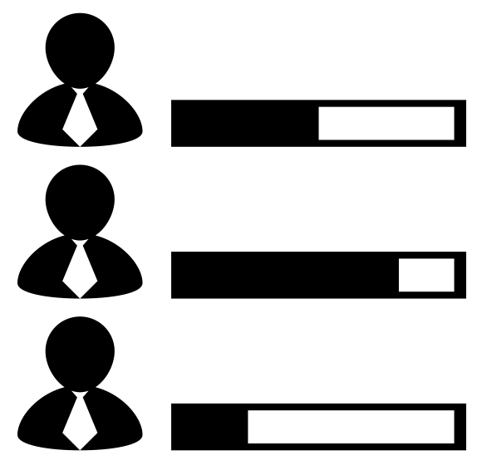

Slide 3



Notes:
Not so long ago, the only research outputs that counted in promotion and tenure, hiring, and for funding were journal articles, books & chapters, and presentations.

Slide 4


Notes:
In that system, the only way of valuing scholarship was through citations, which is very self-referential and closed

Slide 5







Notes:
The types of scholarly products that “count” is expanding, at least in theory. Unfortunately, the practice of tracking only the products that have DOIs works against that ideal.

Slide 6

















Notes:
As are the types of metrics available, but we are still learning what these metrics data mean. Too often, their use is driven by sheer availability, rather than the strategic and thoughtful dissemination.

Slide 7
Changing practices to align with values
Leiden Manifesto for research metrics: http://www.leidenmanifesto.org/
San Francisco Declaration on Research Assessment (DORA): http://www.ascb.org/dora/
  “Do not use journal-based metrics, such as Journal Impact Factors (JIFs), as surrogate measures of the quality of individual research articles, to assess an individual scientist’s contributions, or in hiring, promotion, or funding decisions.”

Slide 8
Why do we need metrics?
P&T review committees can’t read everything
P&T review committee members are not experts in your field
Models for producing scholarship differ by discipline and research methods used
Some metrics are decent indicators of scholarly use (e.g., citation)
Some metrics are decent indicators of public discussion (e.g., Twitter, Facebook, news media attention)
Some metrics are decent indicators of reuse (e.g., data citations)

Slide 9
Terminology
Haustein et al, 2016, Interpreting Altmetrics
Research object: a scholarly object for which an event can be recorded
Event: a recorded activity or action which relates to the research object
Host: the place where research objects are made available and exposed to potential events
Source: a platform where events are available
Consumer: a party that collects and uses events to research objects (types of consumers include aggregators or end user or audience)
NISO RP-25-2016
Impact: The subjective range, depth, and degree of influence generated by or around a person, output, or set of outputs. Interpretations of impact vary depending on its placement in the research ecosystem.
Notes:
Terminology for referring to scholarly products or outputs, acts, and platforms

Slide 10
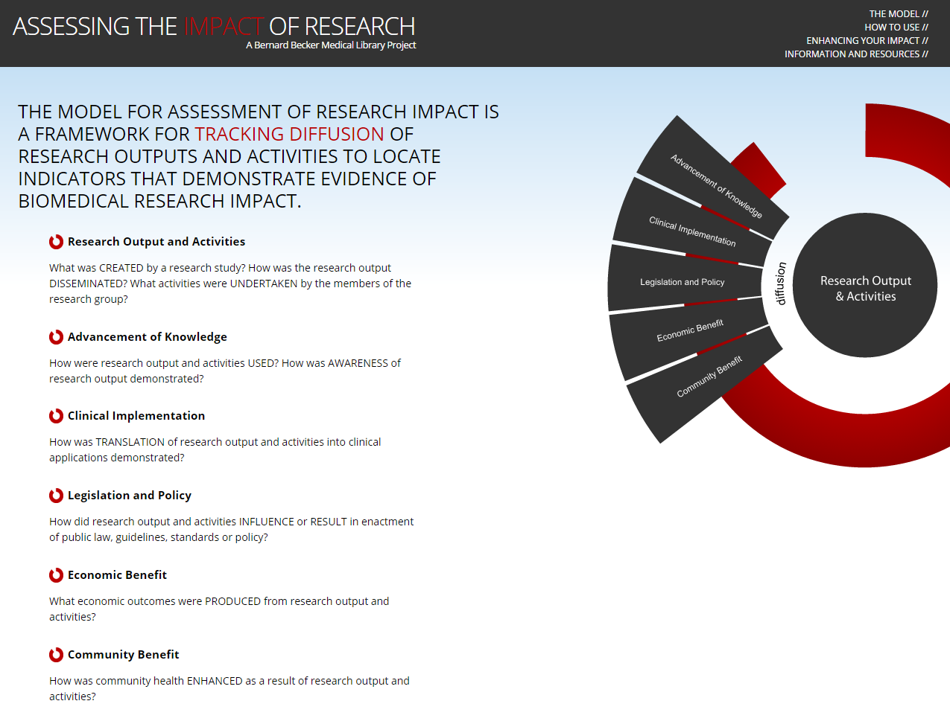
https://becker.wustl.edu/impact-assessment

Slide 11
Impact | Indicators
Research Output & Activities | Biological materials, collaborations, data, databases, repositories, techniques & procedures, grey literature, invention disclosures, mobile apps, patents, trainees, etc.
Advancement of Knowledge | Books/chapters (inclusion in bibliographies, library ownership, textbook use), change in understanding (paradigm shift, lead to new approach), citations (first & second generation citations, countries and institutions represented), conference themes, new centers/institutes
Clinical Implementation (or TRIP) | Biological materials, study cited in clinical decision aid, clinical/practice guidelines, diagnostic application, instruments, quality measure guidelines (gov’t or NPO), reporting requirements
Legislation & Policy | Committee participation, study cited in guidelines, study cited in policy, study cited in enactment of standards
Economic Benefit | Findings cited in reduced costs for delivery of healthcare services, findings result in enhancement of existing resources and expertise, license agreements for use of IP, spinoff or startup company
Community Benefit | Public awareness of risk factors, patient decision materials, cited in public/private insurance benefit plan

Slide 12

Levels of Metrics
Journal/Venue Level Metrics
Output/Article Level Metrics
Author Level Metrics

Slide 13
Citation Metrics
Article/Item-level:
  Citation counts
  Field Weighted Citation Impact (Scopus)
  Eigenfactor Article Influence Score
  Relative Citation Ratio (NIH - https://icite.od.nih.gov/)
Journal-level:
  Journal Impact Factor (JIF)
  5-year JIF
  Eigenfactor
Author-level:
  h-index
  i-10 index (Google Scholar)

Slide 14
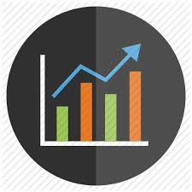

Altmetrics
Social Media Metrics
Web Metrics
View
Use
Share
Recommend
Discuss
*Altmetrics are item-level metrics

Slide 15
Benefits of Altmetrics
Supplement traditional metrics
Scope extends beyond the formal published scholarly record (journals & books)
Timeframe: immediate to short-term impact
Sources: social media platforms where people interact with content and each other on a daily basis (e.g., where people live)
DO capture and link to qualitative data (ex: blog snippets, tweet content)
Notes:
Notes:
Altmetrics – measures more immediate impact of your publication than traditional impact metrics; attempt to be more relevant to researcher and article/item
“Article-Level Metrics only make sense in context, and the most important ones are probably article age, subject area and journal.” Posted at http://api.plos.org/2012/07/20/example-visualizations-using-the-plos-search-and-alm-apis/

Slide 16
Sources of Altmetrics
Publishers
Aggregation services
  Impact Story: http://impactstory.org/
  Altmetric.com: http://www.altmetric.com/
  Plum Analytics: https://plu.mx/g/samples
Subject repositories
  PubMedCentral (PMC)
  arXiv
  SSRN
Institutional repositories

Slide 17
Responsible Use of Altmetrics
Altmetrics aren’t alternative to citation-based indicators, they are complementary
Start with the story, then use metrics to support your narrative
Present metrics in context
Present metrics along with qualitative evidence
Consider using normalized metrics when available
Both citation metrics and altmetrics can be used as indicators of various types of impact, if used appropriately

Slide 18
Try it out
Sign up for an ORCID
Connect your ORCID & Twitter account to ImpactStory profile
Get DOI for your scholarship, if they don’t already have them
Engage with people online about your scholarship
Review your metrics for authenticity, completeness, accuracy
Reflect how these metrics reflect your scholarship, engagement, professional goals

Slide 19
Resources
Altmetrics for librarians: 100+ tips, tricks, and examples
https://www.altmetric.com/libraries-ebook/
The Evolution of Impact Indicators: From bibliometrics to altmetrics
http://scholasticahq.com/altmetrics-the-evolution-of-impact-indicators
The Metric Tide. doi:10.13140/RG.2.1.4929.1363
NISO RP-25-2016 Outputs of the NISO Alternative Assessment Metrics Project http://www.niso.org/topics/tl/altmetrics_initiative/
  Altmetrics Definitions & Use Cases
  Bibliography
Haustein, S. (2016). Grand challenges in altmetrics: heterogeneity, data quality and dependencies. Scientometrics, 1-11.
Sugimoto, C. R., Work, S., Larivière, V., & Haustein, S. (2016). Scholarly use of social media and altmetrics: a review of the literature. arXiv preprint arXiv:1608.08112.
Haustein, S., & Larivière, V. (2015). The use of bibliometrics for assessing research: possibilities, limitations and adverse effects. In Incentives and performance (pp. 121-139). Springer International Publishing.

Slide 20

Heather L. Coates
Digital Scholarship & Data Management Librarian
University Library Center for Digital Scholarship
hcoates@iupui.edu
https://ulib.iupui.edu/digitalscholarship/impact
ORCID: 0000-0003-4290-6997
@IandPangarBan

