Slide 1

Preparing academic libraries to negotiate a sustainable future:
the ONEAL project
Slides available at: [insert IR URL]
Notes:
Learn about a multi-institutional project developing curriculum and open educational resources (OER) to equip academic library workers with negotiation skills within the context of academic libraries work with third party vendors. The project team is intentionally working to center the experiences of BIPOC library workers through each stage of the project including curriculum design, OER creation, and pilot testing. This presentation will walk through the key learnings around negotiations and the curriculum, before opening the session for discussion and feedback. A core ethos of the project is that something created to serve the community cannot be made without the community.
Detailed Description
Academic libraries are facing a multitude of challenges as budgets face further cuts and considering that staffing and services already stripped close to the bone at many institutions. It has become imperative that library workers develop negotiation skills to proactively interact with third-party vendors, many of whom are currently trying to push through significant price increases to recoup after keeping prices stagnant during the height of the Covid-19 pandemic. In many cases, negotiating prices and licensing agreements is learned on the job from fellow colleagues when the need arises such as significant budget cuts, which forces libraries into a reactive stance. Meanwhile, vendors often are equipped with significant training. The dynamics of the academic library and vendor relationship can be changed, through education and training. When library workers seek formal negotiation training, often it is centered on negotiating in business, in general, and fails to understand the nuances that are faced such as long-term relationships where sales representatives just move from vendor to vendor and the entrenchment of many scholars and institutions to traditional subscriptions to resources viewed as “prestige” that are often tied to performance (promotion and tenure). Learn about a multi-institutional project developing curriculum and open educational resources (OER) to equip academic library workers with negotiation skills within the context of academic libraries. The project team is intentionally working to center the experiences of library workers of Black, Indigenous, and people of color through each stage of the project including curriculum design, OER creation, interviews, and pilot testing. This presentation will walk through the key learnings around negotiations and the curriculum as designed to date, before opening the session for discussion and feedback. A core ethos of the project is that something created to serve the community cannot be made without the community. Attendees will be able to share their thoughts and questions, which the project team will be able to take into consideration as learning objects are created in the spring and summer, prior to pilot-testing. Participants will also be provided a list of free resources to help them get started on developing those skill sets while the curriculum and OERs are being developed. This project builds upon prior workshops that have taught negotiation skills to academic library audiences but, by nature, limits the reach to attendees.
Learning Outcomes
Participants will be able to articulate why negotiation skills are a necessary skill set for work and life.
Participants will understand key issues facing academic library workers when negotiating with third-party vendors so that they may begin to proactively plan how to address at their own institutions.
Participants will gain resources to get started in developing negotiation skills so that they may be more prepared for their next negotiation at work.

Slide 2
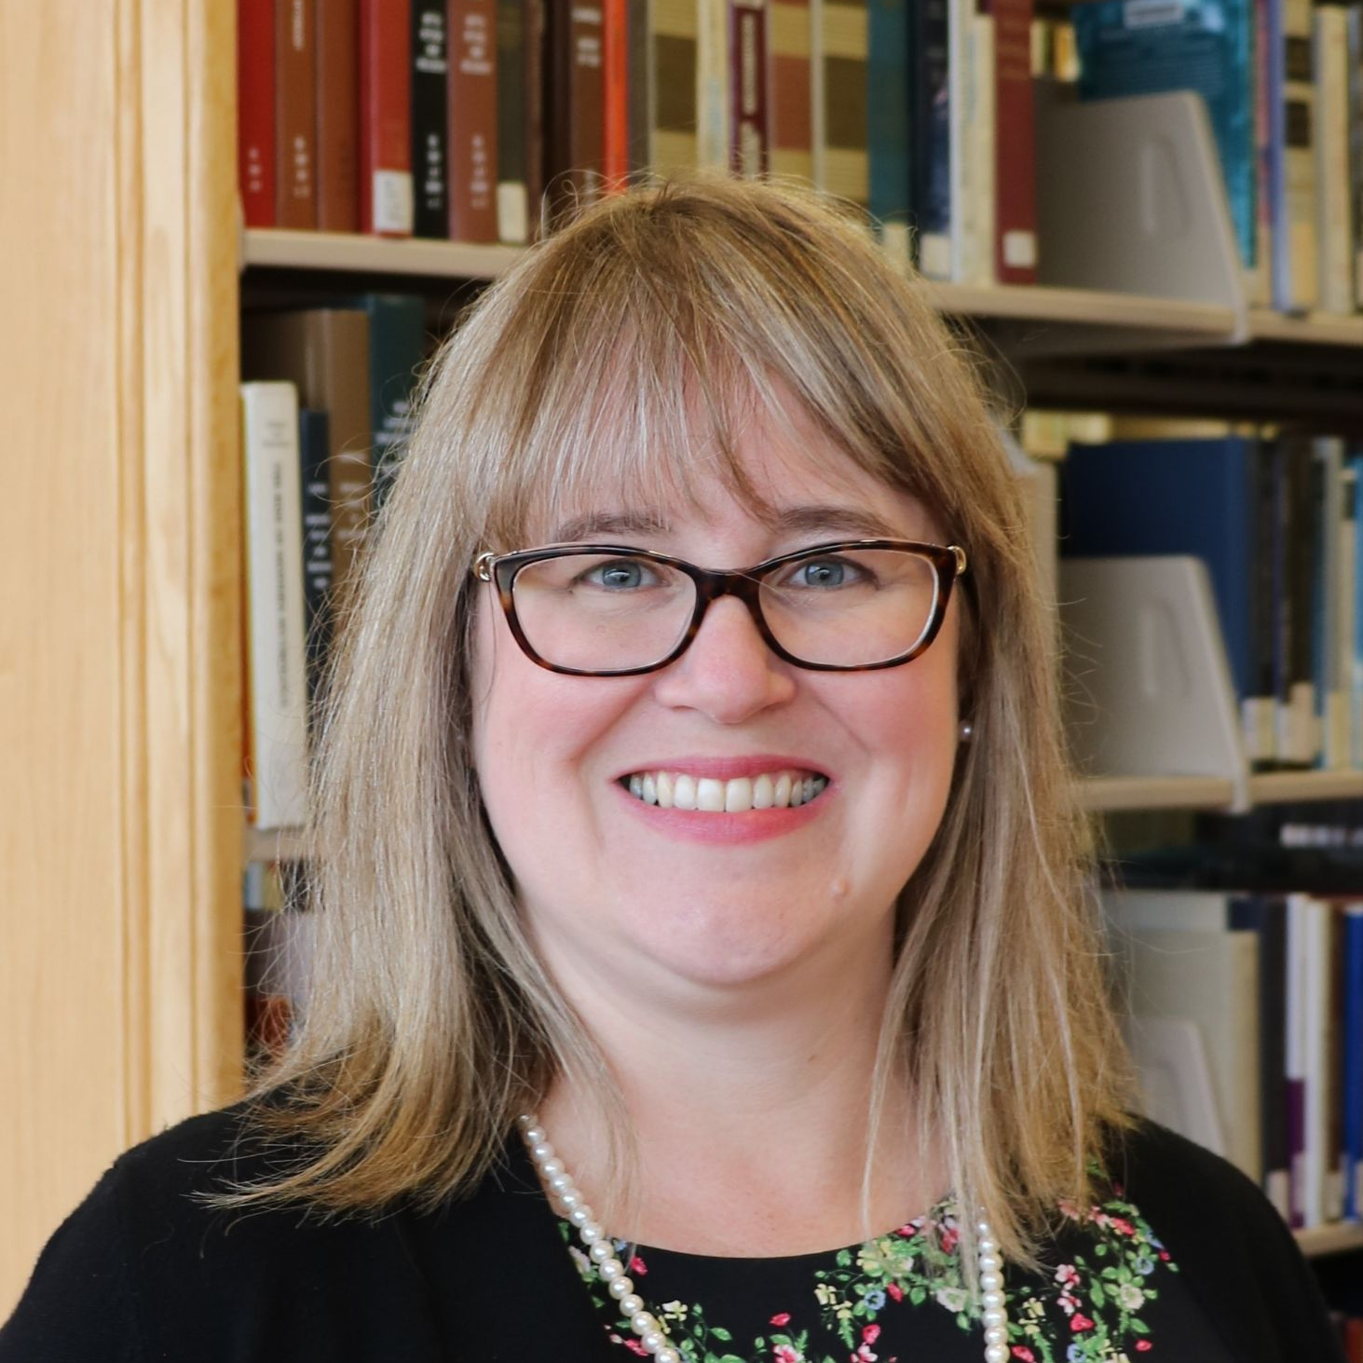

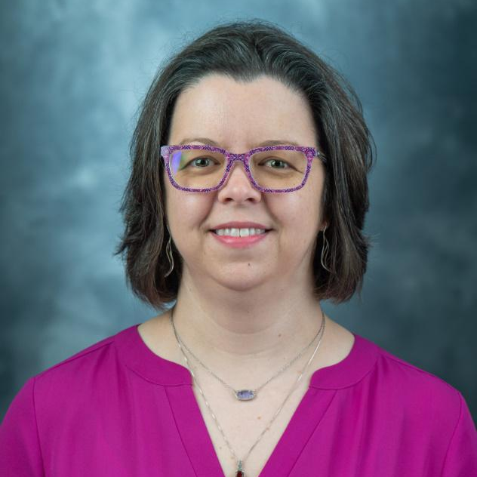
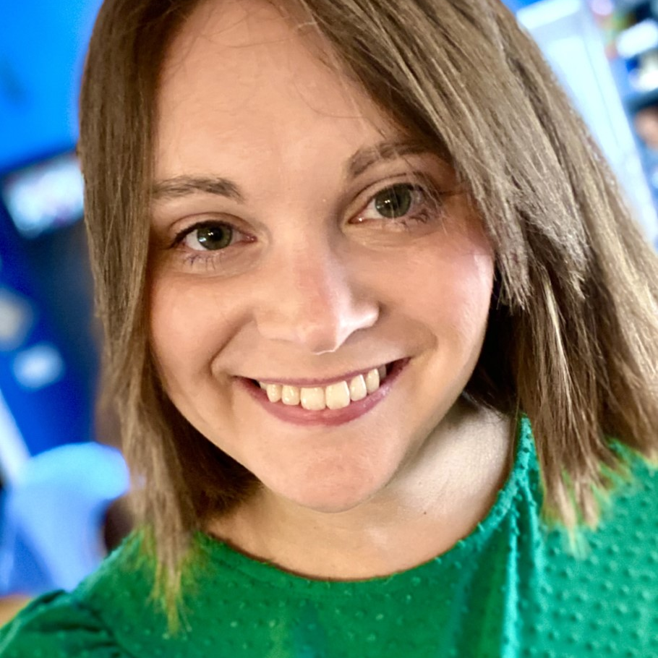
Project Team
Katharine Macy
Project Director, Librarian
IUPUI University Library
macyk@iu.edu
Twitter: @kvmacy
ORCID: 0000-0002-6283-7143
Scarlet Galvan
Collection Strategist
Grand Valley State University
galvansc@gvsu.edu
Twitter: @panoptigoth
ORCID: 0000-0002-9057-2680
Courtney Fuson
Asset Management Librarian
Belmont University
courtney.fuson@belmont.edu
Twitter: @library_chic
ORCID: 0000-0002-1879-5302
Brandy Roldan
Project Assistant
MLIS Graduate Student at IUPUI
broldan@iui.edu
Twitter:
ORCID:

Slide 3
1.
What is the ONEAL project?
And why is it needed?
Notes:
Project Summary handout is available within the institutional repository with the slide deck.
Learn more at: https://iupui.libguides.com/ONEAL and project updates at Github.
KM
More jobs asking for skills in negotiation, resource management strategies, and understanding how licensing terms impact research, teaching, and learning. Meanwhile our exposure to developing these skills often happens on the job. It’s maybe a paragraph or a sidenote of a lecture in library school. There are formalized programs around but they can be expensive. Training may happen at conferences but also that requires resources and is difficult to scale. We want to make this training available to any librarian who is interested in learning this skill set. Developing negotiation skills benefit all types of librarians. This project is focused on academic libraries while the curriculum is framed around negotiating with vendors, significant portions of the curriculum will be useful in other areas of library work and in our personal lives. The skills and strategies developed through completing the curriculum will be useful for negotiating salaries,, relocation allowance, start dates, tenure clocks, and much more. It can help you organize your workplace!
As all of us are aware, many of us are dealing with slow growing, flat, and and often declining budgets. E-resource prices remained stagnant during the Covid-19 pandemic but in many cases vendors are trying to make up for lost growth during that period. This is after decades of averaging 6% annual price growth while budgets have not kept up (5-year annual growth rate of masters and doctoral granting institutions was 2% in 2019). Libraries can negotiate and must negotiate in order to become sustainable. Even small incremental changes at individual institutions can create the ripple that is the start of a tsunami.
Some of you may be wondering - but what If I need to get started today - I need to negotiate something next week and I can’t wait for the curriculum next year. One of the handouts available within the institutional repository where this presentation can be found. Has resources to help you find guidance on negotiation planning, strategy, licensing etc gathered by the project team through the community forums. It includes a resource list that has presentations on negotiation strategies and planning including concepts like BATNA, ZOPA, and understanding how to use no.

Slide 4
OER Materials to be Created
Asynchronous
Online learning modules teaching concepts and application.
Synchronous
Activities and discussion guides that can help groups learn together.
Case Studies
Fictionalized case studies that reflect academic library experiences that enable practicing negotiations. 3 parts:
Library POV
Vendor POV
Teaching note
Notes:
KM

Slide 5
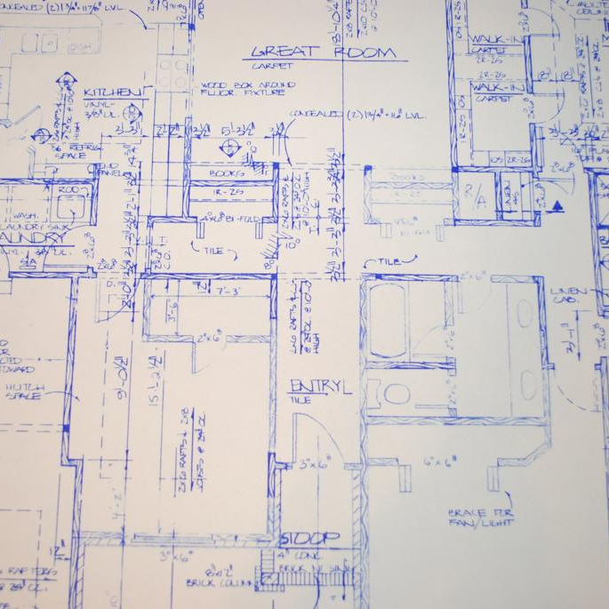
Module Creation
Content Delivery (Video, text, etc)
Resources
Assignment (Active Learning)
Application (Case Studies, Interviews, Panel Discussions)
Assessment (Formative)
Image Source: https://www.flickr.com/photos/75508807@N06/6894587439, CC by 2.0 Attribution
Notes:
KM

Slide 6
the ONEAL project Roadmap
Community Forums
(Fall 2022)
Curriculum Building
(Jan - Jul 2023)
Revise and Launch
(Jan - Mar 2024)
1
3
5
2
4
6
Curriculum Planning Workshop
(Nov 2022)
Pilot Testing
(Aug - Dec 2023)
Outreach
(Mar - Dec 2024)
Notes:
KM
Scarlet is going to take you through some key insights from the community forums we had last fall. In November based on the forums we held a curriculum planning workshop with the project advisory board and 12 academic librarians active in negotiating for resources. Courtney will review an outline of the curriculum. Currently we are actively involved in building the curriculum including doing an interview study which we will analyze for key themes to create fictionalized case studies.
Now Scarlet is going to take you through community involvement and our forums.

Slide 7
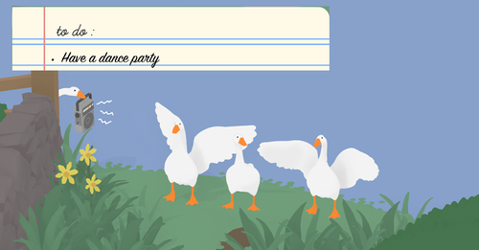
Nothing about the community without the community!
Notes:
SG
When we submitted the grant proposal, we intentionally wrote compensation for the labor of volunteers into the budget. We have been very intentional about soliciting participants for the forums, curriculum planning workshops, and interviews from underrepresented groups and those who work with under-resourced institutions.
DEI Statement:
The ONEAL project includes structural support to both invite and sustain participation from underrepresented library professionals. Our goal to produce open educational resources centered on negotiation practice and strategy will support the development of a critical skill set for managing collections and leading libraries. In each phase of the project, we will consciously invite and include librarians from underrepresented groups, particularly librarians of color and those who work with under-resourced institutions. This is particularly important in the planning and piloting stages of the project. When we solicit volunteers, we will ask that people complete a survey providing information about their interest, as well as the option to disclose demographics and institutional data so that we may ensure representation in attendance at the curriculum workshop, case study interviews, or participating in the pilot study.
We recognize people of color, particularly women of color, are often asked to provide their labor without compensation as part of service opportunities. To address this barrier to participation, a significant portion of the budget for this grant is earmarked to compensate those who participate as an advisory board member, in the 6-hour curriculum planning workshop, in OER content creation, and as pilot-testers. As part of content creation, ONEAL will cite and elevate the work of underrepresented experts and practitioners.
We will prioritize conferences and communication platforms for marginalized communities during our outreach.

Slide 8
2.
Key Insights
Community Forums Fall 2022
Notes:
SG

Slide 9
3.
Drafting the Curriculum
Notes:
CF
Curriculum outline is available within the institutional repository with the slide deck.
After the forums, Brandy transcribed the information from the jamboard, padlets, and forum chats so that we could then go through and look for categories and topics that appeared frequently.
Based on this, we mapped out three broad areas to be the overarching modules for the curriculum. Those areas are Foundations, Strategies, and Issues.
Each of these modules will have a varying number of topics in them. Because this curriculum is designed to work either as a virtual training or as part of a course (either in a library school or offered by another group such as a consortium), there will be asynchronous instruction learning objects as well as support materials for synchronous instruction. There will also be case studies included in the curriculum, to provide some low-stakes practice. The learning content will be delivered in a variety of modalities - some text, some video, etc - and will include active learning assignments to help the participants use the OER to apply this information to their own situations and negotiations.
One of the deliverables we hope to provide is a workbook or set of worksheets that guides the participant through determining local/institutional information as they work through the modules. This helps to keep participants engaged while also providing them with a concrete application of the content to their work.

Slide 10
Learners will be able to:
Analyze their library’s position within negotiations
Apply best practices in principled negotiation when planning and conducting complex negotiations with library vendors.
Optimize available options during negotiations by forming strategies to be used during negotiation and building coalitions of support.
Notes:
CF
Foundations
There are a total of 7 learning objectives that were created to guide the project team. The advisory board, project team, and 12 academic library workers from a variety of institutions helped us to draft the objectives and the curriculum outline during a curriculum workshop this fall.
These are the learning outcomes that should be met primarily by the information covered in the Foundations module.
Foundations will be the foundational information (as the name implies) - this includes historical context, a glossary, basic information about contracts and licensing (the anatomy of a license; the review process), introduction to negotiations, and information about planning for negotiations.
Analyze their library’s position within negotiations (i.e. understand past relationships, library values and priorities, environmental scan. Mission, visions, values, examining procedures. Who is involved in the decisions and process? Are they documented or undocumented?)

Slide 11
Learners will be able to:
Evaluate license clauses in order to understand their potential impact on the library and its user communities.
Identify clauses that are in or out of alignment with the library’s interests and be able to explain why to vendors and other stakeholders.
Explain license clauses (including alternatives to standard vendor language) that protect and advance library interests.
Notes:
CF
Strategies
These are the learning outcomes that should be met primarily by the information covered in the strategies module.
Strategies will focus more on setting priorities for negotiations, managing vendor relationships, power dynamics, and project management type tasks.

Slide 12
Learners will be able to:
Describe current issues facing academic libraries how they relate to negotiating with third party vendors in order to provide guidance and leadership within their organizations.
Notes:
CF
Issues
This is the learning outcome that should be met by the information covered in the issues model.
Issues is where the curriculum will engage with both existing and emerging issues. This includes things like access models, transformative agreements, the intersection of technology and licensing - the impact of text data mining, privacy, authentication methods, and accessibility issues.
(e.g. privacy and surveillance, TDM, OA, different acquisitions models)

Slide 13

Foundations
Creating a strong base for building
Source: by Sigmund on Unsplash: https://unsplash.com/photos/_dJCBtdUu74, CC by 2.0 Attribution
Notes:
Source, unsplash: https://unsplash.com/photos/_dJCBtdUu74
CF

Slide 14
Introduction to Negotiations
Contracts and Licensing
Strategy and Planning
Notes:
CF
Contracts & Licensing
Anatomy of a license
Navigating the contract review process
Understanding local context
Negotiating sticky terms
Intro to Negotiations
It’s a business relationship
Principled negotiations
Empowerment - asking for what you want and need
Yes, you should negotiate!
Negotiation Planning
Understanding your BATNA and reservation price!
Researching vendors and determining ZOPA
Planning concessions
Framing, anchors, first mover advantage
Preparing for no

Slide 15

Strategies
Creates structure for your negotiations
Source: Danist Soh on Unsplash, CC by 2.0 Attribution
Notes:
Photo by Danist Soh on Unsplash
CF

Slide 16
Setting Priorities
Power Dynamics
Relationship Management
Engagement
Notes:
CF
Setting Priorities
Based on values
Using Pareto Analysis when you can’t negotiate every deal
Value creation in the deal
LIving in the gap (managing morale)
Engagement
Solo vs team efforts
Engaging with other librarians, administrators, institutional faculty, students, procurement, and general counsel.
Leveraging relationships (e.g. Consortia)
Managing Vendor Relationships
Facilitating good relationships with vendors
Informing vendors of academic library and institutional context
Managing behavior
Power Dynamics
Understanding price sensitivity and how it impacts relative buying power
Strategies for when you have little power.
Improving your BATNA overtime.

Slide 17
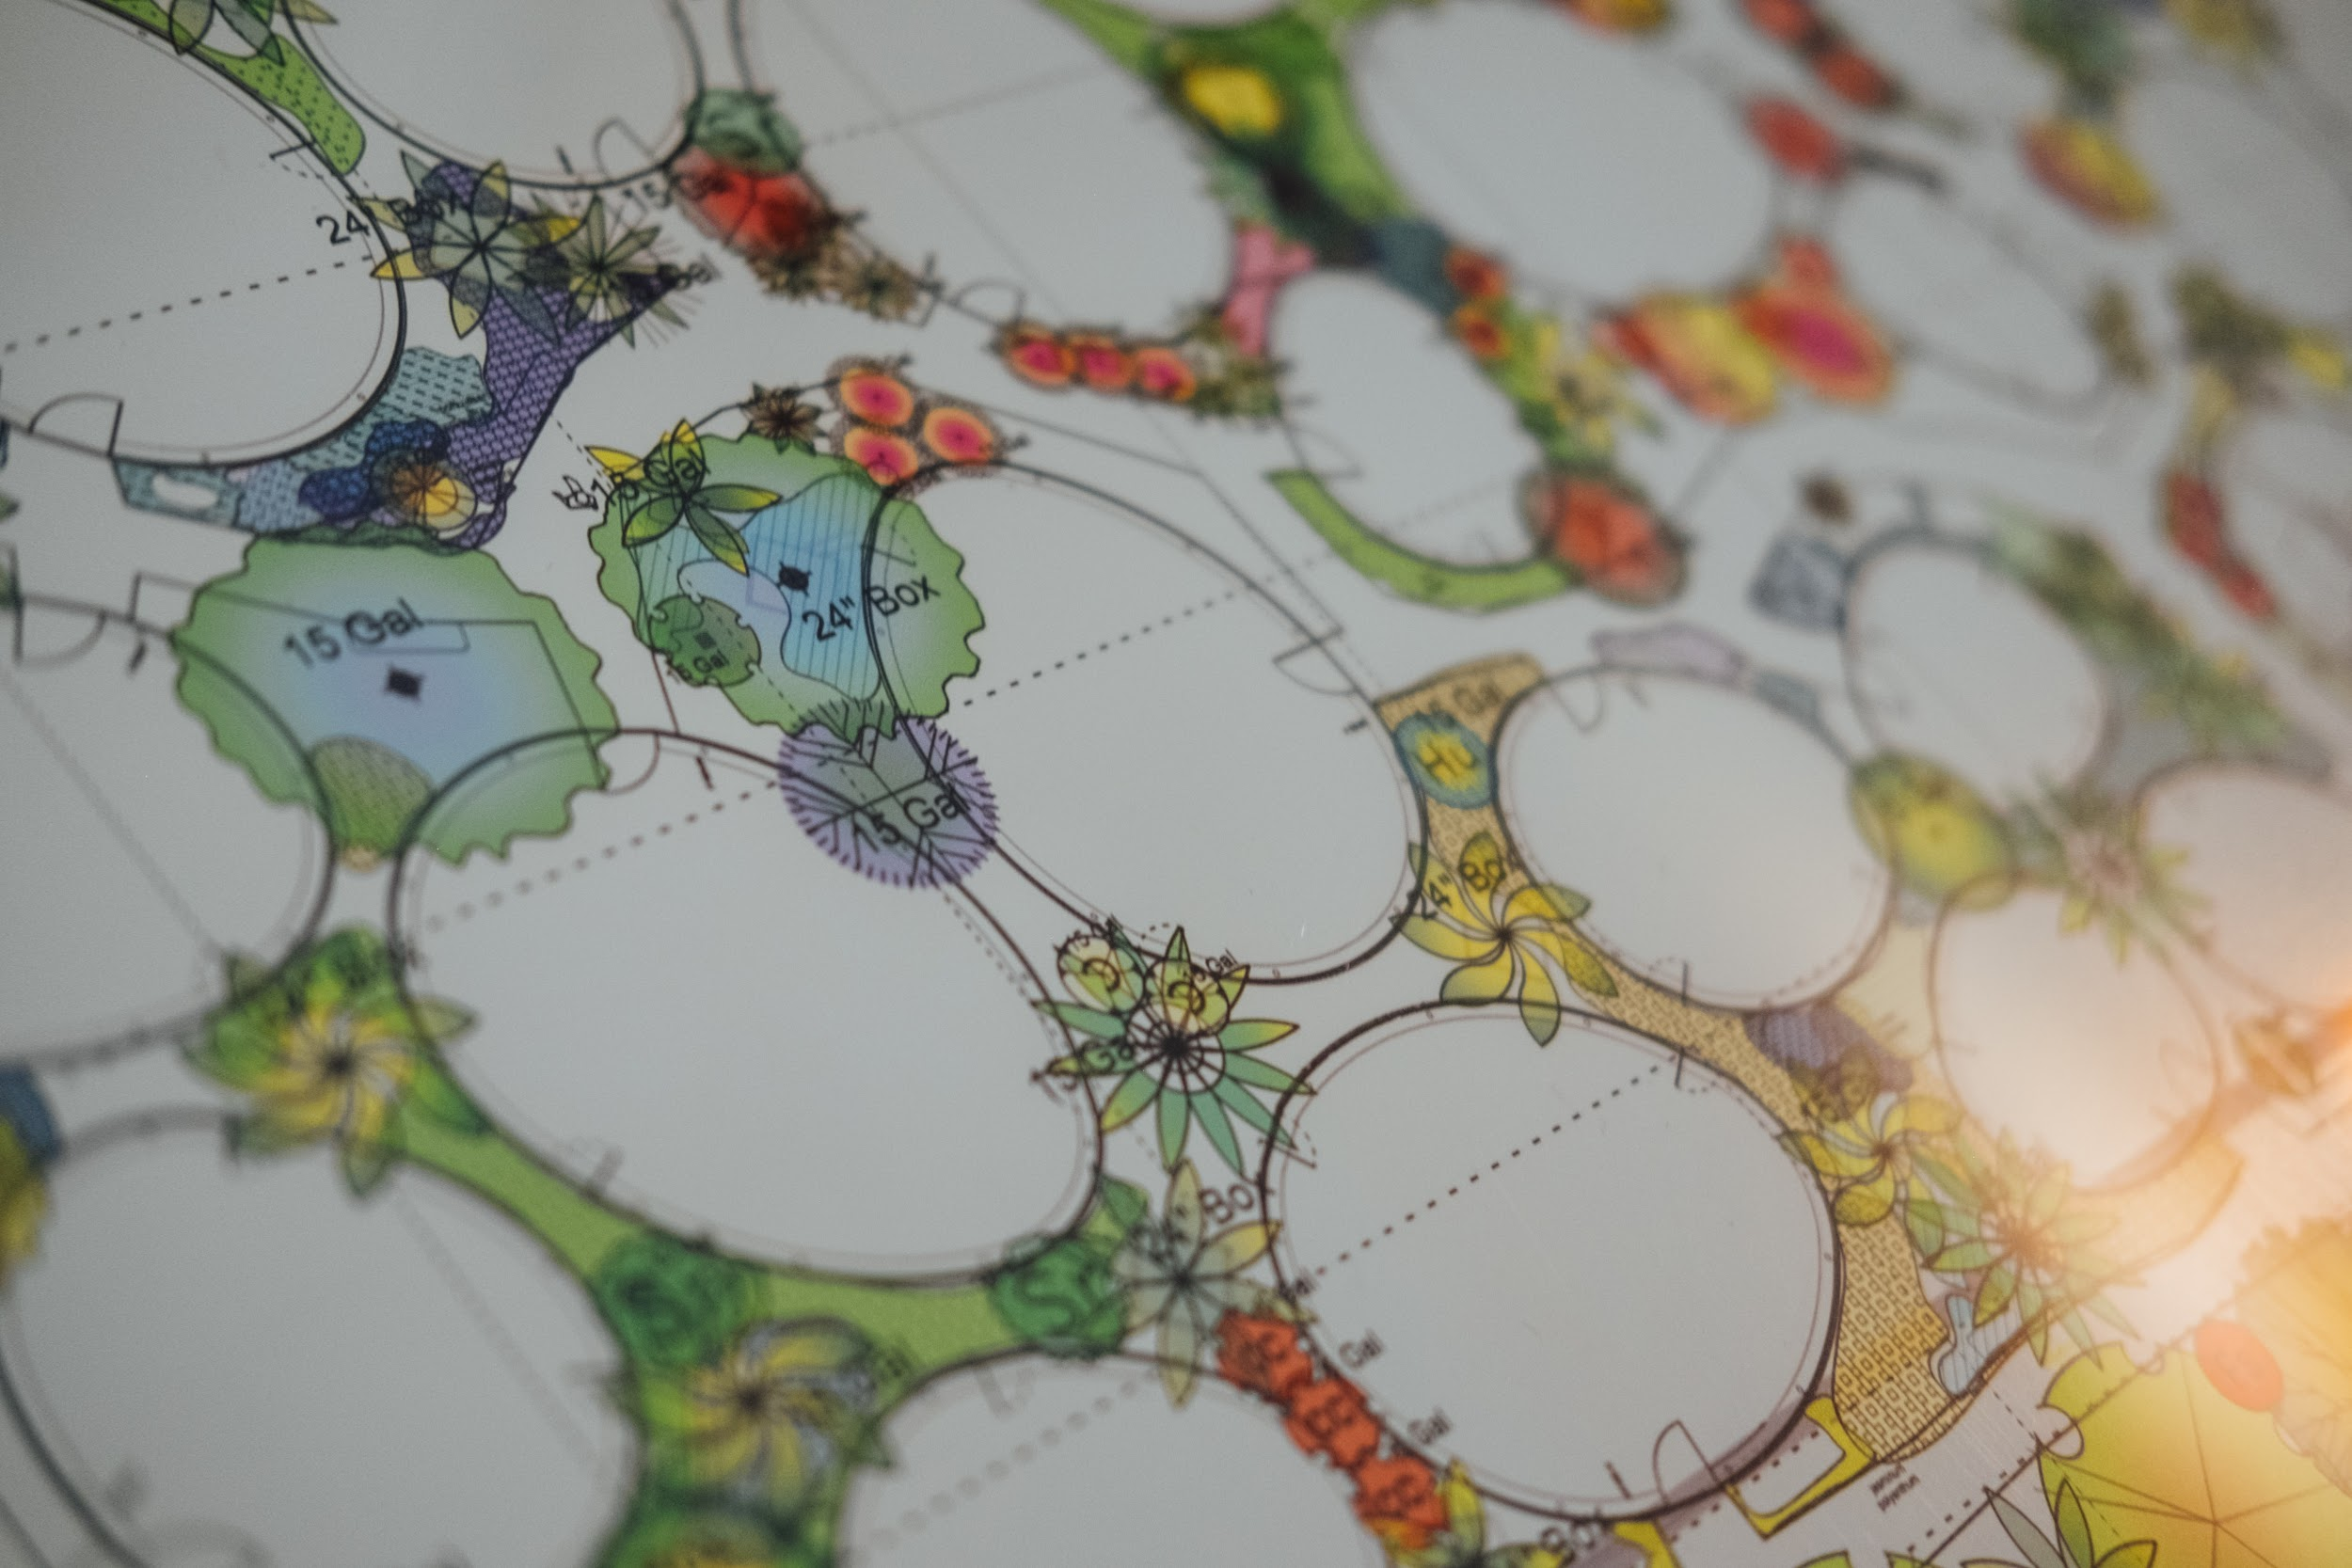
Issues
Designed to change over time and adapt to current conditions
Source: Paul Hanaoka, https://unsplash.com/photos/40JmKOnu6Cc CC by 2.0 Attribution
Notes:
Paul Hanaoka https://unsplash.com/photos/40JmKOnu6Cc
CF

Slide 18
Issues
Acquisitions Models
Intersection between Licensing & Technology
Notes:
CF
Acquisitions Models
Traditional access models
Point of need models
Evidence-based acquisition
Open Access
Transformative agreements
The Intersection of Technology & Licensing
TDM
Privacy & Surveillance
Authentication
Accessibility

Slide 19
4.
How can you get involved?
Notes:
KM

Slide 20
Help us elevate existing content!
Do you have tools, articles, etc. that you have created?
Notes:
KM
Examples: spreadsheets, models, web resources, journal articles.

Slide 21
Help us create new content
Grant has funding to pay for the creation of learning objects.
Notes:
KM
Do you have knowledge & expertise you’d like to share within the curriculum?
Examples: video lectures, readings, assignments, assessments

Slide 22

Look for call outs to be a pilot tester this summer!
The pilot test will run through the fall.
Image source: https://www.flickr.com/photos/136374834@N03/42512240460
Notes:
KM

Slide 23
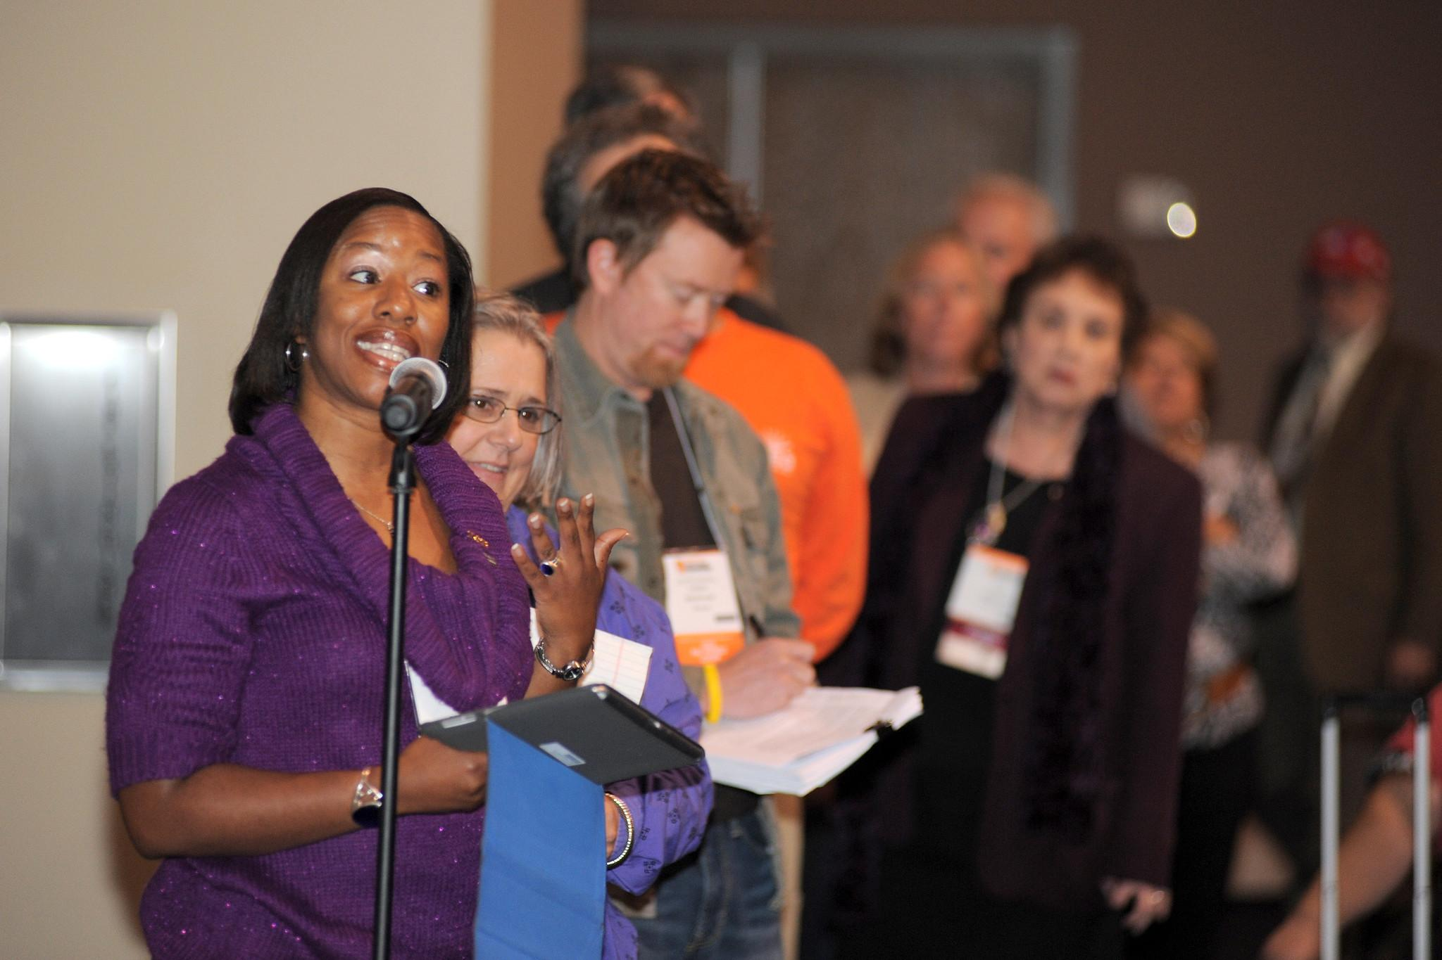
Discussion Now
Ask questions and share your thoughts!
Source: https://www.flickr.com/photos/64018555@N03/8113831039, CC by 2.0 Attribution

Slide 24
Credits
Special thanks to all the people who made and released these awesome resources for free:
Presentation template by SlidesCarnival

