Slide 1
Association Between Maternal Infection and the Use of Cervical Ripening Balloons in Term PROM

Slide 2
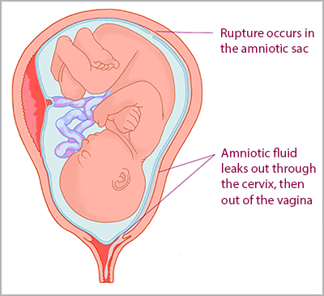
Term Prelabor Rupture of Membranes (PROM)
PROM complicates ~8% pregnancies at term and is usually followed by prompt onset of spontaneous labor and delivery¹
Most significant maternal consequence: intrauterine infection
  Risk increases with the duration of membrane rupture
Notes:
Middleton et al. meta-analysis

Slide 3
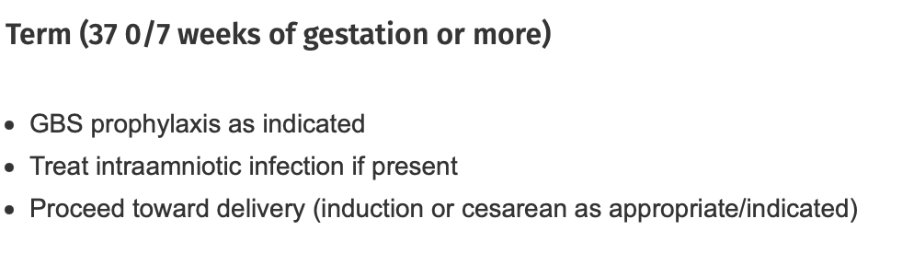
Term PROM: Management
Notes:
Initial management:
Make sure mom and baby are hemodynamically stable and not in distress
Establish gestational age, fetal position, fetal heart rate monitoring to assess fetal status
GBS culture and/or treatment as indicated

Slide 4
Term PROM: Management
Consider expectant management vs. IOL
  IOL reduces time from rupture to birth and the rates of chorioamnionitis or endometritis, or both¹
  IOL reduces admission to NICU¹
  All without increasing risk of cesarean birth or operative vaginal delivery¹
Notes:
Middleton et al. meta-analysis: induction of labor reduced the time from rupture to birth and the rates of chorioamnionitis or endometritis, or both, and also reduced admission to the NICU w/o increasing the rates of cesarean birth or operative vaginal delivery

Slide 5
Term PROM: Management
ACOG Practice Bulletin No. 217: for women with PROM at 37 0/7 weeks, if spontaneous labor does not occur near the time of presentation in those who do not have contraindication to labor, IOL should be recommended
Period of 12-24 hours of expectant management is reasonable, as long as clinical and fetal conditions are reassuring
Notes:
Nearly 80-95% patients start labor spontaneously within 12 and 24 hours respectively
Prevention of group B streptococcal early-onset disease in newborns. ACOG Committee Opinon No. 797. American College of Obstetricians and Gynecologists. Obstet Gynecol 2020;135:eXX-XX. (Level III).
GBS+: administration of abx for GBS prophylaxis should not be delayed while awaiting labor, and immediate induction rather than expectant management is recommended

Slide 6
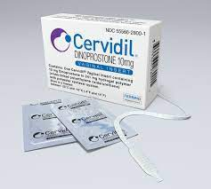
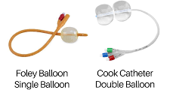
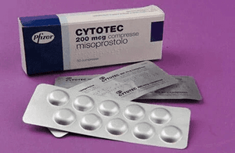
Induction of Labor (IOL)
Cervical ripening: Bishop score of 6 or less
Mechanisms
  Pharmacologic: Dinoprostone (PGE2 analogue), Misoprostol (PGE1 analogues)
  Mechanical: Foley (single balloon) vs. Cook (double balloon)
Notes:
Some studies have shown that using CRB's with vaginal prostaglandins for induction in women with term PROM increases the rate of delivery in less than 24 hours and may reduce the time from induction to delivery in nulliparous women (Devillard)

Slide 7
PICO question
P: In women who have term premature rupture of membranes,
I: is placing a cervical ripening balloon (CRB) w/ or w/o pharmacological induction agents for IOL
C: compared to pharmacological induction agents alone
O: associated with increased rates of maternal infection?
Notes:
We know that there is some potential benefit to using CRB to reduce the time between rupture and delivery. And as I said earlier, the greatest complication of term PROM is maternal infection, which only increases with the duration of rupture. As a result, there is a strong argument for the usage of CRB's in term PROM.
I wanted to look at one of the biggest concerns of using a CRB in women with term PROM.
In women who have term preterm rupture of membranes, is placing a cervical ripening balloon for IOL associated with increased rates of maternal infection compared to pharmacological induction agents?

Slide 8
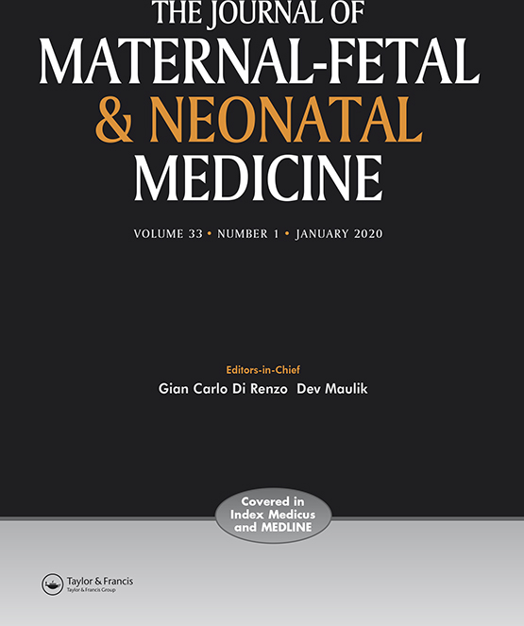


Literature review
Cohort study 2016
Meta-analysis 2021
RCT 2022
Cabrera et al.
Mackeen et al.
Devillard et al.

Slide 9
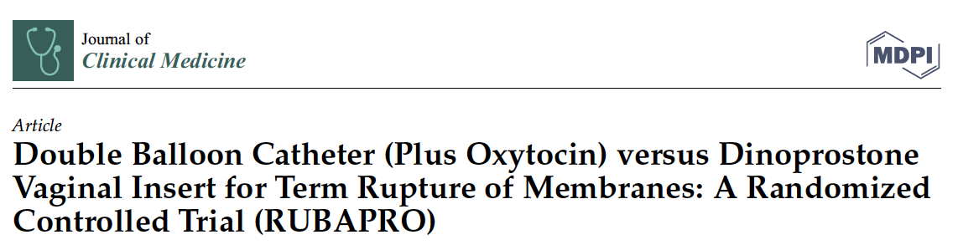
Devillard et al. 2022
Intervention
  Group 1: CRB 80cc for 12 hours and oxytocin 6 hours after device insertion
  Group 2: vaginal Dinoprostone insert for max 24 hours
Primary outcome: Time between induction and delivery
Secondary outcomes:
  Maternal: rate of clinical chorioamnionitis, rate of materno-fetal infection, endometritis, histological chorioamnionitis, delivery rate w/in first 24 h, spontaneous or assisted vaginal delivery rate, rate of caesarean section and indications, postpartum hemorrhage rate, time taken to achieve active labor and full dilatation
  Neonatal: NICU admission, umbilical artery pH <7.15, birth weight, lactates, rate of Apgar score <7 at 5 min
Notes:
Notably, a course of prophylactic abx (amoxicllin, or clindamycin in case of allergy), was administered upon recruitment and up to time of delivery to prevent chorioamnionitis

Slide 10
Study design
Devillard et al. 2022
n = 80
  Inclusion criteria: singleton gestation at term (>37 wks) with PROM (clinical amniotic fluid leakage and/or positive IGFBP1 test), unfavorable cervical examination (Bishop <6), and no contraindications to labor
  Maternal exclusion: those in active labor, suspected IAI, detection of GBS on any vaginal or urinary sample during current or previous pregnancy, placental abruption or significant hemorrhage, any prior uterine surgery, any contraindications to vaginal delivery, HIV or herpetic genital lesions
  Neonatal exclusion: non-cephalic presentation, severe fetal anomalies, IUFD, growth restriction <3rd percentile with Doppler anomalies, and non-reassuring FHR tracing

Slide 11
Outcomes
Devillard et al. 2022
IOL | Clinical chorioamnionitis | Histological chorioamnionitis | Materno-fetal infection
CRB + oxytocin | 0 | 6 (15%) | Probably 1 (2.5%), Confirmed 1(2.5%)
Vaginal Dinoprostone | 1 (2.5%) | 5 (12.5%) | Probably 1 (2.5%), Confirmed 0
p=1.00
p=0.56
p=1.00
Notes:
Clinical chorio defined as fever and combination of fetal tachycardia, or uterine contraction, or purulent fluid from cervical os, or abdominal pain

Slide 12
Conclusions
Devillard et al. 2022
No difference in maternal infection rate between CRB + oxytocin group and vaginal dinoprostone group
Notes:
Participants given systematic antibiotic prophylaxis and exclusion of GBS patients

Slide 13
Strengths & limitations
Devillard et al. 2022
Strengths
Current randomized, controlled trial
Excluded GBS-positive patients and administered systematic antibiotic prophylaxis
  GBS is an independent infectious risk factor in cases of PROM
Limitations
Less generalizable to US populations: do not routinely provide prophylactic abx empirically for term PROM patients
Impossible to blind participants
Small sample size (n=80)
Notes:
Tried to compensate for absence of blinding by using an objective primary outcome
Small sample size: decreases power of study
France national guidelines: prophylactic antibiotics- amoxicillin, or clindamycin in case of allergy- was administered upon recruitment and up to the time of delivery to prevent chorioamnionitis
Note that ACOG states in this same bulletin that there is insufficient evidence to justify the routine use of prophylactic antibiotics with PROM at term in the absence of an indication for GBS prophylaxis

Slide 14
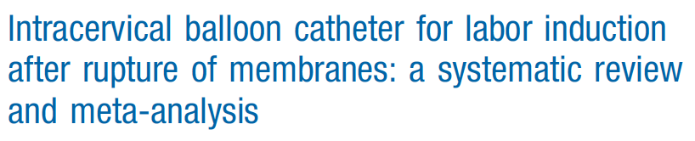
Mackeen et al. 2021
Objective: Compared intracervical balloon catheter with a pharmacologic agent for the IOL after PROM
Primary outcome: intra-amniotic infection, as defined by individual RCTs
Secondary outcomes:
  Maternal outcomes: time to vaginal delivery, cesarean delivery and indication for cesarean delivery, postpartum hemorrhage, endometritis
  Neonatal outcomes: suspected neonatal infection or culture-proven neonatal sepsis, neonatal intensive care unit admission, and 5-minute Apgar score of <7

Slide 15
Study Design
Mackeen et al. 2021
Total of 9 studies assessed
  Randomized trials comparing balloon catheter with or without pharmacologic agents with pharmacologic agents for IOL after PROM at or near term
  Only 4 studies contributed data for analysis (n=605)

Slide 16
Outcomes and Conclusions
Mackeen et al. 2021
Increased risk of clinical chorioamnionitis with the use of a Foley catheter and oxytocin vs. oxytocin alone
  8% vs. 0%, p <0.01
CRB catheter for IOL in PROM at or near term almost doubles the risk of IAI compared with the use of pharmacologic methods for IOL
  Supports the use of pharmacologic agents for IOL in PROM

Slide 17
Strengths & limitations
Mackeen et al. 2021
Strengths
  Meta-analysis
  Larger sample size (n=605)
  More generalizable to our patient population
Limitations
  Did not exclude GBS-positive patients
Notes:
accumulation of evidence can improve the precision and accuracy of effect estimates and increase the statistical power to detect an effect.
30% of patients in this study were GBS+, which is an independent infectious risk factor in cases of PROM

Slide 18
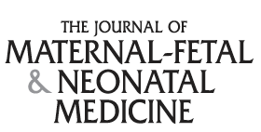
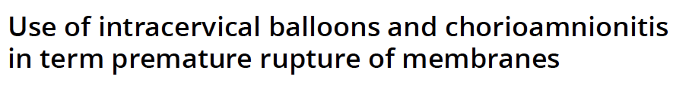
Cabrera et al. 2016
Objective: To evaluate whether cervical ripening and induction of labor in term patients with PROM using an intracervical balloon with or without oxytocin increases the risk of chorioamnionitis
Primary outcome: rate of chorioamnionitis (maternal temp >100.4 degrees Fahrenheit and either maternal tachycardia, fetal tachycardia, or both)
Secondary outcomes
  Maternal outcomes: rate of cesarean delivery, length of the first and second stage of labor
  Fetal outcomes: neonatal outcomes

Slide 19
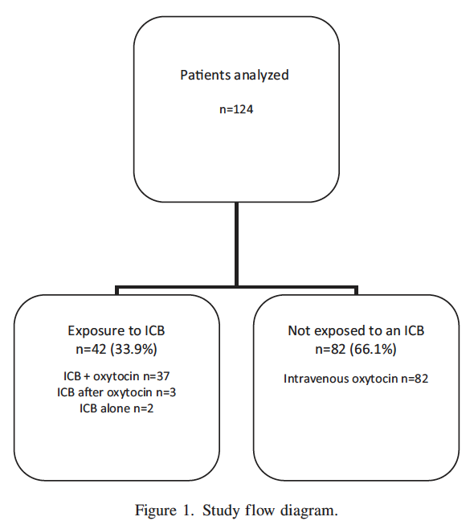
Inclusion
Cabrera et al. 2016
n=124
  Inclusion: singleton gestations with term PROM and a Bishop score <4 or less, who required cervical ripening and labor induction
  Exclusion: pregnancy c/b chorioamnionitis at time of admission, multiple gestation, prenatally diagnosed fetal structural anomalies, or aneuploidy

Slide 20
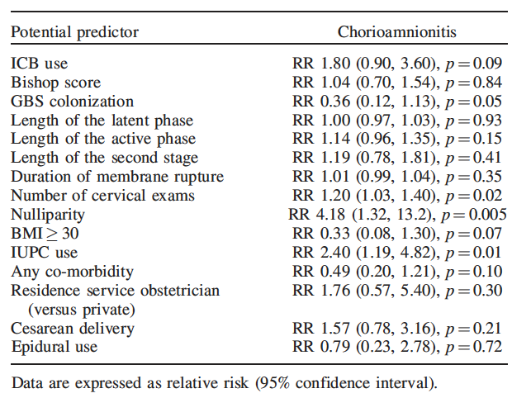
Outcomes
Carbrera et al. 2016
Notes:
Logistic regression models were constructed to evaluate the relationship between the ICB ripening and chorioamnionitis controlling for potential confounders (such as Bishop score, GBS colonization, length of labor stages, duration of membrane rupture, number of cervical exams, etc.)

Slide 21
Conclusions
Cabrera et al. 2016
Placement of an intracervical balloon does not independently increase the risk of chorioamnionitis
  The risk of chorioamnionitis in this study was instead explained more by nulliparity and placement of an IUPC
Notes:
Nulliparity and placement of an IUPC are associated with longer labor, longer length of membrane rupture, and therefore increased potential for infection

Slide 22
Strengths and limitations
Cabrera et al. 2016
Strength
Availability of complete EMR with standardized entries of Bishop score and definitions used by all involved clinicians to diagnose chorioamnionitis clinically
Controlled for potentially confounding factors for infection
Limitations
Small sample size (n=124)
Retrospective cohort study: could not evaluate the effect of clinician's decisions to use an ICB when compared with or without oxytocin alone
  Decision to use ICB w./ oxytocin vs. oxytocin alone is likely explained by difference in parity and cervical dilation
Inadequate power to detect statistically significant difference
Notes:
Using a power of 80% and an alpha level of 0.05, estimate needing at least 185 patients in each arm to find an increase in the rate of chorioamnionitis from 5 to 10% in women undergoing induction of labor for term PROM using an ICB when compared to using oxytocin alone

Slide 23
Implications for practice
ACOG Practice Bulletin No. 217: “there are insufficient data on which to base a firm recommendation for mechanical methods of cervical ripening in the setting of PROM”
Notes:
Looking at the available literature, it seems that there is insufficient evidence to prove an association between maternal infection and CRB use. This idea is echoed in the ACOG practice bulletin. However, the data is still mixed so I similarly believe we can not rule out an association.
Thus, I believe the decision to use a CRB balloon in term PROM women relies on the clinical picture as a whole and shared decision making with the patient.
For instance, potentially not using CRB in women who have other infectious risks such as GBS portage, prolonged rupture, IUPC insertion, etc.

Slide 24
Further Discussion
  ICB’s are low cost and don’t have systemic effects
    IV oxytocin and other ripening agents, such as misoprostol, can lead to tachysystole
  However, ICB’s are more painful to use
    Devillard et al: device placement was significantly less painful for the dinoprostone vaginal insert (visual analog scale of pain intensity 4.6 vs. 2.9 for CRB vs. dinoprostone, p=0.02)

Slide 25
References
Middeleton P, et al. Planned early birth versus expectant management (waiting) for prelabour rupture of memnbranes at term (37 weeks or more). Cochrane Database of Systematic Review 2017, Issue 1. Art. No.:CD005302
Devillard E. Double Balloon Catheter (Plus Oxytocin) versus Dinoprostone Vaginal Insert for Term Rupture of Membranes: A randomized Controlled Trial (RUBAPRO). J Clin Med. 2022 Mar 10;11(6):1525. doi: 10.3390/jcm11061525.
Mackeen AD, Quinn ST, Movva VC. Intracervical balloon catheter for labor induction after rupture of membranes: a systematic review and meta-analysis. Amer Journ of Obstet and Gyn. June 2021.
Cabrera IB, Quinones JN, Durie D, Rust J, Smulian JC, Scorza WE. Intracervical balloon catheter for labor induction after rupture of membranes: a systematic review and meta-analysis. J Matern Fetal Neonatal Med. 2016 Mar;29(6):967-71. doi: 10.3109/14767058.2015.1027191.

