Slide 1


Zone of Possible Agreement: Researching & Predicting Publishers’ Positions
NEGOTIATION 201 SERIES

Slide 2

Hello!
Katharine V. Macy, MBA, MLIS​
Collection Assessment Librarian
IUPUI University Library​
macyk@iupui.edu ​
Twitter: @kvmacy​
ORCID https://orcid.org/0000-0002-6283-7143 ​
​

Slide 3
1.
Defining ZOPA
Why are we talking about this?

Slide 4
Negotiation 101
Deeper dive into a concept discussed in ACRL/SPARC Negotiation 101
Workshop Materials including presentation, resources, and case studies
Video recording coming soon!

Slide 5
ZOPA
$10,000 Min
Seller
$12,500 Max
Buyer
The minimum the seller is willing to sell and the maximum the buyer is willing to pay.
While traditionally price focused, you can attempt to value other important parts of your agreement such as NDAs, perpetual access, and authorized users.

Slide 6
Finding ZOPA
Library Interests (Buyer)
Naturally easier for us to determine
Involves understanding your BATNA (Best Alternative to Negotiated Agreement) and reservation price.
Negotiation 201 BATNA deep dive is July 29th from 3-4pm EDT
Vendor Interests (Seller)
Much more difficult to forecast
Examine:
  Your data
  Vendor pricing to other libraries
  Industry Trends
  Vendor Intelligence

Slide 7
2.
Your Collection’s Data
The first step

Slide 8
Your historical data
Price change data
  Average annual increase at 1-year, 3-year, 5-year
Allows you to predict upper end of the vendor’s range of acceptable agreement. Particularly useful if you are proposing pricing in first-mover advantage strategy.

Slide 9
Your historical data
Use
  If use is dropping off, you can push the vendor’s minimum selling price down.
Cost/Use
  Vendors often justify increases with more access to additional resources and tools.
  If cost/use is increasing those resources and tools do not bring your institution increased value. Can be used to push down the selling price.

Slide 10
3.
Researching Pricing
Finding out what others are paying

Slide 11
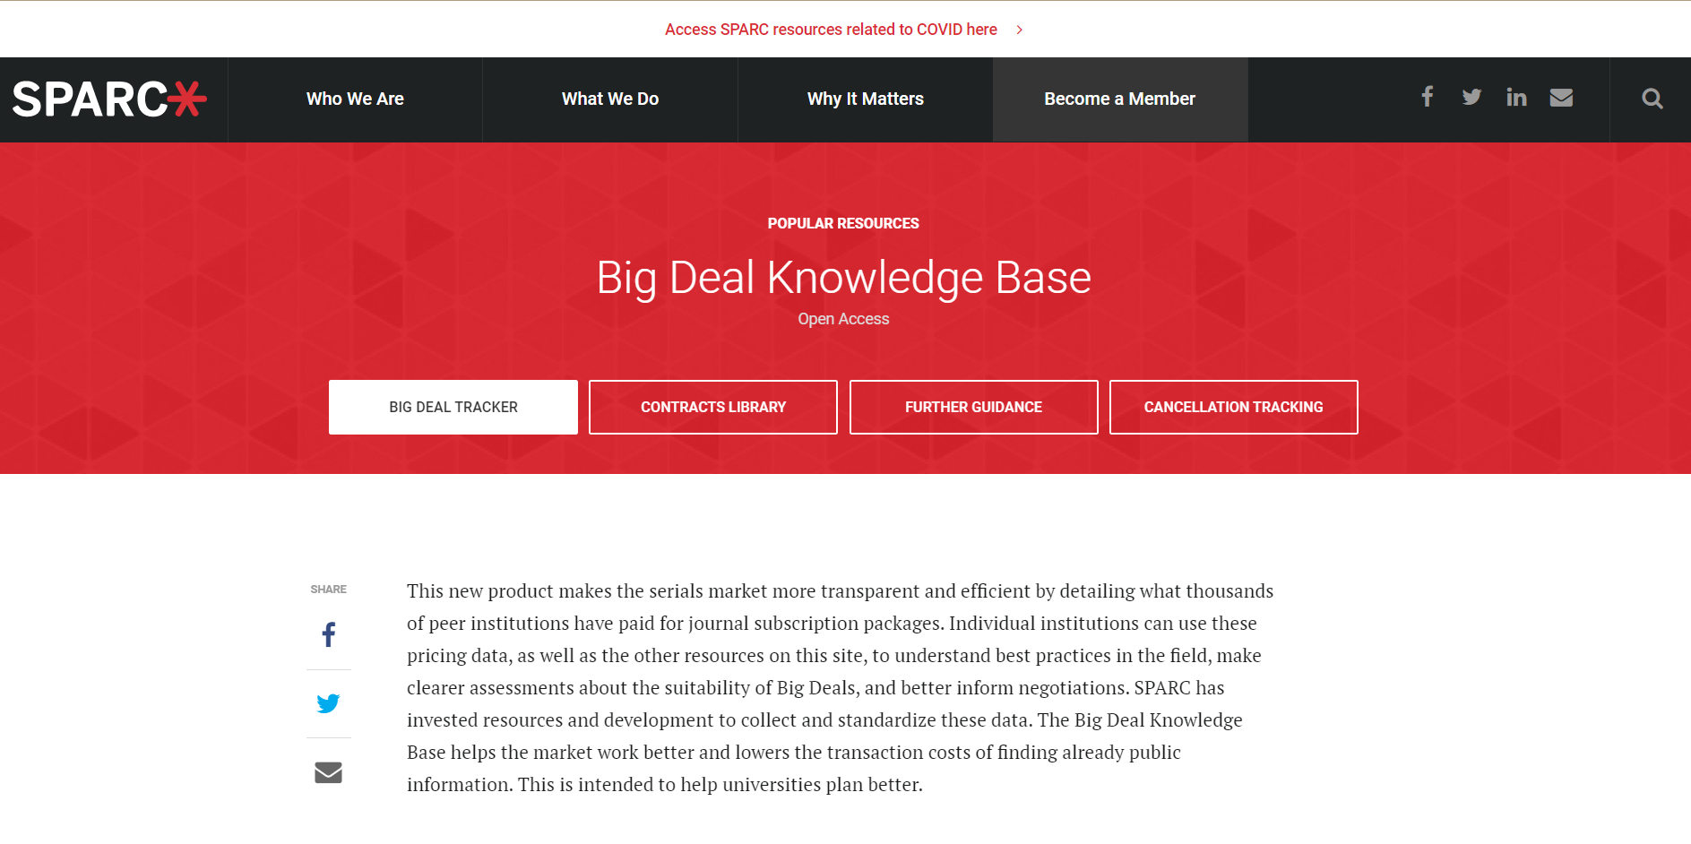
https://sparcopen.org/our-work/big-deal-knowledge-base/

Slide 12
Things to note
Different institutions have negotiated different levels of discounts and concessions on licensing terms within their big deals
  Thornton, J.B. & Brundy, C. (2021). Elsevier Title Level Pricing: Dissecting the Bowl of Spaghetti. Journal of Librarianship and Scholarly Communication, 9(General Issue), eP2410. https://doi.org/10.7710/2162-3309.2410
  Example: Colorado Alliance of Research Libraries (CARL) achieved discounts but gave up perpetual access rights with Elsevier, while Canadian Research Knowledge Network (CRKN) did not.

Slide 13
Transparency Lists
Institutionally created lists of subscription resources with pricing shared openly in compliance with vendor agreements. Some examples (not exhaustive)*
Canadian Association of Research Libraries
Cornell University
Simon Fraser University Library
University of Alberta Library
University of North Texas Library
Why striking NDAs on pricing is important!
*Thank you to Sian Brannon, University of North Texas for compiling.
Notes:
I think the creation of Transparency Lists was extremely helpful to CRKN

Slide 14
Evaluate pricing overtime
While other institutions may not have your exact package you can look at overall trends over time at different institutions.

Slide 15
4.
Industry Trends
Competitive environment in Scholarly Publishing

Slide 16
After a window between the late nineties of the 20th century and the mid-teens of the 21st, when the STM industry grew its revenues by about 5% annually, available data suggests that the industry’s subscription revenue growth has slowed down to perhaps 1-2%. OA revenues have been rising faster, lifting overall revenue growth to 3-4%, still below the growth rate of a decade ago, but introducing a new uncertainty over the future revenue trajectory of the industry.
-- SPARC Landscape Analysis
Aspesi, C., Allen, N. S., Crow, R., Daugherty, S., Joseph, H., McArthur, J. T., & Shockey, N. (2019, March 29). SPARC Landscape Analysis. , https://doi.org/10.31229/osf.io/58yhb

Slide 17
Resources
SPARC Landscape Analysis
Update to the Landscape Analysis
    Need help understanding the nuance of economic and financial information and why it’s important? Librarian’s Guide to Understanding Scholarly Publisher Financial Data.

Slide 18
Some Significant Trends
Scholarly journal revenues flattening*
Vendors are looking to control more of the scholarly communication system.
Vendor reps have increased pressure to aggressively trying to maintain status quo on existing products or to sell the increased value of new integrated tools such as learning analytics.
Moving toward transformative agreements
Read-and-Publish and Publish-and-Read are being embraced by publishers to lock in a significant portion of library budgets. Hedging their bets as OA grows.
Big Deal Cancellations
When institutions aren’t finding a zone of possible agreement, they are cancelling big deals and moving to a la carte purchasing.
*Aspesi, C. & SPARC (Scholarly Publishing and Academic Resources Coalition). (2020, June 22). Update to the Roadmap for Action. 2020 update , https://infrastructure.sparcopen.org/2020-update/update-to-roadmap-for-action

Slide 19
Some Significant Trends
Continued Industry Consolidation
As growth slows in a saturated market, the number or players will continue to reduce, especially as strategic acquisitions occur to increase control of the entire research and scholarly communication process.
Vendors will try to side-step libraries to sell products to university administrations to support research and learning analytics.
Moving toward data analytics*
Vendors see data analytics as an avenue for revenue growth and are looking to link publishing to data in their deals.
They are trying to create a new even bigger deal so vendor reps will be trying to entice libraries to increase their spend through these new offerings, presenting them as a value while making it harder than ever for libraries to breakaway if they sign on.
*Aspesi, C. & SPARC (Scholarly Publishing and Academic Resources Coalition). (2020, June 22). Update to the Roadmap for Action. 2020 update , https://infrastructure.sparcopen.org/2020-update/update-to-roadmap-for-action

Slide 20
4.
Vendor Intelligence
How to research your vendor

Slide 21
Three Types of Ownership
Public
Traded on the public stock exchanges. They are required to file annual financial statements to government agencies. Information is abundant.
Private
Often fully or partially funded by private equity. Hardest to research since not required to make financial information public.
Non-Profit
Scholarly Society Publishers*
Publishers based in the US are required to file 990s which include financial information.
*Not all scholarly societies do their own publishing.

Slide 22
Public Company Research
*SPARC’s Landscape Analysis & 2020 Update summarizes financial performance.
I’ve consolidated the historical financial performance for RELX (FY2014-FY2020) and Wiley (FY2015-2021) into an Excel Spreadsheet
Corporate Website (look for investor relations under About Our Company or About Us)
  Annual Reports / 10-K / 20-F (10-K and 20-F also available via EDGAR)
  Press Releases
News
Industry Reports*
Business Databases (Consolidates information from annual reports/ 10-Ks quickly)
Challenge: Often scholarly journal publishing is only one division of a larger organization. Digging into annual report/10-K can isolate data about the publishing operation.
Notes:
10-K US firms
20-F International firms

Slide 23
Know your profit numbers
Gross Margin
Operating Margin
EBITDA (and the Debt/EBITDA ratio)*
If discussing profit or profit margins in a negotiation I suggest focusing on on operating margin or EBITDA, if available.
*You can find this easily in SPARC’s Landscape Analysis and 2020 Update
Notes:
Operating profit margin is an indicator of how effectively a company is at managing costs. Historically scholarly publishing has not passed along cost efficiencies that you would expect with digitization. This can be seen through the fact that profits have grown at rates faster and revenues (price increases).
EBITDA is an indicator of the cash flow (how much cash would be available) to pay for long term debt. EBITDA creates the most apples to apples comparison to compare different companies.
The Debt/EBITDA indicates the ability to pay off debt. A high ratio (greater than 3.5) indicates a heavy debt load.

Slide 24
A Note on Operating Expenses
Just because it’s a necessary expense needed in running the business does not mean it’s without criticism. Example:
If they are adding more and more employees so their wage and benefits expenses increase, while libraries cut employees and services to continue to buy their product – there is a problem.
SG&A (Sales, General, and Administrative) is an overhead expense that covers sales and marketing and other corporate expenses. Does the SG&A expense seem out of line with others in the industry? What is going on with their executive compensation?
Notes:
You don’t necessarily need to get in these weeds but as a former financial analyst I want to dig into them! (Does a vendor really need to send 7 people to demo a product we already purchase? Have they not heard of web conference calls?)

Slide 25
Private Company Research
Company website (about our company, press releases)
News
Industry reports
Much harder to locate financial data, best sources are often industry reports such as the Landscape Analysis.

Slide 26
Non-Profit Research
Some scholarly societies act as publishers.
Scholarly society website (About Us, Annual Reports, Financials, Press Releases)
News
990s

Slide 27
Where to find financials
Annual Report/Finances page of Society website
Written for society members and board of directors. Often provides consolidated financials as well as financials for different operating divisions (publishing, membership, etc.)
Smaller societies may not publish a financial report outside of a 990.
990
IRS financial reporting form required of US-based non-profits.
May not match annual report due to different reporting metric definitions or go into detail needed to isolate publishing from other society operations.

Slide 28
Resources to find 990s
Guidestar
  Limited access for free
Propublica Nonprofit Explorer
  Open resource
Check both resources because sometimes one resource is more up to date than the other.
Guidestar’s guide on reading 990s

Slide 29

An Example
American Chemical Society
Hard to find on the society website
Search for “annual report”
Click Financials
Click Financial Highlights
Click the link to “financial results” to get the full report

Slide 30
American Chemical Society
American Chemical Society
In annual financial report the “Change in Net Assets Without Donor Restrictions from Operations” is what I’m considering to be the equivalent of Operating Profit (EBIT).
The electronic and other information services division is the scholarly publishing operation.
My financial analysis is available for you!

Slide 31
ACS financial analysis highlight
Estimated Change in Net Assets Without Donor Restrictions (EBIT) in 2020 for all of ACS operations was $62.5MM
EBIT in 2020 for their scholarly publishing operation was $92.2MM, an estimated operating profit of 14.6% up from the prior year (10.3%).
What this means?
Vendor reps will claim that the scholarly publishing arm supports the rest of the society. This is true to the tune of $29.7MM. However, they are gaining a significant portion of earnings beyond. Average increase in Scholarly Publishing revenues grew 6% between 2019 and 2020. They have room to decrease their revenues and maintain operations.

Slide 32
Information beyond financials
Often this can be found in annual reports and financial statements
How has the employee count changed?
Has the number of journals changed?
Does the discussion indicate changes in how scholarly publishing revenue is generated?

Slide 33
Final Thoughts
This research is meant to provide insight on how the vendor may behave
Will they be aggressive to keep price up?
Will they be more likely to concede in order to keep you?
This enables you to try to predict the minimum the vendor may sell to you. You may want to draft two ZOPAs one based on aggressiveness and one on concessions.
As you learn more during the negotiation you likely will need to adjust your estimate.

Slide 34
Final Thoughts
Sometimes the minimum the vendor the minimum is will to sell is higher than the max that you want to pay. In this case you cannot find agreement, so the zone of possible agreement does not exist.
To really understand if this is the case you must understand your BATNA, the best alternative to negotiated agreement and your reservation price (the price where you walk away). Our next workshop on July 29th @3pm EDT focuses on this topic (register).

Slide 35
Thanks!
Any questions?
You can find me at:
@kvmacy
macyk@iupui.edu

Slide 36
Credits
Special thanks to all the people who made and released these awesome resources for free:
Presentation template by SlidesCarnival
Photographs by Unsplash

Slide 37
5.
Appendix
Understanding Financial Numbers & Profit

Slide 38
Gross Margin
Back to Profit Slide
Gross Sales
-returns, discounts, and allowances
Net Sales
-COGS
Gross Profit
Think of Gross Sales as the revenue if you paid list for everything!
Cost of Goods Sold (COGS) are the variable costs to produce a product (so hourly labor and materials).
The higher the gross margin, the more capital the company retains to pay for operating expenses, corporate overhead, debt and owner dividends.
Gross margin always looks incredibly high because it doesn’t include any of the fixed operating costs that are required to run the business.
Gross Profit/Net Sales = Gross Margin

Slide 39
Operating Margin
Back to Profit Slide
Gross Profit
-returns, discounts, and allowances
Net Sales
-COGS
-Operating Expenses
EBIT
Operating expenses are the expenses an organization incurs in normal operations such as rent, equipment, inventory costs, marketing, payroll, insurance, and research and development. Includes accounting adjustments depreciating capital expenditures and amortization. These are do not include the variable costs in producing a product or service.
Earning before interest and tax expenses (EBIT) is the earnings generated after subtracting variable and fixed operating expenses.
Operating profit margin is an indicator of how effectively a company is at managing costs. Historically scholarly publishing has not passed along cost efficiencies that you would expect with digitization. This can be seen through the fact that profits have grown at rates faster and revenues (price increases).
EBIT/Net Sales = Operating Margin

Slide 40
EBITDA
Back to Profit Slide
Gross Profit
-returns, discounts, and allowances
Net Sales
-COGS
-Operating Expenses
EBIT
+Depreciation Expenses
+Amortization Expenses
EBITDA
Earnings before interest, tax, depreciation, and amortization expense (EBITDA). You add back in the depreciation of capital assets such as buildings and equipments as well as the amortization expenses of an intangible asset (e.g. intellectual property). Over a set period, capital and intangible assets lose monetary value.
EBITDA is an indicator of the cash flow (how much cash would be available) to pay for long term debt. EBITDA creates the most apples to apples comparison to compare different companies.
The Debt/EBITDA indicates the ability to pay off debt. A high ratio (greater than 3.5) indicates a heavy debt load.
EBITDA/Net Sales =
EBITDA Margin
(Short Term + Long Term Debt)/EBITDA = Debt/EBITDA Ratio

