Slide 1

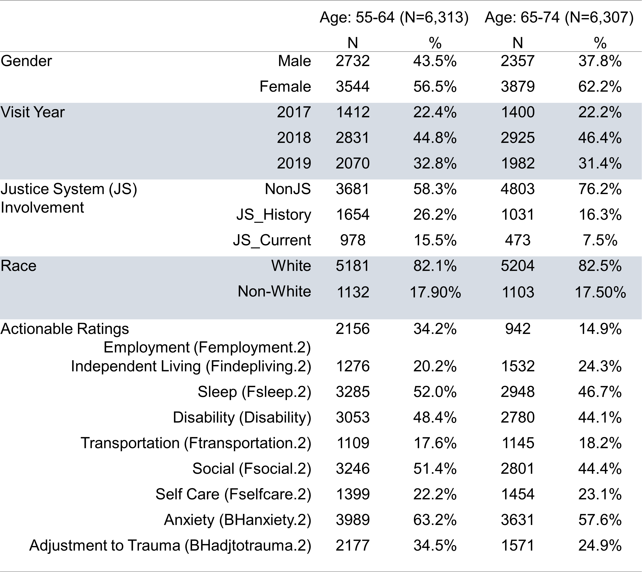
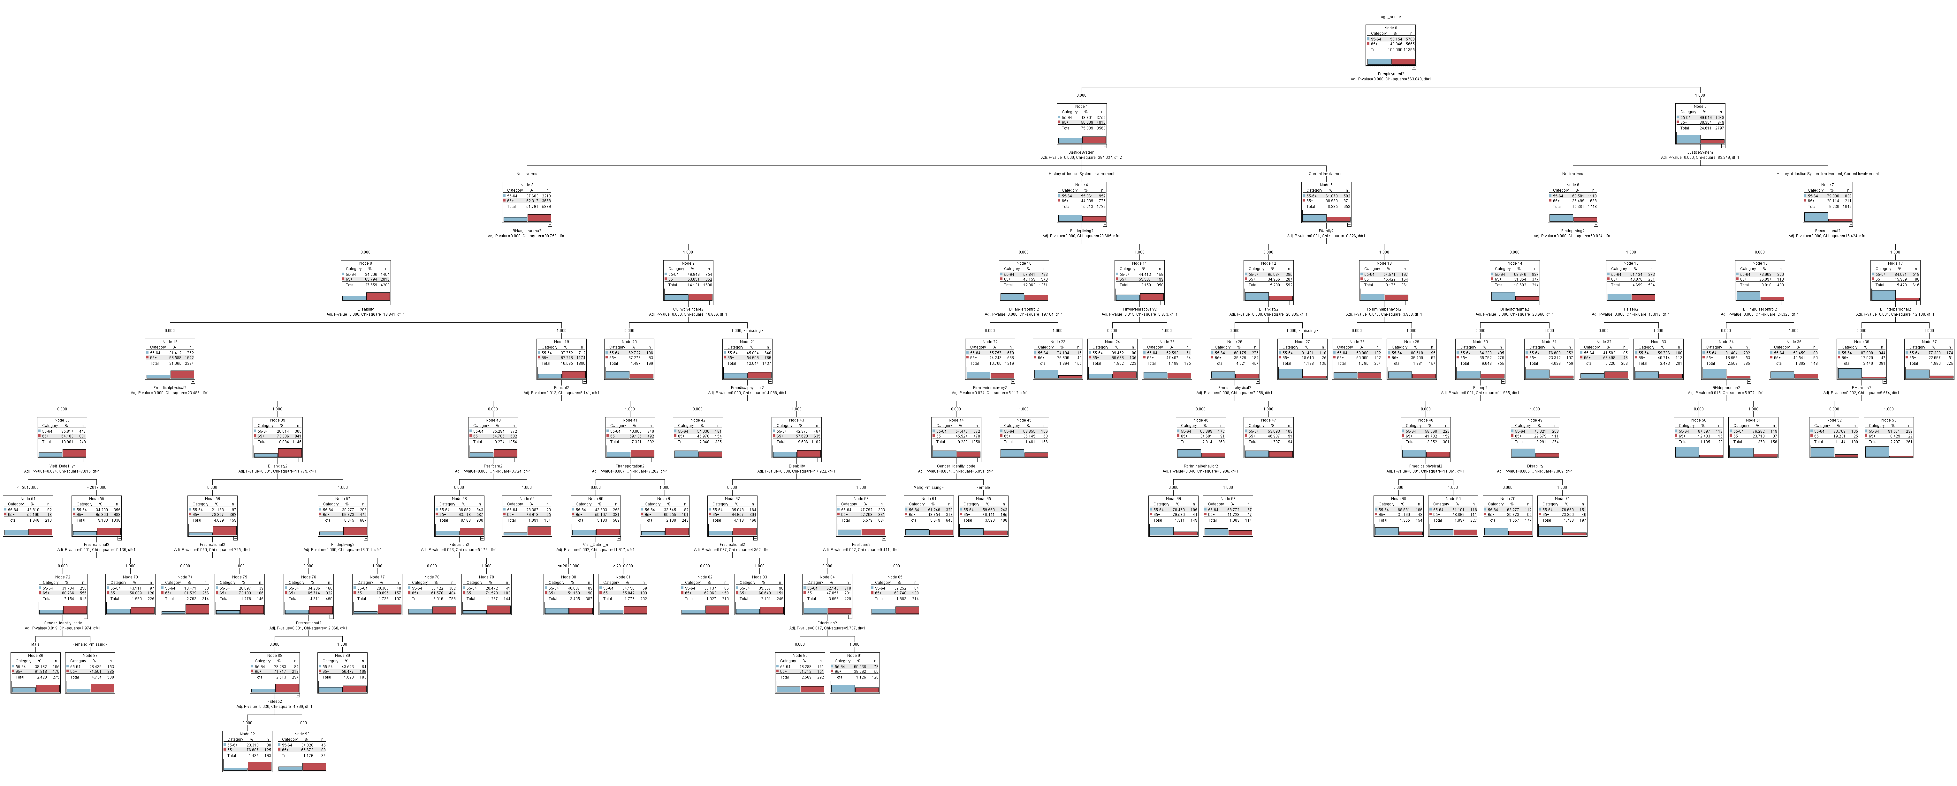
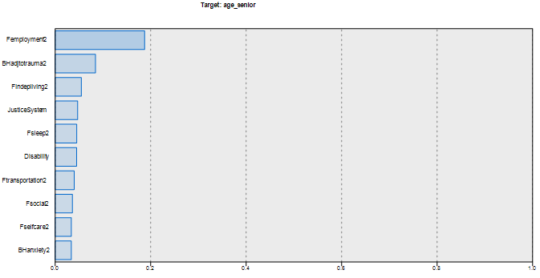

Behavioral Health Needs of Middle-aged and Older Adults Living in Poverty:
Machine Learning-Based Predictive Models
Saahoon Hong; Eun-Hye Grace Yi*, Betty Walton; Hea-Won Kim
Indiana University School of Social Work ; * Indiana State University
Abstract
Methodology
Conclusion
Table 1. Demographic Information & Actionable Ratings
ANSA (with a Balanced Sample Size)
The main purpose of this study was to develop the prediction model for older adults’ behavioral health needs who got involved in state-funded mental health services. Upon repeated construction of a decision tree for 8,071 adults aged 55-74, the top four predictors for classifying older adults include adjustment to trauma, independent living, and legal system involvement. The significant predictors illustrate the dynamics of older adults’ behavioral health needs that could enhance our knowledge and understanding of them, critical for strategic planning.
This study used one Midwestern state’s 2019 publicly funded BH administrative data. A sample of adults aged 55 and older got involved in the publicly funded statewide behavioral health services (total N=8,071; middle-aged adults [aged 55 to 64]: N= 6,313, older adults [aged 65 to 74]: N=1,758).
A balance node provided by SPSS Modeler was used to correct imbalances between the two groups (aged 55 to 64 [N= 6,313], and aged 65 to 74 [N=6,307]).
Adult Needs and Strengths Assessment (ANSA; Lyons, 2009) was completed to facilitate care planning and to monitor outcomes in State Fiscal Year 2019 and initial assessments were completed within three years (2017 thru 2019).
A chi-square automatic interaction detection (CHAID) model was used to detect the relationship between Behavioral Health needs (BH) and age group. The CHAID analysis divided data into training (80% out of the balanced sample) and testing (20%) datasets to test the model.
The findings suggest that employment is the most important predictor for classifying older adults with behavioral health needs, followed by adjustment to trauma, independent living, legal system involvement, sleep, disability, transportation, social skills, and self-care. Interestingly, gender and race were not significantly important in classifying behavioral health needs between middle-aged and older adult groups.
The older adults who had non-actionable ratings on employment and actionable ratings on the legal system (current JS involvement), middle-aged adults were more likely to struggle with anxiety than older adults.
The older adults with non-actionable ratings on employment, legal system, and adjustment to trauma, non-disabled older adults were more likely to present behavioral health needs on medical/physical, anxiety, independent living, recreational, and sleep.
The results could eventually be a basis for classifying older adults’ behavioral health needs and developing strategic plans to meet them.
Introduction
Growing evidence revealed behavioral health (BH) service needs for older adults (WHO, 2020; Webb, 2020; Novotney, 2019). However, the BH service needs and use of older adults living under 200% of poverty (42%; Cubanski et al., 2021) remained largely understudied. To develop contextually sensitive and effective services for older adults in poverty, this study aimed to identify the characteristics and patterns of older adults’ BH service needs compared to those of middle-aged adults.
* () indicating a variable name in the dataset
This study was developed through a
collaborative effort by the IUSSW and DMHA
Acknowledgement
Fig. 1. CHAID for Predicting Older Adults’ Behavioral Health Needs
Fig. 2. Predictor Importance CHAID for Predicting Older Adults’
Behavioral Health Needs

Slide 2
Behavioral Health Needs of Middle-aged and Older Adults Living in Poverty:
Machine Learning-Based Predictive Models
Saahoon Hong; Eun-Hye Grace Yi*, Betty Walton; Hea-Won Kim
Indiana University School of Social Work ; * Indiana State University
Abstract
Table 1. Demographic Information & Actionable Ratings on ANSA (with a Balanced Sample Size)
This study was developed through a
collaborative effort by the IUSSW and DMHA
Acknowledgement
* () indicating a variable name in the dataset

Slide 3
Behavioral Health Needs of Middle-aged and Older Adults Living in Poverty:
Machine Learning-Based Predictive Models
Saahoon Hong; Eun-Hye Grace Yi*, Betty Walton; Hea-Won Kim
Indiana University School of Social Work ; * Indiana State University
Abstract
This study was developed through a
collaborative effort by the IUSSW and DMHA
Acknowledgement
Fig. 1. CHAID for Predicting Older Adults’ Behavioral Health Needs

