Slide 1
Emotional Labor in Archives
Learn & Share
Mikayla Knight Kinley
MLIS Archives Management graduate student
Luddy School, Indiana University Indianapolis
Society of Indiana Archivists Annual Meeting
April 4, 2025

Slide 2
Topics of
Discussion
Ethics of care approach
Trauma-informed archival practice
Support for archivists

Slide 3
WEBCCCHAM
BIPOCWSNLGBTQDF

Slide 4










I. Ethics of care approach
The notion of empathy we are positing assumes that subjects are embodied, that we are inextricably bound to each other through relationships, that we live in complex relations to each other infused with power differences and inequities, and that we care about each other’s well-being.
“
”
Caswell & Cifor, 2016, p. 31

Slide 5

“Affective responsibilities”
The archivist and…
Records creator
Records subject
Users
Community
In a feminist approach, each one of these parties is considered empathetically and in relation to each other and to dominant power structures before archival decisions are made.
Others added later:
Donors
Other archivists
Any others?
“
”
Caswell & Cifor, 2016, p. 34

Slide 6
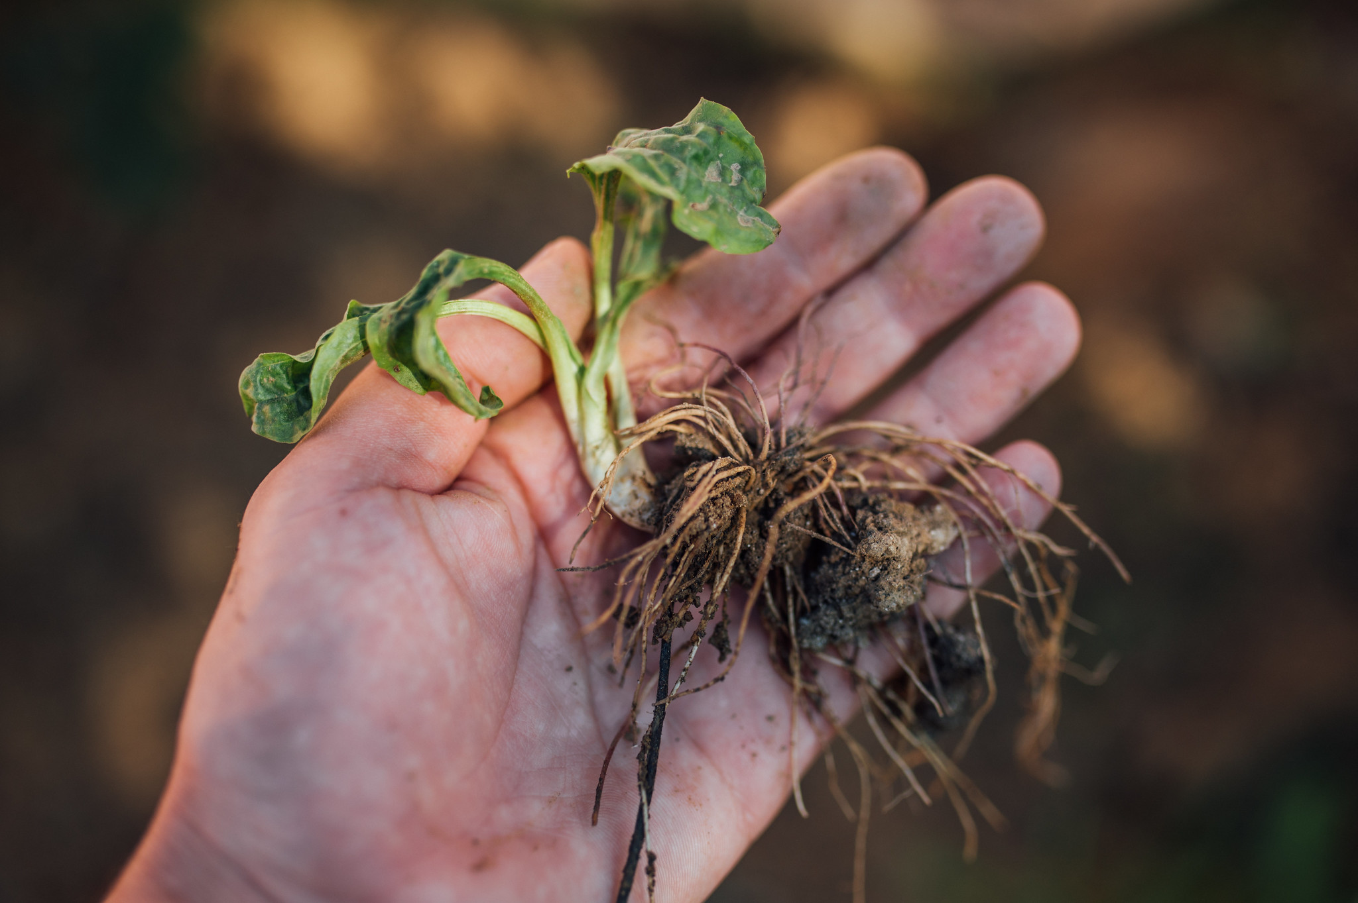
Close-up of a weed pulled from the ground including its roots, 2021, by Ivan Radic, on Flikr
Radical empathy:
“uprooting structural harms”
~
“aim of transforming our systems”
(Arroyo-Ramírez et al., 2021, editors’ note,“Radical Empathy in Archival Practice” special issue, p. 3-4).

Slide 7
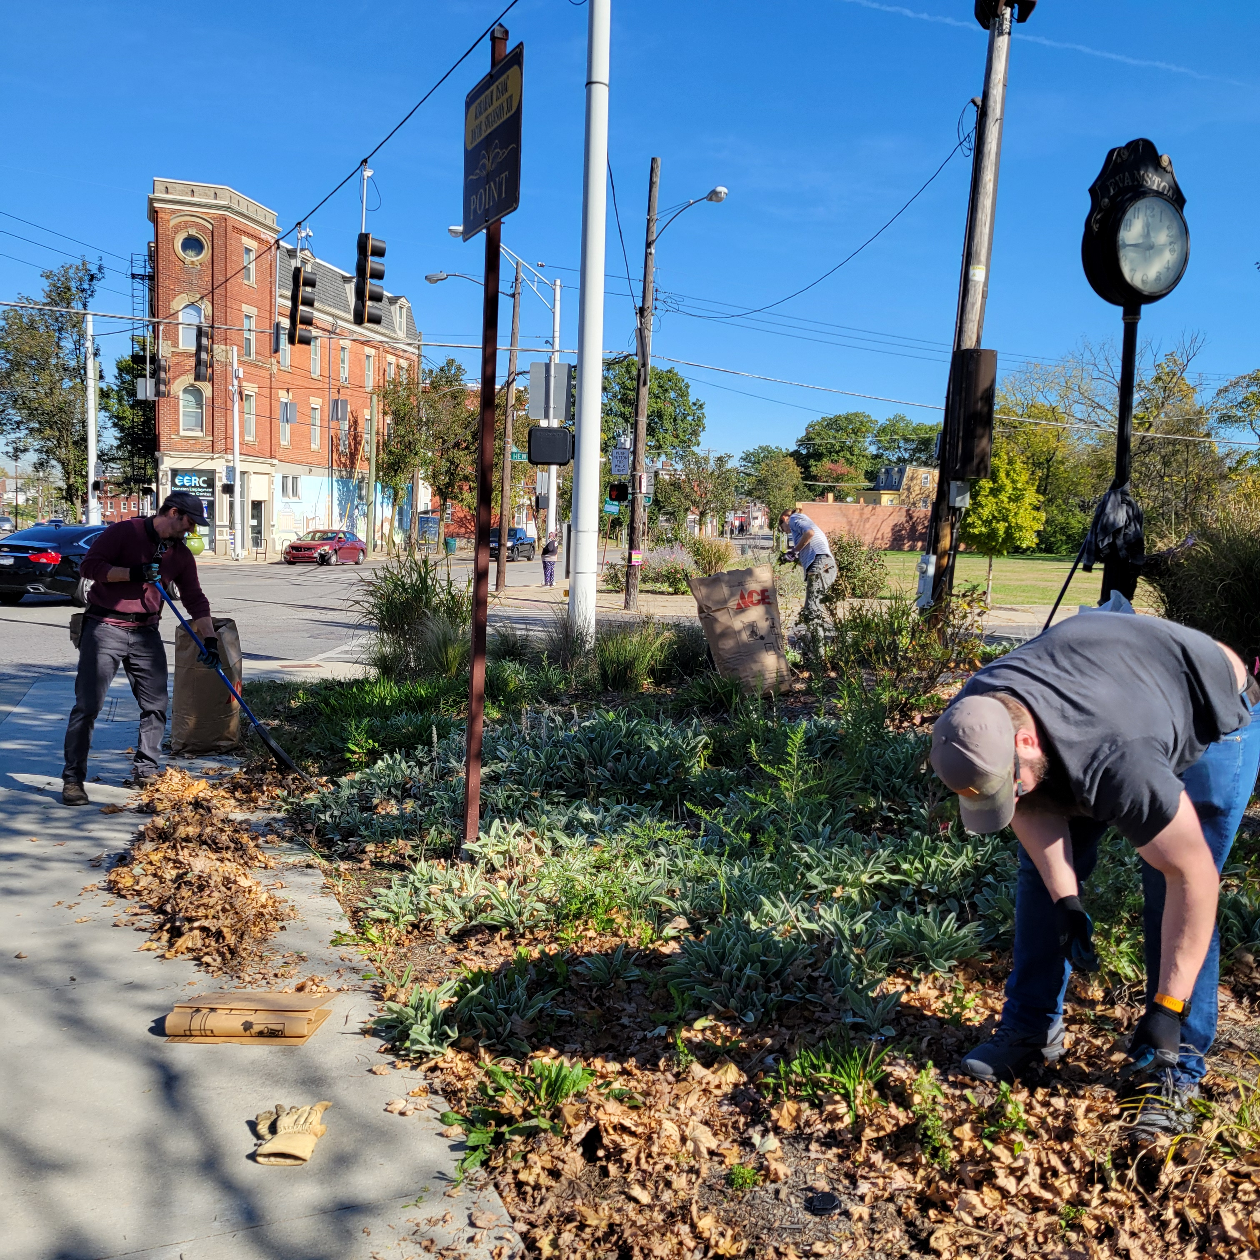
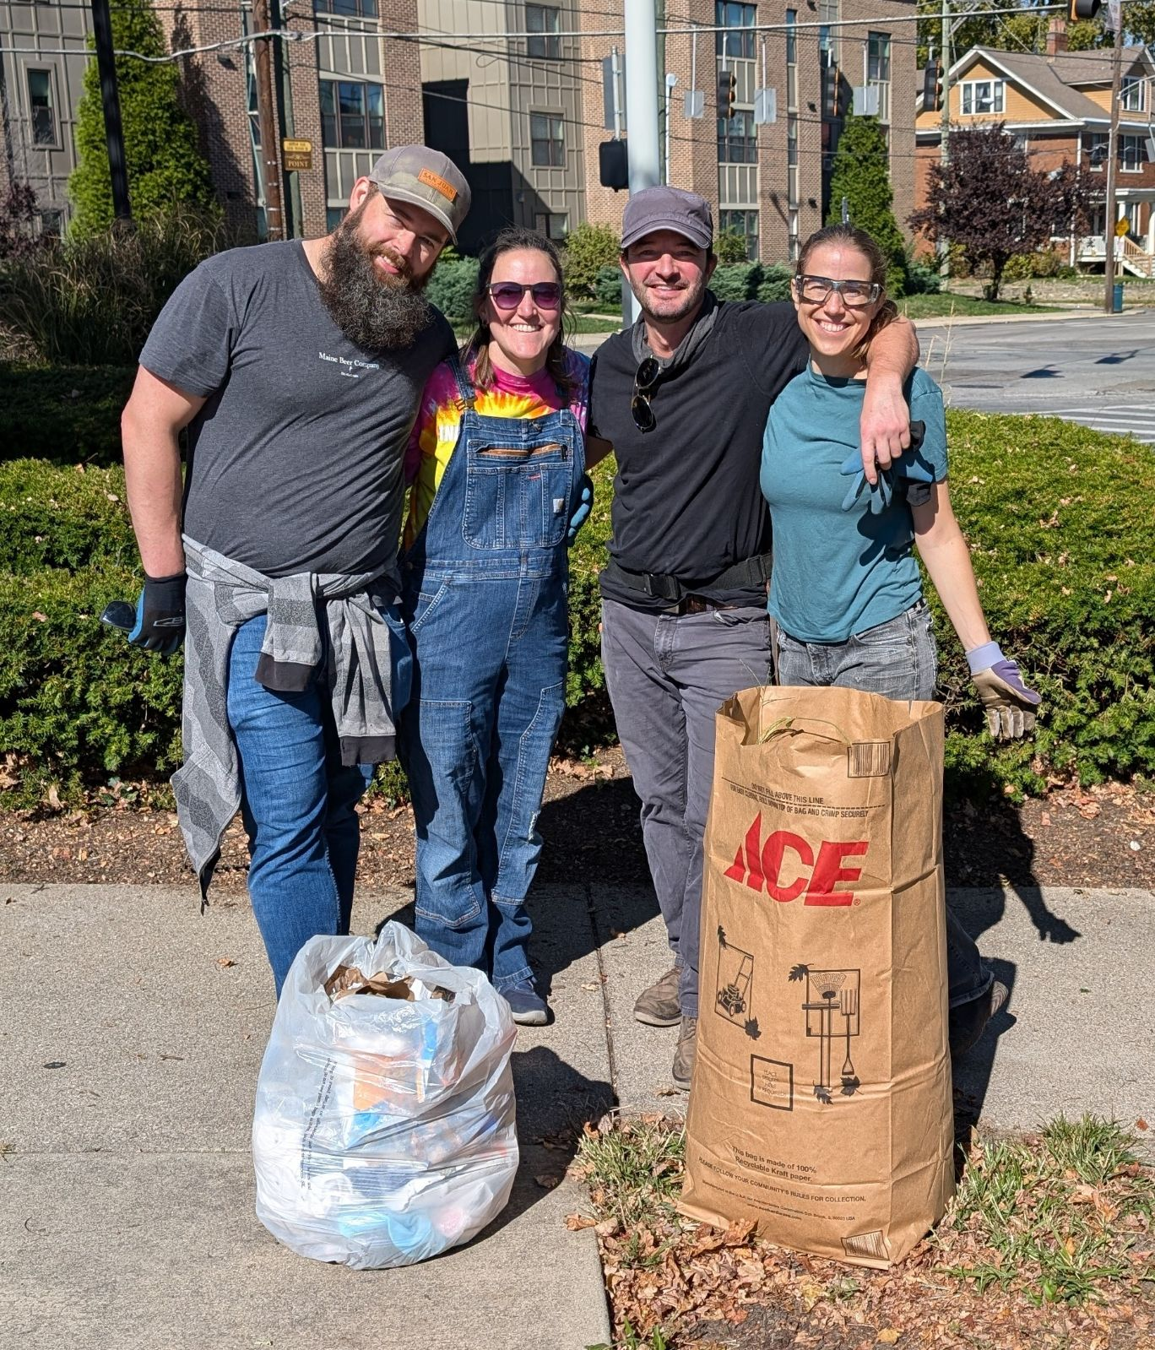
MPLP
MPLPWC
“make it look like someone cares”

Slide 8


“Affective responsibilities”
Ethics of care: discussion
The archivist and…
Records creator
Records subject
Users
Community
Donor
Other archivists
Others?
vs.
“detached professionalism” and “sentinels of accountability”
“caregivers” and
“web of mutual responsibility”

Slide 9
II. Trauma-informed archival practice
Vicarious trauma
Secondary trauma
Emotional labor
Archives both create and document trauma.
“
”
Wright & Laurent, 2021, p. 40

Slide 10
Five principles of trauma-informed archival practice
Trauma-informed archival practice
Empowerment
Collaboration
Let’s discuss!
Choice
Trust & Transparency
Safety

Slide 11

On the other side…
Vicarious trauma
Secondary trauma
Emotional labor
Empathy
Post-traumatic growth
Resilience

Slide 12
IV. Support for archivists
We worked at the pace we needed. We laid down. We closed our eyes. We canceled meetings when our energy was depleted. We took turns being the facilitator, the note-taker, and the meeting-scheduler.
“
”
Arroyo-Ramírez et al, 2016, p. 16

Slide 13
Sources of support
Employer-provided training and support (and training for employers and managers)
Professional organizations, societies, associations, etc.
Graduate school coursework
Online communities

Slide 14
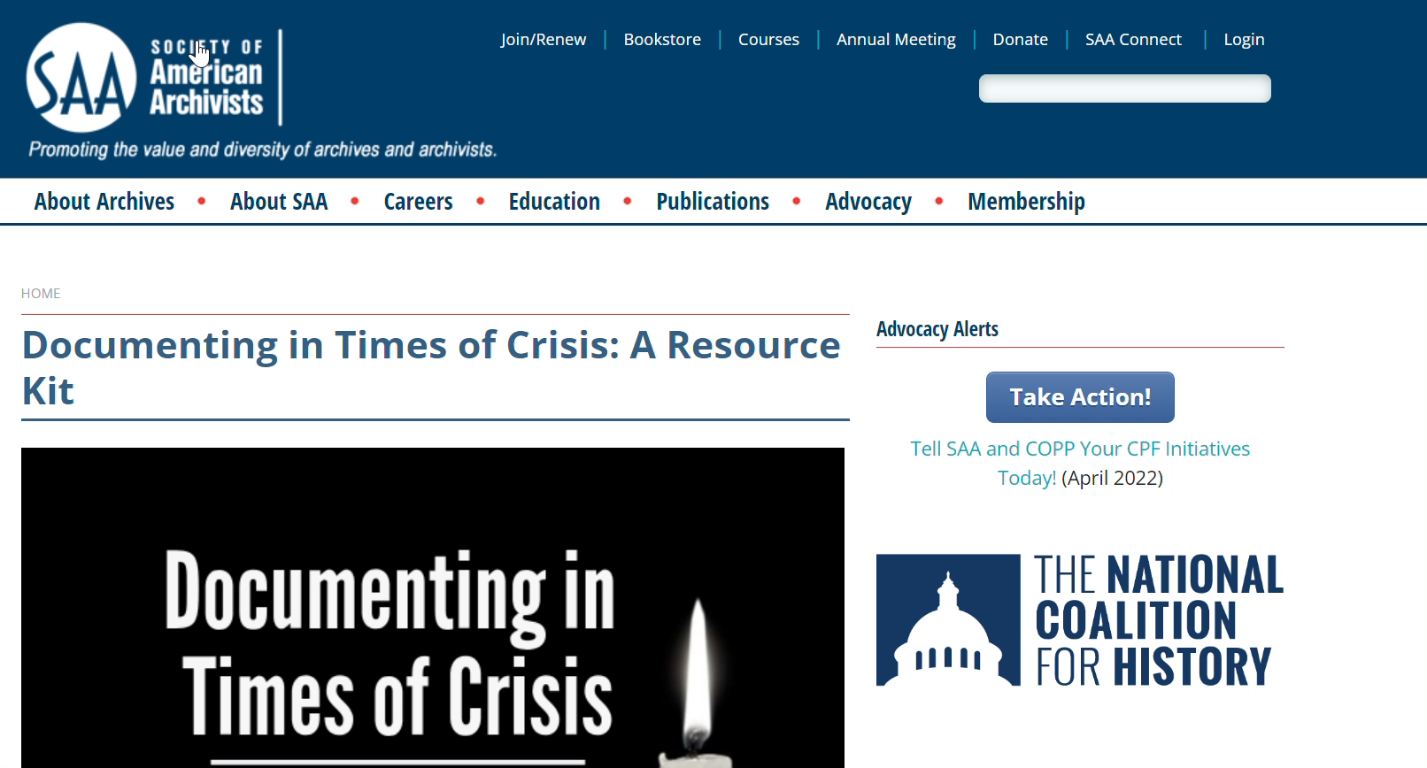
https://www2.archivists.org/advocacy/documenting-in-times-of-crisis-a-resource-kit

Slide 15
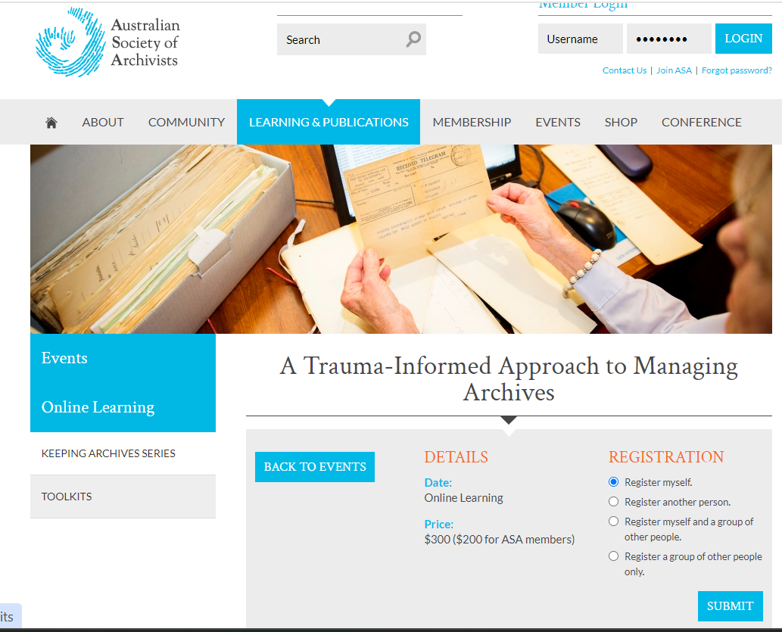
https://www.archivists.org.au/events/event/a-trauma-informed-approach-to-managing-archives

Slide 16
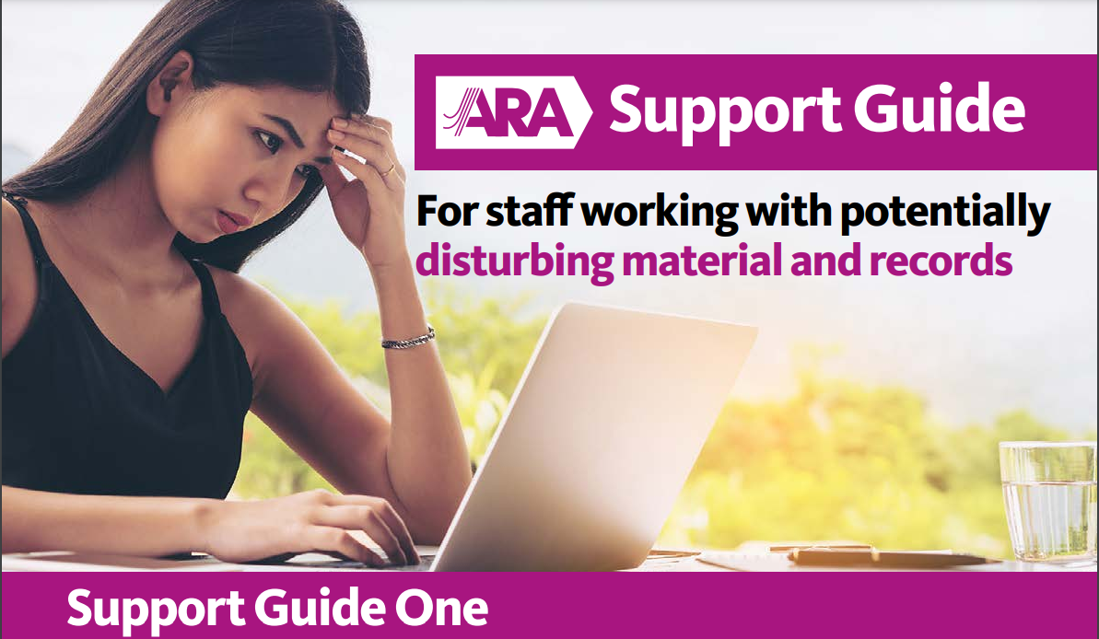
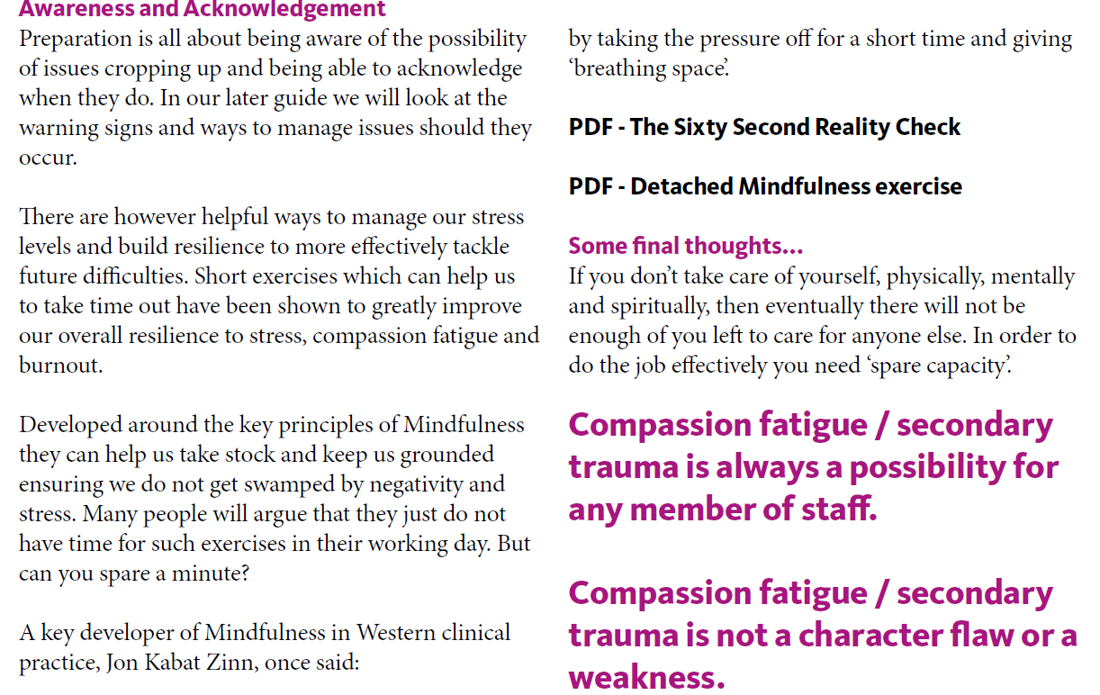
https://www.archives.org.uk/health-wellbeing

Slide 17

Source of support: right here, right now
I am here if you need to talk.

Slide 18
Thank you
Mikayla Knight Kinley
Indiana University – Indianapolis Luddy School MLIS Student
knightmk@iu.edu
Bibliography available here.

