Slide 1
Text KMACY731 once to 22333 to join, then text your message
Or respond at PollEv.com/kmacy731
How do you feel about negotiations?
Respond as many times as you like.
Notes:
While waiting for the meeting to kick off put up this slide or provide this information in the chat.

Slide 2


Negotiations 101
How to conduct principled negotiations for library resources
Notes:
Welcome to Negotiations 101: how to conduct principled negotiations for library resources. This workshop will be structured by first providing theory and concepts around planning and executing negotiations for a bit over an hour. Then the workshop will split into two groups, one side will play the library, the other the vendor. At this time you will be given 20 minutes to take a break and read through the case study. Then Caitlin or Mahasin will help facilitate your group in preparing for the negotiation. We will then come back together and Caitlin and Mahasin will model the negotiation using the plans you developed. After reflecting on the negotiation we will come back together to talk about techniques in negotiation when not in person (phone and email), discuss resources and future support opportunities, and have a few minutes for Q&A. Don’t hesitate to ask questions in the chat through out the session and we will try to address as we can then.

Slide 3
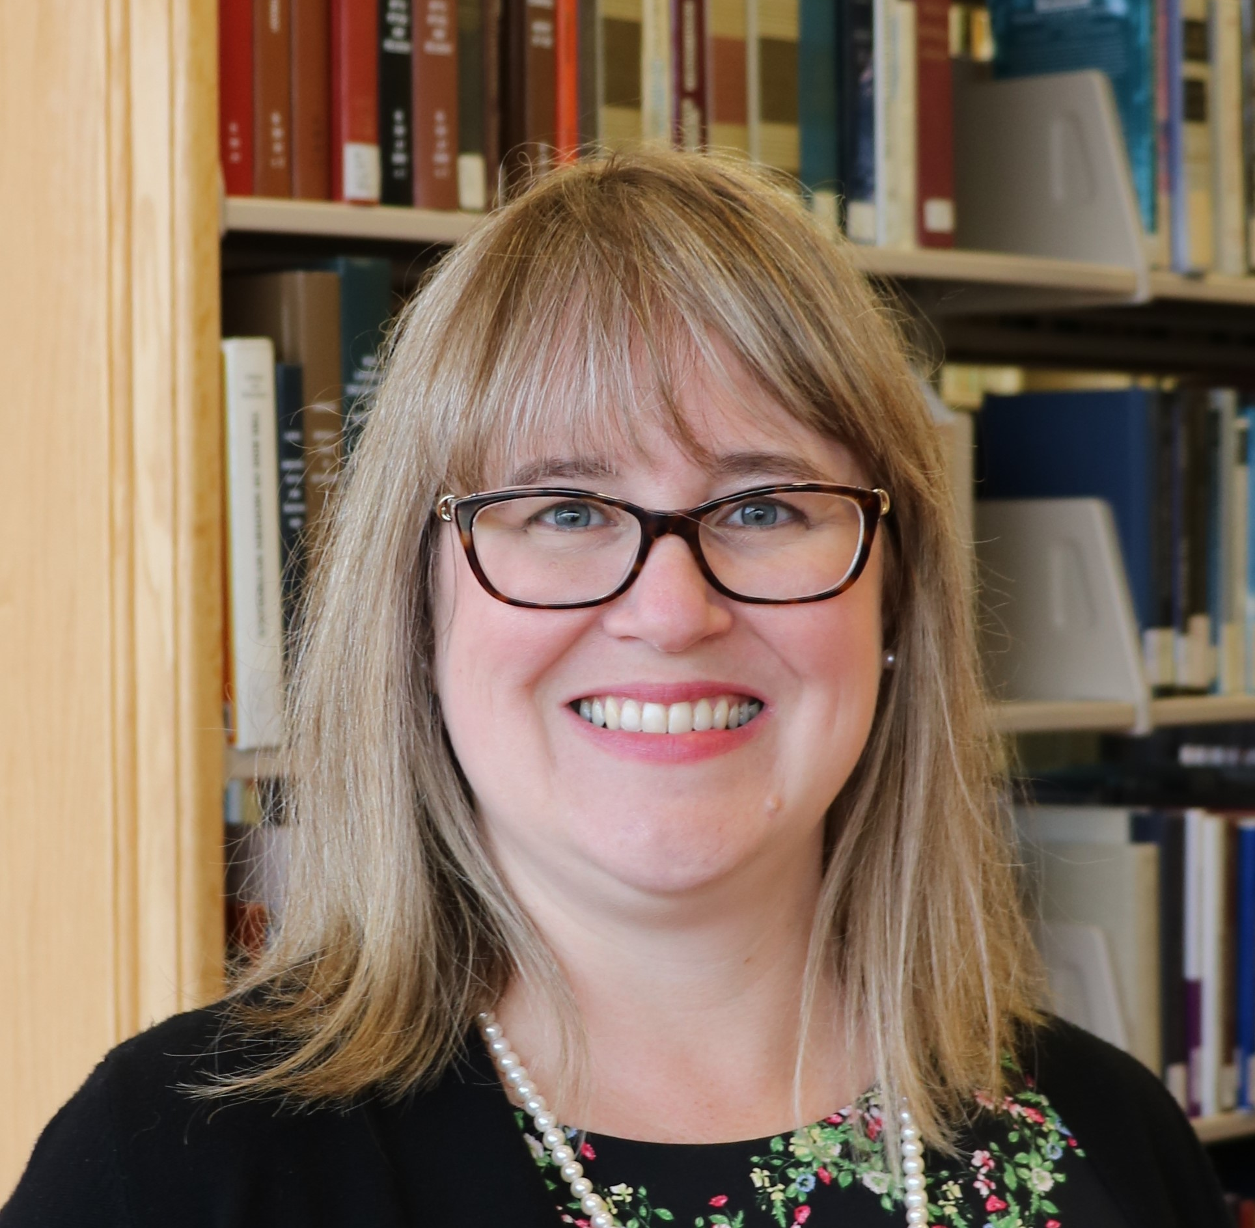
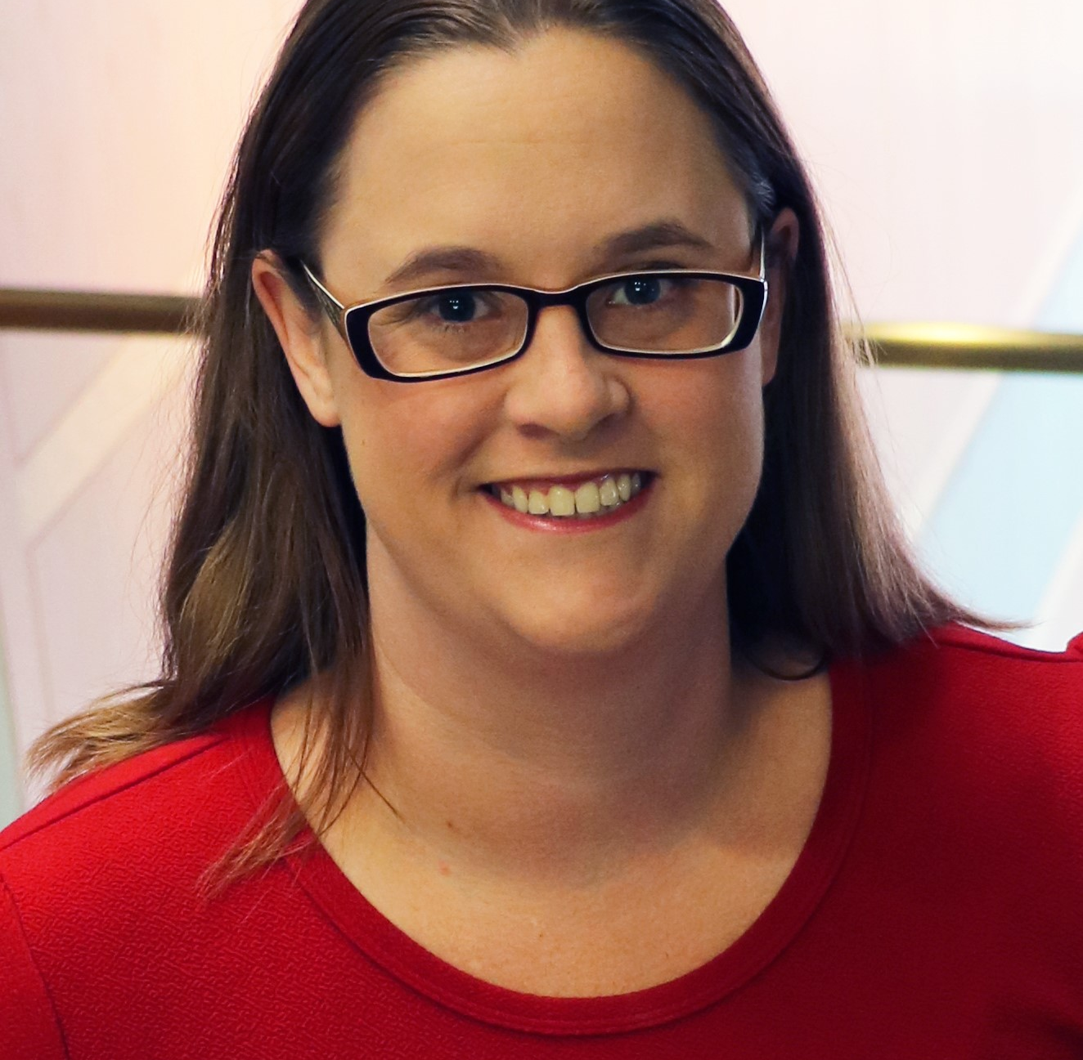
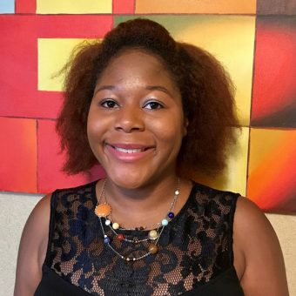
Katharine V. Macy, MBA, MLIS
COLLECTION ASSESSMENT LIBRARIAN
macyk@iupui.edu
Twitter: @kvmacy
ORCID https://orcid.org/0000-0002-6283-7143
Caitlin Pike, MLIS, MPH
RESEARCH ENGAGEMENT & SCHOLARLY COMMUNICATIONS COORDINATOR
caiapike@iupui.edu
Twitter: @libris_fidelis
ORCID https://orcid.org/0000-0002-5758-1737
Mahasin Ameen MLIS
TEACHING & INSTRUCTION LIBRARIAN
mameen@iupui.edu
Twitter: @fivefootsmall
ORCID https://orcid.org/0000-0002-8640-4334
Indiana University – Purdue University Indianapolis University Library
Notes:
We introduce ourselves.

Slide 4
YOUR EXPERIENCES
1
Poll Everywhere
Notes:
Share the Poll
Level set – how this workshop will address issues identified in word cloud

Slide 5
PRINCIPLED NEGOTIATIONS
2
Striving for Mutual Gain
Notes:
First off, I want to cover what it means to conduct a principled negotiation that strives for mutual gain in order to do that though we should discuss the two traditional roles that we want to move away from…

Slide 6
TYPES OF NEGOTIATORS – Two Traditional Roles
SOFT
Focuses on position
“Friends”
Values agreement
More likely to make concessions to avoid conflict
Yields to pressure
Too much trust
HARD
Focuses on position
Adversaries
Needs to “win”
Demands concessions to maintain relationship
Applies pressure
Distrustful
Fisher, R., Ury, W., & Patton, B. (1991). Getting to Yes: Negotiating Agreement Without Giving In (2nd ed.). New York: Houghton Mifflin Company.
Notes:
These roles are as soft and hard negotiators
Soft and hard negotiators both focuses on position and how the individuals are viewed as a result of the negotiation. It tends to turn things personal where there are more winners and losers and a higher likelihood of at least one party being highly dissatisfied.
Soft negotiators want to be viewed as friends with who they negotiate with and highly value agreement. They are much more likely to concede things they would rather not in order to find agreement. They tend to yield to pressure and trust too much.
Meanwhile hard negotiators are all about winning and view the other side as an adversary. They demand concessions to maintain the relationship and applies pressure and are distrustful of the other side.
I think we can all think of negotiations we’ve witnessed with soft and hard negotiators. I believe as librarians the high need to people please can lead us to being soft negotiators and when we encounter vendors who are hard negotiators it helps perpetuate the angst we feel when trying to ask for the things we really need in order to sustainably manage access to our collections.

Slide 7
A Third Way – The Principled Negotiator
PRINCIPLED
Focuses on interests
Relationships based on trust, empathy, and respect.
Sustainability
Not about the money, it’s about the utility!
Allows negotiators to adjust tactics
Fisher, R., Ury, W., & Patton, B. (1991). Getting to Yes: Negotiating Agreement Without Giving In (2nd ed.). New York: Houghton Mifflin Company.
Notes:
There is a third way, which is to approach negotiations as a principled negotiator. Principled negotiators work to not make it about their positions. You aren’t trying to be friends but you also aren’t adversaries. Instead this type of negotiator is focusing on the interests of both parties to try to come to a mutual agreement. This requires preparation and planning. It also means working to build a relationship based on trust, empathy, and respect. It’s about working toward a sustainable partnership. It’s not about the money but the utility. Value in a agreement is not just about the final dollar amount. It also allows those negotiating to adjust tactics to find a mutually satisfying agreement.

Slide 8
PRINCIPLED NEGOTIATORS
“Problem-solvers seeking a win/win situation…Hard on the issues, but soft on the approach to people”
Crawford, A. R. (2008). Licensing and Negotiations for Electronic Content. Resource Sharing & Information Networks, 19(1/2), 15–38. https://doi.org/10.1080/07377790802498523
Notes:
Amy Crawford stated in her article that “Principled negotiators are problem-solvers seeking a win/win situation…they are hard on the issues, but soft on the approach to people.”

Slide 9
FOUR ELEMENTS OF PRINCIPLED NEGOTIATION
People | Separate the people from the problem
Interests | Focus on interests, not positions
Options | Invent multiple options looking for mutual gains before deciding what to do
Criteria | Insist that the result be based on some objective standard
Fisher, R., Ury, W., & Patton, B. (1991). Getting to Yes: Negotiating Agreement Without Giving In (2nd ed.). New York: Houghton Mifflin Company.
Notes:
Fisher, Ury, and Patton in their classic Getting to Yes: Negotiating Agreement Without Giving In state that there are four elements of principled negation.
People – separate the people (and the personalities) from the problem
Interests – Focus on the interests of both parties, not positions. You don’t need to come out friends, but you aren’t adversaries either
Options – Invent multiple options looking for mutual gains before deciding what to do
Criteria – Insist that result be based on some objective standard – is there a way where you can value the options you present?

Slide 10
STRUCTURE OF NEGOTIATIONS
3
MOST OF THE WORK GOES INTO PHASE 1!
Notes:
To plan for a principled negotiation, you need to understand the structure of negotiations. And know that the majority of the work often occurs in phase 1. This is very true for traditional collection licensing deals.

Slide 11
STRUCTURE OF NEGOTATIONS
Pre-Game
Initiating and maintaining relationships
Preparation for the negotiations
In principled negotiations, this is where the most time is spent!
Game
The negotiation
Plan what strategies you can use during the negotiation in pre-game!
Post-Game
Following up and maintaining relationships
TRUST!
Thompson, L. (2013). The truth about negotiations. New Jersey: Pearson Education.
Notes:
There are three phases. Phase 1 where most of your work will occur in traditional resource licensing is the Pre-Game. This is where you initiate and establish relationships with your vendors and prepare a negotiation strategy. The second phase is the Game. The negotiation itself. You execute your planned options and strategies you developed in the pre-game. Be prepared though that if you are ever negotiation a complex deal such as a transformative agreement you may need to occasional update your pre-game work during the game on information you find. The third and final phase of the negotiation is the follow up on your agreement and maintain your relationships, fostering trust.

Slide 12
PRE-GAME
4
The bulk of the effort!
Notes:
The pre-game is where the bulk of the effort should occur when planning a negotiation.

Slide 13
PRE-GAME PROCESS
Build & maintain relationships – Trust!
Collect & analyze data
Plan your negotiation strategies
Notes:
The first step is the build and maintain relationship. Build the foundation of trust through touching base with your vendor reps at conferences, annual meetings with the rep to discuss their resources (learn latest and greatest, discuss challenges, etc.) Having a prior relationship helps smooth the way to focus on interests. The second step is to collect and analyze data about the resource you are negotiating over as well as the vendor itself. Once this is complete you plan your negotiation strategies.

Slide 14

PREPARATION THAT DOES NOT WORK!
Psyching up!
It makes the negotiation more personal and makes the focus positional.
Image by rubyblossom
Thompson, L. (2013). The truth about negotiations. New Jersey: Pearson Education.
Notes:
The research is in and something that does not work is Psyching Up! It makes the negotiation personal and focus positional and not on interests. Whether or not you succeed becomes your identity! If things don’t go well or the way you want, then you feel bad about it.

Slide 15

PREPARATION THAT DOES WORK
Planning that considers both parties’ interests
Image by Nicola Barnett
Notes:
What does work….preparation through analysis and planning strategies that considers both parties’ interests.

Slide 16
Own Your Terms
5
Negotiation Planning Vocabulary
Notes:
Pun intended
To plan for negotiation, it’s important to know certain negotiation concepts and vocabulary.

Slide 17
BATNA
Best Alternative to Negotiated Agreement
Notes:
What you would do if you fail to reach a negotiated agreement.
Cancel
Resubscribe, but look for later alternatives
Be careful to not reveal this early, if at all.
During the negotiation you don’t want to reveal your BATNA (unless you have absolutely reached an impass) but you can signal at your BATNA. Don’t lie about your BATNA. I you say you walk away point is X but it is really Z and they talk you down to Z you will have a difficult time in future negotiations. The other party may ask about your walk away point – divert them away from this by emphasizing you are negotiating for the entire value of the package which can include other things such as support, authorized user access, removing NDAs, fixing price increases, etc.
BATNA can change over time. One year you may choose to resubscribe, but if a deal goes south the vendor has to know you will be looking for alternatives.
Open Access, PDA, and AOD is allowing libraries to change their BATNAs
Don’t just determine your own BATNA, research your other party’s. Are subscriptions down, sales flat, are there new competitive products….

Slide 18
Reservation Price
$
The bottom line, the point in the negotiation where you can go either way. Informed by the BATNA.
Notes:
The bottom line. The point in the negotiation where you could find agreement or go with your BATNA. It is often determined by your BATNA. Don’t reveal this.

Slide 19
ZOPA
Zone of Possible Agreement
$10,000
Min
Seller
$12,500
Max Buyer
Spangler, B. (2003). Zone of Possible Agreement (ZOPA). In Beyond Intractability. Retrieved from http://www.beyondintractability.org/essay/zopa
Notes:
The zone of possible agreement. The minimum the seller is willing to sell, and the maximum the buyer is willing to pay. Try to predict during preparation but be willing to adjust as you learn more information during the active phase of the negotiation.

Slide 20
CONCESSIONS
What you are willing to give up
Notes:
Plan carefully, or you risk giving up too much. Be sure to fully explore the interests.
Points the parties are willing to give up or compromise on in order to find agreement. Plan these carefully and when you will give them up, so you don’t give too much away. Generally speaking it’s good to plan in room for concessions.

Slide 21
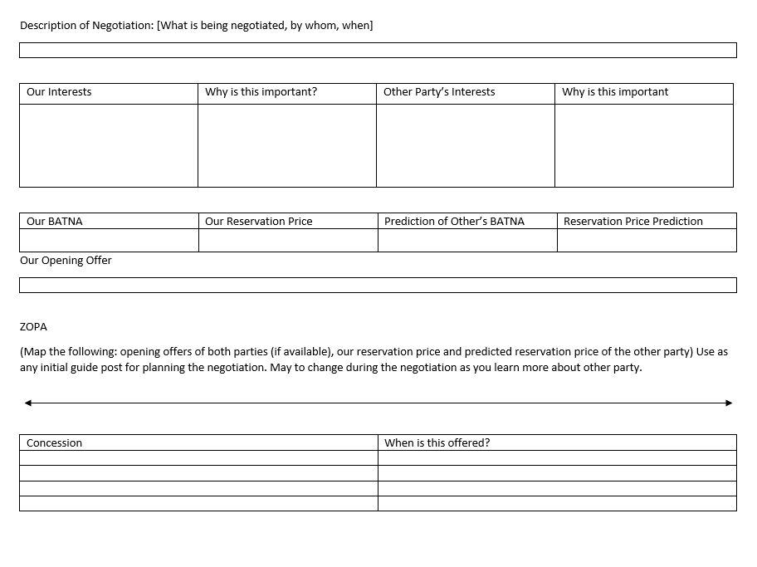
Negotiation Worksheet
Helpful guide for preparing for any type of negotiation
Notes:
We are going to provide you a negotiation sheet to use when planning your own negotiations that helps you think about you and the vendors interests, identifies BATNAs, reservations price, ZOPA, outlines concessions, when to give them, and plans the opening offer. This worksheet will also be used to guide the planning later in the workshop.

Slide 22
PLANNING YOUR NEGOTIATION
Internal review – Determining your interests
Price sensitivity to the resource
Licensing requirements
  Library policy
  University policy
Other considerations
  Accessibility
Notes:
When planning your negotiation a place to start is an internal review that plans your own interests.
-Examine your price sensitivity to the resource (I’ll explain that in a bit!)
-What are your licensing requirements. Be sure to know Library and University policy.
-Are there other considerations such accessibility?
You must know what is important to you and think through priorities and value.

Slide 23
PRICE SENSITIVITY
The extent to which buyers are sensitive to price increases.
Porter, M. E. (2008), “The five competitive forces that shape strategy”, Harvard Business Review, Vol. 86 No. 1, pp. 78–93.
Notes:
Price sensitivity is the eBe careful to not reveal this early, if at all extent to which buyers are sensitive to price increases. Libraries historical shown to be not price sensitive because we have accepted price increases, lately on average of 5-6% while our budgets are flat or decreasing. As a result we cut programs and people. However, analyzing price sensitivity allows us to think about the value of the resource within our community. It allows us to find options to create relative bargaining power when conducting negotiations.

Slide 24
PRICE SENSITIVITY FACTOR METRICS
Price Sensitivity Factor | Metric
Proportion of total cost | Portion of spend
The level of differentiation between products | Content coverage (i.e. overlaps, uniqueness)
The importance of product/service to the buyer for offering a quality service or product to their own customers | Cost per use Cost per citation Stakeholder use in research or teaching (curriculum) Uniqueness within the collection Consortia agreements
The level of competition among end users (customers) | Competitive products Substitutes
Macy, K.V. (2018). Information creates relative bargaining power in vendor negotiations. The Bottom Line, 31(2), 137-149. https://doi.org/10.1108/BL-12-2017-0033
Notes:
The first factor is the proportion of total cost this can be determined by understanding a resource’s portion of the total collection spend.
The second factor is the level of differentiation between products. This is where understanding a resources content coverage, how it overlaps or is unique, is helpful.
The third factor is the importance of a product/service to the buyer for offering a quality service or product to their own customers. So this is about how important is the resource we are buying for us to be able to serve our patrons. Metrics that helps us understand this factor are cost/use, cost per citation, stakeholder use in research or teaching (curriculum), uniqueness within the collection or in the world (archives), and consortia agreements.
The final factor is the level of competition among end users (customers). This is the hardest one for many to wrap their arms around. A good example is the encyclopedia market. A competitive product from recent years is Wikipedia, which is gaining our users attention and completely diverting users from using library services for this type of information. Another example is users getting news information from Twitter or Facebook as opposed to traditional sources. Understanding competitive products and substitutes that our patrons may use in or outside the library to meet an information need helps us understand this factor.

Slide 25

LICENSING REQUIREMENTS - EXAMPLES
AUTHORIZED USE / RESTRICTIONS
How the database may be used. Often specifies not for commercial purposes.
PRICING AND TERM
May also include information on renewal and pricing at renewal. May include clauses to fix price increases.
TERMINATION
Clause specifies how vendor may terminate the contract if customer is in violation. It is in the customer’s best interest to be well defined.
👪
AUTHORIZED USERS
This includes specifying whether walk-ins have access to the resource.
NDAs/ CONFIDENTIALITY
Non-disclosure agreements on pricing. Vendors often want these, while libraries do not.
Other Terms
Product updates, Performance, Payment, Force Majeure, Applicable Law, Dispute Resolution, Indemnification, Entire Understanding, Amendment, Enforceability, Severability
Crawford, A. R. (2008). Licensing and Negotiations for Electronic Content. Resource Sharing & Information Networks, 19(1/2), 15–38. https://doi.org/10.1080/07377790802498523
Notes:
Examples of licensing requirements you ant to consider are:
Authorized use/ restrictions – how it is used and often specifies for academic and not commercial purposes
Authorized users – important to address particular if you want to offer walk-in access
Pricing and term – includes renewal information and pricing at renewal. Can you fix price increases? Does the subscription roll over automatically?
NDAs/Confidentiality – Non-disclosure agreements often focused on institutional pricing. Vendors want these, Libraries don’t.
Termination – Clauses specifies how vendor may terminate the contract if customer is in violation. It is in our best interest to clearly define this.
There are also several other terms you may desire to negotiate. For us personally, I know applicable law is one of those.

Slide 26
PLANNING YOUR NEGOTIATION
External review– Determine their interests
Financials
News & rumors
Competitive offerings (content and pricing)
Openly available pricing data
Price other acquisition models for content (e.g. on demand)
Notes:
It is also important to do an external review of your vendor to outline what you think their interests are. Information that can help:
Company financials
News & rumors (conference networking, online professional discussion groups can be great at gathering this)
Are there competitive offerings of similar products particularly for database resources (content and pricing)
Is there openly available pricing data?
What does the price and total cost of offering access to the resource via other acquisition models such as on demand

Slide 27
SUGGESTED DATABASES FOR RESEARCHING VENDORS
Bloomberg
Hoovers
Mergent Online
Factiva
Orbis
Privco
S&P Global Capital IQ or S&P Global Netadvantage
Article databases: ProQuest Central, Business Source Complete
Notes:
I have several business databases that are useful for finding information on vendors. I highly recommend reaching out to your business librarian they can help you find company and industry profiles. For smaller private companies: Hoovers, Orbis, and Privco are the most useful in my experience.

Slide 28
Awesome Free Resources Offered by SPARC!
Big Deal Knowledge Base
  Big Deal Tracker
  Contracts Library
  Cancellation Tracking
Landscape Analysis
  2020 Update
Coming Soon: Journal Negotiation Tools
Notes:
There are also awesomely available free resources offered by SPARC
The Big Deal Knowledge Base!
Big deal tracker has publically available pricing on Big Deals of journal packages.
Contracts library is a repository of contracts so you can look for sample language
Cancellation tracking shows what universities have walked away from Big Deals.
The Landscape Analysis (published in 2018) and the 2020 update provides an industry analysis looking at finances and economics of scholarly communication. Again I encourage that you reach out to your business librarian to understand information you have questions about within this report.
And later this year [Katharine is or I’m] working with people throughout SPARCs Journal Negotiation Community of Practice lead by Caitlin Carter to develop a website with journal negotiation tools to help prepare for negotiations. [Katharine is or I am] specifically co-leading the group focused on data analysis for negotiations.

Slide 29
KNOW YOUR POWER POSITION IN THE DEAL
Who is the target customer of the resource?
  Academic Resource vs Professional Practice
Can you benefit from consortia agreements?
  Agreements should increase your relative bargaining power
What are your alternatives?
  BATNA
  Competitive Landscape
What goals does this purchase help you achieve?
What values does it support?
Notes:
Doing both the internal and external review allows you then to think through your power position within the deal.
For the resource who is the target customer for that resource?
Is it an academic resource or used in professional practice? For instance the business database, Bloomberg, primary market is banks and financial institutions. The academic market is a secondary market so less power. However, the academic market provides training and is a very effective future sales mechanism so a bit of power is regained.
Can you benefit from consortia agreements? If negotiated effectively this will increase your relative bargaining power.
What are your alternatives?
Think through your BATNA and the competitive landscape
What goals does the purchase of this resource achieve?
Consider library goals, vision, strategy
Consider your institutional goals at departmental and university level
What values does this support? – This is the hardest. We have the ability to vote with our dollar as to what we accept. For example, if a vendor has a bad history with respecting privacy and that is important to us….we need to think about that.

Slide 30
UNACCEPTABLE BEHAVIORS FROM VENDORS
Delaying negotiation conversations until close to the deadline to force agreement
Going around you to teaching/research faculty to exert pressure
Temper tantrums
Threats
Verbal abuse
Notes:
When planning for negotiations you should also consider your expectations of vendors and how you will address unacceptable behaviors. Unacceptable behaviors include:
Delaying negotiation conversations until close to the deadline to force agreement
Going around you to teaching/research faculty to exert pressure
Temper tantrums
Threats
Verbal abuse

Slide 31
PLAN ON HOW YOU WILL ADDRESS THESE BEHAVIORS
Clearly communicate your expectations
Timetable for the negotiation
Expected response times
Inappropriate behaviors
Notes:
We should be forthright with our vendors about our expectations of them in building a sustainable partnership by communicating clearly (perhaps even in writing) our expectations of them. This includes
setting a timetable for negotiations,
expected response times especially if communicating over email, and
inappropriate behaviors such as going around the library to faculty to exert pressure, expectations of being treated with respect and trust.

Slide 32
PLAN ON HOW YOU WILL ADDRESS THESE BEHAVIORS
Temper tantrums (including threats and verbal abuse) are rarely genuine. “They are carefully orchestrated displays designed to evoke a response in the counterparty”.
How to address:
  Take a break
  Normalize emotions – “This is important to us both and it’s normal to feel emotional about it. We both are.”
  Stop talking and start writing. Creates point of focus.
  If vendor has resorted to verbal abuse and threats redirect them to the expectations you had communicated about respect and trust.
Thompson, L. (2013). The truth about negotiations. New Jersey: Pearson Education.
Notes:
Temper tantrums within a negotiation are rarely genuine. Rather they are carefully orchestrated displays to evoke a response in the counterparty. As librarians we want everyone to like us…to people please… so this is designed to make us feel uncomfortable and concede on a point that is very important to us. You need to think about your strategy on how to address this:
First off, best practice is to take a brief break. Create a little distance even if it’s just 10 minutes.
When you come back together normalize the emotions displayed with a statement such as “This is important to us both and it’s normal to feel emotional about it. We both are.
Then to refocus on your own goals stop talking and start writing. If doing this negotiation over a platform like zoom – share your screen so you can outline the points of both parties and this will help you reflect and focus on your goals and not immediately reacting to the other side’s emotional displays. Even if you can’t share what your are writing out with the other party (phone negotiation) the act of writing out the key points of each side will bring your back into the negotiation and out of needing to react to emotion.
If vendor has resorted to verbal abuse and threats redirect them to the expectations you had communicated about respect and trust.

Slide 33
Pre-Game When You Have Little Time
Identify Goals
Goals should reflect interests and explain why it’s important.
Brainstorm Options
What are your alternatives?
Plan Opening Move
Helps anchor your negotiation.
The why helps create solutions during negotiations.
What are
Represents ideal situation.
deal breakers
vs
deal makers?
Thompson, L. (2013). The truth about negotiations. New Jersey: Pearson Education.
Notes:
Sometimes you have less than an hour to plan (like today!) When you do have very little time what you want to do is
First identify your goals which should reflect your interests. Outline why these are important to you. Understanding why may help you create solutions during negotiations.
Brainstorm your alternatives and determine your BATNA. Are there any deal breakers or deal makers?
Plan your opening move. Opening moves anchor your negotiations and represents your ideal situation where you get everything your want.

Slide 34
THE GAME
6
Strategies to use during negotiations
Notes:
Now let’s talk about strategies you should plan for and use during actual negotiation.

Slide 35
FIRST OFFERS – ANCHORS YOUR POSITION
Your ideal offer that outlines
Price / Price Increases
Term
License Terms
Other (Support, Accessibility, Training)
Often vendors make first offer, trying to anchor changes in their favor. Libraries should determine value and derive a counteroffer when this happens. Or, when appropriate, be proactive by submitting a first offer based on determined value to the vendor.
Example: VIVA, Virginia’s Academic Library Consortium
Notes:
First offers anchor your position.
This should be your ideal offer that outlines price including price increases, term, desired licensing terms, and any other import aspect for your agreement. Often vendors make the first offer, trying to anchor changes in their favor. Libraries should determine the value and derive a counteroffer when that happens. But when appropriate, perhaps its time for us to be proactive and submit a first offer based on our determined value to the vendor. One example of this is the work that VIVA has done around planning journal negotiations for their consortia. There is an article about VIVA’s work in the resource list we are providing you with this workshop.

Slide 36
FRAMING
Plan carefully how you frame
Offers and counter offers
Concessions
Decisions can be framed as a win or a loss.
Remember humans are risk averse.
Notes:
Think about how you frame what you say around offers and counter offers and concessions. Decisions can be framed as a win or a loss and remember that humans are risk averse.
An example of framing something as a loss:
We need to keep prices flat but are willing to sign a two-year contract, otherwise we will only sign a 1 year agreement and based on our historical use which is declining we may be making the decision to cut this next year.
Now consider how this statement framed as a win. Perhaps:
We can sign a multiyear contract if you can meet us where we need to be for our budget. We are looking to keep price increases to 2%.
Can you hear the difference? Both could be useful depending on the conversations

Slide 37
NEGOTIATE ISSUES SIMULATANEOUSLY, NOT SEQUENTIALLY
The value of a deal is not just monetary
If you need to negotiate terms beyond pricing it’s best to do it simultaneously
Start with your ideal offer – where you win it all, knowing you will likely need to make concessions.
Plan concessions carefully and don’t reveal too early.
Thompson, L. (2013). The truth about negotiations. New Jersey: Pearson Education.
Notes:
Negotiate issues simultaneously, not sequentially,
The value of a deal is not just monetary
If you need to negotiate terms beyond pricing it’s best to do it simultaneously
Start with your ideal offer – where you win it all, knowing you will likely need to make concessions.
Plan concessions carefully and don’t reveal too early.
Doing this is particularly difficult when negotiating over email because often vendors try to address an issue at a time. It’s important to refocus the negotiation on the entire ask and that each piece brings value and must be considered holistically.

Slide 38
MAKE MULTIPLE OFFERS OF EQUIVALENT VALUE SIMULTANEOUSLY
Example
Willing to sign a 3-year contract
Determine value of contract with fixed price increase, fixed price per year, and pay all three years up front.
Determine what license concession you wish from the vendor depending on pricing agreement.
Thompson, L. (2013). The truth about negotiations. New Jersey: Pearson Education.
Notes:
Another offer is to make multiple offers of equivalent value at the same time. For example
Willing to sign a 3-year contract
Determine value of contract with fixed price increase, fixed price per year, and pay all three years up front.
Determine what license concession you wish from the vendor depending on pricing agreement.

Slide 39
TRUST DURING THE GAME!
FOUR KINDS OF REPUTATION
Liar-Manipulator
Tough but Honest
Nice and Reasonable
Cream Puff
Relationships are important!
Thompson, L. (2013). The truth about negotiations. New Jersey: Pearson Education.
Notes:
You need to work to maintain trust during the negotiation. Research shows that there are four primary types of negotiation reputation.
Liar-Manipulator
Tough but Honest
Nice and Reasonable
Cream Puff
Most of us want to target tough-but-honest and nice-and-reasonable. Planning principled negotiations allows you to get there. Also if you are a soft negotiator “cream puff” don’t expect to get to tough but honest over night. It’s also perfectly okay to be nice and reasonable….just always negotiate to your interests not position.
If you are negotiating with a Liar-Manipulator remember your strategies for managing unacceptable behavior.
Above all relationships are important.

Slide 40
POST-GAME
7
Maintaining trust
Notes:
Cement the deal, perhaps with an email that outlines the conversation, while you wait for a contract.
If the deal goes your way don’t gloat. If it doesn’t go your way remain cordial and don’t act out. Unless you are willing to burn that bridge and potentially other bridges.
Just a sidenote on timely response after the deal: remember you are negotiating with people whose performance and compensation is tied to their activity, so if you may an agreement in April/early May it is important to get agreements signed and perhaps make payment if appropriate before the end of that quarter as a good faith effort for your rep.

Slide 41
LARGE GROUP CASE STUDY
20 minutes (take a break) and read the case.
Work through the negotiation prep worksheet and develop a plan (30 minutes)
Notes:
We are going to spit the group in half. Caitlin’s group is going to prepare the library side of this negotiation and Mahasin’s group is going to do the vendor side. These groups are randomly assigned. Don’t fret too much if you don’t get on the half of the case you wanted. Going through this exercise even as the vendor will help you practice outlining vendor interests and the strategies for making a plan are the same. After we split everyone will actually be given about 20 minutes to take a break and read through the case. Don’t log out. Come back to your smaller group at ##:## and be prepared to help either Caitlin or Mahasin flesh out a negotiation plan using the worksheet based on the case information. You will have 30 minutes to do this. Afterward we will all come back together and Caitlin and Mahasin will negotiate the deal using the plan.
Caitlin P and Mahasin will distribute worksheet and case study links via chat in breakout rooms.

Slide 42
WATCHING THE GAME
8
Fish bowl activity
Notes:
The negotiation

Slide 43
SMALL GROUP DISCUSSION
Were the negotiators able to find agreement? Why or why not?
What did each side do well?
What would you approach differently?
Notes:
Now we are going to break out into small groups for ## minutes. Discuss these questions. Were the negotiators able to find agreement, why or why not?
What went well on each side? What would you approach differently.

Slide 44
Reflection + More Best Practices
9
Notes:
Thanks for rejoining. Does anyone want to share any comments about the negotiations or what your small group discussed?
Katharine may offer some commentary based on what she witnessed.

Slide 45
BEST PRACTICES WHEN NEGOTIATING BY PHONE
CHALLENGE
Miss kenetic and visual cues which gets in the way of rapport.
Conversation can feel out of sync.
BENEFIT
You can have all your notes and options spread out and available for reference during the conversation.
Engage in a bit of small talk at the beginning.
Consider using Zoom to gain visual cues (absolutely not required!)
Don’t multitask, focus on the conversation.
To help resolve the issue with turn taking by signaling when you are finished speaking.
End the conversation in a personal, friendly way. People remembers beginnings and endings.
Thompson, L. (2013). The truth about negotiations. New Jersey: Pearson Education.
Notes:
The last piece of best practice we want to share is around negotiating over the phone or by email.
Key challenges are:
Miss kenetic and visual cues which gets in the way of rapport.
Conversation can feel out of sync.
A benefit you gain from this mode of negotiation:
You can have all your notes and options spread out and available for reference during the conversation.
Best practices to optimize this negotiation are:
Engage in a bit of small talk at the beginning.
Consider using Zoom to gain visual cues (absolutely not required!)
Don’t multitask, focus on the conversation.
To help resolve the issue with turn taking by signaling when you are finished speaking.
End the conversation in a personal, friendly way. People remembers beginnings and endings.

Slide 46
BEST PRACTICES WHEN NEGOTIATING BY EMAIL
CHALLENGE
No emotional cues
Sometimes one or both sides get mean (dehumanization)
Delayed responses
Parties trying to negotiate multiple issues sequentially
BENEFIT
You have time to discuss and think through responses.
Potential for first mover advantage
Must be prepared to respond with facts and data!
Consider making the first offer to set the anchor
Focus on the value of the entire deal, don’t try come to agreement on one issue at a time.
Don’t forget you are negotiating with a human.
Work to find linguistic convergence in how you communicate with vendors. Work to mirror vendor’s language.
Start the conversation early and set expectations for response time through out the conversation.
Thompson, L. (2013). The truth about negotiations. New Jersey: Pearson Education.
Notes:
In regards negotiating by email
Challenges include:
No emotional cues
Sometimes one or both sides get mean (dehumanization)
Delayed responses
Parties trying to negotiate multiple issues sequentially
Benefits you gain:
You have time to discuss and think through responses.
Potential for first mover advantage
Best practices are:
Must be prepared to respond with facts and data!
Consider making the first offer to set the anchor
Focus on the value of the entire deal, don’t try come to agreement on one issue at a time.
Don’t forget you are negotiating with a human.
Work to find linguistic convergence in how you communicate with vendors. Work to mirror vendor’s language.
Start the conversation early and set expectations for response time through out the conversation.

Slide 47
WRAP UP
Resources
Further avenues of support
Evaluations & Negotiation Practice
Q&A
Notes:
A list of resources that can help in developing negotiation skills is libraries is available at:
SPARC is working to develop further avenues of support. A journal negotiation website to help with analyzing journal packages including data analysis, stakeholder communication strategies, understanding impact, and ideas for reinvestment is forthcoming. We also desire to help you form a mini-community of practice so we can support each other as we develop skills learning negotiation strategy. The key word is practice. It takes time and regularly working these skills to develop them. We’d like you to complete the following survey and let us know if you would like to participate in discussion groups within this cohort of attendees to talk about how you have applied what you have learned today and seek advice on issues you are currently addressing. This will also help SPARC understand what is working and not working, and what tools and resources can be developed to help meet your needs. Also if you are interested you can indicate that you’d like to be paired up with someone within your time zone. I will then connect the two of you and distribute a second case study so that on your own you can practice preparing for an e-resource negotiation and conduct a mock-negotiation. Lastly there is a few short evaluation questions that can help us improve this workshop.
We’d like to spend the remaining time answering questions you may have.

Slide 48
CREDITS
Special thanks to all the people who made and released these awesome resources for free:
Presentation template by SlidesCarnival

