Slide 1
Young Adults with Behavioral Health Services and Justice System Involvement
Saahoon Hong, Ph.D.
18th Annual TCOM Pre-Conference
SCHOOL OF SOCIAL WORK
INDIANA UNIVERSITY

Slide 2
BHS ?
State Prisoner
37%
Jail Inmates
44%
(Bronson & Berzofsky, 2017)

Slide 3
Background
AGENDA
2. Critical factors of categorizing/predicting
adults with dual-system involvement
3. Policy Implication

Slide 4
Adults with BHS and Justice System Involvement

Slide 5
Background
The Bureau of Justice Statistics reported that 37% to 44% of persons in the criminal justice system had mental health issues (Bronson & Berzofsky, 2017).
Young adults with mental health needs experience increased criminal behaviors, peaking at 16-25 years (Stolzenberg & D’Alessio, 2007; Pullmann, 2010).
Lack of support for young adults' behavioral health needs increases the likelihood of further involvement in the justice system (Sung et al., 2011; Williams, 2015).

Slide 6
SECTION TITLE GOES HERE IF NECESSARY
Maximum diversion of individuals with serious mental illness
In one Midwestern state, the third highest referral source for adult behavioral health services was the criminal justice system, following self and health care referrals.
Little is known about individuals’ needs, challenges, and successes after they were involved in dual justice and behavioral health systems.

Slide 8
Study Aim
SECTION TITLE GOES HERE IF NECESSARY
1. To identify critical factors predicting dual behavioral health and justice system involvement for adults participating in publicly funded treatment and support services
2. To examine behavioral health service outcomes

Slide 9
Methods

Slide 10
Sample & Inclusion Criteria
SUBTITLE GOES HERE IF NECESSARY
ANSA Legal Functioning (criminal justice system involvement) item and the legal basis of referral indicator were used.

Slide 11
Flowchart of the dataset development
ANSA 2019
Age 18 to 65+
(n=69,423)
ANSA 2019
Age 18-25
(n=8,140)
BHS ONLY (n=4,649)
BHS with History of JS
(n=1,443)
BHS with Current JS
(n=2,048)

Slide 12
SUBTITLE GOES HERE IF NECESSARY
BHS Only vs. Current JS Involvement (n=6,697)
Male (46%), White (82%), Black (10.2), Hispanic (7.5%)
30.5% presented current justice system involvement.
Male*Current JS (65%); Black*Current JS (12.1%) Slides with multiple paragraphs of text have shown to significantly decrease the attention of the audience.

Slide 13
Figure 1. Mean TAI differences between BHS and Current dual system involvement

Slide 14
Figure 1. Mean TAI differences between BHS and Current dual system involvement

Slide 15
Data Analysis
Chi-squared automatic interaction detection (CHAID) with a balance node
A HLR model

Slide 16
Figure 1. Mean TAI differences between BHS and Current dual system involvement

Slide 17
Results

Slide 18

Research Question #1.
What critical factors were critical in predicting dual behavioral health and justice system involvement for adults participating in publicly funded treatment and support services?

Slide 19
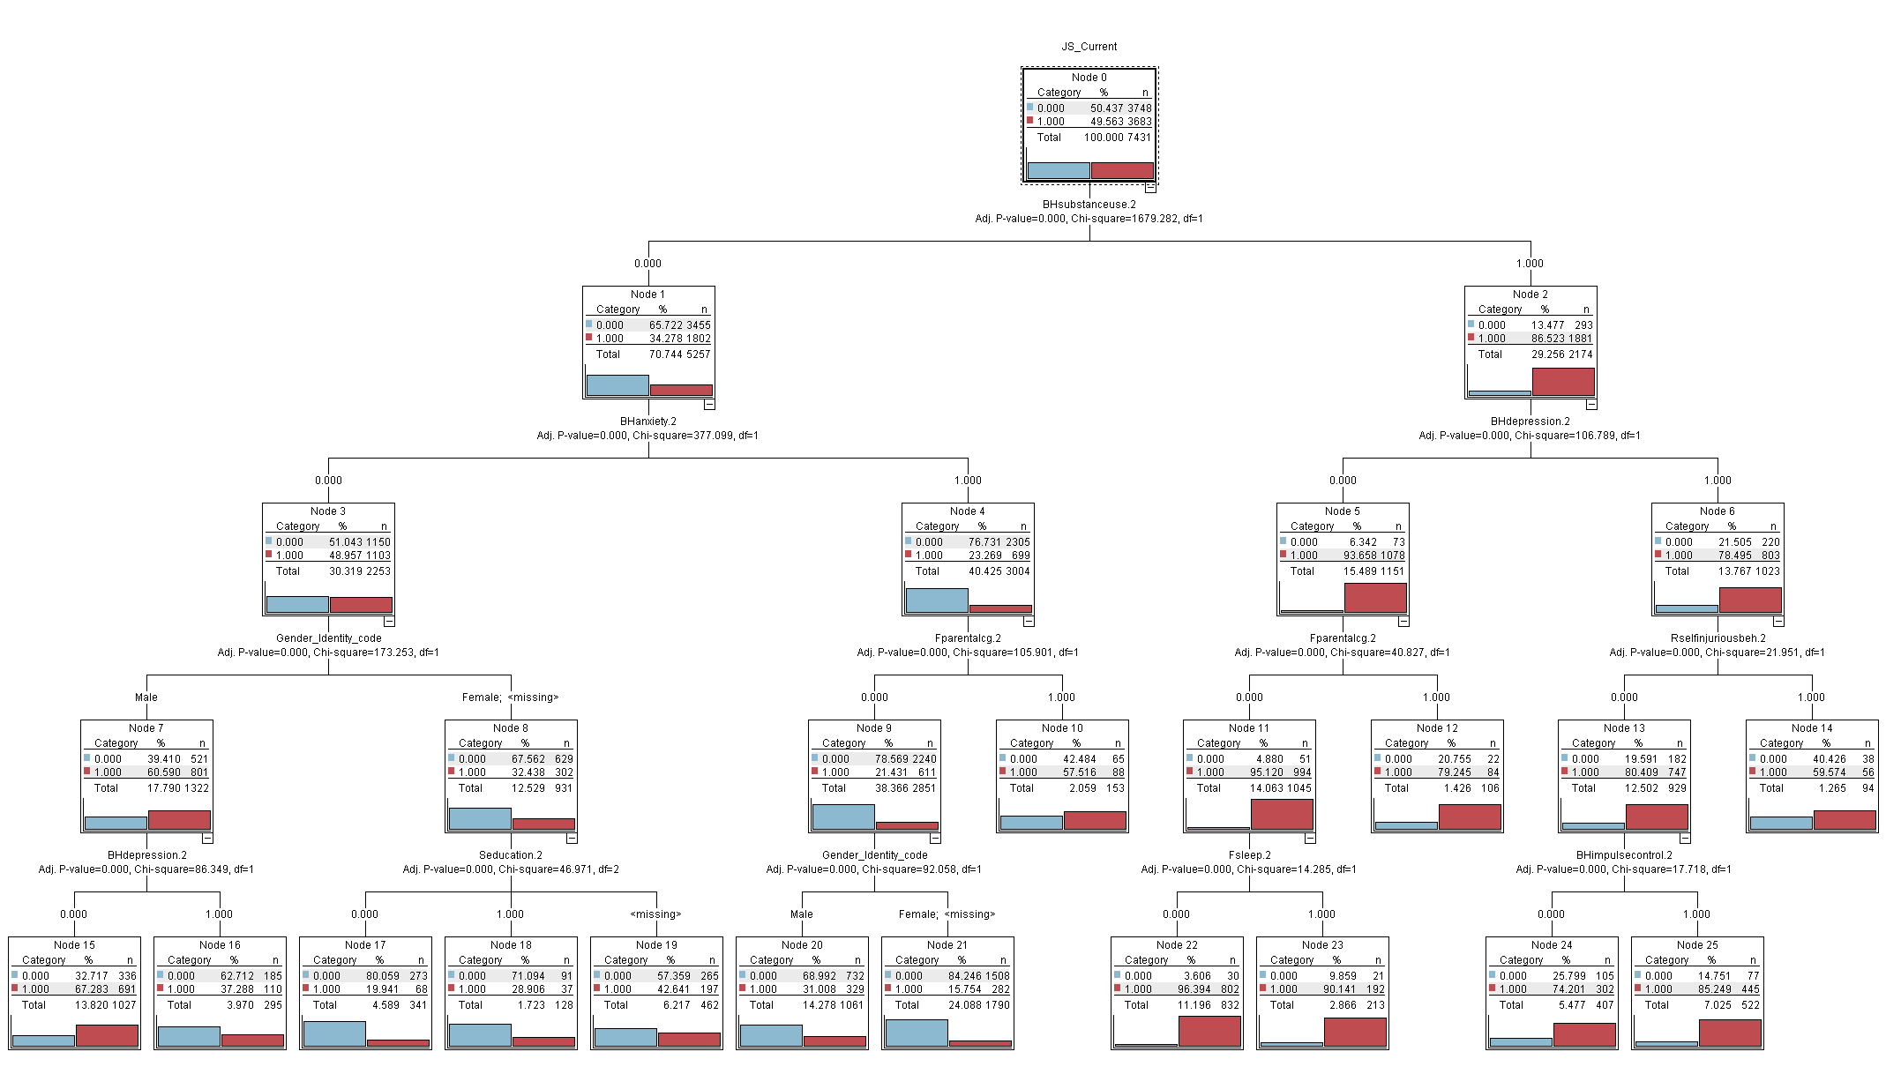

Slide 20
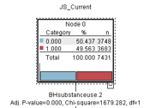
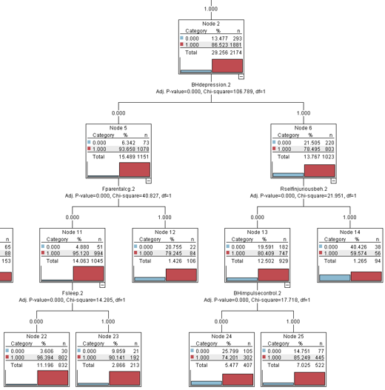

Slide 21
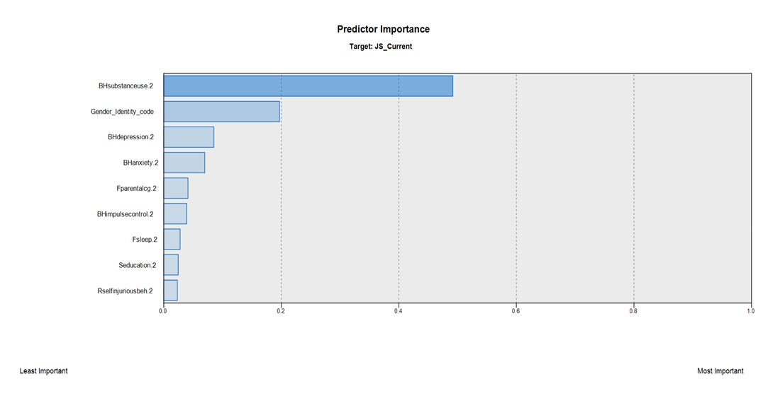
Predictor Importance for the target variable of Current Dual System Involvement

Slide 22
Research Question #2.
To what extent dual-system involvement was associated with behavioral health outcomes (TAI Reduction Rate)?

Slide 23
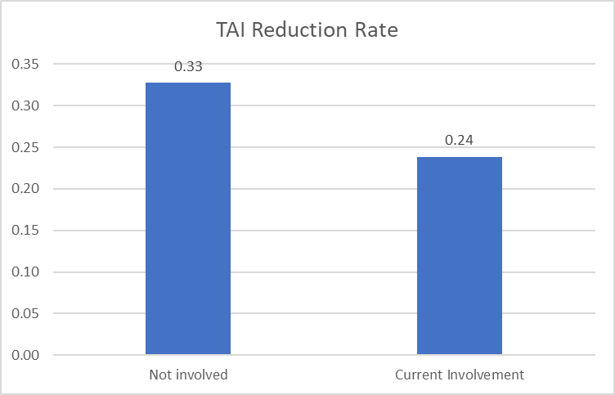

Slide 24
HLM Results for TAI Reduction Rate
 | Model 1 |  |  | Model 2
 | B | SE | p | B | SE | p
(Constant) | 4.13 | 0.21 | 0.00 | 5.61 | 0.23 | 0.00
Gender: Male | 0.05 | 0.13 | 0.72 | -0.48 | 0.13 | 0.00
White (Reference)
Native American | 0.62 | 1.33 | 0.64 | 1.08 | 1.31 | 0.41
Asian | -1.93 | 0.84 | 0.02 | -1.86 | 0.82 | 0.02
Black | -0.10 | 0.21 | 0.62 | -0.03 | 0.21 | 0.89
Hawaiian | 0.76 | 2.57 | 0.77 | 0.62 | 2.53 | 0.81
Other Single | -0.43 | 0.47 | 0.36 | -0.53 | 0.46 | 0.25
Hispanic | 0.17 | 0.24 | 0.48 | 0.12 | 0.24 | 0.62
Multi-Race | 0.50 | 0.41 | 0.22 | 0.54 | 0.40 | 0.18
Current JS: Dual System |  |  |  | -2.18 | 0.14 | 0.00
a. Dependent Variable: TAI Reduction Rate

Slide 25
Conclusion

Slide 26
Substance Use (SUD) was the strongest predictor of characterizing dual system involvement
Dual behavioral health and justice system involvement experienced lower rates of clinical improvement.
CHAID Decision tree model: Intersection of ANSA items and demographic information.
Further in-depth analysis of dual-system involvement that leads to support infrastructure to better manage behavioral health needs.

Slide 27
5. From Communimetrics to Psychometrics
-Communimetrics with high validity and reliability
-Psychometrics with contextual knowledge

Slide 28
References
Bronson, J., & Berzofsky, M. (2017). Indicators of mental health problems reported by prisoners and jail inmates, 2011–12. Bureau of Justice Statistics, 1-16.
Pullmann, M. D. (2010). Predictors of criminal charges for youth in public mental health during the transition to adulthood. Journal of child and family studies, 19(4), 483-491.
Sung, H. E., Mahoney, A. M., & Mellow, J. (2011). Substance abuse treatment gap among adult parolees: Prevalence, correlates, and barriers. Criminal Justice Review, 36(1), 40-57. doi: 10.1177/0734016810389808
Stolzenberg, L., & D’Alessio, S. (2007). Co-offending and the agecrime curve. Journal of Research in Crime and Delinquency, 45, 65–86.
Williams, R. (2015). Addressing Mental Health in the Justice System. NCSL legisbrief, 23(31), 1-2.

Slide 29


Acknowledgement
This study was developed
through a collaborative effort
by
IU School of Social Work
&
Division of Mental Health and Addiction

Slide 30


Slide 31
Contact Information
Saahoon Hong, Ph.D.
Assistant Research Professor
Indiana University School of Social Work
saahong@iu.edu

