Slide 1
Assessing HIDDEN OUTCOMES
of Civic or Community Engagement during College
Ohio Campus Compact
August 3, 2017

Slide 2
Welcome

Slide 3
Outcomes for today
List civic goals.
Differentiate between civic goals and measureable civic outcomes.
Articulate civic learning outcome statements for teaching/learning experiences during college.
Begin designing your course/program with the end in mind.

Slide 4
Today’s Presenters
H. Anne Weiss
Kristin Norris
Indiana Campus Compact
Indiana University Purdue University Indianapolis (IUPUI) Office of Community Engagement
AmeriCorps Alumna (*NCCC, *VISTA, *VISTA Leader)
PhD student at Indiana University
PhD from Indian University
Director of Assessment @ Indiana University Purdue University Indianapolis (IUPUI) Office of Community Engagement
Indiana Campus Compact Advisory Council Chairperson
Dorks for all things civic,
assessment
& inquiry-related.

Slide 5
Changing environment
Advancing the Civic Purpose of Higher Education in what Context?

Slide 6

Recent Pew Center Survey>>
A majority of Republicans and Republican-leaning independents (58%) now say that colleges and universities have a negative effect on the country (up from 45% last year).

Slide 7

UCLA’s “American Freshman Survey”
2016 & 2017 incoming first-year students are the most politically polarized students in the 51 year history of this survey.
Notes:
ewer than ever incoming freshman (just 46%) describe their political beliefs as “middle of the road”

Slide 8
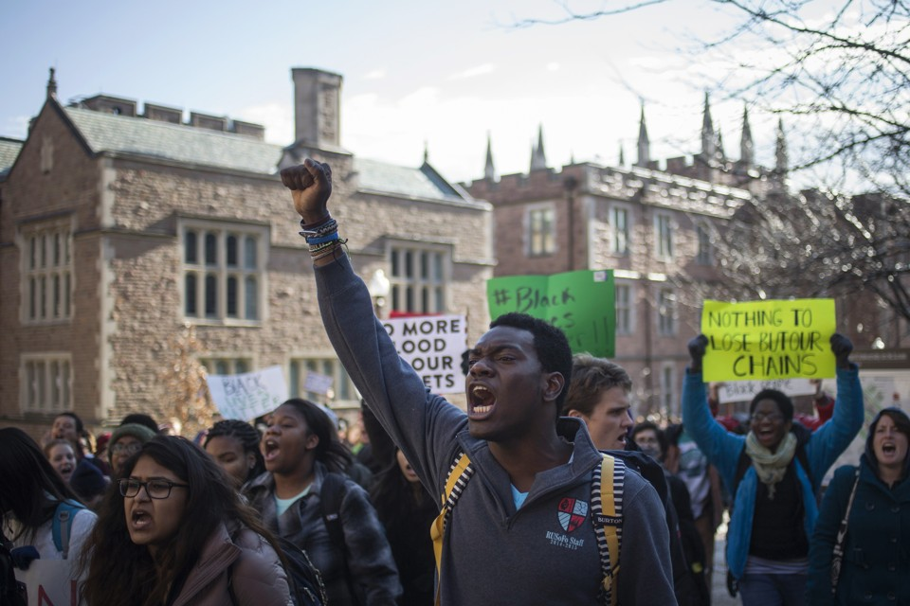
UCLA’s “American Freshman Survey”
2016 & 2017 higher and higher percentages of students say they would likely participate in protests during college.
Notes:
ewer than ever incoming freshman (just 46%) describe their political beliefs as “middle of the road”

Slide 9
Changing environment
Advancing the Civic Purpose of Higher Education in what Context?

Slide 10
The Current Narrative
“Fabulous 5” numbers (students, hours, community partners, faculty-teaching, courses offered).
Descriptive information about our programs be they curricular, co-curricular, outreach, events, activities, etc.
  Anecdotal
  Quantity = Quality
Stories of “doing good”

Slide 11
Proposing a new narrative
Community engagement is THE strategy through which we can achieve our institutional mission and goals (aka, higher education as a public good AND for the public good).

Slide 12
A new narrative results in…
…broader interpretation for “what counts” as community engagement.
  HINT: it is not just service-learning courses anymore!
….increased value for public scholarship, community-engaged research, and outreach programs as they are now viewed as imperative to the overall success of the institution, its constituents, and its surrounding community (partners and members).
…institutional change (e.g., engaged departments).
…better understanding of why higher education exists… to contribute to vibrant and thriving communities (i.e., civic purpose).

Slide 13
Changing environment
= MORE OPPORTUNITIES & MORE EVIDENCE!

Slide 14
A CALL TO ACTION
Identify mechanisms for tracking & monitoring civic engagement activities in order to
form rigorous strategies for measuring, assessing, and/or evaluating the “impact” of this work
& ultimately tell a better, deeper story of your instituion’s impact through civic engagement.
Notes:
Norris’s rant - will SHORTEN :)
New narrative in HE through data: Develop a strategy for changing the narrative in higher education that shifts the focus away from the fabulous five and toward a broader understanding of community engaged activities and how it impacts students, faculty, staff, community, and the institution.
Telling a Story/Reporting: Identify the ways in which data should be used for research, assessment, and informed decision making
EXPANDING THE TENT - MOVING BEYOND TRADITIONALLY ACCEPTED FORMS OF CE
GETTING BEYOND DOING GOOD

Slide 15
Why Outcomes Assessment
Why CIVIC outcomes assessment?

Slide 16
Why IT MATTERS: civic outcomes assessment
We still have lots of questions when it comes to the impact of CE on the civic learning and developmental outcomes of college.
It helps us get beyond telling a story of how volunteering/serving is “good” for our students.
It will inform your practice as an instructor/educator, leading to…
  …a more transparent teaching/learning processes for our students.
  …stronger, proven teaching strategies that beget civic learning and development (being a reflective practitioner; Shön, 1983).

Slide 17
Why IT MATTERS:
LEVELING the PLAYING Field (campus)
Various fields/levels where civic learning can be strategically placed and assessed.
Lesson level
Unit
Program of Study
School/Division
Institution
Don’t forget: community playing field as well!

Slide 18
Why it matters: Leveling the Field
Institution
IUPUI
School
Center/ Office
Liberal Arts
Center
Department
Program of Study
Program
Communication Studies
Org. Comm
Scholarship
Course
Course
Project 1
Intro to Public Speaking
Group Comm
Alter. Breaks
Project 1
Project 2
Project
Project 2
Persuasive Speech
Informative Speech
Capstone
Traning Team Leaders
Notes:
Kristin

Slide 19
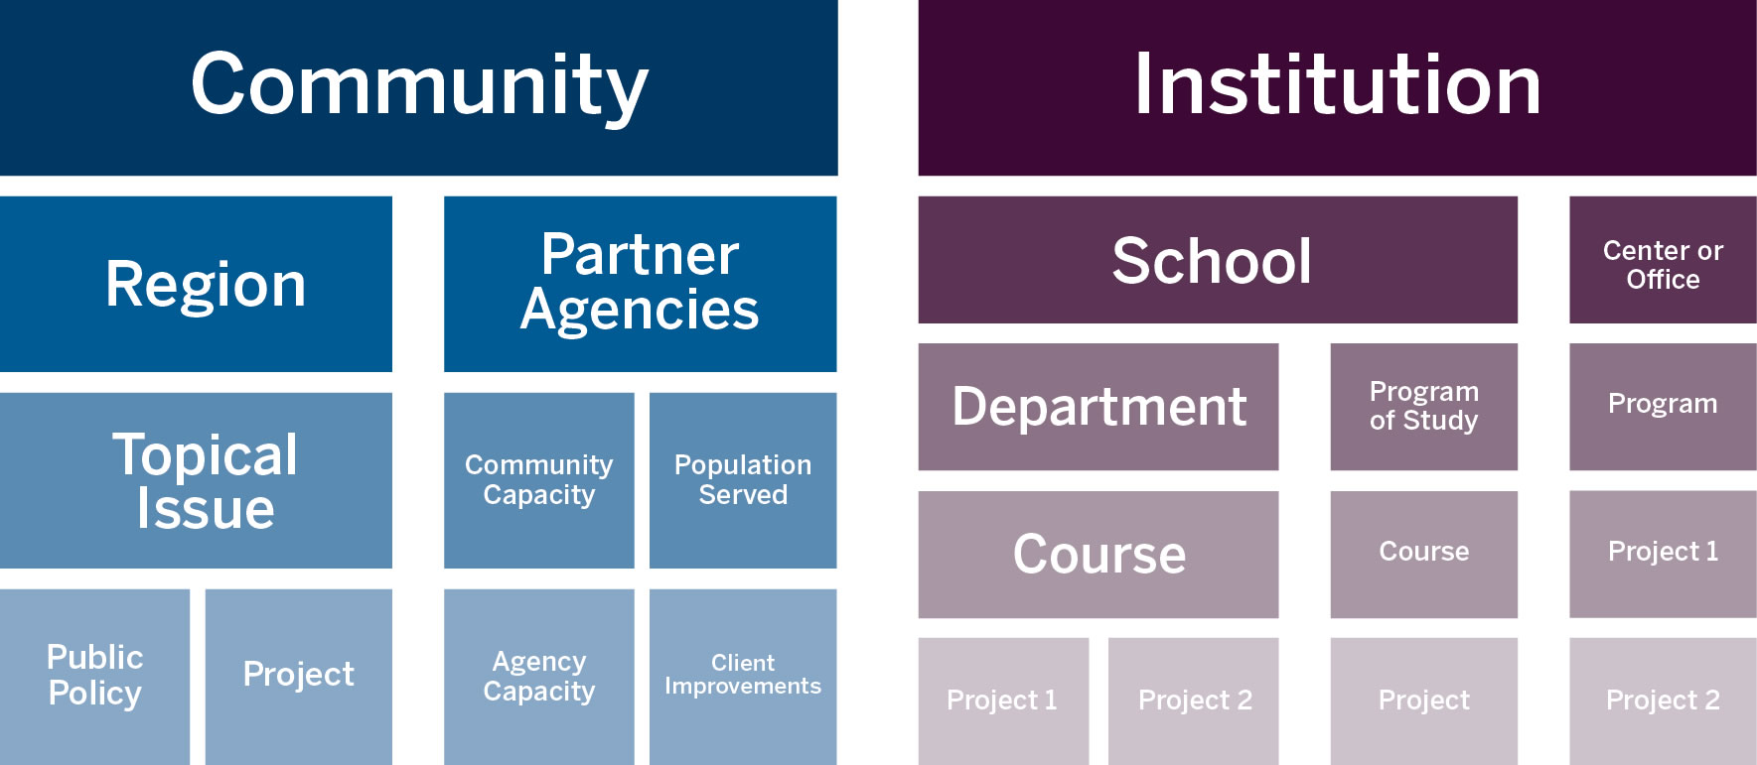

Slide 20
Why IT MATTERS: civic outcomes assessment
At the unit/lesson level
  Build a structure for a unit or session
  Focus each unit or session
  Give learners a clear picture of what to expect
  Provide criteria for constructing assessments
  Guide the selection of learning activities
  Teach learners how to be successful

Slide 21
Why IT MATTERS: civic outcomes assessment
At the course level
  Build a foundation for your course
  Define your expectations
  Describe how your course is relevant to the students’ personal, academic, and/or professional development
  Keep you focused on what is important
  Enable students to articulate what they are learning and have learned.

Slide 22
Why IT MATTERS: civic outcomes assessment
At the school- or institutional-level
  Give foundation, guidance to general education learning outcomes.
    AND where this learning occurs (mapping across a program of study)
  Informs strategic planning (“to what ends…”)
  Speaks to the public mission of your institution.
  Leveraging assessment results for national rewards, recognitions, and accreditation purposes.

Slide 23
Let us get to work
Civic Goals & Outcomes During College

Slide 24
REVIEW Examples OF
CIVIC GOALS

Slide 25
BEING CIVICALLY LITERATE
CIVIC KNOWLEDGE
“Any learning that contributes to student preparation for public involvement in a diverse democratic society. The knowledge, skills, and values that make an explicitly direct and purposeful contribution to the preparation of students for active participation.”
Howard, 2001, p. 45
Leadership
Civic Engagement
Social Justice
Leadership
Civic Engagement
Social Justice
Leadership
Civic Engagement
Social Justice

Slide 26
POSESSING A CIVIC IDENTITY
CIVIC IDENTITY
“Those fully engaged, fully human citizens of their communities. They see their role in life as contributing to the long-term greater good. And perhaps most importantly, they have the courage to act.”
Knefelkamp, 2008, p. 3
Leadership
Civic Engagement
Social Justice
Leadership
Civic Engagement
Social Justice
Leadership
Civic Engagement
Social Justice
Notes:
Knefelkamp (2008) identified some essential characteristics of civic identity : (1) it develops over time through engagement with people of difference, who bring varied interpretations of life and experiences to bear in meaningful dialogue; (2) civic identity is not the same as complex intellectual and ethical development, but is connected. Cognitive complexity does not necessarily yield positive moral action, yet arises in the face of complex alternatives. So, in developing student’s cognitive capacities within the context of moral challenges will result in their capacity to think and act as citizens; (3) civic identity requires integration of critical thinking and the capacity for empathy. It challenges us to identify with others who may be different from ourselves while acting consistently in the face of unexpected circumstances; (4) civic identity becomes a deliberately chosen and repeatedly enacted aspect of the self. In summary, Knefelkamp (2008) describes people with a mature sense of civic identity as “Those fully engaged, fully human citizens of their communities. They see their role in life as contributing to the long-term greater good. And perhaps most importantly, they have the courage to act” (Knefelkamp, 2008, p. 3).
This is all from Knefelkamp. How do I structure it so that #1 – it makes sense, #2 – I give all the credit to Knefelkamp?

Slide 27
HAVING CIVIC EFFICACY or BEING A CIVIC AGENT
CIVIC EFFICACY & AGENCY
“Emphasizes not only individual action, but also the collective capacity to act on common challenges across difference.” (Boyte, 2008, p. 25)
“..interest, involvement, or engagement in attending to political information along with the sense that one has the capacity to understand [and address] a political situation…” (Torney-Purta, et al, 2015, p. 35)
Leadership
Civic Engagement
Social Justice
Leadership
Civic Engagement
Social Justice
Leadership
Civic Engagement
Social Justice

Slide 28
VALUING EQUITY, JUSTICE, DIVERSITY
NORMALIZING VOTING, CIVIL DISOBEDIENCE
DEMOCRATIC VALUES & NORMS
“…belief in basic principles of democracy (grounded historically and in the present) and to actions… avoid[ing] a sense of apathy” (Torney-Purta, et al, 2015, p. 35).

Slide 29
The ultimate goal in higher ed
CIVIC MINDED GRADUATE
“a person’s inclination or disposition to be knowledgeable of and involved in the community, and to have a commitment to act upon a sense of responsibility as a member of that community.” (Bringle & Steinberg, 2010, p. 429).

Slide 30
Working Break
Do not leave yet!

Slide 31
I.D. a relevant civic goal
Get out your device (smart phone, tablet, laptop)

Slide 32

Task
LOOK UP YOUR INSTITUTION’S MISSION OR VISION STATEMENT
Notes:
Review registration.

Slide 33
Institution’s Mission or Vision
Go to: PollEv.com/anneweiss584
Enter some phrases or words that speak civic to you.
Civic: relating to the duties, activities, knowledge, skills or abilities of people in relation to their community (town, city, local area, globe/world, somewhat geographically conceived).
Notes:
Examples:
Ethical leaders, social actors, change agents, social entreprenuers,
In what ways are your students expected to behave civically and
In what ways are they expected to think civically…

Slide 34
Working Break
Respond to poll and come back in 5 minutes!

Slide 35
We must differentiate between
GOALS
OUTCOMES
Ambiguous, General Statements
Large/Meta-level
Long range
Should be consistent with the mission of the institution
Specific
Measurable
Contain Active Verbs
Operationalized

Slide 36
Levels of civic learning
Institution
IUPUI
School
Center/ Office
Liberal Arts
Center
GOALS
Department
Program of Study
Program
Communication Studies
Org. Comm
Scholarship
Course
Course
Project 1
Intro to Public Speaking
Group Comm
Alter. Breaks
Project 1
Project 2
Project
Project 2
Persuasive Speech
Informative Speech
Capstone
Traning Team Leaders
OUTCOMES
Notes:
Kristin

Slide 37
Example: BUS-X 103
Civic Goal
Outcome
Effectively working with others across difference.
Students identify components of team work that lead to everyone having a voice in the project through a one-page minute paper after reading essay from Harvard Business Review (Haas & Mortensen, 2016).

Slide 38
Example: SOC-R 205
Civic Goal
Outcome
Active participant in society to address social issues.
Students can list relevant agencies/organizations responsible for addressing homelessness in CITY as an answer to a question on the midterm exam.
Students can distinguish relevant readings (from class) and how they contribute to their knowledge about “solving homelessness in CITY” through an team presentation.

Slide 39
Goals TELL US NOTHING!
Goals “working with others” or “active participant” will not allow…
Students to know what is expected of their work.
Colleagues to know the focus of your department’s pedagogy.
Employers to know what your student can do!

Slide 40
Let’s Get Specific
broad CIVIC Goal>> toward specific CIVIC Outcome(s)

Slide 41
CIVIC OUTCOME STATEMENTS SHOULD…
Describe what students should be able to do, based on their learning histories…
Rely on active verbs that identify what students should be able to demonstrate, represent, or produce over time. (Maki, 2004; Adelman, 2015)
Be operationalized (where or how are students enacting the verb)
Exist across and within different levels.
Inform decisions & practices!!!!

Slide 42
Civic Outcome Statements Should Be…
Specific
Measurable
Operationalized
Useful
Meaningful, and
Allow for one or more methods of data collection and measurement to be tied with the intended outcome.

Slide 43
Review Handouts
“Examples” and the “CMG Rubric 2.0”

Slide 44
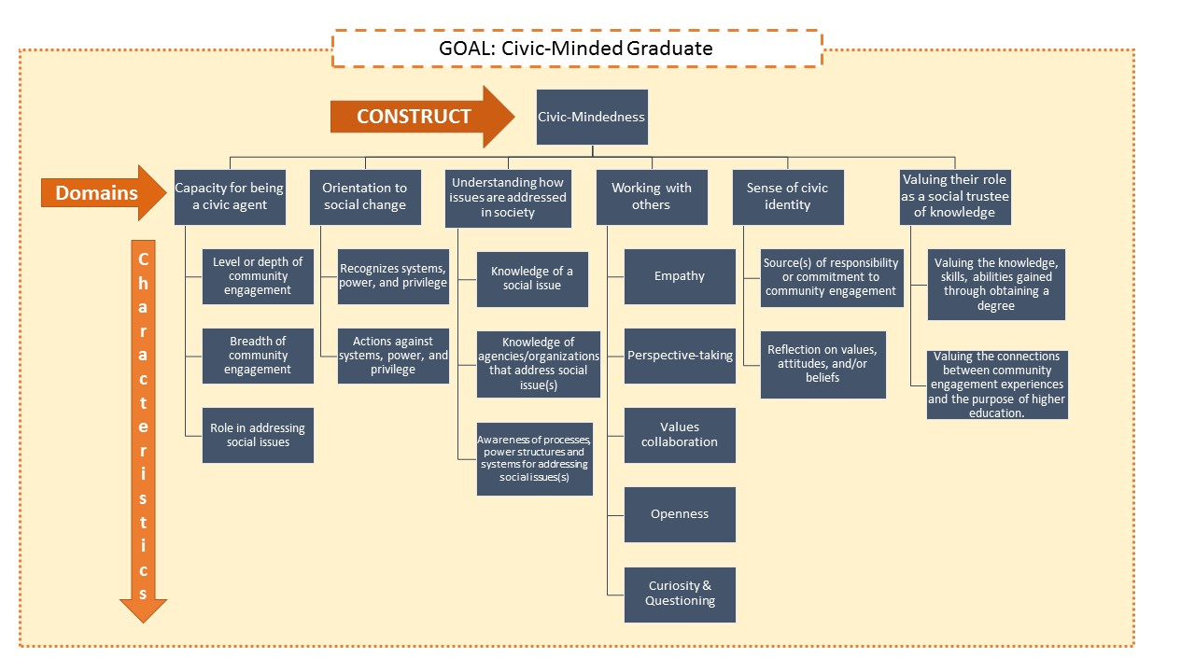
CMG Rubric 2.0

Slide 45
Let’s Practice
Writing Measureable Civic Learning Outcome Statements

Slide 46
ACTIVITY
Get into groups of 3-4
Pick a civic goal (literacy, agency, identity, mindedness, instilling democratic values and norms, other?)
KEEPING ^THIS^ GOAL IN MIND…
3. Pick one verb (from a set of active verbs)
4. Write a learning outcome statement using ^THAT^ verb, related to that goal.
REPEAT with a different verb.
Be prepared to share your favorite or “strongest” statement.
WINNERS: Most LO Statements

Slide 47
Please share
Write out your “best” statement…
WAIT,
Operationalize it!!

Slide 48
Planning for Assessment
The Matrix = Your Assessment Plan

Slide 49

You are halfway there!

Slide 50
Digging In
Instructional/Program Activities & Characteristics:
Design Matters

Slide 51
Intro to Taxonomies/Design Map
ANOTHER, important, source of evidence in the assessment plan
Facilitates faculty self-reflection on teaching and course design
Facilitates organizational sense-making
Notes:
ANOTHER, important, source of evidence in the assessment plan
Operationalizes high-impact practices
Highlights variations in course design, which can be used to explain variations in student learning
Facilitates faculty self-reflection on teaching and course design
Validates practice and concretely identifies opportunities for growth.
Reinforces the value of scaffolding learning
Facilitates organizational sense-making
Communities of faculty advance/learn together from each other by seeing various operationalizations of teaching according to the design map.
Invites collective reflection on teaching approaches and philosophies

Slide 52
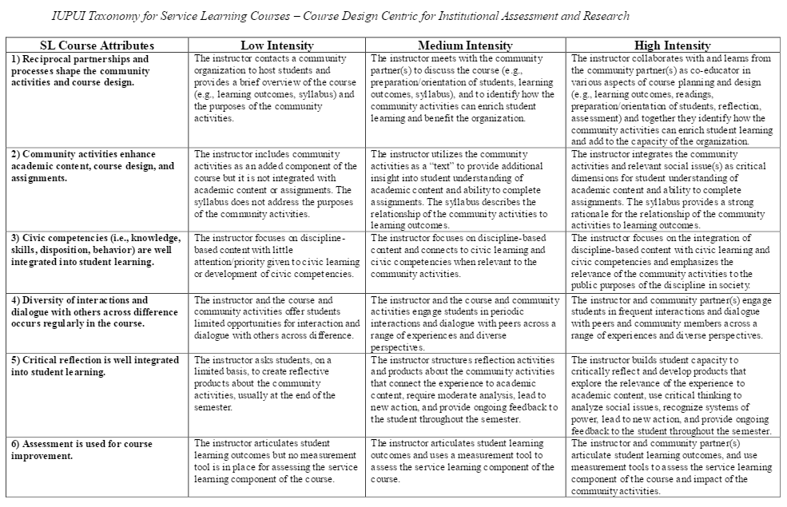
Tools To Assess Process: Taxonomy / Design Maps

Slide 53
Tools To Assess Process:
Taxonomy / Design Maps
 |  | Advanced Community-Engaged Learning (ACEL) Designation
Attributes of ACEL Course | Low Intensity | Moderate Intensity | High Intensity
1) Extent to which disciplinary skills/concepts are used to address civic issues | The instructor assigns students a community-based project or service experience, but does not build their capacity to work as students of their discipline by equipping them with specific and relevant disciplinary skills, methods, and concepts. | The instructor assigns students a community-based project and explicitly introduces disciplinary-specific skills, methods, and concepts that students are to use while addressing a community issue. | The instructor presents students with an array of disciplinary skills, methods, and concepts. Students then think critically about the causes, consequence and possible responses to civic issues and choose from the array of disciplinary tools available to them as they prepare for action.
2) Role of students, faculty, and community partners within the design of community-based work | The instructor assigns a highly-scripted project or direct service that provides an illustration of how a civic issue might be addressed. Community stakeholders are involved as recipients of service and typically have minimal opportunities to provide feedback before final products are turned in by students. | The instructor assigns a project that follows a recipe and students work with community stakeholders to adapt the project template to the context, needs, and details of their present situation. Community stakeholders are guides to students and may also be recipients of project outcomes. They have significant opportunities to provide ongoing feedback on projects before students turn in final products. | The instructor, students, and community collaborators engage in non-scripted, consequential work to respond to a civic issue. Community stakeholders are collaborators in the problem identification and work undertaken.
3) Role of civic values and civic empathy in determining possible responses to civic issues Note: Civic values include intellectual humility, openness, an orientation toward justice, and respect for human dignity. Civic empathy is the capacity to imagine oneself in the place of others who face vastly different circumstances. | The instructor introduces civic values and/or civic empathy but does not make clear how adopting one or more value stances would change the approach to the project being done or service being provided. | The instructor introduces civic values and/or civic empathy and facilitates student consideration of how adopting one or more value stances would change their possible approaches to addressing the civic issue of concern to the class. | The instructor builds student capacity to apply one or more civic values and/or civic empathy to collaborations with community stakeholders. Students are asked to identify specific instances in which they utilized civic values/civic empathy and describe how their approach would have changed had their work embodied additional values or different values than it had.

Slide 54

Why assessing “process” matters
Beyond Assessing Outcomes
FIDELITY
The extent to which the delivery of an intervention (aka, program) adheres to the protocol as intended by the developers of that intervention.
Notes:
Interpreting outcome findings: Implementation data are necessary for understanding
why a program succeeds or fails to produce positive outcomes. The data may also
elucidate differences in outcomes between sites in multi-site evaluations, ensure
internal validity, and help avoid Type III errors.4

Slide 55
On that note:
MANY THINGS INFLUENCE LEARNING
Intentional assessment & design, faculty experience level, student characteristics, etc.

Slide 56
OTHER FACTORS INFLUENCING CIVIC OUTCOMES
Student Characteristics
  Prior volunteer/service experience
  Hours worked off campus
  Unmet financial need
  Empathic concern
Faculty Characteristics
  Level of experience with community engagement
  Gender
Service
  Contact: Direct vs indirect service
  Project vs hours
  Student self-select partner or project vs assigned
  Percieved value of service to organization
Reflection
  How often and when
  Dialogue/Discussion vs. Written
  Community partner involvement

Slide 57
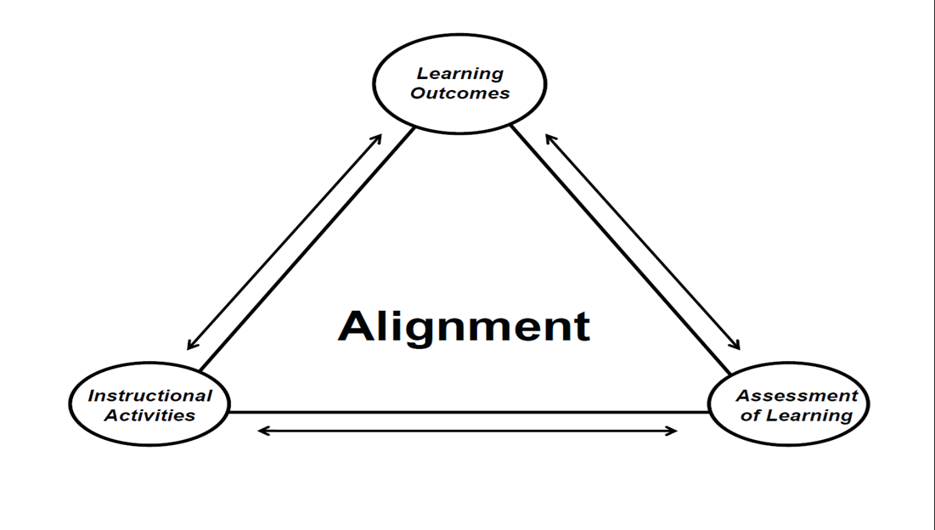
DO NOT FORGET :
CLOSE THAT ASSESSMENT LOOP

Slide 58
Assessing HIDDEN OUTCOMES
of Civic or Community Engagement during College
Ohio Campus Compact
August 3, 2017

