Slide 1

Negotiation Strategies to Empower you in Work & Life: A virtual Workshop
March 29 & March 30, 2023, 10-12:30pm CDT

Slide 2
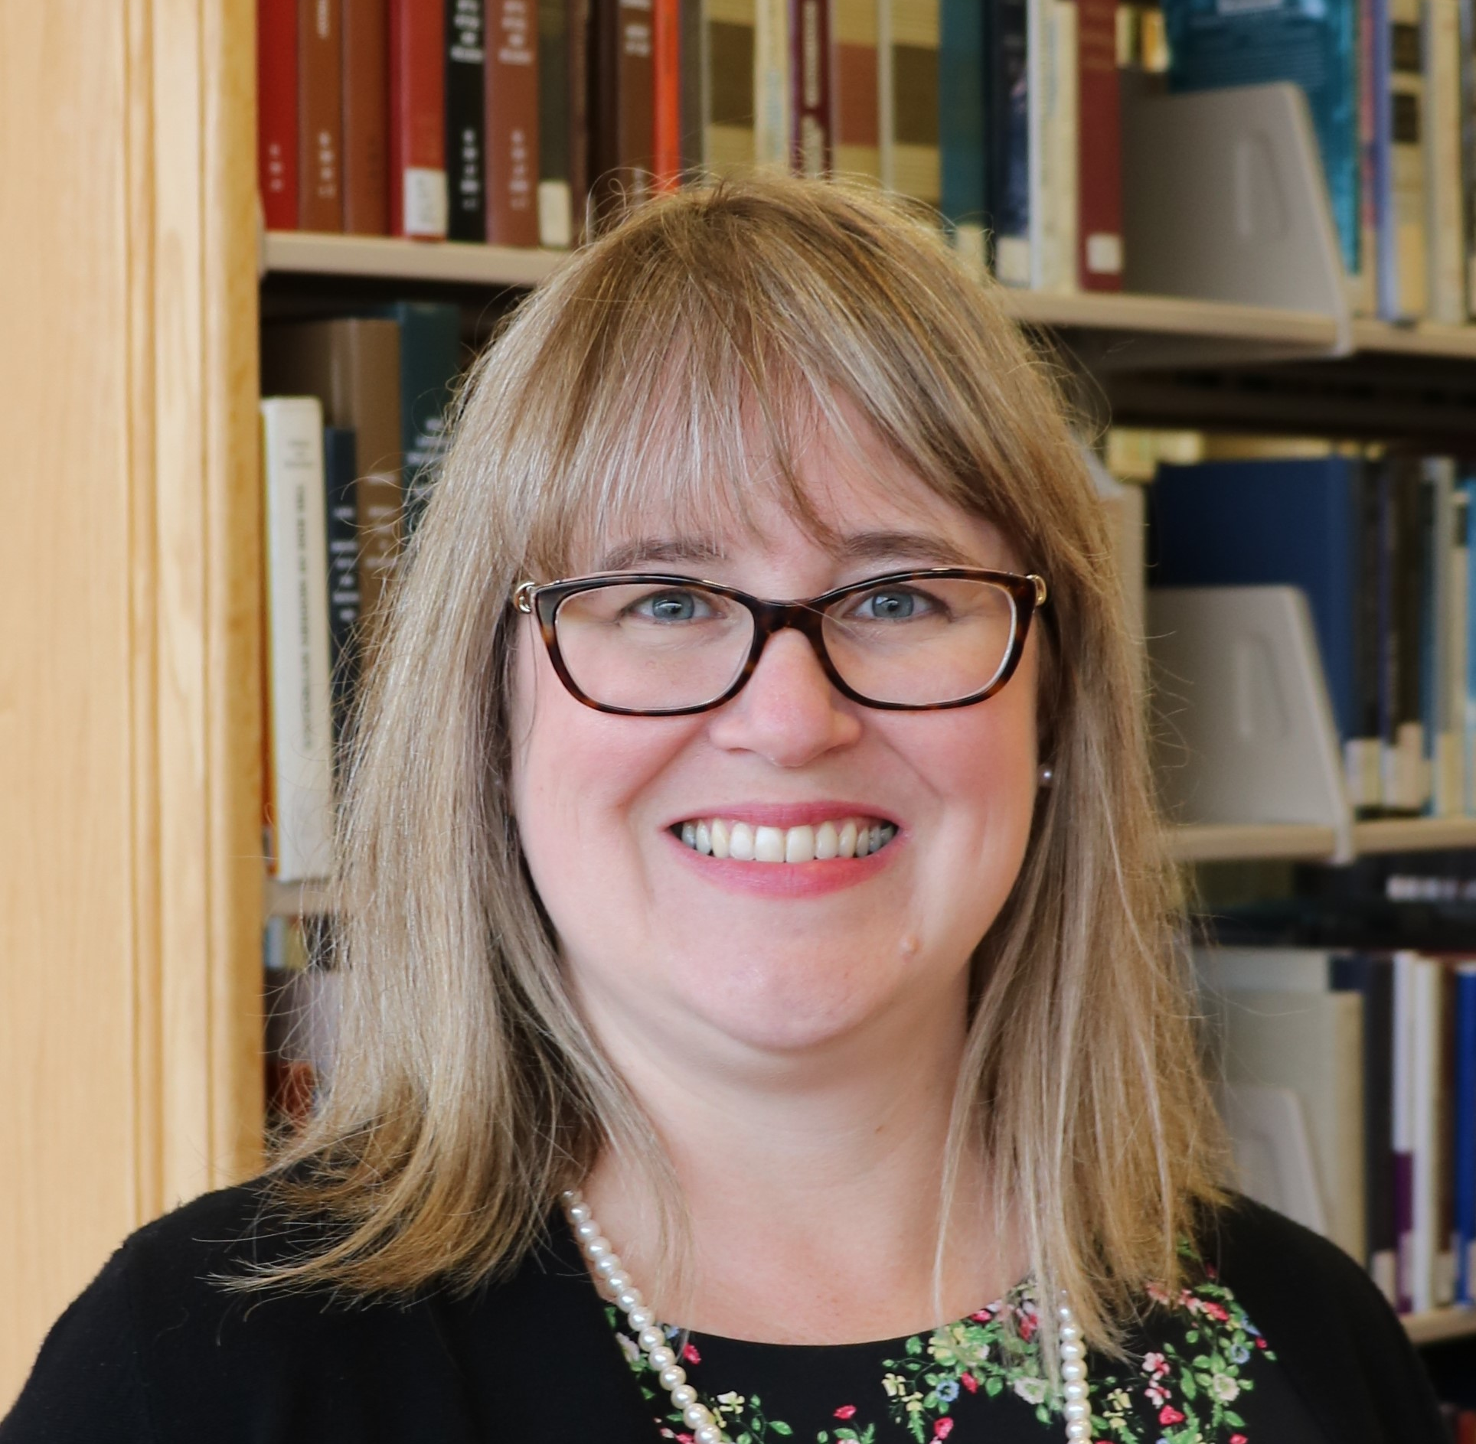
Katharine V. Macy, MBA, MLIS
COLLECTION ASSESSMENT LIBRARIAN
Indiana University-Purdue University Indianapolis
macyk@iupui.edu
Twitter: @kvmacy
ORCID https://orcid.org/0000-0002-6283-7143

Slide 3
Workshop Structure
Day 1 |  | Day 2
10:00-10:50 | Negotiation skills | 10:00 – 10:05 | Welcome
10:50 – 11:00 | Break | 10:05 – 10:30 | Case Study 2 Negotiation
11:00 – 11:30 | Case Study 1 Negotiation | 10:30 – 10:45 | Debrief
11:30 – 11:45 | Debrief | 10:45 – 10:55 | Break
11:45 – 11:50 | Break | 10:55 – 11:20 | Case Study 3 Negotiation
11:50 – 12:20 | E-Resource Negotiations | 11:20 – 11:35 | Debrief
12:20 – 12:30 | Wrap-Up & Homework | 11:35 – 11:40 | Break
 |  | 11:40 – 12:30 | More Best Practices & Q&A

Slide 4
PRINCIPLED NEGOTIATIONS
1
Striving for Mutual Gain
Notes:
First off, I want to cover what it means to conduct a principled negotiation that strives for mutual gain in order to do that though we should discuss the two traditional roles that we want to move away from…

Slide 5
TYPES OF NEGOTIATORS – Two Traditional Roles
SOFT
Focuses on position
“Friends”
Values agreement
More likely to make concessions to avoid conflict
Yields to pressure
Too much trust
HARD
Focuses on position
Adversaries
Needs to “win”
Demands concessions to maintain relationship
Applies pressure
Distrustful
Fisher, R., Ury, W., & Patton, B. (1991). Getting to Yes: Negotiating Agreement Without Giving In (2nd ed.). New York: Houghton Mifflin Company.
Notes:
These roles are as soft and hard negotiators
Soft and hard negotiators both focus on position and how the individuals are viewed as a result of the negotiation. It tends to turn things personal where there are more winners and losers and a higher likelihood of at least one party being highly dissatisfied.
Soft negotiators want to be viewed as friends with who they negotiate with and highly value agreement. They are much more likely to concede things they would rather not in order to find agreement. They tend to yield to pressure and trust too much.
Meanwhile hard negotiators are all about winning and view the other side as an adversary. They demand concessions to maintain the relationship and applies pressure and are distrustful of the other side.
I think we can all think of negotiations we’ve witnessed with soft and hard negotiators. I believe as librarians the high need to people please can lead us to being soft negotiators and when we encounter vendors who are hard negotiators it helps perpetuate the angst we feel when trying to ask for the things we really need in order to sustainably manage access to our collections.

Slide 6
A Third Way – The Principled Negotiator
PRINCIPLED
Focuses on interests
Relationships based on trust, empathy, and respect.
Sustainability
Not about the money, it’s about the utility!
Allows negotiators to adjust tactics
Fisher, R., Ury, W., & Patton, B. (1991). Getting to Yes: Negotiating Agreement Without Giving In (2nd ed.). New York: Houghton Mifflin Company.
Notes:
There is a third way, which is to approach negotiations as a principled negotiator. Principled negotiators work to not make it about their positions. You aren’t trying to be friends, but you also aren’t adversaries. Instead, this type of negotiator is focusing on the interests of both parties to try to come to a mutual agreement. This requires preparation and planning. It also means working to build a relationship based on trust, empathy, and respect. It’s about working toward a sustainable partnership. It’s not about the money but the utility. Value in an agreement is not just about the final dollar amount. It also allows those negotiating to adjust tactics to find a mutually satisfying agreement.

Slide 7
PRINCIPLED NEGOTIATORS
“Problem-solvers seeking a win/win situation…Hard on the issues, but soft on the approach to people”
Crawford, A. R. (2008). Licensing and Negotiations for Electronic Content. Resource Sharing & Information Networks, 19(1/2), 15–38. https://doi.org/10.1080/07377790802498523
Notes:
Amy Crawford stated in her article that “Principled negotiators are problem-solvers seeking a win/win situation…they are hard on the issues, but soft on the approach to people.”

Slide 8
FOUR ELEMENTS OF PRINCIPLED NEGOTIATION
People | Separate the people from the problem
Interests | Focus on interests, not positions
Options | Invent multiple options looking for mutual gains before deciding what to do
Criteria | Insist that the result be based on some objective standard
Fisher, R., Ury, W., & Patton, B. (1991). Getting to Yes: Negotiating Agreement Without Giving In (2nd ed.). New York: Houghton Mifflin Company.
Notes:
Fisher, Ury, and Patton in their classic Getting to Yes: Negotiating Agreement Without Giving In state that there are four elements of principled negation.
People – separate the people (and the personalities) from the problem
Interests – Focus on the interests of both parties, not positions. You don’t need to come out friends, but you aren’t adversaries either
Options – Invent multiple options looking for mutual gains before deciding what to do
Criteria – Insist that result be based on some objective standard – is there a way where you can value the options you present?

Slide 9
STRUCTURE OF NEGOTIATIONS
2
MOST OF THE WORK GOES INTO PHASE 1!
Notes:
To plan for a principled negotiation, you need to understand the structure of negotiations. And know that most of the work often occurs in phase 1. This is very true for traditional collection licensing deals.

Slide 10
STRUCTURE OF NEGOTATIONS
PLANNING
Initiating and maintaining relationships
Analysis of positions and options
In principled negotiations, this is where the most time is spent!
THE NEGOTIATION
Plan what execution strategies
Offer/Counter
Concessions
Managing behavior
POST-NEGOTIATION
Following up and maintaining relationships
TRUST!
Thompson, L. (2013). The truth about negotiations. New Jersey: Pearson Education.
Notes:
There are three phases. Phase 1, where most of your work will occur in traditional resource licensing is the planning, sometimes referred to the pre-game (think chess). This is where you initiate and establish relationships with your vendors and prepare a negotiation strategy. The second phase is the actual negotiations, playing the game. You execute your planned options and strategies you developed in the planning. Be prepared though that if you are ever negotiation a complex deal such as a transformative agreement you may need to occasional update your planning work during the negotiation based on information you discover. The third and final phase of the negotiation is the follow up to your agreement and the maintenance of your relationships, fostering trust.

Slide 11
PLANNING THE NEGOTIATION
3
The bulk of the effort!
Notes:
Planning is where the bulk of the effort should occur

Slide 12
PLANNING PROCESS
Build & maintain relationships – Trust!
Collect & analyze data
Plan your negotiation strategies
Notes:
The first step is the build and maintain relationship. Build the foundation of trust through touching base with your vendor reps at conferences and annual meetings with the rep to discuss their resources to learn the latest and greatest, discuss challenges, etc. Having a prior relationship helps smooth the way to focus on interests. The second step is to collect and analyze data about the resource you are negotiating over as well as the vendor itself. Once this is complete you plan your negotiation strategies.

Slide 13

PREPARATION THAT DOES NOT WORK!
Psyching up!
It makes the negotiation more personal and makes the focus positional.
Image by rubyblossom
Thompson, L. (2013). The truth about negotiations. New Jersey: Pearson Education.
Notes:
The research is in and something that does not work is Psyching Up! It makes the negotiation personal and focus positional and not on interests. Whether or not you succeed becomes your identity! If things don’t go well or the way you want, then you feel bad about it.

Slide 14

PREPARATION THAT DOES WORK
Planning that considers both parties’ interests
Image by Nicola Barnett
Notes:
What does work….preparation through analysis and planning strategies that considers both parties’ interests.

Slide 15
Own Your Terms
4
Negotiation Planning Vocabulary
Notes:
Pun intended
To plan for negotiation, it’s important to know certain negotiation concepts and vocabulary.

Slide 16
BATNA
Best Alternative to Negotiated Agreement
Notes:
What you would do if you fail to reach a negotiated agreement.
For vendor resources this may be to cancel
You always have a BATNA even if you don’t like it.
If you are unhappy but resubscribe to a resource it means you’ve reached agreement. What you need to do now is work to improve your BATNA by looking for alternatives, perhaps getting stakeholders on board to making the hard decision.
Be careful to not reveal your BATNA early, if at all.
During the negotiation you don’t want to reveal your BATNA (unless you have absolutely reached an impass) but you can signal at your BATNA. Don’t lie about your BATNA. I you say you walk away point is X but it is really Z and they talk you down to Z you will have a difficult time in future negotiations. The other party may ask about your walk away point – divert them away from this by emphasizing you are negotiating for the entire value of the package which can include other things such as support, authorized user access, removing NDAs, fixing price increases, etc.
BATNA can change over time. Open Access, PDA, and AOD is allowing libraries to change their BATNAs
Don’t just determine your own BATNA, research your other party’s. Are subscriptions down, sales flat, are there new competitive products….

Slide 17
Reservation Price
$
The bottom line, the point in the negotiation where you can go either way. Informed by the BATNA.
Notes:
The bottom line. The point in the negotiation where you could find agreement or go with your BATNA. It is often determined by your BATNA. Don’t reveal this.

Slide 18
ZOPA
Zone of Possible Agreement
$10,000
Min
Seller
$12,500
Max Buyer
Spangler, B. (2003). Zone of Possible Agreement (ZOPA). In Beyond Intractability. Retrieved from http://www.beyondintractability.org/essay/zopa
Notes:
The zone of possible agreement. The minimum the seller is willing to sell, and the maximum the buyer is willing to pay. Try to predict during preparation but be willing to adjust as you learn more information during the active phase of the negotiation.

Slide 19
CONCESSIONS
What you are willing to give up
Notes:
Points the parties are willing to give up or compromise on in order to find agreement. Plan these carefully and when you will give them up, so you don’t give too much away. Be sure to fully explore their interests during the negotiation. Generally speaking it’s good to plan in room for concessions.

Slide 20
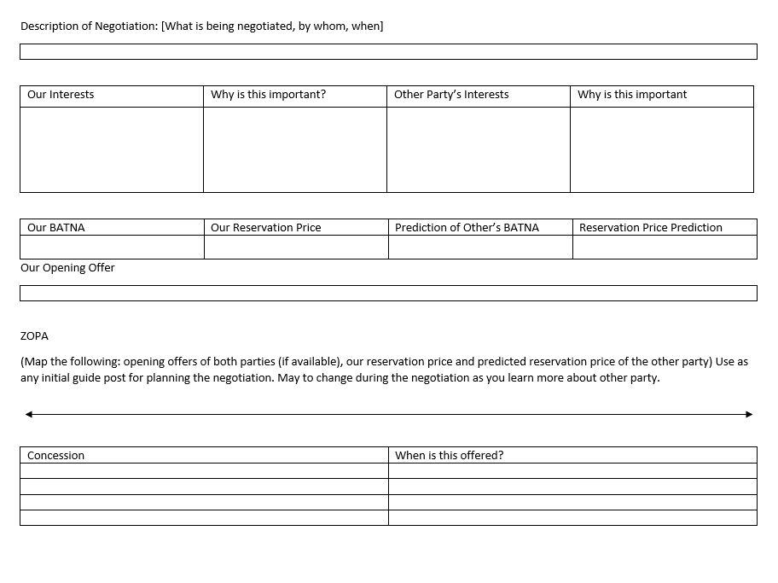
Negotiation Worksheet
Helpful guide for preparing for any type of negotiation
Notes:
I’ve created a negotiation sheet to use when planning your own negotiations that helps you think about you and the vendors interests, identifies BATNAs, reservations price, ZOPA, outlines concessions, when to give them, and plans the opening offer. The link to this worksheet is in the resources list.

Slide 21
Pre-Game When You Have Little Time
Identify Goals
Goals should reflect interests and explain why it’s important.
Brainstorm Options
What are your alternatives?
Plan Opening Move
Helps anchor your negotiation.
The why helps create solutions during negotiations.
What are
Represents ideal situation.
deal breakers
vs
deal makers?
Thompson, L. (2013). The truth about negotiations. New Jersey: Pearson Education.
Notes:
Sometimes you have less than an hour to plan (like today!) When you do have very little time what you want to do is
First identify your goals which should reflect your interests. Outline why these are important to you. Understanding why may help you create solutions during negotiations.
Brainstorm your alternatives and determine your BATNA. Are there any deal breakers or deal makers?
Plan your opening move. Opening moves anchor your negotiations and represents your ideal situation where you get everything your want.

Slide 22
THE NEGOTIATION
5
Strategies
Notes:
Now let’s talk about strategies you should plan for and use during actual negotiation.

Slide 23
TRUST DURING NEGOTIATONS
FOUR KINDS OF REPUTATION
Liar-Manipulator
Tough but Honest
Nice and Reasonable
Cream Puff
Relationships are important!
Thompson, L. (2013). The truth about negotiations. New Jersey: Pearson Education.
Notes:
You need to work to maintain trust during the negotiation. Research shows that there are four primary types of negotiation reputation.
Liar-Manipulator
Tough but Honest
Nice and Reasonable
Cream Puff
Most of us want to target tough-but-honest and nice-and-reasonable. Planning principled negotiations allows you to get there. Also, if you are a soft negotiator “cream puff” don’t expect to get to tough but honest over night. It’s also perfectly okay to be nice and reasonable….just always negotiate to your interests not position.
If you are negotiating with a Liar-Manipulator remember your strategies for managing unacceptable behavior.
Above all relationships are important.

Slide 24
FIRST OFFERS – ANCHORS YOUR POSITION
Your ideal offer that outlines
Price / Price Increases
Term
License Terms
Other (Support, Accessibility, Training)
Often vendors make first offer, trying to anchor changes in their favor. Libraries should determine value and derive a counteroffer when this happens. Or, when appropriate, be proactive by submitting a first offer based on determined value to the vendor.
Example: VIVA, Virginia’s Academic Library Consortium
Notes:
First offers anchor your position.
This should be your ideal offer that outlines price including price increases, term, desired licensing terms, and any other import aspect for your agreement. Often vendors make the first offer, trying to anchor changes in their favor. Libraries should determine the value and derive a counteroffer when that happens. But when appropriate, perhaps its time for us to be proactive and submit a first offer based on our determined value to the vendor. One example of this is the work that VIVA has done around planning journal negotiations for their consortia. There is an article about VIVA’s work in the resource list we are providing you with this workshop.

Slide 25
FRAMING
Plan carefully how you frame
Offers and counter offers
Concessions
Decisions can be framed as a win or a loss.
Remember humans are risk averse.
Notes:
Think about how you frame what you say around offers and counter offers and concessions. Decisions can be framed as a win or a loss and remember that humans are risk averse.
An example of framing something as a loss:
We need to keep prices flat but are willing to sign a two-year contract, otherwise we will only sign a 1-year agreement and based on our historical use which is declining we may be making the decision to cut this next year.
Now consider how this statement framed as a win. Perhaps:
We can sign a multiyear contract if you can meet us where we need to be for our budget. We are looking to keep price increases to 2%.
Can you hear the difference? Both could be useful depending on the conversations

Slide 26
NEGOTIATE ISSUES SIMULATANEOUSLY, NOT SEQUENTIALLY
The value of a deal is not just monetary
If you need to negotiate terms beyond pricing, it’s best to do it simultaneously
Start with your ideal offer – where you win it all, knowing you will likely need to make concessions.
Plan concessions carefully and don’t reveal too early.
Thompson, L. (2013). The truth about negotiations. New Jersey: Pearson Education.
Notes:
Negotiate issues simultaneously, not sequentially,
The value of a deal is not just monetary
If you need to negotiate terms beyond pricing, it’s best to do it simultaneously
Start with your ideal offer – where you win it all, knowing you will likely need to make concessions.
Plan concessions carefully and don’t reveal too early.
Doing this is particularly difficult when negotiating over email because often vendors try to address an issue at a time. It’s important to refocus the negotiation on the entire ask and that each piece brings value and must be considered holistically.

Slide 27
MAKE MULTIPLE OFFERS OF EQUIVALENT VALUE SIMULTANEOUSLY
Example
Willing to sign a 3-year contract
Determine value of contract with fixed price increase, fixed price per year, and pay all three years up front.
Determine what license concession you wish from the vendor depending on pricing agreement.
Thompson, L. (2013). The truth about negotiations. New Jersey: Pearson Education.
Notes:
Another offer is to make multiple offers of equivalent value at the same time. For example
Willing to sign a 3-year contract
Determine value of contract with fixed price increase, fixed price per year, and pay all three years up front.
Determine what license concession you wish from the vendor depending on pricing agreement.

Slide 28
POST-NEGOTIATION
6
Maintaining trust
Notes:
Cement the deal, perhaps with an email that outlines the conversation, while you wait for a contract.
If the deal goes your way don’t gloat. If it doesn’t go your way remain cordial and don’t act out. Unless you are willing to burn that bridge and potentially other bridges.
Just a sidenote on timely response after the deal: remember you are negotiating with people whose performance and compensation is tied to their activity, so if you may an agreement in April/early May it is important to get agreements signed and perhaps make payment if appropriate before the end of that quarter as a good faith effort for your rep.

Slide 29
Negotiation #1 Job Offer
7

Slide 30
E-Resource Negotiations
8

Slide 31
PLANNING YOUR NEGOTIATION
Internal review – Determining your interests
Price sensitivity to the resource
Licensing requirements
  Library policy
  University policy
Other considerations
  Accessibility
Notes:
When planning your negotiation, a place to start is an internal review that plans your own interests.
-Examine your price sensitivity to the resource. Price sensitivity is the extent to which buyers are sensitive to price increases. Libraries historical shown to be not price sensitive because we have accepted price increases, lately on average of 5-6% while our budgets are flat or decreasing. As a result, we cut programs and people. However, analyzing price sensitivity allows us to think about the value of the resource within our community. It allows us to find options to create relative bargaining power when conducting negotiations.
-What are your licensing requirements. Be sure to know Library and University policy.
-Are there other considerations such accessibility?
You must know what is important to you and think through priorities and value.

Slide 32
PRICE SENSITIVITY
The extent to which buyers are sensitive to price increases.
Porter, M. E. (2008), “The five competitive forces that shape strategy”, Harvard Business Review, Vol. 86 No. 1, pp. 78–93.
Notes:
Price sensitivity is the extent to which buyers are sensitive to price increases. Libraries historical shown to be not price sensitive because we have accepted price increases, lately on average of 5-6% while our budgets are flat or decreasing. As a result, we cut programs and people. However, analyzing price sensitivity allows us to think about the value of the resource within our community. It allows us to find options to create relative bargaining power when conducting negotiations.

Slide 33
PRICE SENSITIVITY FACTOR METRICS
Price Sensitivity Factor | Metric
Proportion of total cost | Portion of spend
The level of differentiation between products | Content coverage (i.e., overlaps, uniqueness)
The importance of product/service to the buyer for offering a quality service or product to their own customers | Cost per use Cost per citation Stakeholder use in research or teaching (curriculum) Uniqueness within the collection Consortia agreements
The level of competition among end users (customers) | Competitive products Substitutes
Macy, K.V. (2018). Information creates relative bargaining power in vendor negotiations. The Bottom Line, 31(2), 137-149. https://doi.org/10.1108/BL-12-2017-0033
Notes:
The first factor is the proportion of total cost this can be determined by understanding a resource’s portion of the total collection spend.
The second factor is the level of differentiation between products. This is where understanding a resources content coverage, how it overlaps or is unique, is helpful.
The third factor is the importance of a product/service to the buyer for offering a quality service or product to their own customers. So this is about how important is the resource we are buying for us to be able to serve our patrons. Metrics that helps us understand this factor are cost/use, cost per citation, stakeholder use in research or teaching (curriculum), uniqueness within the collection or in the world (archives), and consortia agreements.
The final factor is the level of competition among end users (customers). This is the hardest one for many to wrap their arms around. A good example is the encyclopedia market. A competitive product from recent years is Wikipedia, which is gaining our users attention and completely diverting users from using library services for this type of information. Another example is users getting news information from Twitter or Facebook as opposed to traditional sources. Understanding competitive products and substitutes that our patrons may use in or outside the library to meet an information need helps us understand this factor.

Slide 34

LICENSING REQUIREMENTS - EXAMPLES
AUTHORIZED USE / RESTRICTIONS
How the database may be used. Often specifies not for commercial purposes.
PRICING AND TERM
May also include information on renewal and pricing at renewal. May include clauses to fix price increases.
TERMINATION
Clause specifies how vendor may terminate the contract if customer is in violation. It is in the customer’s best interest to be well defined.
👪
AUTHORIZED USERS
This includes specifying whether walk-ins have access to the resource.
NDAs/ CONFIDENTIALITY
Non-disclosure agreements on pricing. Vendors often want these, while libraries do not.
Other Terms
Product updates, Performance, Payment, Force Majeure, Applicable Law, Dispute Resolution, Indemnification, Entire Understanding, Amendment, Enforceability, Severability
Crawford, A. R. (2008). Licensing and Negotiations for Electronic Content. Resource Sharing & Information Networks, 19(1/2), 15–38. https://doi.org/10.1080/07377790802498523
Notes:
Examples of licensing requirements you ant to consider are:
Authorized use/ restrictions – how it is used and often specifies for academic and not commercial purposes
Authorized users – important to address particular if you want to offer walk-in access
Pricing and term – includes renewal information and pricing at renewal. Can you fix price increases? Does the subscription roll over automatically?
NDAs/Confidentiality – Non-disclosure agreements often focused on institutional pricing. Vendors want these, Libraries don’t.
Termination – Clauses specifies how vendor may terminate the contract if customer is in violation. It is in our best interest to clearly define this.
There are also several other terms you may desire to negotiate. For us personally, I know applicable law is one of those.

Slide 35
PLANNING YOUR NEGOTIATION
External review – Determine their interests
Financials
News & rumors
Competitive offerings (content and pricing)
Openly available pricing data
For resource negotiations price other acquisition models for content (e.g., on demand, a la carte)
Notes:
It is also important to do an external review of your vendor to outline what you think their interests are. Information that can help:
Company financials
News & rumors (conference networking, online professional discussion groups can be great at gathering this)
Are there competitive offerings of similar products particularly for database resources (content and pricing)
Is there openly available pricing data?
What does the price and total cost of offering access to the resource via other acquisition models such as on demand

Slide 36
SUGGESTED DATABASES FOR RESEARCHING VENDORS
Bloomberg
Hoovers
Mergent Online
Factiva
Orbis
Privco
S&P Global Capital IQ or S&P Global Netadvantage
Article databases: ProQuest Central, Business Source Complete
Notes:
I have several business databases that are useful for finding information on vendors. I highly recommend reaching out to your business librarian they can help you find company and industry profiles. For smaller private companies: Hoovers, Orbis, and Privco are the most useful in my experience.

Slide 37
Awesome Free Resources Offered by SPARC!
Big Deal Knowledge Base
  Big Deal Tracker
  Contracts Library
  Cancellation Tracking
Landscape Analysis
    2021 Update
Data Analysis for Negotiation
Notes:
There are also awesomely available free resources offered by SPARC – centered on academic libraries but Data Analysis for Negotiations can be much more widely applicable.
The Big Deal Knowledge Base!
Big deal tracker has publicly available pricing on Big Deals of journal packages.
Contracts library is a repository of contracts so you can look for sample language
Cancellation tracking shows what universities have walked away from Big Deals.
The Landscape Analysis (published in 2018) and the 2020 update provides an industry analysis looking at finances and economics of scholarly communication. Again I encourage that you reach out to your business librarian to understand information you have questions about within this report.
Data Analysis for Negotiation – a set of articles developed by the Data Analysis Working Group with SPARC’s Negotiation Community of Practice.

Slide 38
KNOW YOUR POWER POSITION IN THE DEAL
Who is the target customer of the resource?
  Academic Resource vs Professional Practice
Can you benefit from consortia agreements or other partnerships?
  Agreements should increase your relative bargaining power
What are your alternatives?
  BATNA
  Competitive Landscape
What goals does this purchase help you achieve?
What values does it support?
Notes:
Doing both the internal and external review allows you then to think through your power position within the deal.
For the resource who is the target customer for that resource?
Is it an academic resource or used in professional practice? For instance, the business database, Bloomberg, primary market is banks and financial institutions. The academic market is a secondary market so less power. However, the academic market provides training and is a very effective future sales mechanism, so a bit of power is regained.
Can you benefit from consortia agreements? If negotiated effectively this will increase your relative bargaining power.
What are your alternatives?
Think through your BATNA and the competitive landscape
What goals does the purchase of this resource achieve?
Consider library goals, vision, strategy
Consider your institutional goals at departmental and university level
What values does this support? – This is the hardest. We have the ability to vote with our dollar as to what we accept. For example, if a vendor has a bad history with respecting privacy and that is important to us….we need to think about that.

Slide 39
Negotiators with stronger alternatives set higher aspirations (Pinkley et al., 1994; Wong, 2014), demand more from their opponent (de Dreu, 1995), and behave more agentically to achieve their goals (Magee et al., 2007). “
Schaerer, M., Schweinsberg, M., & Swaab, R. I. (2018). Imaginary alternatives: The effects of mental simulation on powerless negotiators. Journal of Personality and Social Psychology, 115(1), 96–117. https://doi-org.proxy.ulib.uits.iu.edu/10.1037/pspi0000129.supp (Supplemental)

Slide 40
So BATNA is a source of power.
What do you do when your BATNA is weak?
How do you negotiate from a position of powerlessness?

Slide 41
Strategy #1: Mental Simulation
Imagine if you had a stronger alternative
What would you ask for?
How would you restructure your initial offer or your counter-offer
Center yourself within this place as you begin and conduct your negotiation.
Schaerer, M., Schweinsberg, M., & Swaab, R. I. (2018). Imaginary alternatives: The effects of mental simulation on powerless negotiators. Journal of Personality and Social Psychology, 115(1), 96–117. https://doi-org.proxy.ulib.uits.iu.edu/10.1037/pspi0000129.supp (Supplemental)
Notes:
You may have to come down but this will set your start point higher and result in a more positive outcome than if you started with a weak BATNA anchoring what you feel like you can ask for.

Slide 42
If you need help developing your simulation
Look at deals that others have managed to negotiate:
  Big Deal Knowledge Base
  Transparency Lists
Example: CRKN Licensing Principles leading to CRKN Elsevier Deal
Notes:
Yes CRKN is a large consortia, but don’t let that stop you imagining the type of deal you could structure using their example.

Slide 43
Strategy #2: Use If-Then Scenario Planning
Outline scenarios that could occur and how you will react. This can include reacting to negative behaviors, responding to claims and retorts from the vendor, and knowing how you will adjust based on tactics.
Jäger, A., Loschelder, D. D., & Friese, M. (2017). Using self-regulation to overcome the detrimental effects of anger in negotiations. Journal of Economic Psychology, 58, 31–43. https://doi.org/10.1016/j.joep.2016.09.003

Slide 44
Managing Vendor Behavior
9

Slide 45
UNACCEPTABLE BEHAVIORS FROM VENDORS
Delaying negotiation conversations until close to the deadline to force agreement
Going around you to teaching/research faculty to exert pressure
Temper tantrums
Threats
Verbal abuse
Notes:
When planning for negotiations you should also consider your expectations of vendors and how you will address unacceptable behaviors. Unacceptable behaviors include:
Delaying negotiation conversations until close to the deadline to force agreement
Going around you to teaching/research faculty to exert pressure
Temper tantrums
Threats
Verbal abuse

Slide 46
PLAN ON HOW YOU WILL ADDRESS BAD BEHAVIOR
Clearly communicate your expectations
Timetable for the negotiation
Expected response times
Inappropriate behaviors
Notes:
We should be forthright with our vendors about our expectations of them in building a sustainable partnership by communicating clearly (perhaps even in writing) our expectations of them. This includes
setting a timetable for negotiations,
expected response times especially if communicating over email, and
inappropriate behaviors such as going around the library to faculty to exert pressure, expectations of being treated with respect and trust.

Slide 47
PLAN ON HOW YOU WILL ADDRESS BAD BEHAVIORS
Temper tantrums (including threats and verbal abuse) are rarely genuine. “They are carefully orchestrated displays designed to evoke a response in the counterparty”.
How to address:
  Take a break
  Normalize emotions – “This is important to us both and it’s normal to feel emotional about it. We both are.”
  Stop talking and start writing. Creates point of focus.
  If vendor has resorted to verbal abuse and threats redirect them to the expectations you had communicated about respect and trust.
Thompson, L. (2013). The truth about negotiations. New Jersey: Pearson Education.
Notes:
Temper tantrums within a negotiation are rarely genuine. Rather they are carefully orchestrated displays to evoke a response in the counterparty. As librarians we want everyone to like us…to people please… so this is designed to make us feel uncomfortable and concede on a point that is very important to us. You need to think about your strategy on how to address this:
First off, best practice is to take a brief break. Create a little distance even if it’s just 10 minutes.
When you come back together normalize the emotions displayed with a statement such as “This is important to us both and it’s normal to feel emotional about it. We both are.
Then to refocus on your own goals stop talking and start writing. If doing this negotiation over a platform like zoom – share your screen so you can outline the points of both parties, and this will help you reflect and focus on your goals and not immediately reacting to the other side’s emotional displays. Even if you can’t share what you are writing out with the other party (phone negotiation) the act of writing out the key points of each side will bring your back into the negotiation and out of needing to react to emotion.
If vendor has resorted to verbal abuse and threats redirect them to the expectations you had communicated about respect and trust.

Slide 48
Day 2 Homework
Read & Prepare
  Case Study 2 – E-resources renewal
  Case Study 3 - Makerspace

Slide 49
Day 2

Slide 50
Workshop Structure
Day 1 |  | Day 2
10:00-10:50 | Negotiation skills | 10:00 – 10:05 | Welcome
10:50 – 11:00 | Break | 10:05 – 10:30 | Case Study 2 Negotiation
11:00 – 11:30 | Case Study 1 Negotiation | 10:30 – 10:45 | Debrief
11:30 – 11:45 | Debrief | 10:45 – 10:55 | Break
11:45 – 11:50 | Break | 10:55 – 11:20 | Case Study 3 Negotiation
11:50 – 12:20 | E-Resource Negotiations | 11:20 – 11:35 | Debrief
12:20 – 12:30 | Wrap-Up & Homework | 11:35 – 11:40 | Break
 |  | 11:40 – 12:30 | More Best Practices & Q&A

Slide 51
Negotiation #2: Medsplain
10

Slide 52
Negotiation #3: Makerspace
11

Slide 53
PREPARING FOR NO
12
Three types of No

Slide 54
TACTICAL NO
“Turning down a proffered deal in hopes of generating a better offer.”
Sebenius, J. K. (2017). BATNAs in Negotiation: Common Errors and Three Kinds of “No.” Negotiation Journal, 33(2), 89–99. https://doi.org/10.1111/nejo.12176

Slide 55
RESET NO
Can occur at any stage in the process. You “’move away from the table’ to improve your no-deal option and/or worsen that of the other side.”You plan to return to active negotiation after resetting up the deal so that it can be modified to achieve your own negotiation objectives and a more preferred deal.
Sebenius, J. K. (2017). BATNAs in Negotiation: Common Errors and Three Kinds of “No.” Negotiation Journal, 33(2), 89–99. https://doi.org/10.1111/nejo.12176

Slide 56
FINAL NO
When you cannot find a feasible agreement.
Sebenius, J. K. (2017). BATNAs in Negotiation: Common Errors and Three Kinds of “No.” Negotiation Journal, 33(2), 89–99. https://doi.org/10.1111/nejo.12176

Slide 57
Using Technology in Negotiations
13
Email, Phones, and Zoom

Slide 58
BEST PRACTICES WHEN NEGOTIATING BY PHONE (ZOOM)
CHALLENGE
Miss kinetic and visual cues which gets in the way of rapport (if camera off on Zoom)
Conversation can feel out of sync.
BENEFIT
You can have all your notes and options spread out and available for reference during the conversation.
Engage in a bit of small talk at the beginning.
Consider using Zoom or similar conference tool and turn on the camera to gain visual cues (absolutely not required!)
Don’t multitask, focus on the conversation.
To help resolve the issue with turn taking by signaling when you are finished speaking.
End the conversation in a personal, friendly way. People remembers beginnings and endings.
Thompson, L. (2013). The truth about negotiations. New Jersey: Pearson Education.
Notes:
The last piece of best practice we want to share is around negotiating over the phone or by email.
Key challenges are:
Miss kinetic and visual cues which gets in the way of rapport.
Conversation can feel out of sync.
A benefit you gain from this mode of negotiation:
You can have all your notes and options spread out and available for reference during the conversation.
Best practices to optimize this negotiation are:
Engage in a bit of small talk at the beginning.
Consider using Zoom to gain visual cues (absolutely not required!)
Don’t multitask, focus on the conversation.
To help resolve the issue with turn taking by signaling when you are finished speaking.
End the conversation in a personal, friendly way. People remembers beginnings and endings.

Slide 59
BEST PRACTICES WHEN NEGOTIATING BY EMAIL
CHALLENGE
No emotional cues
Sometimes one or both sides get mean (dehumanization)
Delayed responses
Parties trying to negotiate multiple issues sequentially
BENEFIT
You have time to discuss and think through responses.
Potential for first mover advantage
Must be prepared to respond with facts and data!
Consider making the first offer to set the anchor
Focus on the value of the entire deal, don’t try come to agreement on one issue at a time.
Don’t forget you are negotiating with a human.
Work to find linguistic convergence in how you communicate with vendors. Work to mirror vendor’s language.
Start the conversation early and set expectations for response time through out the conversation.
Thompson, L. (2013). The truth about negotiations. New Jersey: Pearson Education.
Notes:
In regards negotiating by email
Challenges include:
No emotional cues
Sometimes one or both sides get mean (dehumanization)
Delayed responses
Parties trying to negotiate multiple issues sequentially
Benefits you gain:
You have time to discuss and think through responses.
Potential for first mover advantage
Best practices are:
Must be prepared to respond with facts and data!
Consider making the first offer to set the anchor
Focus on the value of the entire deal, don’t try come to agreement on one issue at a time.
Don’t forget you are negotiating with a human.
Work to find linguistic convergence in how you communicate with vendors. Work to mirror vendor’s language.
Start the conversation early and set expectations for response time through out the conversation.

Slide 60
RESOURCES
Negotiation Worksheet
Reading List

Slide 61
KEY LESSONS FROM THIS WORKSHOP
Concepts
Strategies
Preparation
Execution
What did you learn?

Slide 62
What do you still have questions about?
14

Slide 63
CREDITS
Special thanks to all the people who made and released these awesome resources for free:
Presentation template by SlidesCarnival

