Slide 1
The Subtlety of Privilege and Bias
Alice Jones, Office for Intergroup Dialogue and Civil Community
Amanda Bonilla, Social Justice Education
Sept. 22, 2014

Slide 2
Learning Objectives:
Learn Bennet’s Schema of Intercultural Sensitivity and how it can impact behavior in the hiring process
Define and discuss unconscious bias
Evaluate ways to manage unconscious bias throughout the search committee process
Discuss on-boarding in a culturally inclusive manner
Learn helpful ways to find a voice on the search committee
Identify next steps and how to implement

Slide 3
Bennet’s Schema - 3 Levels of Intercultural Sensitivity:
Defense
Minimizers
Acceptance
Notes:
-Minimizers: Looking for “Afro-Saxons” or “Hispanic-Saxons”. There is a tendency to support those who behave similar to oneself in terms of educational background, social skills, values/behaviors, and not deviating from the traditional academic mold.
-Consider then the dynamics of an 8 person search committee at a predominately white insititution. 2 in defense, 4 minimizers and 2 in acceptance. How likely will an African American and/or Lation candidate be considered, interviewed and recommended within this group.

Slide 4
Bennet’s Schema - 3 Levels of Intercultural Sensitivity:
1) Defense: View those different as less valuable, would tend to think negatively of terms such as “affirmative action,” would view this as “special privileges.” Any other culture different than my own is not as good.
    Examples: “Why don’t these people speak my language?,” “These people don’t value life the way we do.”
Notes:
-Minimizers: Looking for “Afro-Saxons” or “Hispanic-Saxons”. There is a tendency to support those who behave similar to oneself in terms of educational background, social skills, values/behaviors, and not deviating from the traditional academic mold.
-Consider then the dynamics of an 8 person search committee at a predominately white insititution. 2 in defense, 4 minimizers and 2 in acceptance. How likely will an African American and/or Lation candidate be considered, interviewed and recommended within this group.

Slide 5
Bennet’s Schema - 3 Levels of Intercultural Sensitivity:
  2) Minimizers: Either a superficial recognition of cultural differences (food, dress) or a broad brush approach which minimizes differences. Also, a tendency to support diversity only with those who “fit” the dominant culture and are like themselves.
    Examples: “Customs differ, of course, but we are all pretty much the same.”
Notes:
-Minimizers: Looking for “Afro-Saxons” or “Hispanic-Saxons”. There is a tendency to support those who behave similar to oneself in terms of educational background, social skills, values/behaviors, and not deviating from the traditional academic mold.
-Consider then the dynamics of an 8 person search committee at a predominately white insititution. 2 in defense, 4 minimizers and 2 in acceptance. How likely will an African American and/or Lation candidate be considered, interviewed and recommended within this group.

Slide 6
Bennet’s Schema - 3 Levels of Intercultural Sensitivity:
  3) Acceptance: Recognize and appreciate cultural differences, often, though they would be strong advocates for diverse hiring but some times feel ill-equipped to improve changes
  Kayes, P. (Winter, 2006).
Notes:
-Minimizers: Looking for “Afro-Saxons” or “Hispanic-Saxons”. There is a tendency to support those who behave similar to oneself in terms of educational background, social skills, values/behaviors, and not deviating from the traditional academic mold.
-Consider then the dynamics of an 8 person search committee at a predominately white insititution. 2 in defense, 4 minimizers and 2 in acceptance. How likely will an African American and/or Lation candidate be considered, interviewed and recommended within this group.

Slide 7
How does this impact communication and behavior?
Microagressions are brief and commonplace daily verbal, behavioral, and environmental indignities, whether intentional or unintentional, that communicate hostile, derogatory, or negative racial, gender, sexual‐ orientation, and religious slights and insults to the target person or group” (Sue, et al, 2007).
Microassault: Explicit and intentional discriminatory actions by verbal or nonverbal attack against someone’s identity with intention to hurt the victim through name‐calling, avoidant behavior, or purposeful discriminatory actions. For example: "You're in America, you need to speak English.”
Adapted from Grossmont University
Notes:
-Transition by saying, how does this manifest? People don’t often come out and say negative things towards candidates of color. Things often come out in the form of microagressions

Slide 8
How does this impact communication and behavior?
Micro insults: Are often characterized by nonverbal or verbal remarks or comments that unintentionally convey rudeness and insensitivity and demean a person’s heritage or identity.
Examples: “You speak so well” (directed towards a Black male), a female physician at an emergency room is mistaken by male patients as a nurse, “What are you?”
Micro invalidations: Characterized by verbal comments or behaviors that exclude, negate, or nullify thoughts, feelings, or experiential reality of a person’s identity. Examples:
“There is only one race. The human race.”
“I am not homophobic. I have a gay friend.”
“I don’t see color”
“Oh, I have OCD too. I’m a perfectionist.”
Adapted from Grossmont University
Notes:
Tie back to the Schema. If you have people on the search committee who are in defense or minimization, this micro behavior can occur towards agent group candidates.

Slide 9
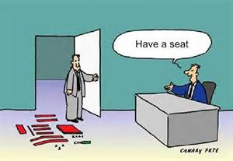
On the other side of the coin…
Micro-affirmations: hard to see acts, small, often unconscious but very effective
Two interview scenarios…but first…an interview joke:
Notes:
Read the Affinity Bias Example:
Ross. H, & Rowe, M. (August 2008).
Imagine, for example, that you are conducting an
interview with two people, we’ll call them Sally and John. John reminds you of yourself when you were younger, or of someone you
know and like. You have that sense of familiarity or “chemistry.” You instantly like him, and though you are not aware of why, your
mind generates justifications. (“He seems like a straightforward kind of guy. I like the way he ‘holds’ himself.”) You ask him the first
interview question and he hems and haws a bit. After all, it’s an interview. He’s nervous. Because you feel an affinity toward him, you pick up on his nervousness. You want to put him at ease. You say, “John, I know it’s an interview, but there’s nothing to be nervous about. Take a breath and let me ask the question again.” John nails it this time and he’s off and running to a great interview. The whole interaction took four seconds, yet it made a world of difference.
Then you sit down with Sally. There is nothing negative about her, just no real connection. It is a very “business-like” interaction. You
ask her the first question and she’s a little nervous too, but this time you don’t pick up on it. This interview moves forward, but not
quite as well as John’s. The next day a co-worker asks you how the interviews went, and you respond: “John was great…open, easy
to talk to. I think he’ll be great with staff and clients.” And your reply about Sally? “She’s okay, I guess.” Your perceptions about the
interviews constitute your reality. You probably don’t even remember the four-second interaction that changed John’s entire interview.
In fact, if somebody asks you, you would swear you conducted the interviews exactly the same way with the same questions. Your own
role in influencing the outcomes was completely invisible to you, driven by your background of comfort with John.
FROM: CDO Insights
Micro affirmations: Apparently small acts, which are often ephemeral and hard to see, events that are public and private often unconscious but VERY Effective which occur wherever people wish to help others succeed.

Slide 10
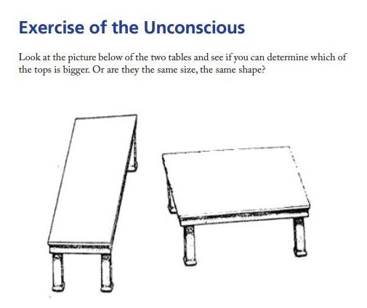
Notes:
The example of micro affirmations gets us to unconscious bias. Look at this example. The tables are the same size but look very different based on perspective.
Ross. H, & Rowe, M. (August 2008). : To get us started on unconscious bias, let’s talk about some examples: “Less than 15% of American men are over 6 foot tall. Yet, 60% of corporate CEOs are over 6 foot tall. Less than 4% of American men are over six foot two and 36% of corporate CEO’s are over six two. Do they say, “Get us a tall guy!” NO!
Similar patterns are true for generals and admirals and Presidents of the US.
“Seems unfair to choose a CEO based on height just as it is unfair to give employees lower performance evaluations because they are overweight. Or to prescribe medical procedures to people more often because of their race, or treat the same people different ways because of their clothing, or to call on boys more often than girls when they raise their hands, and yet all of these things are continually happening.”
Organizational Unconscious: What does the organization hold as important? Who gets promoted? How? Etc. Conversation.

Slide 11
Examples on Search Committees where we see unconscious bias…
Saying someone is just “not a good fit.”
“Merits,” “Qualifications”
Non-traditional candidates
Veteran candidates / transferable skills

Slide 12
Ways to Combat Hidden Bias:
Reframe the conversation to discuss fairness, not “protected classes”
Review every aspect of the employment life cycle for hidden bias: Screening, interviewing, onboarding…
Support projects that encourage positive images of persons of color, LGBT, veterans, and other social identity groups on campus
Conduct anonymous employee surveys
Say it! If you think something is preferential, say it. Be respectful but be open.
Think outside the box: Non-traditional candidates, transferable skills etc.
Notes:
Invite the group to brainstorm more ideas.

Slide 13
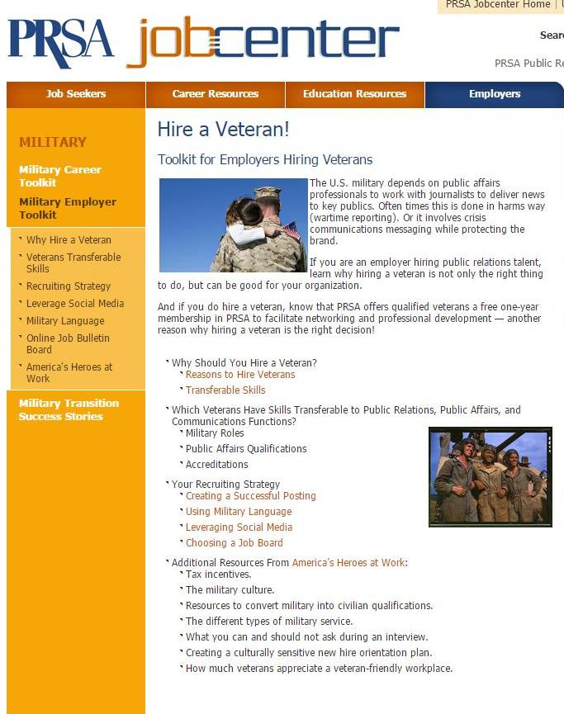
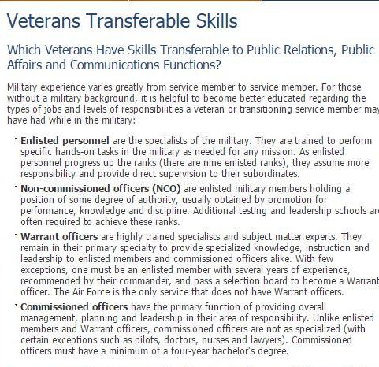
Advocacy Tools:
Transferable Skills for all Veterans:
Leadership
Commitment
Diversity
Practical Experience
Maturity and Focus
Schwartz, M. (September 15, 2014).
Notes:
-Many resources for Military to Civilian Transferable skills tools. This is good for vets to use, but also employers to use.
-Language: It is important for military to learn how to put their skills into civilian terms but ALSO important that employers can look at a resume and understand how skills can transfer even in non-traditional candidates
-Understanding military classifications: Enlisted, Non-Commissioned etc.

Slide 14
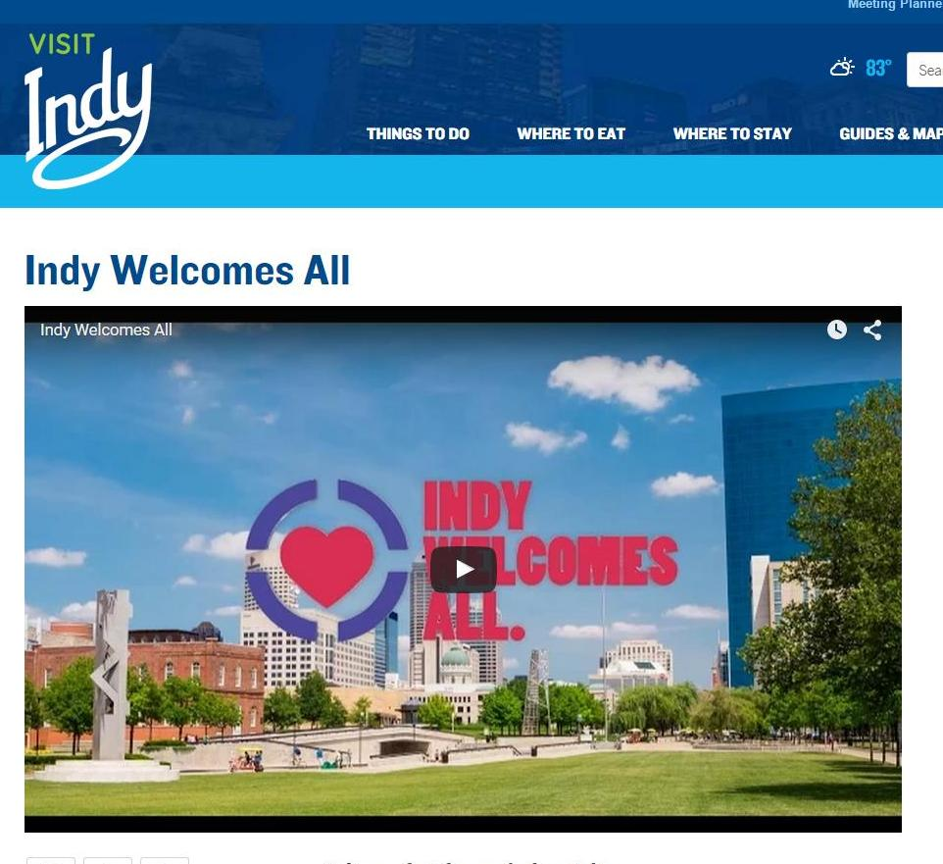
On Campus Interviewing and Onboarding:
Affinity groups
Cultural aspects and events around Indy
Places to live
Things to know
Surviving v. Thriving
Notes:
-Visit Indy gives out free brochures and materials. Even in on campus interviews, these are great to hand out so candidates can learn about Indy.
-Find out information that candidate is interested in and send resources
-Talk about the difference between surviving and thriving as a member of an underrepresented or otherwise oppressed group in higher education. DISCUSS.

Slide 15
On the Search Committee:
Develop Search Committee Code of Ethics, evaluate practices such as looking on candidate’s social media…ethical or non-ethical?
You as the EIA Advocate should not be the only one asking Diversity questions, make a plan beforehand
In assessing answers to Diversity questions, consider things such as: Did they use inclusive language, did they address all members of the committee when answering?
Recognize language of unconscious bias
Keep in mind the Levels of Intercultural Sensitivity
Questions?
Notes:
-These are suggestions only…things to think about
-Code of Ethics, we do have examples if anyone is interested.
-Diversity Questions: Again, we have examples
-What sort of questions do EIA advocates have, what things to you think you will see? Perhaps discuss how to handle certain situations.
-Also DISCUSS here what NOT to do. Ways to lose credibility on search committees.

Slide 16
Next Steps…
Implementation, Thoughts, Fears??
Continued trainings
Use the TEAM as a resource

Slide 17

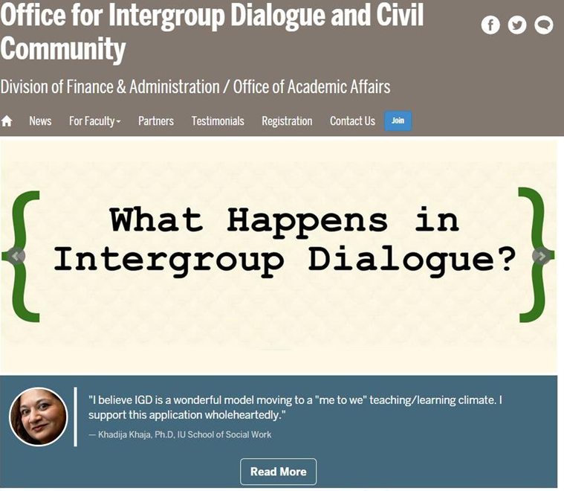

Find and Follow Us…
Intergroup Dialogue at IUPUI
@JagDialogue
Notes:
Shameless Plug

Slide 18
Contact Us:
Alice Hoenigman Jones, ahoenigm@iupui.edu
Amanda L. Bonilla, abonilla@iupui.edu

Slide 19
References:
  Kayes, P. (Winter, 2006). New paradigms for diversifying faculty and staff in higher education: Uncovering cultural biases in the search and hiring process. Diversity Works. Retrieved from: http://files.eric.ed.gov/fulltext/EJ759654.pdf
  Sue et al. (May-June 2007). Racial micro aggressions in everyday life. American Psychologist. Vol. 62, #4. Retrieved from: http://world-trust.org/wp-content/uploads/2011/05/7-Racial-Microagressions-in-Everyday-Life.pdf
  Ross. H, & Rowe, M. (August 2008). Proven strategies for addressing unconscious bias in the workplace. CDO Insights. Vol. 2, Issue 5. Retrieved from: http://www.cookross.com/docs/UnconsciousBias.pdf
  Schwartz, M. (September 15, 2014). Five transferable skills for veterans. Kaplan test prep. Retrieved from: http://gre.kaptest.com/2014/09/15/5-transferable-skills-for-veterans-going-back-to-grad-school/
  (June 2011). Guidelines for recruiting a diverse workforce. North Carolina State University, Office for Institutional Equity and Diversity. Retrieved from: http://oied.ncsu.edu/oied/hiring/OEO_Recruitment_Guidelines.pdf
  Lester, P. (January 2001). The hazing of academic job applicatnts: the applicant bill of rights. Chronicle of Higher Education. Archives. Retrieved from: http://chronicle.com/article/A-Bill-of-Rights-for-Job/21222/

