Slide 1
SCHOOL OF SOCIAL WORK
Predicted Mental Illness of Asian-American amid the COVID-19 Pandemic & Approaches to Treatment
Saahoon Hong & Betty Walton
Indiana University School of Social Work
Cultural Competency Conference:
Policy, Practice & Innovation in Mental Health & Addiction
May 19, 2021

Slide 2
Behavior Health Issues among Asian Americans

Slide 3
COVID 19-Related Stressors
-Loss of their loved one
-Illness
-Economic hardship
-Suicide Ideation
-Anxiety
-Depression
-Substance use

Slide 4
Racial Discrimination and Harassment against Asian Americans (H-L, 2020)
-Verbal assault
-Property vandalism
-Coughing on
-Physical assault

Slide 5
Behavioral Health Issues among Asian Americans (Vines et al., 2017; Hunte & Barry, 2012; Yoo et al., 2009)
-Somatic symptoms
-Smoking, drinking, and illicit drug use
-Anxiety, depression, distress, and substance

Slide 6
Indiana Study

Slide 7
Predicted Mental Illness on the Adults Needs and Strengths Assessment in 2019 and 2020

Slide 8
Research Questions
To identify the effect of the pandemic on the behavioral health service utilization during the pandemic by a machine learning method
To examine predictors that distinguished Asian Americans and non-Asian Americans by utilizing Indiana Adult Needs and Strengths Assessment (ANSA) data.

Slide 9
Method
Participants. Participants, aged 18 and above, were eligible for Medicaid and all of them enrolled in the state-funded mental health and addiction services.
Predictors. The Adult Needs and Strengths Assessment (ANSA) items in the six domains: (1) strengths, (2) life functioning, (3) cultural factors, (4) caregiver needs and resources, (5) behavioral health needs, and (6) risk behaviors.
Analysis. Chi-square automatic interaction detection (CHAID), a machine learning-based data mining algorithm, was applied to detect the race-specific associations among ANSA items. CHAID is a data mining algorithm used for building decision trees by detecting structural linkages among predictors

Slide 10
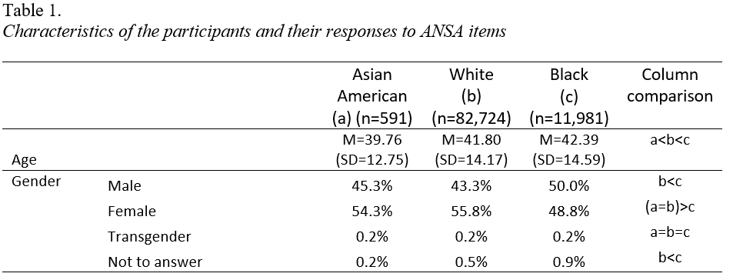

Slide 11
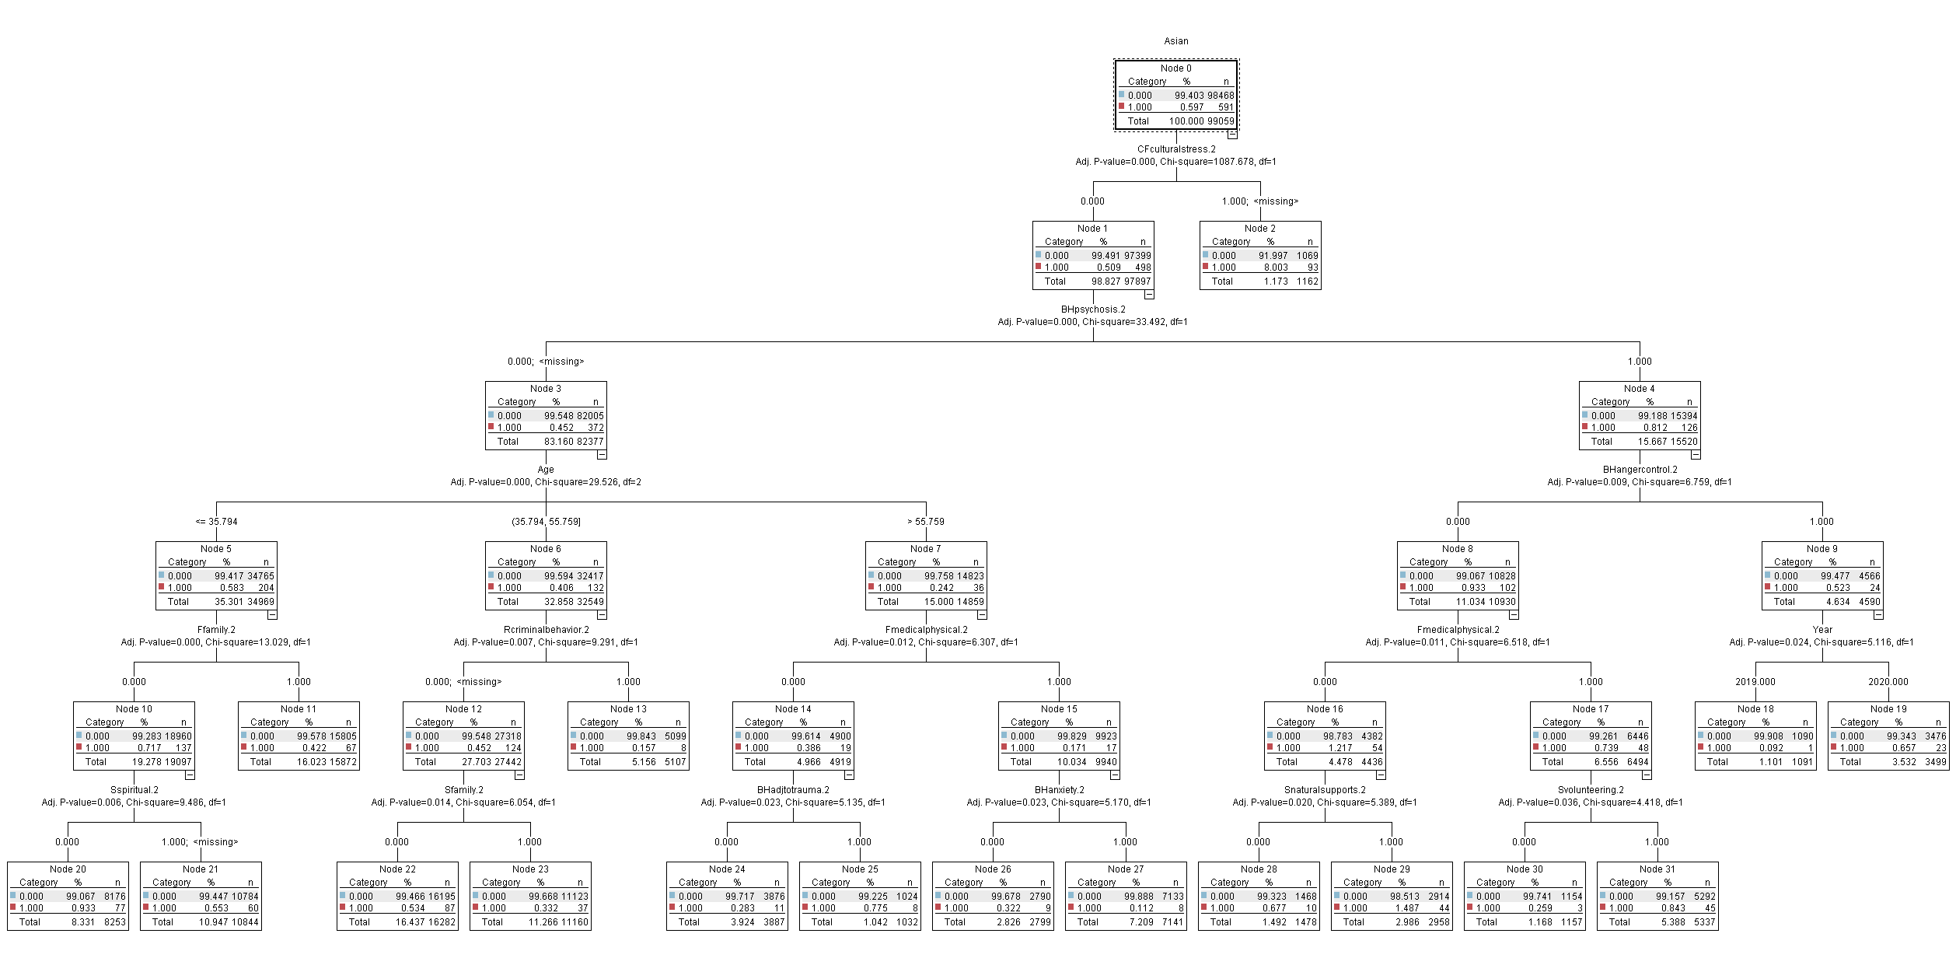

Slide 12
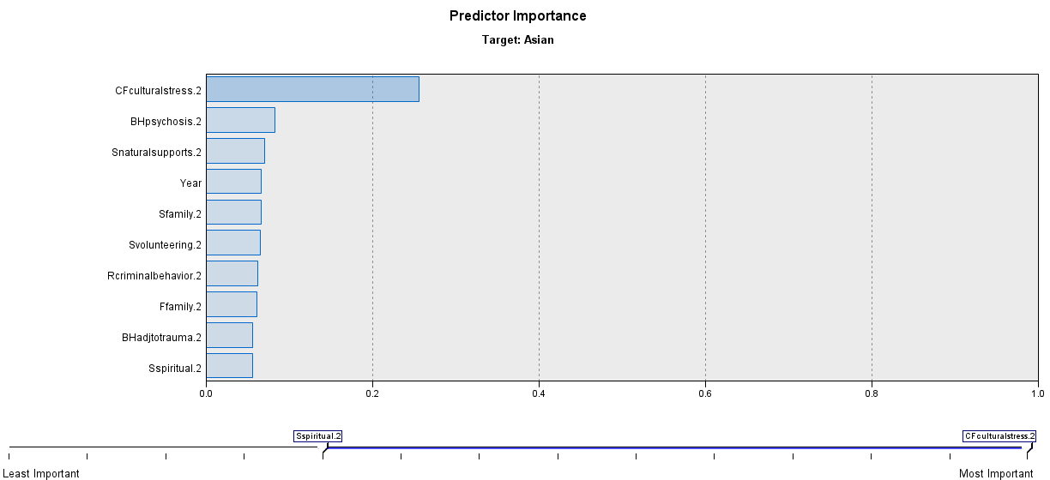
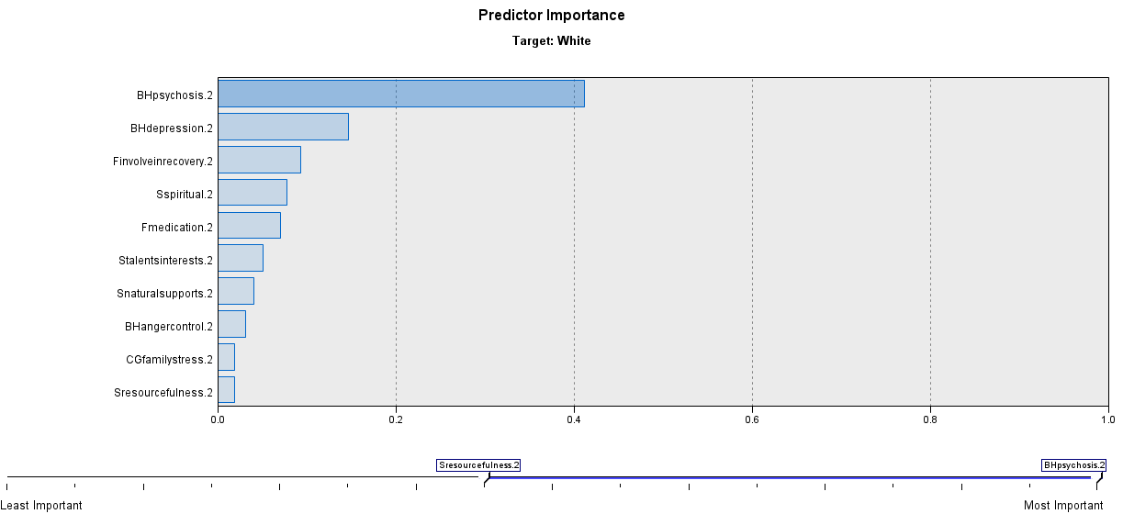

Slide 13
Results
-Asian Americans faced a higher risk for mental illness in the shadow of the COVID-19 pandemic.
-Pandemic-related cultural stress was the most significant predictor in the analysis.
-This significant predictor was different from the results for White and Black.
In summary, Asian Americans and their mental health states were more likely to get influenced by the COVID-19 pandemic and pandemic-related stressors.

Slide 14
Culturally Competent Approaches to Asian-American Community

Slide 15
Culturally Responsive & Respectful Care
Cultural Humility
A cultural humility perspective challenges us to learn from the people with whom we interact, reserve judgment, and bridge the cultural divide between our perspectives, in order to facilitate well-being and promote improved quality of life.
Culturally Responsive Care
The ability to learn from and relate respectfully to people from your own and other cultures.
Notes:
Culturally Responsive care also plays a role as the ability to learn from people from diverse cultural backgrounds.
It is strongly believed that “Personal change” is based on a deeper understanding of one’s own culture, values and history.

Slide 16

What are the most frequent questions that you ask a client with cultural diversity?
Notes:
What are the most frequent questions that you ask a client with cultural diversity? (Could you select all that apply)
The question is originated from the Washington state department of Children, youth, and family’s infographics of cultural diversity.
POLL. What are the most frequent questions that you ask a client with cultural diversity? (select all that apply)
1. Have you ever been treated poorly because of your ethnicity, race or beliefs? If so, in what ways?
2. Have people made incorrect assumptions about you or your family in a way that’s caused problems?
3. What spiritual or religious beliefs are important to you and your family, and how do they impact day-to-day life?
4. Does your culture have a perspective on receiving counseling or mental health therapy?
5. What do you do and who do you turn to for help when your family has needs or troubles?
6. How does your culture help with coping from anxiety, sadness or other troubles?
Source.
https://www.dcyf.wa.gov/sites/default/files/pdf/CulturallyResponsiveQuestions.pdf (Washington State Department of Children, Youth & Families).
https://counseling.online.wfu.edu/blog/10-diversity-questions-counselors-ask/

Slide 17
What are the most frequent questions that you ask a client with cultural diversity? (select all that apply)
1. Have you ever been treated poorly because of your ethnicity, race or beliefs? If so, in what ways?
2. Have people made incorrect assumptions about you or your family in a way that’s caused
problems?
3. What spiritual or religious beliefs are important to you and your family, and how do they impact
day-to-day life?
4. Does your culture have a perspective on receiving counseling or mental health therapy?
5. What do you do and who do you turn to for help when your family has needs or troubles?
6. How does your culture help with coping from anxiety, sadness or other troubles?
    Source. https://counseling.online.wfu.edu/blog/10-diversity-questions-counselors-ask/
Notes:
Source.
https://www.dcyf.wa.gov/sites/default/files/pdf/CulturallyResponsiveQuestions.pdf (Washington State Department of Children, Youth & Families).
https://counseling.online.wfu.edu/blog/10-diversity-questions-counselors-ask/

Slide 18
Implications for Practice
Consider culture (cultural identity, values, beliefs, experiences):
Engagement
Communication
Accommodations – access to services (Language, Traditions, Cultural Stress)
Collaborative assessment and consensus based planning
Involvement in recovery

Slide 19

Notes:
So I’m going to stop this presentation and will start questions. ….
Indiana study is one example showing what cultural-related research in behavioral health services looks like, how we think about actions and community engagement, and the role that the service provider can play....
We have heard about the under-representation of Asian-Americans in behavioral health services.
As we see, there is a growing number of Asian-Americans who were struggling with cultural stress.
As we all agree, Changes can only take place when we start to acknowledge the relationship between cultural-specific stressors and behavioral health needs.

Slide 20


Acknowledgement
This study was developed through a collaborative effort
by the
IU School of Social Work
and
DMHA

Slide 21
REFERENCE
Cheng H-L. Xenophobia and Racism Against Asian Americans During the COVID-19 Pandemic: Mental Health Implications. Journal of Interdisciplinary Perspectives and Scholarship. 2020;3(1):3.
Hunte HE, Barry AE. Perceived discrimination and DSM-IV-based alcohol and illicit drug use disorders. Am J Public Health. 2012;102(12):e111-117.
Vines AI, Ward JB, Cordoba E, Black KZ. Perceived Racial/Ethnic Discrimination and Mental Health: a Review and Future Directions for Social Epidemiology. Curr Epidemiol Rep. 2017;4(2):156-165.
Yoo HC, Gee GC, Takeuchi D. Discrimination and health among Asian American immigrants: disentangling racial from language discrimination. Soc Sci Med. 2009;68(4):726-732.

Slide 22
Contact Information
Saahoon Hong, Ph.D.
Assistant Research Professor
saahong@iu.edu
Betty Walton, Ph.D.
Associate Research Professor
Indiana University School of Social Work
beawalto@iu.edu
INDIANA UNIVERSITY SCHOOL OF SOCIAL WORK

