Slide 1
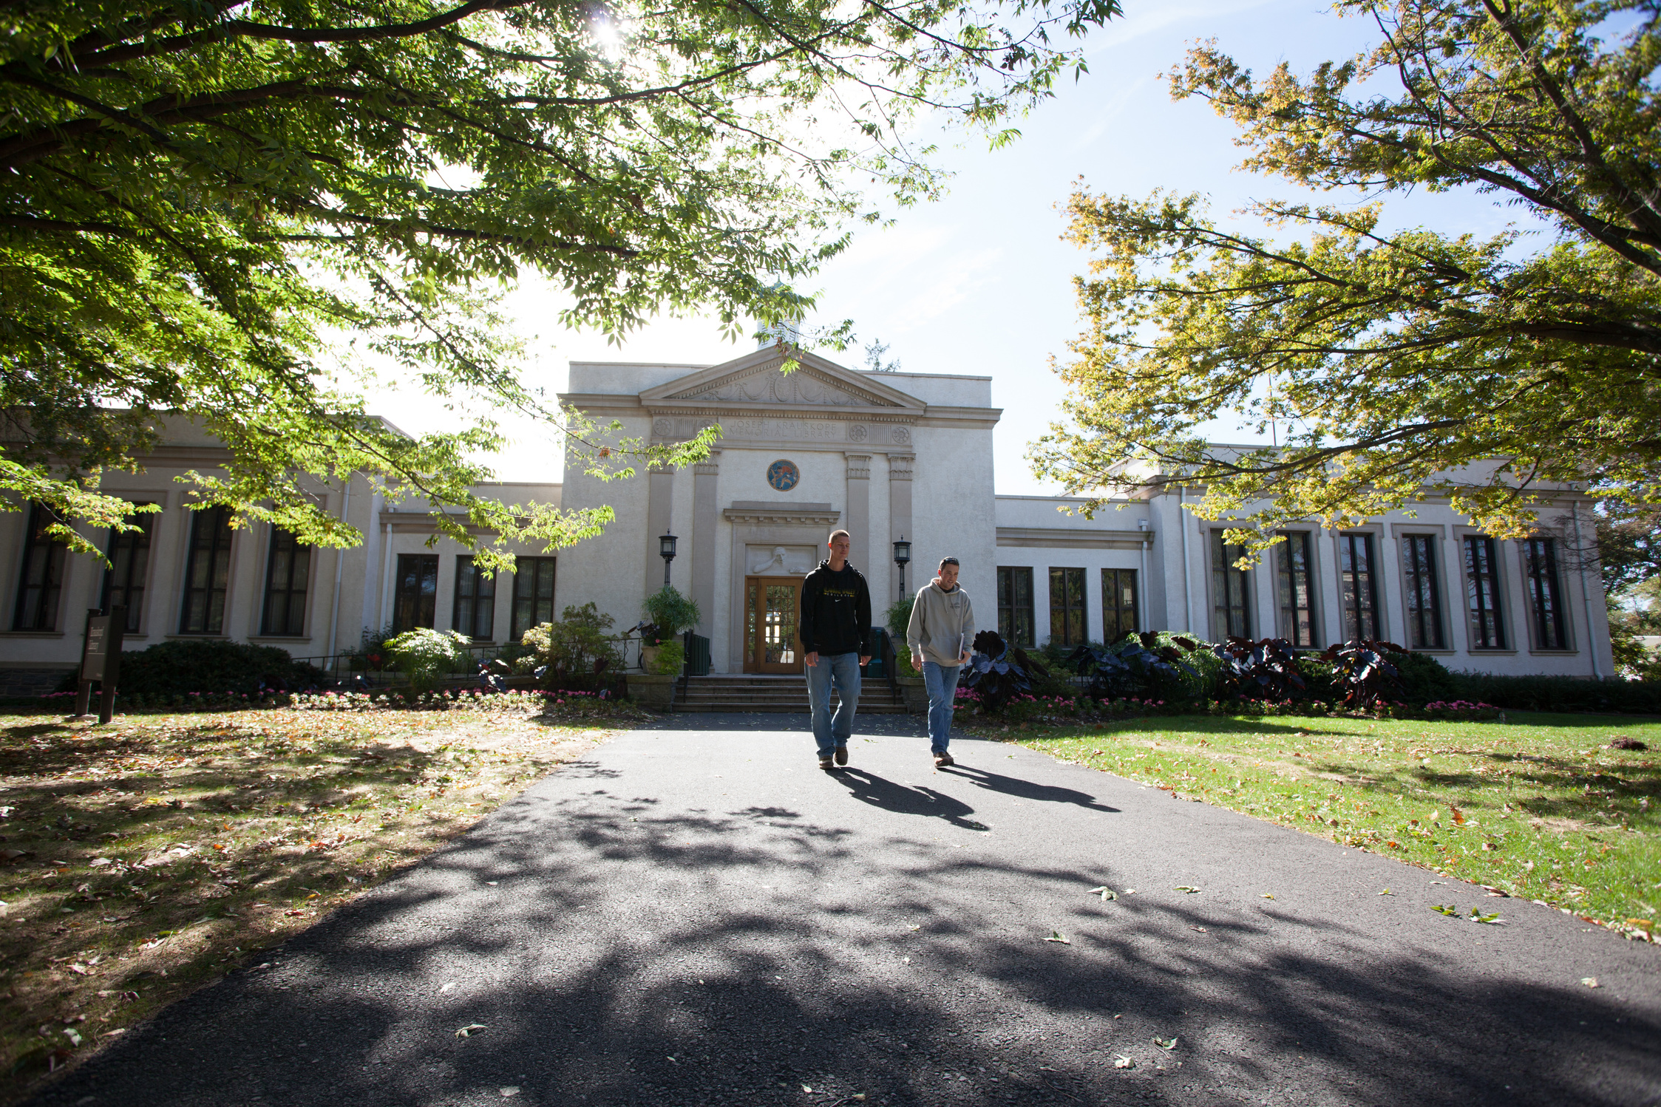

RAISE THE BAR
They Can Reach It! Students in Library Leadership
Presented by
Claire Drolet, MLS
Access Services Librarian at Delaware Valley University, 2024

Slide 2
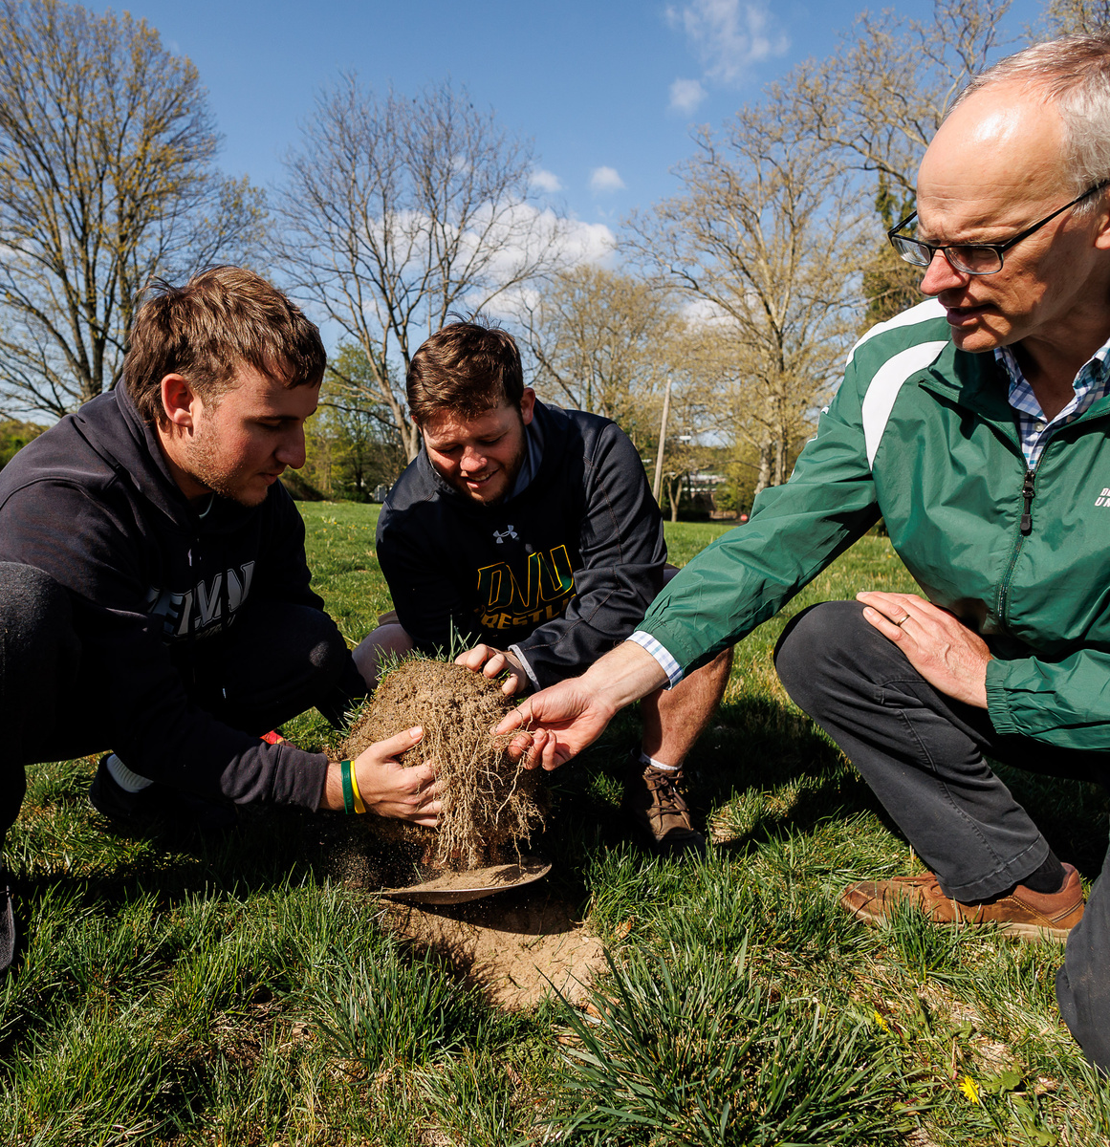

Dr. Doug Linde examines
turfgrass with his students (2023)
“Science with Practice” / Experiential Learning
~2200 FTE, 14:1
Animal Science, Small Animal Science,
Conservation and Wildlife Management,
Biology, Zoo Science
5 FT Faculty Librarians
20-24 student library assistants annually

Slide 3




OVERVIEW
Shifting Perspectives
Key Steps
Task Master to Mentor
Documentation, Communication, Consultation
Learning from Teaching
Reflective Cycles
Applying classroom & professional experience
Progress, not perfection

Slide 4




TASK MASTER
MENTOR
What makes a ‘good’ boss? Am I one?
#millenialmanager journey
Mental, emotional, philosophical shift and balance; relationship-based
Caring for young people, guiding them through formative years
What can I teach them? How can I invest in them? How can I prepare them?
How can I make this a safe, learning environment?
Gilligan’s Ethics of Care
Shifting Perspectives

Slide 5

Difficult to balance being a friend & boss & mentor
Caring for them means choosing to get close to them... things can get really personal and emotional. Well beyond anything library related.
Sadly, you can’t reach everyone...
Strategies I employ:
  vary managerial style by student (tailored approach)
  always have an open door, but it’s a choice to walk through it
  regular overtures, check ins, and communication
  those who need you ‘more’ will gravitate toward you when they are ready
THIS IS HARD

Slide 6

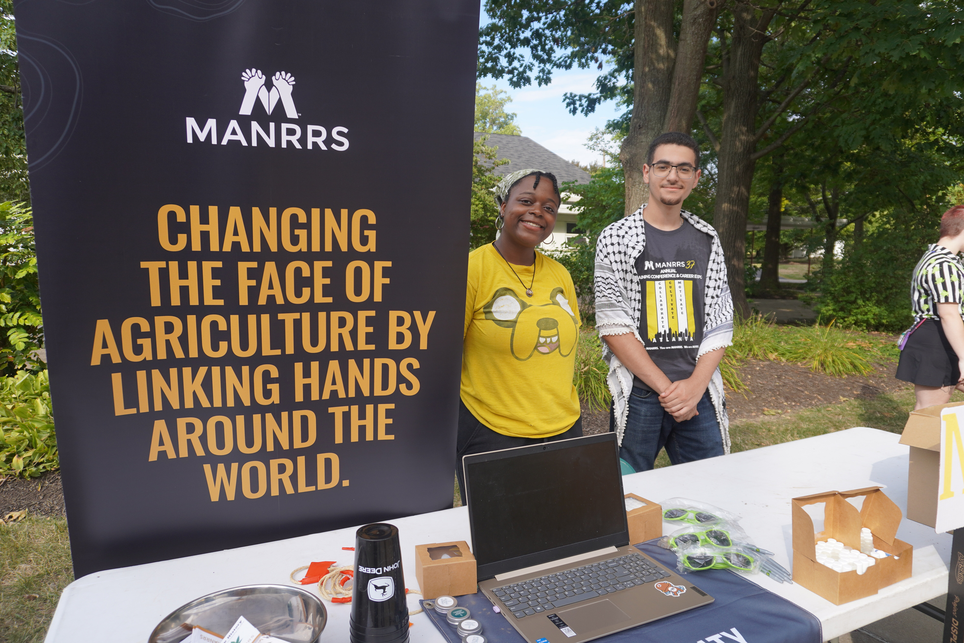



The DelVal First-Year Experience
  PART 1
    Orientation - resource navigation, places, campus tech
    Integration - peer mentors, clubs, events, departments
    Organization - how to network, policies, academic success
    Foundation - personal integrity, solution-focused thinking, campus citizenship, everyday leadership, culture and diversity
  PART 2
    Experiential Learning, Teamwork and Groups
    Academic Research & Plagiarism
    Professional Skills (NACE)
    Resume, Cover letters, Career Research and Exploration, Networking, Interviewing, Professional Development, Skill Verbalization
MANRRS Club
Signup Table, 2024
Learning by Teaching

Slide 7
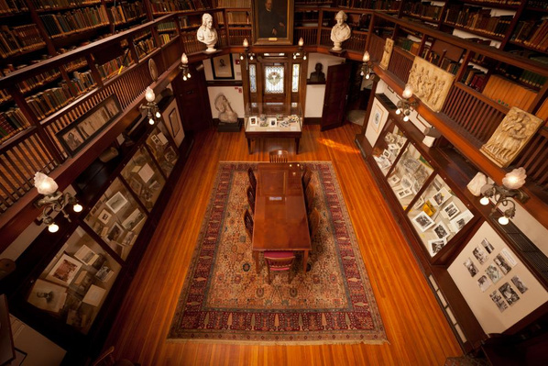
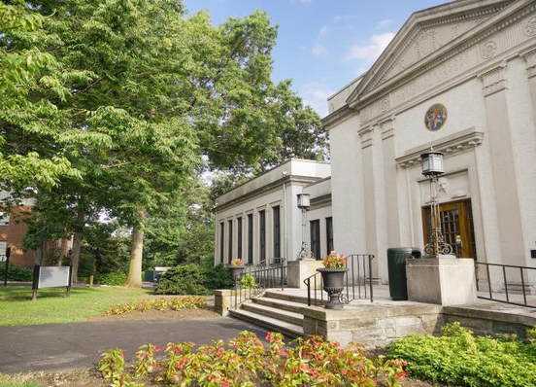
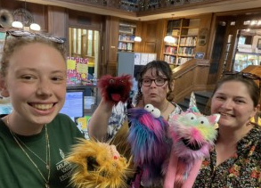
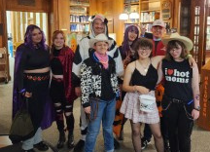

KRAUSKOPF MEMORIAL LIBRARY
M-TH 7a-10p, F 7a-8p, Sat 11a-6p, Sun 2p-10p
5 FT Faculty Librarians, 21 student staff
ONE circulation / service desk
Post-COVID, lost 2 paraprofessionals (aka night and weekend student supervision!). Ups and downs, took a while to get it right.
Now have an elite team of 8 Student Supervisors and 13 Student Assistants
DelVal Students & Library, 2023
Key Steps
@delvallibrary on Instagram!

Slide 8
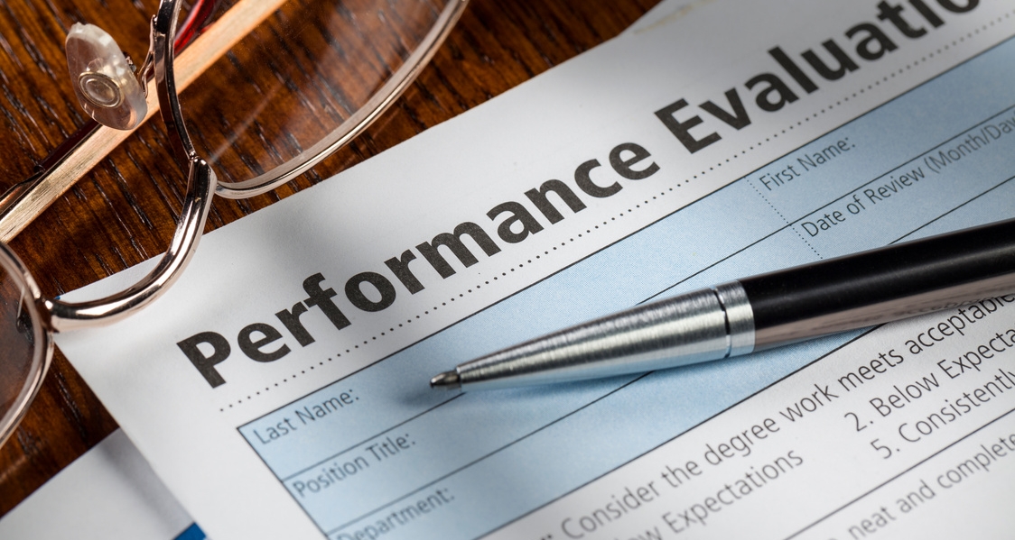


DOCUMENTATION
Job Description(s)
Contract
What they’ll do, and what they’ll learn.
Very clear expectations - make explicit what you think is implicit.
Evaluations
Important feedback tool for them and for you!
Notes:
Job Desc. = value add, what can they put on their resume? precise expectations on hours, times, rate, physical activity
Contract: dress code, conversation, homework, what happens 'if'... including disciplinary procedures. Get HR involved on best practice for this. Revise / resign annually, helps to reinforce.
Evals - give them plenty of room to reflect on themself and you. What do they want, need, from you to succeed? What else are they interested in? you could come up with new projs. this way. Great annually, but there are things you can't ignore till once a year, so keep your door open, observe, and reach out regularly. New idea to use this as a way to help them connect what they’ve learned at the library to what they will use in future jobs.

Slide 9



(MORE) DOCUMENTATION
To-Do and How-To
MIX MEDIUMS!
Step-by-step for just about everything.
Ask “What is the easiest way to digest this information?” Be flexible!
Training
Peer-to-Peer with follow-ups and retraining
Notes:
To Do - daily, shiftly, weekly, supers vs. LAs. Gives them a run down of what they need to do each shift, with the autonomy of how and when to do it. Recently started using MS tasks to help with signaling.
How To - if it's documented, it means everyone can do it. No specialized knowledge required! Gives everyone a chance to learn something knew and avoids knowledge-loss as students rotate out. If it can't be easily documented, I have think if that's something I really want my students to do. helps me differentiate between responsibility levels - see chart next!
Training - peer to peer, mostly, with my checklist (consistency) and checkins (1-on-1).
Mixed Mediums - libwizard tutorial? video? one-page typed? quiz? hands-on? I stay flexible and try to provide multiple mediums for learning styles.

Slide 10
DELVAL LIBRARY ASSISTANT JOB CHART
Student Library Assistant (all) | Student Library Supervisor (all+) | Librarians ONLY (all++)
Assist and communicate with patrons Handle walk-in, telephone, text and email questions / requests Troubleshoot library computers, printers and scanners Remind patrons of upcoming closing times Track hourly and daily statistics of visitors and interactions Process circulation transactions in the online circulation system Check-outs, check-ins Renewals and reserves Maintain physical collections and spaces Shelve materials Tidy-up shelved items and patron spaces Inventory sections of the collection Assist in processing withdrawn and newly added items Assist Librarians and Student Library Supervisors in various projects, including but not limited to: Display and social media content curation Shifting and relocating collections Checking holdings against reports Searching for lost, missing, claimed-returned items | Monitor Library Report issues to Access Services Librarian (ASL), Library Director (LD) and Student Library Supervisors (SLS) as needed Oversee the Library nights & weekends, communicate & enforce policy with patrons Supervise Library Assistants Train Library Assistants (LA) and retrain as needed Remind LAs of policies, rules, and resources (not discipline). Report repeat behavior to ASL Delegate tasks to LAs Maintain Collections Shelf-read to maintain shelf-order. Run reports and inventory, act on lost and missing items, report progress to ASL. Promote Library Coll., Spaces, Services Display curation and maintenance for library display shelves Social media content curation (Instagram, TikTok, and Facebook) Coordinate with other LAs, SLSs, and ASL to plan and stagger content / events throughout the school year Other BASIC research guidance for patrons –Refer complex research questions and requests to a Librarian. | The ASL directly manages all students, including: Disciplinary Action Yearly Reviews Advanced Training Special Patron Services Assessing and Waiving Patron Fines Adding and Removing Patron Records Adding / Removing privileges for Alumni and the Public Faculty & Staff Inquiries – reserves, ILL, team study halls, space booking, etc. Bibliographic Actions Purchasing decisions and adding to collection Withdrawing decisions and removing from collection Reclassifying collections, items and locations Phys / Digi Collection Assessment Social Media and Calendar Management Posting alerts, service changes, etc. on website and posting on social media accounts Research FULL research sessions with students Troubleshooting Tech Databases, Circ Computer, etc. major things that LAs can’t do.
Notes:
Previously I made the mistake of NOT clearly defining the roles and duties, and so it became a sort of Oprah moment where I was just throwing the supervisor title at everyone. Now I have a very clear, progressive structure that helps everyone know what to pass up the chain.
The more distinguished nature of the super job comes with 8-10+ hours a week - most students usually only get 6-8 hrs a week. Can't differentiate pay, either, so how to give them more? why is it worth their while? Adding tasks for them that give them supervisory, task management, communication, critical thinking experience. Non-supers have a chance to participate and get that experience, but it’s the supers actual job to do it.

Slide 11
DELVAL LIBRARY ASSISTANT JOB CHART -> NACE
NACE | Student Library Assistant | Student Library Supervisor (extra!)
Career & Self Development | Information literacy and some self-taught skills required *working on additional professional development. | Self-efficacy and motivation to learn and do more in a supervisory role, helping other students develop their skills
Communication | Marketing/advertising around the library, connecting with peers and patrons | Handling a degree of tough conversations with peers, patrons, knowing when to triage to librarian / PS, etc.; developing appropriate Social Media
Critical Thinking | Display Curation, Information Literacy, problem solving | One Health Guide Curation, Interlibrary Loan
Equity & Inclusion | Display curation, generating ideas for events, signage, and changes in practice / policy, making all feel welcome and heard | Meeting students where they are, helping to train and triage, watching for patron and student insights to apply
Leadership | In the DelVal Student Community (visible role, elite team, civic leadership on campus) | Supervisor in charge, delegation and mentorship, crisis management (lite). *working on additional training
Professionalism | Customer service, appearing interested and available to help, managing tasks, meeting expectations | Being a role model and elevating their performance as ‘in charge’
Teamwork | Desk Functions (in pairs) and on Teams | Delegation, ensuring the job gets done together, ensuring library priorities are fulfilled
Technology | Tech Troubleshooting, Information Tech, basic office applications, etc. | Interlibrary Loan, Social Media, Canva

Slide 12
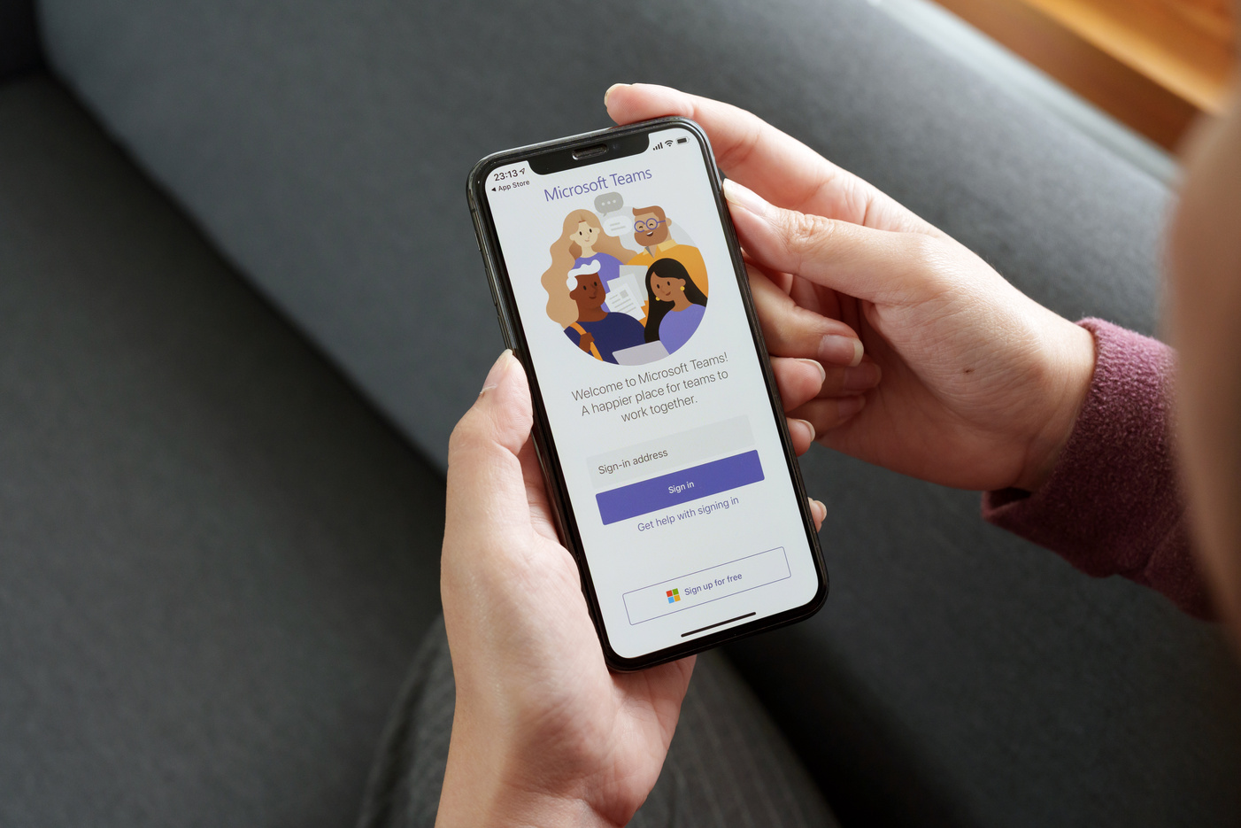


COMMUNICATION
MS Teams - using the right tool for the job!
Student Assistant Focus Groups
TAKE VISIBLE ACTION
Librarians & Other Departments
Notes:
LOTS of things to say about MS teams, but this is not an advertisement for microsoft. I have just found that using the right communication / collaboration tools can make all the difference. Students (in general) get a lot of email that they ignore, so I moved to a Teams platform several years ago. Makes it fast and easy to work as a team with little to no emails needed, and little to no texts, either. Lots of integrated tools. Encourages familiarity without forcing friendships and exchange of too much personal information. They may chat separately when they become friends, but this starts them off.
Student focus groups were HUGE for me. I did many of these over the years, consulting the students themselves on what they want out of the job, what problems they see, how could we do things better. Learned to do smaller groups rather than a large 'sage on the stage' situation, and 1on1s are nice but harder to track / see a pattern. In future, I will be trying to talk LESS and listen even MORE, asking them questions instead of telling them things and asking for them to respond. Need to show them I’m genuinely listening – and I will act on what I can. What I can’t act on, I am forthright with them about it.
Librarians & other campus personnel. Need support, buy-in, consistency, and consultation. Work out where the boundaries are. For instance, my colleagues tended not to tell my students to do anything out of respect for me, while the students themselves thought it was weird that only I asked them to do things. Think about the dynamic in your library. Is managing students a team effort, and what role does everyone play? Not just librarians - how can CSPD, the student employment office, or HR / Administration play a role? Knowing what I'm doing here has made others come to me for advice for their students as an excellent example.

Slide 13
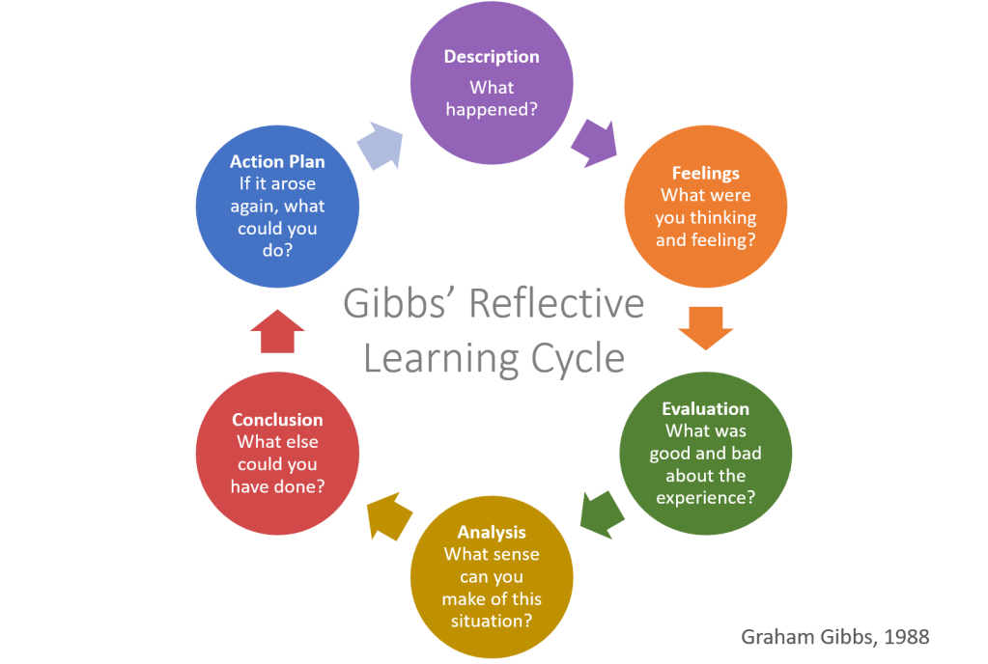

Reflective Cycles
Progress, not perfection!
  Used in FYE for students, applies well to employer & teacher concerns, too!
  Cyclical nature of hiring and graduation lends to a cyclical review, reassessment, and readjustment of employment program.
  Students and needs change often. Be flexible.
  Success comes in many forms, not all measurable.
  Every experience is a learning moment.
Reflective Cycles

Slide 14
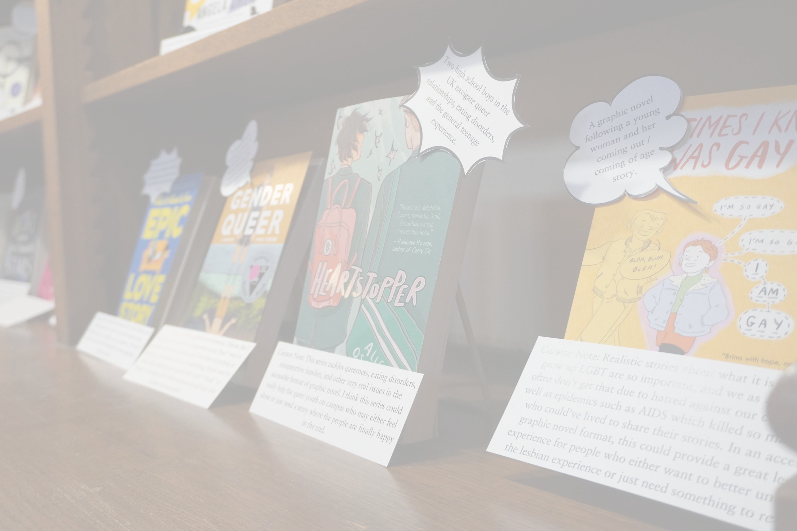
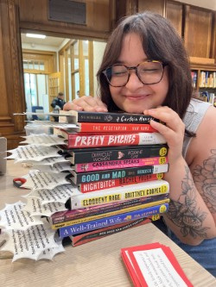
Our Successes!
Student Curator Project Initiation
Increasingly student-made book displays, social media, and signage
Well-run circulation desk - caring, capable and friendly staff!
Fast & thorough communication and coordination our among team.
Positive feedback and engagement in the library
Sense of pride and community on campus
They come back to visit and keep in touch!
Caroline Honsel ‘25 with her Student Curator Collection (2024)

Slide 15
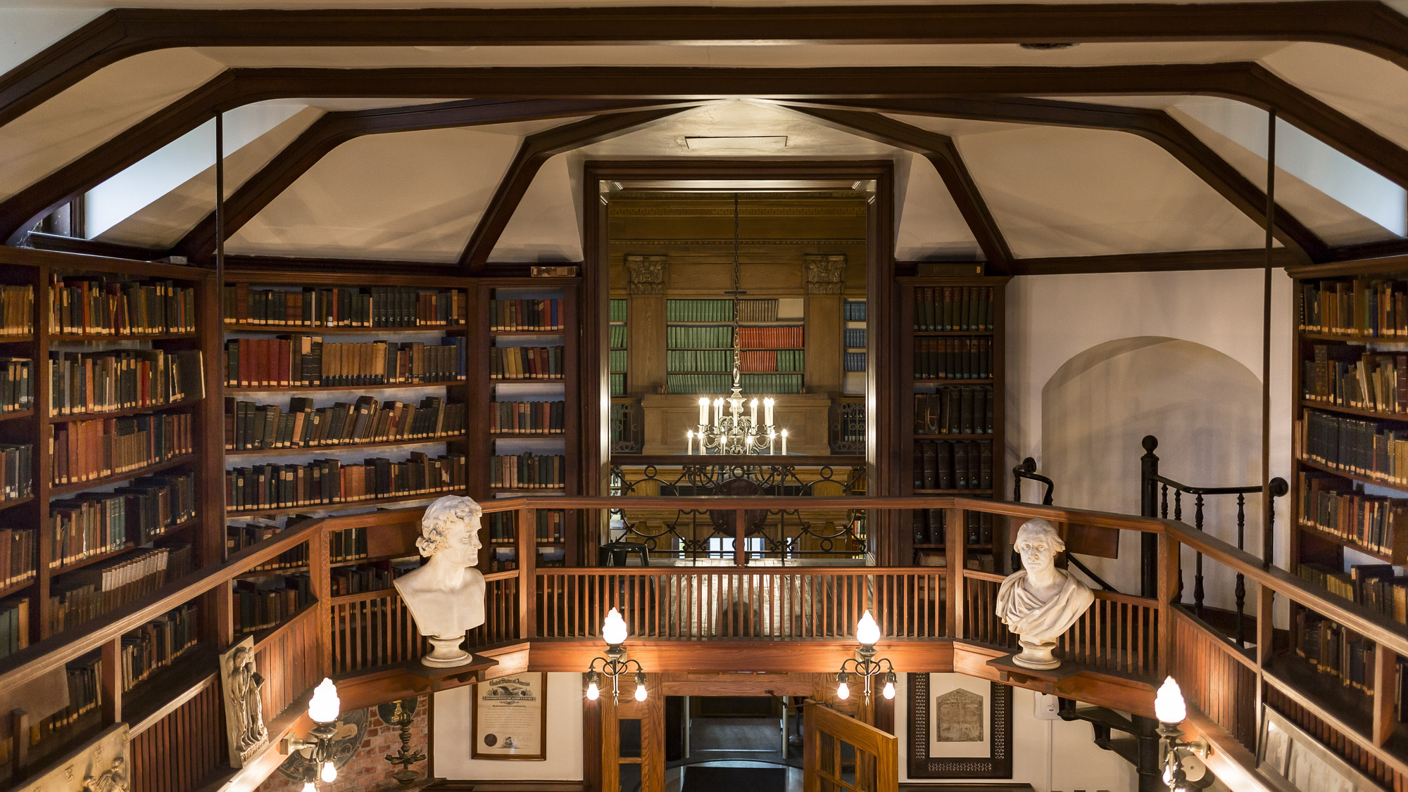
THANK YOU
https://www.linkedin.com/in/clairedrolet
Claire.Drolet@delval.edu
QUESTIONS?

