Slide 1
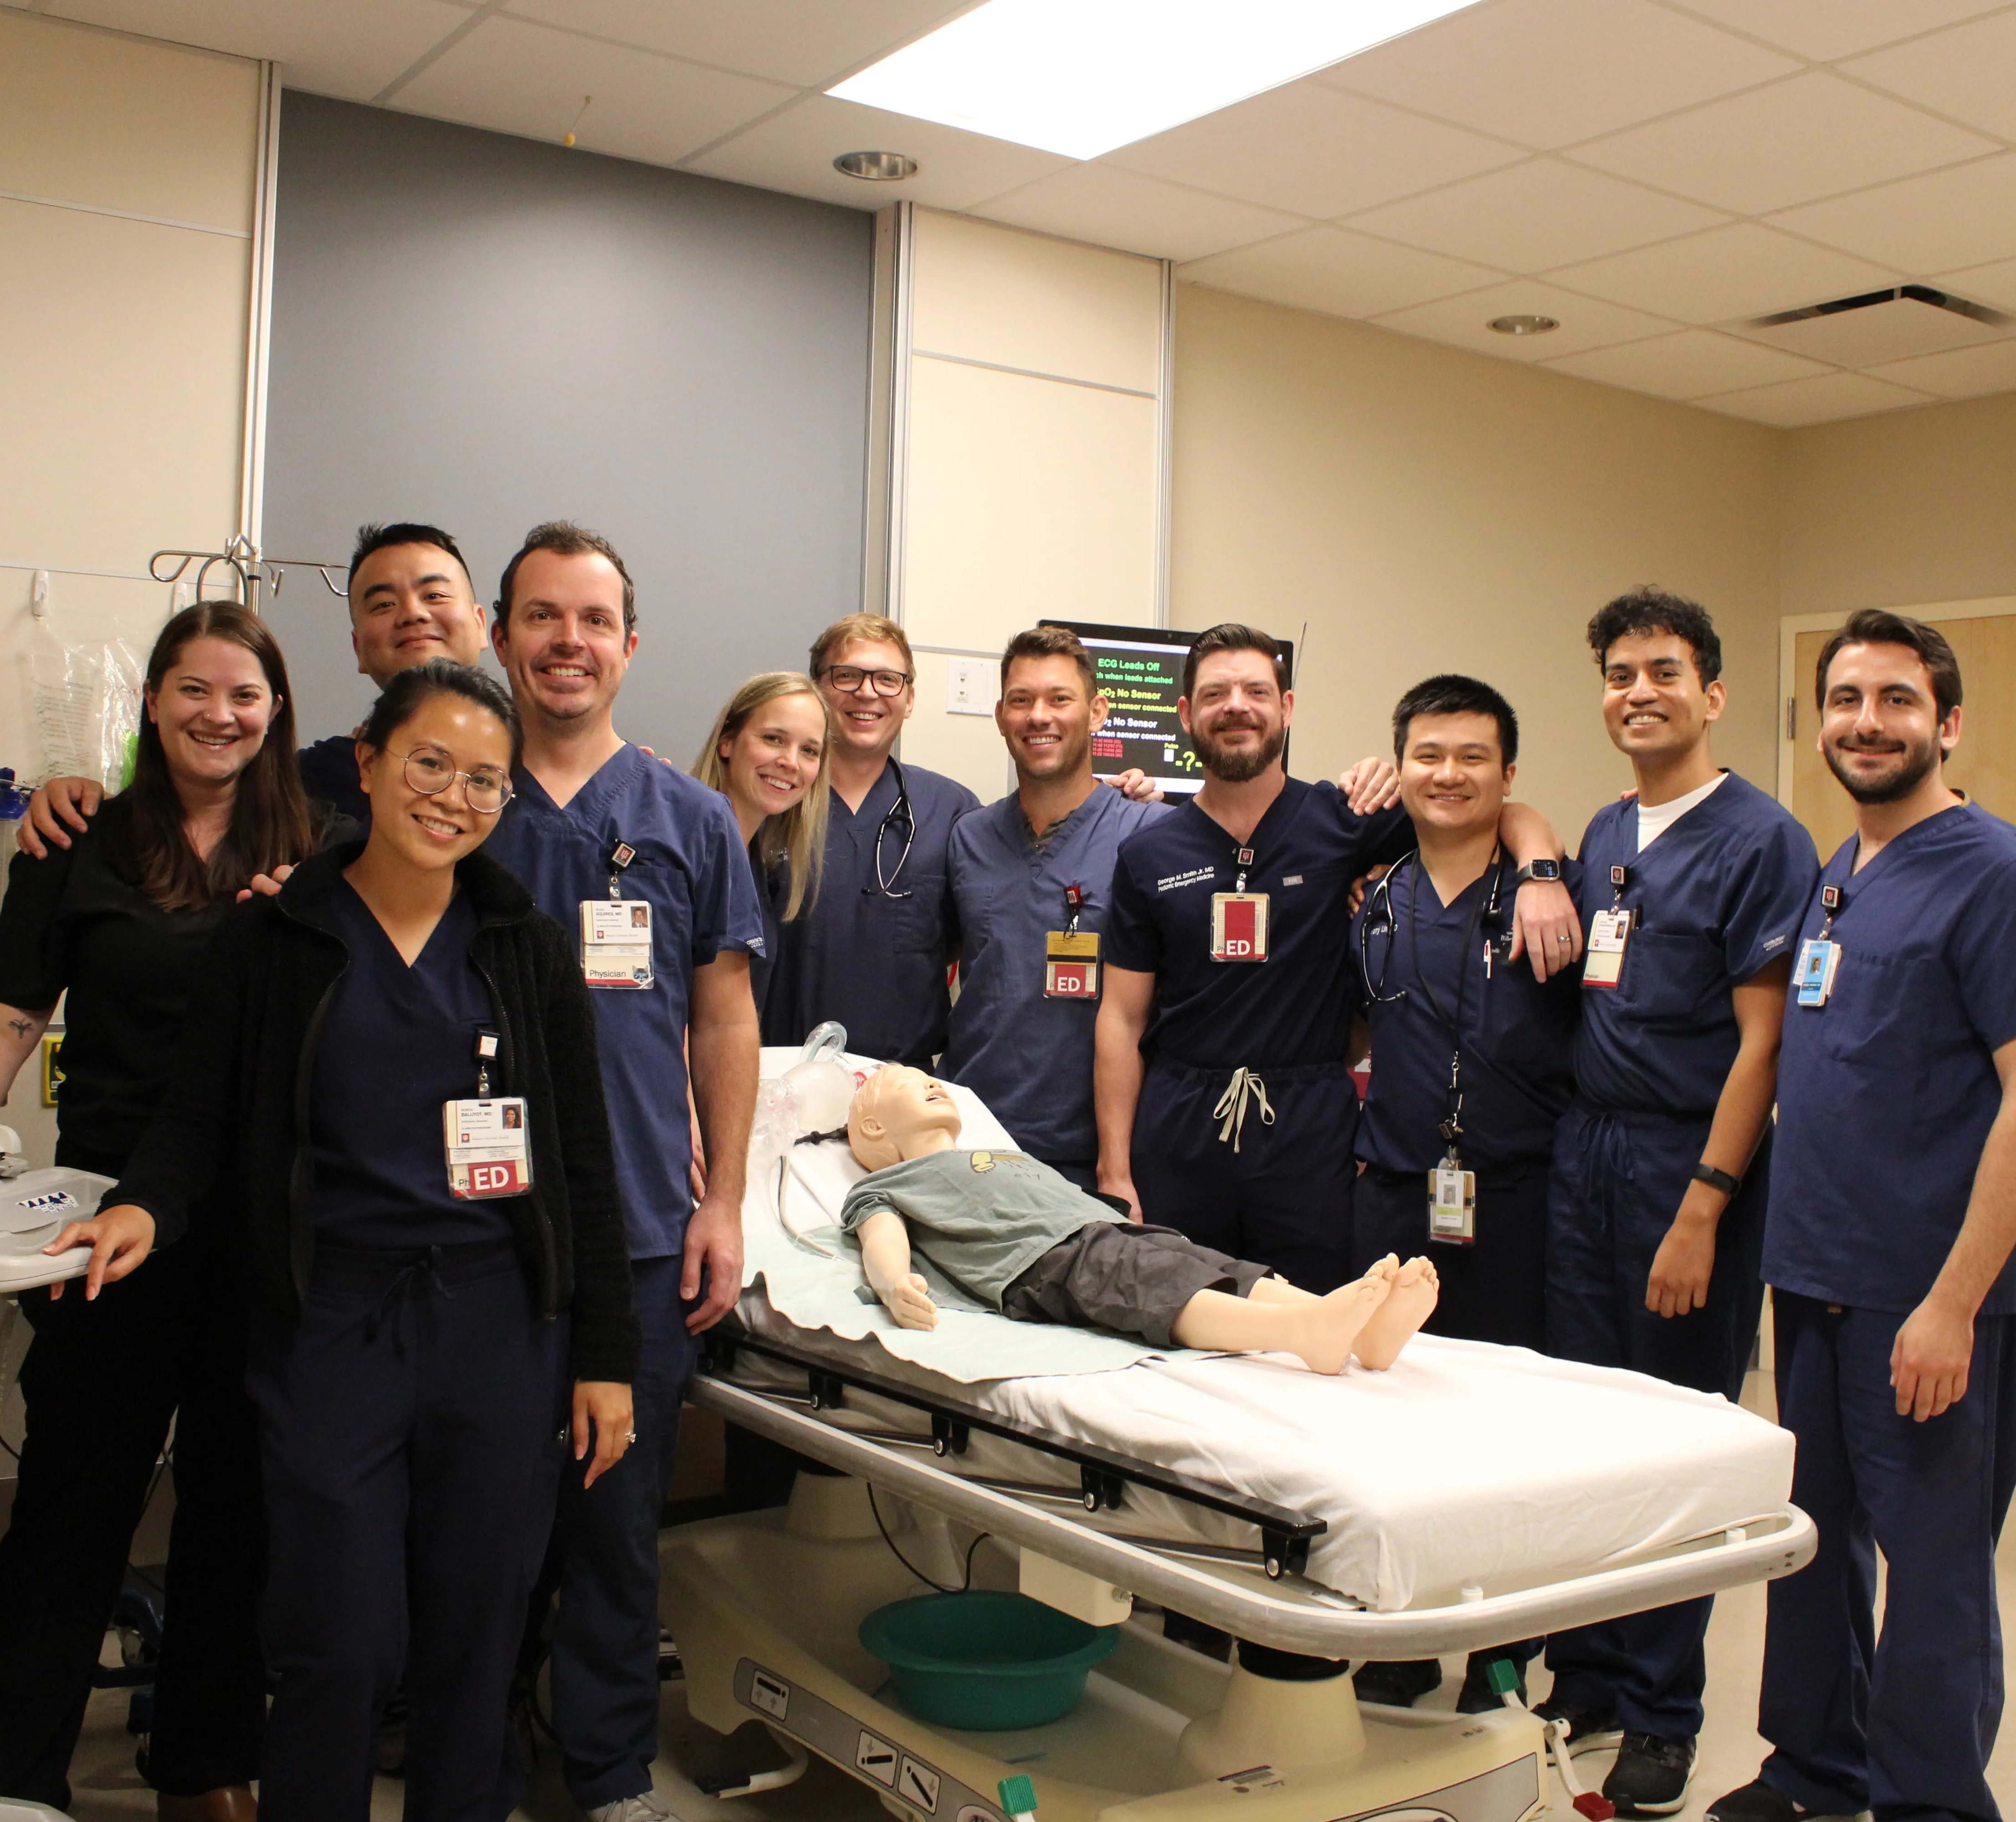

Slide 3
Pediatric Emergency Medicine Fellows Must
Demonstrate Proficiency in:
biostatistics
clinical and laboratory research methodology
study design
preparation of applications for funding
critical literature review
principles of evidence-based medicine
ethical principles involving clinical research
“engage in projects in which they develop hypotheses or in projects of substantive scholarly exploration and analysis that require critical thinking.”

Slide 4

The barriers significantly correlated with predicted future clinical research time were designing a feasible research project (p=0.002) and identifying an interesting research question (p=0.006).
Michelson, K. A., Nigrovic, L. E., Nagler, J., McAneney, C. M., & Mistry, R. D. (2020). Research interest in pediatric emergency medicine fellows. Pediatric emergency care, 36(2), e38-e42.

Slide 6

We are training future leaders who need to feel comfortable engaging with research and innovation after graduation

Slide 7

Improving Fellow Research Study Design Skills and Confidence
Through Gamification
Anne Whitehead, MD
Associate Professor of Clinical Emergency Medicine and Pediatrics
Program Director, Pediatric Emergency Medicine Fellowship
Nathan Alves, PhD
Research Director, Indiana University Emergency Medicine
Associate Professor of Emergency Medicine, Associate Professor of Biomedical Engineering
Indiana University School of Medicine Department of Emergency Medicine

Slide 8
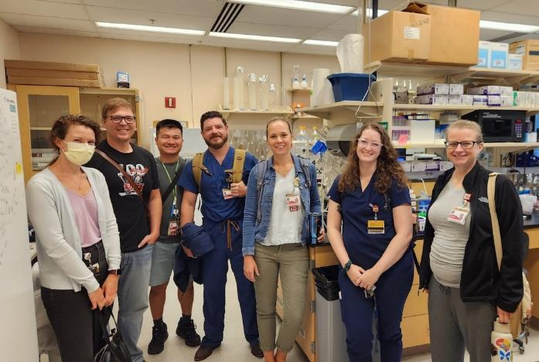
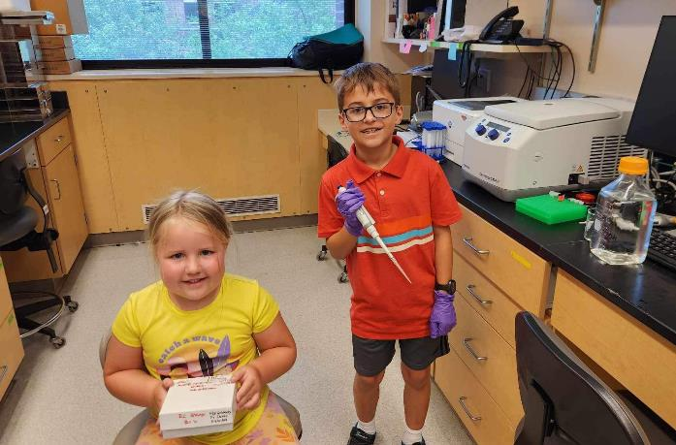
More structured mentorship
Increased and clarified expectations
Early focus on project design

Slide 9
S.U.perior P.E.rformance in R.esarch F.rom small groU.p collaboratioN. game
SUPER FUN game

Slide 10

Two-hour session during scheduled weekly education
Fellows work in teams of 2-3
Teams develop a research question and design a study to best answer that question within a set of practical parameters

Slide 11
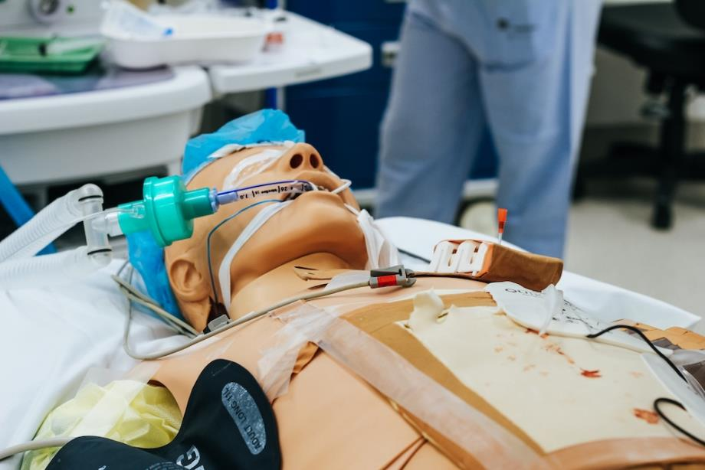
  3-year time period
  Limited budget and opportunity for grants
  Access to patient population representative of real life

Slide 12

Each team will produce a presentation describing their proposed study
relevant background
question/hypothesis
aims
study design
timeline
budget
dissemination plan

Slide 13

Was the research question asked important for the field of pediatric emergency medicine?
What was the degree of novelty of the question?
How strong was the study design in answering the question?
Could this this study feasibly be done in the 2 year window, with the resources available here?
Will the study have a significant impact on patient care once results disseminated as planned?

Slide 14
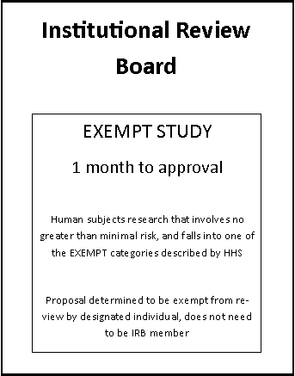
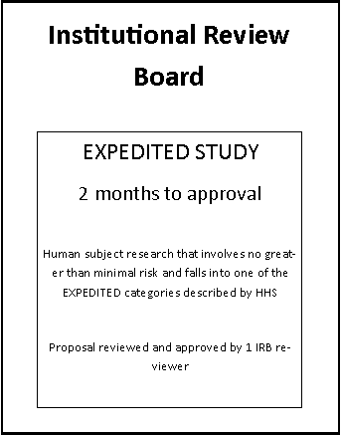
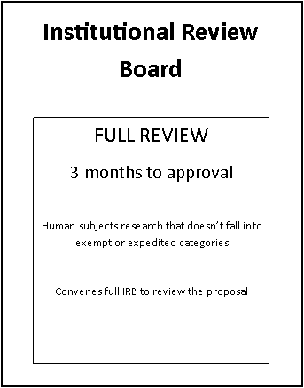
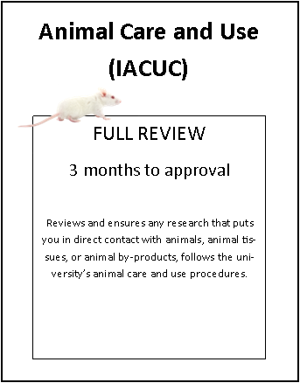

Slide 15
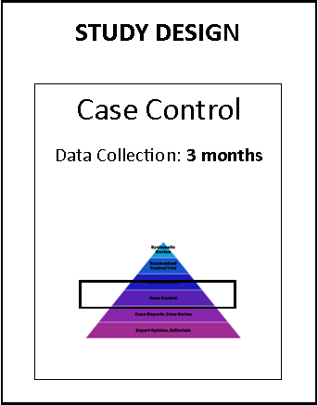

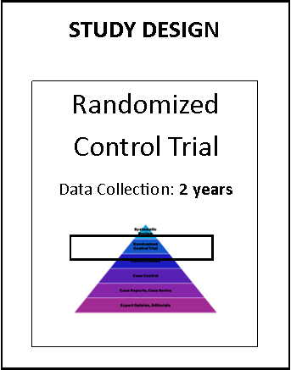

Slide 16


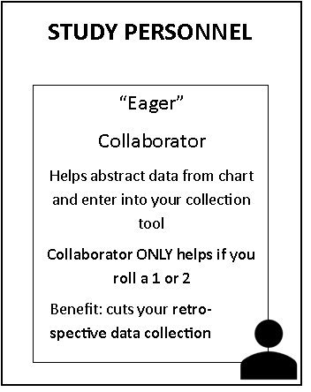

Slide 17
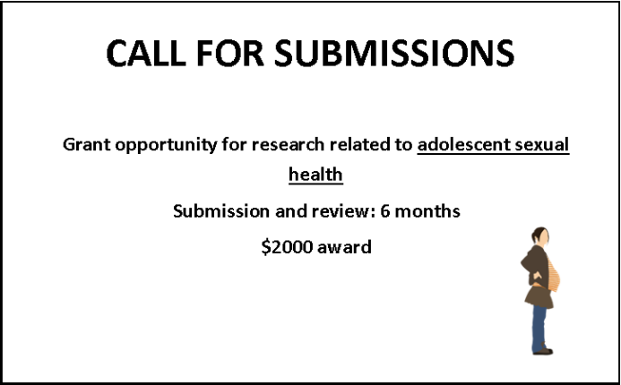
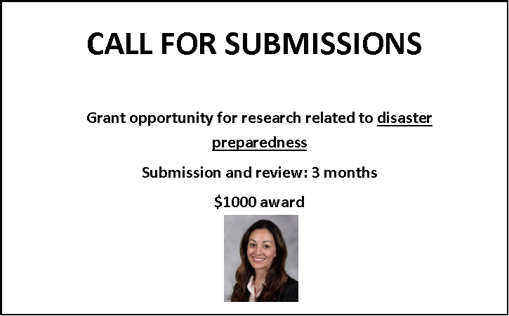
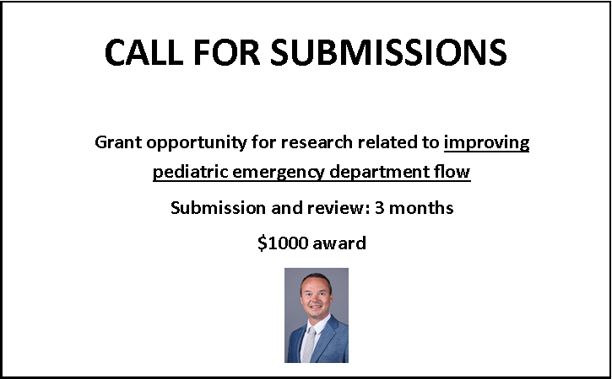
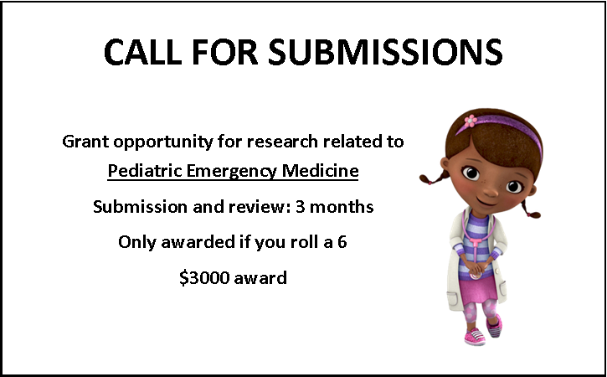

Slide 18
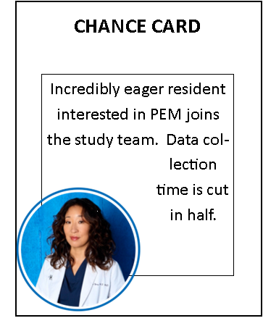
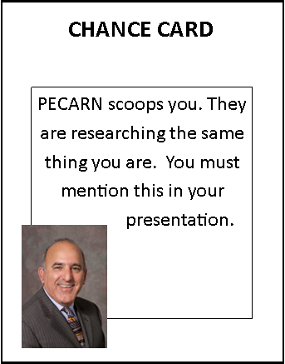
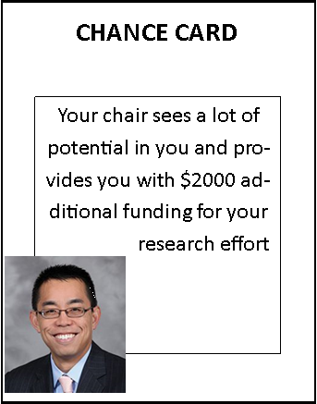

Slide 19
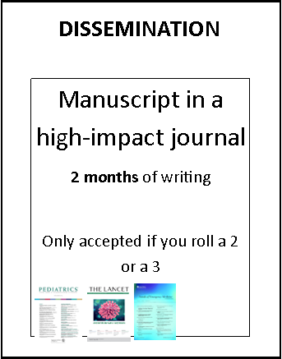
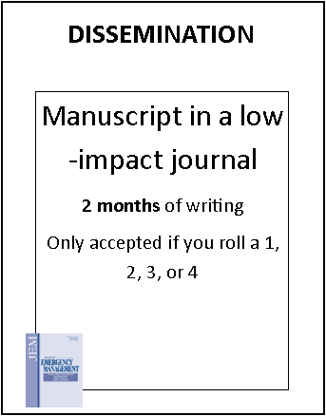
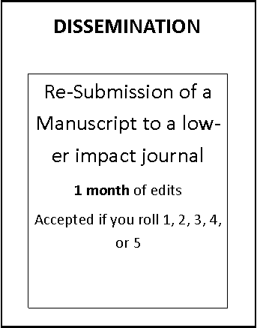
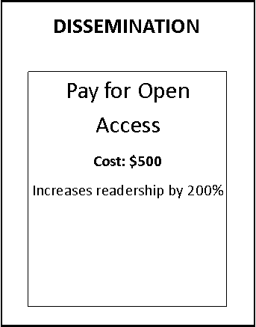

Slide 20
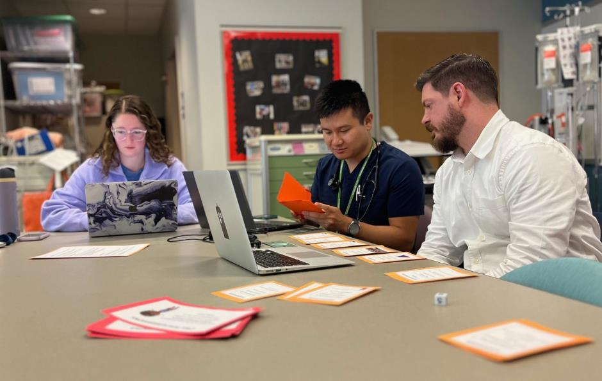
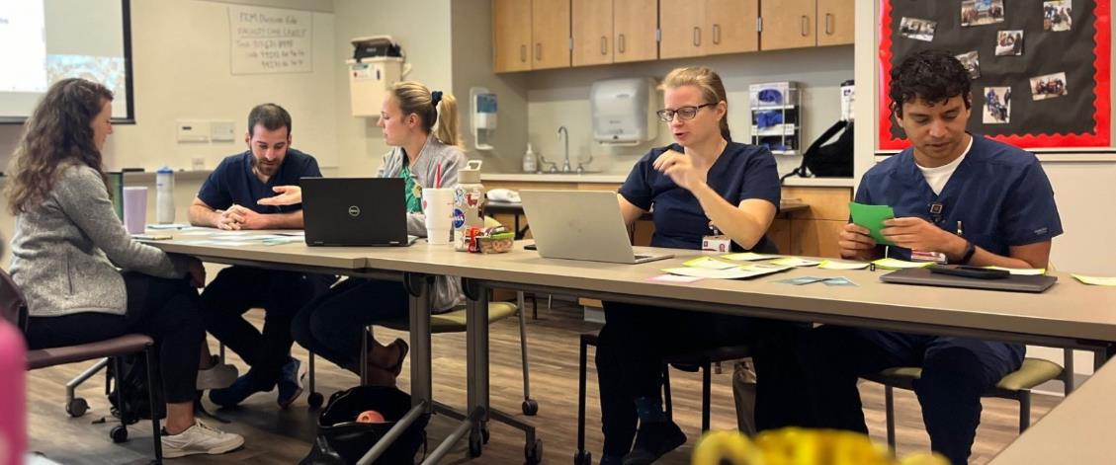
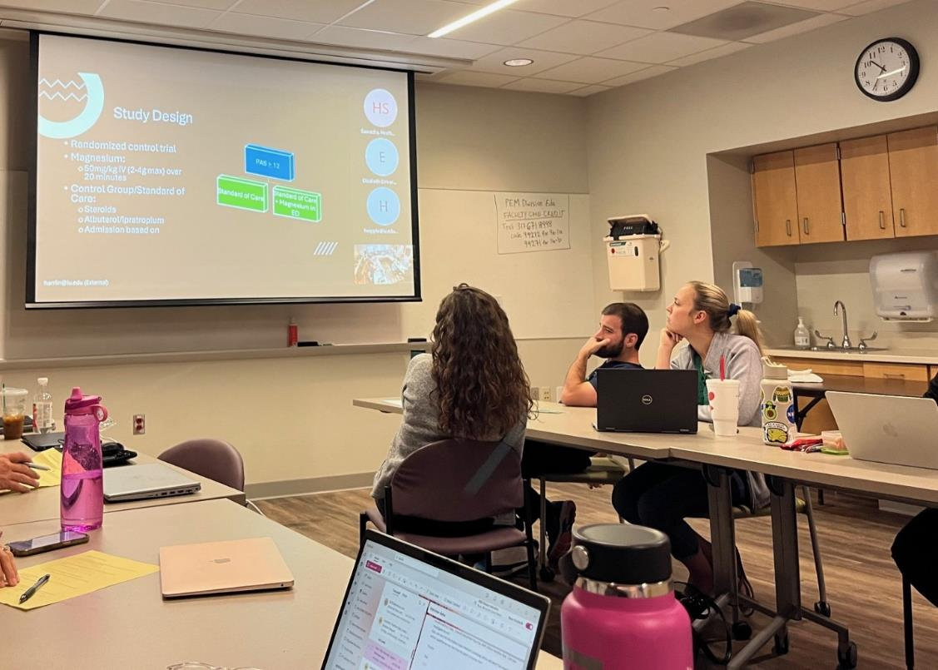
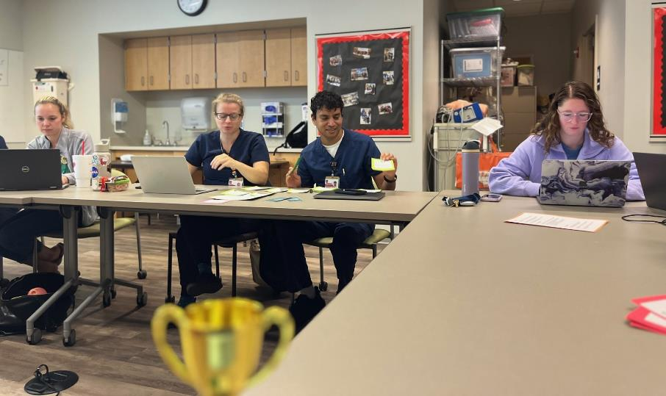

Slide 21

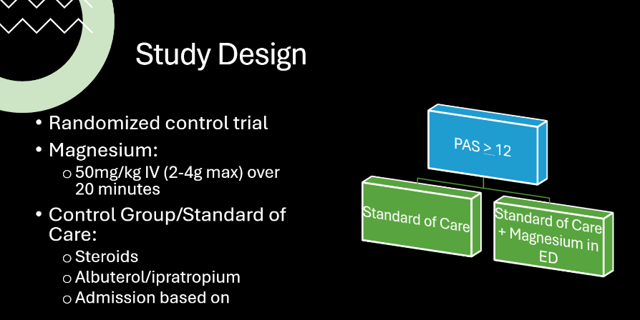
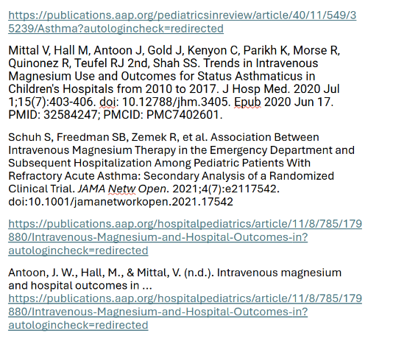
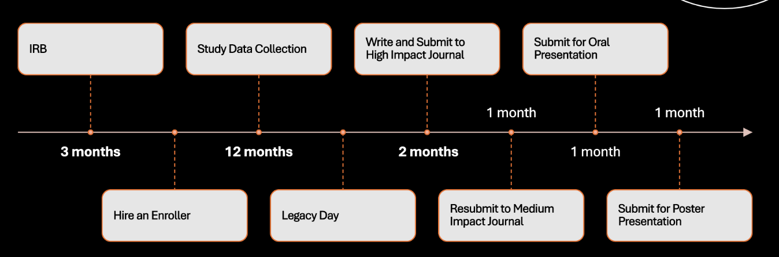

Slide 24
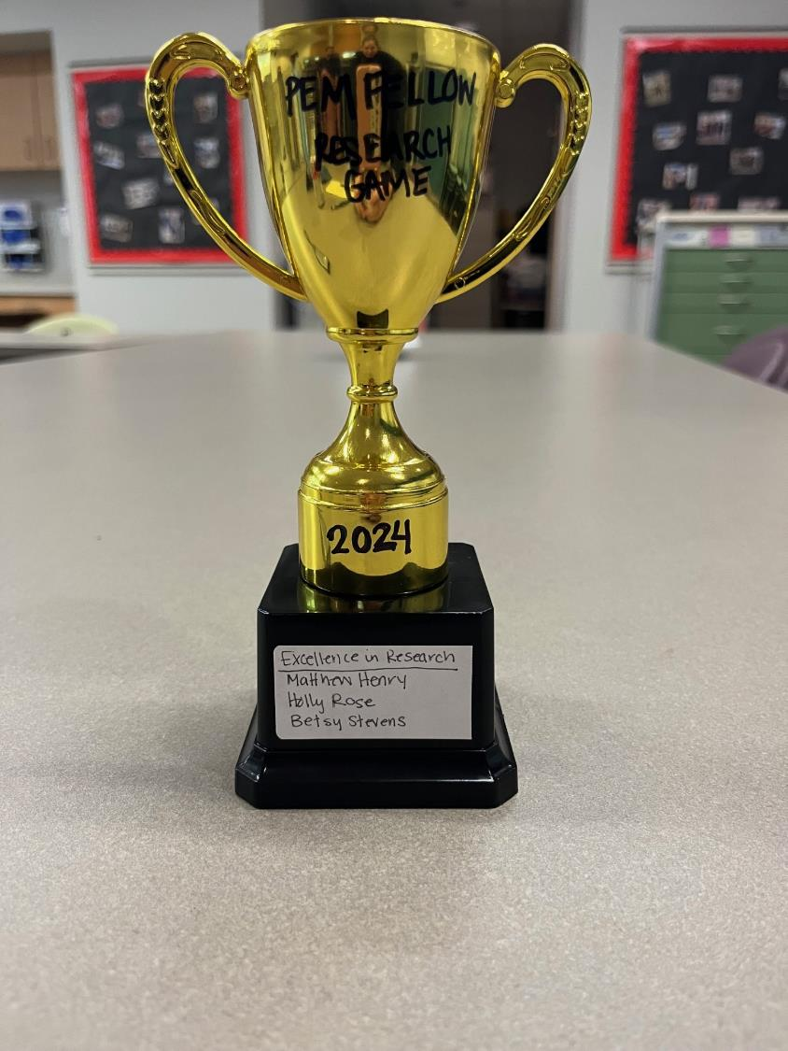
Fun
Valuable
Improved comfort
Biggest gains in comfort in skills key for early project implementation

Slide 25
Yearly repetition within the PEM Fellowship
Expansion/Generalization to other training programs
Measurement of longer-term outcomes:
fellow project publication rates
re-submission rates
involvement in research after graduation
annewhit@iu.edu

