Slide 1
Preparing for the NIH Data Management & Sharing Policy at Indiana University
NNLM National Center for Data Services - NIH Data Management and Sharing Session 2 - Practitioner Perspectives: Internal Outreach & Policy
February 22, 2022 | Heather L. Coates
INDIANA UNIVERSITY

Slide 2
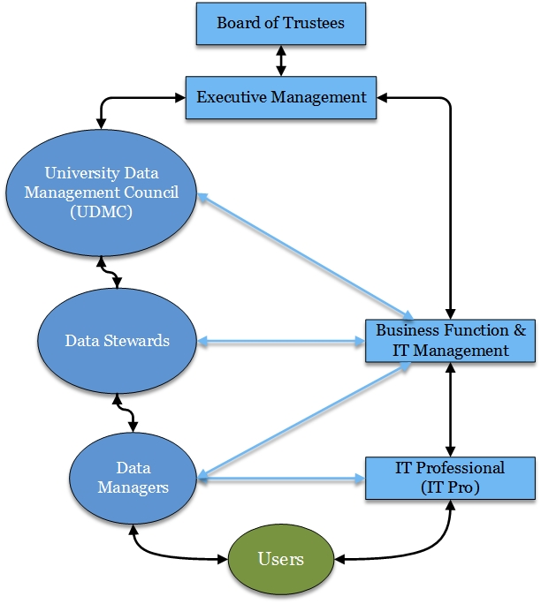
IU Data Governance
DM-01 passed in 1991
2017 - appointed Data Steward for Research Data
2019 – IU RDM Guidance released
2020 – NIH Final DMS Policy released
2021 – IU Research Data Management Plan Working Group convened
2022 – discuss revisions of existing data policies
Key policies & rules for data mgmt: https://datamanagement.iu.edu/governance/policies/index.html
Notes:
Each of our institutions has its own culture with differing strengths and areas for growth. Even within the research mission, there’s a lot of variation in priorities and approaches to supporting research. What I’ll try to do in these next couple of slides is to describe the strengths on which we’re building to prepare for the NIH data policy.
The first area of relative strength we’re building on is the IU data governance/administration program, which was established by our former Chief Data Officer Sara Chambers. The first data policy, DM-01, was passed in 1991 and IU has had a data governance program since. Over the past three decades, this program developed a robust set of policies, standards, and processes to ensure that institutional data are protected and appropriately managed. However, we know that the governance/stewardship/management needs of research data do not always align with that of institutional data.
Around 2015, I started asking a lot of questions about research data policies at IU. That led to developing a draft research data policy with collaborators in Research Compliance. In 2017, I was appointed the first University Data Steward for Research Data and it became my responsibility to try to figure out answers to the questions I’d been asking.
While there were data stewards for various domains – student, employee, health, research administration, etc - there had not previously been a data steward for research data. Like other data stewards, the appointment is in addition to my primary job. Unlike many other data stewards, I do not supervise a team or manage the systems on which my data domain is housed. Instead, the daily management of research data is left to the scientists, as it should be. But this poses interesting challenges for governing research data.
For the first couple of years, I focused on generally trying to understand what data governance is and how it plays out at IU. In practice, this meant learning about existing policies, processes, and the authority vested in data governance, UISO, UIPO, research administration, and general counsel.
In 2019, I adapted the early draft of a research data policy into a guidance document and released a DMP template. By the time the NIH data policy was released, I had a better sense of the various policies and processes that it might affect. In the fall of 2021, we convened the IU RDMP Working Group and began our work. Earlier this year, we began discussing how existing policies could be revised to improve clarity and align with funder requirements like the NIH policy.

Slide 3


IU School of Medicine Information Management Initiative
IUSM Information Management Advisory Board
Erin Foster
Beth Whipple
2018 – IUSM IM Initiative begins
2020: IUSM DMP requirement Year 1 (Qualtrics)
2022: IUSM DMP requirement Year 3
2019: ELN rollout, develop IUSM DMP
2020: IUSM DMP requirement Year 2 (FireForm)
Notes:
The second area of relative strength is the IUSM Information Management effort, which included the rollout of an electronic lab notebook as well as a school-wide DMP requirement. This began in 2018, with conversations from industry consultants hired by senior leadership. There were several elements to the initiative, two of which were the rollout of an electronic lab notebook and implementation of a School-wide Data Management Plan requirement. You may have heard Erin Foster and Beth Whipple speak about this work already, but in case not, I’ve provided links to their presentations and publications at the end of my slides.
The DMP requirement was not initially identified as a goal for this initiative. Instead, it came about organically as we discussed related data management and storage issues associated with adoption of an ELN platform.
The first year for the DMP mandate was 2020 and we’re in the midst of analyzing the submissions from 2021. Our goal is to use the information gathered in these DMP to provide support for researchers to comply with the NIH data policy.
2018 – IUSM Information Management initiative begins
2019 – ELN rollout, develop IUSM DMP
2020 – IUSM DMP requirement year 1, integrated into Departmental Review process
2021 – IUSM DMP requirement year 2, migrate DMP from Qualtrics to FireForm

Slide 4
Identifying the opportunities
SECTION TITLE GOES HERE IF NECESSARY
Analyze the policy
Consider how it might affect existing institutional and research workflows, procedures, systems
Identify potential conflicts or obstacles
Notes:
Because I was already immersed in talking to people about issues related to data management and sharing, this became another thread of the conversation.
I basically analyzed the policy, developed a 1-page summary about it and began to circulate it with key stakeholders, asking for their thoughts about how the change in policy may affect research at IU.
For me, it became another clear indication that now was a great time to act, but the lack of alignment between broader policies and initiatives introduces a lot of confusion when trying to identify a common path forward. It’s helpful to be able to point to journal policies, funder requirements, initiatives from the AAU, APLU, and National Academies, but it takes a lot of time and effort to make sense of how each might affect research within institutions.

Slide 5
Gathering collaborators
Built on existing connections and processes
Attempted to bridge gaps in forming the Working Group
Identify how to effectively engage faculty researchers
Notes:
When the policy was released in 2020, our campus Working Group that came out of the AAU-APLU Public Access to Research Data was in the midst of exploring support and models for data sharing. The momentum towards forming a Working Group to address the NIH policy was helped by these recent conversations.
In identifying and recruiting collaborators, we started by building on existing relationships but also wanted to bridge some of the gaps. We also knew that we had to engage faculty, but were not entirely clear on when or how to do so.
Over time, our conversations with other research support units and gathered collaborators, made it clear that this Working Group would be able to proceed more quickly as a grassroots effort rather than a top-down initiative.

Slide 6
IU RDMP Working Group Members
Julie Aders, Sr. Data Administration Program Manager
Heather Coates, Data Steward for Research Data & Associate Librarian
Marcia Gonzales, Senior Associate General Counsel
Katie Gray, Associate Director for Research Administration, Proposals & Awards
Beth Johnson, University Director, HRPP
TBD, University Director, Research Contracting (formerly Katie Morris)
Claire Tempel, HIPAA Privacy Officer & Data Steward for Health Data
Beth Whipple, Assistant Director of Research and Translational Sciences for Ruth Lilly Medical Library
Levi Dolan, NLM Associate Fellow, Ruth Lilly Medical Library
Ethan Fridmanski, Data Services Librarian, Wells Library, IU Bloomington

Slide 7
IU RDMP Working Group: Aims
SUBTITLE GOES HERE IF NECESSARY
Inform all stakeholders about the NIH Data Management & Sharing (DMS) Policy.
Invite input from stakeholders to identify specific challenges, opportunities, and supports needed to comply with funder policies, including the NIH DMS Policy.
Identify potential mechanisms for a sustained conversation between stakeholders about data management and sharing more broadly, including funder, publisher, and institutional requirements.
Identify a long-term executive sponsor for this continued work.
Notes:
Our broad aims are to:
inform all stakeholders – researchers, grants administrators, IT pros, UITS Research Technologies, etc – about the policy
Gather input from stakeholders about how the policy may affect the research workflows, processes, practices at IU
As we synthesize the input, identify potential mechanisms for sustaining a conversation about data management and sharing across the institution
Convince an executive sponsor that this work is important, valuable, and needs a sponsor to adequately address the issues

Slide 8
IU RDMP Working Group: Activities
Organize presentations to inform stakeholders and to gather input about current practices and the opportunities, barriers, and support needed for developing and implementing DMS Plans
Produce a report summarizing the input gathered
Identify needs and opportunities for strengthening connections and developing resources
Notes:
The bulk of the working group effort is focused on pushing information out to stakeholders and gathering input. So far, we have just begun providing presentations to highly affected schools, but we will shift focus to synthesizing the input and identifying opportunities for improving support in the summer and fall.

Slide 9
Policy Analysis
Key policy elements | DM-01 | DM-01S | DM-02 | Other
Definitions | Yes | Yes | Yes
Ownership | Yes | Yes | No | May be superseded by Research Agreements
Classification | Yes | Yes | Yes
Access rights | No | Yes* | No
Storage | No | Yes* | No
Data management | No | Yes* | No
Retention | No | No | No | No
Discard & Disposal | No | No | No | Critical Data Guide
Archiving & Preservation | No | No | No
Sharing & Dissemination | No | No | Yes* | Various types of Research Agreements
Related policies & requirements | Yes | Yes | Yes
Notes:
The second aspect of this work at IU is related to research data policy. As I mentioned, we have existing policies that speak to some aspects of the key issues in research data management and sharing, but there are gaps and some modifications are needed.
In early 2021 and again in 2022, I conducted an environmental scan of existing research data policies at research intensive institutions in the US. Based on information gathered from the scan, and Kristin Briney, Abigail Goben, and Lisa Zilinski’s 2015 paper on institutional data policies, I identified key elements of research data policies. Using this, I conducted a gap analysis of our existing data policies, which is what this table summarizes.
Terminology/language is a constant challenge – people understand data access and sharing to mean different things; even when we define them institutionally, those definitions may not align with the ways in which the terms are used in their field of research or professional/scholarly communities
Sharing & dissemination includes transfer of copies

Slide 10
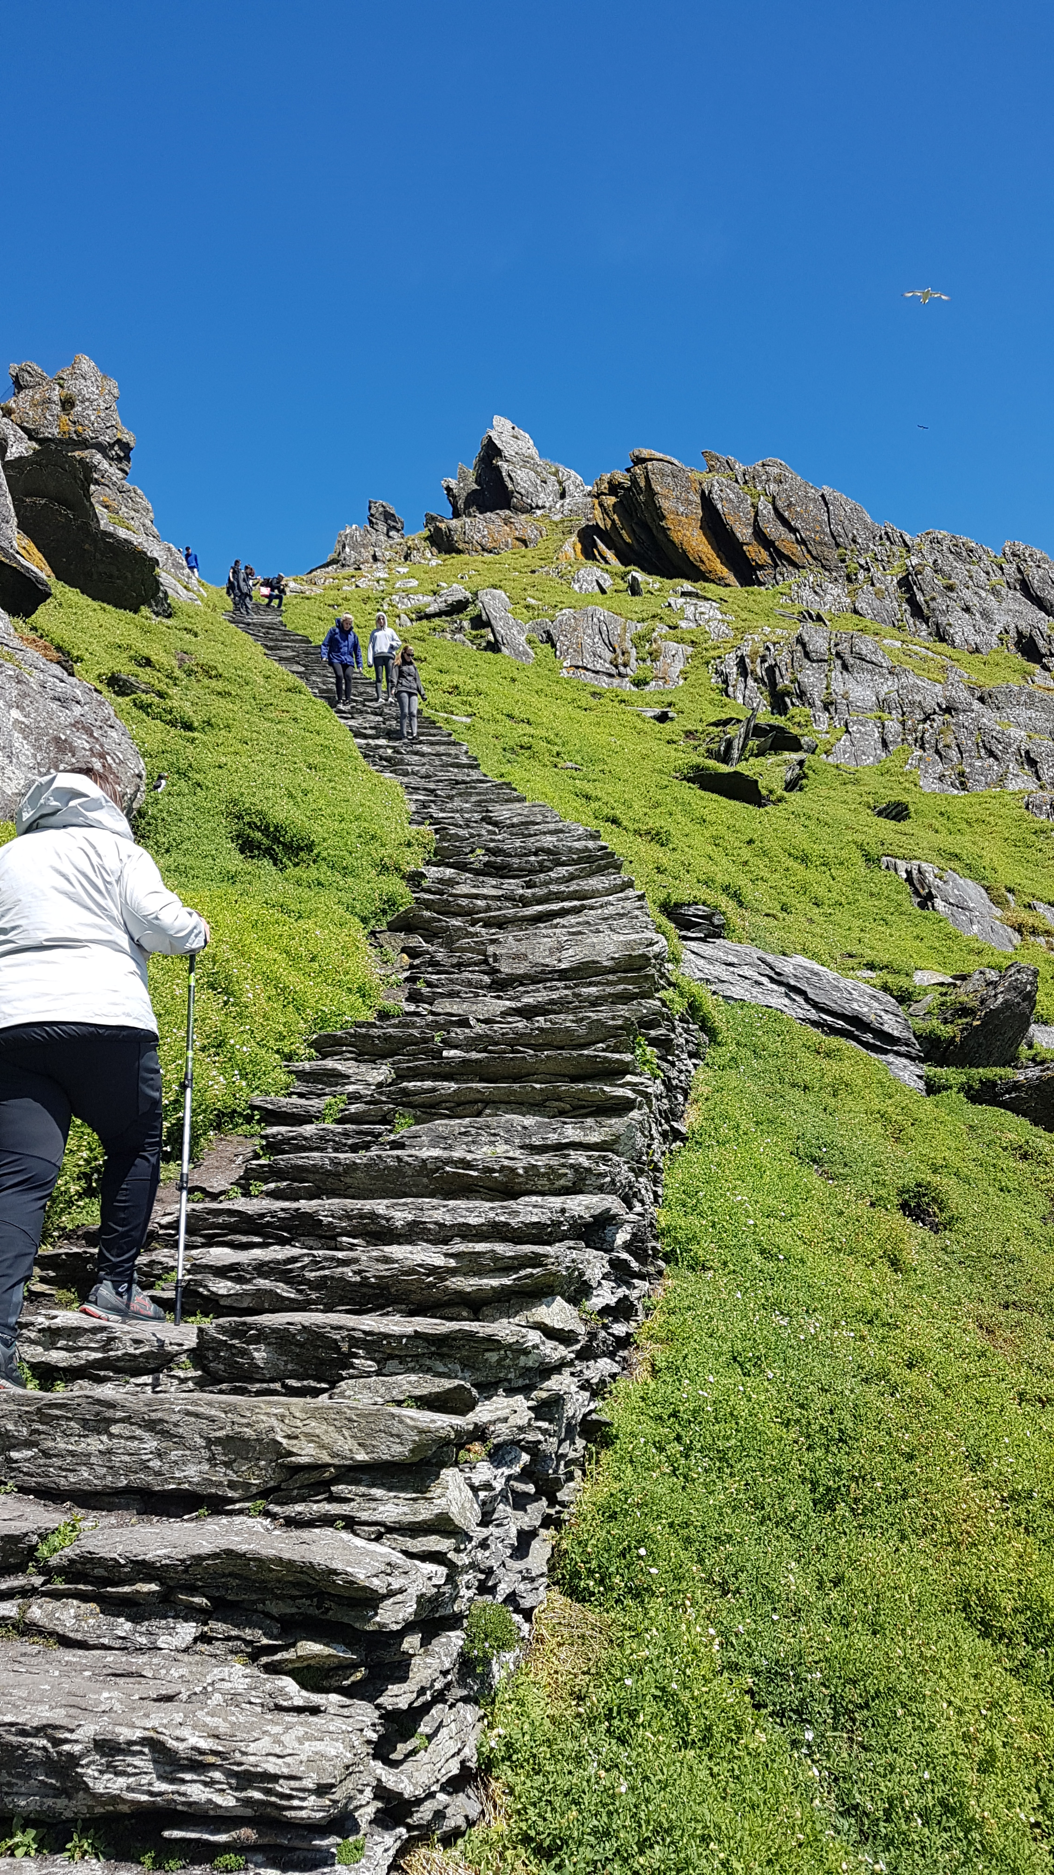
Roadmap for 2022
Meet with highly affected schools and units
Hold open sessions
Gather input from stakeholders
Synthesize input and write a report
Distribute report to stakeholders
Units implement changes to systems & processes
Notes:
Though we have started meeting with highly affected units, we still have a long way to go. For now, we are assuming that the NIH will take a light hand in enforcing this new policy, at least for the first couple of years, similar to the approach used for the Public Access Policy.

Slide 11
Resources
Foster, E. D., Whipple, E. C., Rios, G. R. (in press). Implementing an institution-wide electronic lab notebook initiative. Journal of the Medical Library Association.
Whipple, E. C. & Rios, G. G. (2021). Navigating institutional research information management priorities: Rolling out of an institutional data management plan (DMP) requirement. Medical Library Association Annual Meeting, online. Available at https://hdl.handle.net/1805/25921.
Whipple, E. C., Foster, E. D., Coates, H. L. (2019). Using an electronic lab notebook system to promote data management plans. Medical Library Association Annual Meeting. Available at https://hdl.handle.net/1805/23220.
Briney, K., Goben, A., & Zilinski, L. (2015). Do You Have an Institutional Data Policy? A Review of the Current Landscape of Library Data Services and Institutional Data Policies. Journal of Librarianship and Scholarly Communication, 3(2). https://doi.org/10.7710/2162-3309.1232
Guide to Accelerate Public Access to Research Data (p. 34). (2021). Association of American Universities (AAU) & Association of Public and Land-grant Universities (APLU). https://www.aplu.org/library/guide-to-accelerate-access-to-public-data/file

Slide 12

Heather L. Coates
Digital Scholarship & Data Management Librarian, IUPUI University Library
University Data Steward for Research Data, Indiana University
hcoates@iupui.edu
ORCID: 0000-0003-4290-6997
Co-founder of the Metrics Toolkit

