Slide 1
Shifting into Data Governance roles: Encounters of three data librarians
@IASSIST22
Abigail Goben (Data Librarian & Policy Advisor, UIC)
Heather Coates (Data Librarian & Data Steward, IUPUI)
Kristin Briney (Biology Librarian, Caltech)
Notes:
Abigail

Slide 2
Overview
Intro to Data Governance
Experiences at Our Institutions
The Value of Getting Involved
Notes:
Abigail

Slide 3
What is data governance?
“Data governance is a system for defining who within an organization has authority and control over data assets and how those data assets may be used.” (Thor Alavsrud 2021)
Data governance is “a system of decision rights and accountabilities for information-related processes, executed according to agreed-upon models which describe who can take what actions with what information, and when, under what circumstances, using what methods.” (Data Governance Institute)
“Data governance is a quality control discipline that encompasses the classification, collection, storage, access, use, sharing, maintenance, integrity, privacy and security of institutional information.” (IU UDMC Charge)
Notes:
Heather
There are many definitions of data governance, most of which come out of a business context. The three listed here all speak to different but important aspects of research data governance in higher education.
The definition from Alavsrud is nice and concise...a good place to start.
The definition from the Data Governance Institute is helpful for describing the scope of data governance work, particularly when it intersects with the work of other units like IT and infosec.
The definition comes out of the IU University Data Management Council charge, which frames data governance as a quality control discipline.
Many definitions I’ve seen tend to emphasize the work done during active use of the data by the organization, but give very little thought to long-term issues such as curation, preservation, and discard. For much of the administrative data institutions have, retention schedules are based on legal requirements and data are discarded as soon as possible to minimize risk. The same approach doesn’t work for research data, so this is another area where governing research data needs to be distinguished from administrative or operational data.

Slide 4
The Role of Data Governance in Higher Ed
Long-term Stewardship
Compliance
Minimize Risk
Funder & Community Rights
Protect IP & License
Identify Partners
Enable Collaboration
Add Data Value
Notes:
Abigail
Ensure that compliance requirements are met
Minimize risk of data breach or unauthorized access
Protecting Intellectual Property, data as an asset, data licensing
Enable collaboration
Increase the value of data
Enable effective long-term stewardship of research data
Balance the rights of the researcher, community partners, and funders
Identifying the partners and boundaries at the university and beyond
Heather
Data governance needs a purpose, ideally one that comes from within the organization and with input from all the stakeholders. Some common goals or priorities we see in higher ed are related to security, compliance, and protecting IP.
For data governance efforts to be successful and survive, the purpose needs to agreed upon, clearly communicated, and periodically reassessed. If data governance gets in the way of people being able to use the data, data governance won’t happen; people will find ways to circumvent the processes put in place, which puts an organization in the mode of policy enforcement and penalties.
A key challenge for research data governance in higher education is the conflict between the underlying culture of commercialization created by the Bayh-Dole Act and the less immediate benefits of curating and sharing research data more broadly. There is an important opportunity for research data governance programs to more clearly communicate the possible options related to data sharing and to help researchers navigate this space. At most institutions, a small percentage of researchers are likely to purse patents and commercialization, while many more would benefit from sharing data, openly or in controlled ways.

Slide 5
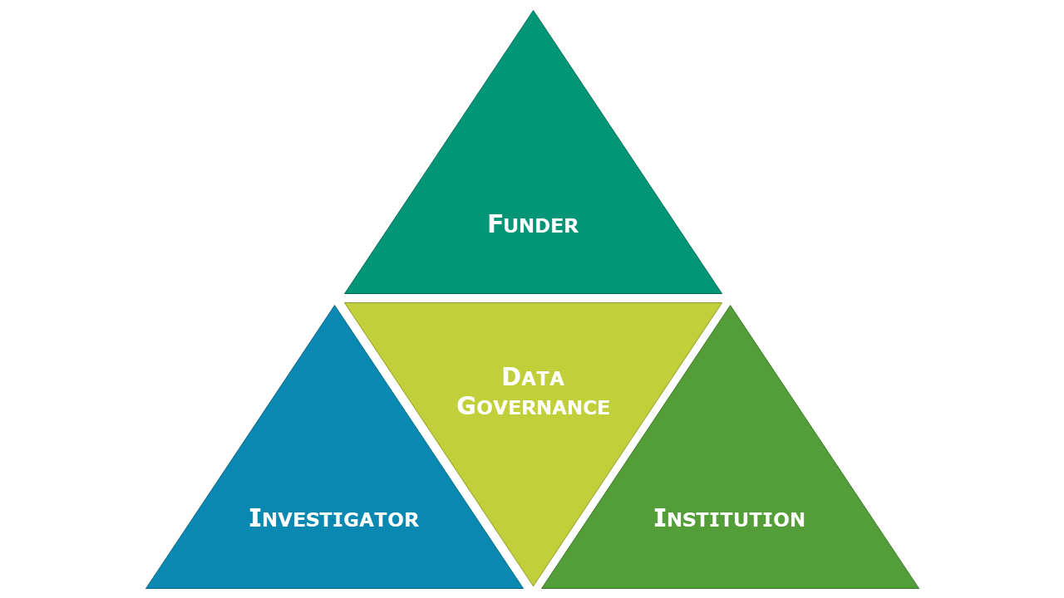
Data governance is a shared responsibility
Notes:
Heather –
Data governance generally tends to be described and operationalized at the level of individual organizations or institutions. But governing research data requires that we balance institutional priorities with those of funders, investigators, and others across any given research community. Governing research data is truly a community effort.
Researchers often encountered obstacles or friction when you try to help researchers share data. In some cases, those may be related to data governance decisions or gaps in policy and process. The boundaries of research data governance are often unclear.

Slide 6


California Institute of Technology (CalTech) Journey
Kristin Briney
Biology & Biological Engineering Librarian
Caltech Library
Notes:
Kristin’s narrative
https://www.flickr.com/photos/caltech/39649368475

Slide 7
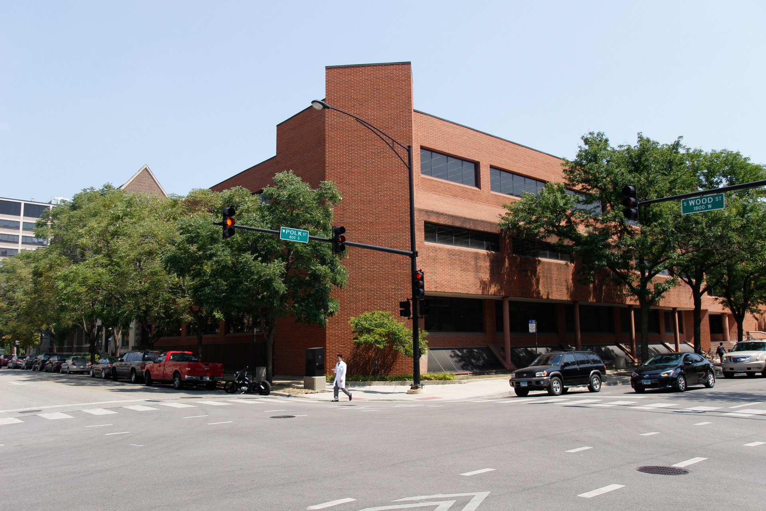
University of Illinois at Chicago Journey
Abigail Goben
Data Librarian,
Policy Advisor

Slide 8
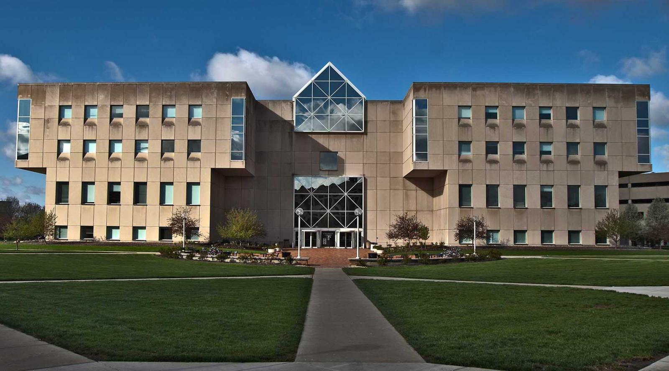
Indiana University (IU)
Journey
Heather Coates
Digital Scholarship & Data Management Librarian, IUPUI University Library
Indiana University Data Steward for Research Data
Notes:
Heather
During my first few years as a data librarian, I spent a lot of time learning to navigate the various research support services across the IU system and asking lots of questions on behalf of those I was consulting with. Reading Kristin & Abigail’s 2015 article “Do you have an institutional data policy?“ helped me to identify some of the unnamed obstacles I had been encountering, particularly for data sharing. Much of the research on my campus involves human participants and is subject to The Common Rule, so I started asking questions of our HIPAA Privacy Officer and Health Data Steward and the Research Integrity Office. Eventually, those conversations led to creation of an informal working group of folks who were willing to draft a comprehensive research data policy for IU. We wanted a policy that addressed data ownership, storage, retention, management, sharing, and preservation. The conversations were a great venue for us to learn from each other and get a glimpse into other perspectives on these issues.
It was only after we had been meeting for many months that our Chief Data Officer learned of the group and I learned about the existing data governance structure. It turns out that IU already had a policy that defined research data as institutional data, in most cases. In early 2017, I was appointed the first Indiana University Data Steward for Research Data and began figuring out how research data governance can fit into a data governance program that has been around since 1991. Over the past five years, I’ve learned about the institutional responsibilities for governing research data and done my best to advocate for policies, processes, and resources that make it easier for researchers to jointly steward research data with IU and their funders. It truly is a community effort that takes a highly-coordinated approach.

Slide 9

Who is responsible?
Dominance of IT perspective
Differentiating governance by data domains
Rapidly changing external policies & pressures
Local process & bureaucracy (or lack thereof)
Local training & documentation
Local policy
Issues emerging from the intersections of research, compliance, & IT
Many unknown unknowns
Notes:
Heather
We have found tremendous value in engaging with the various stakeholders at our institutions about research data governance to be incredibly valuable. It has helped us to identify gaps at each of our institutions, including:
• A lack of clarity about who is responsible for the various facets of research data governance
• The IT perspective, particularly IT security, dominates data governance conversations at many institutions. We believe that data governance conversations need to be more representative of stakeholders like the researchers themselves, libraries, research administrators who are reviewing and executing agreements, general counsel, and departmental administrators. When policies and processes don’t reflect the reality of research, people often bypass them, introducing a whole other set of issues.
• A need to differentiate data governance by data domains, particularly so that research specific terminology and context can be appropriately integrated into policies, processes, guidance, and resources.
• Additionally, research data governance is subject to rapidly changing external policies and pressures, such as the National Institutes of Health Data Management & Sharing Policy that will take effect in January 2023. Local policy, processes, and bureaucracy associated with information and data security may simply exclude issues relevant to research or introduce additional obstacles.
• We sometimes see research projects held up when the protocol raises questions or concerns that are not clearly in the scope of research administration, research compliance, and IT. This lack of clarity and subsequent delays are hugely frustrating to researchers, particularly when they are on tight deadlines and the purpose of data governance has not been clearly communicated.
• Finally, there are a lot of unknown unknowns – In general, research data governance has not been adequately supported to answer key but basic questions, such as
o What data do we have?
o Where is it?
o How long should we keep it?
o Who should have access?

Slide 10
Thank you
WHAT NEXT?
Investigate your institution
Connect with someone new
Have a conversation
Abigail Goben: agoben@uic.edu
Heather Coates: hcoates@iupui.edu
Kristin Briney: briney@caltech.edu
Notes:
Heather
In case you are interested in learning more about data governance at your institution, we have some recommendations for getting started:
1. Do some investigating to find out if your institution has a data governance body, who is represented, what their scope of authority is, and what processes exist
2. Once you have a basic outline, reach out to connect with someone new to learn more
3. Finally, have a conversation with them about your questions, or ask them what they consider to be the priorities, challenges, gaps, etc. If you can, keep the conversation going. In our experience, it takes years of investment in relationships before things begin to change.

