Slide 1
Preparing to negotiate the deal:
analyzing licenses, evaluating terms of the deal, and developing strategies

Slide 2
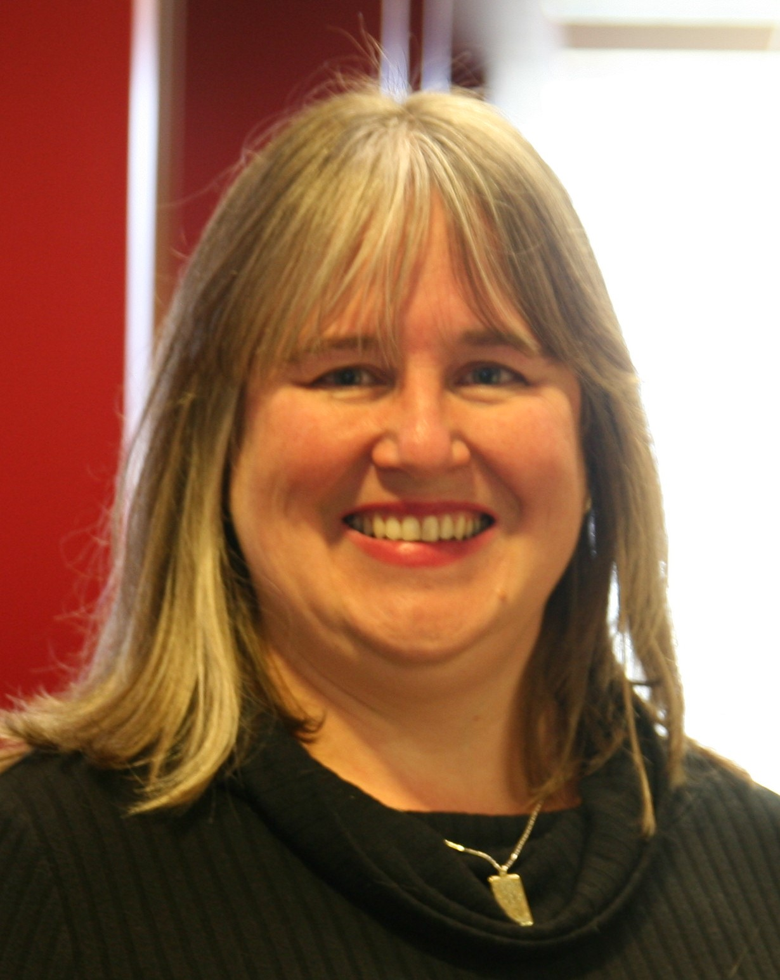
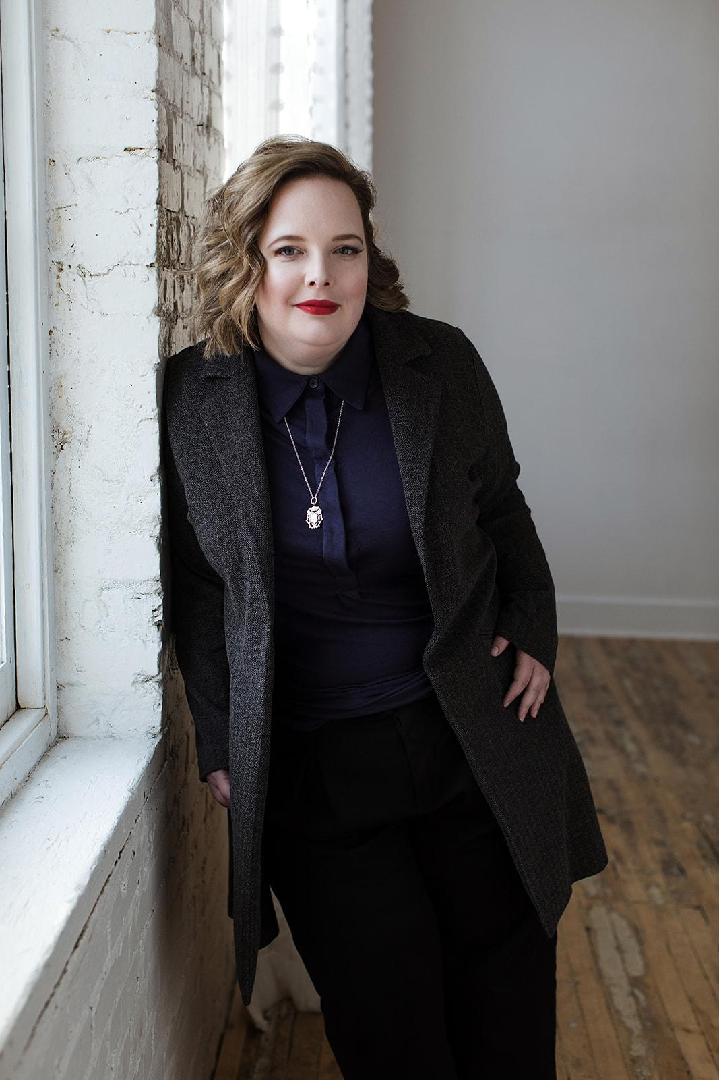

Your Instructors
Katharine V Macy
Scarlet Galvan
Courtney Fuson
Interim Associate Dean of Scholarly Communiction & Content Strategies,
IU Indianapolis
macyk@iu.edu
Collection Strategist,
University of Chicago
scarletg@uchicago.edu
Asset Management Librarian,
Belmont University
courtney.fuson@belmont.edu

Slide 3


The ONEAL Project
Open Negotiation Education for Academic Libraries
Funded by the IMLS Laura Bush 21st Century Librarian Program
While project was academic library focused, skills in curriculum are widely applicable to all types of libraries.

Slide 4
The Curriculum
https://sparcopen.org/our-work/negotiation-resources/oneal/

Slide 5
Plan for Today
License
Business Terms
01
02
Negotiation Planning
Fishbowl
03
04
Evaluating the License
Evaluating the Business Terms
Bringing it all together to develop a negotiation plan
We’ll ask for a volunteer to practice negotiating the plan against Scarlet (who will play our vendor rep)

Slide 6


01
License

Slide 7
A few notes and disclaimers

Slide 8
It’s all in the license
Accessibility standards
Learning management system use
Course reserves
User privacy
Scholarly sharing, re-use, interlibrary services
AI, text and data mining
Post-cancellation access rights
Service level agreements
Authentication
…and on and on

Slide 9
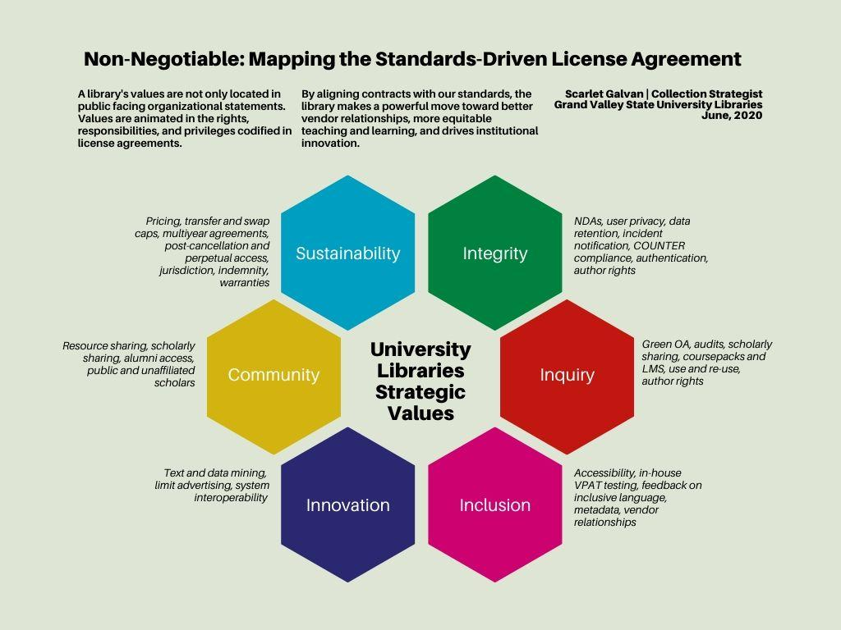

Slide 10
Shall, will, must
“we would never do that to a librarian!” if this is a relationship management tool, what does it tell us?

Slide 11
E-Resource Licensing Explained: An A-Z Licensing Guidebook for Libraries
Rachael Samberg; Katie Zimmerman; Samantha Teremi; Erik Limpitlaw; and Sandra Enimil

Slide 12
Stem essentials it’s okay if you’re new at this.
Legal documents are their own genre.

Slide 13
02
Business Terms

Slide 14
First Offer from vendor
Vendor Proposed Pricing | 2025 Price | 2025 Est $ / Use | Annual % Inc. | 2026 Price | 2027 Price | Total Contract Price
2025 Proposed Pricing – 1 YR | $30,129.84 | $21.08 | 8% |  |  | $30,129.84
2025 Proposed Pricing – 2 YR | $29,711.37 | $20.79 | 6.5% | $31,645.61 |  | $61,353.98
2025 Proposed Pricing – 3 YR | $29,292.20 | $20.50 | 5% | $30,757.55 | $32,295.42 | $92,345.87

Slide 15
BATNA
Best Alternative To a Negotiated Agreement. Everyone has a BATNA. You just may not like it.
Notes:
BATNA stands for Best Alternative To a Negotiated Agreement. Everyone always has a BATNA, but you may not like it. For instance, if you cancel and it’s a resource embedded into instruction for perhaps a chemistry class and it’s close to the start of a new term, cancelling will likely upset teaching faculty. You can improve that BATNA the next year by working with faculty to become familiar with an alternate resource through a trial. We will dive more deeply into BATNA in the third video of this lesson. Your BATNA should consider things beyond pricing including licensing terms.

Slide 16
BATNA for JOURNAL Packages
Why might this BATNA be favorable or unfavorable?

Slide 17
Evaluating No Deal

Slide 18
Internal data to gather
Price of individual journals
Journal use statistics (Unique Item Requests in COUNTER5)
Cost for article request through ILL – for this case $21/article
Cost for article request from an on-demand service (such as Get It Now or Article Galaxy) for publisher – for this case $33/article
What percentage of requests come from on-demand versus regular ILL – for this case it is a 50/50 split.

Slide 19
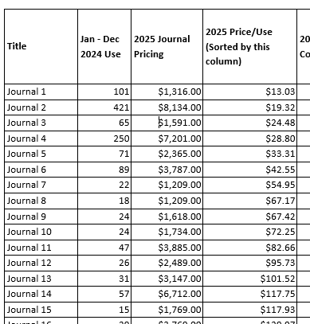
Getting Started – Creating Exhibit 2
Create a spreadsheet with journal title, annual usage, and journal price
Calculate Cost/Use (Price/Use)
Sort in ascending order price per use.
Then number the journals.
  In real life title is two columns (actual title, and another that assigns number (1 through total number of journals in the package, where 1 = lowest cost per use)

Slide 20
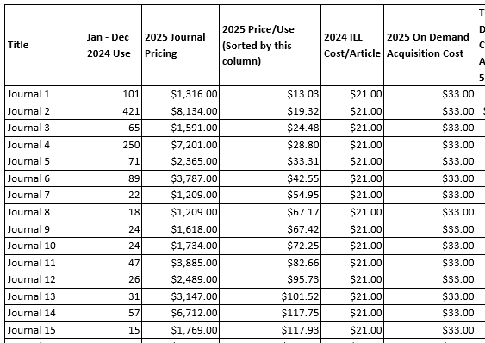
Next Steps
The ILL cost per article and On-Demand cost per article in the next two columns

Slide 21
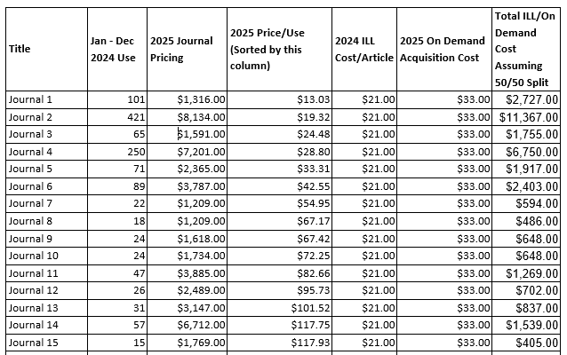
Add Total ILL/On Demand Cost Assuming 50/50 Spit
Formula to calculate:
((Use * 0.5) * ILL Cost per article))
+
((Use * 0.5) * On Demand Cost per Article))

Slide 22
Determining A LA CARTE Options
Creating Exhibit 3
You want to determine the cost of subscribing to some journals those with the lowest cost per use, while going to article level access with a mix of on-demand and ILL for the rest.
There are 35 possible scenarios you can create.

Slide 23
Determining A LA CARTE Options
Scenario 1 subscribes to Journal number 1 only, and provides access to the other 34 journals through a mix of on-demand and regular ILL.
Scenario 2 subscribes to Journals 1 – 2, then provides access to articles in journals 3-35 through on-demand and regular ILL.
Scenario 3 subscribes to Journals 1 – 3, then provides access to articles in journals 4-35 through
on-demand and regular ILL.

Slide 24
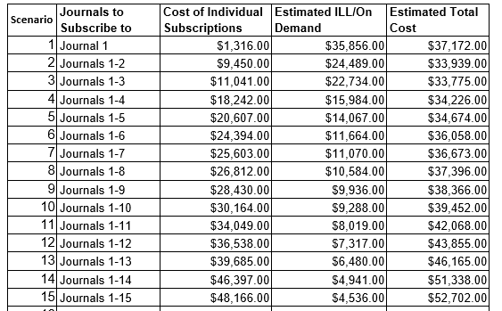

Slide 25
Estimating costs of A LA CARTE
After creating scenarios in the spreadsheet add the following columns
Cost of Individual Subscriptions - This will be the cost of subscribing to the journals in each scenario
Estimated ILL/On Demand Costs – This will be the cost of accessing the remainder of the journals not subscribed to via On Demand or ILL.
Estimated Total Cost = Cost of Individual Subscriptions + Estimated ILL/On Demand Costs
Cost of Individual Subscriptions and
Estimated ILL/On Demand Costs can be calculated
using formulas to data in Exhibit 2.

Slide 26
ONEAL Lesson Negotiation Planning Part 2 has an activity that walks through creating a similar analysis

Slide 27
Offer vs batna
Let’s Compare

Slide 28
Analyzing the offer
Price increases are higher than the market: 5% a year at three year deal feels too high considering annual increase for scholarly publishing according to Library journal is 5% a year.
We should get discount lower than the average than the with a multi-year deal.- guaranteeing cash flows.
If we pay all three years up front we would get an even larger discount - elimination of financial exigency risk
Going A La Carte could mean subscribing to only a few journals and with anticipated ILL/On Demand costs may actually be slightly higher but if we can get our ideal terms it may be worth signing.
At the bare minimum: terms that need to be revised: AI and TDM language, accessibility and term that needs to be removed: Audit
This negotiation case was designed so there is not a clean solution - signing could go either way - it is supposed to be complicated.

Slide 29
Why research the vendor?

Slide 30
Know your profit numbers
Gross Profit & Gross Margin
Operating Profit & Operating Margin
EBITDA (and the Debt/EBITDA ratio)*
If discussing profit or profit margins in a negotiation I suggest focusing on operating margin or EBITDA, if available.
Librarian’s Guide to Understanding Scholarly Publisher Financial Data
Notes:
First off you need to understand your profit numbers and what the different ones mean. I have read articles discussing profit margin that clearly was comparing one companies gross margin to another’s operating margin and another’s EBITDA – it was an apples to oranges to bananas comparison. Understanding these numbers will make it easier for you to do your own analysis as well as read the analysis of others such as what you find in SPARC’s Landscape Analysis. I will say from my personal point of view as a former financial analyst - I suggest focusing on operating profit and operating margin or EBITDA (when this is available).
What is the difference between profit and margin? Profit is the dollar amount, while margin is a percent of sales. So when you hear that someone has a 10% operating margin that means that their operating profit is 10% of their net sales revenue.
I have created a Librarian’s Guide to Understanding Scholarly Publisher Financial Data

Slide 31
Gross margin
Gross margin = Gross Profit/Sales. Gross Profit is the Revenue less the Cost of Good Sold and does not include necessary operating expenses including rent, insurance, management salaries.
The higher the gross margin, the more capital the company retains to pay for operating expenses, corporate overhead, debt and owner dividends.
Gross margin always looks incredibly high because it doesn’t include
any of the fixed operating costs that are required to
run the business.
Business decisions are rarely made based on
gross margin!

Slide 32
Operating Margin
EBIT = Earnings Before Interest and Taxes
Operating margin = EBIT (Operating Profit) / Revenue
EBIT (Operating Profit) is the Gross Profit less Operating Expenses.
It is an indicator of how effectively a company is at managing costs.
Historically scholarly publishing has not passed along cost efficiencies that you would expect with digitization. This can be seen through the fact that profits have grown at rates faster than revenues (price increases).

Slide 33
EBITDA
EBITDA stands for earnings before interest, tax, depreciation, and amortization expense. You add back in the depreciation of capital assets such as buildings and equipment as well as the amortization expenses of an intangible asset (e.g. intellectual property). Over a set period, capital and intangible assets lose monetary value.
EBITDA is an indicator of the cash flow (how much cash would be available) to pay for long term debt. EBITDA creates the most apples to apples comparison to compare different companies. This is my preferred metric when I can use it.
EBITDA Margin = EBITDA/Revenue
Notes:
https://www.instagram.com/peakframeworks/p/CixbHiJMiET/?

Slide 34
Total Debt to EBITDA
(Short Term + Long Term Debt)/EBITDA = Debt/EBITDA Ratio
Using EBITDA and the debt information from financial statements allows you to calculate the Debt/EBITDA ratio which indicates the ability to pay off debt. A high ratio (greater than 3.5) indicates a heavy debt load.

Slide 35
Income Statement |  | 2022 | 2023 | 2024
Currency in Millions |  | USD | USD | USD
 | Total Revenue | $ 2,504.30 | $ 2,489.70 | $ 2,356.90
- | Cost Of Goods Sold | $ 789.00 | $ 771.40 | $ 689.00
= | Gross Profit | $ 1,715.30 | $ 1,718.30 | $ 1,667.90
 | Gross Margin | 68% | 69% | 71%
- | Operating Expenses | $ 1,423.80 | $ 1,384.90 | $ 1,410.40
= | EBIT (Operating Profit) | $ 291.50 | $ 333.40 | $ 257.50
 | Operating Margin | 12% | 13% | 11%
+ | Depreciation & Amortization | $ 98.10 | $ 70.50 | $ 85.40
= | EBITDA | $ 389.60 | $ 403.90 | $ 342.90
 | EBITDA Margin | 16% | 16% | 15%
/ | Total Debt | $ 940.34 | $ 1,125.40 | $ 1,248.90
= | Total Debt/EBITDA | 2.4x | 2.8x | 3.6x

Slide 36
What do we know about the vendor in this case?
Revenues have been falling
Total Debt/EBITDA is above 3.5 so heavy debt load so they have increased risk. They have been acquiring to help build their future product which is centered around AI.
Knowing this they may be more likely to do what they can to keep you as a customer, especially if you guarantee cash flows for a period of time (discount for multi-year).
Use financial data to try to understand how you think the vendor may react to your requests.

Slide 37
03
Negotiation Planning
Notes:
There are some things that we can’t demonstrate in today’s workshop because they are things that happen over the longer term. An excellent example of that would be relationships – one of the key factors in negotiations is building and maintaining working relationships with your vendors. This is crucial for establishing trust and respect and maintaining those during active negotiations. This does not mean that you have to be besties with your sales rep! This means that you need to be able to trust, communicate, and respect the sales rep you are negotiating with. That’s very difficult to do if you’re meeting them for the first time as you are also trying to negotiate pricing and/or a license.
Building and maintaining those relationships requires work from both parties – you must be up front in your communications with the vendor, even if those conversations are sometimes uncomfortable. Hopefully, some of the things we go over today will help you both during active negotiations and with the relationship part of things.
Another thing that we aren’t able to do today in depth is the data collection and analysis. We could spend more than an entire workshop on that! So we’ve done a bit of the legwork for you there, but you can find out how to do it yourself in the ONEAL Curriculum.
The part of negotiation planning that we are going to work on today is the strategies part! We’re going to take the information that’s been presented in the case study and use it to help us plan our negotiation. After my section, we’ll have a mock negotiation session and put those strategies to use!

Slide 38
Remember:
DON’T
DO
Psych yourself up! (or out!)
Consider both parties’ interests as you plan!
Notes:
It’s one thing to know that you are prepared and that you have strategies and scripts in your hand, ready to go. It’s another to tell yourself “I’m awesome and I’m going to nail this negotiation!” Telling yourself that makes it more personal than it should be and will make compromise more difficult for you. It will feel more like you failed personally if things don’t go the way you want them to. Going into a negotiation with the idea that there are winners or losers is a good way to feel terrible if you don’t get exactly what *you* wanted out of the negotiation.
Instead, consider the interests of both parties as you plan. Planning helps you see the various outcomes and the ways they can work for you. If you have to decide to sign a deal that you’re not okay with because the alternative (such as cancellation) is untenable, the planning process will help you work on improving your alternatives before the next negotiation. Planning helps you see the offers that might work for both parties and helps you to be able to present your offers effectively.

Slide 39
Review of Key Terms
Notes:
We have probably already thrown around some terms that you might not be familiar with. I’d like to go over some of the acronyms you’ll be using for negotiations, as well as some of the other terms we’ll use.
Katharine has already talked about BATNA – Best Alternative To a Negotiated Agreement.

Slide 40
BATNA
Best Alternative To a Negotiated Agreement
Everyone has one. You may not like it, though.
Notes:
BATNA stands for Best Alternative To a Negotiated Agreement. Everyone always has a BATNA, but you may not like it. This is what happens if your negotiation is not successful – is it cancellation? A licensing term that you’re not thrilled about? A price that’s going to hurt somehow? As you can imagine, your BATNA may not be something you *really* want to do, but it’s your Plan B.
For instance, if you cancel and it’s a resource embedded into instruction for perhaps a chemistry class and it’s close to the start of a new term, cancelling will likely upset teaching faculty. You can improve that BATNA the next year by working with faculty to become familiar with an alternate resource through a trial or training on an existing alternate.

Slide 41
Reservation Price
Your bottom line. This is the point in the negotiation where you can either agree or walk away.
Notes:
Reservation price is your bottom line, it’s the point in the negotiation where you can go either way, sign the deal or decide to walk away. This is informed by your BATNA and is often the maximum price you are willing to pay the seller informing one end of your ZOPA, or Zone of Possible Agreement.

Slide 42
Concessions
What are you willing to be flexible on to come to an agreement?
Notes:
Concessions are the things that you are willing to give up during *this* negotiation in order to come to an agreement. Some negotiations (like licensing terms) are a long-game, so conceding one year does not mean that you can’t keep bringing it up in future negotiations. You’ll make different concessions depending on what you have found out about the vendor and their interests. If you learn that they never budge on a particular licensing term, then maybe you plan to concede that.
You do want to be sure you’re not giving up too much too early, which is a delicate balance to strike. We’ll talk a bit more about that when we get into strategies in a little bit.

Slide 43
ZOPA
Zone Of Possible Agreement
The range between the minimum the seller is willing to sell for and the maximum the buyer is willing to pay.
Notes:
The maximum you’re willing to pay is generally the reservation price. While traditionally price focused, you can attempt to value other important aspects of your agreement such as NDAs, perpetual access, authorized users, accessibility when determining your ZOPA.
You might decide that your reservation price is $X, but that if they’re willing to give you specific license terms (remove the NDA, perpetual access), your reservation price might move to $X+1,000.
Finding your ZOPA does require that data collection and analysis that we talked about earlier – the reservation price is probably easiest to determine because you know what your budget can or can’t handle. You’ll also need to consider your BATNA and possible concessions to help in finding your ZOPA. Then, to try to determine if it will be something the vendor will go for, you’ll need to do the data gathering and analysis. If the data you find shows that the vendor is having financial problems, they’re probably not going to be willing to grant any significant discounts, for example.

Slide 44
Tactics for Negotiations
Notes:
We’re going to cover 7 different strategies that you can use in negotiating. Most of these are from L. Thompson’s book The Truth About Negotiations from 2013.

Slide 45
Opening Offer / Counter-Offer
Your ideal situation – you get everything you want before concessions
Notes:
Keep in mind that your opening offer or counter-offer will probably not be accepted immediately! That’s okay – it’s a starting point and your opening move. Both parties will have the opportunity to consider the offer and continue to make counter-offers until someone either steps away or agrees.

Slide 46
First Offer
Aspirational!
Anchors the negotiation
Outlines everything you want:
  Price
  Business terms
  Licensing terms
  Other (support, accessibility, training)
Notes:
The first offer anchors the negotiation. Vendors often try to make the first offer trying to anchor the negotiations in their favor (higher price, better license terms, etc). Libraries can make the first offer! We know when our renewals are coming up too, so you can absolutely make the first offer.
You should outline everything that you want out of the deal: price and price increases, business terms (things like NET 30 or invoice dates), Licensing terms, and anything else important to you – accessibility, training, support.
If you make the first offer, you are taking first mover advantage.

Slide 47
First Offer
Do not frame opening offers as demands – this will close off the conversation and cause pushback.
One way to present an opening offer would be: “We are excited to add this resource to our collection! In respect of your time, I’m sharing our agreement that outlines our preferred terms. I’m eager to discuss this, answer any questions, and resolve any issues.”
This example is a modified example found on pages 66 of Leigh Thompson’s (2013) The Truth About Negotiations.
Notes:
Do not frame opening offers as demands – this will close off the conversation and cause pushback. “We are excited to add this resource to our collection! In respect of your time, I’m sharing our agreement that outlines our preferred terms. I’m eager to discuss this, answer any questions, and resolve any issues.”

Slide 48
Counter-Offer
Determine what your opening offer would have been without receiving the first offer from the vendor.
Don’t demand your opening offer anyway, especially if it’s radically different than what you received from the vendor.
Notes:
Figure out what the deal is worth to you. This should be aspirational and not necessarily what you expect them to agree to immediately. Outline your ideal terms – pricing, business terms, licensing, and anything else important to you.
Present your counter-offer. Don’t make it a demand because that will cause a chilling effect in the negotiation and may even stop it entirely. Soften your language to present your counter – “Thank you for sending this proposal. We’ve spent time revieing the proposal and preparing some preferred terms based on our analysis. The terms we’re presenting are quite different from what you proposed, but we’d like to share them with you in order to begin the discussion.”

Slide 49
Counter-Offer
Don’t make it a demand because that will cause a chilling effect in the negotiation and may even stop it entirely.
Soften your language to present your counter – “Thank you for sending this proposal. We’ve spent time revieing the proposal and preparing some preferred terms based on our analysis. The terms we’re presenting are quite different from what you proposed, but we’d like to share them with you to begin the discussion.”
This example is a modified example found on pages 66-67 of Leigh Thompson’s (2013) The Truth About Negotiations.

Slide 50
Framing
Humans are risk averse.
Decisions can be framed as a win or a loss, which can impact how they are received.
Notes:
Words have meaning! Words are important! The next strategy you’ll want to consider when negotiating is framing. Think about how you frame what you say around offers and counter offers and concessions. Decisions can be framed as a win or a loss and remember that humans are risk averse.

Slide 51
Examples
Framing as a Win
Framing as a Loss
We’d be happy to sign a multiyear agreement if you can meet us where we need to be for our budget. We are looking to keep annual price increases to 2%.
We need to keep increases flat, but we’re willing to sign a 2-year contract. Otherwise, we will only sign a 1-year agreement. Our usage is historically declining, and we may decide to cut this resource next year.
Notes:
Can you hear the difference in the two? Both framings can be useful, depending on the overall context of the negotiation.

Slide 52
Revealing Your Interests
https://youtube.com/clip/UgkxnguGNmZfmZgITrzak1SF-jj7MxQOfnUV?si=dGdIrRvd6bbSkLd7
Notes:
Full Song: https://youtu.be/bESGLojNYSo?si=Pc0wyvJMXqWkcuus
Clip: https://youtube.com/clip/UgkxnguGNmZfmZgITrzak1SF-jj7MxQOfnUV?si=dGdIrRvd6bbSkLd7
Keeping a poker face will not get you the best offer. You need to let vendors know what is important to you. You don’t want to reveal your BATNA (unless you’re at an absolute stalemate), but you do want to reveal your interests so that you can work toward better solutions.
You can be direct about it and tell vendors your specific interests, or you can signal at them.

Slide 53
Revealing Your Interests
“If I was to rank order the issues in this license, I’d say that the striking the confidentiality statement and adding the accessibility language are a priority over indemnity stating specifically the state of Indiana, we could just leave the state jurisdiction blank.”
“Keeping the total cost down over the next three years is priority, and we might consider paying all three years upfront if we can get this resource for X.”
“Authorized use to allow for text mining is more important than privacy practices, but I care about both issues.”
(adapted from page 78 of Leigh Thompson’s (2013) book
Notes:
These are some direct ways to express your interest while you are negotiating.

Slide 54
Negotiate Multiple Issues
The value of the deal is not strictly monetary - it’s best to negotiate all terms simultaneously.
Start with your ideal offer – but know you’ll likely need to make concessions
Expect resistance!
Notes:
All terms would be pricing and any other things of interest to your institution – license terms, business terms, etc. This may mean that you have a team of people to work with at your institution during the negotiation. This is where planning is helpful – if you can determine the key interests of all parties at your institution and know their individual BATNAs and/or concessions ahead of time, then you can plan the overall negotiation to best match those ideals.
Expect resistance from vendors – they will especially want to negotiate one thing at a time if you are negotiating via email. Remind them that you are looking at the value of the entire agreement and that the price cannot be separated from the terms.

Slide 55
Concessions
Failing to plan = unexpected or unintended concessions
How to plan? Review prior negotiations
Notes:
Failing to plan means that you’ll probably make concessions too quickly, before you discover the other party’s interests. Failing to plan can also result in concessions that are larger than you wanted or meant to give. Failing to plan may also mean that you don’t get any concessions from the other party.
How to plan? Review your previous negotiations with that vendor. What were concessions offered and when? If you haven’t been tracking that information, that’s okay – be sure to start! In the meantime, reflect on negotiations with other vendors for potential guidance.

Slide 56
Concessions – Best Practices
Get curious!
Work from least important to most important.
Draw attention to your concessions.
Notes:
There are some best practices for making concessions:
If the first offer is refused, don’t offer a deep concession. Instead get curious! Ask questions. Work to uncover the other party’s interests.
Compare the other party’s interests to your priorities and use this to determine where it can be strategic to make a concession.
Make concessions on the issues that are the least important to you first.
If you make a concession draw attention to it. The other side is going to try to not acknowledge the concession. Don’t let them do that. An example of how you can draw attention to a concession is:
“The original indemnity clause places the jurisdiction in Delaware, our preferred language places jurisdiction in Indiana. I am willing to concede this, if we leave the jurisdiction blank and you add our preferred language around accessibility to the agreement.”

Slide 57
Multiple Offers
Determine and make multiple offers of equal value.
Notes:
An example of one way to make multiple offers is to state that you are willing to sign a 3-year contract.
You will then want to figure out the value of the contract at a fixed price increase, fixed price per year, and if you paid it all three years up front.
Then determine what licensing concession you desire depending on the pricing agreement.
You should note that if you are paying all three years up front you should get a significant price concession since you are reducing their risk by paying the contract in full.
Also, anytime you offer up a multi-year contract it should be significant improvement compared to paying annually since you are guaranteeing cash flows except perhaps in the case of financial exigency. You are reducing their risk.

Slide 58
Types of “No”
Tactical No
Reset No
Final No
Hoping for a better offer
Stepping away to improve your position but plan to return
No agreement found.
Notes:
Tactical no – you’re turning down an offer in the hope of getting a better offer
Reset no – you’re stepping away to improve your BATNA / negotiating position and plan to return.
Final no – no agreement can be found. Both parties walk away.

Slide 59
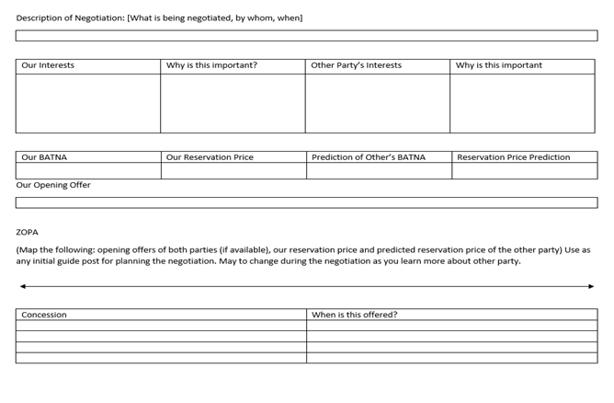
Negotiation Worksheet
Notes:
Negotiation Worksheet – this can be helpful in planning any negotiation, whether in your work or personal life. This worksheet will help you consider the interests of both parties, BATNA, reservation price, and any concessions you’re willing to make (and when to make them)
We’re going to give you some time to go through the worksheet with your small group (X people nearest you) and plan your negotiation based on the information in the case study. Then we’ll take a break and come back and negotiate!

Slide 60
04
The Fishbowl
Notes:
A volunteer practices negotiating against Scarlet our rep.

Slide 61
04
Discussion /
Wrap Up
Notes:
Observations about the Fishbowl, the day. Q&A, Resources

Slide 62
Resources Mentioned

Slide 63
Licensing
Zavala, Melina, and Matthew Reidsma. 2020. “Trust, But Verify: Auditing Vendor-Supplied Accessibility Claims.” The Code4Lib Journal, no. 48 (May). https://journal.code4lib.org/articles/15122.
Zimmerman, Katie, Rachael Samberg, Samantha Teremi, Sandra Enimil, and Erik Limpitlaw. 2024. E-Resource Licensing Explained. Association of Research Libraries. https://berkeley.pressbooks.pub/eresourcelicensingexplained/.

Slide 64
Business Terms
Unsub - https://unsub.org/
Negotiation Planning Part 2: This lesson focuses on how to do an internal review of the library’s position when planning for negotiations. https://sparcopen.org/our-work/negotiation-resources/oneal/oneal-curriculum/negotiation-planning-part-2/
Romaine, Siôn, Barbara Albee, Cynthia M. Elliott, and Stephen Bosch. 2024. “OA, AI, and DEI—Triple Advantage or Triple Threat? | Periodicals Price Survey 2024.” Library Journal, April 22, 2024. https://www.libraryjournal.com/story/oa-ai-and-dei-triple-advantage-or-triple-threat-periodicals-price-survey-2024.
Negotiation Planning Part 3: This lesson focuses on how to do an external review of a vendor when planning for negotiations. https://sparcopen.org/our-work/negotiation-resources/oneal/oneal-curriculum/negotiation-planning-part-3/
Macy, Katharine V. 2021. “Librarian’s Guide to Understanding Scholarly Publisher Financial Data.” https://scholarworks.iupui.edu/handle/1805/26256.

Slide 65
Negotiation Practice
ONEAL website: https://oneal-project.org/
Discord Community: https://oneal-project.org/discord/

Slide 66





THANKS!
https://sparcopen.org/our-work/negotiation-resources/oneal/

