Slide 1

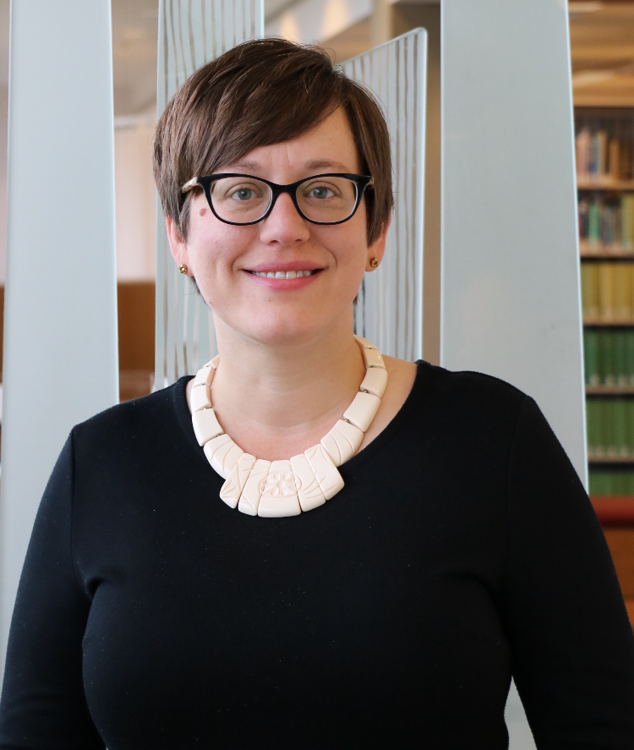
Simplifying Content Delivery with InstantILL: Integrating Link Resolvers, OA Searching, and Interlibrary Loan Requesting
Mike Paxton & Tina Baich
IUPUI University Library
ER&L Conference, March 2020
Notes:
TINA

Slide 2


Collaborators
Notes:
TINA

Slide 3
Agenda
Why InstantILL?
What is InstantILL?
How does InstantILL work?
What are the results?
How can you implement InstantILL?
Notes:
TINA

Slide 4
Why InstantILL?
User perspective
lack of unified discovery
poor user experience
desire for convenience & speed
Library perspective
steers traffic away from library collections & services
false impressions of user needs
potential loss of funding and access
Diminishing the perceived need for black open access. Interlending & Document Supply Conference, October 2017.
Notes:
[TINA]
I want to start with a bit of context for why I became involved in this project.
For a number of years, I’ve studied the intersections of open access and interlibrary loan. In 2017, my research evolved into a call to action for my resource sharing colleagues. Beyond utilizing open access for the benefits it brings to ILL — faster delivery, reduced cost, and greater fulfillment of requests, ILL practitioners are perfectly positioned to advocate for improvements to library systems. Our users want convenience and speed, while we as libraries continue to offer a fractured discovery environment that leads to poor user experience. This steers traffic away from library collections & services, which in turn gives libraries (and campus administrators) a false impression of user needs and could lead in reductions in library funding. These same issues, plus the myriad search options for locating open access content, have lead our users to turn to alternative methods for obtaining articles — methods that aren’t always legal. Large-scale copyright violation through the use of tools like Sci-Hub could also lead to suspension of library access by publishers. I called on my colleagues to push their libraries to take action to address the underlying discovery issues that plague our users.
When I gave this paper in 2017, I was aware of the Open Access Button and their stated desire to work with libraries, but it felt like a true moment of serendipity to hear Joe McArthur, Director of the Open Access Button, speak at the same conference. He outlined a path to addressing the user perspective I’ve just described that also enabled us to more rigorously promote open access content than had been possible with any of the ILL workflows I had created within our existing systems. It was as if he had read my mind and translated my thoughts into an action plan. I knew I had to heed my own words and help make this community-owned, open source solution a reality.

Slide 5
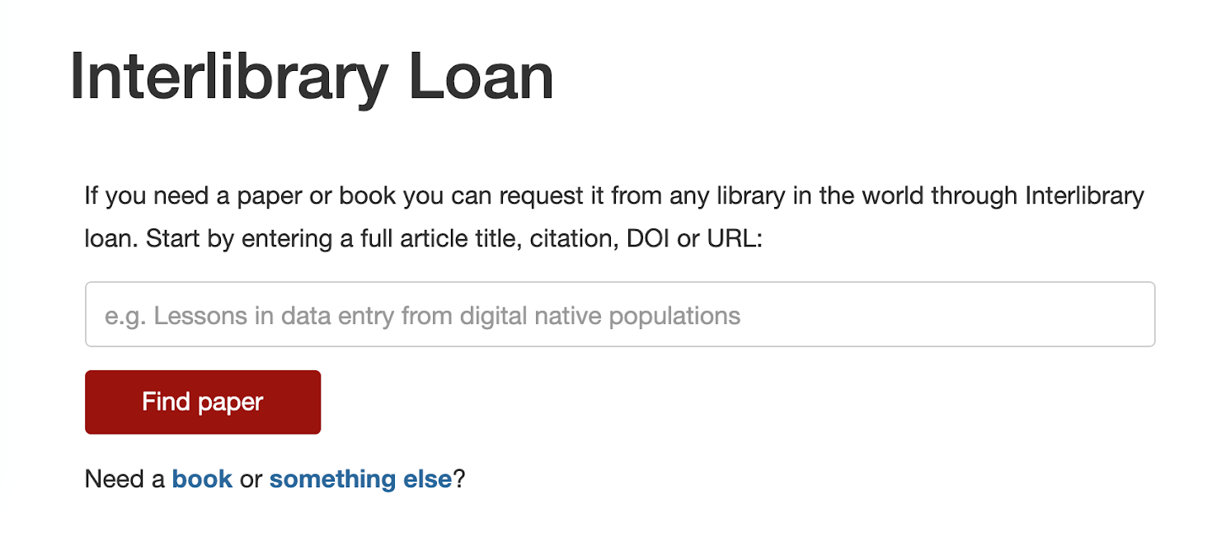
What is InstantILL?
Integrates link resolver results, Open Access searching, and ILL request submission into a single, simple user interface
Notes:
MIKE
What it isn’t:
A link resolver
(That gets asked a lot)
What it is:
a known-item search tool
that consolidates multiple steps
Attempting to make getting articles legally as simple as scihub or #icanhazpdf

Slide 6
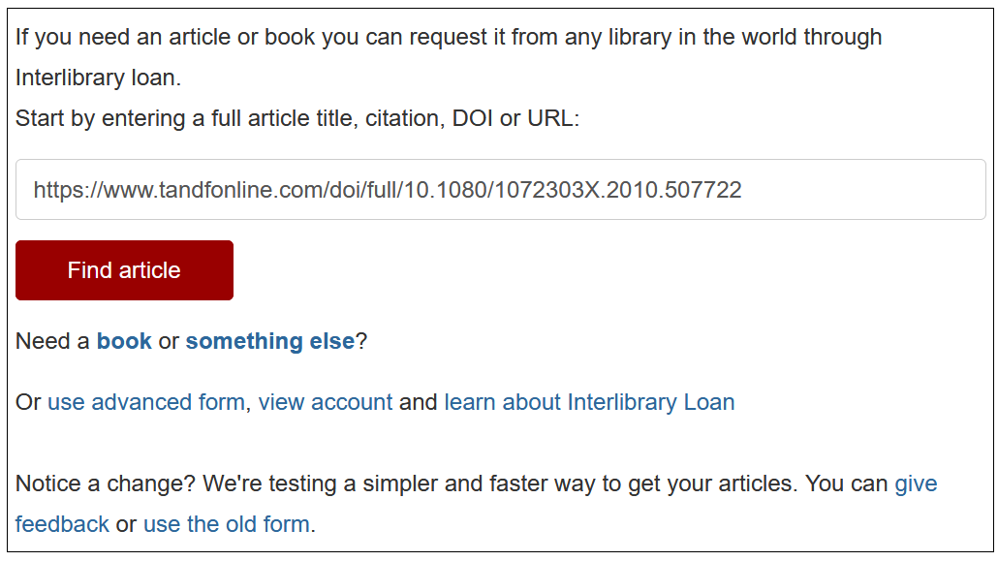
How does InstantILL work?
Patrons search by article title, full citation, URL, DOI, PMCID, or PMID
Notes:
MIKE
“How does InstantILL work?” as in “How does a car work?” - operational, not mechanical
Users can search by a variety of identifiers
Instead of having users provide all the metadata in a form, InstantILL uses a single search box and matches the identifier to a set of article metadata
Metadata sources include:
Unpaywall Data
Share
CORE
OpenAIRE
Dissem.in
Europe PMC
BASE
Crossref

Slide 7
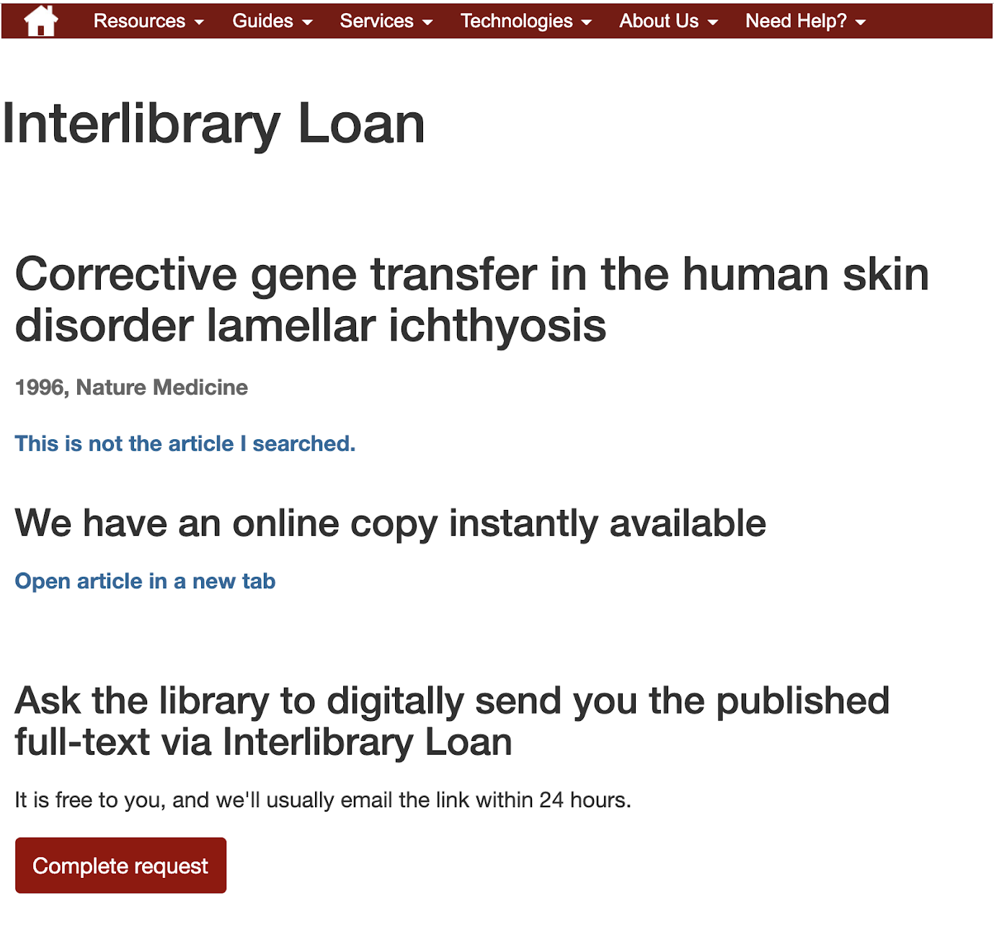
How does InstantILL work?
Subscription availability via link resolver
Notes:
MIKE
First, InstantILL queries your link resolver
If there is an available copy you’re paying for, patrons get that link
The experience should be similar to using a Citation Linker to query a link resolver, but again - just one field, not a form to manually supply metadata
In case something goes wrong (occasionally wires get crossed), there is an option to either correct the citation or to send the request to interlibrary loan instead

Slide 8
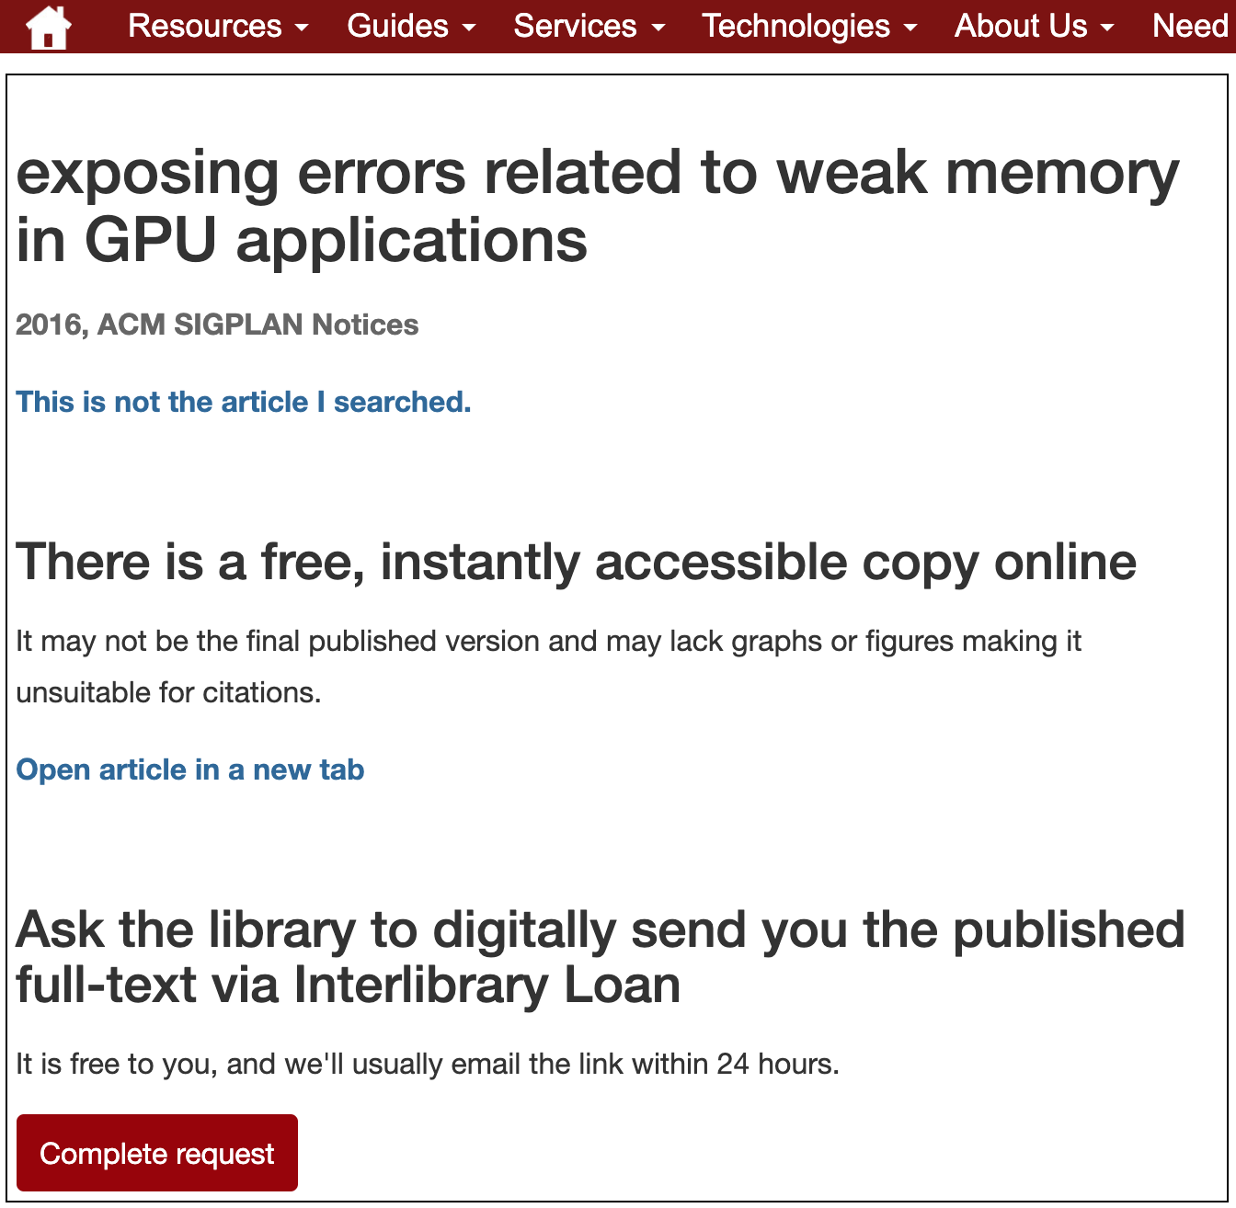
How does InstantILL work?
Open access availability via Open Access Button
Notes:
MIKE
Second, if the link resolver doesn’t return a found item but OpenAccessButton finds an OA copy, InstantILL will provide that link
This won’t be a ResearchGate or Academia.edu link
Sometimes (often) this is a pre-print version - if it doesn’t meet the user needs, or if they just love interlibrary loan, they can send the request to ILL instead

Slide 9
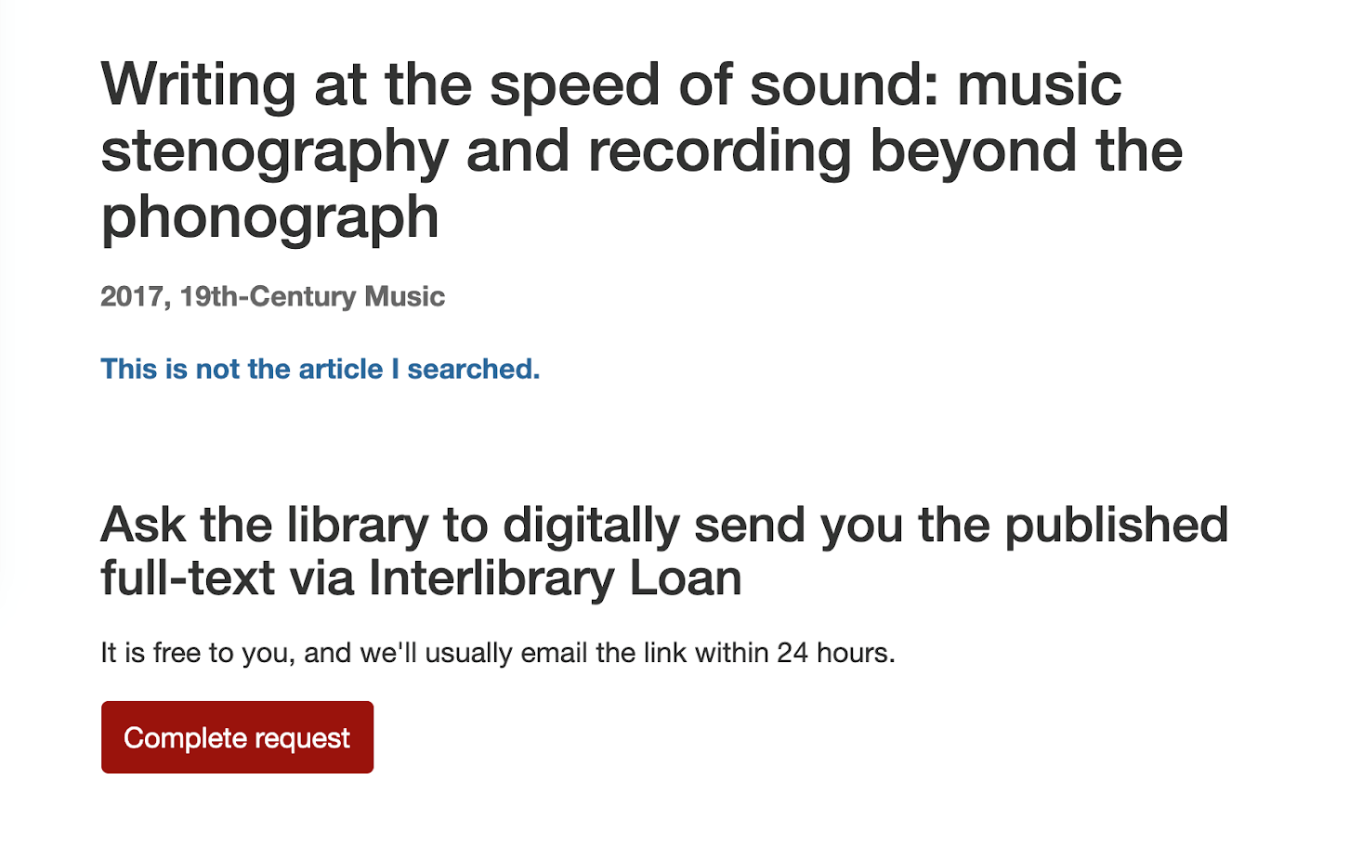
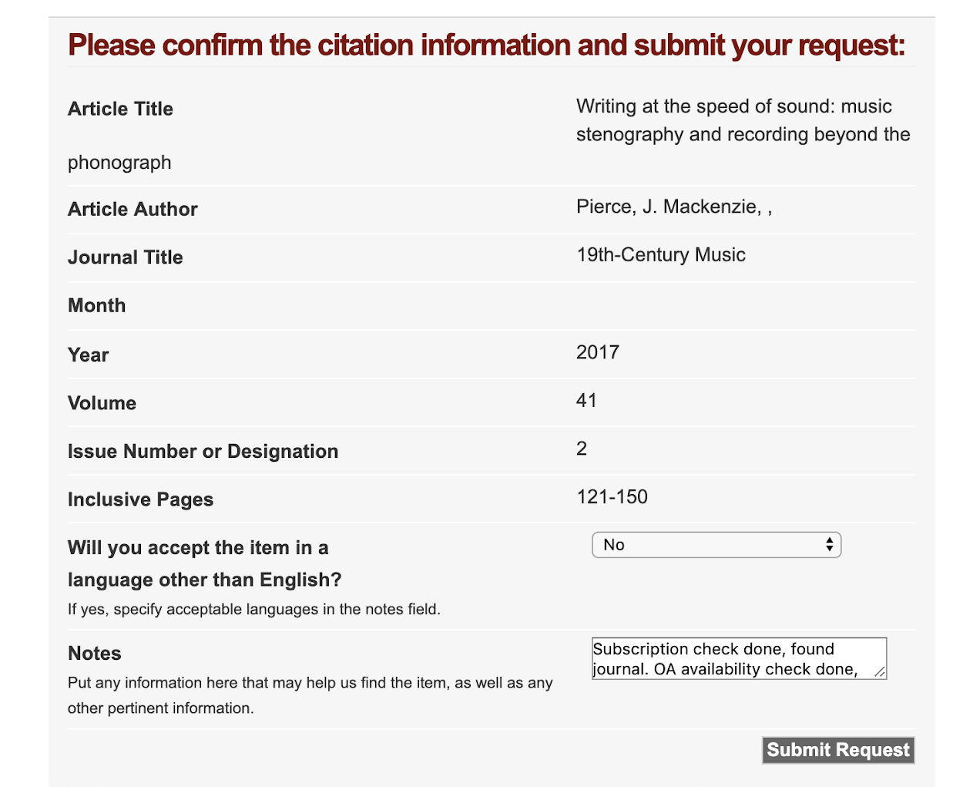
How does InstantILL work?
ILL request submission
Notes:
MIKE
Third, if no paid copy and no OA version are found, InstantILL provides a link to submit to ILL
This screen gives the patron a chance to confirm that the correct article metadata is matching
title, journal, and year are shown
Other metadata is behind the scenes
When the paron clicks “Complete request”, InstantILL sends the metadata to your ILL system via OpenURL
(this can also be configured to send an email instead)
The form at right shows the full set of metadata has been supplied
Mike used ILLiad OpenURL mapping to send these requests to a customized article form, that does not give patrons the option to change the metadata.
The custom form DOES add a note to staff, indicating that InstantILL has already checked for local and OA copies
Depending on your preferences, you can save staff time by not checking these again
You could also send them to the standard article form
If we trusted the machines completely, this step could be eliminated - but giving users a chance to confirm the citation seems wise and prevents mismatches
We have occasionally had matching errors reported by our users
When we report these to OAB, they have been quick to confirm and fix the underlying bug

Slide 10
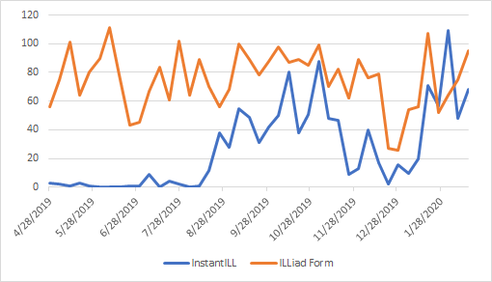
What are the results?
 | InstantILL form | ILLiad Article Form
All Time | 1180 | 3285
After Adding to Forms | 1140 | 1976
Notes:
MIKE
Access Query: after April 26 (date added to ILL webpage), borrowing or doc del, either cited in is “oabill” or cited in is null AND request type is article
Count of transaction number by week
Combine weeks 53 & 1
Numbers pulled feb 24, 2020

Slide 11
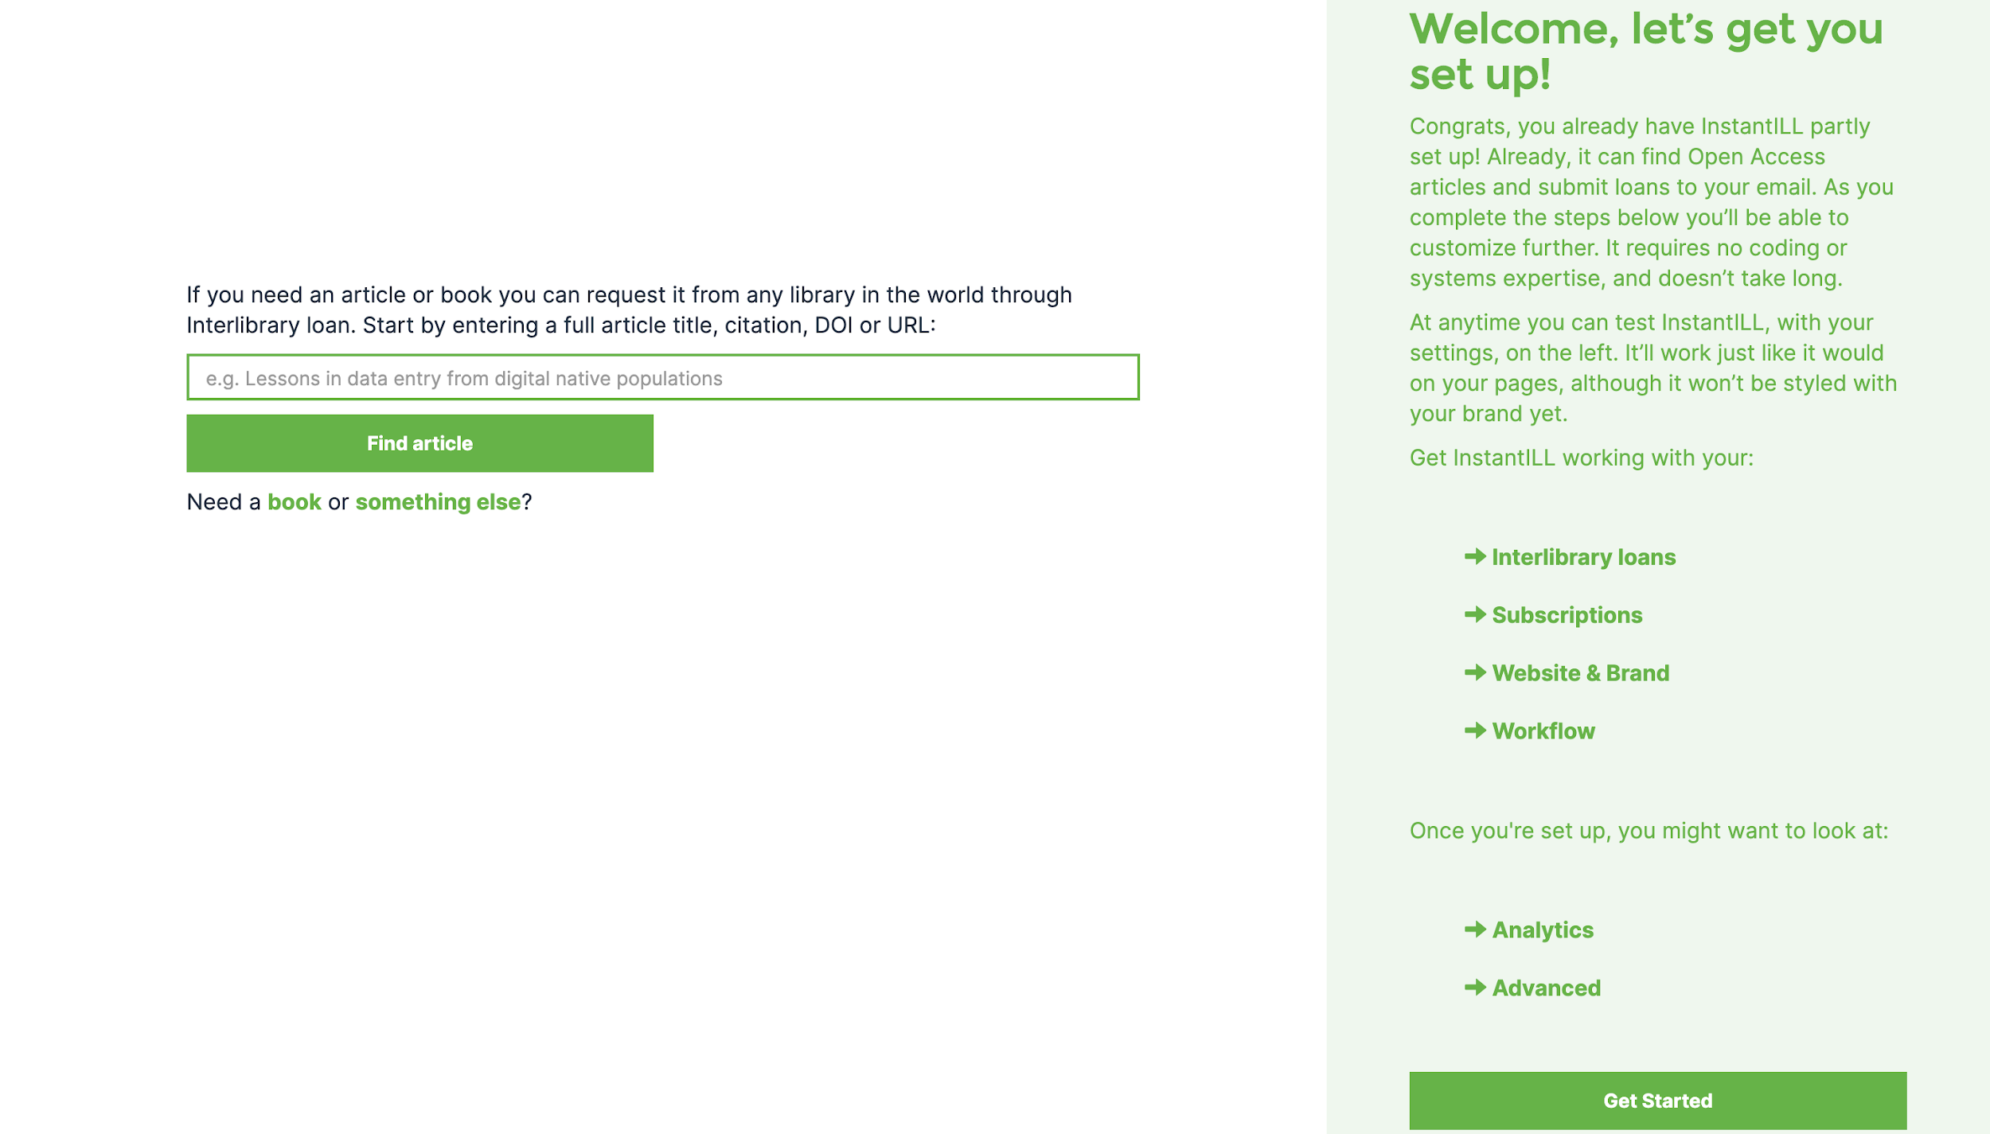
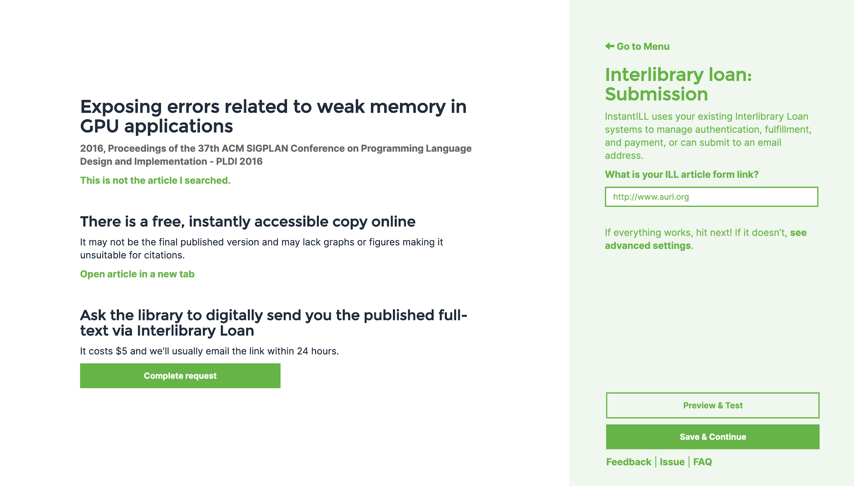
How do you implement InstantILL?
Notes:
MIKE
Simply
Mike is not a coder - confidence level is making adjustments to ILLiad webpages/following Atlas’s documentation to create a new request form, NOT writing new scripts or creating original CSS.
“Take something that works similarly, copy it, and break it until it does what you want”
Joe McArthur & team built the setup process to support this level of user, and also people who are less confident
A series of forms asks for info, such as
ILL Article Form URL
Library info (name of library, email address, other ILL forms, About ILL URL)
Link resolver provider and base URL
This sounds complicated - they provide examples of what they’re looking for
You can match the example, or ask the person at your library who manages your link resolver
At each step, the box on the left side of the screen is updated to reflect the changes you’ve made
Before deploying locally, you can check whether your settings+InstantILL are performing as expected

Slide 12
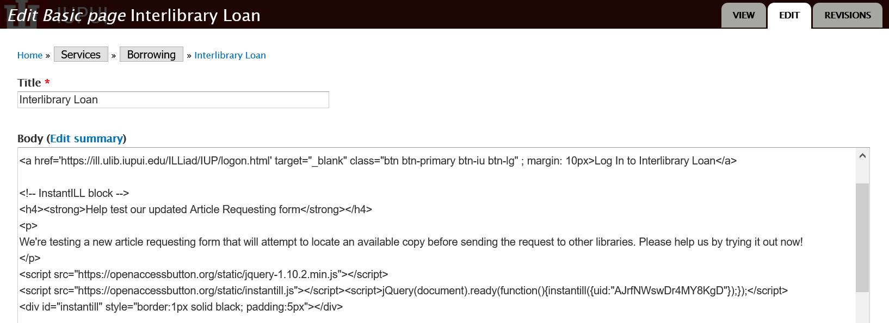
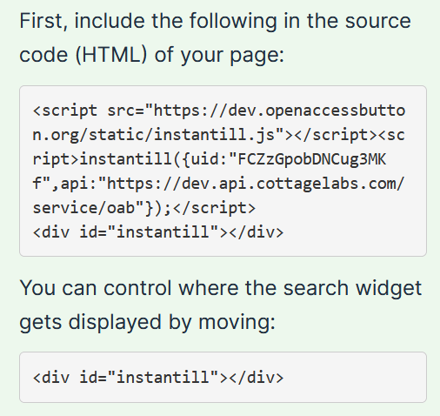
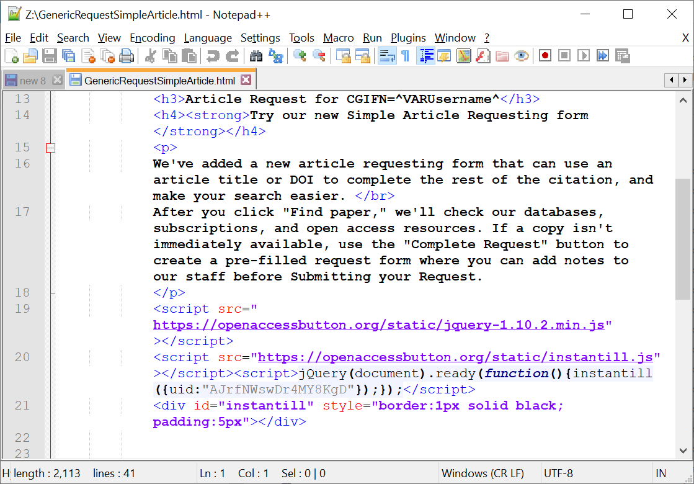
How do you implement InstantILL?
Notes:
MIKE
At the end of the process, the InstantILL setup gives you a chunk of HTML
You can add this to your library’s CMS (here, in Drupal) or to an HTML file (here, in Notepad)

Slide 13
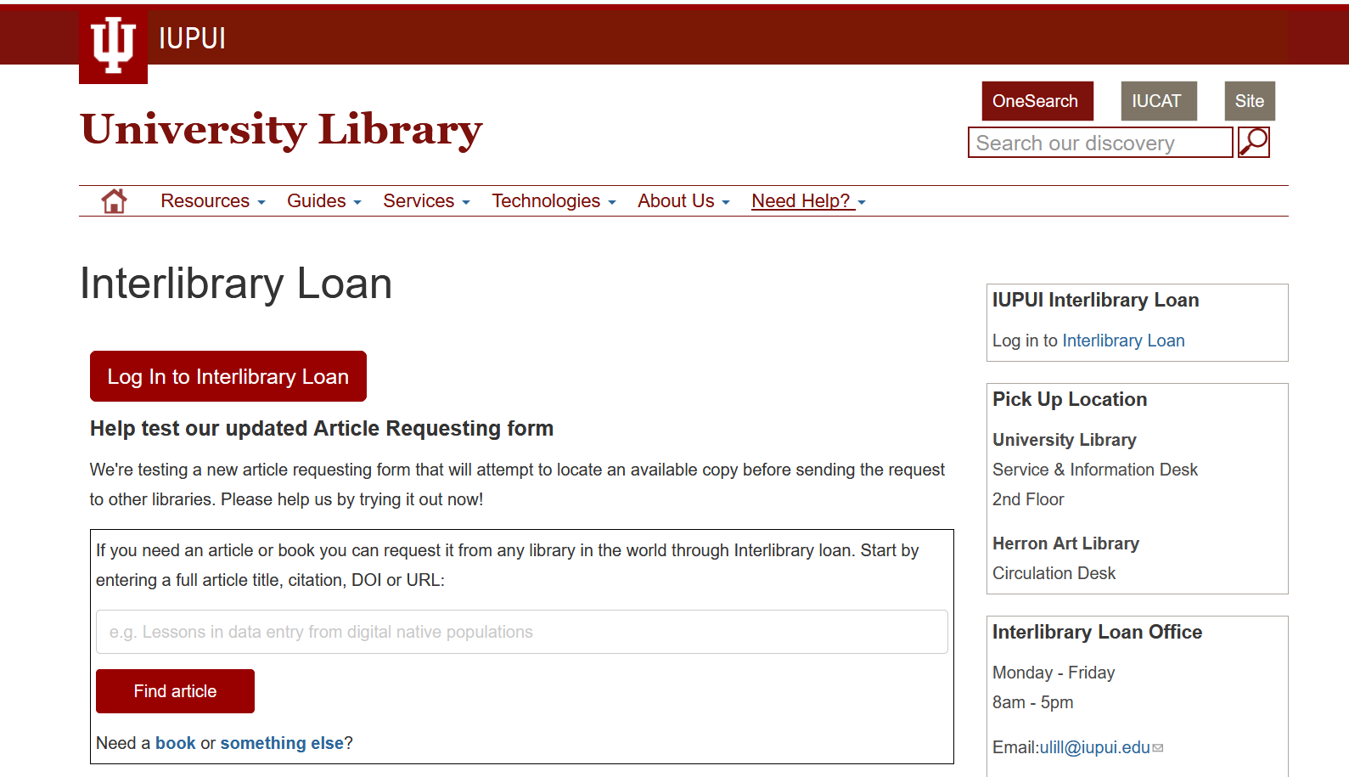
How do you implement InstantILL?
Notes:
MIKE
Ex 1: our locally configured form, embedded on our About ILL page

Slide 14
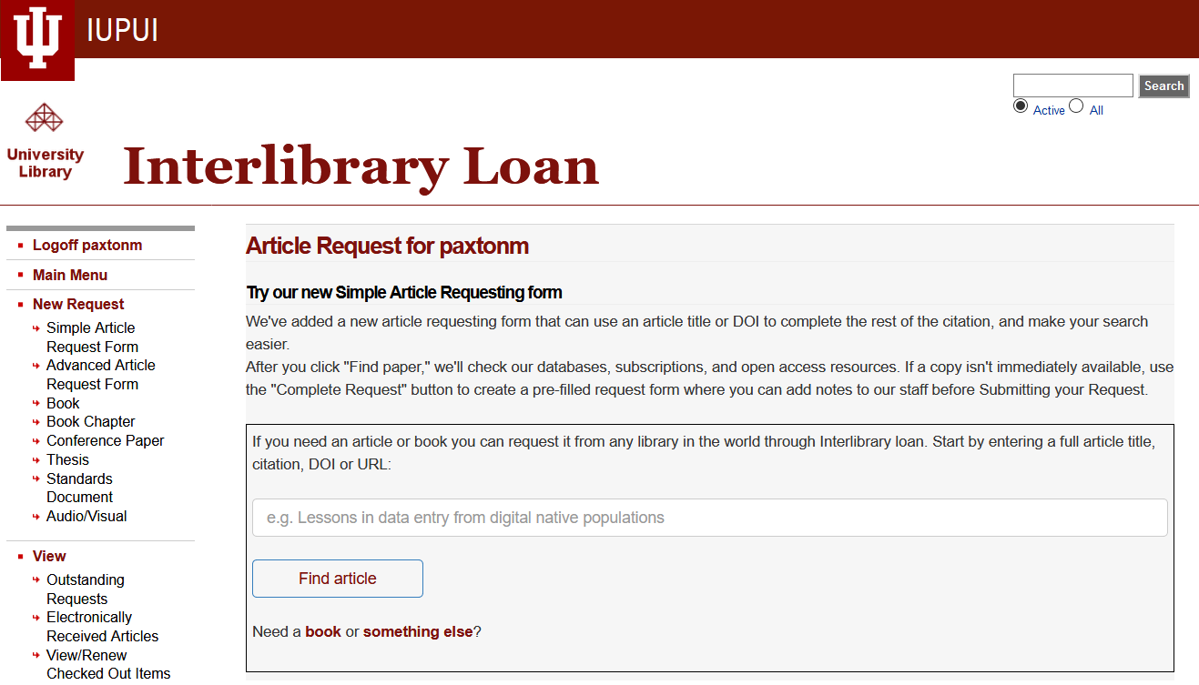
How do you implement InstantILL?
Notes:
MIKE
Ex 2: in our local ILL system
We’re not yet onto ILLiad 9.1 webpages; this will be even prettier in a few months!

Slide 15


Many, many thanks!
Joseph McArthur
Co-Founder & Director, Open Access Button
Gary Maixner
UX & Project Management Librarian
Notes:
MIKE

Slide 16
Many thanks!
Kristi Palmer
Kevin Petsche
Rich Wing
Teodora Durbin
Arcadia Fund & SPARC
Cottage Labs & Mark MacGillivray & Sam Ballard
The many libraries & librarians who have offered interest, support, & expertise. Including Janet Chandler & Christopher Beevers.
Notes:
MIKE

Slide 17
Read more
Baich, Tina. 2017. Diminishing the perceived need for black open access. Interlending and Document Supply Conference, Paris, France, October 4-6, 2017. [Available at: http://hdl.handle.net/1805/14178]
Paxton, Mike, Gary Maixner III, Joseph McArthur, and Tina Baich. 2019. “Engineering a Powerfully Simple Interlibrary Loan Experience with InstantILL.” In Beyond the Paywall: Resource Sharing in a Disruptive Ecosystem. Proceedings from the 16th IFLA ILDS Conference, held at National Library of Technology in Prague, Czech Republic, October 9-11, 2019, http://repozitar.techlib.cz/record/1432. [Preprint available at: http://hdl.handle.net/1805/20422]
Notes:
MIKE

Slide 18
Questions?
paxtonm@iupui.edu
cbaich@iupui.edu * @tinabaich
InstantILL.org

