Slide 1

the ONEAL project
OpenCon Community Call November 2023

Slide 2
Project team
Katharine V. Macy
Project Director/Principal Investigator
Indiana University - Indianapolis (IUPUI)
Scarlet Galvan
Co-Principal Investigator
Grand Valley State University
Courtney Fuson
Co-Principal Investigator
Belmont University

Slide 3


ONEAL
Open Negotiation Education for Academic Libraries:
The creation of a nontraditional OER with lesson plans, readings, lectures, hands-on assignments to support individual learners and groups.
Funded by the Laura Bush 21st Century Librarian Grant Program with IMLS

Slide 4
The Curriculum
Foundations
Strategies
issues
Contracts & Licensing, Negotiation Strategy, Preparing for Negotiations
Priority setting, Stakeholder Engagement, Vendor Management
Accessibility, Intersection of licensing and technology, Acquisition Modules
Notes:
Curriculum broken down into three major sections - Foundations, Strategies, and Issues. Each module covers a variety of topics and all content is mapped to the seven learning objectives that we set out for the curriculum as a whole.
The foundations module includes introductory information (glossary, historical context, overview, etc) and is designed to help get folx started in their learning about negotiations.
The strategies module is focused on providing structure for negotiations - setting your priorities, managing who is or should be involved before and during negotiations, and managing relationships with vendors
The issues module is the most forward-looking module. This is where we provide information on the current and forthcoming issues in the field. This includes things like acquisitions models (point of need, EBA, DDA, Open Access, transformative agreements, etc), text and data mining (TDM), privacy & surveillance, authentication, and accessibility.
Foundations and Issues are within the scope of the original IMLS grant and are being completed first for launch in early 2024. The strategies module will likely launch later that year.

Slide 5
roadmap
01
02
03
community
Pilot testing
Launch
Fall 2022: Community forums and curriculum planning workshop
Curriculum building
Fall 2023: Testing foundations module lessons and accessibility lesson
Spring 2024
2023-24: Interviews, OER and revision
Notes:
Progress thus far:
One year ago - Community: Held 3 community forums, community planning workshop included advisory board and 11 librarians from the community
Curriculum Building: Interviewed 38 librarians who work in negotiations, we are in the process of analyzing those interviews for key themes which will inform the creation of new negotiation case studies and has informed the building of learning objectives created for the curriculum. We have finished drafting the content in the foundations module which includes 4 lessons: Contracts & licensing, Introduction to Negotiations, and Negotiation Planning parts 1, 2, & 3 which covers negotiation strategy, internal analysis, and researching vendors. Invited expert content creators have also drafted the accessibility lesson in the issues module.
Fall 2023, AKA Now! Pilot Testing: 30 pilot testers are currently reviewing the drafted content. We are getting feedback from them about the content, structure, and pacing of the curriculum.
In early 2024 we will revise this content based on feedback with plans to launch foundations and accessibility in March 2024 were we plan to present at conferences. We will also be extending outreach, offering to speak at groups to introduce the curriculum more widely. We are continuing to draft lessons and new case studies through 2024.
Launch is anticipated in late Spring 2024

Slide 6


Challenges
Grant administration at institutional level (lag time!)
Multiple intersecting specialized areas of expertise.
Varying degrees of comfort with ambiguity.
Paradigm shift for learners as they look at different ways to think about and approach negotiations.

Slide 7
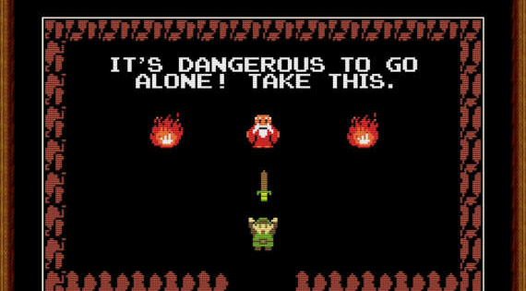

Slide 8
Opportunities
Community of Practitioners
Licensing for Open

Slide 9

Impact!
Notes:
Pilot testers have noted how almost soul searching the curriculum is!
People are considering new ways to understand how to value collections
Learners are learning techniques that vendors have been well trained in. For example journaling about each negotiation about what happened - how the other reacted - what worked, what didn’t. Vendors have been doing this from the get go with customer relationship management solutions provided by companies like Salesforce.com

Slide 10




THANKS!
Do you have any questions? What issues are you facing in negotiations?
How can we help?
https://oneal-project.org/

