Slide 1

Texts from Last Night:
Student Perceptions of Research and Space in Libraries
Yoo Young Lee, Web & Digital Initiatives Librarian, University of Ottawa
M. Sara Lowe, Educational Development & Assessment Librarian, IUPUI
Willie Miller, Informatics & Journalism Librarian, IUPUI
Notes:
Willie will intrduce us all.

Slide 2
Background
Needs assessment
Space assessment + user experience + Information Literacy instruction
Notes:
(SL) Definition I found that seems good - Conducting a needs assessment is a systematic process of investigating a population or community to assess the state of current resources such as knowledge, abilities, interests, and approaches pertinent to the focus of the needs assessment such as a concern, aspiration, or intention.
A needs assessment is a focused examination of the way things currently are and the way things can or should be in order to fill a gap in services, (e.g., establish trainings to address a specific need). https://cyfar.org/ilm_1_9
WM
IUPUI University Library was in the beginning stages of a renovation of two floors. The architects and designers were interested in know everything we could about student study habits. Nationally, there is a growing trend of universities investing in informal learning spaces. Georgia Tech, MIT, and Purdue are a few examples of universities that have recently built learning hub buildings that integrate teaching spaces with informal learning spaces that one would otherwise find in a library (study rooms, movable furniture, white boards, etc.). Because the library is a centralized space for informal learning and because we are usually at the table when this kind of space is developed, we were interested in the intersections between the formal learning in the classroom and research assignments, the information resources student use in completing their assignments, and the features of the space in which they complete their work. We were also interested in these intersections, because librarians teach students about research in courses and we develop educational webpages and provide access to resources to support student work.

Slide 3
Method
n=20 participants (initially)
5 questionnaires (fall 2017)
Individual de-briefs with n=9 participants who did all 5 surveys
Software: survey = Qualtrics, SMS = ClassPager
Notes:
WM
For this study, we wanted to view the progression of a student’s full semester to get a glimpse of the changes in their relative effort over time. So, we designed a survey with 20-item questionnaires that were delivered five times across the fall 2017 semester through the SMS messenger ClassPager.
Students received $10 Amazon gift cards for each questionnaire. The questionnaires asked students about the kinds of assignments they were working on in the moment, if they have developed research questions, where they had done research, how they felt about the assignment, and where they were studying. This gave us quantitative data.
In our debriefs, we asked about their preferences in their study environments, their reasoning in choosing sources for research projects, and we had them diagram a model of the research process to indicate how they did research for courses. Students were paid $20 for the debrief conversations.

Slide 4
Lessons Learned
Logistics
Survey software
Data analysis for a small n
Time and resources
Notes:
SL
Challenging to handle logistics of paying for participation esp. after every text (5) & debrief
Qualtrics texting service costs money! Free options are limited.
Data analysis can be challenging esp. if you can’t track a participant through each survey and debrief
Output of time to develop and deploy multiple surveys didn’t = return on investment. Could have done fewer surveys.

Slide 5
Data
Easier
One-time survey
Usage data
Harder
One-on-one debriefs
Mixed Methods
Longer duration
Gate counts
Notes:
SL
Using and combining data to make decisions beyond what we normally collect.
There is the low-hanging fruit – for example, gate count. But doing something that took more time/effort – can yield more nuanced results that actually help you make decisions.

Slide 6
Data Analysis
A total of 14 undergraduate students participated in one of the study series, but only 9 students completed all surveys and in-person debriefing session.
In spite of small sets of data, data itself was very rich to identify their academic life throughout the semester.
Challenge: How to represent data in a meaningful way?
  Personas
Notes:
YY
Summarize results from this study

Slide 7




My Student Life at IUPUI
One major year-long research project
Name: Sophie
Major: Psychology
Year: Junior
Age: 21
W3
W6-W7
W12
W14-W15
Research Question
2 hours
Research Question
Research Question
Research Question
6-10 hours
1-3 hours
1-3 hours
Develop it based on course materials
Revise and learn more about it using research guides
Learn more about it using Google and research guides
If needed, verify it using Google and research guides
Search
1 hour
Search
Search
1-3 hours
Search
1 hour
1-3 hours
Find sources in citation from biographies and library A-Z databases list
Like week 6 and week 7, but add more from sources’ citation that I found
Focus on specific library databases and instructor’s recommendation
Search more in specific library databases and recommendation by instructor
Evaluation & Writing
2 hours
Evaluation & Writing
Evaluation & Writing
2 hours
Evaluation & Writing
1-3 hours
5 hours
Select my sources based on author’s reputation and develop an outline
Select my sources based on relevancy and scholarly sources
Select my sources based on relevancy, scholarly sources, and recent publication
Finalize my sources based on relevancy, scholarly sources
Not prepared
Not satisfied
Frustrated
Prepared
Satisfied
Confident

Slide 8

My Student Life at IUPUI
More than one research project, paper, assignments
Name: David
Major: Education
Year: Senior
Age: 23
W3
W6-W7
W12
W14-W15
1-2 hours
1-3 hours
Research Question
2 hours
Research Question
2 hours
Research Question
Research Question
For new research assignment, develop it based on course materials
Learn more about it using Google and course materials
Develop it based on background research in Google, research guides, and Wikipedia
If needed, verify it using Google, Wikipedia and citation
Search
1 hour
Search
1 hour
Like week 6 and week 7, but add more from sources’ citation that I found
1-3 hours
Search
Search
1 hour
Search in specific library databases
Focus on specific library databases
Start from Canvas, research guide, and instructor’s recommendation and then Google, Google Scholar, and IUCAT
Evaluation & Writing
1-3 hours
Evaluation & Writing
6 hours
Evaluation & Writing
1-3 hours
Select my sources based on relevancy, scholarly sources, recent publication, and overall quality
Consider all criteria including author’s reputation and verify my citation using Purdue Owl
Select my sources based on relevancy, scholarly sources and overall quality
Evaluation & Writing
0 hour
Not prepared
Not satisfied
Frustrated
Prepared
Satisfied
Confident

Slide 9

My Student Life at IUPUI
More than one research project, paper, assignments
Name: Catie
Major: Science
Year: First year
Age: 18
W3
W6-W7
W12
W14-W15
1 hour
3-5 hours
Research Question
0 hour
Research Question
0 hour
Research Question
Research Question
Learn more about it using Google and Wikipedia
Learn more about it using Google and Wikipedia
Search
0 hour
Search
0 hour
Evaluation & Writing
0 hour
Evaluation & Writing
0 hour
Search
1 hour
Search
Use Google and Canvas course site to find out my sources
5+ hours
Use IUCAT and A-Z Database list
Homework
Quiz
Homework
Quiz
Exam
Evaluation & Writing
5+ hours
Evaluation & Writing
1 hour
Select my sources based on relevancy
Select my sources based on relevancy and scholarly source
Not prepared
Not satisfied
Frustrated
Prepared
Satisfied
Confident

Slide 10

My Student Life at IUPUI
One major research project
Name: Simone
Major: Social science
Year: Junior
Age: 20
W3
W6-W7
W12
W14-W15
Research Question
1 hour
Research Question
0 hour
Research Question
0 hour
Research Question
0 hour
Develop it based on background research in Google, Wikipedia and recommendation by instructor
Search
Search
0 hour
Search
0 hour
0 hour
Completed in the previous weeks using CDC website
Evaluation & Writing
0 hour
Evaluation & Writing
0 hour
Search
0 hour
Evaluation & Writing
3-5 hours
Exam
Homework
Quiz
Exam
Select my sources based on relevancy
Submit my report always in advance
Evaluation & Writing
0 hour
Not prepared
Not satisfied
Frustrated
Prepared
Satisfied
Confident

Slide 11
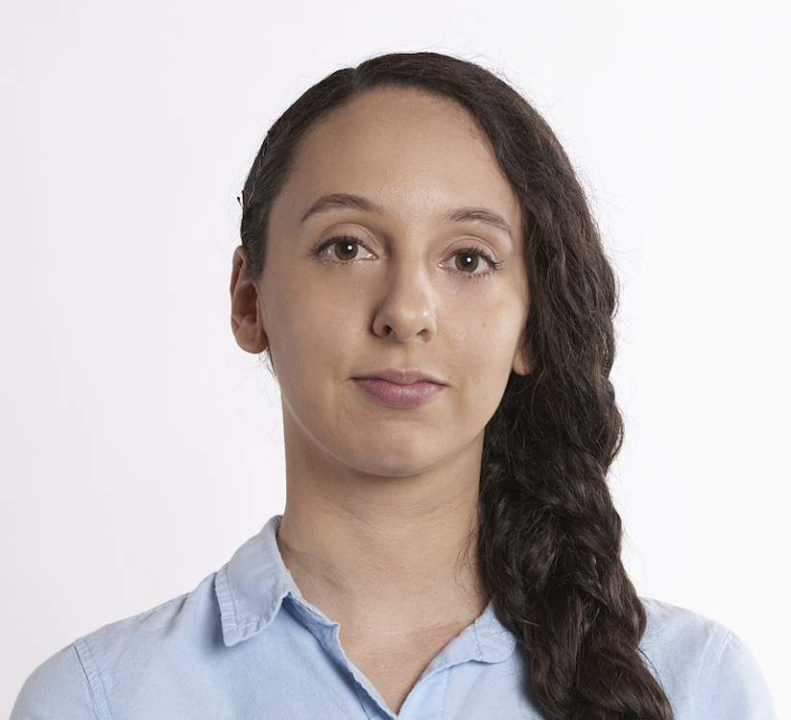
My Student Life at IUPUI
More than one research project, paper, assignments
Name: Nathalie
Major: Health science
Year: Senior
Age: 25
W3
W6-W7
W12
W14-W15
2-4 hours
1-3 hours
Research Question
0 hour
Research Question
1.5 hours
Research Question
Research Question
Develop it based on Google, course materials, library website and specific health-related website
Learn more about it using Google, research guide and course materials
Search
0 hour
If needed, verify it using course materials
Evaluation & Writing
0 hour
Search
1-3 hours
Search
1-3 hours
Use Google, Canvas, and library databases
Find more sources in Google Scholar, Google, specific library databases
Homework
Quiz
Group project
Search
0 hour
Evaluation & Writing
Evaluation & Writing
5+ hours
Evaluation & Writing
6 hours
0 hour
Consider all criteria to select my sources
Consider all criteria but author’s reputation to select my sources
Not prepared
Not satisfied
Frustrated
Prepared
Satisfied
Confident

Slide 12








Where do I study?
I spent the most time preparing/studying for all my assignments this week at home.
I am extremely likely to study at home again in the future.
Because of technology available for me
I study mostly alone.
Because of convenient location for me
I sometimes prepare for my assignments with others.
Because of amenities such as food, beverages
Because of perfect environment to study for me (e.g., noise level, privacy)
Notes:
YY

Slide 13
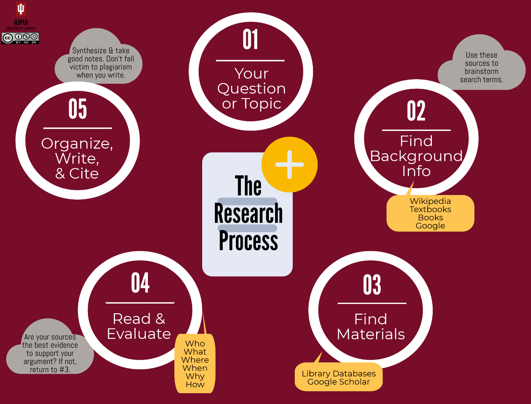
Data to Decision Making (aka Closing the Loop)
Notes:
SL
N=9
3 birds with one stone – user experience, information literacy, and space needs
Viewing students holistically – because often what we do is look more narrowly at one or two things – which may give a less than complete picture of student research needs/habits
So how to take this data and make it actionable?
-Adding this to discussion about space usage and needs, Present to colleagues
-User experience – how are students using our resources?
-Informing our Information Literacy instruction – for example, students largely align with the research process taught in multiple classes.

Slide 14
Questions?
Contact Us
Yoo Young Lee | yooyoung.lee@uottawa.ca
Sara Lowe | mlowe@iupui.edu
Willie Miller | wmmiller@iupui.edu

Slide 15
Credits
Icon made by Freepik from www.flaticon.com and licensed by Creative Commons BY 3.0
Icon made by Freepik from www.flaticon.com and licensed by Creative Commons BY 3.0
Icon made by Freepik from www.flaticon.com and licensed by Creative Commons BY 3.0
Icon made by Vectors Market from www.flaticon.com and licensed by Creative Commons BY 3.0
Icon made by Smashicons from www.flaticon.com and licensed by Creative Commons BY 3.0
Icon made by Picol from www.flaticon.com and licensed by Creative Commons BY 3.0
Icon made by Freepik from www.flaticon.com and licensed by Creative Commons BY 3.0
Icon made by Twitter from www.flaticon.com and licensed by Creative Commons BY 3.0
Icon made by Smashicons from www.flaticon.com and licensed by Creative Commons BY 3.0
Icon made by Freepik from www.flaticon.com and licensed by Creative Commons BY 3.0
Icon made by Chanut from www.flaticon.com and licensed by Creative Commons BY 3.0
All images from pixabay with CC0 Creative Commons

