Slide 1
Knowledge Diffusion & Utilization within a System of Care Model
(Supporting Routine Use of Information for Planning
& Progress Monitoring)
Betty Walton, Isaac Karikari, Christine Garry, & Erin Tock
Notes:
Erin.

Slide 2



Introductions
Erin Tock, Manager for Advocacy & Inclusion
IN-SOC Advisory Board Facilitator
SOC Evaluation Team
Betty Walton, Ph.D., LCSW
Isaac Karikari, Ph.D.
Christine, Garry, MSW, LSW
Notes:
Erin.

Slide 3

Working Indiana State Infrastructure
CISCISC Executive Leadership
CISC Executive Director
CISC Committee Members
Mental Health & Substance Abuse
Child Safety and Services
Cross Systems
& Juvenile Justice
Educational Outcomes
Child Oversight Committee
Data Mapping & sharing
Trauma Informed Care Committee
State Interagency Child Collaboration
DMHA
DOC
DCS
DOE
DWD
BDDS
ISDH
ICJI
JDAI
INSOC Advisory
Youth and Family
Notes:
Erin.

Slide 4
Overview
Transitioning from required collection & reporting of grant data to routinely using information for planning and quality improvement processes at direct service, program, and system levels
Explores necessary conditions for the successful use of information to plan and monitor progress
Highlights tips
Applying tips to your practice
Notes:
Erin.

Slide 5
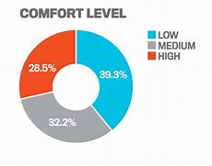
Exploring comfort levels with ‘DATA’
Notes:
Erin.

Slide 6
Using data (information) to manage services, programs, organizations & systems
Notes:
Betty.

Slide 7
Basics…
Access to data
  Siloes?
  Shared?
Convert data into understandable information
Determine how data (information) will be used
Notes:
Betty.

Slide 8
But, it’s not just about technology
Adopt System of Care values & principles
Involve youth and families
Support equity (cultural & linguistic considerations)
Collaborate
Link data to system’s strategic plan, to programs (services), & to outcomes (system, programs, youth & families)
Notes:
Betty.

Slide 9

Activity…
Identify 1-3 tips that would be helpful in your System of Care
Jot them down
Near the end of the workshop, we’ll discuss how tips could be implemented in your SOC
Notes:
Betty. Provide worksheet.

Slide 10
TIP 1
Engage Advisory Board in selecting instrument
Ensure that youth & families are involved
Engage stakeholders to help recruit survey participants
Use process to explain SOC
Use results in planning & to monitor progress
Self-assessment of state & local SOC development
Notes:
Isaac. Follow by ‘listening’ activity.

Slide 11
SOCIS Factors | State-County Comparison | 2014 Mean | 2016 Mean | 2018 Mean
Family Choice and Voice | State | 3.16 | 3.38 | 3.21
 | County | 3.2 | 3.22 | 3.14
Individualized Culturally Competent Treatment | State | 3.7 | 3.81 | 3.62
 | County | 3.85 | 3.92 | 3.79
Outreach and Access to Care | State | 2.97 | 2.86 | 2.85
 | County | 3.05 | 2.92 | 2.85
Transformational Leadership | State | 3.7 | 3.69 | 3.39
 | County | 3.58 | 3.55 | 3.5
Theory of Change | State | 3.61 | 3.54 | 3.26
 | County | 3.65 | 3.55 | 3.48
Implementation Plan | State | 2.6 | 2.95 | 2.6
 | County | 2.43 | 2.28 | 2.19
Population of Concern | State | 2.39 | 2.68 | 2.61
 | County | 2.2 | 2.13 | 2.18
Interagency Cross-Sector Collaboration | State | 3.06 | 3.48 | 3.23
 | County | 3.12 | 3.18 | 3.36
Values and Principles | State | 4.41 | 4.24 | 3.99
 | County | 3.81 | 3.98 | 3.95
Comprehensive Finance Plan | State | 2.93 | 2.95 | 2.76
 | County | 2.7 | 2.66 | 2.59
Skilled Provider Network | State | 2.29 | 1.94 | 1.97
 | County | 2.21 | 2.01 | 1.98
Performance Measuring System | State | 3.15 | 2.85 | 2.78
 | County | 2.97 | 2.82 | 2.68
Provider Accountability | State | 3.63 | 2.83 | 2.76
 | County | 3.36 | 3.32 | 3.17
Management and Governance | State | 3.39 | 3.39 | 3.16
 | County | 3.32 | 3.28 | 3.25
General System Performance | State | 3.01 | 3.17 | 2.57
 | County | 2.9 | 2.72 | 2.67
Notes:
Isaac.

Slide 12
Notes:
Isaac.

Slide 13
TIP 1B
Learning curve
  Could be helpful to incorporate training/shadowing opportunities
Can serve as a coordinator or liaison
Can help youth & families have a bigger voice/involvement
Can serve as a source of information & support with evaluation activities
Complete independent studies
Recruit future child behavioral health evaluators
Include college students in the evaluation process
(from a Research Assistant’s Perspective)
Notes:
Christine.

Slide 14
Activity…
Communication & Dissemination Activity
Notes:
Christine. Use script or image. Be sure to bring enough copies (CMG).

Slide 15
TIP 2
We need CLC in collecting data
Visualize your data
Construct a narrative
Anticipate both academic and colloquial expectations
Engage everyone you can in seeking explanations for your data
Make data accessible, understandable, and meaningful to youth & families
Notes:
Erin (will lead) & Christine (jump in later-on). Comment on how families helped to revise the SOCIS. We have shifted to including more graphics, but both mediums (written words and graphics) need to be available.

Slide 16
Primary Household Language
 | Primary Household Language | Medicaid Member Children | % of All Medicaid Children | Medicaid MH Children | % of All MH Children | MH % of Medicaid | Avg. Annual MH Services
1 | English | 664,006 | 89.77% | 122,899 | 91.08% | 18.5% | $ 2,602
2 | Spanish | 35,991 | 4.87% | 2,287 | 1.69% | 6.4% | $ 1,105
3 | Not Available | 32,063 | 4.33% | 9,551 | 7.08% | 29.8% | $ 5,603
4 | Burmese | 6,375 | 0.86% | 141 | 0.10% | 2.2% | $ 946
5 | Armenian | 683 | 0.09% | 42 | 0.03% | 6.1% | $ 1,403
6 | Chinese | 332 | 0.04% | 7 | 0.01% | 2.1% | $ 472
7 | Somalian | 83 | 0.01% | 7 | 0.01% | 8.4% | $ 266
8 | Other | 71 | 0.01% | 6 | 0.00% | 8.5% | $ 191
9 | Vietnamese | 41 | 0.01% | 1 | 0.00% | 2.4% | $ 32
10 | Rumanian | 26 | 0.00% |  | 0.00% | 0.0%
11 | French | 18 | 0.00% |  | 0.00% | 0.0%
12 | Japanese | 4 | 0.00% | 1 | 0.00% | 25.0% | $ 10,107
13 | Polish | 1 | 0.00% |  | 0.00% | 0.0%
 |  | 739,694 | 100.0% | 134,942 | 100.0% | 18.2% | $ 2,787
NA (Not Available) are those with no Primary Household language in the data, 77% of which were Receiving Adoption Assistance and 18% of which were Title IVE foster children, with 7% miscellaneous other aid categories
Several languages (Chinese, Somalian, Vietnamese, etc.) may be more significant from a Medicaid perspective, but had very few identified MH children.
(VanDyke, 2017)
Notes:
Erin & Christine. (Expect it to be adjusted within the next week.)

Slide 17
TIP 2B
For a program, organization, or system, run overall outcome report(s)
Then, re-run outcomes by gender, age group, race/ethnicity, and geography
Move from occasional reports to routine practice
Disaggregate data to identify disproportionate access to care and disparities in outcomes
Notes:
Isaac.

Slide 18
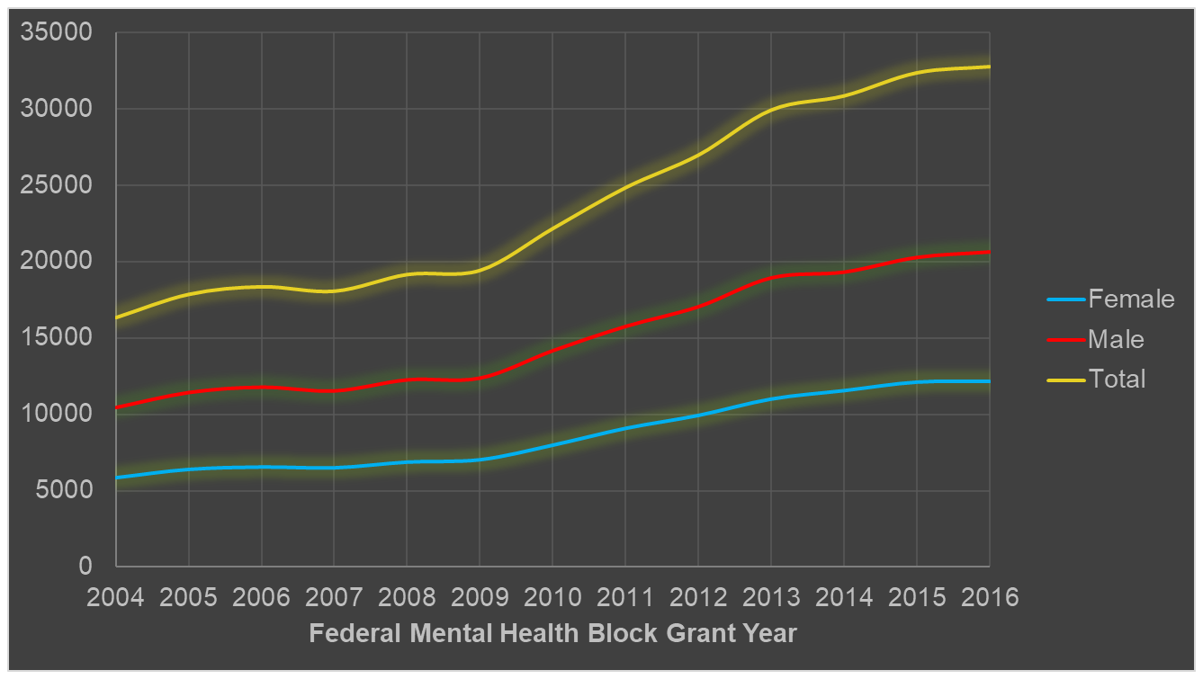
Mental Health Service Utilization 0 -12 Years Group
(Walton, Karikari & Garry, 2017)
Notes:
Isaac.

Slide 19
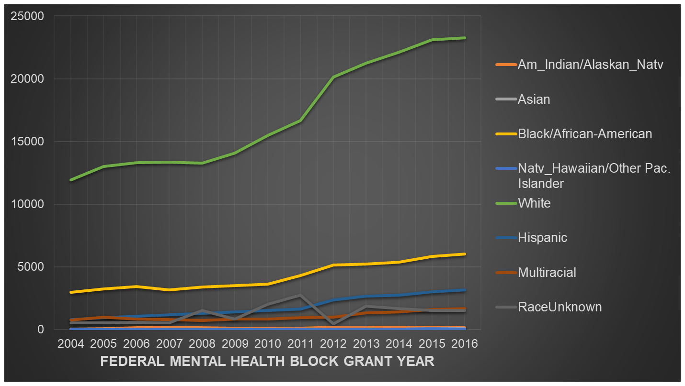
Mental Health Service Utilization 0 -12 Years Group (2004 – 2016)
(Walton, Karikari & Garry, 2017)
Notes:
Isaac.

Slide 20
TIP 2C
Public Version
Family-Friendly
Advisory and Governance Boards
Research Briefs
Academic Version
There are various formats that can be used…
Notes:
Christine.

Slide 21
TIP 3
Analyze existing administrative data to trace the development of home & community-based services over time
Identify gaps in services
Compare estimated number of eligible children/youth with program enrollment
Trace growth in MHBG-supported services for children & youth; compare with prevalence & census
Compare with similar programs in other jurisdictions
Consider impact of policy changes
Use data to support service implementation
Notes:
Betty.

Slide 22
TIP 4
Work with experts
Training
Coaching
Consider provider, supervisory, organizational & system factors
Support/monitor fidelity to model (improves outcomes!)
Use information to monitor progress, modify training & coaching & policies to support effective implementation
Use implementation science to support implementation of evidence-based practices (training, coaching, supportive policies, and progress monitoring)
Notes:
Betty.

Slide 23
TIP 5
Often, information is limited to 1 organization’s or 1 system’s data
Creates incomplete, distorted picture
Worth addressing challenges in sharing data
Collaborate with behavioral health, Medicaid, child welfare, & juvenile justice to share & access data
Notes:
Betty.

Slide 24
Evaluation
5 Tips to improve the quality and collection of useful information
Notes:
Isaac & All (as appropriate).

Slide 25
Micro-manage
Delegation/Devolution
Providing supplementary/complementary resources/support
Establishing a robust feedback channel
Using the capital within the system (e.g., Local SOC Subcommittee, Youth & Family Subcommittee, etc.)
Notes:
Isaac & All (as appropriate). If time permits, Christine to talk about IPP & coordination with SOC Coordinators.

Slide 26
ACTIVITY…….
In small groups of 4 to 6, discuss how 1 or 2 tips could be used in your System of Care.
Notes:
All. (Give audience 10-15 minutes to make these connections.)

Slide 27
Thank you for your interest and participation!
Notes:
All.

Slide 28
Contact information:
Betty Walton: Betty.Walton@fssa.IN.gov
Isaac Karikari: Isaac.Karikari@fssa.IN.gov
Christine Garry: Christine.Garry@fssa.IN.gov
Erin Tock: ETock@namiindiana.org
Notes:
All.

