Slide 1
Assessing Student Learning in Co-Curricular Undergraduate Programs
Dominique M Galli, MS, PhD
IUPUI – Center for Research and Learning
CUR Biennial 2018

Slide 2
Center for Research and Learning
Campus-wide unit that directs UG research since 2004
Multiple programs funded by campus, federal agencies, philanthropic support
Academic year and summer programs
Open to students in all disciplines
One-on-one and interdisciplinary team-based faculty-mentored research
Provides student stipends and project supply funds

Slide 3
Learning Outcomes
High Impact
Activities
Assessment

Slide 4
Learning Outcomes
PUL 1: Core Communication and Quantitative Skills
PUL 2: Critical Thinking
PUL 3: Integration and Application of Knowledge
PUL 4: Intellectual Depth, Breadth, and Adaptiveness
PUL 5: Understanding Society and Culture
PUL 6: Values and Ethics
PUL = Principles of Undergraduate Learning

Slide 5
Assessment of Learning-Qualitative
Progress and final research reports, abstracts, poster presentation
PULs: communication, application of knowledge,
critical thinking, intellectual depth
Personal reflection
PULs: communication, critical thinking
Responsible Conduct of Research online module
PUL: ethics and value

Slide 6
Assessment of Learning-Quantitative
Survey of students (self-assessment) and mentors (assessment of student)
Rating of learning experience
Rating of mentor-mentee relationship

Slide 7
Quantitative Assessment
Survey Demographics
# of participants: 376 (students), 129 (mentors)
Student gender: M 49% : F 51%
Class status: freshmen (12%), sophomore (22%), junior (29%), senior (37%)
Discipline: STEM/Health Sciences 86%
First research experience: 52%

Slide 8
Agreed or Strongly agreed in %

Slide 9
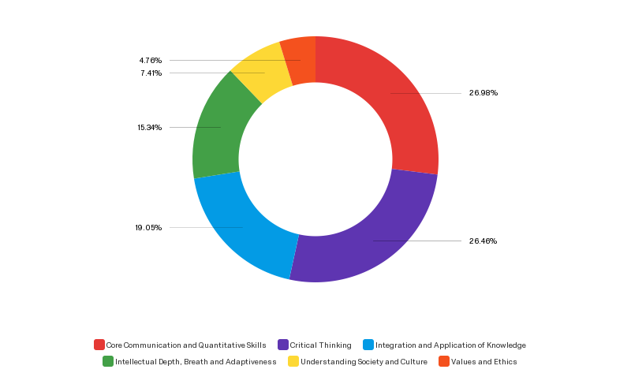
PULs identified by students
16%
22%
69%
50%
65%
73%

Slide 10
Quantitative Assessment
88% of mentors agreed/strongly agreed that students improved their oral communication skills and their scientific writing skills.
88% of mentors agreed/strongly agreed that students improved their critical thinking skills
89% of mentors agreed/strongly agreed that students improved their application of knowledge

Slide 11
Quantitative Assessment
90% of students indicated that they would like to continue being engaged in research although 60% will require a paid experience.
96% of mentors were willing to continue mentoring undergraduate students

Slide 12
Support of Quantitative Data with Qualitative Data
Look at the list of PULs and select three that you think your research experience focused on with respect to the skills that you were able to gain as a result of your participation. For each of these three PULs, explain how your research experience helped you to develop your skills in that area.

Slide 13
Select Student Excerpts
During my time in this [research] experience, I was able to learn how to not only explain what I was doing to other people working in the lab, but I also developed the ability to present my work to people who are not in the specific field that I was working in, as well as others who were not even in the field of science or research.
I cannot stress enough how valuable it was to have the opportunity to share my research with individuals completely outside the science world at Posters On The Hill. The ability to translate my personal area of expertise to a lay audience is absolutely crucial to my ability to work on a team with others and effectively communicate with future patients.

Slide 14
In the experimental design process, I used my knowledge from relevant publications to determine the steps and materials needed to perform certain experiments. For example, when designing experiments, we considered the cost, probability, and resources needed. This required that we foreshadow possible challenges to determine solutions to improve experimental efficiency.
The most important thing that I improved on over the course of the year is critical thinking. Several of the experiments that we perform are adapted from other labs, but the experiments need to be tailored to test something that is specific to your own lab and it is up to the researcher to figure out the best way to tweak these procedures to produce the most accurate results.

Slide 15
In the lab, it is essential to follow good moral and ethical values to ensure that the results are honest and accurate for all experiments. My mentor taught me to be able to hold myself accountable to possible mistakes that may occur in the protocol and relying on ethical judgments to determine whether the mistake can be overcome without manipulating the experiment.
We also had to be very careful to not jump to conclusions when presented with compelling data. Several times we have collected data that are exactly what we wish them to be, but upon further inspection have discovered that the data is not completely accurate, or is incomplete and requires further explanation. In this competitive world it is very tempting to produce results fast and establish your reputation as a researcher. But if people misrepresent data, it only restricts the overall goal of research of making progress.

Slide 16
Summary
Qualitative and quantitative data confirm student learning through research especially in the areas of communication, critical thinking and application of knowledge.
Self-assessments by students align with mentor assessments of student learning.

