Slide 1
Experiences & Advice from the Institutional Perspective of a Consortium-Based Digital Collection Management System Migration
Evan N. Miller
Digital Preservation and Digital Collections Archivist, Indiana University Indianapolis

Slide 2

Evan N. Miller, M.A., M.L.I.S.
Biography
Job Timeline
2019
Special Collections Associate
Butler University
Areas of Interest
Indiana and local history
Historical exhibits
Metadata & metadata remediation
System migrations
Digital preservation
Supporting the archival profession
2022
Digital Archivist
Wabash College
2024
Digital Initiatives Librarian
Butler University
2025
Digital Preservation and Digital Collections Archivist
IU Indianapolis

Slide 3
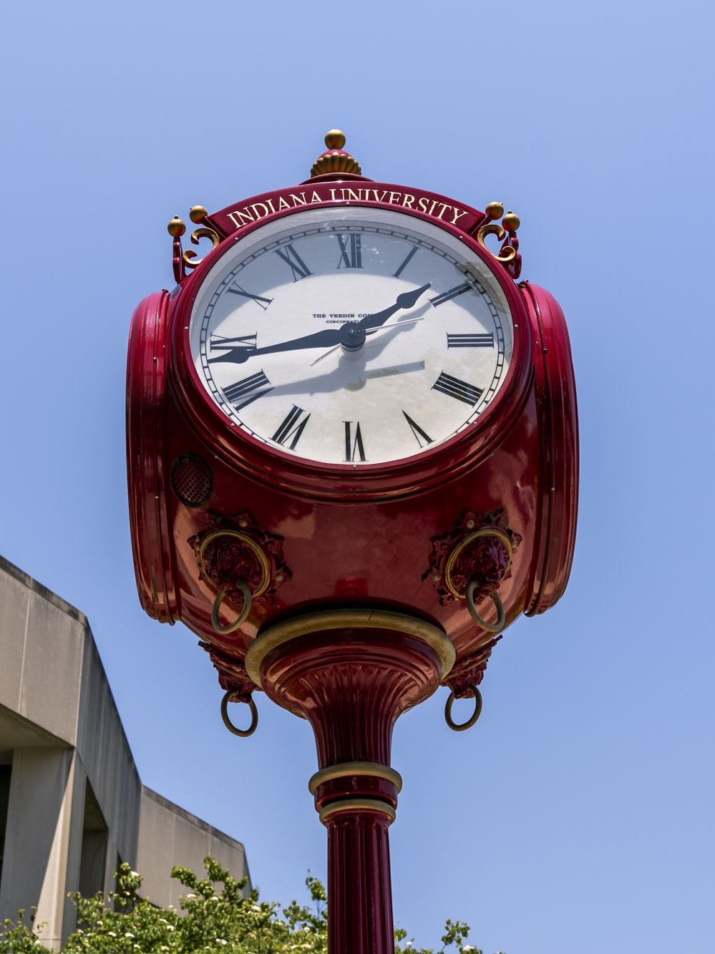
Agenda
01
Background
02
Assessment
03
Migration Workflow
04
Applying the Migration Workflow
Public Domain, Indiana University

Slide 4
Artificial Intelligence is not discussed in this presentation.
Initial work initially began prior to ChatGPT’s release (2022) and major AI development
At the time, there were no institutionally-approved or paid services available
Ethical considerations

Slide 5
Background
1.

Slide 6
Timeline
Background
2013
2019-2021
2022
2006
2017
2021
2023-2024
Logos the property of their respective organizations.

Slide 7
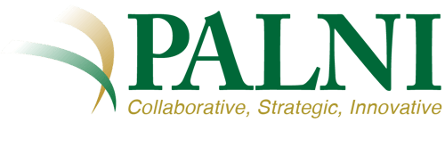

Timeline
Background
PALNI (Private Academic Library Network of Indiana) offers CONTENTdm to members
2013
2019-2021
2022
2006
2017
2021
2023-2024
Logos the property of their respective organizations.

Slide 8
Timeline
Background
2013
2019-2021
2022
2006
2017
2021
2023-2024
PALNI Institutional Repository Task Force finds 70% of members did not have an institutional repository (IR) system
Logos the property of their respective organizations.

Slide 9
Timeline
Background
PALNI begins collaboration with PALCI (Partnership for Academic Library Collaboration and Innovation) to support development of open-source IR system
2013
2019-2021
2022
2006
2017
2021
2023-2024
Logos the property of their respective organizations.

Slide 10
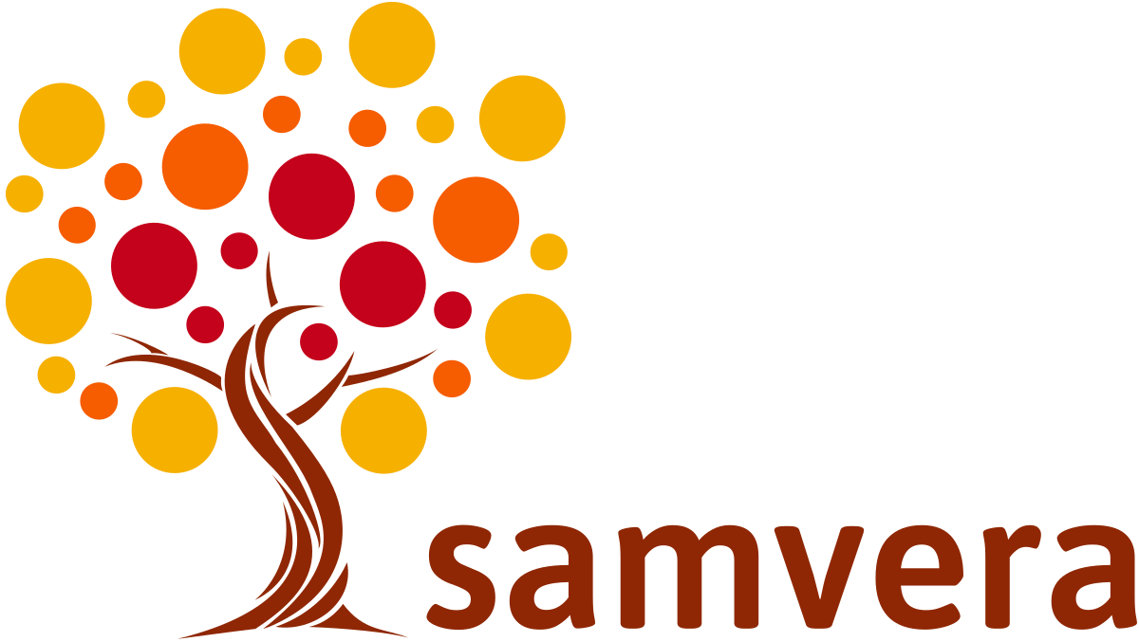
Timeline
Background
2013
2019-2021
2022
2006
2017
2021
2023-2024
Samvera’s Hyku (IR system) is tested and selected for continued PALNI-PALCI development
Logos the property of their respective organizations.

Slide 11

Timeline
Background
Grant awarded to PALNI-PALCI to continue Hyku development to support more use cases (e.g. consortiums) and different kinds of materials (e.g. cultural heritage)
2013
2019-2021
2022
2006
2017
2021
2023-2024
Logos the property of their respective organizations.

Slide 12
Timeline
Background
PALNI Hyku Migration Task Force creates internal resources for members
2013
2019-2021
2022
2006
2017
2021
2023-2024
PALNI begins encouraging members to use Hyku for cultural heritage digital collections
Logos the property of their respective organizations.

Slide 13
Timeline [Complete]
Background
PALNI begins collaboration with PALCI (Partnership for Academic Library Collaboration and Innovation) to support development of open-source IR system
Grant awarded to PALNI-PALCI to continue Hyku development to support more use cases (e.g. consortiums) and different kinds of materials (e.g. cultural heritage)
PALNI Hyku Migration Task Force creates internal resources for members
PALNI (Private Academic Library Network of Indiana) offers CONTENTdm to members
2013
2019-2021
2022
2006
2017
2021
2023-2024
PALNI Institutional Repository Task Force finds 70% of members did not have an institutional repository (IR) system
Samvera’s Hyku (IR system) is tested and selected for continued PALNI-PALCI development
PALNI begins encouraging members to use Hyku for cultural heritage digital collections
Logos the property of their respective organizations.

Slide 14
Logistics
Background
No timeline
  Moving deadlines and changing details
No consistent communication
No written or consistent documentation about past projects
Internal consortium resources focused on lists and articles, not workflows
  General recommendation was to individually upload single items and/or use student help
New system had no metadata customizability

Slide 15
Takeaways
Background
Timeline would be methodical yet efficient
  Assess collection-by-collection and complete manageable tasks when time allowed
Documentation creation would be key
  Gather institutional knowledge and understand development of collections over time
Bulk import would be crucial and necessary for efficiency
  Too many items and collections to undertake item-level uploads
Create workflows that could be used by others
  Attempt to use no new tools or software for individuals who may not want to learn new tools

Slide 16
Assessment
2.

Slide 17
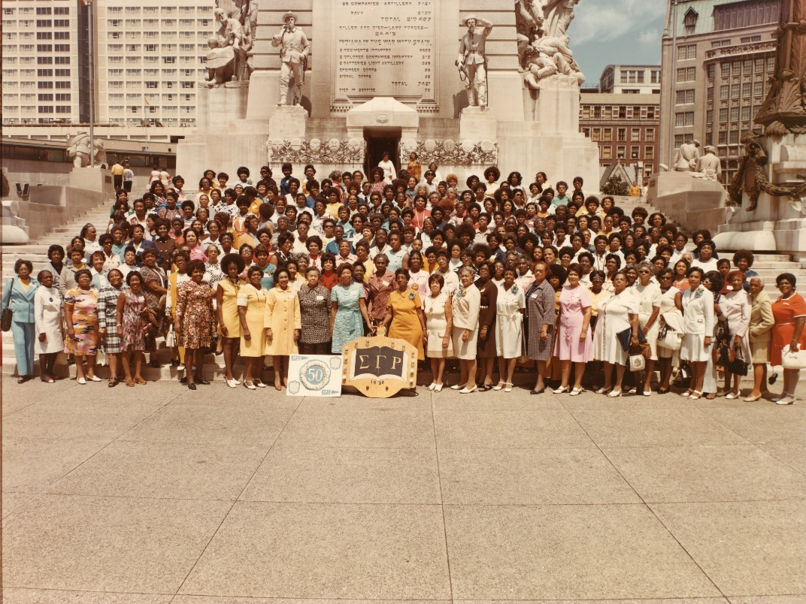
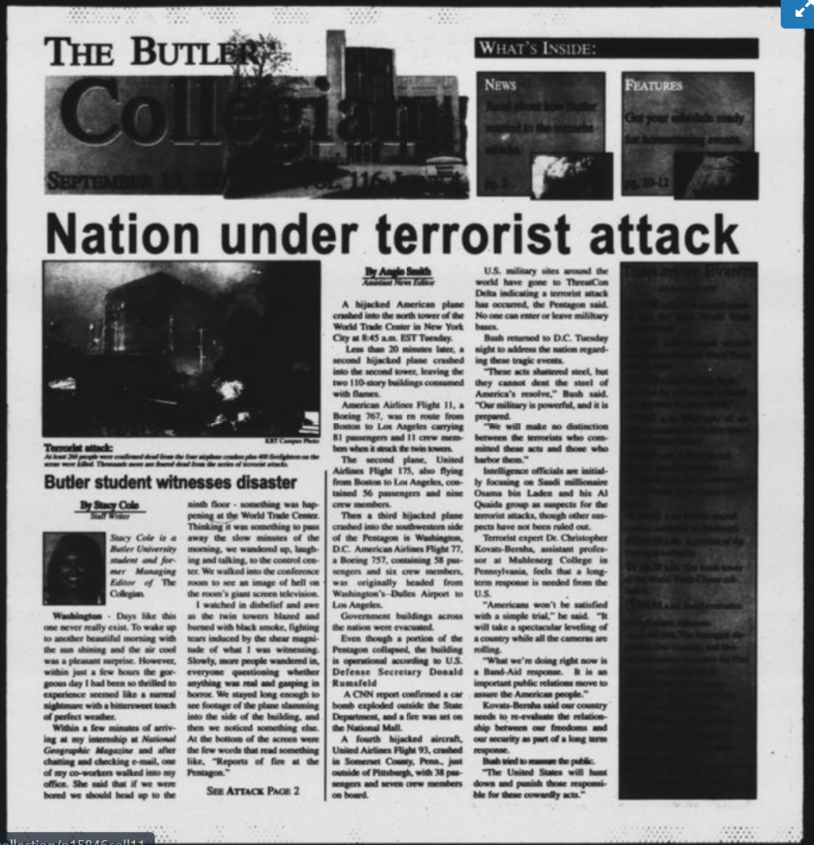
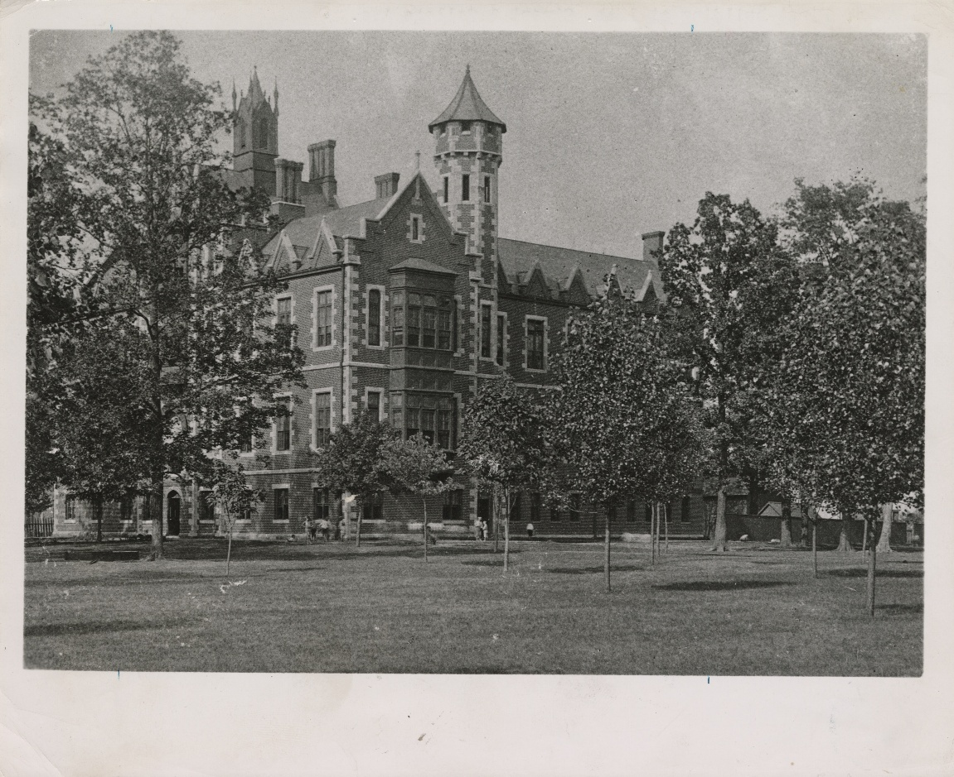
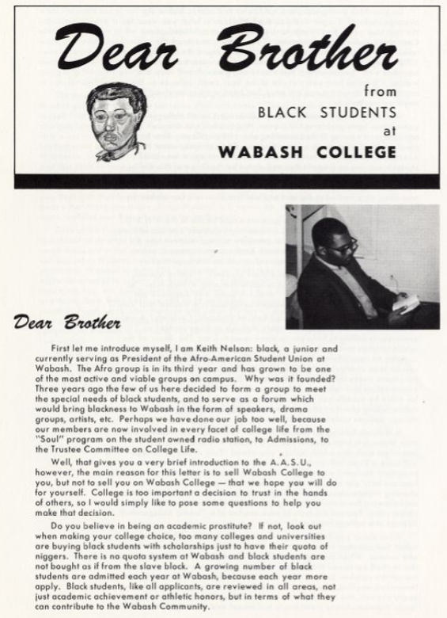
Items: Cultural Heritage Materials
Assessment
Sigma Gamma Rho Centennial Collection, Butler University, PALNI Digital Collections, https://palni.contentdm.oclc.org/digital/collection/SigmaGammaRho.;
The Butler Collegian Archives, Butler University, PALNI Digital Collections, https://palni.contentdm.oclc.org/digital/collection/p15846coll11.;
Butler University Buildings and Grounds Collection, Butler University, PALNI Digital Collections, https://palni.contentdm.oclc.org/digital/collection/BldgsGrnds.;
Malcolm X Institute of Black Studies Collection, Wabash College, PALNI Digital Collections, https://cdm15705.contentdm.oclc.org/digital/collection/MXIBS.

Slide 18
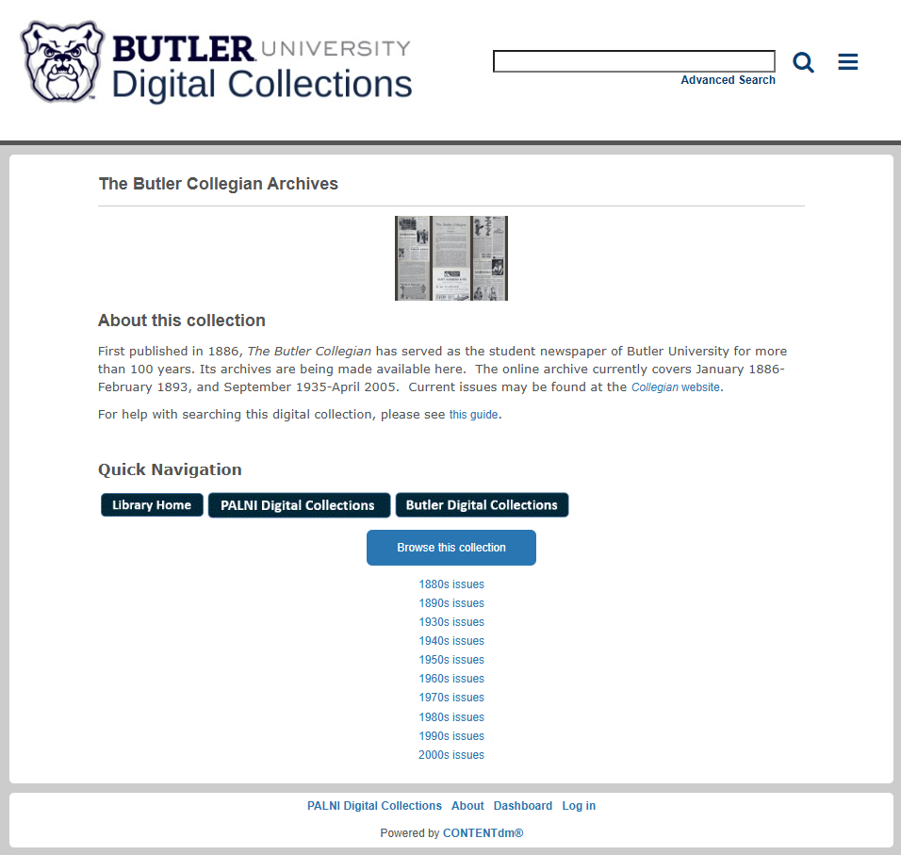
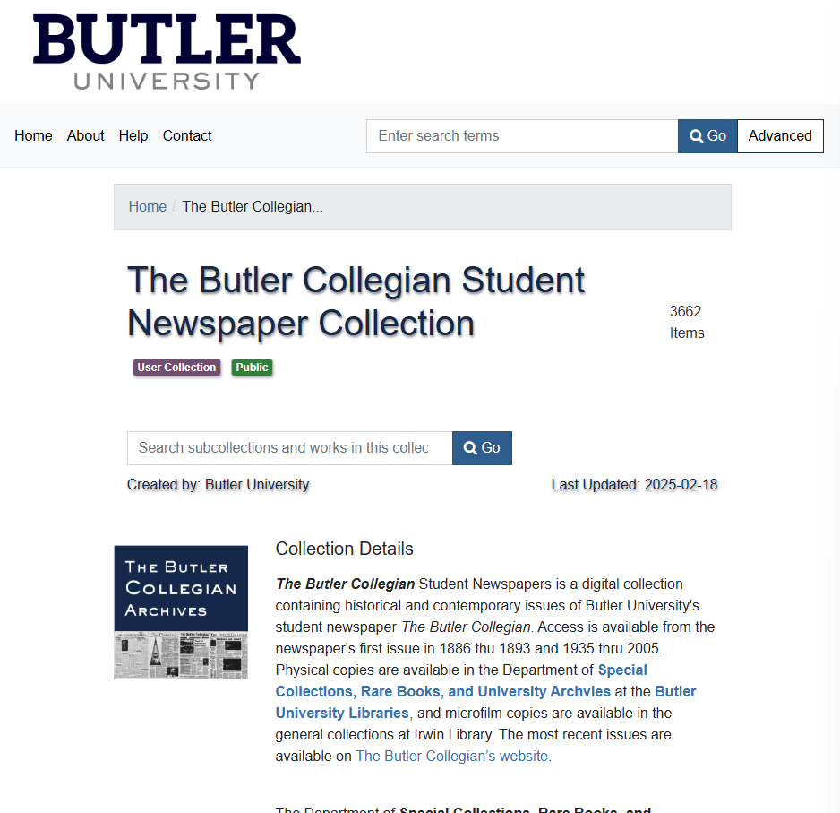
System Comparison: Collection Engagement
Assessment
CONTENTdm Collection Landing Page
Hyku Collection Landing Page
The Butler Collegian Archives, Butler University, PALNI Digital Collections, https://palni.contentdm.oclc.org/digital/collection/p15846coll11.; The Butler Collegian Student Newspaper Collection, Butler University Digital Collections [beta], accessed April 1, 2025.

Slide 19
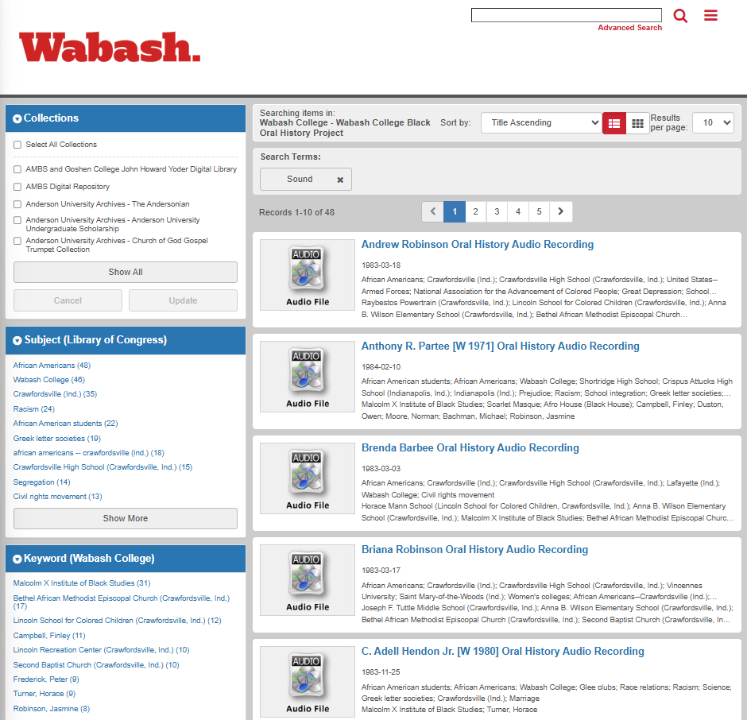
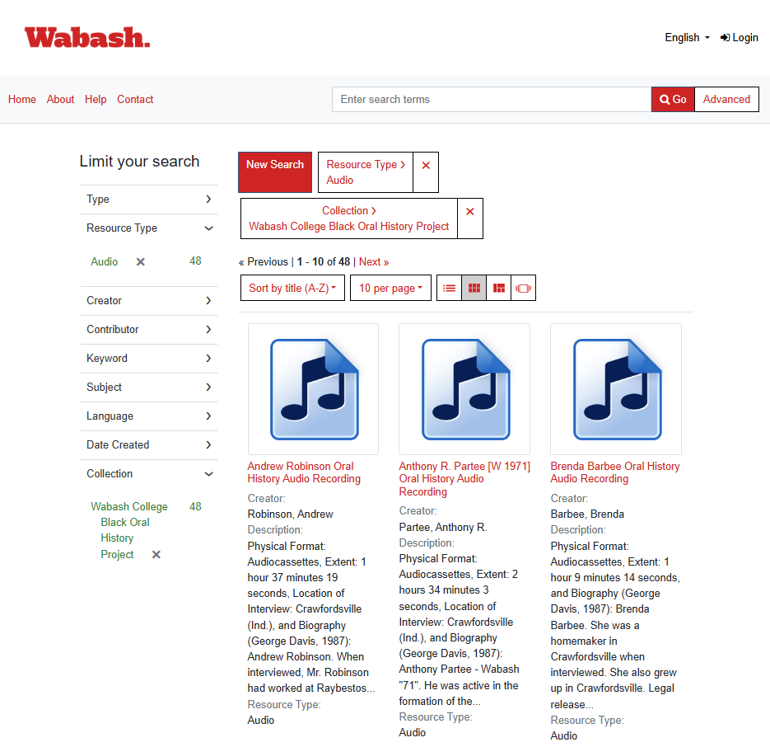
System Comparison: Search
Assessment
CONTENTdm Search Results Page
Hyku Search Results Page
Search page, Wabash College Black Oral History Project Collection, Wabash College, PALNI Digital Collections, https://cdm15705.contentdm.oclc.org/digital/collection/p15705coll79.; Search page, Wabash College Black Oral History Project Collection, Wabash College Institutional Repository, https://wabash.hykucommons.org/collections/c219b7d3-bcc3-4b8c-8978-6bc1aacb0fdf.

Slide 20
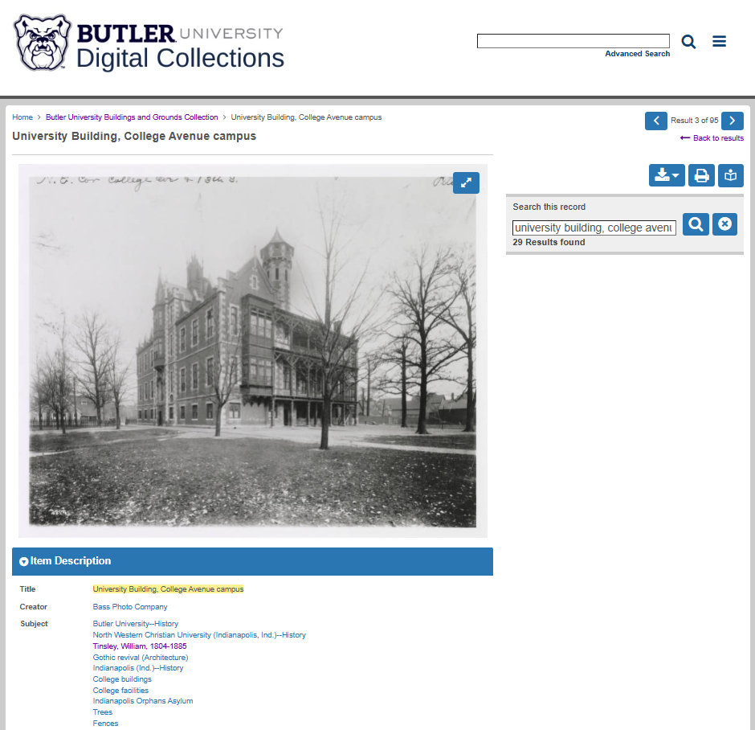
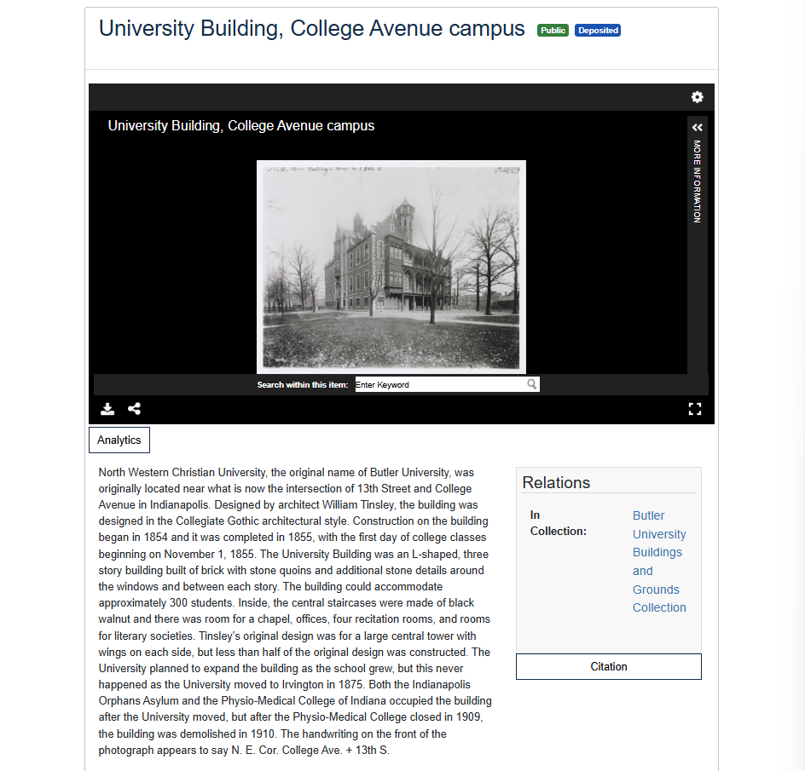
System Comparison: Metadata
Assessment
CONTENTdm Item Landing Page
Hyku Item Landing Page
Butler University Buildings and Grounds Collection, Butler University, PALNI Digital Collections, https://palni.contentdm.oclc.org/digital/collection/p15846coll11.; Butler University Buildings and Grounds Collection, Butler University Digital Collections [beta], accessed April 1, 2025.

Slide 21
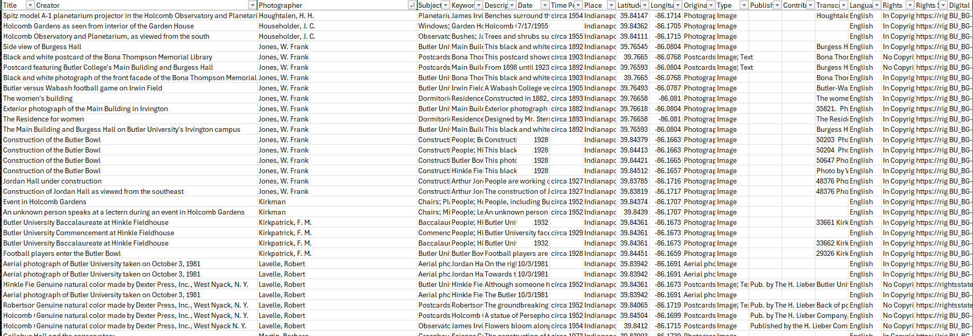
Metadata: It’s Complex… and Complicated
Assessment
Metadata export, Butler University Buildings and Grounds Collection, Butler University, PALNI Digital Collections, https://palni.contentdm.oclc.org/digital/collection/BldgsGrnds.

Slide 22
For data migrations, it is preferable to go from less detail to more, rather than the opposite direction, which can result in combining fields and losing specificity in the catalogue. A balance needs to be achieved between specificity and being able to find what is required. Not every asset should have its own edge case of metadata.
– Kathryn Claypool et al., “One System to Rule Them All: The Story of Merging Two Inventory Management Systems,” Journal of Digital Media Management (2019)
[Emphasis added]

Slide 23
Takeaways
Assessment
Collection-by-collection migration strategy
  Allow for streamlined delegation, remediation, and testing
  Gather and document institutional knowledge along the way
Ensure all metadata is moved, merged, or saved
  Some metadata would have to be stored outside of the system…
  … BUT all legacy metadata would be preserved in other systems or as documentation
Metadata remediation would need to happen early in the process
  Inconsistent metadata practices had developed over time…
  … and would cause issues bulk importing and user searching

Slide 24
Migration Workflow
3.

Slide 25
The key to migrating [systems] is understanding what users need it to do and having a plan for migrating functionality that users depend on–the goal is more about migrating an effect than it is about migrating data.
– Kyle Banerjee, “Institutional Repositories and Digital Collections,” Migrating Library Data: A Practical Manual (2017)
[Emphasis added]

Slide 26
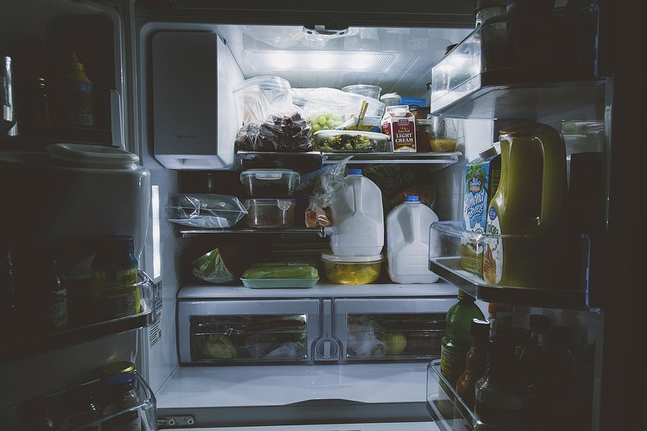

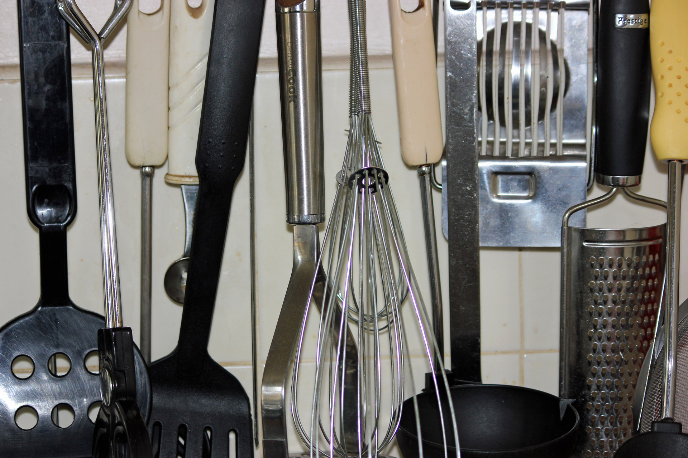
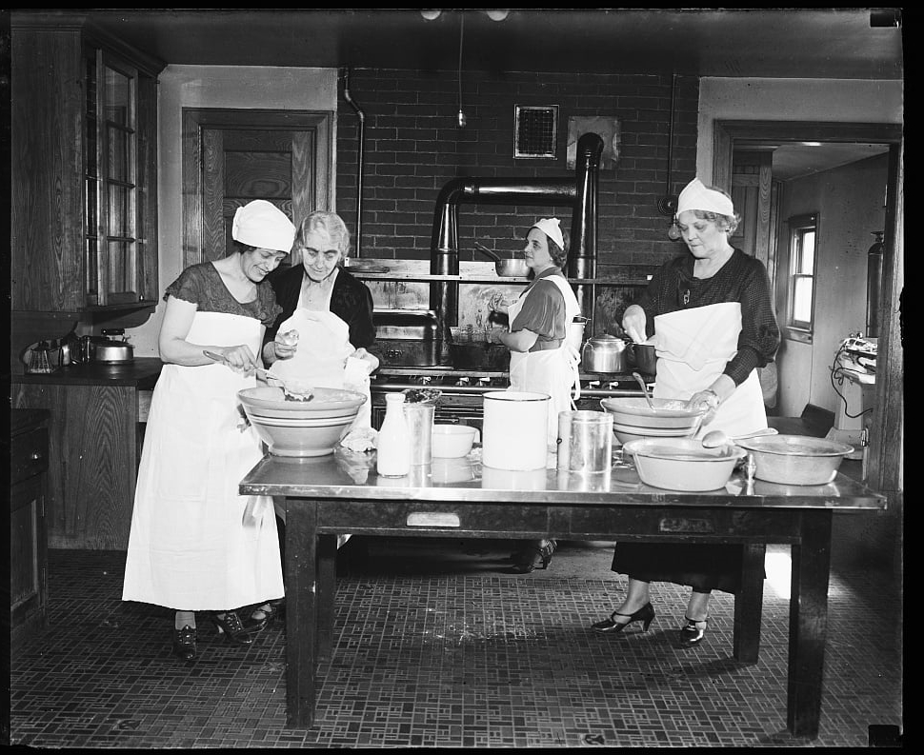

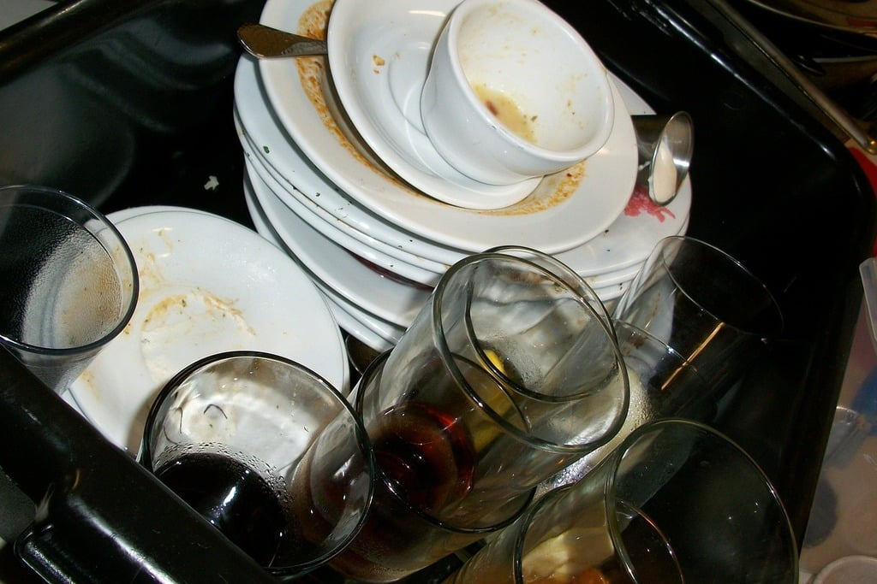
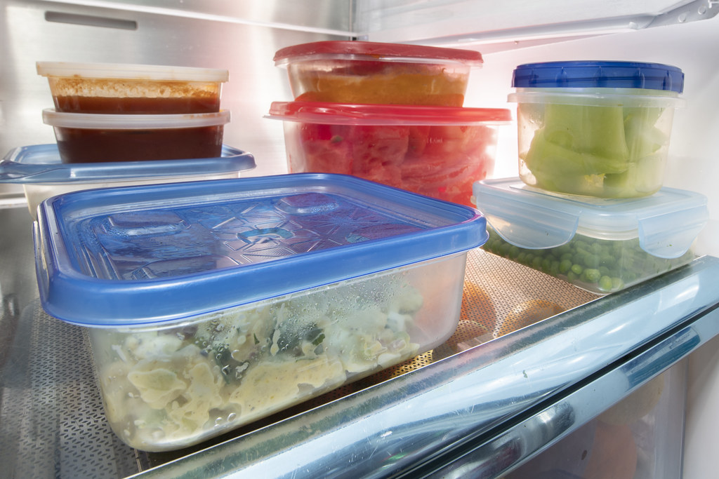
Food Metaphor
Migration Workflow
All images are public domain (CC0 license)
Collect
Prepare
Review
Serve
Cleanup
… ingredients for the chosen recipe
… ingredients (e.g. measuring, chopping) using your preferred tools
… the recipe prior to combining the ingredients to make the meal, following the prescribed steps
… the meal after setting the table
… the kitchen and put away leftovers

Slide 27
The Steps
Migration Workflow
Collect
Prepare
Review
Serve
Cleanup

Slide 28
The Steps
Migration Workflow
Collect
Prepare
Review
Serve
Cleanup
Locate digital files
Export metadata from old systems
Bring together all files and information into one location
Assess collection and document

Slide 29
The Steps
Migration Workflow
Collect
Prepare
Review
Serve
Cleanup
Evaluate metadata fields and metadata schema (e.g. Dublin Core)
Create metadata crosswalk mapping old system metadata field to new system metadata field
Perform cleanup on exported metadata & complete metadata remediation

Slide 30
The Steps
Migration Workflow
Collect
Prepare
Review
Serve
Cleanup
Convert files to needed file formats (e.g. Word to PDF, .xlsx to .csv)
Create batches of files to bulk import (e.g. zipped file with digital files and metadata spreadsheet)
Document method and next steps

Slide 31
The Steps
Migration Workflow
Collect
Prepare
Review
Serve
Cleanup
Upload/Bulk import to system in batches
Test uploads (e.g. searching, selective item- and collection-level viewing
Edit and refine

Slide 32
The Steps
Migration Workflow
Collect
Prepare
Review
Serve
Cleanup
Cleanup working files (e.g. delete duplicates, save documentation and final metadata spreadsheets)
Prepare files and metadata for digital preservation
Be prepared for next migration

Slide 33
The Steps [Complete]
Migration Workflow
Collect
Prepare
Review
Serve
Cleanup
Locate digital files
Export metadata from old systems
Bring together all files and information into one location
Assess collection and document
Evaluate metadata fields and metadata schema (e.g. Dublin Core)
Create metadata crosswalk mapping old system metadata field to new system metadata field
Perform cleanup on exported metadata & complete metadata remediation
Convert files to needed file formats (e.g. Word to PDF, .xlsx to .csv)
Create batches of files to bulk import (e.g. zipped file with digital files and metadata spreadsheet)
Document method and next steps
Upload/Bulk import to system in batches
Test uploads (e.g. searching, selective item- and collection-level viewing
Edit and refine
Cleanup working files (e.g. delete duplicates, save documentation and final metadata spreadsheets)
Prepare files and metadata for digital preservation
Be prepared for next migration

Slide 34
Since no system lasts forever, migration is necessarily part of digital preservation work. Keeping this in mind, a migration project does not result in a conclusive endpoint but simply a step in a larger workflow that will include future migrations.
– Brianna Gormly, “Migration,” Patricia C. Franks (Editor), The Handbook of Archival Practice (2021)
[Emphasis added]

Slide 35
Applying the
Migration Workflow
4.

Slide 36
Example Digital Collection
Applying the Migration Workflow
Butler University Buildings and Grounds Collection
Archival collection stored in Department of Special Collections, Rare Books, and University Archives at Butler University
2019 initiative reprocessed archival collection and prioritized digitization of images
From 2020 to circa 2024, metadata was created with uploads occurring as each building/subseries was completed
Metadata was highly detailed and customized
  Wanted to provide increased access to institutional history and improve search
Butler University Buildings and Grounds Collection, Butler University, PALNI Digital Collections, https://palni.contentdm.oclc.org/digital/collection/BldgsGrnds

Slide 37
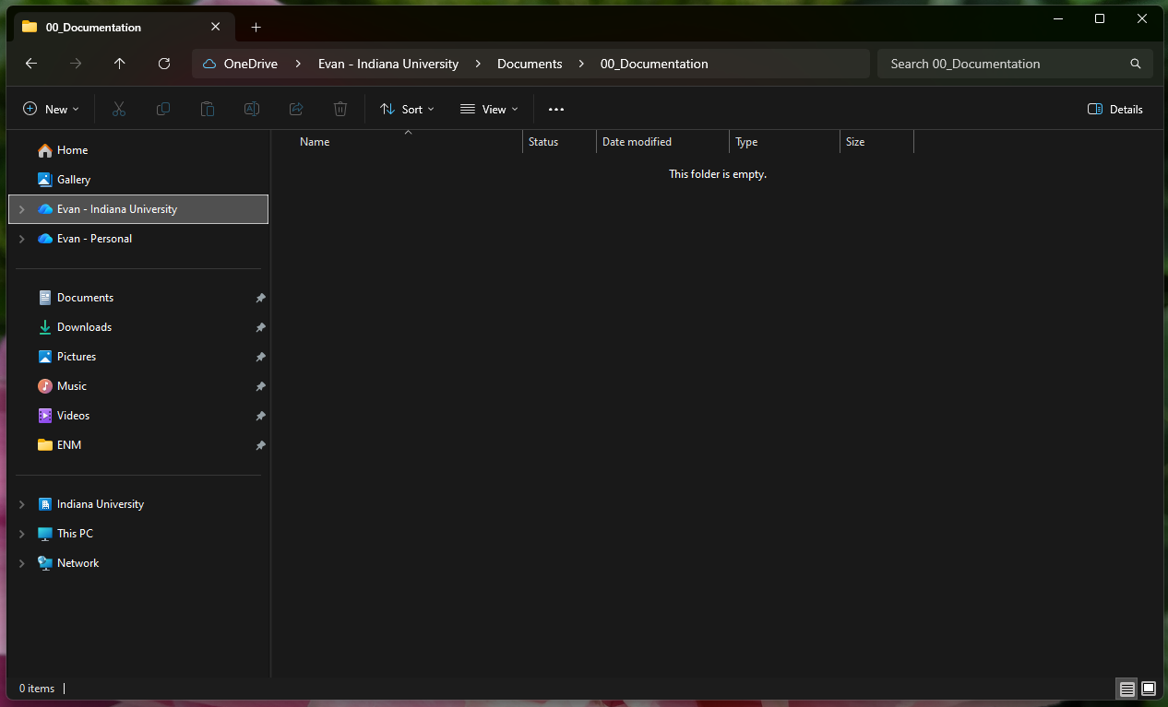
Collect
Applying the Migration Workflow
Gather Files, Metadata, and Documentation
Search across current, legacy, and available storage spaces
  Microsoft Teams, Google Drive, Local Server Shared Drives, Miscellaneous Hard Drives
Look for:
  Preservation and access copies of digitized and born-digital items
  Metadata exports (current version from system or legacy spreadsheets)
  Collection/Project Documentation
Create folders for each digital collection

Slide 38
Prepare
Applying the Migration Workflow
Metadata Remediation
Collection-by-collection assessment and remediation
Map legacy system fields to equivalent and/or sufficient fields in new system (crosswalk)
Bulk-complete common metadata edits (e.g. misspellings, inconsistent capitalization, etc.)
Structure spreadsheet for bulk import
Metadata export, Butler University Buildings and Grounds Collection, Butler University, PALNI Digital Collections, https://palni.contentdm.oclc.org/digital/collection/BldgsGrnds.

Slide 39
Prepare
Applying the Migration Workflow
Metadata Crosswalk
Legacy System Field | Dublin Core | Controlled Vocabulary | New System Field
Title | title | N/A | Title
Creator | creator | [Last Name, First Name] | Creator
Photographer | creator | [Last Name, First Name] | Creator
Subject | subject | LOCSH | Subject
Keyword | subject | Local List | Subject
Rights Statement | rights | RightsStatements.org | Rights
Longitude/Latitude | N/A | N/A | Description
Transcript | N/A | N/A | Description

Slide 40
Prepare
Applying the Migration Workflow
Common Metadata Remediation Workflows in Microsoft Excel
01
→
Merge Columns
Combine Metadata Fields
02
→
Adding Duplicate Entry to the Same Metadata Field for Multiple Items
Adding an Entry to Multiple Rows
03
→
Create Consistent Date Entries (Date Field or Text String) for Multiple Items
Date Formatting & Bulk Creation
04
→
Allows for Finding Duplicate Entries, Misspellings, and Inconsistencies in Controlled Vocabulary
Creating a Master Keyword Term List

Slide 41
Review
Applying the Migration Workflow
Reformat and Prepare Files for Bulk Import
Convert files to needed file formats (e.g. .tif to .jpg, .xlsx to .csv)
  Combining single-page PDFs into one multi-page PDF: Evermap AutoSplit Plugin for Adobe Acrobat
  Converting multiple preservation copies (.tif) to access version (.jpg): Adobe Bridge Image Processor
  Determining duplicate copies: TreeSize
Create batches to bulk import using a zipped folder containing:
  Folder “files” with items to upload
  .csv spreadsheet formatted with proper column headings (metadata fields) and one row for each item in “files” folder
Document along the way!

Slide 42
Serve
Applying the Migration Workflow
Bulk Import and Test
Perform bulk import
Verify uploads are received and ingested
  Sometimes requires a deeper dive into the backend and reviewing each batch record
Complete test searches and selective item- and collection-level viewing
  Ensure that users can find what they need and do it easily
Edit and refine as needed

Slide 43
Cleanup
Applying the Migration Workflow
Prepare for the Next Migration!—And Save on Storage Space Now
Cleanup working files by:
  Delete zipped file
  Delete working/edited files not uploaded
  Move access copies (what was uploaded) to department-accessible storage
  Move preservation copies to separate, more-restricted storage location
  Create folder for all past and current documentation (including metadata spreadsheet) and add to other department records
Begin thinking about digital preservation policies and procedures

Slide 44
As the collection migrations near completion, the collections would be well served by a holistic review of the digital image collections, as well as review collection-by-collection in order to evaluate whether some of the unique metadata can be highlighted within the collection without hurting interoperability.
– Jocelyn Olson Triplett, “Increasing Interoperability through the Transformation and the Consolidation of Image Collections’ Metadata,” Organization, Representation and Description through the Digital Age (2018)
[Emphasis added]

Slide 45
Conclusion

Slide 46
Takeaways
Conclusion
Migrations take time and testing
Metadata remediation adds time upfront but saves energy during the migration process
Keep user needs as a focus, such as prioritizing search
Creating metadata spreadsheets can help with bulk metadata remediation and creating documentation for future migrations
Migrations are more than one person or institution
  Support your community and share experiences and advice

Slide 47
Bibliography
Banerjee, Kyle. “Institutional Repositories and Digital Collections.” Migrating Library Data: A Practical Manual. Kyle Banerjee and Bonnie Parks, editors. Neal-Schuman, 2017, pp. 183-200.
Claypool, Kathryn et al. “One System to Rule Them All: The Story of Merging Two Inventory Management Systems.” Journal of Digital Media Management, vol 8, no. 1, 2019, pp. 6-14.
Gormly, Brianna. “Migration.” Franks, Patricia C., editor. The Handbook of Archival Practice, Rowman & Littlefield, 2021, pp. 253-260.
Miller, Evan N. "Migration, Metadata, & Remediation." Presentation, Society of Indiana Archivists Fall Workshop, Crawfordsville, Indiana, 17 October 2025.
Triplett, Jocelyn Olson. “Increasing Interoperability through the Transformation and the Consolidation of Image Collections’ Metadata.” Organization, Representation and Description through the Digital Age. Christine M. Angel and Caroline Fuchs, editors. De Gruyter, 2018, pp. 228-240.

