Slide 1
PIDs, Wikidata, and Notability on Wikipedia
WikiConference North America 2025 - New York, NY
October 17, 2025
Olivia MacIsaac
Research Information Management Librarian
omacisaa@iu.edu
ORCID: 0000-0002-3870-6653
Jere Odell
Director, Center for Digital Scholarship
jdodell@iu.edu
ORCID: 0000-0001-5455-1471
Except for when noted elsewhere, this work is licensed by the authors under CC BY 4.0

Slide 2

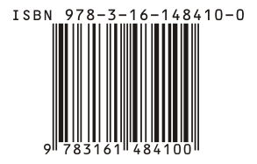

PID = persistent digital identifier
A PID is a stable link or a long-lasting reference to a digital resource shared on the web. It’s more stable than just a URL.
A PID is usually a string of numbers and characters. For example, ORCID, which stands for Open Research & Contributor Identifier, is a PID for authors that is 16 digits: https://orcid.org/0000-0002-3870-6653
More commonly known PIDs are Digital Object Identifiers (DOI) and International Standard Book Number (ISBN).

Slide 3
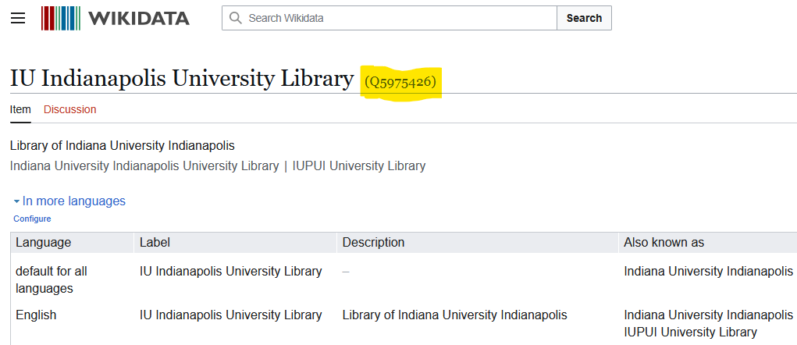
…you might be familiar with this PID.
Notes:
Add image of Wikidata

Slide 4



PIDs we focused on for this project

Slide 5

We did consider another PID…
…but this PID did not have a date we could easily identify.

Slide 6

Indianapolis Prize
Prize offered by the Indianapolis Zoo (in our city!)
International biannual contest with well-known judges (e.g. E.O. Wilson)
Related to environmentalism and the Sustainable Development Goals (SDGs)
6 finalist per award (finalists receive $50,000)
Winners receive recognition and $250,000
2006-2025: 33 finalists; 10 winners
Some candidates were finalists in multiple years
https://en.wikipedia.org/wiki/Indianapolis_Prize
Notes:
We are from Indianapolis, but this is an international prize for conservationists

Slide 7
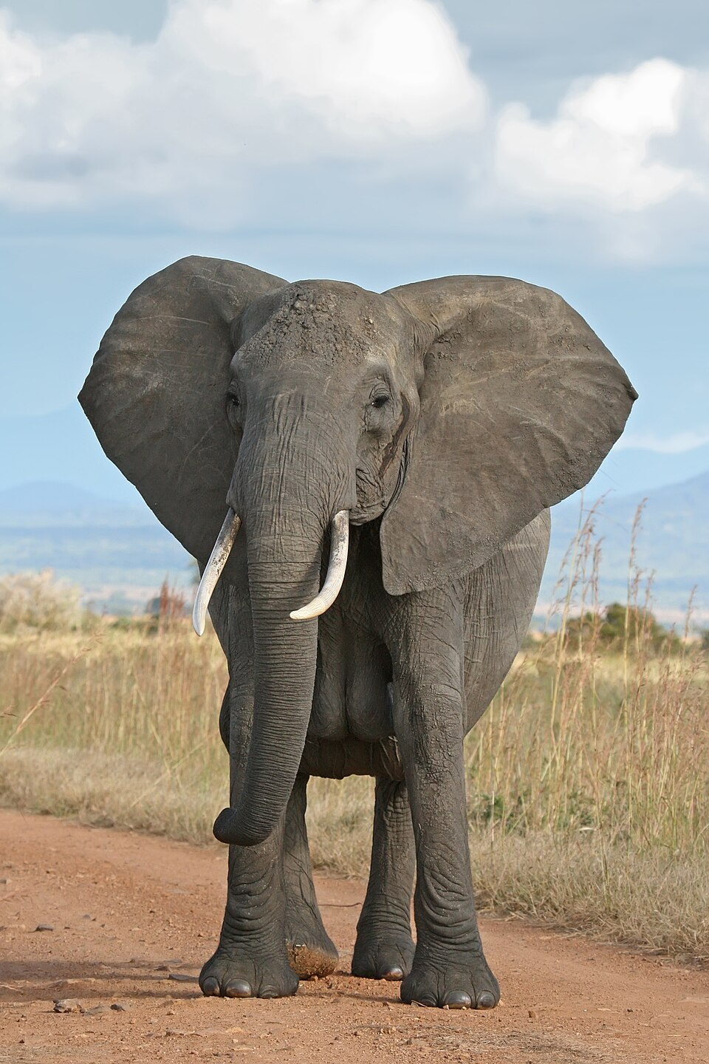
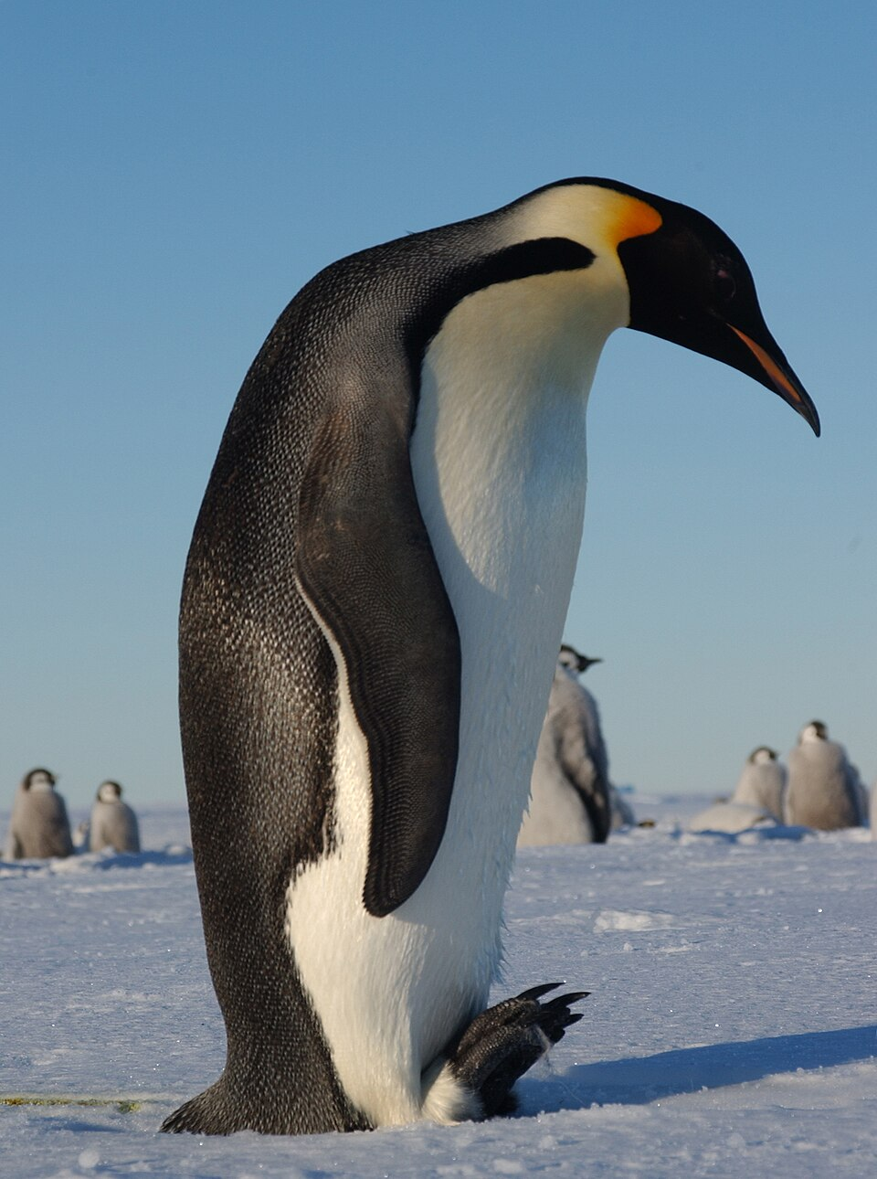
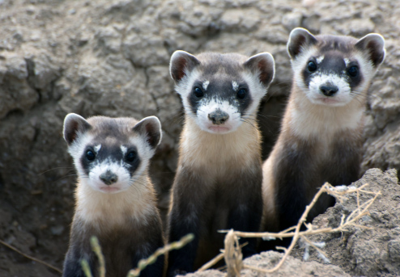
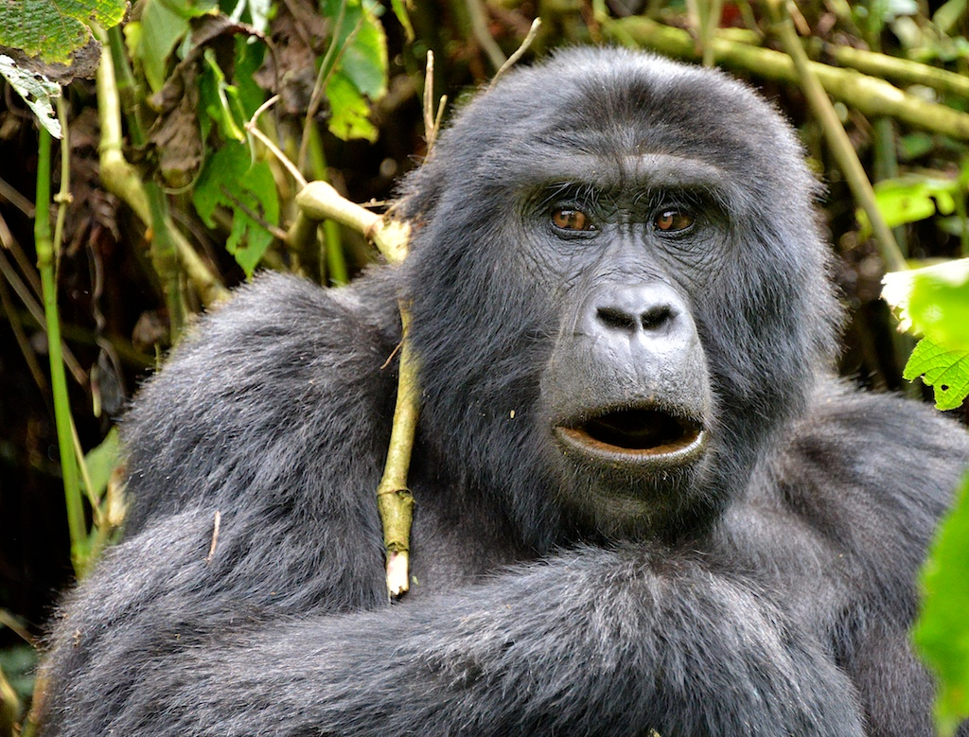
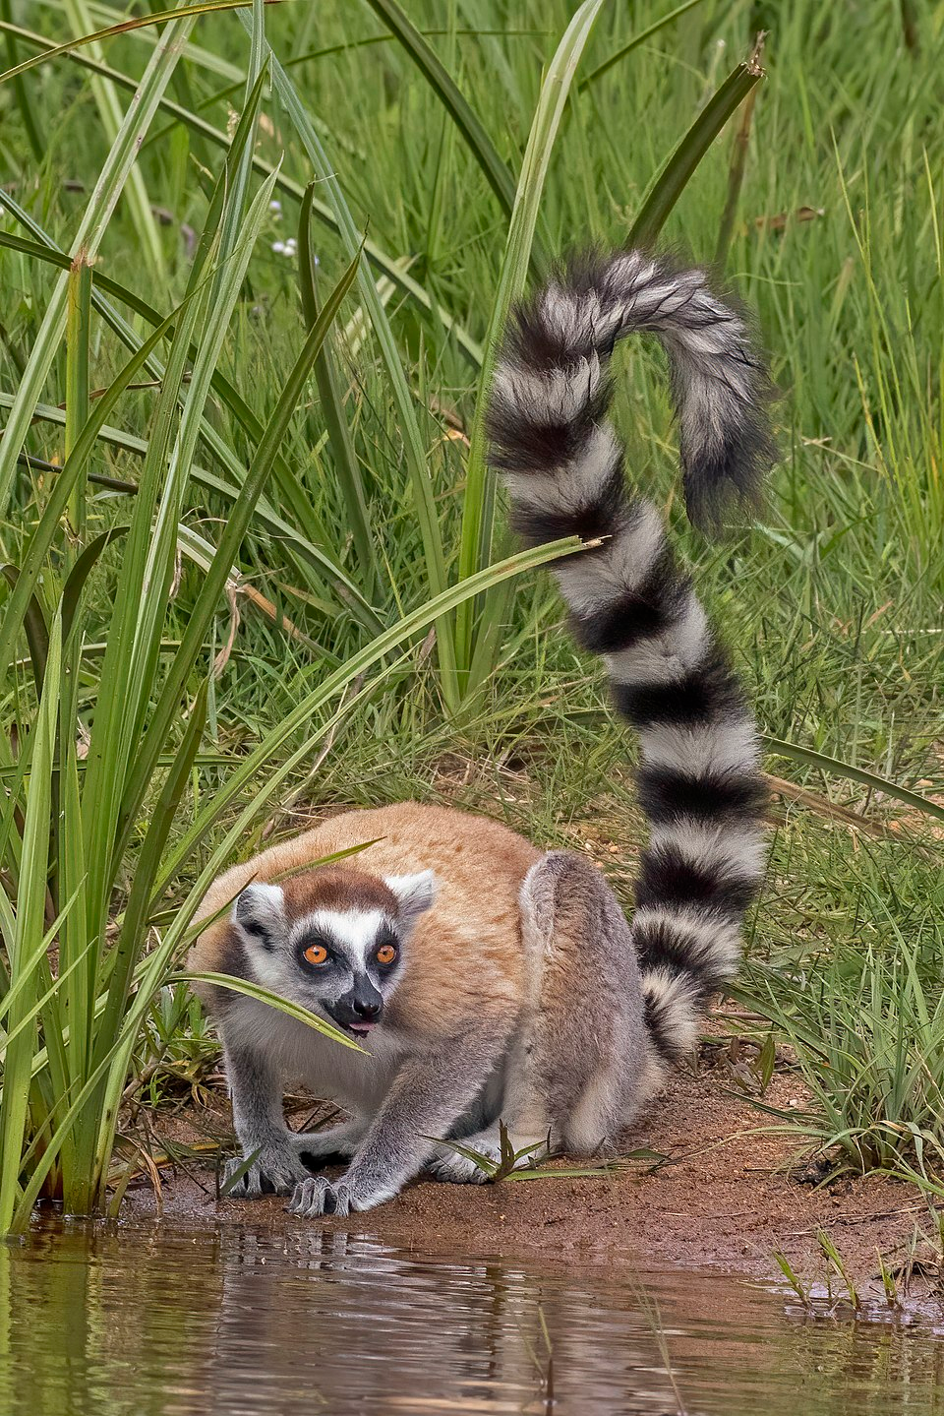
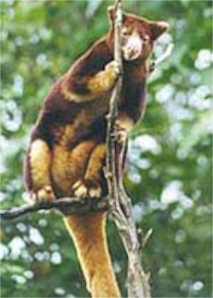
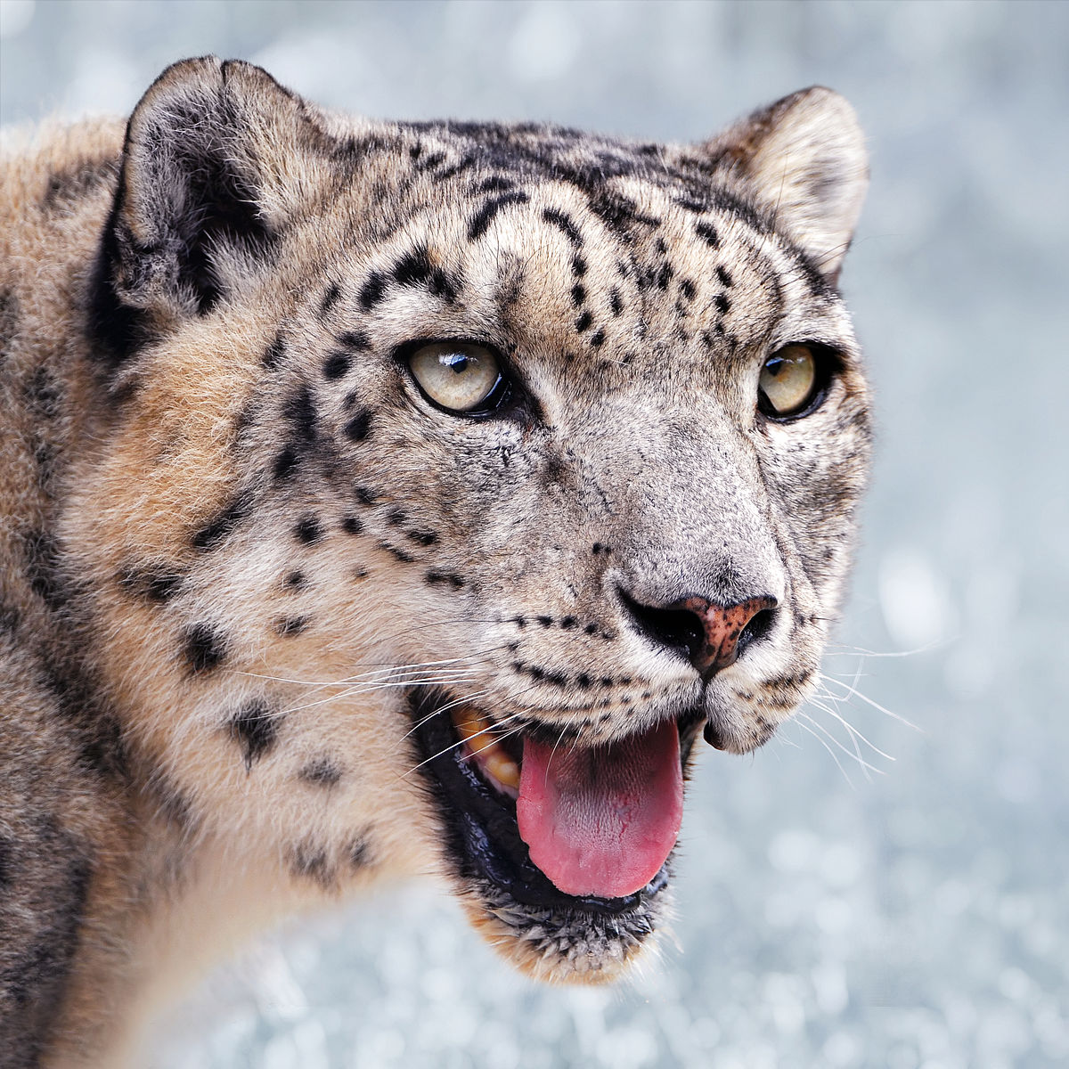
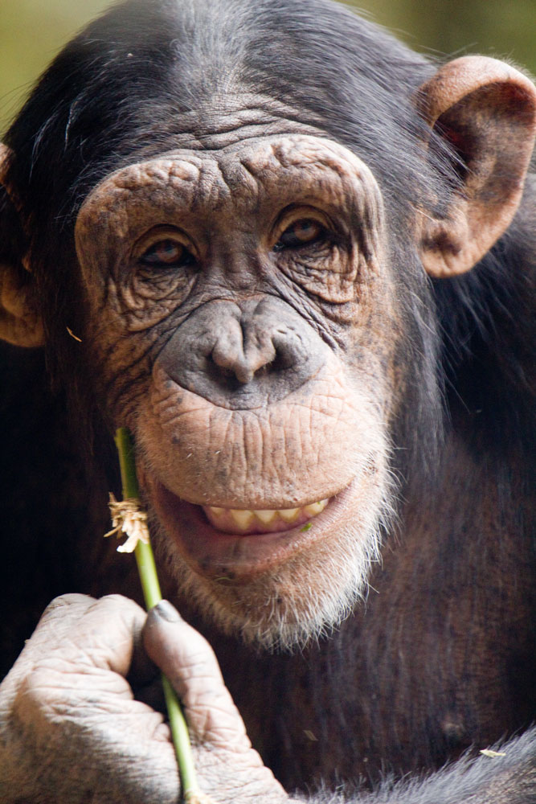
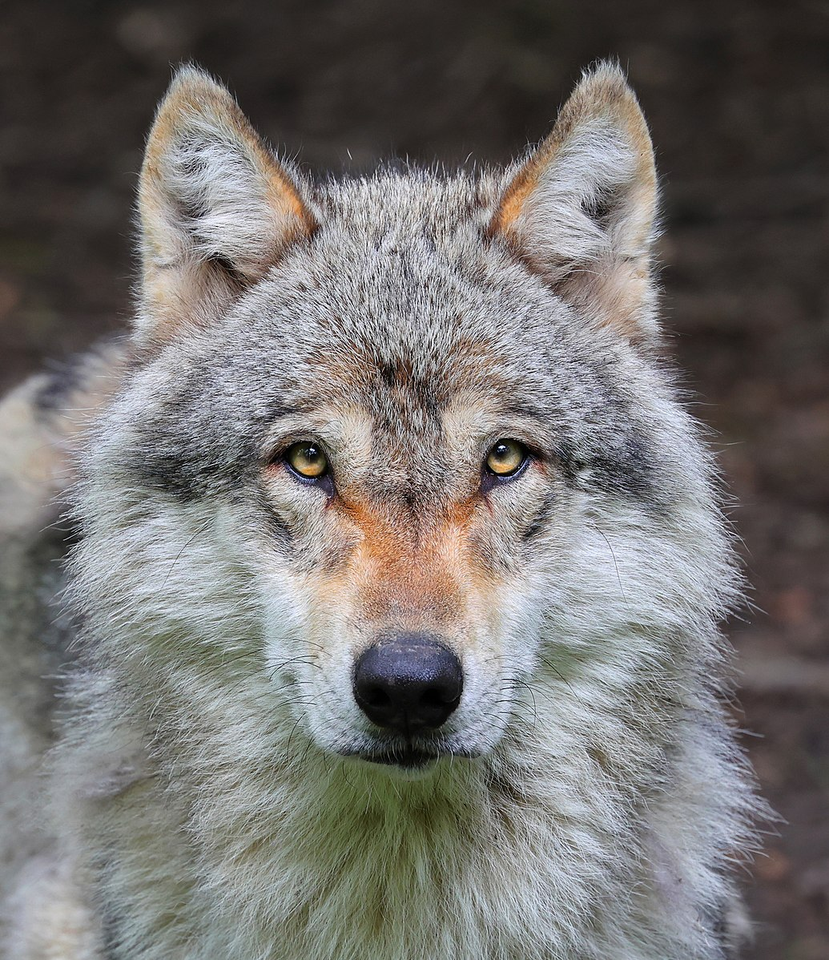
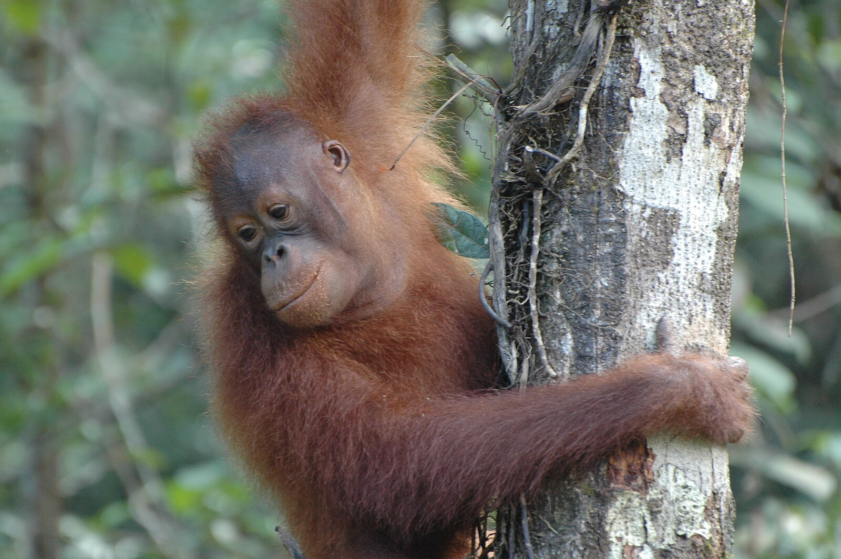
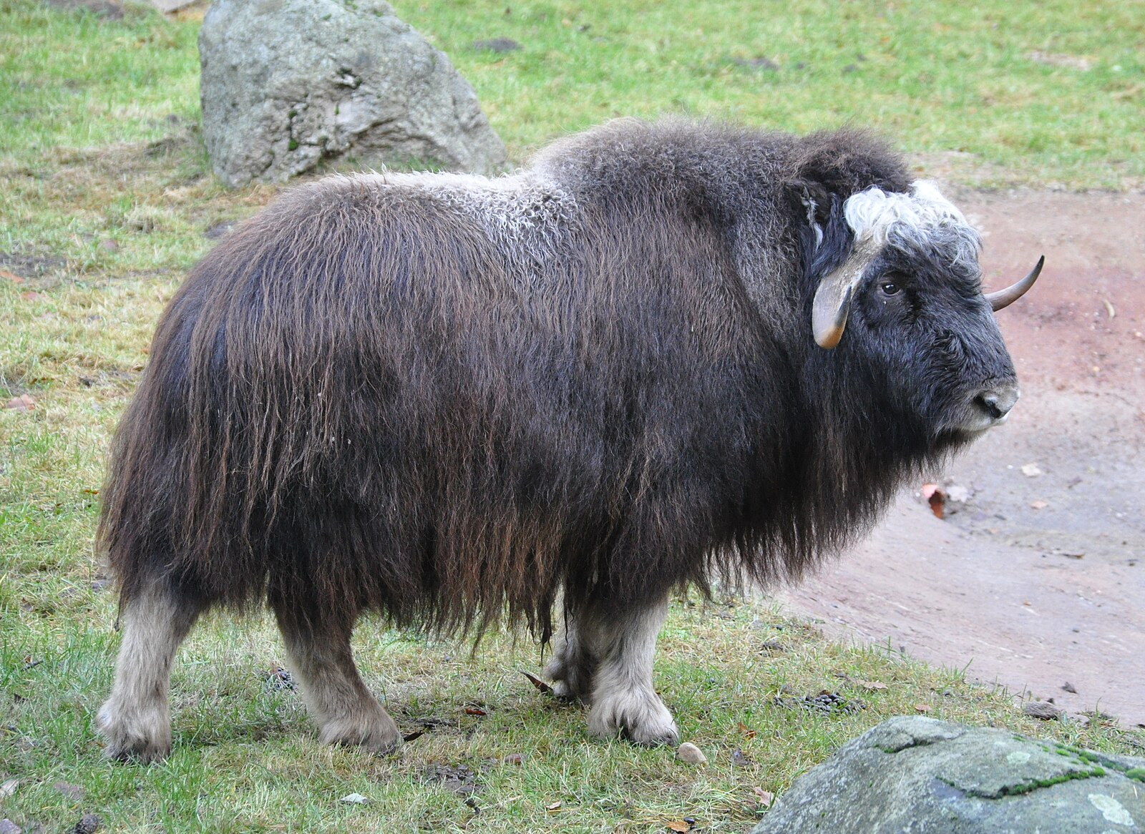
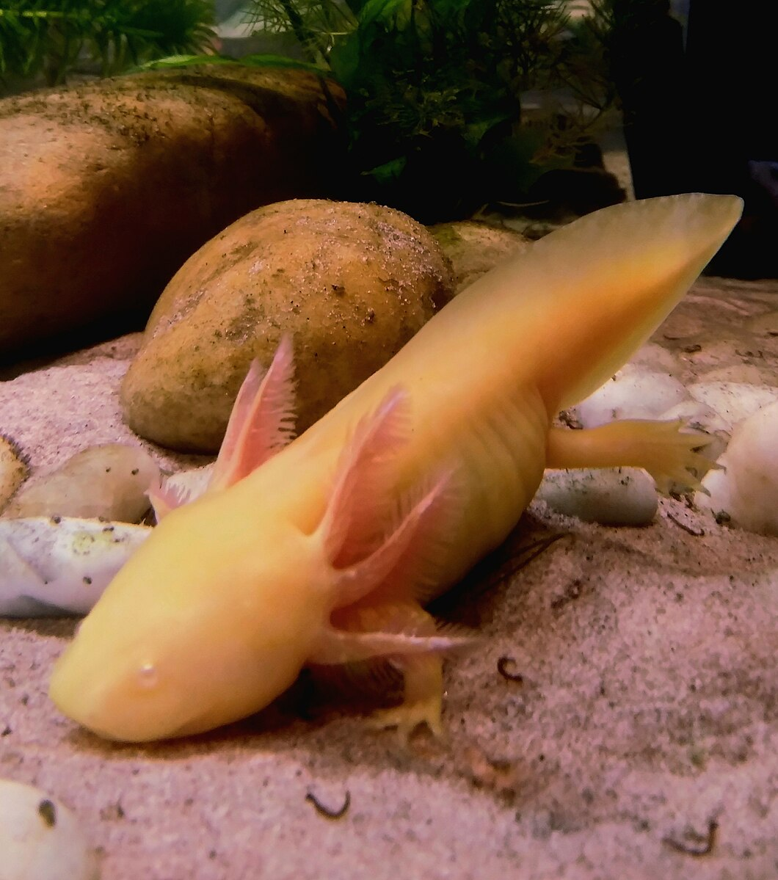
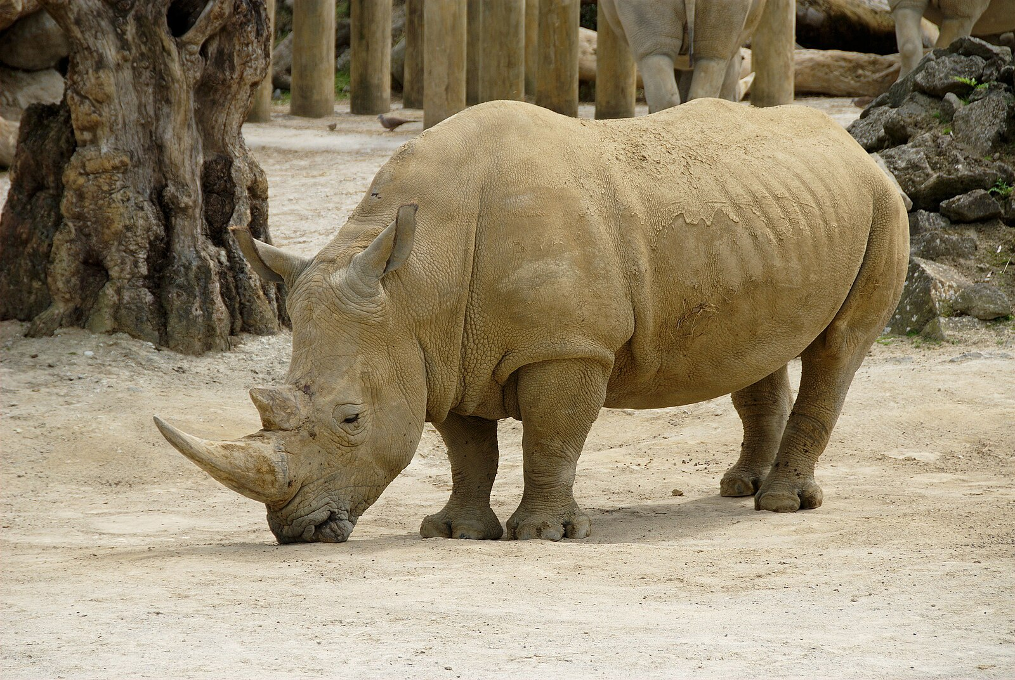
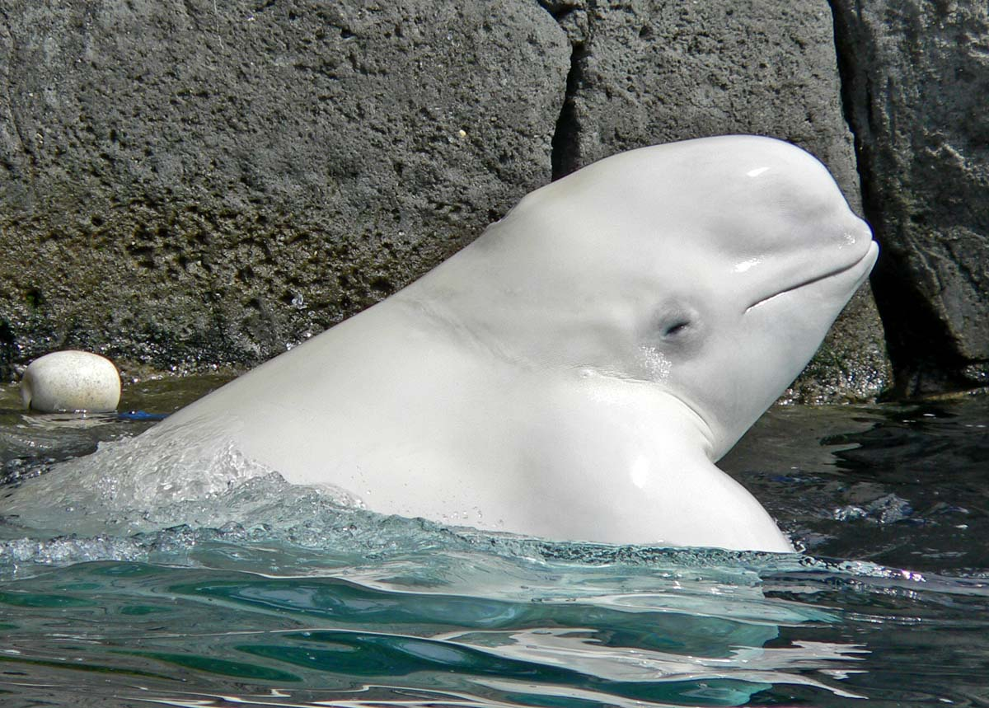
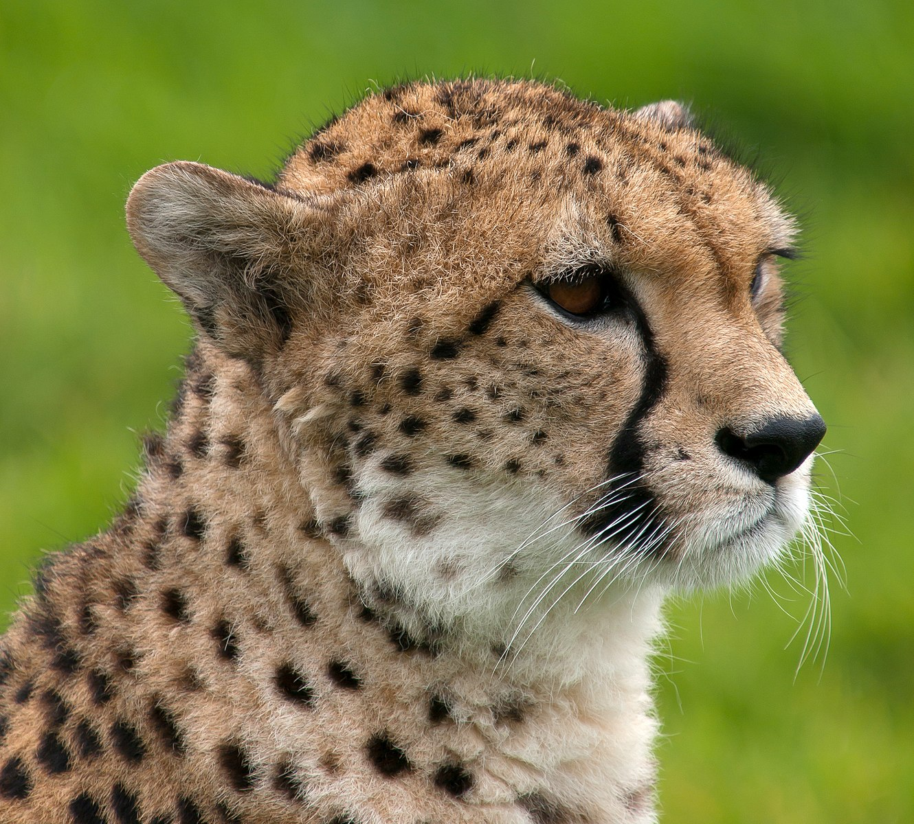
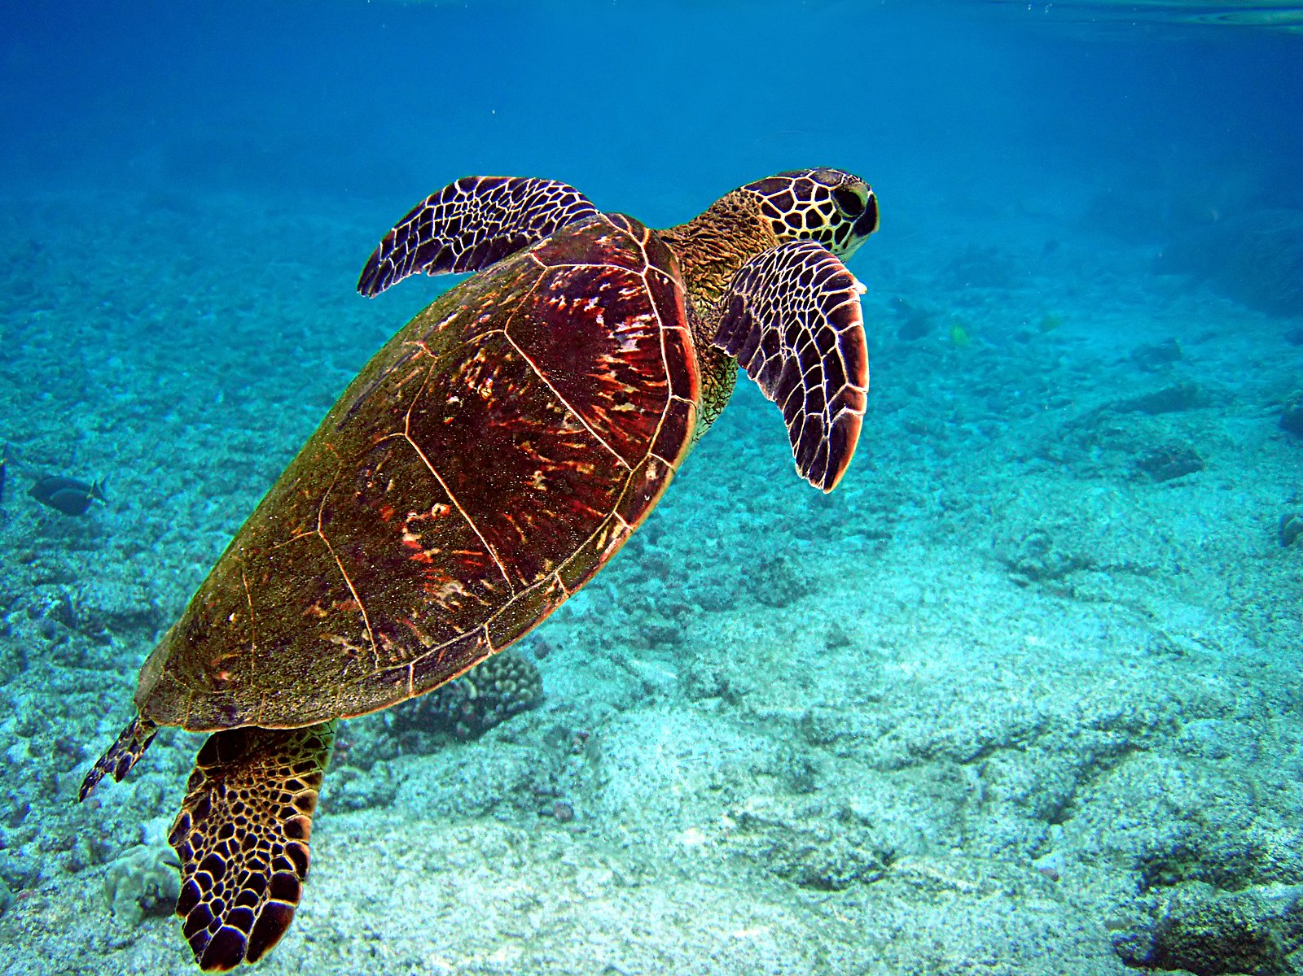
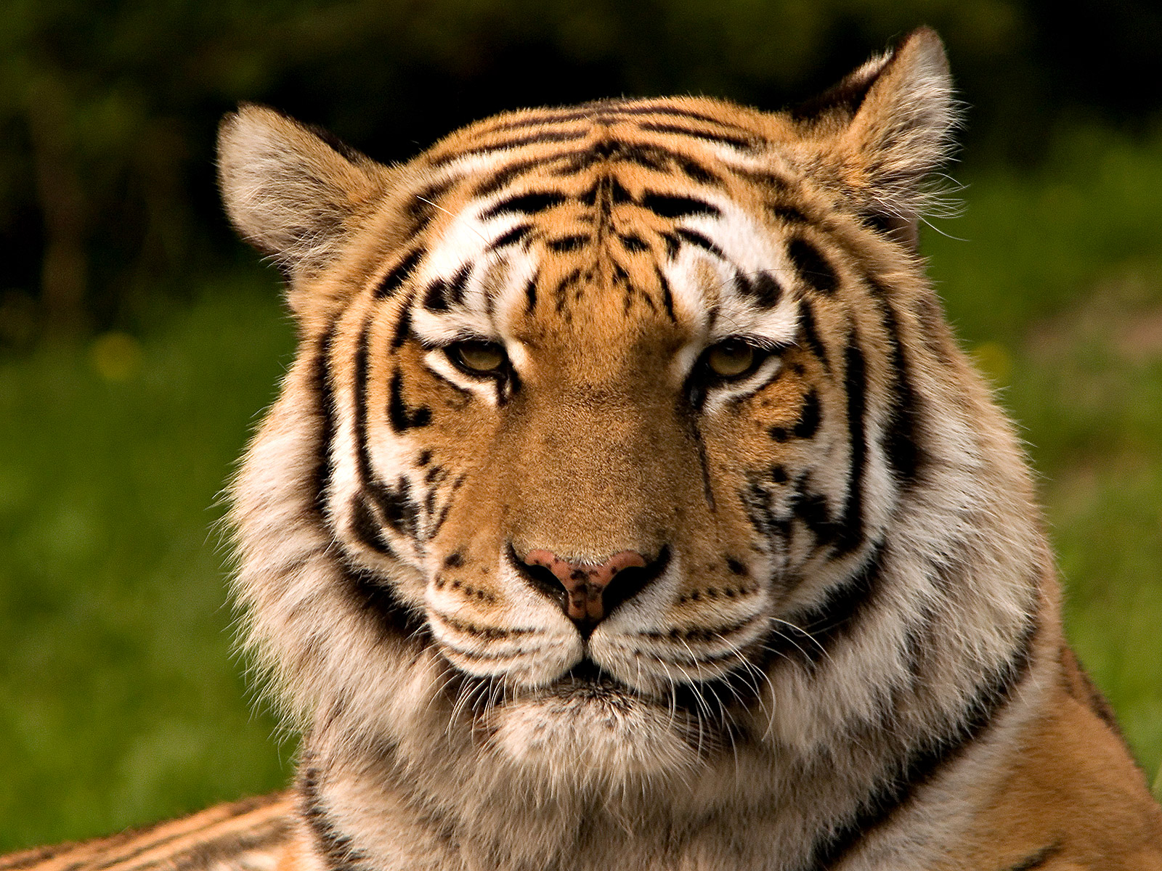
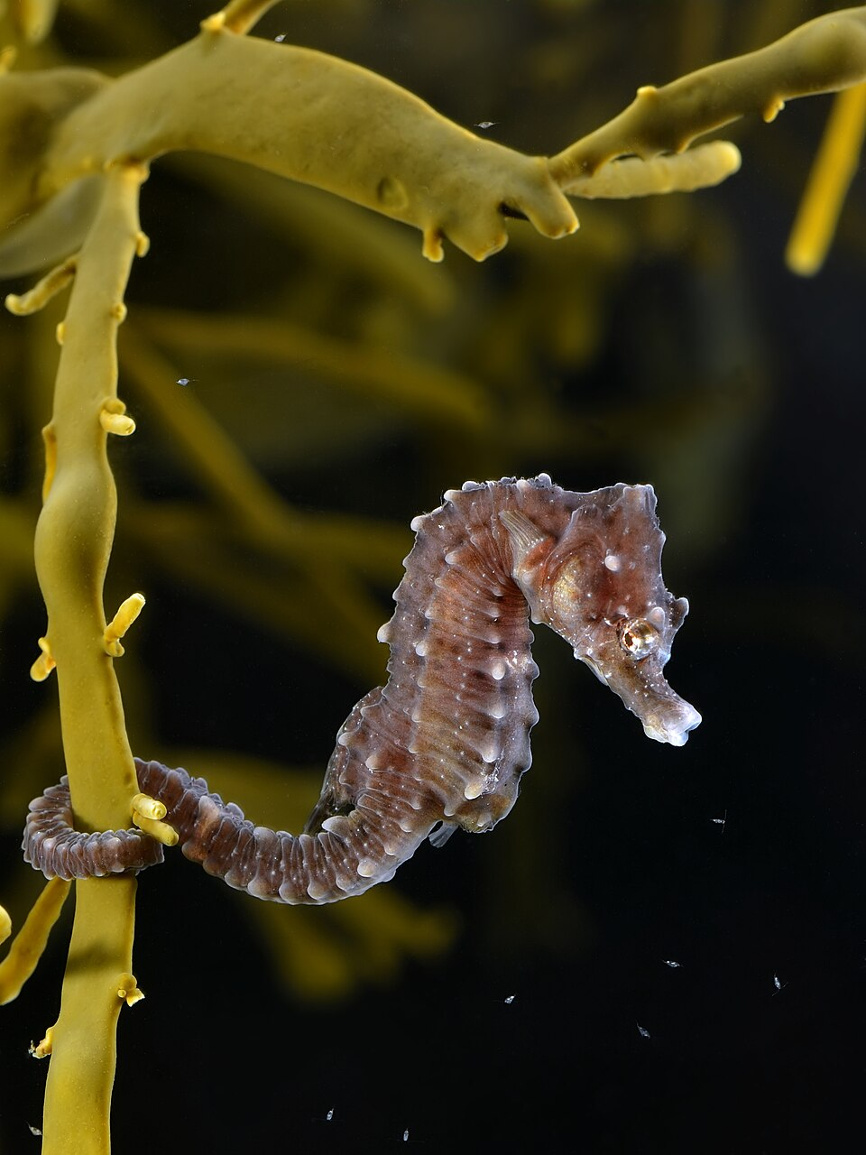
Notes:
Images from Wikimedia Commons:
https://commons.wikimedia.org/wiki/File:Dendrolagus_matschiei4.jpg
https://commons.wikimedia.org/wiki/File:2014_Borneo_Luyten-De-Hauwere-Bornean_orangutan-02.jpg
https://commons.wikimedia.org/wiki/File:Mountain_Gorilla,Bwindi,_Uganda_(15135296098).jpg
https://commons.wikimedia.org/wiki/File:Chimp_portrait_(5312048385).jpg
https://commons.wikimedia.org/wiki/File:Emperor-walk_hg.jpg
https://commons.wikimedia.org/wiki/File:Ovibos_moschatus_qtl3.jpg
https://commons.wikimedia.org/wiki/File:Ring-tailed_lemur_(Lemur_catta).jpg
https://commons.wikimedia.org/wiki/File:Chelonia_mydas_is_going_for_the_air_edit.jpg
https://commons.wikimedia.org/wiki/File:African_rhinoceros.jpg
https://commons.wikimedia.org/wiki/File:Hippocampus_hippocampus_(on_Ascophyllum_nodosum).jpg
https://commons.wikimedia.org/wiki/File:Black-footed_ferrets_three.png
https://commons.wikimedia.org/wiki/File:Delphinapterus_leucas_head_3.jpg
https://commons.wikimedia.org/wiki/File:Cheetah_portrait_Whipsnade_Zoo.jpg
https://commons.wikimedia.org/wiki/File:Sibirischer_tiger_de_edit02.jpg
https://commons.wikimedia.org/wiki/File:Snow_leopard_portrait-2010-07-09.jpg
https://commons.wikimedia.org/wiki/File:TheAxolotl.jpg
https://commons.wikimedia.org/wiki/File:Loup_gris_(Canis_lupus_).jpg
https://commons.wikimedia.org/wiki/File:African_Bush_Elephant.jpg

Slide 8
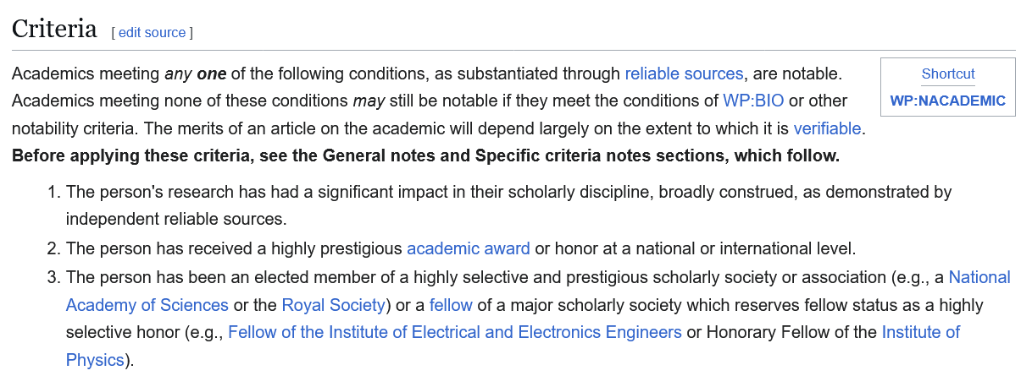
WP:Notability (academics)

Slide 9
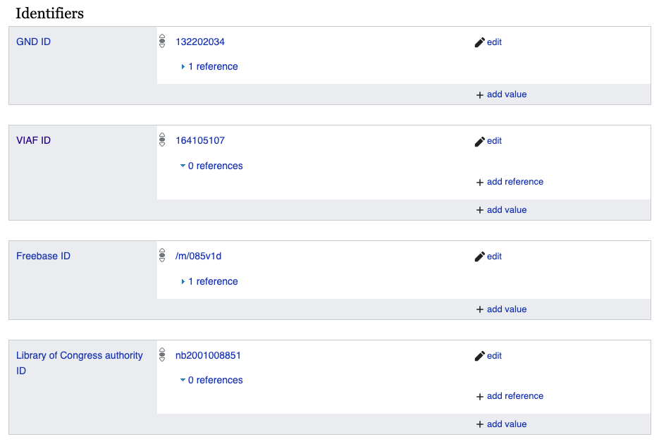
Question and Methods
Do persistent identifiers indicate an increased likelihood of “notability” for Wikipedia [EN]?
Creation date of PID relative to creation date of Wikipedia entry.
Creation date of entry relative to date of Prize finalist.
Count and type of PIDs per Prize finalist.
PIDs with displayed creation dates (Wikidata, LCNAF, and ORCID) relative to Wikipedia entry for Prize finalists.
https://commons.wikimedia.org/wiki/File:Identifiers_on_Wikidata.png

Slide 10
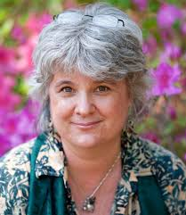
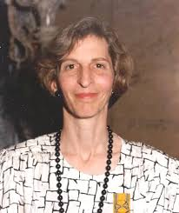
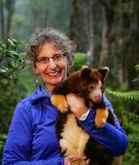
The People
Women in Red
33 people (21 men, 12 women)
10 winners (8 men, 2 women)
24 Wikipedia entries (as of Sept. 24, 2025):
73% of the people have entries
80% of Prize winners have entries (two most recent winners do not)
Men with entries: 71% (15/21)
Women with entries: 75% (9/12)
Average wait for an entry after prize nomination: 1.4+ years
Karen Eckert
Holly Dublin
Lisa Dabek
Photos: Indianapolis Zoo: https://www.indianapoliszoo.com/

Slide 11
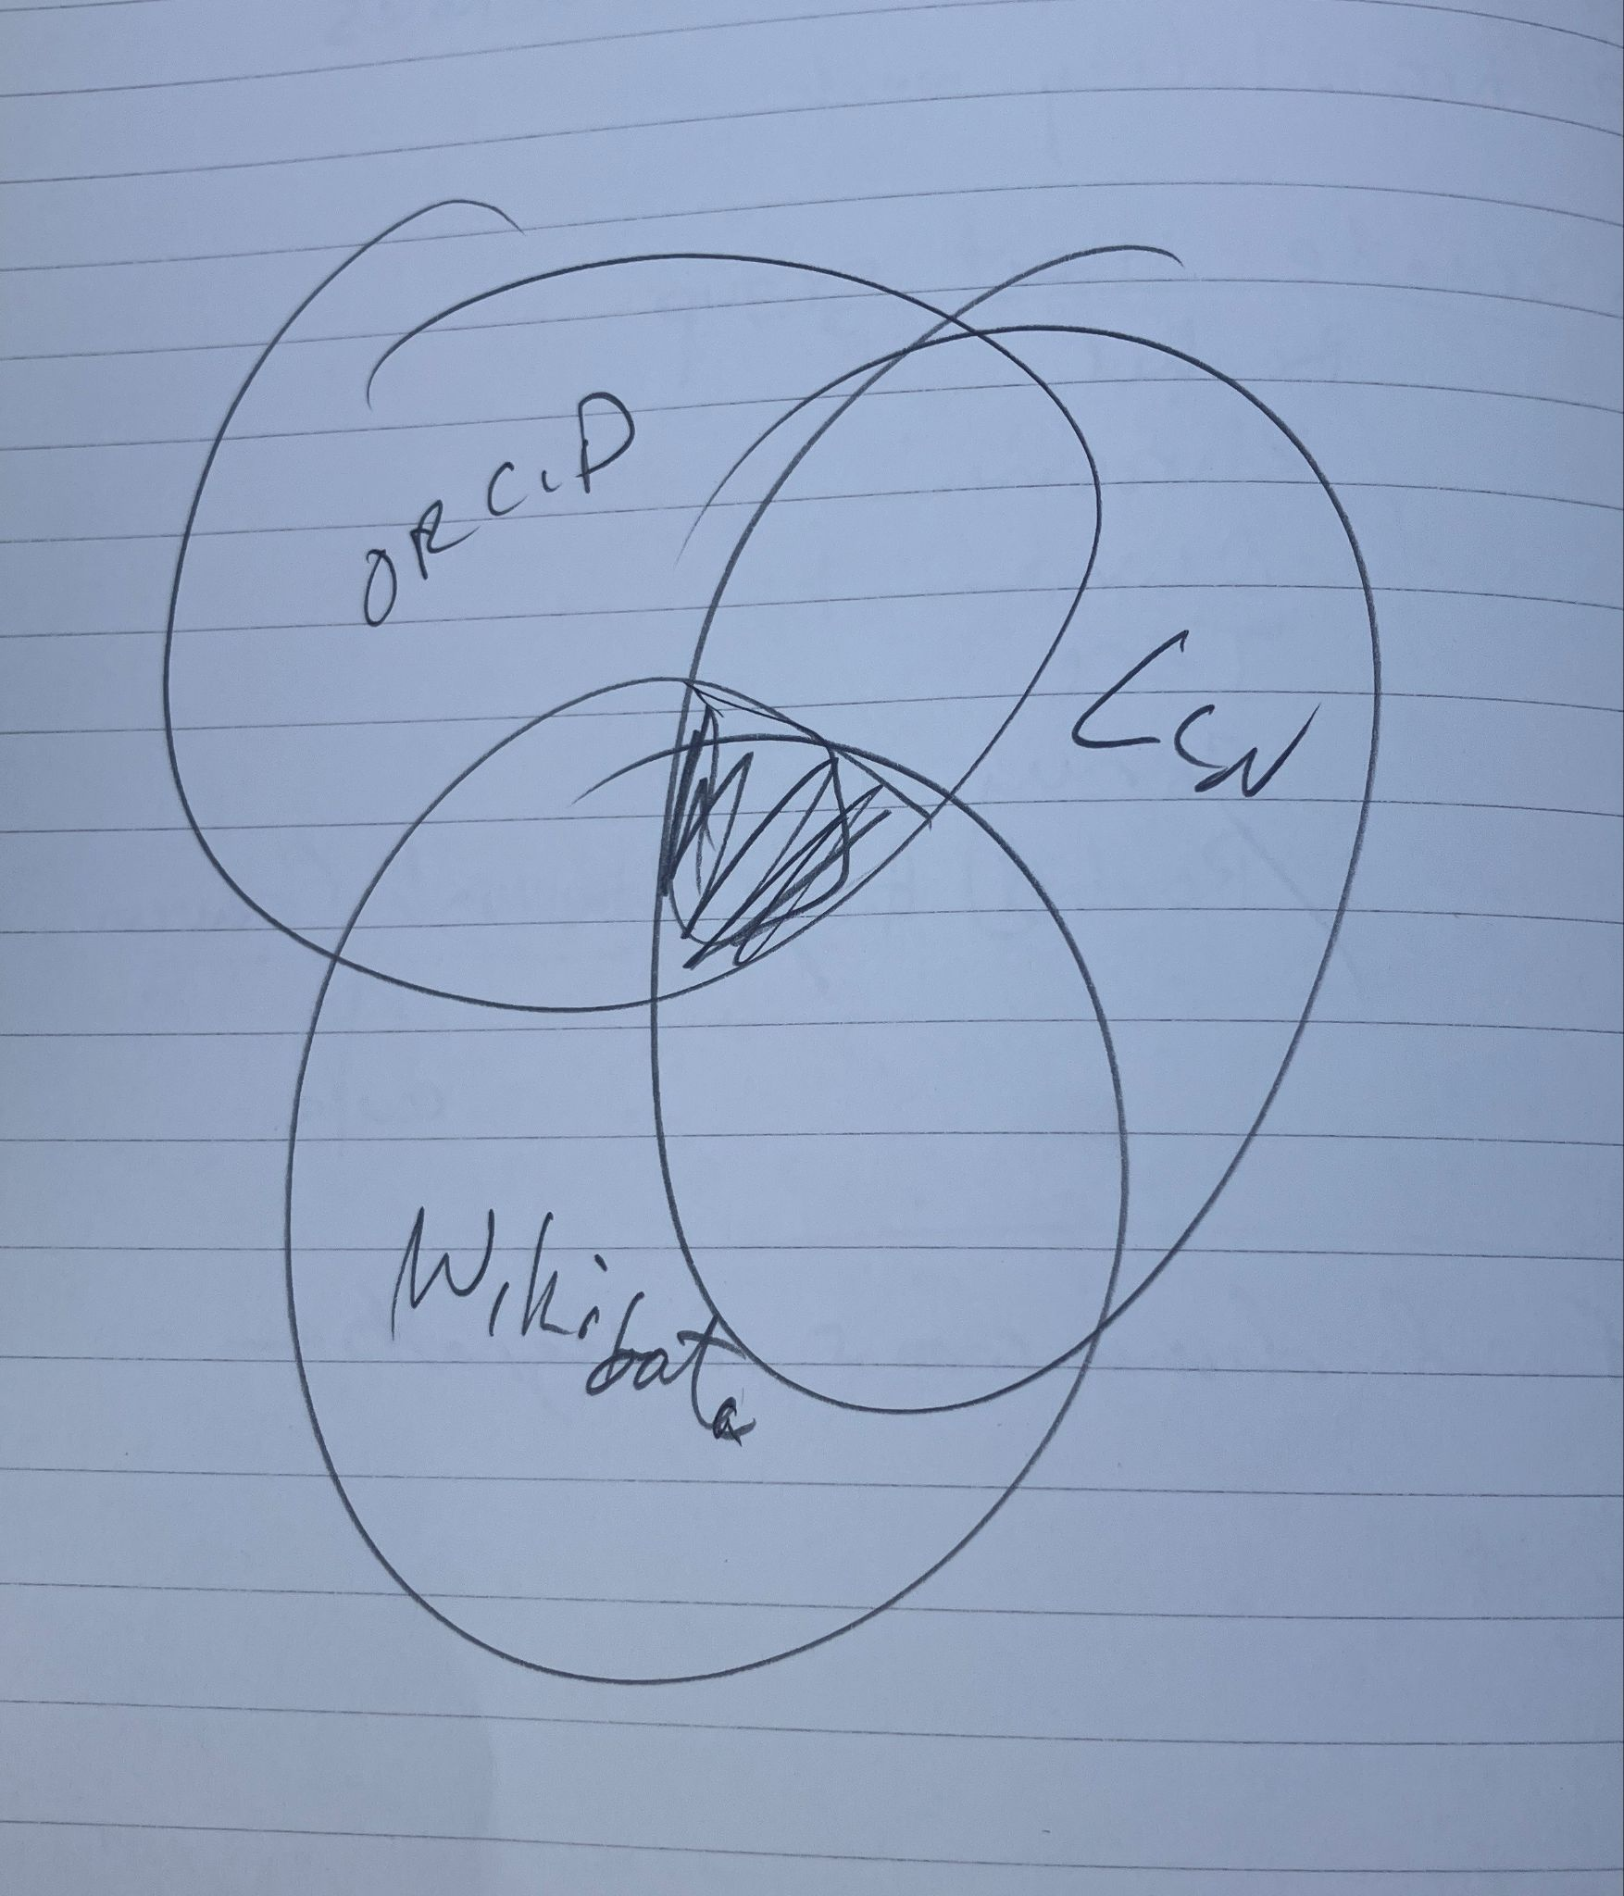
Venn diagram of people who have all three identifiers
The Power of PIDs?
20 people have all three PIDs
16 (80%) of these have Wikipedia entries
An increase of 7 percentage points over the norm
However … most people received Wikipedia entries before receiving all three PIDs.
Excluding award years that predate Wikipedia: 27% (4/15) received all PIDs before their entries.

Slide 12
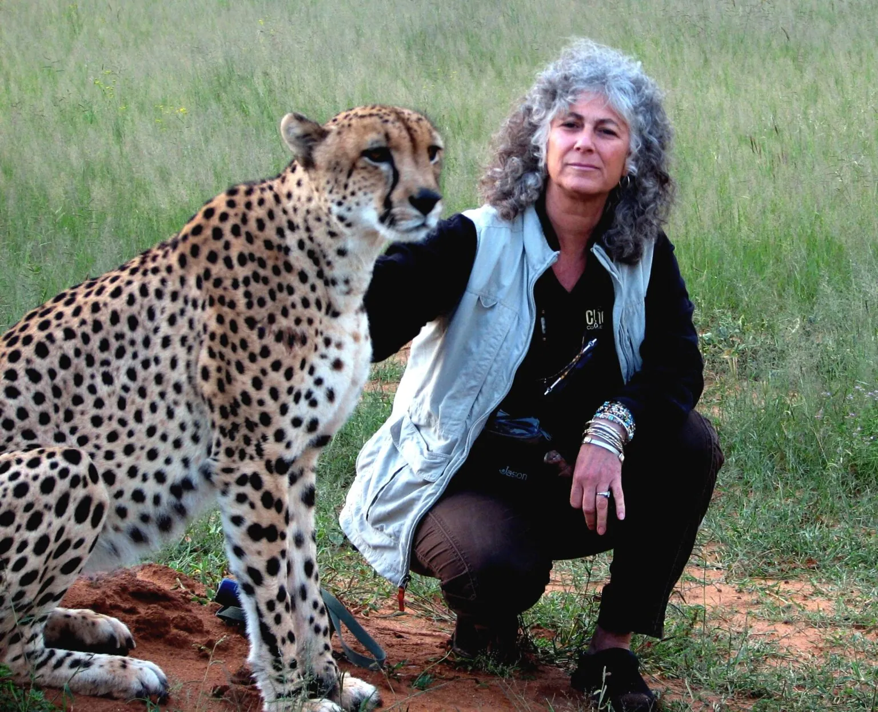
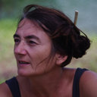
The Power of Q
The Indianapolis Prize (2006) list predates the launch of Wikidata (2012)
85% (28/33) have a Wikidata entry
86% (24/28) of those have a Wikipedia entry: a bump of 13 points over the norm
36% (4/11) of post-2012 candidates received Q before WP
Average wait for a WP entry after Q: 3.5 months
Laurie Marker: waited 4.6 years
Caroline Blanvillain: waited 3.6 years
Photos from: Indianapolis Zoo and ResearchGate

Slide 13

The Value of the Library of Congress Name Authority File
LC Name Authorities (1970s) predate Wikipedia and the Prize by decades
85% (28/33) have a LCNAF
75% (21/28) of these also have WP entries (but 3 people have WP w/o LCNAF): a bump of 2 points over the norm
Using Wikipedia’s launch as day one, the average wait between LCNAF and WP is 8.3 years
Waited more than 19 years for a WP entry: Laurie Marker, Caroline Blanvillain, and Simon Stuart
Photos from: Indianapolis Zoo and ResearchGate

Slide 14

ORCID?
The Indianapolis Prize (2006) predates ORCID (2010)
73% (24/33) have an ORCID
71% (17/24) of these also have WP entries: 2 points less than the norm
29% (5/17) received an ORCID before WP
29% (7/24) of people with WP entries, have no ORCID
Using WP’s launch date as day one, the average wait for a WP entry after ORCID: - 4.3 years
Laurie Marker: waited 4.8 years
Caroline Blanvillain: waited 6.1 years
Gerardo Ceballos: waited 9.5 years
Photos from: Indianapolis Zoo, ResearchGate, and Wikimedia Commons

Slide 15
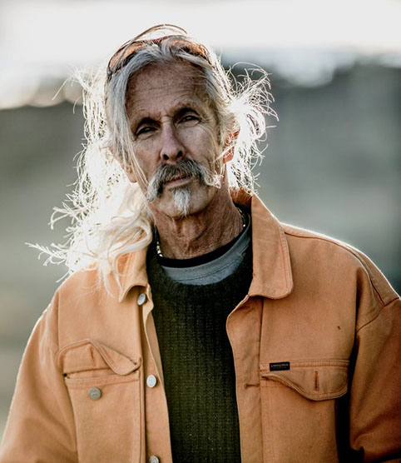
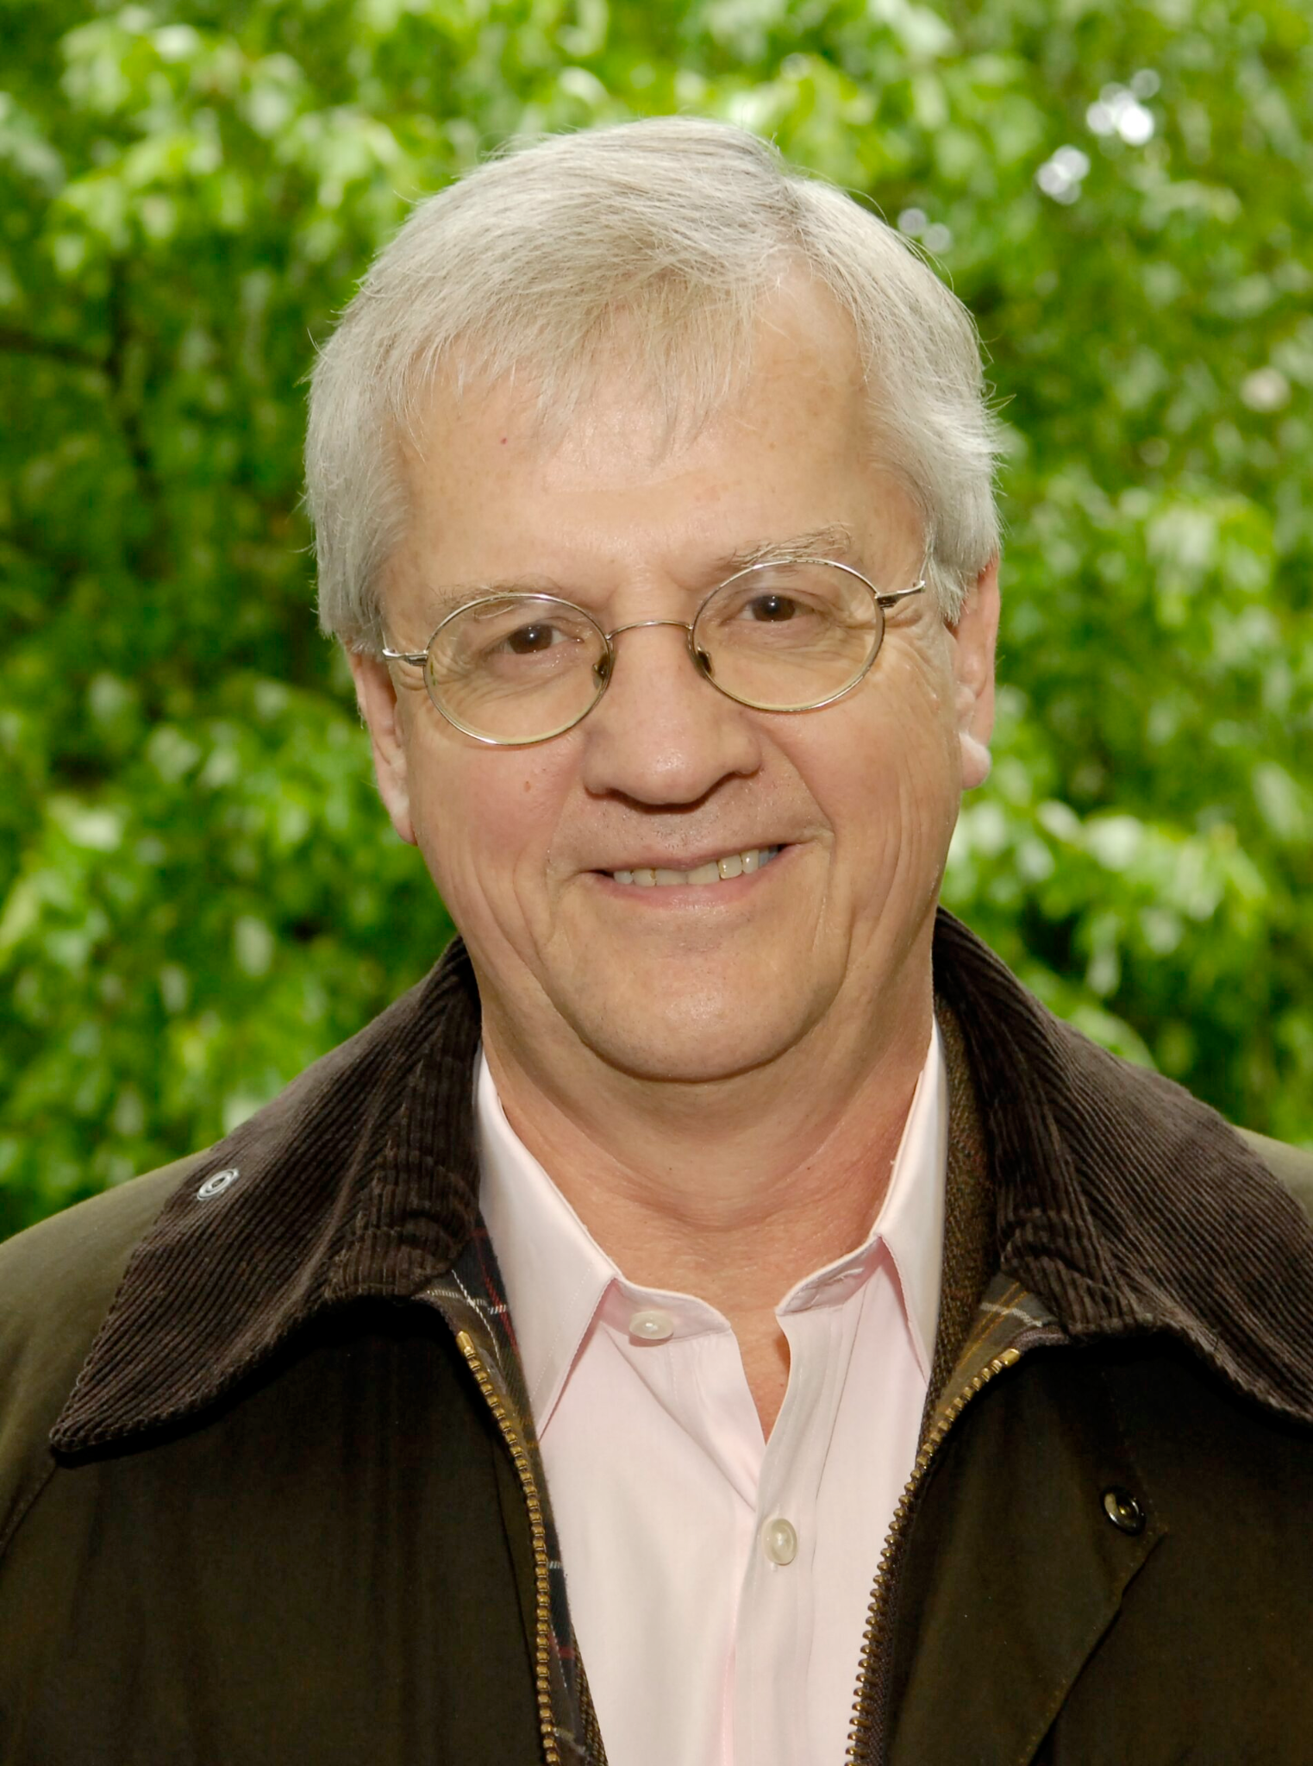
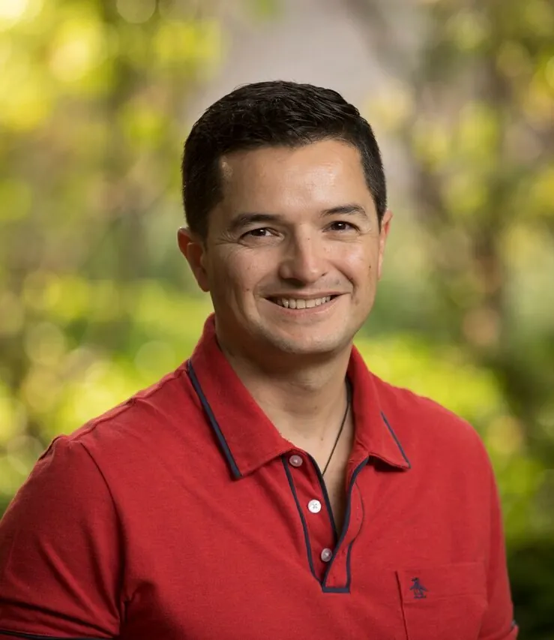
Overdue for Wikipedia Entries
Four people have all three PIDs and no Wikipedia entries
Holly T. Dublin, 2006 finalist: Q134691635
Joel Berger, 2018 finalist: Q97446574
John G. Robinson, 2020 finalist: Q55245227
Pablo Borboroglu, 2023 winner: Q106097317
Photos: Indianapolis Zoo: https://www.indianapoliszoo.com/

Slide 16
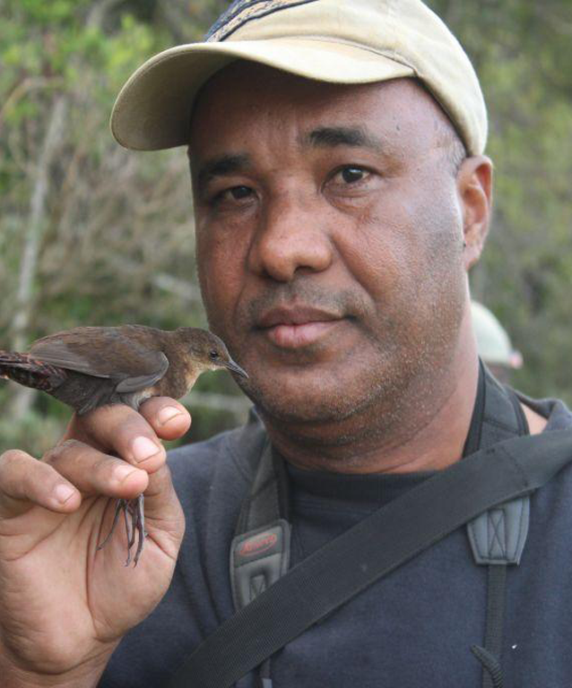
One PID … Prize Winner
Waiting for an entry.
Lily-Arisón Rene de Roland
ORCID: https://orcid.org/0000-0003-2149-8170
2025 Indianapolis Prize Winner
National Director of The Peregrine Fund’s Madagascar Program
Photo: Indianapolis Zoo

Slide 17

Gender: Mixed Results
Indianapolis Prize finalists who are women are:
  more likely to have Wikipedia entries
  more likely to have an entry before becoming a Prize finalist (average years: 4.3)
Men are more likely to receive an entry after becoming a Prize finalist (average years after Wikipedia entry: 1.4)
Women are more likely to be outliers:
  Holly Dublin: has all three PIDs; still waiting for Wikipedia
  Laurie Marker: waited 4.6 years after receiving all three PIDs
  Caroline Blanvillain: waited 3.6 years after receiving all three PIDs
Women are less likely to win the Indianapolis Prize (80% men … just like Wikipedia)

Slide 18
Are PIDs a Good Indicator of Notability?
Wikidata: +13 percentage points - wrote an article or something; maybe on a topical, Wikiproject worklist (perhaps this one is just too common?)
LCNAF: +2 percentage points - probably wrote at least one book
ORCID: -2 percentage points - self-selected, but maybe because the person was required by a funder or publisher (perhaps they have an established program of research, but maybe “notable” people just don’t really see a need for an ORCID)
Weak indicators on their own, but stronger together?
All three PIDs: +7 percentage points

Slide 19

An Indicator of “Notability”? (Does this already exist?)
An indicator that suggested notability was more or less likely would help when we:
  Plan worklists for edithathons
  Teach new editors
  Contribute to AFC
If not PIDs, would Wikidata Item Quality help?
Other ideas?

Slide 20

Thoughts and musings
Our population is very small: 33 people
These are scientists, mostly
They are also prize finalists and winners (so of course they are more likely to be notable)
Maybe other PIDs are more predictive?
Maybe a total number of PIDs is more predictive?

Slide 21
Questions?
Olivia MacIsaac
Username: Olgrmac
omacisaa@iu.edu
Jere Odell
Username: Jaireeodell
jdodell@iu.edu

