Slide 1

Utilizing Canvas as a Tool for Peer Educator Onboarding and Training
Ryan Anderson, MPH, CHES, CHWC
Assistant Director,
Health and Wellness Promotion
Indiana University Indianapolis

Slide 2

Session Agenda
Introduction of Peer Health Education program
Overview of Canvas Course
Larger Training Curriculum
Evaluation of the Course
Implementation Strategies Across Institutions

Slide 3
Learning Outcomes
Explore diverse applications of a LMS tool for developing training materials, identifying effective practices for potential implementation
Explain how the Canvas course is used alongside other training and development methods to center accessibility of information for peer educators
Identify key pieces of peer educator feedback used to update the course after its first year

Slide 4
Health and Wellness Promotion
Health and Wellness Promotion is an education and outreach office in the Division of Student Affairs dedicated to fostering a healthy campus environment that supports student well-being through a comprehensive range of programs and services. We help students prevent personal setbacks that interfere with academics, help students thrive across seven elements of wellness, and reach their full potential inside and outside the classroom.
Four professional staff, 12 student employees

Slide 5
Peer Health Educators
Initially student organization, then volunteers, employees since 2020
Currently six Peer Health Educators and one Graduate Student Employee
Presentations by request, events, peer-led events, social media, office hours
Work around 5-10 hours per week

Slide 6
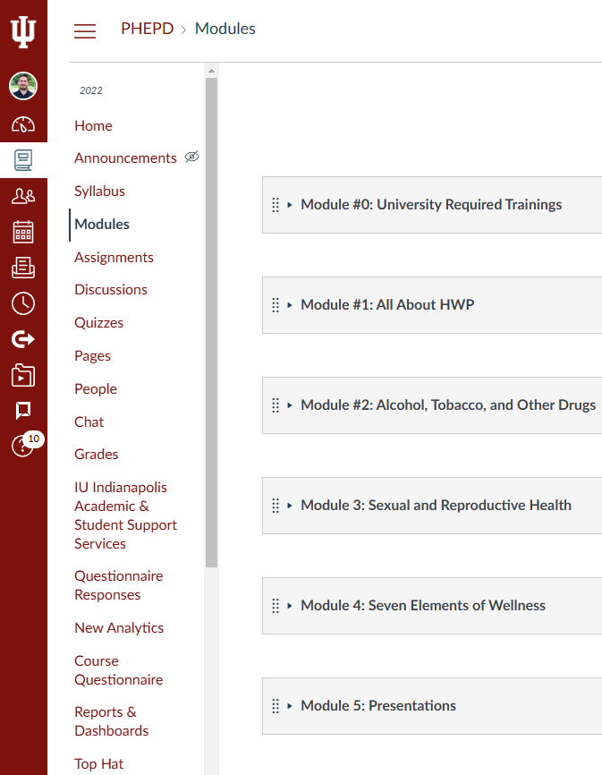
Canvas LMS by Instructure
Learning Management System (LMS)
Used by Indiana University system for classes, trainings, external pages, etc.
Important used in this course: modules, assignments, quizzes, pages

Slide 7
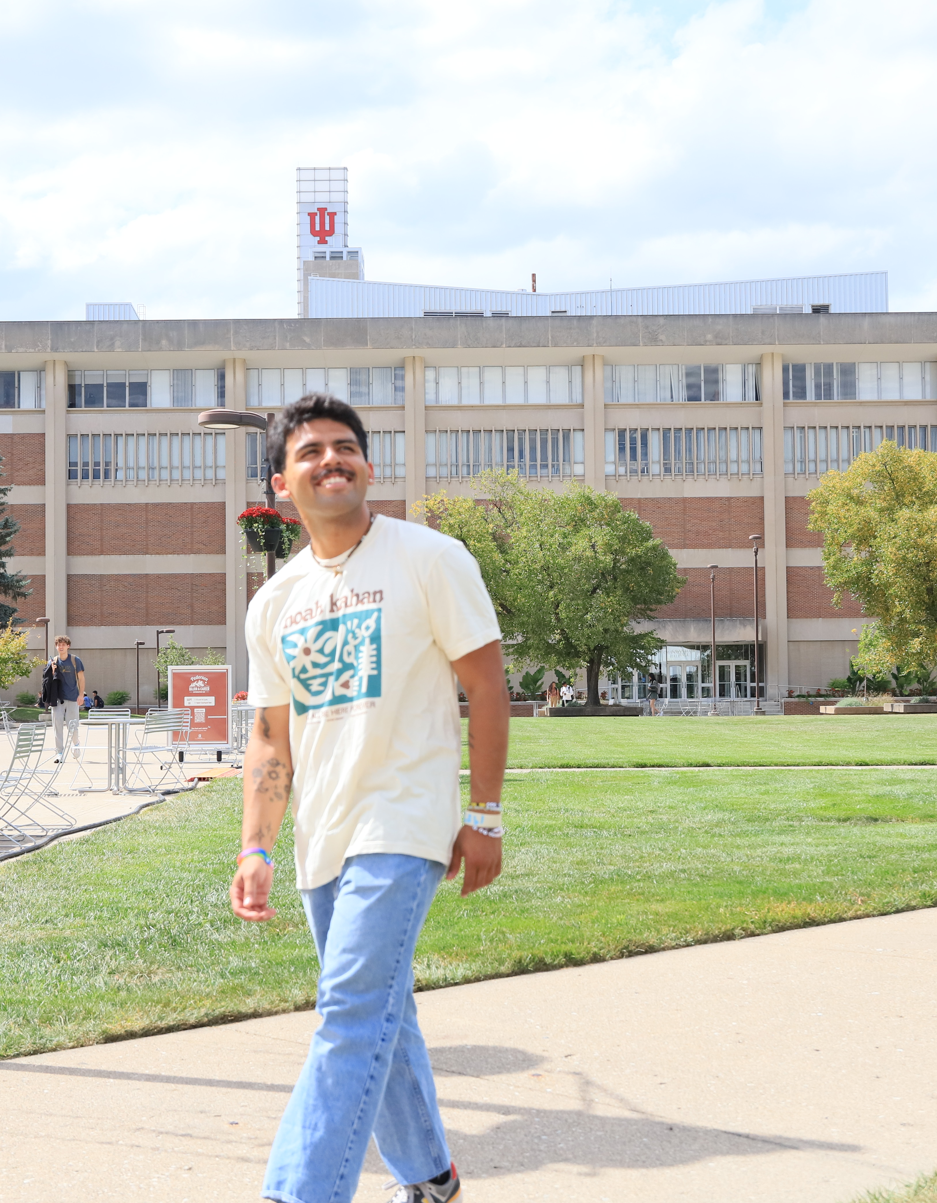
PHE Personal Development Course
Short course on Canvas to help orient new peer educators or other student employees to HWP
Initially created to move away from "training retreat" model and increase accessibility of information

Slide 8
Current Topics Covered
Required university trainings
All about Health and Wellness Promotion
Content specific modules
Sexual/reproductive Health
Alcohol, tobacco, and other drugs
IU Indy Wellness Framework
Presentations, Programming Planning, Standards of Practice
Module Knowledge Check Quizzes
Notes:
Required training: FERPA, Campus Security Authority, Sexual Misconduct
PHE Overview, PWI, Health and Wellness Services, Coaching

Slide 9
How does this fit with everything else?
Onboarding blocks
Student expectations, grab-and-go services, etc.
Overview of all presentations
In-person training
First two weeks of weekly meetings (1.5 hours each)
Weekly meetings
Team building
Professional development

Slide 10
Course Evaluations
Criteria | Fall 2022 Strongly Agree/Agree (n=7) | Fall 2023 Strongly Agree/Agree (n=6) | Fall 2024 Strongly Agree/Agree (n=7)
Learning objectives were clear | 100% | 100% | 100%
Course content was organized and well planned | 100% | 100% | 100%
Course workload was appropriate | 100% | 100% | 100%
Course gave you tools to succeed as a PHE | 71% | 85% | 100%

Slide 11
Course Evaluations
Year | Most Helpful | Improvements
2022 | Connecting my personal wellness to the dimensions Healthy relationships modules Active learning activities | More information about HWP programs and services Remove financial wellness section or rework it
2023 | Personal wellness connections. Info about health and wellness coaching | More information about the day-to-day of being a Peer Health Educator Too many experiential assignments
2024 | Info about recovery community Programming planning module | Too many module quizzes

Slide 12
Updates and Changes
Multitudes of topics -----> more about the role
Modules about each dimension of wellness removed
Condensed to Seven Elements of Wellness module
Experiential learning components removed
Program planning module, overview of the role, standards of practice added

Slide 13

Future of the Course
Plan is to continue to use the Canvas course in the future
Replace at least two module quizzes
Potentially being used as a potential model for other student employee training

Slide 14
What if my institution doesn't use Canvas?
Blackboard Tool | Canvas Tool | Differences
Folder | Modules | Organization of learning materials
Users | People | Information about the students; cannot see students' email
Discussion boards/forums/threads | Discussions | There’s no need to make a discussion thread per group. Lack of anonymity and force moderation options.
Assignments | Assignments | Assignment created and published, added to, assignment page; instructors can limit the type of file
Table adapted from Seton Hall University IT
Notes:
https://www.shu.edu/technology/canvas-blackboard-comparison.html - Blackboard, Moodle, Google Classroom, etc.

Slide 15
Implementation
Think, pair, share
What content would you include?
How could this fit into your current training materials?
How would you evaluate the course?

Slide 16
Q&A and Contact Information
Ryan Anderson, MPH, CHES, CHWC
Assistant Director, Health and Wellness Promotion
Email: anderry@iu.edu

