Slide 1
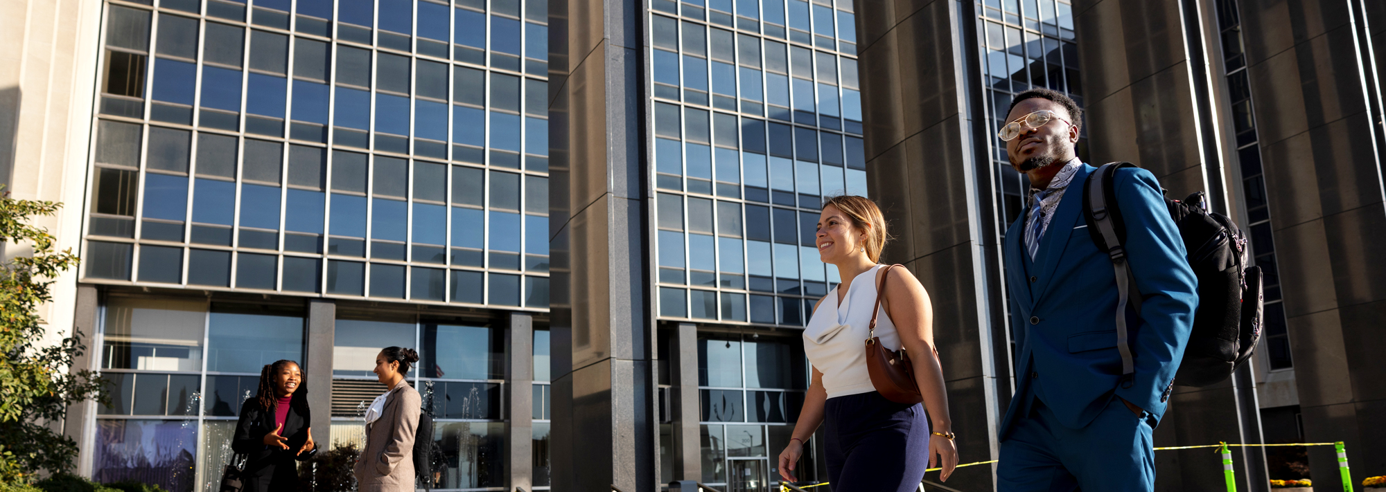

Sense of Belonging
Maya Elchal, Vibha Kamath, Kimberly Hestermann & Mason Charlton

Slide 2
Table of Contents
Introductions
5
Personal Perspectives
1
2
Research Topic Overview
Findings
6
3
Background
Recommendations
7
4
Research
Call to Action
8

Slide 3
Introductions
MEET THE TEAM

Slide 4
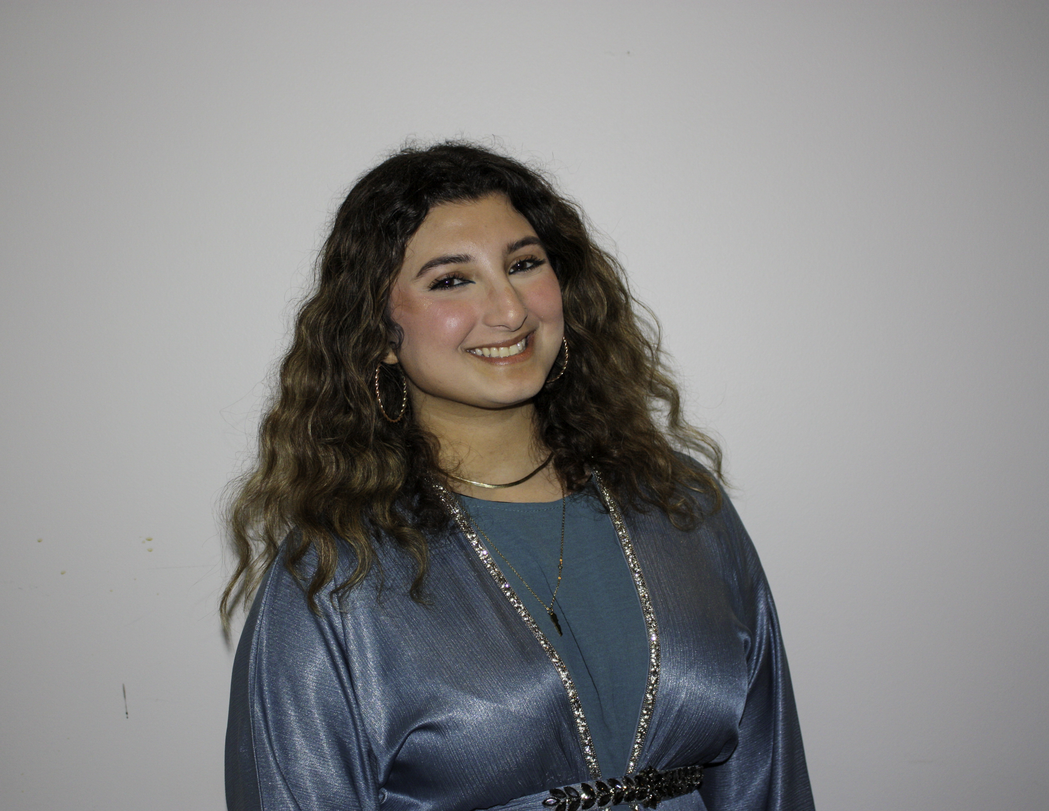
Maya El-Chal
SENIOR
About me:
Double major in biology and neuroscience with a minor in psychology
President of the Middle Eastern Student Association
FYS mentor for three years
AED of Internal Affairs and Director of Volunteers in the Regatta Steering
PLTL recitation leader for two years and PLTL Superleader for two years
Lab TA for both biology and chemistry

Slide 5
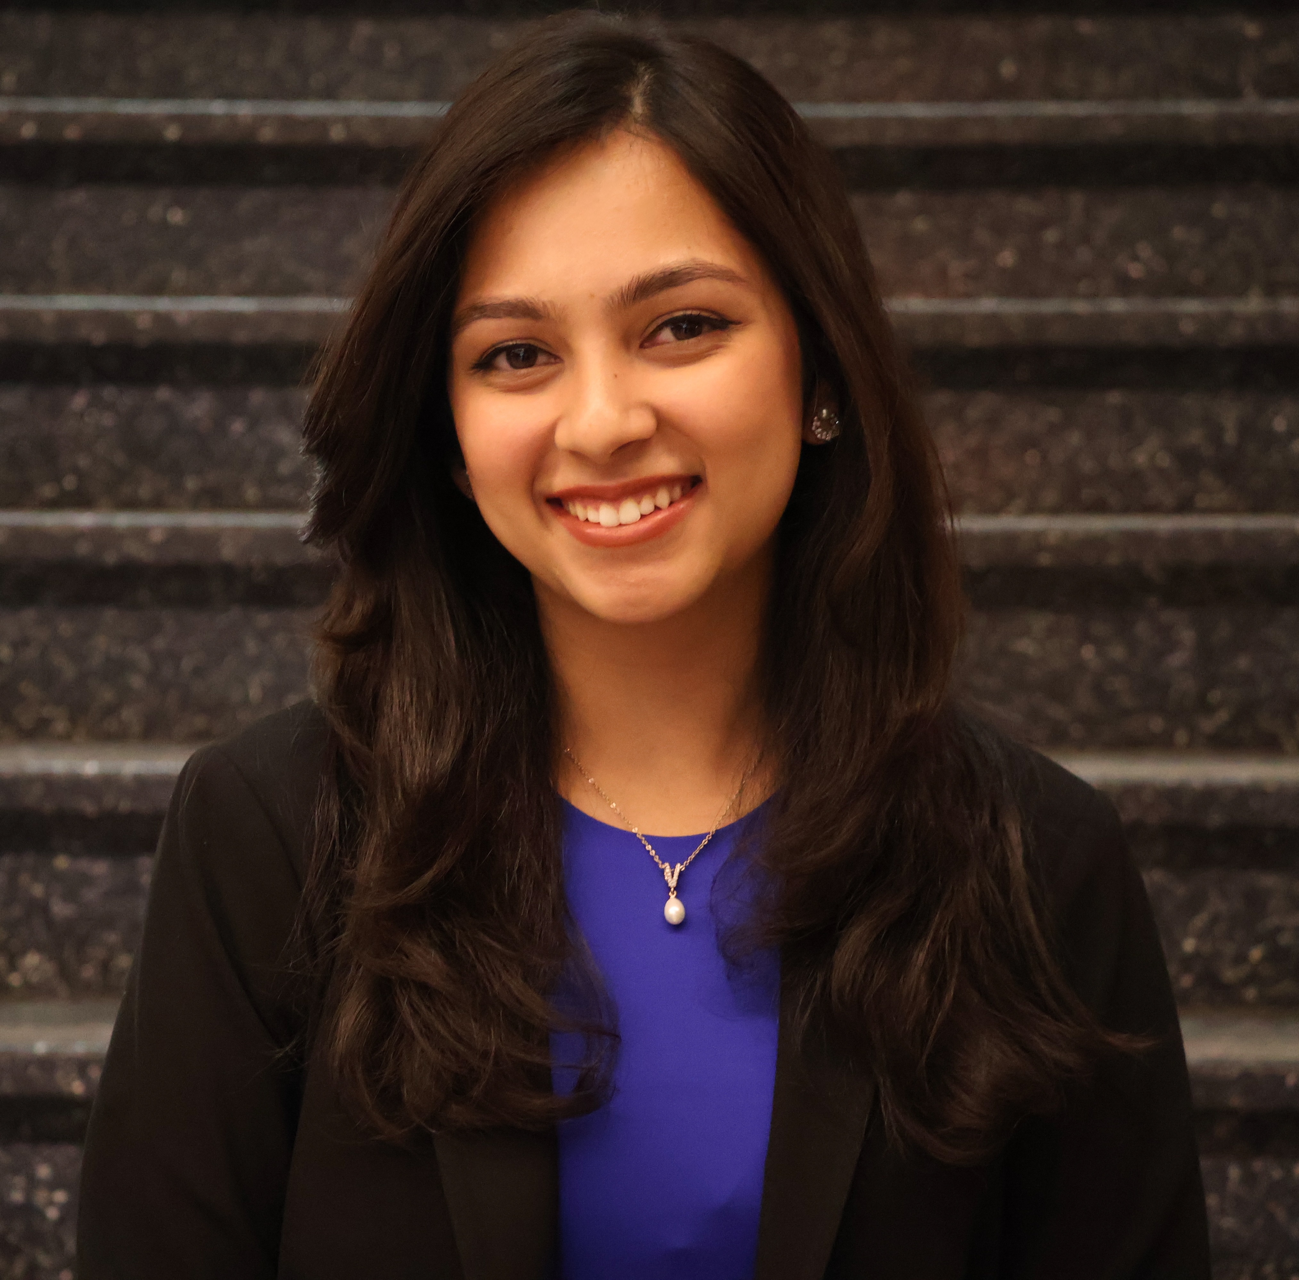
Vibha Kamath
JUNIOR
About Me:
Pursuing a triple major in Finance, Accounting and International Studies.
Executive Director of Regatta
TA for BUS-K 303 (Technology in Business)
Kelley Honors Advisory Board
Co-Director of Late Nights – Student Activities Programming Board (SAPB)
Co-Vice President of Community Relations – ALD/PES

Slide 6
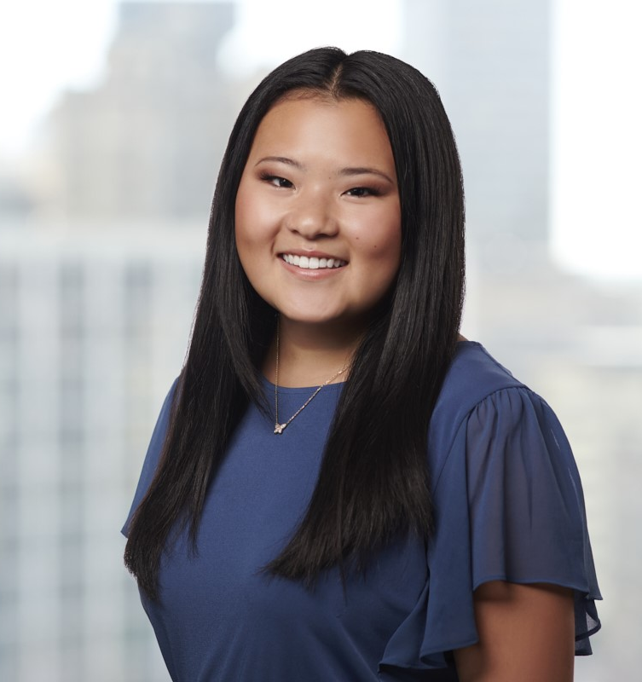
Kimberly Hestermann
JUNIOR
About Me
Pursuing a double major in philanthropic studies and finance
Women in Business President
Passionate about mental health advocacy and suicide prevention

Slide 7
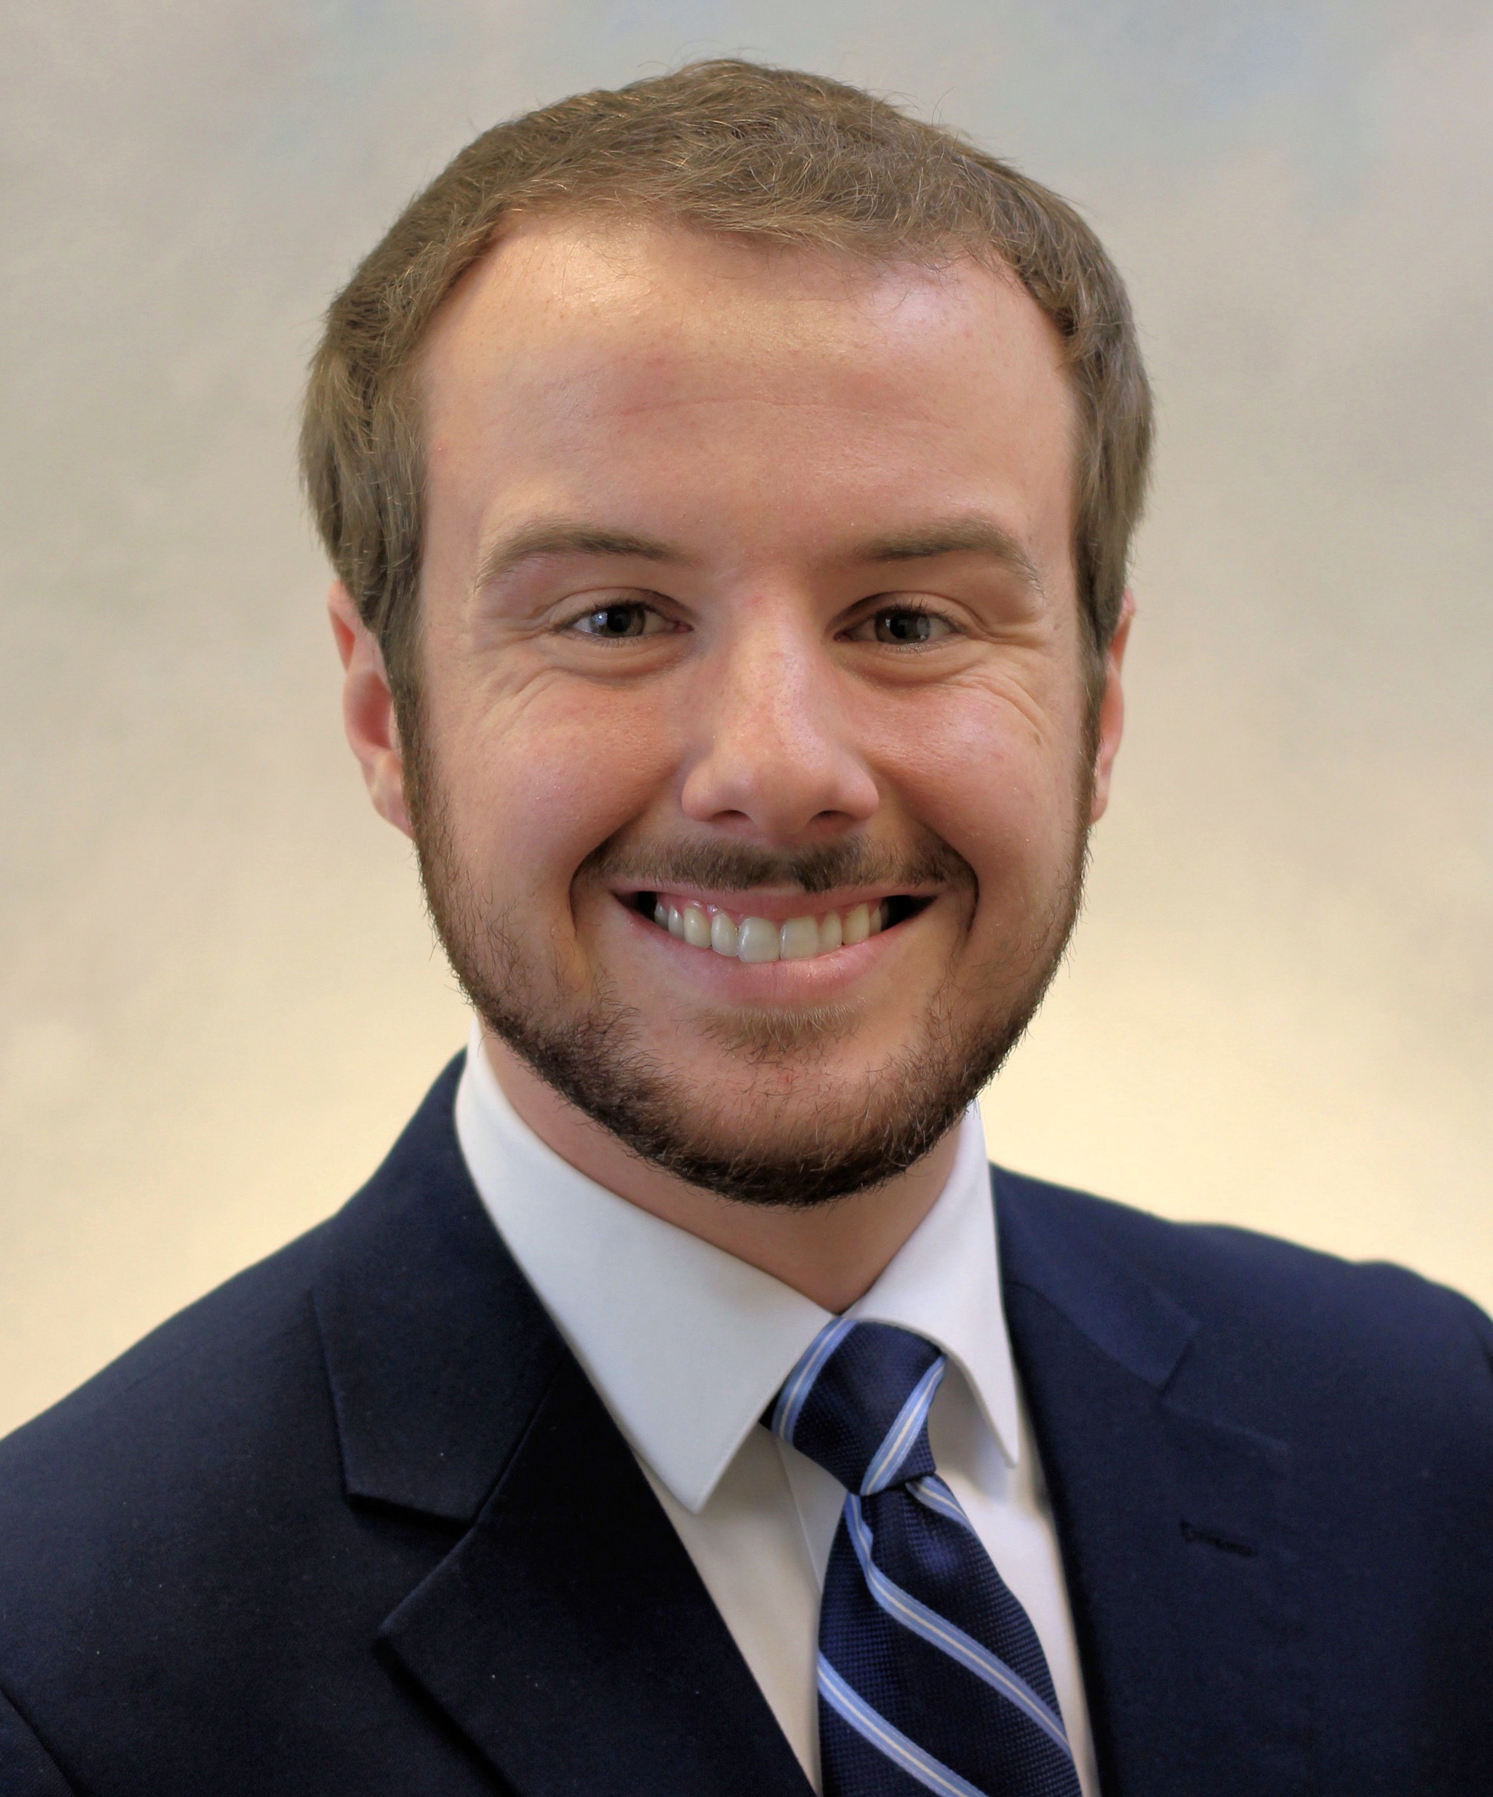
Mason Charlton
Senior
About Me:
Pursuing a degree in Management with a minor in Policy Studies at O’Neill School of Public and Environmental Affairs.
Pursing a Masters of Public Affairs with a focus on Economics
Former legislative Intern in the Indiana Senate
Candidate for the Indiana Governors Followship 2025

Slide 8
Topic Overview

Slide 9
Topic Overview
We were interested in exploring how the Purdue and IU split has impacted student morale and their overall sense of belonging on campus. The transition raised important questions for many students, including concerns about the value and accreditation of their degrees, and whether the change would affect student engagement and enrolment.
This project gave us the opportunity to better understand how the student body is experiencing and processing the shift—and to identify areas where the university can continue to support its community through this period of change.

Slide 10
Background

Slide 11
Background
The IU/Purdue split impacted more than just administration—it shaped students' social lives and overall campus experience.
A strong sense of belonging is key to student success, influencing academic performance, retention, and well-being.
Students who feel connected to their university are more likely to get involved and build meaningful relationships.

Slide 12
Background
Research aimed to explore how the transition to separate institutions may have disrupted student networks, changed the campus culture, and shifted how students see their place in the university.
Hope to better understand how the split has shaped students' sense of belonging and identify ways to strengthen connections in this new chapter for IU Indianapolis.

Slide 13
Research

Slide 14
Research
Research was conducted through Qualtrics.
Individual members on our team also reached out to their individual schools to further collect data. Professors were also asked to see if they could advertise the survey in class. Along with individual schools were asked to see if they could publish the survey.
To be able to take the survey, students had to be enrolled as IU students.

Slide 15
Personal Perspectives

Slide 16
Maya
Sense of belonging may vary depending on the category (for example whether it is about the degree itself or student organizations), and regardless of results, there is always room for improvement in every aspect of a student's college life.
Vibha
Unsure about what it meant for our identity as a campus.
Questions about what the split meant to students' degree and opportunities.

Slide 17
Kimberly
Current sophomores, juniors, and seniors began studying at IUPUI and weren't under the impression that the schools would split.
Social aspects across schools are impacted more than academically.
Mason
I feel like the accreditation is different because of the Split. People have always known IUPUI now its IUI. People don’t fully know about the new switch in my area.

Slide 18
Findings

Slide 19
Findings
Logistics
120 respondents
32% Freshman, 14% sophomores, 31% juniors, 31% seniors
Demographic breakdown
67% commuters
32% first-generation students

Slide 20
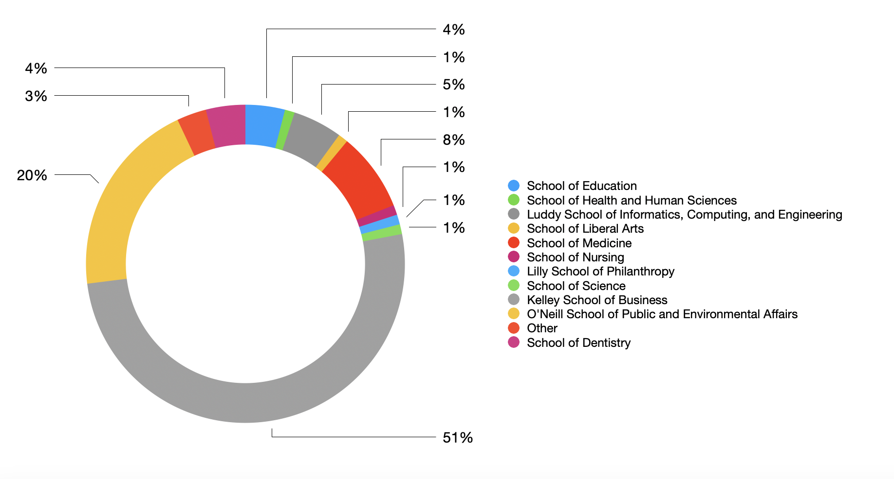
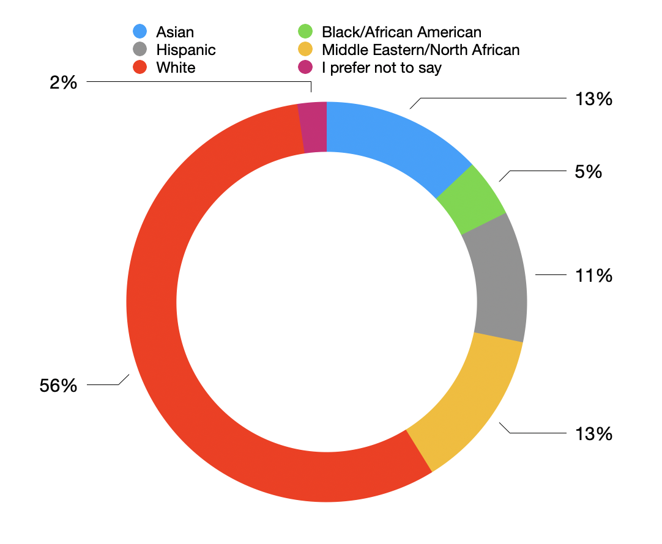

Slide 21
Findings
Students enrolled prior to the split
Feeling connected to campus after the split
Averaged 2.65/5, with 1 being not connected at all and 5 being completely connected
My major has lost its value
92% strongly disagree or disagree
Sense of belonging to a community on campus
76% agree or strongly agree
73% are involved with a student organization
Students enrolled after the split
Feeling connected to campus after the split
Similar results to enrolment prior (average of 2.65/5)
My major has lost its value
86% disagree or strongly disagree
Sense of belonging to a community on campus
75% agree or strongly agree
40% are involved with a student organization

Slide 22
Findings
Students enrolled prior to the split
Feeling connected to faculty on campus
Averaged 2.93/5, with 1 being not connected at all and 5 being completely connected
Feeling that the student voice matters on campus
53% disagree or strongly disagree
Students enrolled after the split
Feeling connected to faculty on campus
Similar results to enrolment prior to the split
Feeling that the student voice matters on campus
19% disagree or strongly disagree

Slide 23
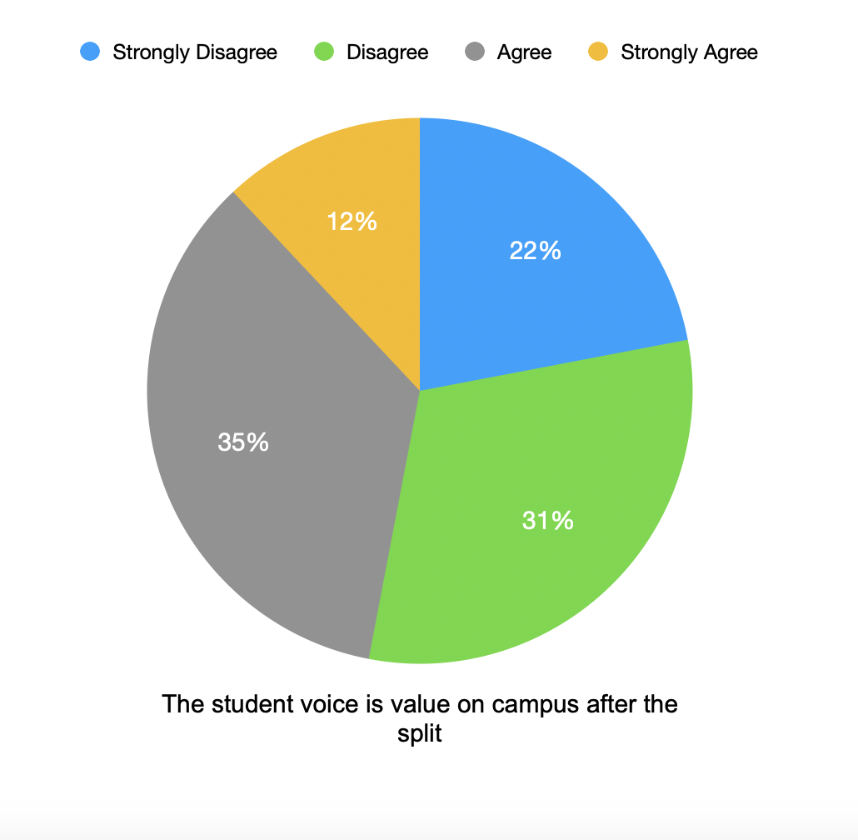
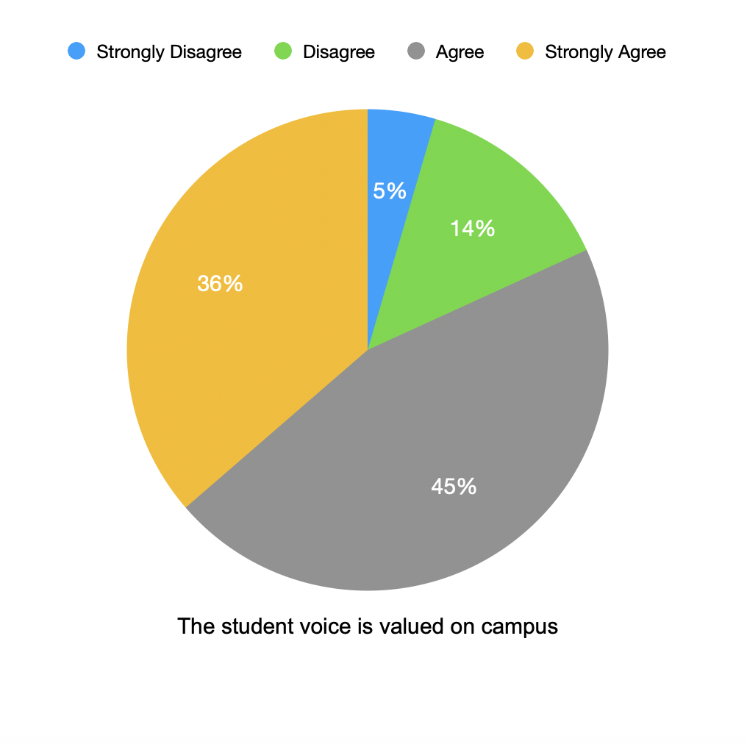

Slide 24
Findings - How do students think they could feel more connected to campus? (Direct student quotes)
"More opportunities for casual meetups and networking events for students from different programs. And please bring good coffee shop to campus so we don’t have to buy coffee from outside"
"I personally feel very connected to my small communities on campus. However, I struggle to connect with campus as a whole, as I don’t really feel like admin cares about their students. For example, the school of liberal arts is dying in favor of a nursing campus. I love my liberal arts classes and have learned so much from them."
"I feel if we had more faculty members participate in student events would be a relaxed way of interacting with students and staff.”
"Have some community building initiatives like host some town halls or student forums for open discussions where students can share how they’re feeling and offer suggestion about campus improvements"

Slide 25
Recommendations

Slide 26
Recommendations
Yearly Check Ins
Opportunities to Listen
Strengths-Forward Focus
Many students who are freshman had more positive outlooks on campus, and it would be interesting to see if this continues as they become upperclassmen.
IU Indianapolis should continue to emphasize the strengths of its programs, highlight alumni success stories, and actively market the university’s unique offerings to build confidence in its academic reputation.
Host open forums, town halls, or listening sessions where students can voice concerns about the split and campus life. Follow up with tangible action to build trust and transparency.
It would be helpful to take yearly analytics to see how student perspective changes after the split.

Slide 27
Recommendations
Having more casual meetups, partnership and networking events for students would more so help have a deeper sense of belonging.
Role of Faculty
Who would be in charge of these changes?
One possible department is Division of Student Affairs, given that it is the umbrella for many divisions, including housing and student organizations.
Serendipitous Connections
Having more faculty involvement outside of classes was also recommended by students to feel more relaxed around professors and administration.

Slide 28
Call to Action

Slide 29
Call to Action
This isn’t about reversing the split—it’s about shaping what comes next. We call on campus leaders to keep listening, keep checking in, and keep building a community where every student feels seen, heard, and valued. Let’s not wait for issues to arise. We need to be proactive, not reactive. The future of our student experience depends on what we do now.
Campus administration and faculty should always work towards bettering the student community, even if it is already doing well, as there is always room for improvement.

Slide 30
Maya Elchal Vibha Kamath Kimberly Hestermann Mason Charlton

