Slide 1
Solar Decathlon Final Presentation
Project Members: Whit Grote, Sifiso Moyo, & Christian De La Rosa
Project Manager: Evan Carlson
Faculty Advisor: Afshin Izadian
Faculty Sponsors: Robert Weissbach & Darrell Nickolson
IUPUI

Slide 2
Overview
EET Solar Decathlon Final Presentation
Solar Decathlon Definition
Stakeholders Requirements
Solar PV Generation Model
HVAC (Geothermal/VRF) System
Battery Storage Room
Net Zero Feasibility Tool
Stakeholders Requirements Satisfied
Notes:
Make sure we talk about everything listed on this slide.

Slide 3

What is the Solar Decathlon?
Decathlon competition preps next generation of low-carbon buildings powered by renewable energy.
Started in 2002, consists of Design and Build challenges.
Provides students with unique training in clean energy
Educates public about zero energy designs and smart home solutions.

Slide 4
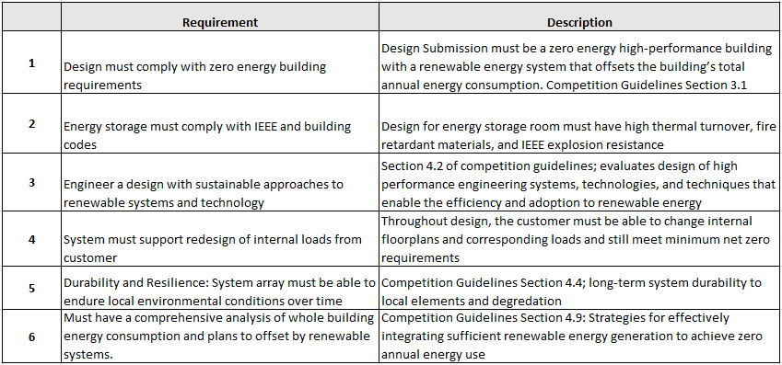
Stakeholder Requirements
EET Solar Decathlon Final Presentation
NREL 2023 Competition Guidelines
Notes:
Whit

Slide 5
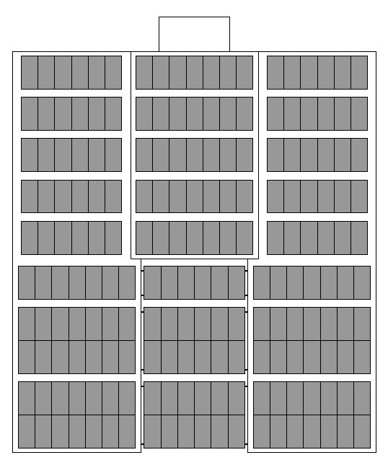

Solar PV Generation Model
2023 Design Challenge
System Size: 272 panels total
192 Panels roof mounted
80 Panels mounted on car park shades
Available square footage on the roof : 5236 sq ft
Total array square footage on roof : 4500 sq ft
Estimated annual array output: 474.5 MWh
(1,140,416 kBTU per year)
NREL.GOV PVWatts Calculator
Notes:
Evan
10 Second
This is an arial view of building showing where we want to place panels on the roof. These are the suggested panel location to reach net-zero with the photovoltaic implementation that we chose.

Slide 6
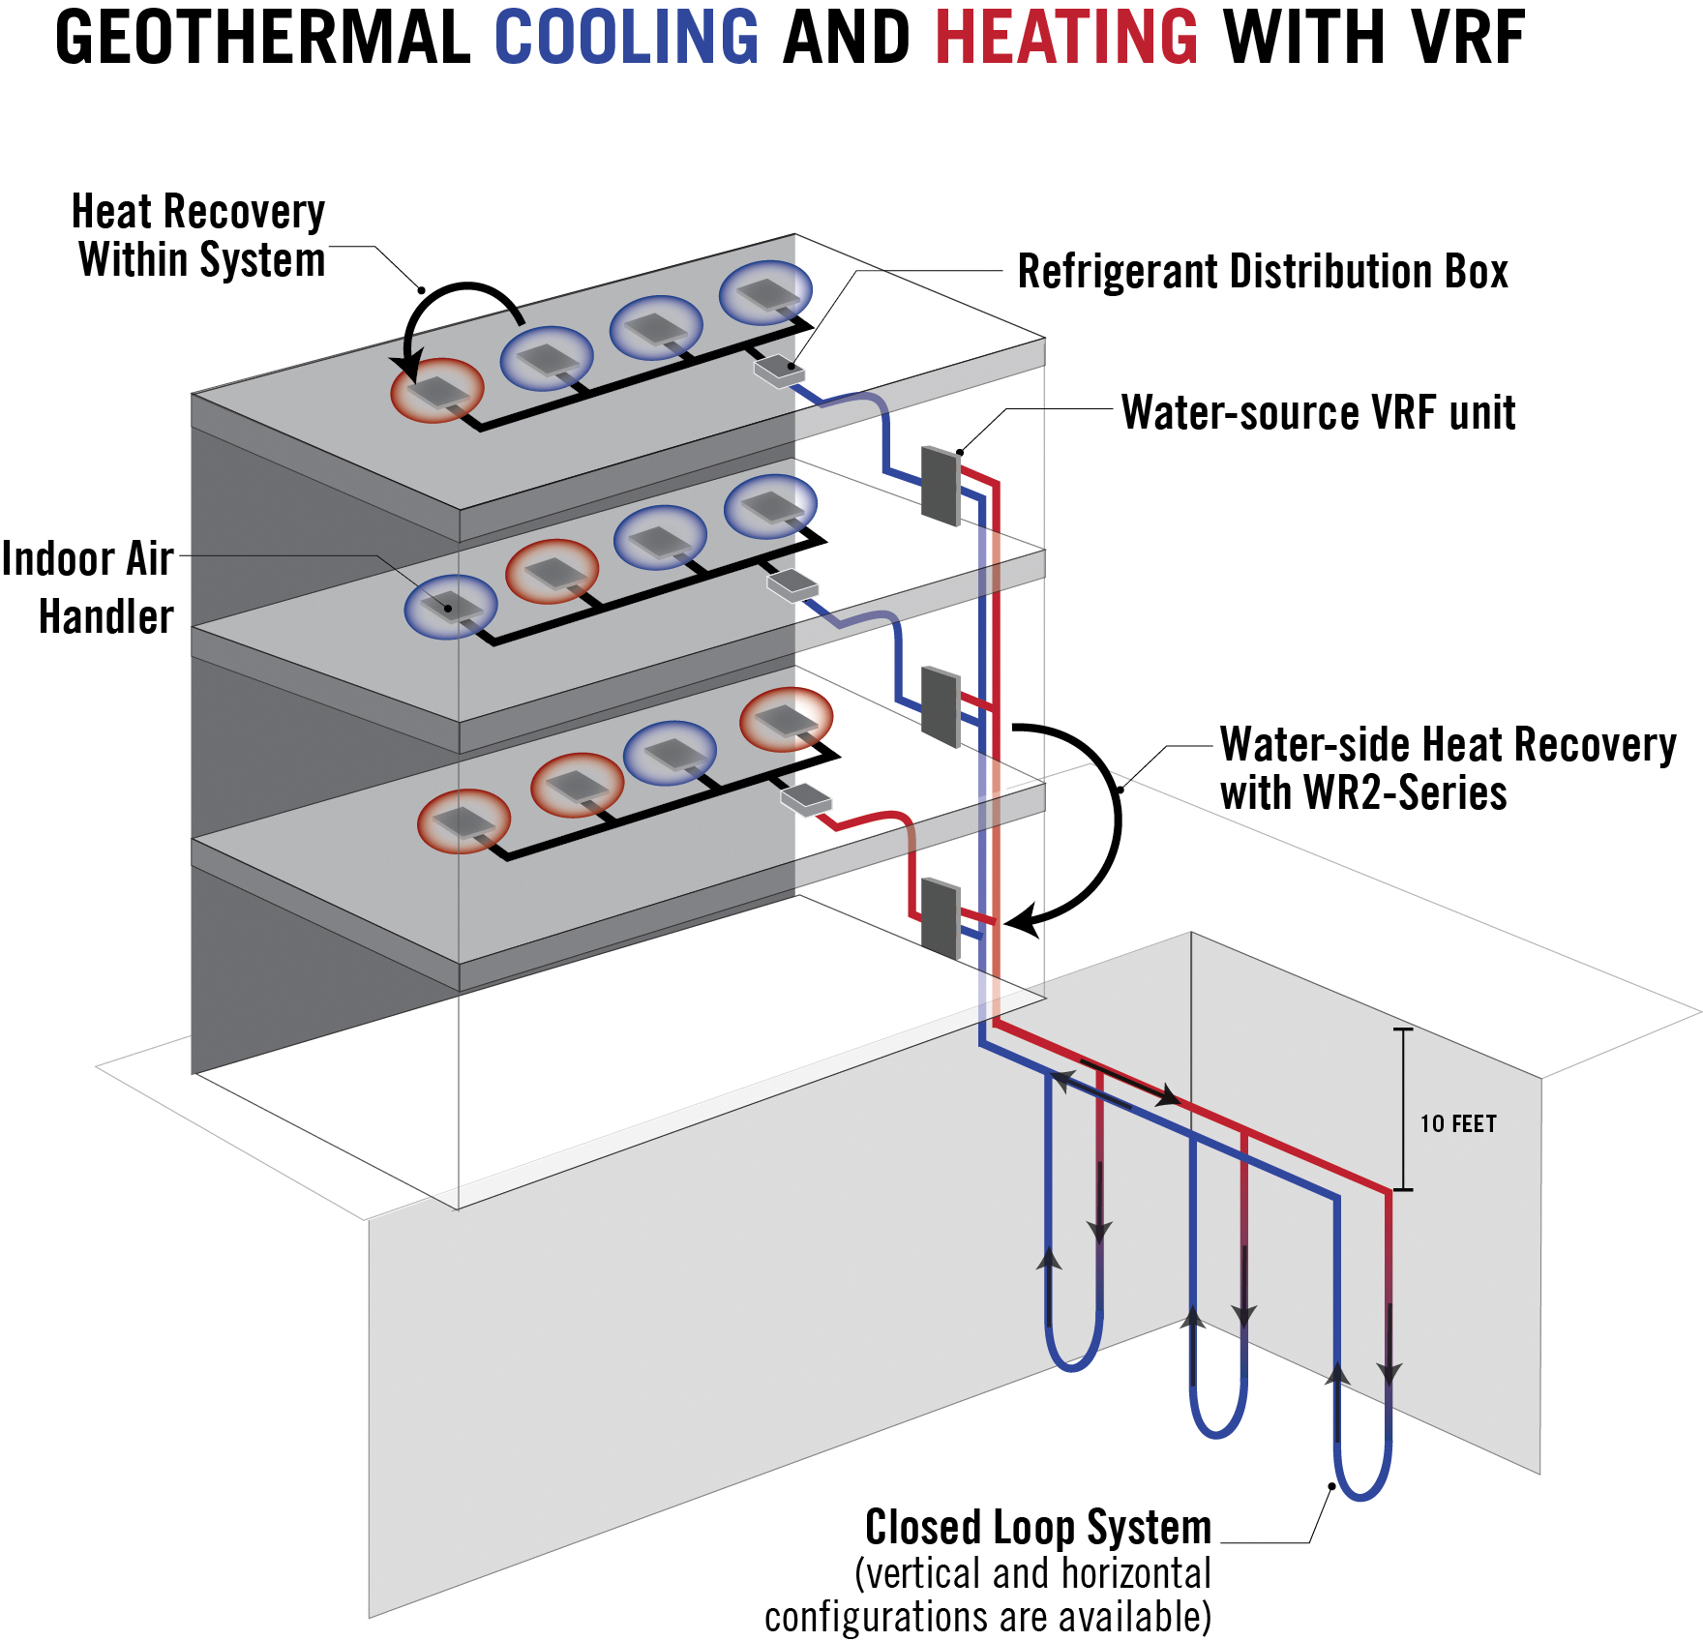
Geothermal VRF System
EET Solar Decathlon Final Presentation
Combines a Geothermal system with a Variable Refrigerant Flow system
Combining both systems outputs excellent energy efficiency for heating and cooling.
VRF provides personal comfort in each room, while Geothermal uses underground climate to balance medium temperature.
Notes:
Christian.
(Say Full Name “Variable Refrigerant Flow”)
Water-source VRF zoning systems combine the efficiency benefits of a geothermal system with the sophistication of VRF zoning systems. This technology takes advantage of an INVERTER-driven compressor, coupled with a closed geothermal loop, instead of utilizing air as a heat exchange medium.
How it works:
Water/Refrigerant will flow through pipes that are buried into the ground, this is done because the earth is always at a constant temperature when you dig deep enough. Depending on the room if it's too hot and needs cold air then the hot air will be transferred from the indoor unit to the refrigerant in the pipes, which is cycled to the ground where it'll transfer the warm temperature into the ground and the cooler temperature will be transferred into the pipes and cycled into the indoor unit.

Slide 7

Battery Storage Room
2023 Design Challenge
10x10 Room - 100 sq ft
3 Enphase 10.5kW batteries.
IEEE building standard 2030.2.1-2019 compliant
Fire rated to NFPA 70 standards
Passive ventilation
Ease of access for servicing
Tempered glass wall allows residents to see into the battery room
Notes:
Evan
30 second
By using a tempered glass storefront, the general public can see directly inside the battery room. We want them to be able to see that the batteries are charging and discharging. It gives the feeling that our building is “in-motion.” This room is on the exterior, south end of the building as an annexation. If we need to increase the size of the room to fit more batteries, we can do that.

Slide 8
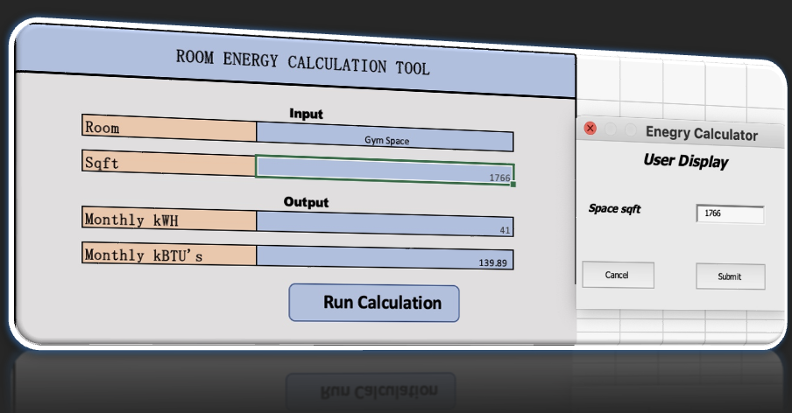
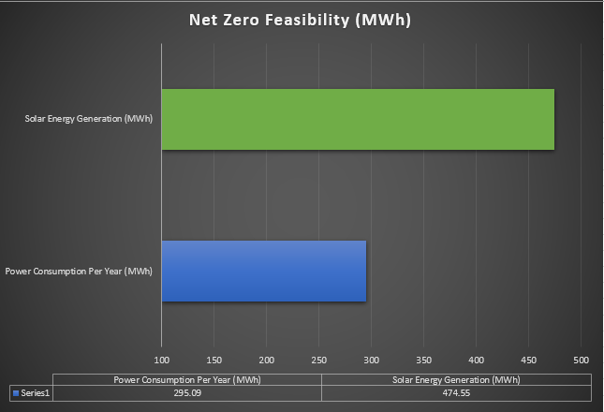
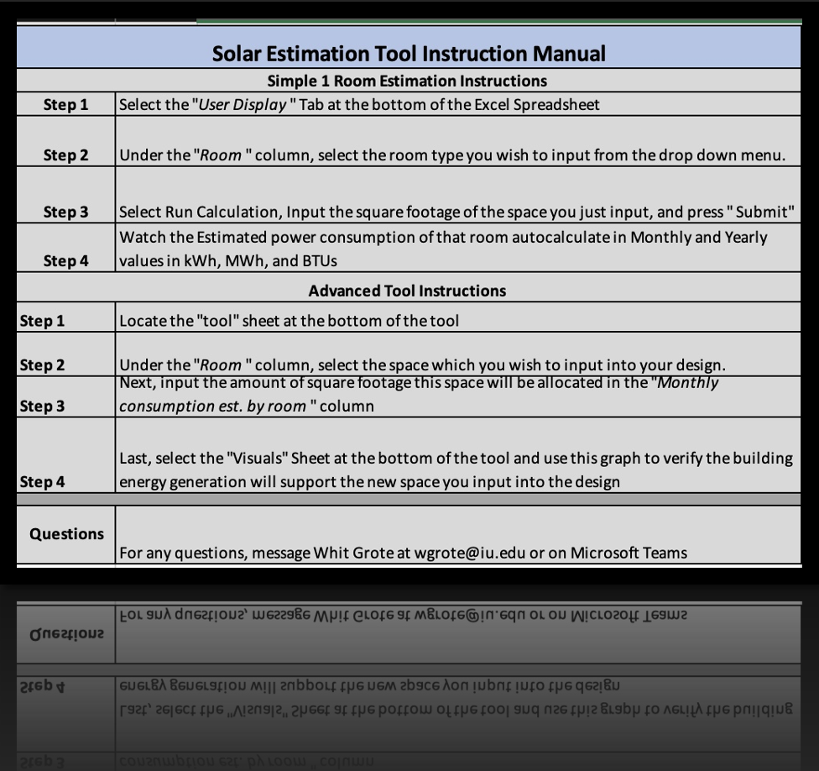
Net Zero Feasibility Tool
EET Solar Decathlon Final Presentation
Easy to input parameters to test ideas and output real time data using automated energy calculations based on specific spaces and power loads
Notes:
Whit
Designed by the Electrical team. As the Interior Design students begin to plan out the lighting and plug loads, we can directly see the impact it will have on our renewable energy generation and consumption.

Slide 9
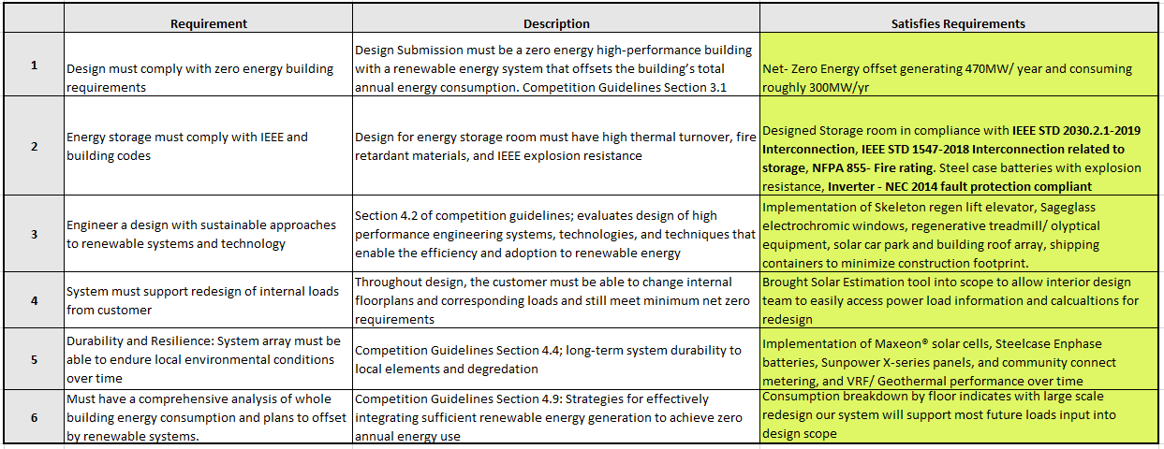
Satisfying Stakeholder Requirements
EET Solar Decathlon Final Presentation

Slide 10
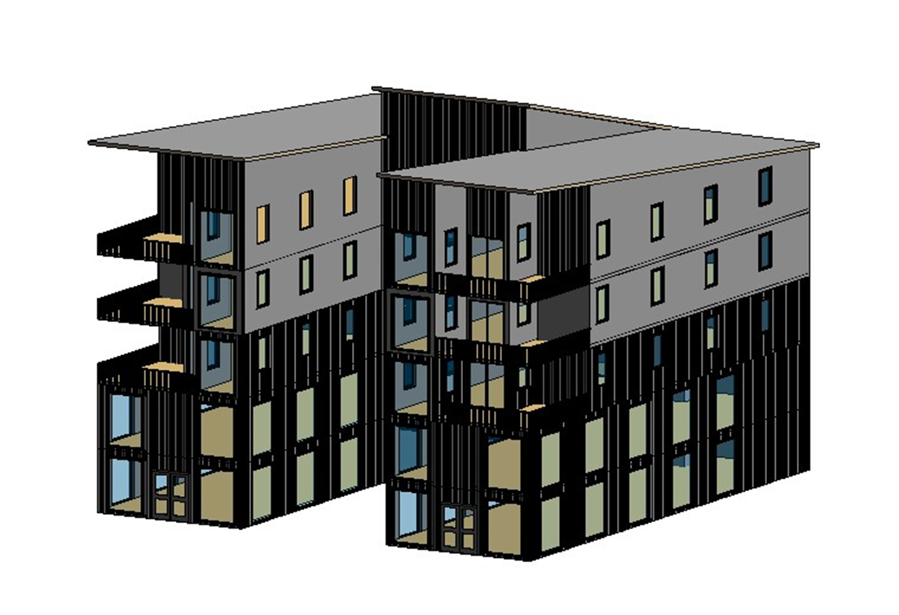
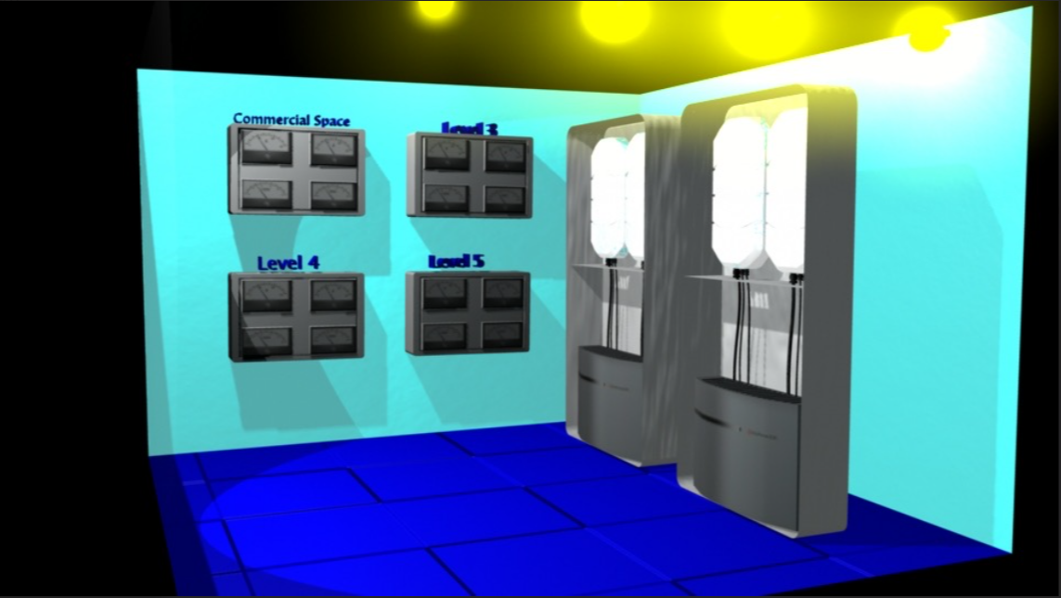
EET Solar Decathlon Final Presentation
Building Design
Located on the ground floor of the south side of the building.
Notes:
Sifiso

Slide 11
Questions?
Whit Grote, Sifiso Moyo, Christian De La Rosa

